Slide 1
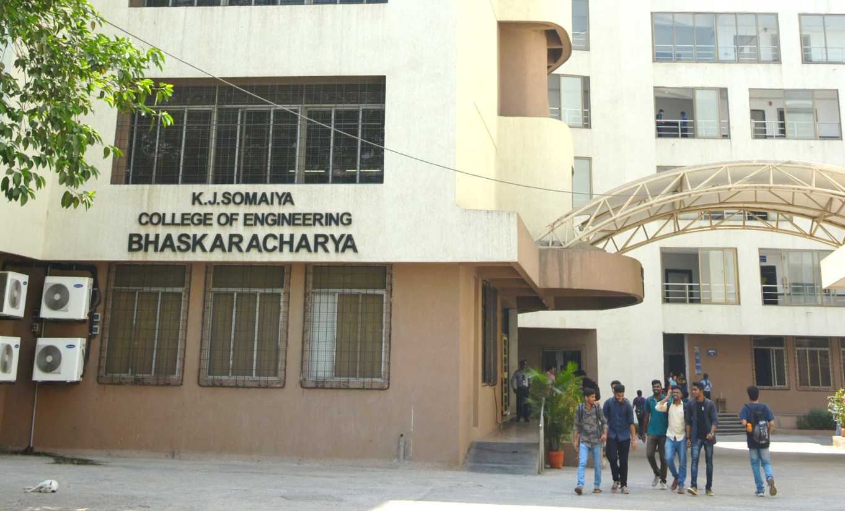

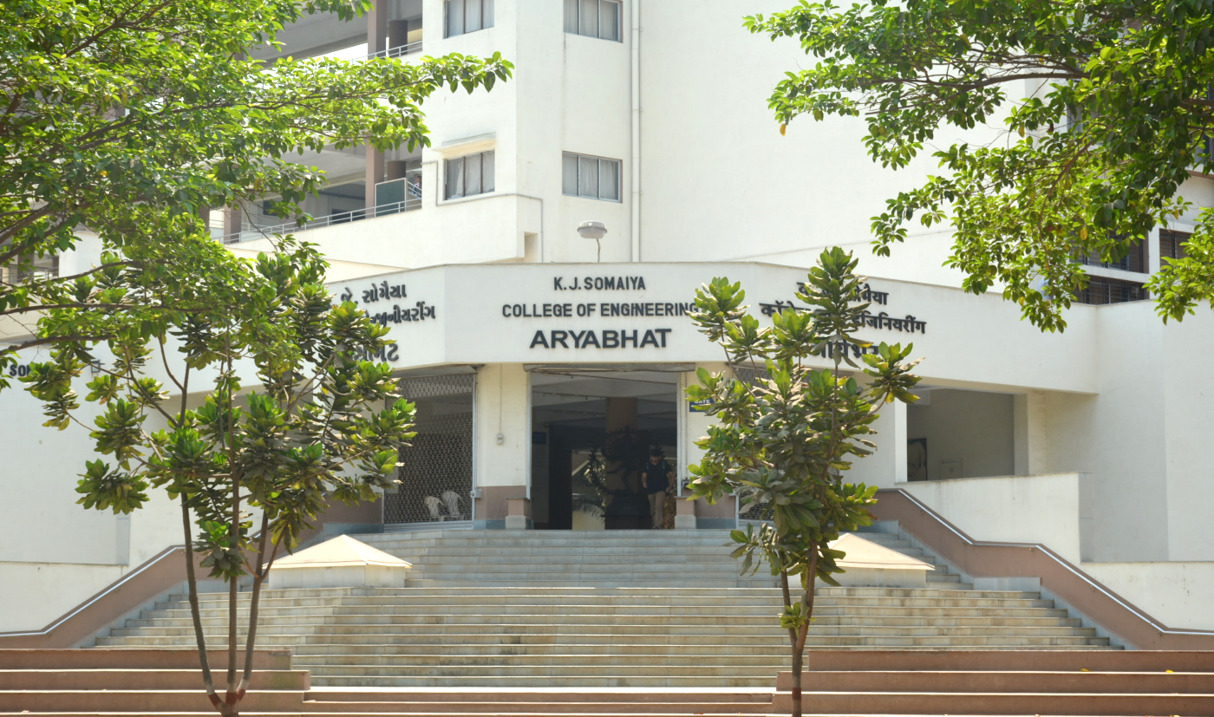
AquaWise
Smart Water Conservation and Awareness Portal
UN SDG 6 · Clean Water and Sanitation
TEAM · TY EXCP-A
GUIDE
Jaineel Patel Roll No. [______]
[Teammate name] Roll No. [______]
Prof. Sonia Joshi
COURSE
K J Somaiya School of Engineering
Web Programming Laboratory
216U40L501 · Semester V
Notes:
TALKING POINTS (≈30 s)
• Greet the panel; introduce both team members and our guide, Prof. Sonia Joshi.
• Project: AquaWise, a smart water conservation and awareness portal.
• Built for Web Programming Laboratory (216U40L501), TY EXCP-A.
• Mapped to UN SDG 6, Clean Water and Sanitation, mainly targets 6.1 (safe drinking water) and 6.4 (water-use efficiency).
• Stack from our syllabus: HTML5, CSS3, Bootstrap 5, JavaScript, React, Node.js/Express, MongoDB, session-based auth, Postman, cloud deployment.
• One line to set up the talk: “AquaWise helps a household measure its water use, act correctly in a water crisis, and report problems to its housing society.”

Slide 2




Problem Statement
2.1 billion
people lacked safely managed drinking water in 2024 [1]
What households are missing
No way to see usage against official norms
600 million
Indians face high to extreme water stress [2]
No clear first steps when supply fails or turns unsafe
Society complaints scattered across calls and chats
2×
India’s projected water demand vs supply by 2030 [2]
No single portal linking awareness, advice and action
AquaWise: measure, advise and act in one portal
Notes:
TALKING POINTS (≈45 s)
• Global scale [1]: WHO/UNICEF JMP (Aug 2025) — 2.1 billion people, 1 in 4, lacked safely managed drinking water in 2024; 106 million still drink untreated surface water.
• India [2]: NITI Aayog’s Composite Water Management Index (June 2018) — about 600 million Indians face high to extreme water stress; India ranks 120th of 122 countries on water quality; demand is projected to be twice the available supply by 2030.
• The gap we target is at household and society level:
– People don’t know how their daily use compares with the norm (CPHEEO plans for 135–150 litres per person per day in cities).
– In a leak, supply cut or contamination, nobody knows the right first steps or whom to call.
– Complaints to the society get lost in phone calls and chat groups, with no tracking.
• AquaWise answers each gap with one feature: measure (calculator), advise (crisis engine), act (society portal).
• If asked: the ‘2×’ and deaths figures come from the CWMI report; we cite the report directly.

Slide 3
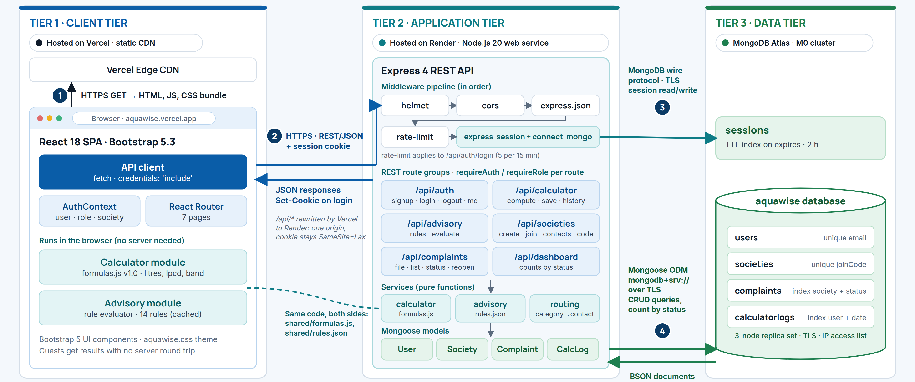
System Architecture
Notes:
TALKING POINTS (≈60 s) — walk the numbered arrows
• Three tiers: React + Bootstrap client, Node.js/Express REST API, MongoDB Atlas.
• ① The browser loads the React build (HTML, JS, CSS) over HTTPS from Vercel’s CDN.
• Client tier: the calculator and advisory modules run in the browser, so guests get instant results without a server call. AuthContext holds the logged-in user, role and society.
• ② The API client calls the Express REST API over HTTPS with JSON, sending the session cookie (fetch with credentials: 'include'). Vercel rewrites /api/* to Render, so the browser sees one origin and the cookie can stay SameSite=Lax.
• Application tier middleware, in order: helmet (security headers), CORS, JSON body parser, rate-limit on login (5 attempts / 15 min), express-session with connect-mongo. Routes then check requireAuth / requireRole.
• Six route groups: auth, calculator, advisory, societies, complaints, dashboard. Business logic lives in pure-function services: calculator, advisory rules, complaint routing.
• ③ Sessions are stored in MongoDB (TTL index, 2-hour expiry) over TLS.
• ④ Mongoose models (User, Society, Complaint, CalculatorLog) read and write BSON documents in Atlas over mongodb+srv (TLS).
• Same formulas and rules file are shared by client and server, so results always match.
• Passwords are bcrypt-hashed; secrets live in Render environment variables.

Slide 4



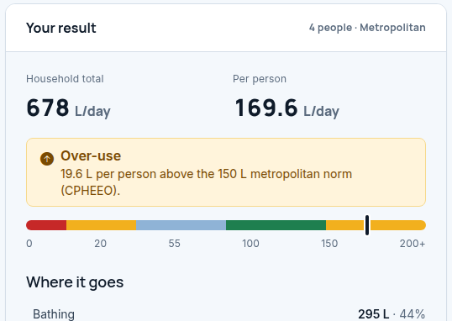
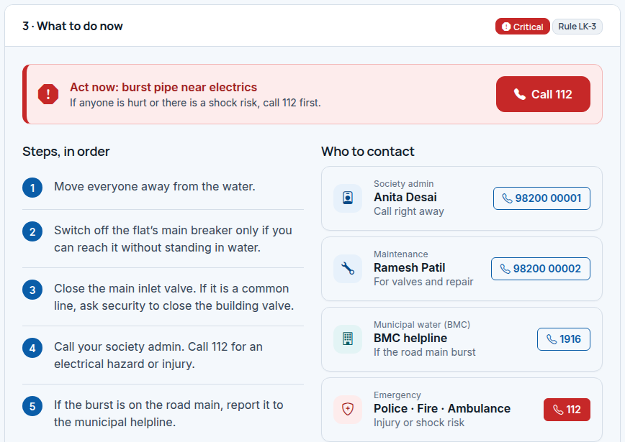
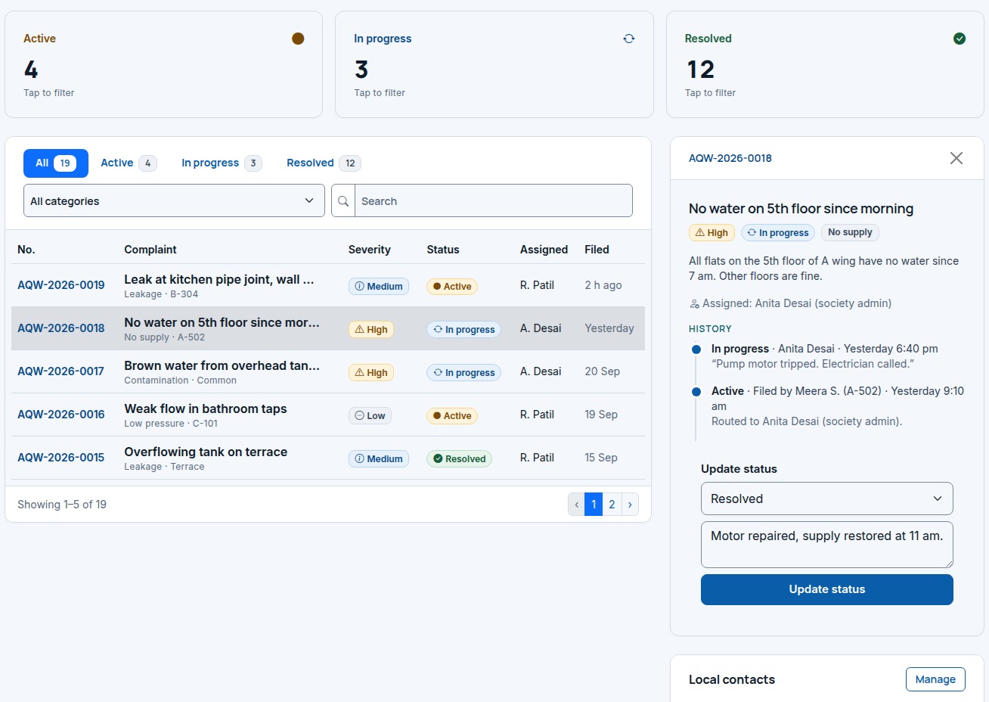
Features of the Designed System
Water Usage Calculator
Crisis Advisory Engine
Society Portal
Litres per day by activity and per person
Checks WHO and CPHEEO norms; flags over- and under-use
5 problems, 14 rules: ordered steps and contacts
Critical cases show a one-tap 112 call
Join by society code; complaints auto-routed by type
Dashboard tracks active, in-progress and resolved issues
Notes:
TALKING POINTS (≈70 s)
1) Water Usage Calculator
• Inputs: adults, children, city type, bathing (shower/bucket), toilet type, washing-machine loads, garden area, tap habits, dripping taps, optional litres received.
• Output: litres per day for 8 activities, household total and litres per person per day (lpcd).
• Compared with WHO service levels (20 / 50 / 100 L) [3], Jal Jeevan Mission’s 55 L [5] and CPHEEO’s 70 / 135 / 150 L norms [4]; flags over-use and under-supply.
• Example on screen: 4 people in Mumbai → 678 L/day, 169.6 L per person → over-use against the 150 L metro norm.
2) Crisis Advisory Engine
• 5 problem types: leakage, no supply, unsafe drinking water, low pressure, contamination.
• Up to 3 questions set the severity (low / medium / high / critical); 14 rules return ordered steps plus contacts.
• Critical cases (e.g., burst pipe near electrics) show a one-tap 112 button; boiling/disinfection steps follow CDC guidance.
• Rules are stored as data (JSON), not hard-coded, so they are easy to test and update.
3) Society Portal
• Session-based signup/login; join a society with a 6-character code.
• File a complaint; it is routed automatically to the society contact who handles that category, else to the society admin.
• Dashboard: counts of active, in-progress and resolved; admin updates status with a note; every change is kept in a history timeline; residents can reopen within 7 days.

Slide 5
Result, Conclusion and References
Results (design and prototype stage)
References
−14.7%
14
7
[1] WHO and UNICEF, “1 in 4 people globally still lack access to safe drinking water,” WHO News, Aug. 26, 2025. [Online]. Available: https://www.who.int/news
[2] NITI Aayog, “Composite Water Management Index,” Govt. of India, New Delhi, India, Rep., Jun. 2018.
[3] G. Howard and J. Bartram, Domestic Water Quantity, Service Level and Health. Geneva, Switzerland: WHO, 2003.
[4] CPHEEO, Manual on Water Supply and Treatment, 3rd ed. New Delhi, India: Ministry of Urban Development, 1999.
[5] Ministry of Jal Shakti, “Jal Jeevan Mission: Har Ghar Jal,” Govt. of India. [Online]. Available: https://jaljeevanmission.gov.in
[6] W. B. DeOreo et al., Residential End Uses of Water, Version 2. Denver, CO, USA: Water Research Foundation, 2016.
per-person use with efficient fixtures (169.6 → 144.7 L)
advisory rules covering 5 crisis types
responsive screens; all text meets WCAG AA
Conclusion
One portal links awareness, crisis advice and society action
Sourced, rule-based logic keeps every number explainable
Next: real usage data, SMS alerts, multilingual interface
Notes:
TALKING POINTS (≈35 s)
• Results so far (design and prototype stage — replace with test results once the build is complete):
– Calculator verified against our hand-worked example: 169.55 L per person per day; switching to efficient shower, toilet and washing machine gives 144.70 L, a 14.7% drop, inside the 150 L norm.
– Advisory engine: 14 rules across 5 problem types, each mapped to one test case.
– 7 screens designed and prototyped in Bootstrap 5 at desktop (1440 px) and mobile (390 px); all colour pairs pass WCAG AA contrast.
• Conclusion: AquaWise brings awareness, crisis guidance and society action into one portal, and every number it shows is traceable to a source.
• Future scope: real meter or bill data, SMS/WhatsApp alerts, regional languages, wider city helpline coverage.
• References in IEEE format on the slide. Thank the panel and invite questions.

