Slide 1
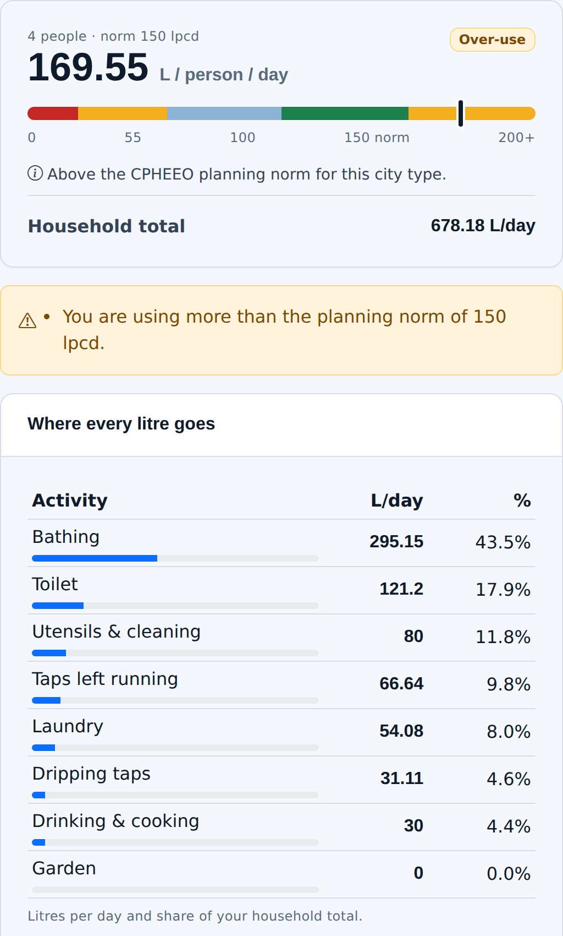
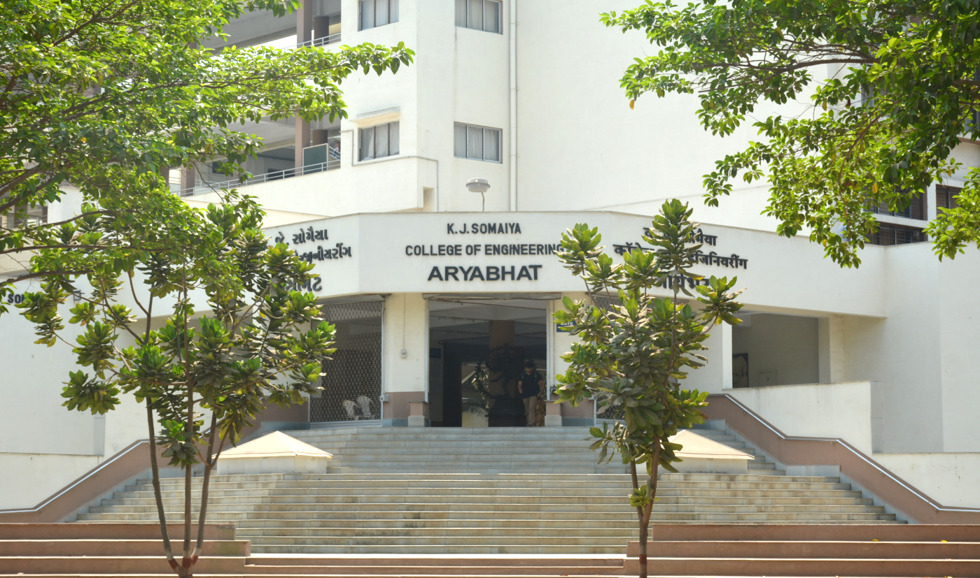
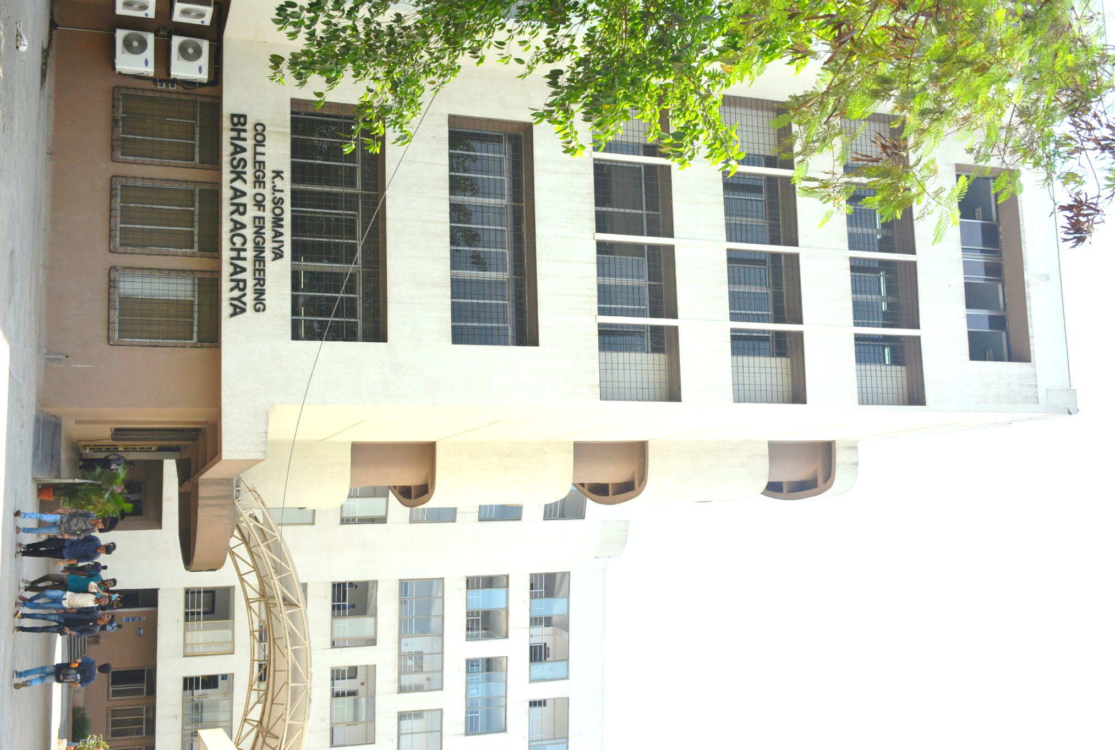
AquaWise
Smart Water Conservation and Awareness Portal
A household water calculator, crisis advisory engine and society complaint portal for UN SDG 6, targets 6.1 and 6.4
TEAM
GUIDE
[Name 1] Roll No. [____]
[Name 2] Roll No. [____]
Prof. Sonia Joshi
COURSE
INSTITUTION
Web Programming Laboratory (216U40L501)
Sem 5 · TY EXCP-A
K J Somaiya College of Engineering
Somaiya Vidyavihar University
Running app: calculator result for the 4-person test household (TC-C01)
Notes:
SAY (≈45 s)
Good morning. We are [Name 1] and [Name 2] from TY EXCP-A; our guide is Prof. Sonia Joshi. Our project is AquaWise.
Before the problem, look at the screenshot on the right. That is our running application, not a mock-up: a family of four in Mumbai, 678 litres a day, 169.55 per person, already flagged as above the city norm.
The next four minutes are about three things: how we made that number trustworthy, what the family should do next, and who in their building should act on it. Three tools, one database, and a test behind every figure we show.
LIKELY QUESTIONS
Q1. Why put three tools in one project instead of doing one well?
→ Each covers a different failure: not knowing your usage, not knowing the first step, not knowing who fixes it — they share one user, one society and one database.
Q2. Which SDG 6 targets, exactly?
→ 6.4 (water-use efficiency) through the calculator; 6.1 (safe drinking water) through the advisory and complaint routing.

Slide 2
Households cannot act on water problems they cannot measure, diagnose or route to the person responsible
2.1 billion people
Where a household sits: litres per person per day
one in four worldwide lacked safely managed drinking water in 2024
50 L/person/day
200 L/day for a family of 4 (TC-C07): flagged under-supply. They need water, not shorter showers.
169.55 L/person/day
Our test household of 4 in Mumbai (TC-C01): flagged over-use against the 150 L norm.
WHO/UNICEF JMP, 2025 [1]
~600 million Indians
face high to extreme water stress; India ranks 120th of 122 countries on water quality
NITI Aayog CWMI, 2018 [2]
critical
under-supply
basic
within norm
over-use
severe
0
20
55
100
150
200+
135–150 L/person/day
Band edges: WHO 20 and 100 L [4] · Jal Jeevan Mission 55 L · CPHEEO metro norm 150 L and IS 1172 upper limit 200 L [3]
Indian urban planning norm; the Jal Jeevan Mission adequacy line is 55 L/person/day
CPHEEO Manual [3]; Jal Jeevan Mission, MoJS
The gap: awareness sites say “save water”; none tells a household its own number, what to do at 2 a.m. when the tap runs brown, or who in the building fixes it.
Notes:
SAY (≈45 s)
Most water-awareness material tells everyone the same thing: save water. But a household cannot act on advice that is not about them.
Look at the two ends of our scale. A family on tanker supply getting 50 litres per person is already below the Jal Jeevan Mission line. Telling them to take shorter showers is not just useless, it is wrong: their problem is supply. Our test household at 169.55 is the opposite case.
So the calculator flags under-supply as well as over-use. And when something goes wrong at night, the next question is always: who do I call, and who in this building owns it?
LIKELY QUESTIONS
Q1. NITI Aayog’s index is from 2018 — is it still valid?
→ It is the national baseline most studies still cite; we quote it with its year on the slide and would swap in a newer edition if you prefer.
Q2. Why compare against 150 and not 135 lpcd?
→ Mumbai is a metropolitan city with sewerage, where CPHEEO plans for 150; the user picks the city type and the norm switches to 135 or 70.

Slide 3
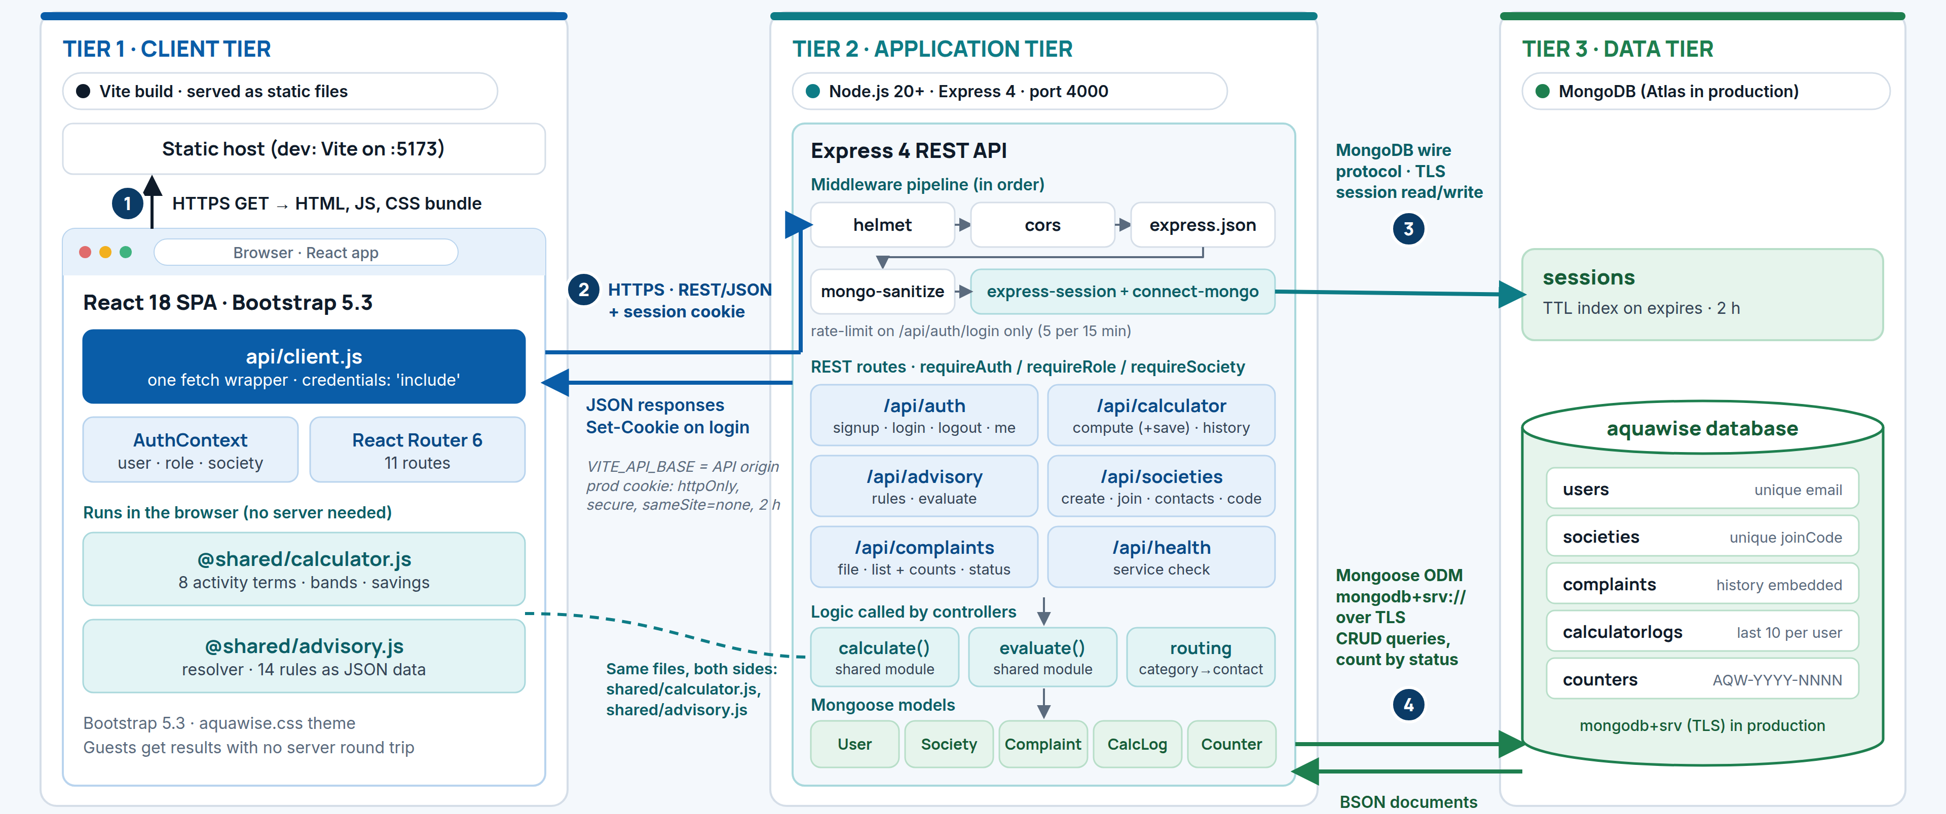
One formula module runs in the browser and on the server, so a guest’s result and a saved result cannot disagree
1
1
Three tiers
React 18 + Bootstrap 5.3 client; Express 4 REST API with express-session; MongoDB (Atlas in production).
server/src/app.js
3
2
One shared module
Browser and server import the same shared/calculator.js and shared/advisory.js.
2
TC-API-22: API result = module result, 678.18 L/day
3
Client numbers never trusted
Every route validates its input; results sent in a request body are discarded and recomputed.
// client/src/pages/Calculator.jsx
import { calculate, defaultInputs, … } from '@shared/calculator.js'
// server/src/controllers/calculatorController.js
import { calculate } from '../../../shared/calculator.js'
TC-API-24: forged total discarded, server figure stored
Our architecture diagram (top) and the same import in both tiers, verbatim from the repository (bottom)
Notes:
SAY (≈45 s)
The decision we would defend first is the shared folder.
The calculator runs in the browser, so a guest gets an answer without an account. But when a logged-in user saves a result, the server cannot trust what the browser sent; anyone can edit a request. Writing the formulas twice, once in React and once in Express, works until someone changes a constant in only one copy.
So the formulas and the advisory rules live in one folder that both sides import. Our API test sends a forged total; the server discards it, recomputes and stores its own figure. The numbered arrows show a request's path.
LIKELY QUESTIONS
Q1. Why server-side sessions instead of JWT?
→ Our syllabus specifies session-based auth, and a server session can be destroyed — TC-API-06 shows /me returns 401 straight after logout.
Q2. If the maths runs in the browser, can’t a user fake a saved result?
→ No: the server recomputes from the inputs and ignores any results field — TC-API-24 sends a forged total and asserts it was discarded.

Slide 4
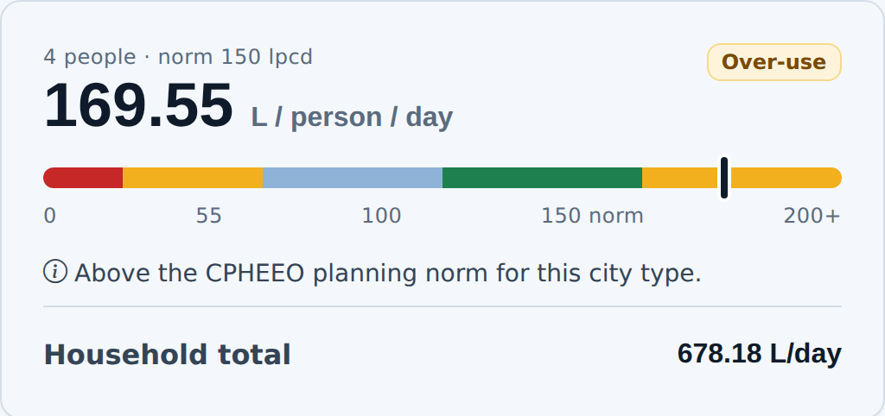
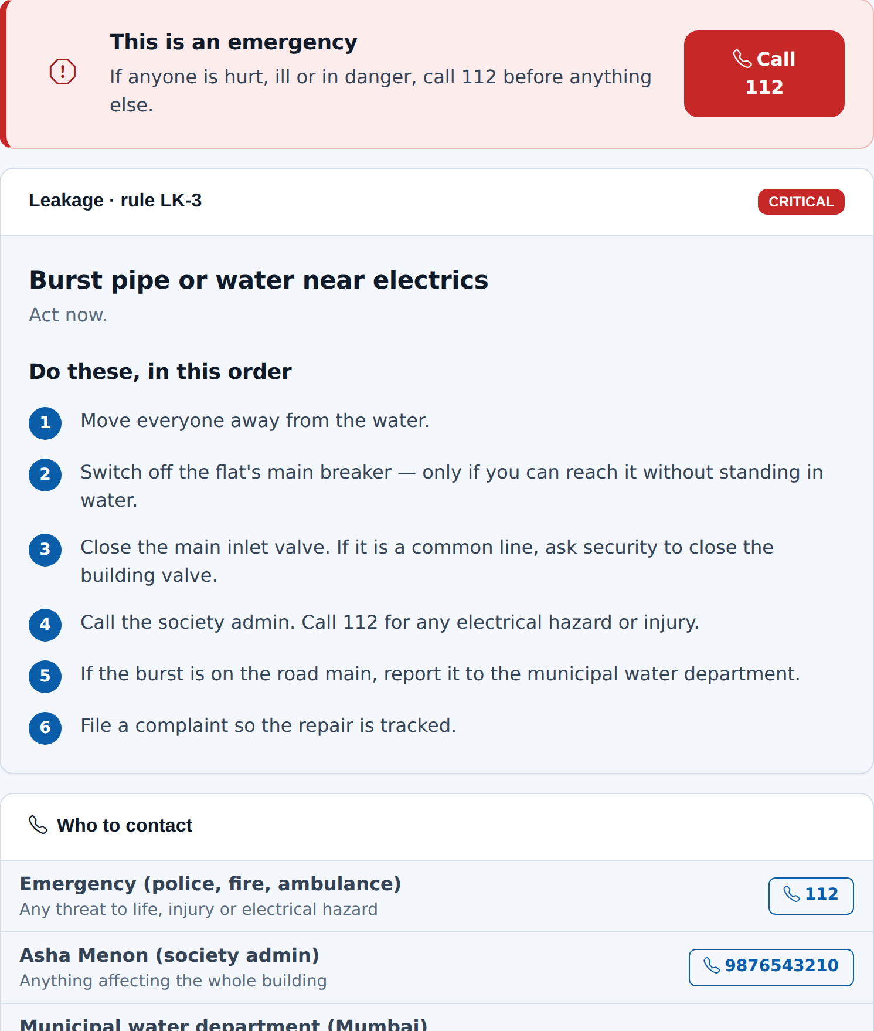
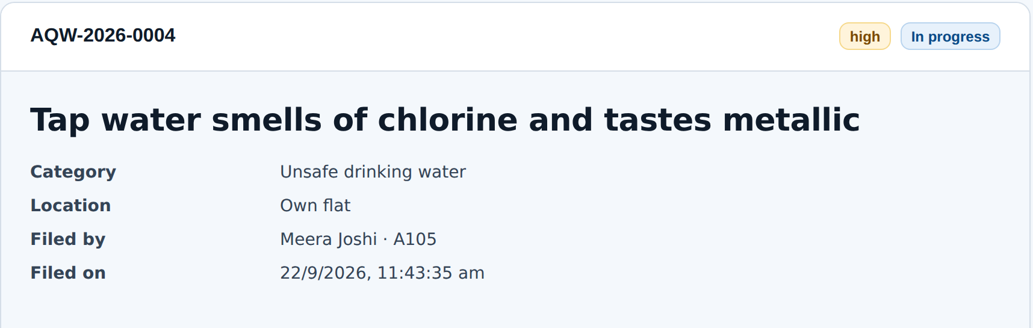
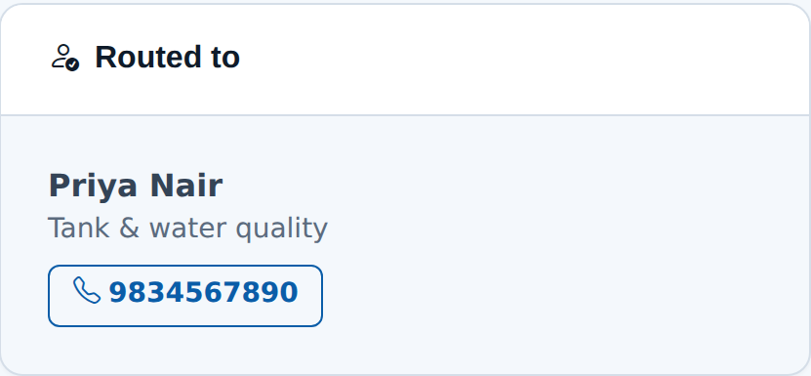
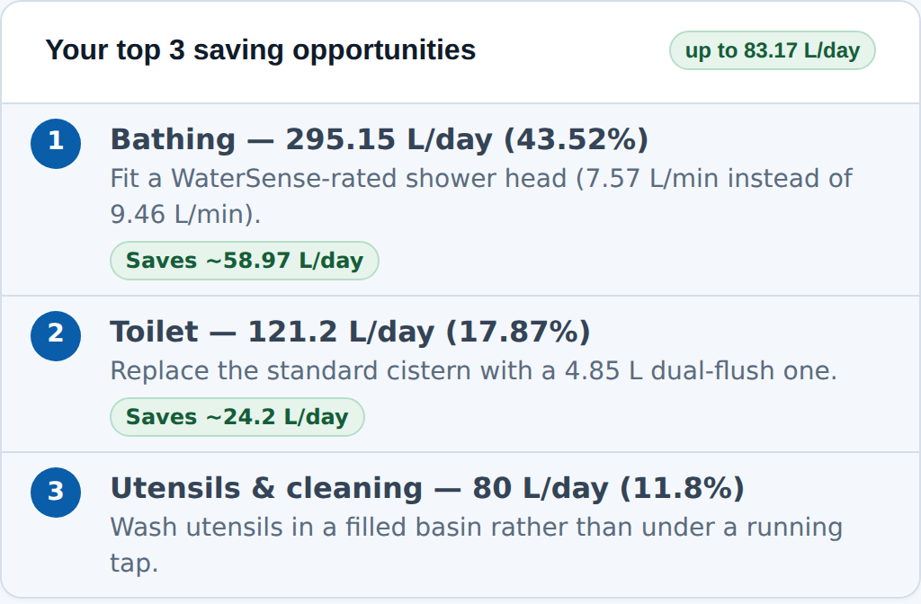
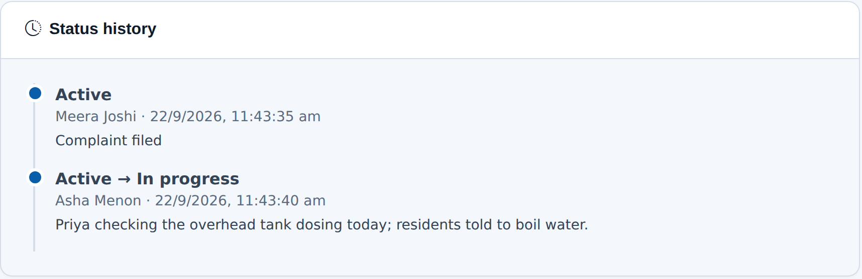
Each tool ends in something to do today: a ranked saving, a numbered step with a number to call, or a routed complaint
1
Water usage calculator
2
Crisis advisory engine
3
Society complaint portal
Routed by category
not to the admin
Result panel for the TC-C01 household, running app
Rule LK-3 for a logged-in Sagar Darshan CHS member
AQW-2026-0004 after the admin moved it to in progress
8 activity terms checked against CPHEEO and WHO norms. 678.18 L/day = 169.55 L/person/day: over-use at 150. Top fix saves 58.97 L/day.
14 rules across 5 problem types, stored as JSON and matched most-severe-first. Critical rules raise 112; members get their society’s contacts.
Routed by category: unsafe drinking water went to Priya Nair, tank & water quality. Every change is appended; the filer can reopen within 7 days.
TC-C01, TC-C09 · shower flow: US EPA WaterSense [5]
shared/advisory-rules.json · TC-A03, TC-A08, TC-A12
TC-M14 · TC-API-13, TC-API-20
Notes:
SAY (≈45 s)
Each tool ends with something a person can do today.
The calculator ranks where the litres go and prices the fix: for our test household, a WaterSense shower head alone saves about 59 litres a day.
The advisory engine asks at most three questions. Burst pipe, water near the switches: rule LK-3, critical. The 112 banner comes first, then six steps in fixed order, then the society admin's real number, because this user is a member.
And the portal routes by category. Complaint 0004 was about drinking water, so it went to Priya Nair, who handles tanks and water quality, not to the secretary. Every status change is kept.
LIKELY QUESTIONS
Q1. Why rules and not machine learning for the advisory?
→ Safety advice has to be predictable and auditable; each of the 14 rules is a JSON record with a unit test, and we have no labelled data to train on.
Q2. What happens if no contact handles a complaint’s category?
→ It falls back to the society admin, so nothing is ever unassigned — TC-API-14.

Slide 5
All 52 automated tests pass, and testing caught six defects before they reached the demo
Automated tests · run 22 Sep 2026
Conclusion
23 / 23 unit · shared/
29 / 29 API end-to-end · every endpoint and permission boundary
Rule-based advice and automatic routing turn water awareness into something a household can act on the same day.
The society layer matters most: it is where individual advice usually stops.
npm test · npm --prefix server test · results logged in docs/testing.md
3 of 3
41
360 px
functionalities working end to end against a live MongoDB
functional requirements specified and implemented
every route checked: no horizontal scroll
Next: a verified municipal contact directory beyond Mumbai; India-measured fixture data instead of US EPA figures.
TC-M05, TC-M10, TC-M14
docs/REQUIREMENTS.md
TC-M01, after D5 and D6
6 defects found by tests and fixed
D1 | TC-C01 | Misspelt constant made every total NaN; caught because the expected 678.18 came from the requirements, not our code
D2 | TC-C04 | Test bypassed the bathing-mode rule; test corrected
D3 | TC-API-19 | Test expected 403; server correctly refuses the move with 400
D4 | TC-M17 | Newest timeline entry showed “A member”; author repopulated
D5 | TC-M01 | Calculator 12 px too wide at 360 px; gutter g-4 on mobile
D6 | TC-M01 | Dashboard 2 px too wide at 360 px; filters now wrap
References
[1] WHO and UNICEF, Progress on Household Drinking Water, Sanitation and Hygiene 2000–2024. New York, NY, USA: UNICEF/WHO, 2025.
[2] NITI Aayog, “Composite Water Management Index,” Govt. of India, New Delhi, India, Rep., Jun. 2018.
[3] CPHEEO, Manual on Water Supply and Treatment, 3rd ed. New Delhi: MoUD, 1999; BIS, IS 1172:1993.
[4] G. Howard and J. Bartram, Domestic Water Quantity, Service Level and Health. Geneva: WHO, 2003.
[5] U.S. EPA, “WaterSense.” [Online]. Available: https://www.epa.gov/watersense
[6] U.S. CDC, “How to make water safe in an emergency.” [Online]. Available: https://www.cdc.gov/water-emergency
Notes:
SAY (≈45 s)
The result we trust most is the test suite, because we can rerun it in front of you: fifty-two automated tests, twenty-three on the pure logic and twenty-nine that drive the real API, including every permission check.
The more useful part is the defect list. Six defects, all found by tests or a scripted run-through. The first mattered most: a misspelt constant turned every total into "not a number". The test caught it only because the expected 678.18 came from our requirements, worked by hand.
Next, we want verified helplines beyond Mumbai and Indian fixture data instead of US figures. Thank you; we are happy to take questions.
LIKELY QUESTIONS
Q1. Didn’t you write the tests to match your own code?
→ The expected values come from the requirements document, calculated by hand — which is exactly how defect D1 was caught.
Q2. What about the manual test cases?
→ Eighteen are listed in docs/testing.md; six are recorded as passing so far (including 360 px layout and all three end-to-end flows), and we complete the rest in the demo run-through.

