Slide 1
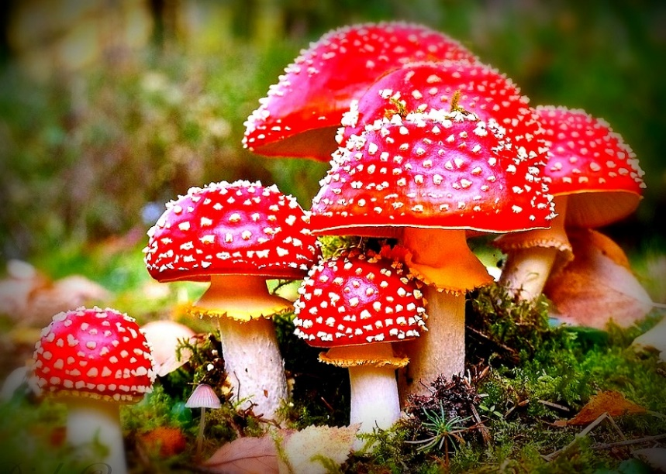
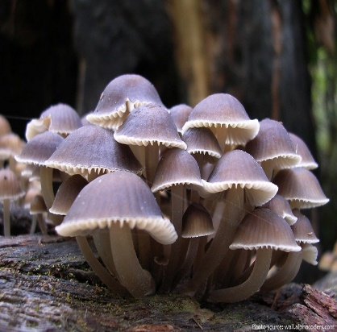
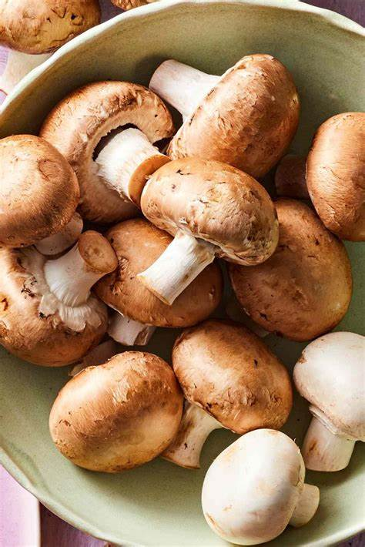
The Fungus Among Us!
Jorge Serrano
Jessica Parker
Charles Descheneaux
Jennifer Bowling
Joyce Ghali
Justin Mangaroo
Project 4 August 31st, 2023

Slide 2
Applications Used
Python Matplotlib
Tableau
Machine Learning
Confusion Matrix
Scikit-learn

Slide 3
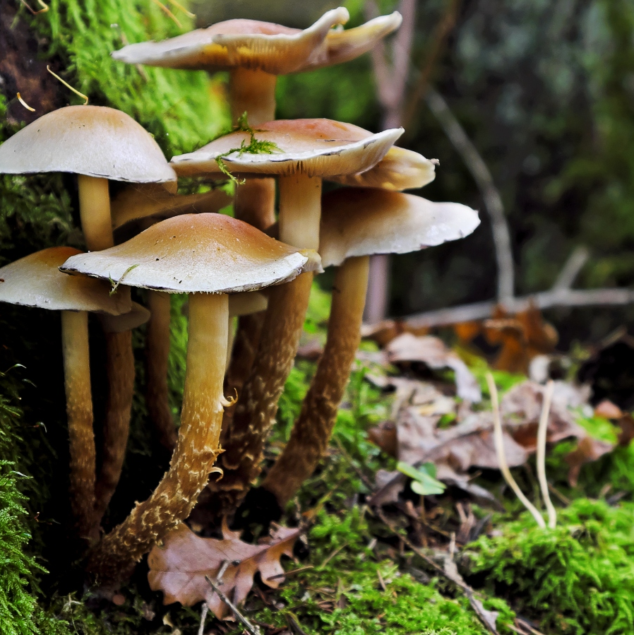
Introduction
“Mushrooms are delicious, fascinating, unique, dangerous and sometimes just plain weird.”
Mushrooms have many purposeful uses such as being an ingredient for various recipes, medicinal, and nutritional values.
Therefore, it is very important to identify whether they are edible or poisonous.
Source: https://grocycle.com/mushroom-facts/

Slide 4
Original Dataset Columns & Descriptions
cap-shape: bell=b,conical=c,convex=x,flat=f, knobbed=k,sunken=s
cap-surface: fibrous=f,grooves=g,scaly=y,smooth=s
cap-color: brown=n,buff=b,cinnamon=c,gray=g,green=r, pink=p,purple=u,red=e,white=w,yellow=y
bruises: bruises=t,no=f
odor:almond=a,anise=l,creosote=c,fishy=y,foul=f, musty=m,none=n,pungent=p,spicy=s
gill-attachment:attached=a,descending=d,free=f,notched=n
gill-spacing: close=c,crowded=w,distant=d
gill-size: broad=b,narrow=n
gill-color: black=k,brown=n,buff=b,chocolate=h,gray=g, green=r,orange=o,pink=p,purple=u,red=e, white=w,yellow=y
stalk-shape: enlarging=e,tapering=t
stalk-root: bulbous=b,club=c,cup=u,equal=e, rhizomorphs=z,rooted=r,missing=?
stalk-surface-above-ring: fibrous=f,scaly=y,silky=k,smooth=s
stalk-color-above-ring: brown=n,buff=b,cinnamon=c,gray=g,orange=o, pink=p,red=e,white=w,yellow=y
spore-print-color: black=k,brown=n,buff=b,chocolate=h,green=r, orange=o,purple=u,white=w,yellow=y

Slide 5
Classifications Targeted
Class
Odor
Gill Size
Gill Color
Spore Print Color

Slide 6
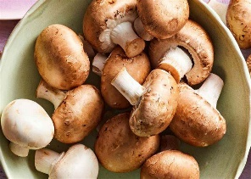

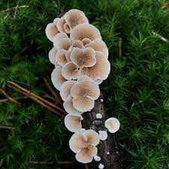
To Eat or Not to Eat!!!!!
Poisonous
Edible
The ingestion of poisonous mushrooms can result in serious illness and/or death. In 2016 the CDC conducted a study, stating that there were 1300+ emergency department visits due to accidental poisonous mushroom ingestions.
According to Cleveland Clinic, the average American consumed nearly 3 lbs of mushrooms a year. Edible mushrooms are used for medicinal purposes in dietary powders, liquids, and supplements. Mushrroms are good sources of selenium, Vitamin B6, potassium, and zinc.

Slide 7
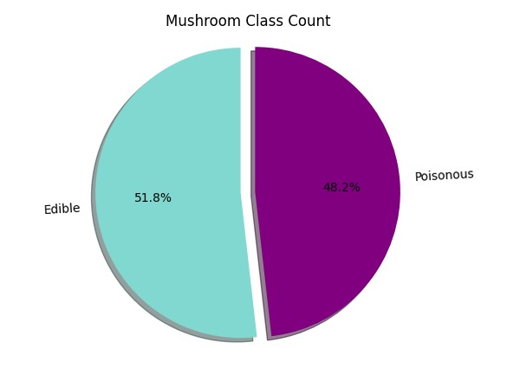
Python - Matplotlib
Used to create the plt.pie function, to create the following visualization.

Slide 8
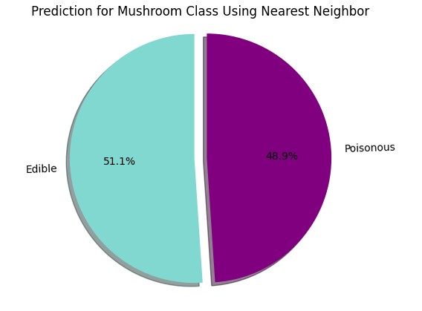
Nearest Neighbor
This machine learning technique that predicts the edible vs. poisonous mushrooms, in our dataset.

Slide 9
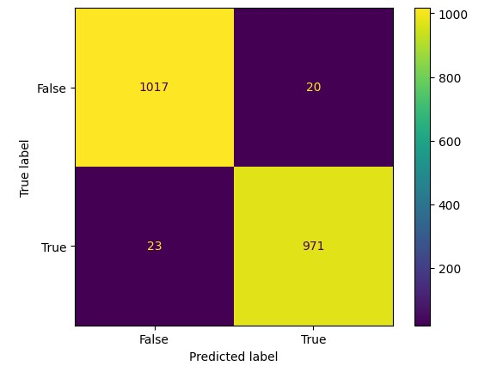
Confusion Matrix
This machine learning technique was used to define the performance of the model’s algorithm.
This predicts the reliability of the model.

Slide 10
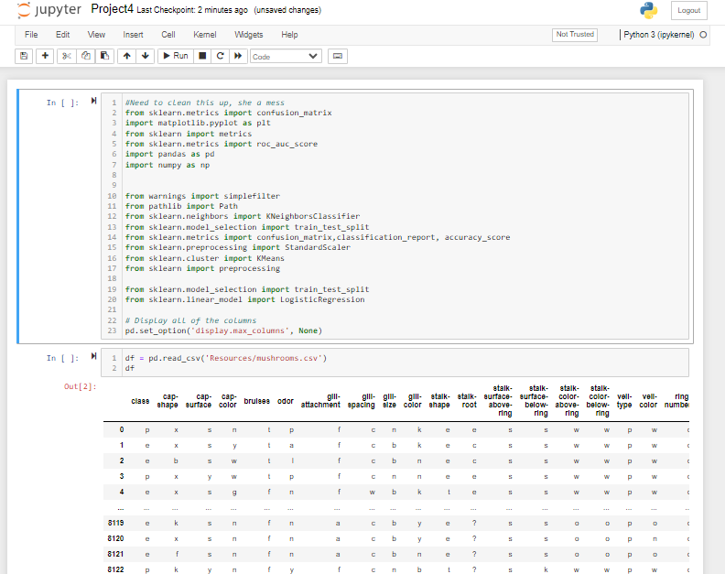
Jupyter Notebook
Used to clean and transform data, creating data visualizations using machine learning and python matplotlib.

Slide 11
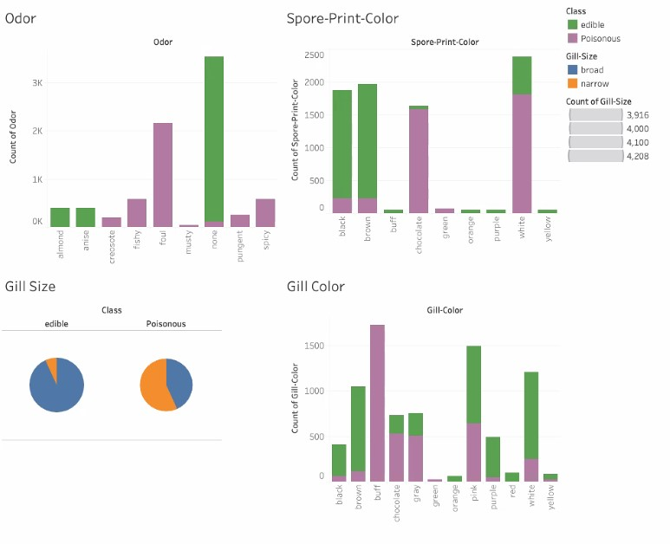
Tableau
Odor, Spore Print Color, Gill Size, and Gill Color are often used to help distinguish poisonous mushrooms from edible mushrooms.
Our data shows that most edible mushrooms have no odor, have broad gills, have black to brown spore print color, and gill colors are a variety.

Slide 12
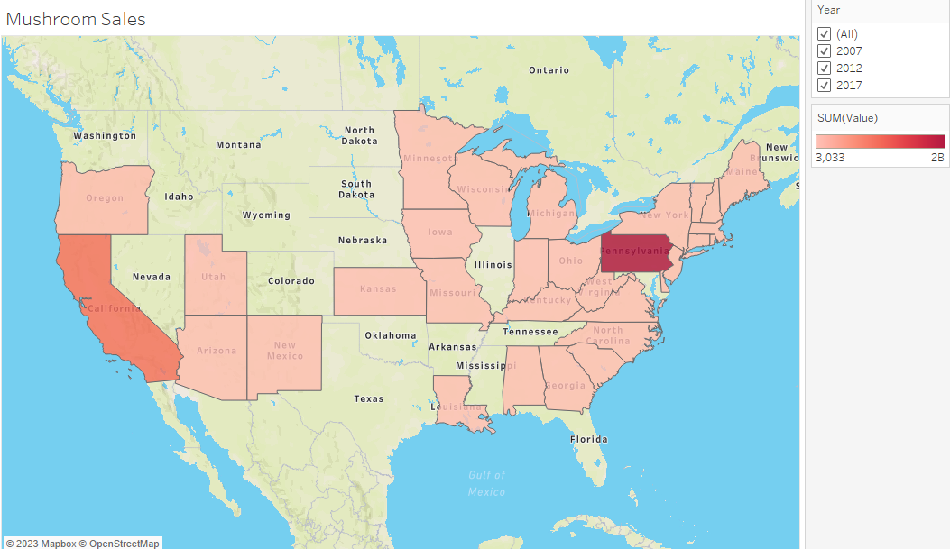
Tableau
For the maps: In 2017 USDA reported Mushroom sales over $1.3B.
Pennsylvania and California are the two main states accounting for 65% of total sales
28 total states reported Mushroom sales to the USDA

Slide 13
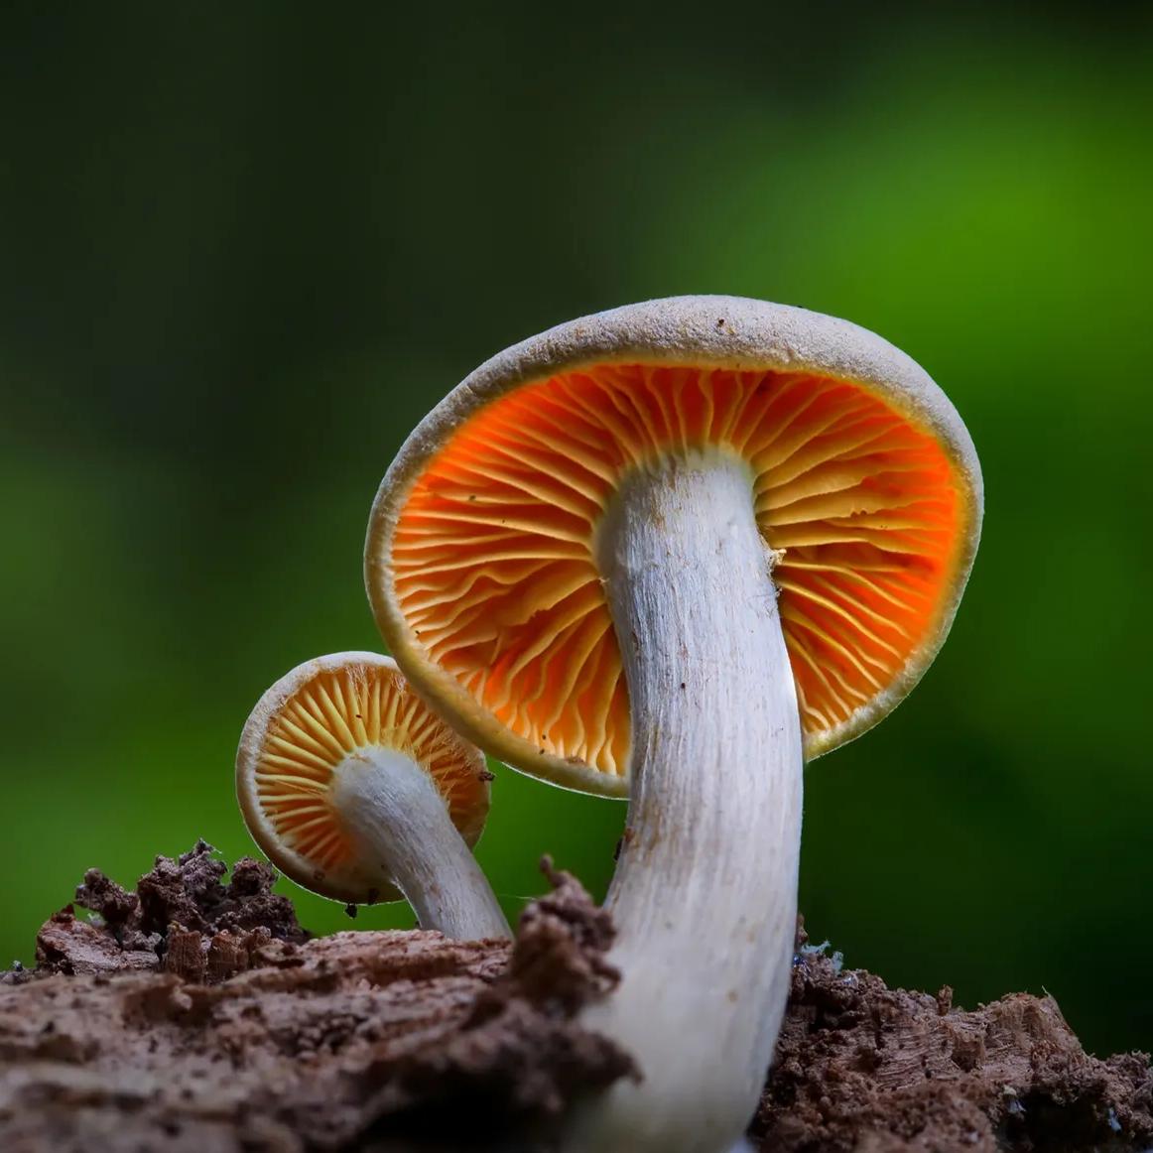
Sources
Datasets:
https://www.kaggle.com/code/dima806/poisonous-mushrooms-predict-ml-shap/notebook
https://quickstats.nass.usda.gov/results/2FFE6231-5FD9-3F81-BDCE-A79DBC298CEB
Fun Facts: https://grocycle.com/mushroom-facts/
Cover Slide Images:
https://eclinik.net/wp-content/uploads/2016/06/magic-mushrooms.jpg
https://justfunfacts.com/wp-content/uploads/2018/02/mushrooms.jpg
https://static.onecms.io/wp-content/uploads/sites/37/2019/03/27180444/cremini-mushrooms-9dc59b2b.jpg
Dataset columns & descriptions:
https://github.com/gtxsy/Poison-Mushrooms-in-North-America/blob/master/images/original_dataset_columns.png
Information on Poisonous and Edible Mushrooms:
Health Care Utilization and Outcomes Associated with Accidental Poisonous Mushroom Ingestions — United States, 2016–2018 | MMWR (cdc.gov)
Health Benefits of Mushrooms – Cleveland Clinic
Maps
https://quickstats.nass.usda.gov/results/2FFE6231-5FD9-3F81-BDCE-A79DBC298CEB

