Slide 1
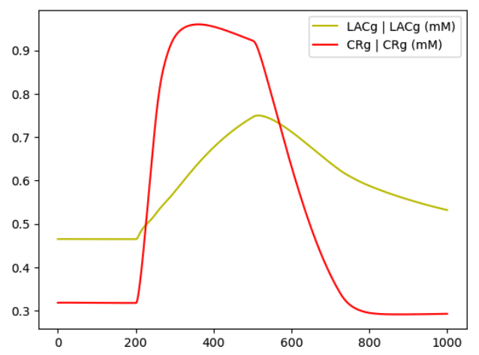
Nash Equilibrium

