Slide 1
Architecture
Work Order

Slide 2
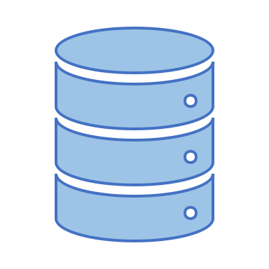



Has its own DB – anyway to get rid?
PROPOSITION 1
SAP Cloud foundry
SAP MDK App
‘Adapter’
(Node JS)
Notify Pub
(Spring)
POST
POST
MDK can connect because it exposes an ODATA SRV
CF BIND SERVICE
Notify Sub
Image + Audio
(Spring)
GCP
Service
Broker
Subscribe
CRUD
Google Cloud Platform
Cloud Queue
Cloud ML
Cloud DB
Async Events
AI Services
My SQL (data upload)

Slide 3
PROPOSITION 2
SAP Cloud foundry
SAP MDK App
Notify Pub
(Spring)
Has its own DB – anyway to get rid?
POST
We could rewrite Notify Pub, following the SCP tutorials and publish from there.
CF BIND SERVICE
Notify Sub
Image + Audio
(Spring)
GCP
Service
Broker
Subscribe
CRUD
Google Cloud Platform
Cloud Queue
Cloud ML
Cloud DB
Async Events
AI Services
My SQL (data upload)

