Slide 1
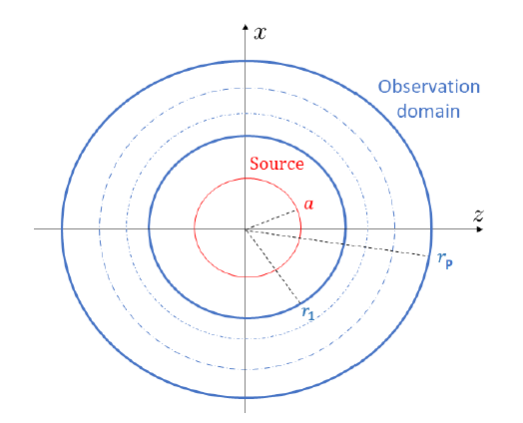









Problem illustration
$$\underline{x}$$
$${\underline{a}}_{m}^{∗}$$
For mth observation point,
Since
we have
where

Slide 2



Phase retrieval by PhaseLift
How to solve$\underline{\underline{X}}$? Since rank($\underline{\underline{X}}$) should equal 1 and positive semidefinite,
Equivalent under some condition

Slide 3





Phase retrieval by PhaseLift
$x_{L}$ column vector of $\underline{\underline{X}}$.
Iteratively solved by gradient descent method
where
Analytical estimation available
step size

Slide 4
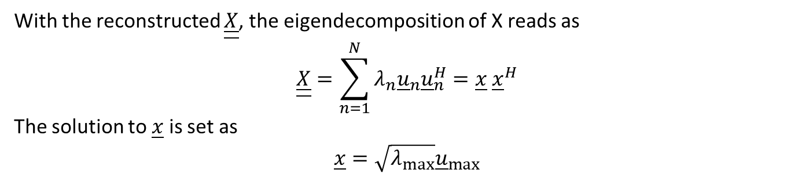
Phase retrieval by PhaseLift
The iterative reconstruction procedures stop when max iteration number reached or data fitting error below some threshold or reconstructed $\underline{\underline{X}}$ shows convergence.
With the reconstructed $\underline{\underline{X}}$, the eigendecomposition of X reads as
$$\underline{\underline{X}}=\sum_{n=1}^{N}{λ_{n}{\underline{u}}_{n}{\underline{u}}_{n}^{H}}=\underline{x} {\underline{x}}^{H}$$
The solution to $\underline{x}$ is set as
$$\underline{x}=\sqrt{λ_{max}}{\underline{u}}_{max}$$

Slide 5






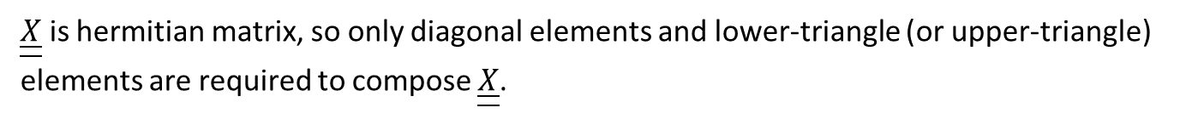



Reducing number of unknowns
$\underline{\underline{X}}$ is hermitian matrix, so only diagonal elements and lower-triangle (or upper-triangle) elements are required to compose $\underline{\underline{X}}$.
$${\underline{x}}_{T2}$$
Since
$${\underline{x}}_{T1}$$
we have
$${\underline{x}}_{D}$$
where

Slide 6




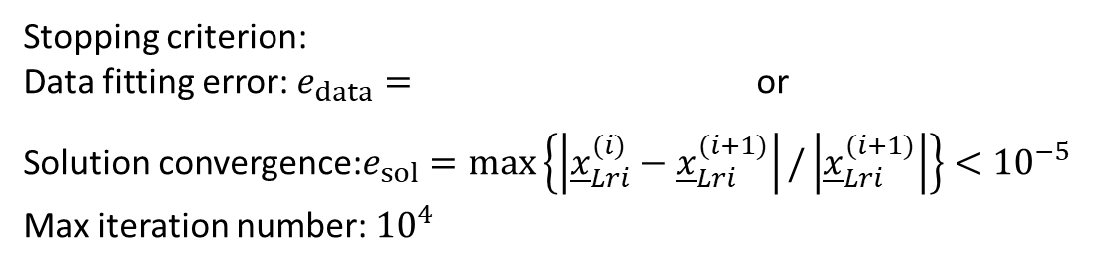

Settings for simulation
$$N_{0}$$
Observations on four circles,
On each circle, 49 observations with uniform angular step are collected.
Wavelength $λ=1mm$ and value of $β$ determined by
Both real and the imaginary parts of each component of $X^{(0)}$ are realizations of uniform distributions supported on the set [−30, 30].
Stopping criterion:
Data fitting error: $e_{data}=$ or
Solution convergence:$e_{sol}=max\left\{\left|{\underline{x}}_{Lri}^{(i)}−{\underline{x}}_{Lri}^{(i+1)}\right|/\left|{\underline{x}}_{Lri}^{(i+1)}\right|\right\}<{10}^{−5}$
Max iteration number: ${10}^{4}$
$${re}_{data}=\frac{\left|e_{data}\left({\underline{x}}_{Lri}^{\left(i\right)}\right)−e_{data}({\underline{x}}_{Lri}^{(i−1)})\right|}{e_{data}\left({\underline{x}}_{Lri}^{\left(i\right)}\right)}$$
$<{10}^{−5}$
$$<{10}^{−3}$$

Slide 7
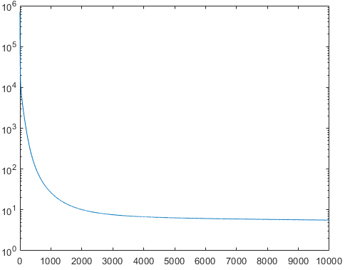
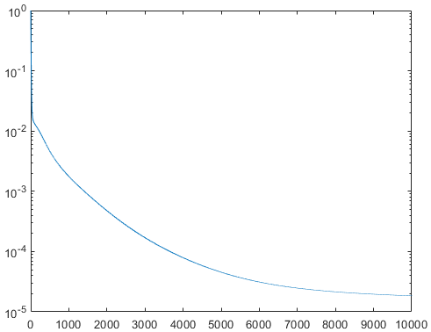
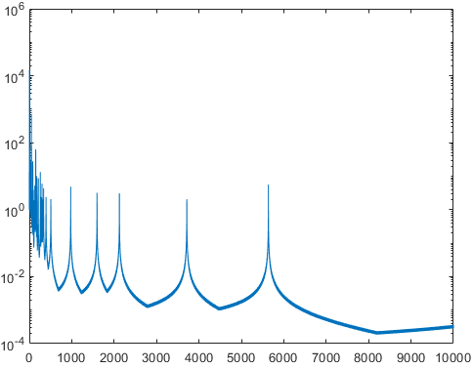



Results
$$e_{data}$$
$${re}_{data}$$
Iteration index
Iteration index
$$e_{sol}$$

Slide 8
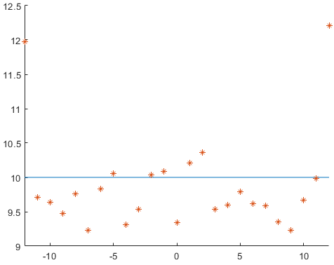
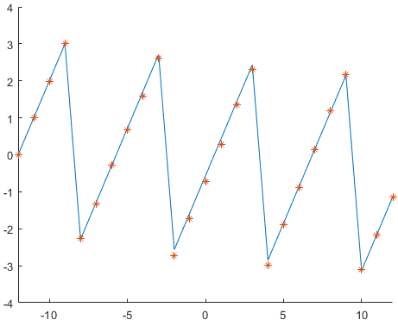


Results
$$\left|c_{n}\right|$$
Expansion order
$$angle(c_{n})$$
Expansion order

