Slide 1






Algorithm
arg min
solved by gradient approach
Optimal step size
$$\frac{dφ\left({\underline{x}}^{\left(j\right)}−α\hat{∇}φ\right)}{dα}=c_{3}α^{3}+c_{2}α^{2}+c_{1}α+c_{0}=0$$
Case 1: one real root and a pairs of complex conjugate roots
Case 3: three real roots. Choose the one corresponding with the min data fitting error

Slide 2
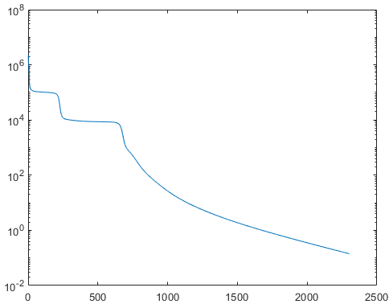
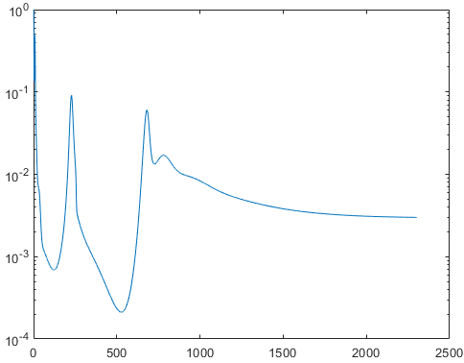
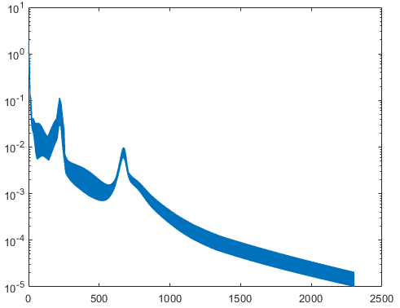



Results
$$e_{data}$$
$${re}_{data}$$
Iteration index
Iteration index
$$e_{sol}$$

Slide 3
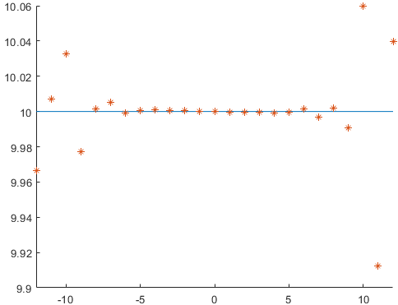
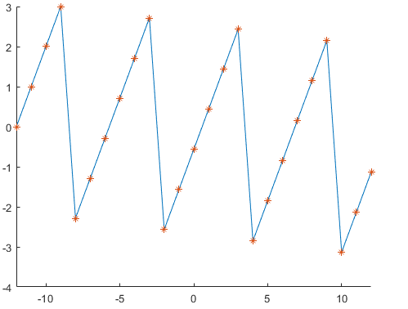


Results
$$\left|c_{n}\right|$$
Expansion order
$$angle(c_{n})$$
Expansion order

