Slide 1
Digital Signal Processing
Lab 4 Introduction

Slide 2
DSP Lab 4 -- Description
Lab 4 will help you understand various noise contributions in the system.
Being able to make good temperature measurements is key in completing the final project
There are a number of sections to this lab that need to be understood as you proceed

Slide 3
Pneumonia Detection System

Slide 4
Quantization Noise and Sensor Noise

Slide 5
Oversample Averaging

Slide 6
Adding Dithering

Slide 7
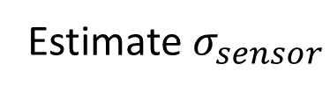
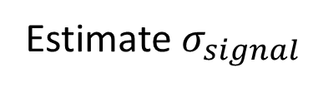
DSP Lab 4 -- Description
Part 1a -- Estimate of the temperature sensor noise
Estimate $σ_{signal}$
Estimate $σ_{sensor}$

Slide 8
DSP Lab 4 -- Description
Part 1b – Try using oversampling to try and reduce quantization noise
Add oversample averaging to see if that improves things

Slide 9
DSP Lab 4 -- Description
Part 1c – Build and test a DAC to generate a dithering signal. Using dither to reduce the effects of quantization noise
Add “dither” noise to better distribute Q-Noise

Slide 10
DSP Lab 4 -- Description
Part 1d – Estimate the improved resolution and effective number of bits
Part 2 – Calculating signal to noise ratio
estimate of the temperature sensor noise

Slide 11
DSP Lab 4
Estimating Sensor Noise

Slide 12
Chatter Noise Demo

Slide 13
Estimating the Sensor Noise
The sensor has an average DC value with some noise impressed on it
Q = 128
ADC Output = 128
Input Voltage
with noise
When the average DC and input noise is away from the threshold the value is a fixed output
Threshold
Q = 127

Slide 14
Estimating the Sensor Noise
The sensor has an average DC value with some noise impressed on it
Q = 128
When the average DC and input noise does not cross the threshold the value is a fixed output
Threshold
Input Voltage
with noise
ADC Output = 127
Q = 127

Slide 15
Estimating the Sensor Noise
As the peaks of the noise cross the threshold some toggling of the output value occurs
Q = 128
ADC Output = 128
ADC Output = 127
Input Voltage
with noise
Threshold
The peaks of the noise will sometimes cross the threshold causing the output to toggle occasionally
Q = 127

Slide 16
Estimating the Sensor Noise
As the mean is centered at the threshold the output “chatters”
Q = 128
ADC Output = 128
ADC Output = 127
Input Voltage
with noise
Threshold
The noise on the signal crosses the threshold often causing the output to toggle frequently
Q = 127

Slide 17
Estimating the Sensor Noise
As the signal drifts further downward the “chatter” lessens
Q = 128
Threshold
Input Voltage
with noise
ADC Output = 128
ADC Output = 127
Q = 127

Slide 18

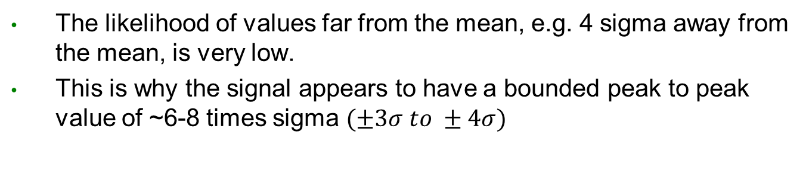


Peak to Peak Value of Normally Distributed Noise
The likelihood of values far from the mean, e.g. 4 sigma away from the mean, is very low.
This is why the signal appears to have a bounded peak to peak value of ~6-8 times sigma $(±3σ to ±4σ)$
$$1σ$$
$$6σ$$
$$2σ$$

Slide 19
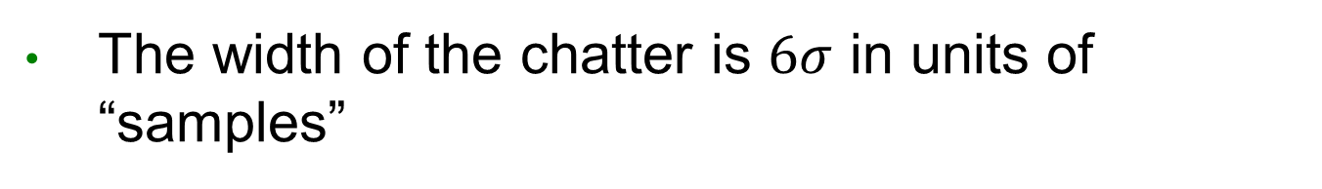
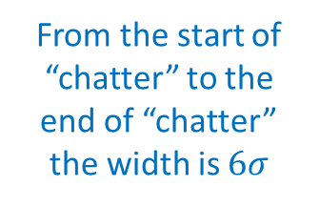
Estimating the Sensor Noise
The width of the chatter is $6σ$ in units of “samples”
Q = 128
ADC Output = 128
ADC Output = 127
From the start of “chatter” to the end of “chatter” the width is $6σ$
Threshold
ADC Output = 128
ADC Output = 127
Q = 127

Slide 20
Measuring Sensor Noise Using the “Pinch” Test
The sensor temperature is elevated (by pinching the sensor) and then allowed to decay
As the temperature cools the voltage will slowly decrease and move between quantization levels

Slide 21
Measuring Sensor Noise Using the “Pinch” Test
The time (samples) between clusters estimates the magnitude of the bit in “samples”
Q = 128
128
Threshold
“Chatter”
128
Q = 127
The time between clusters of
chatter estimates the size of a quantization level
The width of chatter estimates the peak to peak noise
127
“Chatter”
Threshold
126
Q = 126

Slide 22
Measuring Sensor Noise Using the “Pinch” Test
Adjust your procedure to get several clusters that have a significant width of “chatter”

Slide 23



Measuring Sensor Noise Using the “Pinch” Test
Measure the distance between clusters. This is representative of the quantization magnitude
$$d_{1}=621−465=156$$
n=799
n=465
n=621
$$d_{2}=799−621=178$$
$$d_{average}=167$$

Slide 24
Measuring Sensor Noise Using the “Pinch” Test
Measure the width of the clusters. This is representative of the standard deviation of the noise
n=50
n=47
Use the average
width
Average = 52.33
n=60

Slide 25
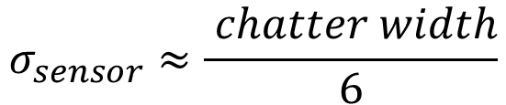
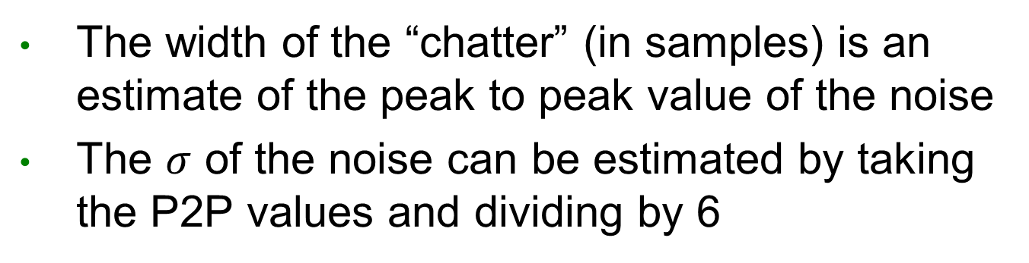
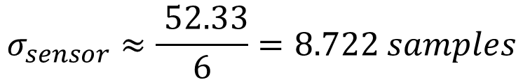
Estimating Sensor Noise
The width of the “chatter” (in samples) is an estimate of the peak to peak value of the noise
The $σ$ of the noise can be estimated by taking the P2P values and dividing by 6
$$σ_{sensor}≈\frac{ chatter width}{6}$$
Units are samples
$$σ_{sensor}≈\frac{ 52.33}{6}=8.722 samples$$

Slide 26
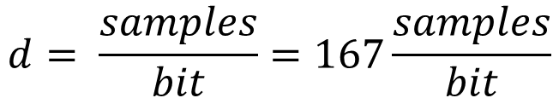
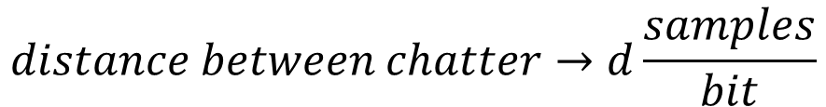
Estimating Sensor Noise
The distance between each bit can be represented by the number of samples between “clusters” of “chatter”
We can use this to estimate how large a bit is in samples
$$distance between chatter→d\frac{samples}{bit}$$
$$d= \frac{samples}{bit}=167\frac{samples}{bit}$$

Slide 27
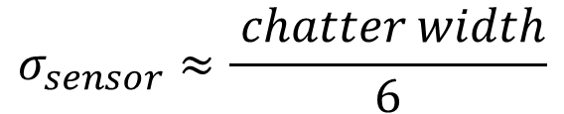
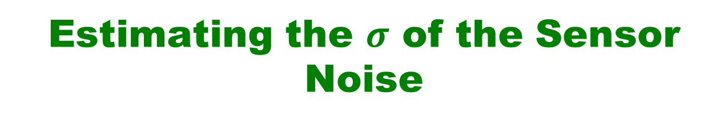
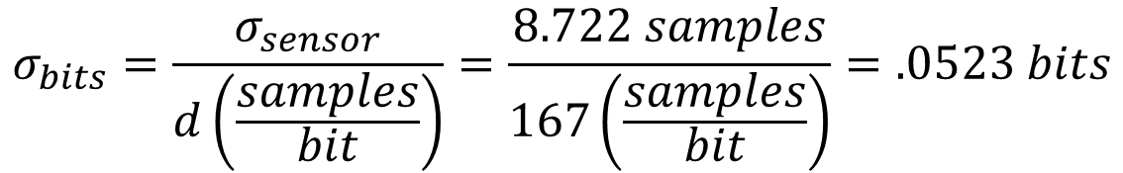
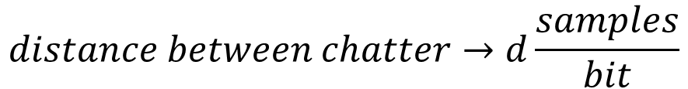
Estimating the $σ$ of the Sensor Noise
The we can estimate the sensor noise in bits or code values
$$σ_{sensor}≈\frac{ chatter width}{6}$$
$$distance between chatter→d\frac{samples}{bit}$$
$$σ_{bits}=\frac{σ_{sensor}}{d\left(\frac{samples}{bit}\right)}=\frac{8.722 samples}{167\left(\frac{samples}{bit}\right)}=.0523 bits$$

Slide 28
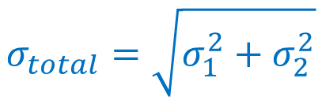

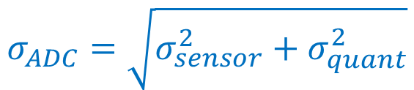
Estimate the ADC output Noise
Recall that $σ$ of multiple noise sources add in quadrature
$$σ_{total}=\sqrt{σ_{1}^{2}+σ_{2}^{2}}$$
The total output noise of the ADC is the combination of the sensor noise and quantization noise
$$σ_{ADC}=\sqrt{σ_{sensor}^{2}+σ_{quant}^{2}}$$

Slide 29
DSP Lab 4
What is our signal?
How Compute SNR?

Slide 30
What is Our Signal?
Simply -- The signal is the information that we are interested in.
It could be a DC voltage

Slide 31
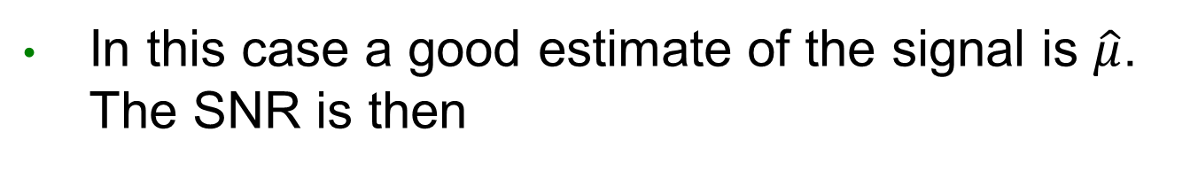
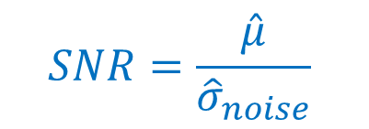
What is Our Signal?
In this case a good estimate of the signal is $\hat{μ}$. The SNR is then
$$SNR=\frac{\hat{μ}}{{\hat{σ}}_{noise}}$$

Slide 32
What is Our Signal?
It could be the variation in the signal around a DC level
A sine wave or other time varying signal

Slide 33
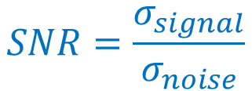
What is Our Signal?
In this case a good estimate of our signal level is the standard deviation of the signal and the SNR is:
$$SNR=\frac{σ_{signal}}{σ_{noise}}$$

Slide 34
What is our Signal?
In this lab, in some cases we have used a linear regression fit to estimate our signal
The signal level would then be the standard deviation of the fitted values

Slide 35
DSP Lab 4
Oversample Averaging

Slide 36
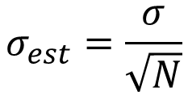
Using Oversample Averaging to Decrease Noise
We know that the “typical” error of the estimate of the mean decreases as one increases the number of samples
$$σ_{est}=\frac{σ}{\sqrt{N}}$$
If we take multiple samples of a signal then average them the standard deviation of our estimates should decrease

Slide 37
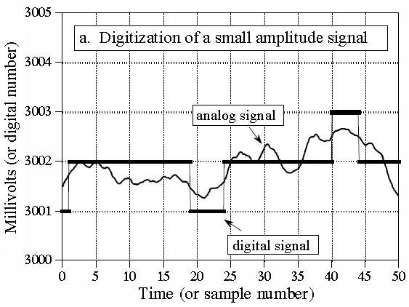
Using Oversample Averaging to Decrease Noise
However if the noise is “hidden” by quantization levels this may not be effective
Taking multiple samples of the same value doesn’t help improve the noise
We’ll try this to see what happens

Slide 38
DSP Lab 4
Dithering

Slide 39
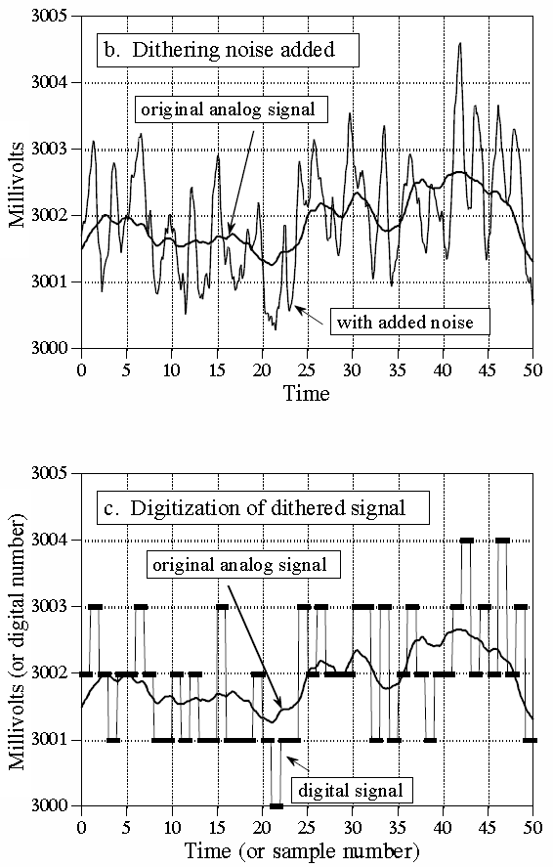
Decreasing Noise by Adding Noise?
We’ll see if adding noise, then oversampling and averaging will improve the situation
Called “Dithering”

Slide 40
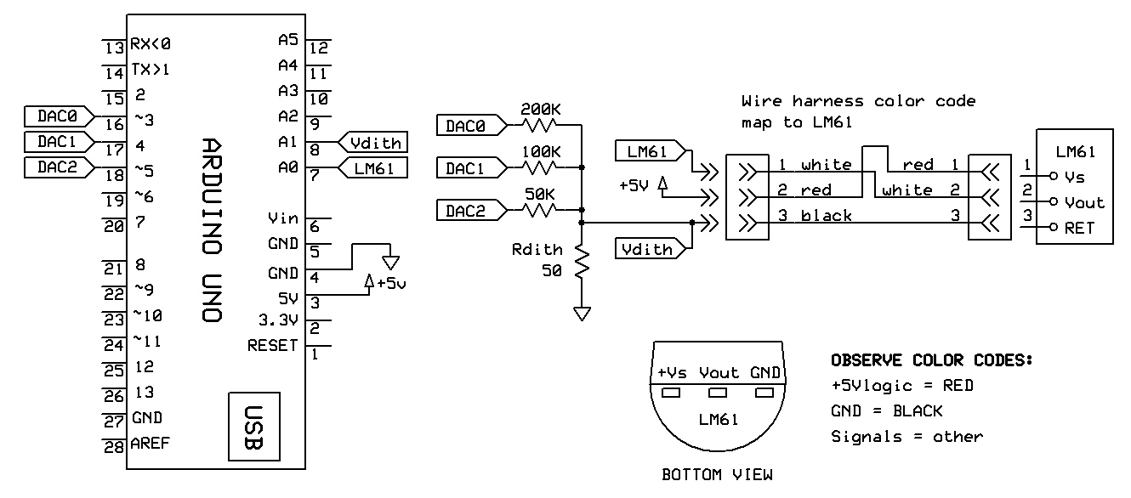
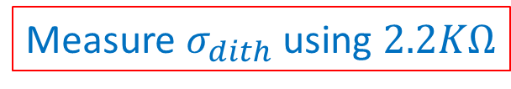
Creating a 3-Bit DAC to Generate Dither Noise
Be sure to follow the schematic below
Connect LM61 to A0, V_{dith} to A1
Measure $σ_{dith}$ using $2.2KΩ$

Slide 41
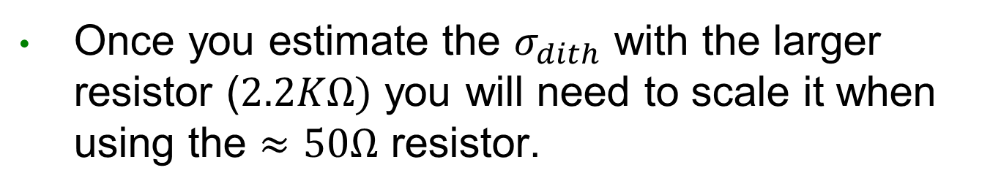


Creating a 3-Bit DAC to Generate Dither Noise
Once you estimate the $σ_{dith}$ with the larger resistor ($2.2KΩ)$ you will need to scale it when using the $≈50Ω$ resistor.
$$σ_{dither_2.2K}$$
$$σ_{dither_50}$$
How should $σ_{dither}$ be scaled?

Slide 42
Lab Pointers
The key result of this lab is Table 1
Make sure you understand what it tells you
Handout Tables are included in myCourses so you don’t have to create them (2 tables)

Slide 43
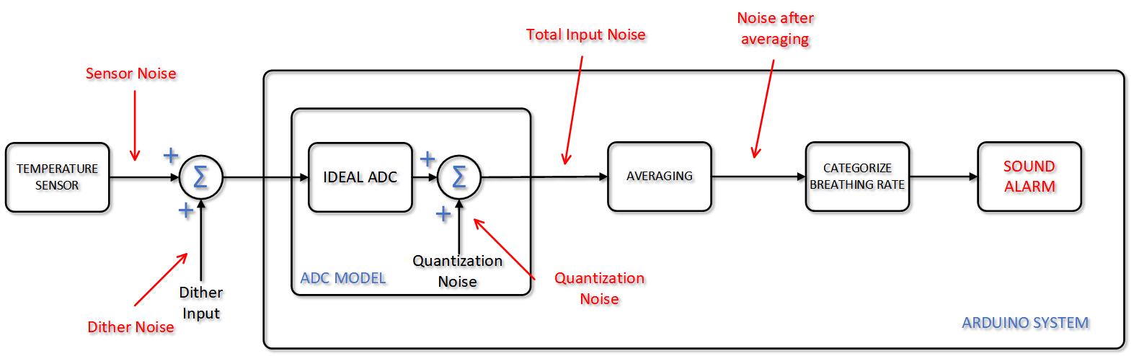
Lab Pointers
Locations of signals and noise referenced in the table

