Slide 1
Prepositions
By:- Palak Thakkar

Slide 2
What is Preposition??
Preposition is nothing but a word describes the relation between two nouns.
Eg: He goes to college.
The book is on the table.
Ram is siting in the class.
Prepositions Vs. Adverbs (describe the verb)
He goes into (preposition) the office.
He goes in. (adverb)
To: Preposition vs. Verb
Preposition: Sahil gave 1000 rupees to Rohan.
Verb: He locked the door to keep everyone out

Slide 3
Types of Prepositions
Location
Time
Direction
Place/Spatial Relation
Phrasal Verbs
In
On
At
In
On
At
Within
By
For
Since
During
From…To
In
Into
On
Onto
To
Toward
Around
Along
Within
Against
Across
Through
Above
Under
Beneath
Beside
Behind
Between
Etc.
At
Fro
With
Of
About

Slide 4
Location
Surface
(On)
Enclosed area
(In)
Point
(At)
On tells us that the following noun is located on a surface.
On the table
On the floor
On the chair
In tells us the noun is in an enclosed space (surround or closed off on all sides). Basically, when something is inside another thing.
In a box
In a room
In a country
At tells us that the following noun is located at a specific point or location. It shows an exact position.
She is waiting at the entrance
We are at the mall
The garden is at the end of the road
Notes:
At vs. in
At is used when the location is emphasized and in is used when the building is emphasized
Eg: She is at the library
She is in the library

Slide 5
In
Parts of the day – in the morning
Months – in December
Seasons – in winter
Years/decades/centuries – in 2015/ in the 1990’s/ in the 20th century
On
Days of the week – on Mondays
Dates – on 5th June 1986
Particular days – on my birthday/ on the following day
At
Night – at night
Clock – at 7 o’clock/ at 6:35 p.m.
Holidays – at Christmas/ at the weekend
During
Throughout/within a period – She works during the day/ An accident occurred during the night
By
Not later than; at or before – I’ll have it done by tomorrow
Within
Inside of – within 20 minutes; within an hour
For
Used to show an amount of time – He lived Oxford for 3 years
Since
From a particular time in the past till now – First bird sighting since 1995
From…to
Used to show when something starts and ends – We’re open from 8 a.m. to 7 p.m.
Time
Point
Extended
In
On
At
During
By
Within
For
Since
From…To

Slide 6
Direction
Movement to a surface (On/Onto)
Movement toward an enclosed area (In/Into)
Movement to a destination (To/Toward)
On is used when something is stationary on a surface.
Onto is a dynamic preposition (it means it shows movement). Onto is used when a change is position/direction is seen.
The cat jumped onto the sofa/ The cat is jumping on the sofa.
In is used when something is in an enclosed space.
Into is also a dynamic preposition. It is used when there is change in position from outside something to inside something.
The cake is placed into the oven/ The cake is in the oven
To is used when you want to move from one place to another, i.e. an end destination.
Towards is used when you are on the way to the destination or something is coming in your direction.
He is walking toward his office/ They want to go to Manali for the weekend

Slide 7
Place/Spatial Relation
Confined/limited movement
Relative movement
Relative position
Around
Along
Within
Across
Through
Out of
Above
Over
Under
Beneath
Off
Near
Between
Beside
Behind
Among
Before
Etc.

Slide 8
Place/Spatial Relation
Confined/limited movement
Relative position
Relative movement
Around
Circling something
We walked around the block.
Along
Following the length of something
We walked along the road.
Within
Inside of a specific distance
within one kilometre.
Around
Along
Within

Slide 9
Place/Spatial Relation
Confined/limited movement
Relative position
Relative movement
Across
From one side to the other
We walked across the field.
Through
Across; from end to end of something
The main road through town
Out of
To the outside of something
She went out of the room.
Across
Through
Out of

Slide 10
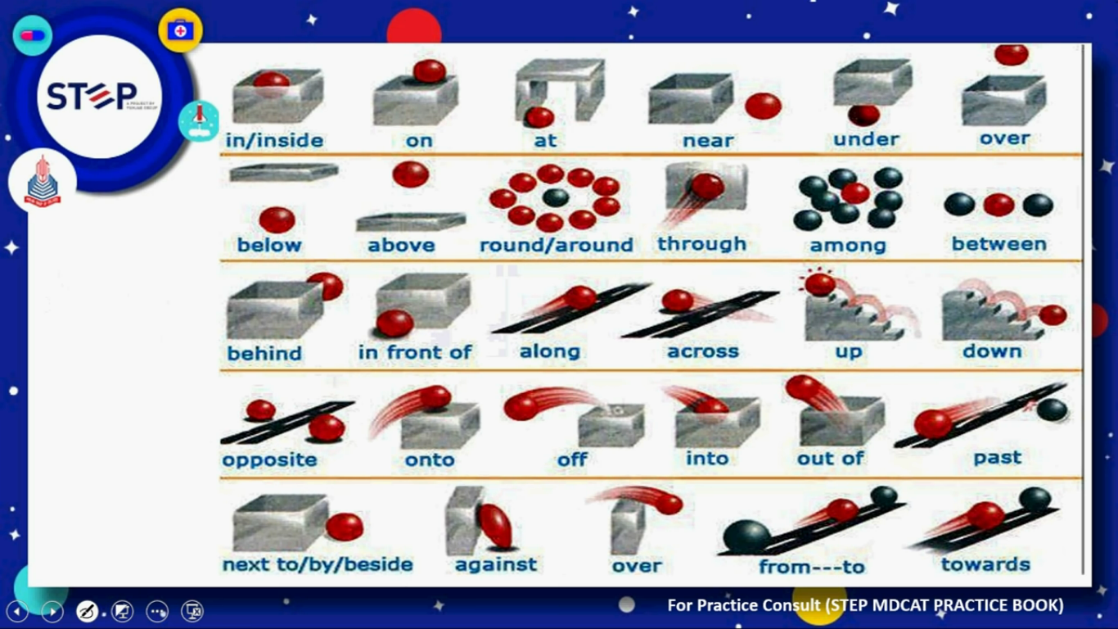

Slide 11
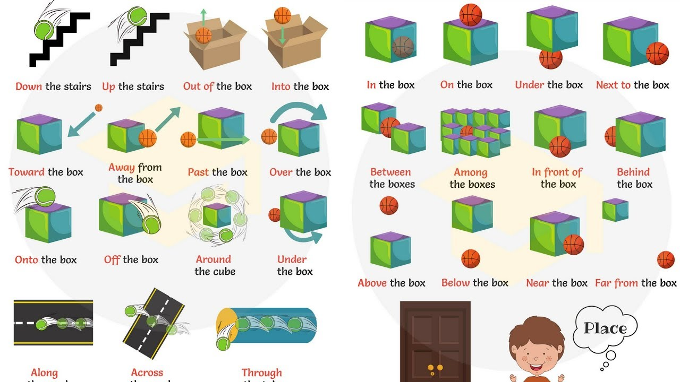

Slide 12
What are Phrasal verbs??
Phrasal verbs are nothing but a combination of prepositions and verbs.
Some verbs require specific prepositions to be used after them in a sentence. The combination of such a verb and its required preposition is called a phrasal verb.
Eg: She is waiting for him.
They are listening to music.
A burglar broke into the house.
They do not agree with each other.
Note: Phrasal verbs must have an object in the sentence. The object comes directly after the phrasal verb.
Take off (plane)
Take over (gain control)
Take out (to remove)
Take after (resemble)
Take on (work)
Take up (hobby)

Slide 13
Break
Break away (separate)
Break down (fail, stop)
Break even (neither profit nor loss)
Break in (enter a place by force)
Break out (escape)
Break up (end a relationship)

Slide 14


