Slide 1
Employee Management System
We Do what we have to do

Slide 2
Introduction
Employee Management System is a Standalone application specially designed for a particular organization,college or a to a Software company.
With this System it will be easier to manage all the employees and their data.
It gives the complete structured information about the employees to us once we store.
Provides in-build attendance management.

Slide 3
Technologies Used
Java
Swings (For Interface design)
Java Database Connectivity (JDBC)
MySQL
Hashing

Slide 4

Java
Java is a general-purpose computer-programming language that is class-based, object-oriented, and specifically designed to have as few implementation dependencies as possible.
There are lots of applications and websites that will not work unless you have Java installed, and more are created every day.
Features of Java
Abstraction
Encapsulation
Polymorphism

Slide 5

Features of Java
Abstraction
Abstraction is the process of abstraction in Java which is used to hide certain details and only show the essential features of the object.
In other words, it deals with the outside view of an object (interface).

Slide 6
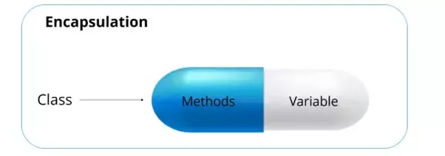
Features of Java
Contd...
Encapsulation
Encapsulation in java is a process of wrapping or binding code and data together into a single unit, for example capsule i.e. mixed of several medicines.
We can create a fully encapsulated class in java by making all the data members of the class private. Now we can use setter and getter methods to set and get the data in it.

Slide 7

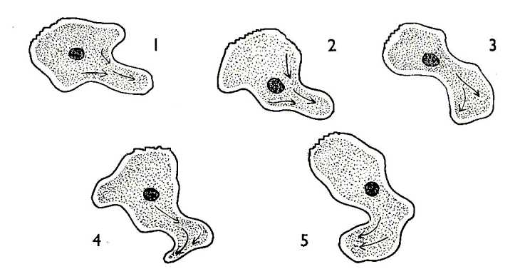
Features of Java
Contd...
Polymorphism
Polymorphism is a term or a feature that any object oriented programming language provides that, an object or an entity that exists in many forms.
Method Overloading
Same name but different parameters
Method Overriding

Slide 8
Swings
Swing is a part of JFC (Java Foundation Classes). Building Graphical User Interface in Java requires the use of Swings.
Swing Framework contain a large set of components which allow high level of customization and provide rich functionalities, and is used to create window based applications.
Swing was developed to provide a more sophisticated set of GUI components than the earlier Abstract Window Toolkit (AWT).

Slide 9
Java Database Connectiviey
Java Database Connectivity (JDBC) is an application programming interface (API) for the programming language Java, which defines how a client may access a database.
It is a Java-based data access technology used for Java database connectivity and it is part of the Java Standard Edition platform, from Oracle Corporation.

Slide 10
Java Database Connectiviey
Contd...
JDBC Driver
JDBC drivers implement the defined interfaces in the JDBC API, for interacting with your database server.
JDBC drivers enable you to open database connections and to interact with it by sending SQL or database commands then receiving results with Java.
The Java.sql package that ships with JDK, contains various classes with their behaviours defined and their actual implementaions are done in third-party drivers. Third party vendors implements the java.sql.Driver interface in their database driver.

Slide 11
Java Database Connectiviey
Contd...
Types of Drivers
JDBC-ODBC bridge.
Native-API driver.
Network-Protocol driver (Middleware driver)
Database-Protocol driver (Pure Java driver) or thin driver (fully Secured and new).

Slide 12
MySQL
MySQL is a freely available open source Relational Database Management System (RDBMS) that uses Structured Query Language (SQL).
SQL is the most popular language for adding, accessing and managing content in a database.
It is most noted for its quick processing, proven reliability, ease and MySQL has become the leading database because flexibility of use.

Slide 13
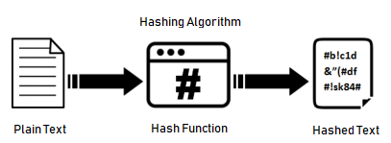
Hashing
Hashing is the transformation of a string of characters into a usually shorter fixed-length value or key that represents the original string.
Popular Hashing Algorithms
Md5
SHA
sha1
sha2

Slide 14
Hashing
Contd...
md5 hashing algorithm
md5(str)
Calculates an MD5 128-bit checksum for the string. The value is returned as a string of 32 hex digits, or NULL if the argument was NULL. The return value can, for example, be used as a hash key.
Ex.
Md5(‘Hello’);
Output : “ 8b1a9953c4611296a827abf8c47804d7 “

Slide 15
Hashing
Contd...
sha1
Calculates an SHA-1 160-bit checksum for the string.
The value is returned as a string of 40 hex digits, or NULL if the argument was NULL.
One of the possible uses for this function is as a hash key. See the notes at the beginning of this section about storing hash values efficiently
sha1(‘Hello’)
Output : “ f7ff9e8b7bb2e09b70935a5d785e0cc5d9d0abf0 ”

Slide 16
Hashing
Contd...
SHA2
sha2( String , bit_length )
Calculates the SHA-2 family of hash functions (SHA-224, SHA-256, SHA-384, and SHA-512). The first argument is the cleartext string to be hashed.
The second argument indicates the desired bit length of the result, which must have a value of 224, 256, 384,512, or 0 (which is equivalent to 256).
If either argument is NULL or the length is not one of the permitted values, the return value is NULL.
Otherwise, the function result is a hash value (wanted output) containing the desired number of bits.

Slide 17
Hashing
Contd...
SHA2 sample outputs
sha2(‘Hello’,256)
Ouput : “ 185f8db32271fe25f561a6fc938b2e264306ec304eda518007d1764826381969 “
sha2(‘Hello’,512)
Output
“3615f80c9d293ed7402687f94b22d58e529b8cc7916f8fac7fddf7fbd5af4cf777d3d795a7a00a16bf7e7f3fb9561ee9baae480da9fe7a18769e71886b03f315 ”

Slide 18
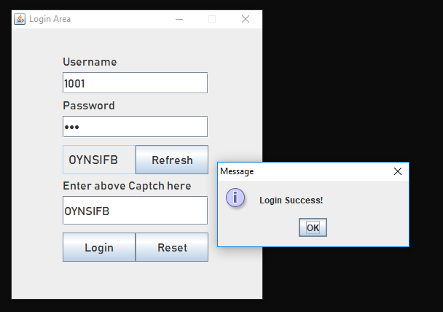
Project Pages
Login Page

Slide 19
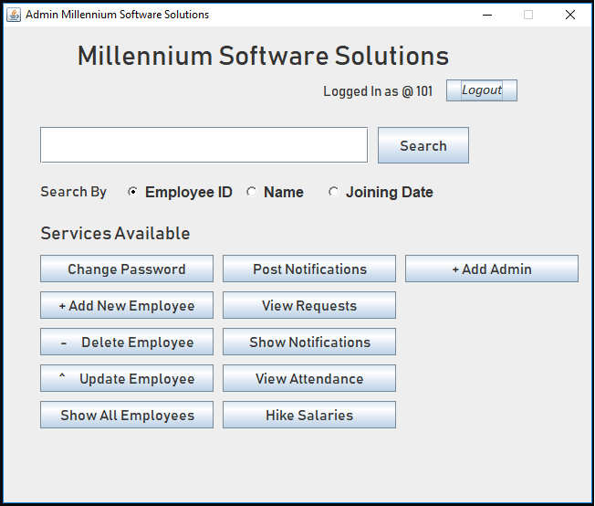
Project Pages
Contd...
Admin Home Page

Slide 20
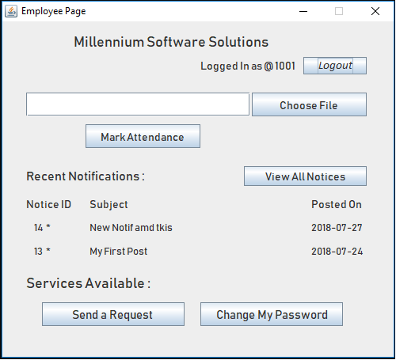
Project Pages
Contd...
Employee Homepage

Slide 21
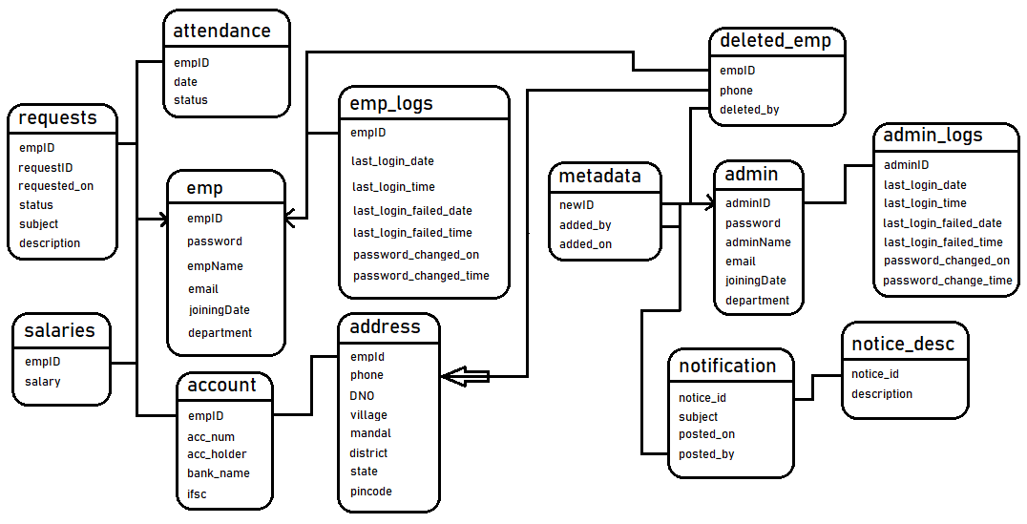
Database ER Diagram
<
<

Slide 22

Project Live Demo

Slide 23

N130068
N130937
N130021

