Slide 1
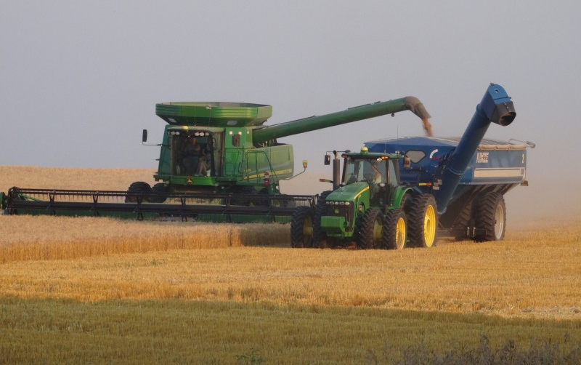

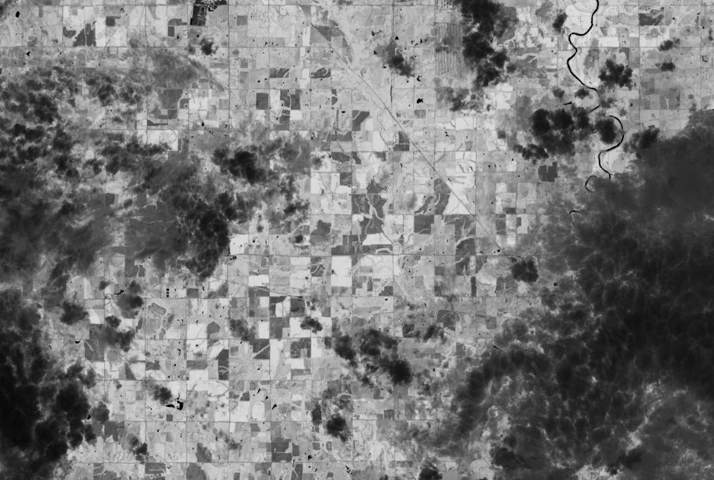
R for Spatial Humanities
Raechel A. White
@CurmudgeonPhD
Geography, Environment and Spatial Science
“The meaning of space, especially as place or landscape, is always being constructed through various contests that occur over power.”

Slide 2
R Packages
Spatial Packages (RGDAL, SP/SF)
Humanities Packages
Raster
RASTER
RSToolbox
Vector
GGMAP
GISTools
Web
Leaflet
OCR
PDFTOOLS
TESSERACT
Text Analysis/NLP
TM
CORENLP
Networks
IGRAPH
GeoTagging/Parsing
GEOPARSER

Slide 3
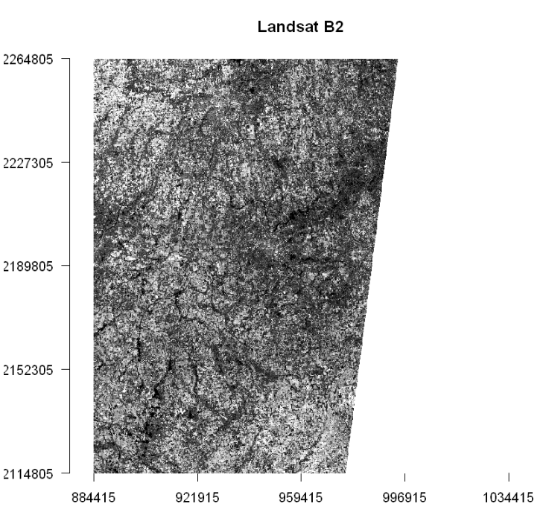
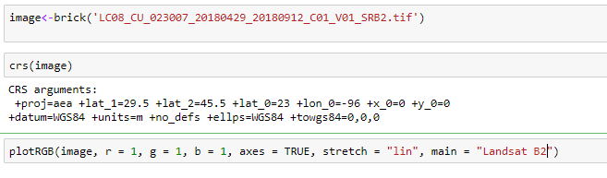
Raster

Slide 4
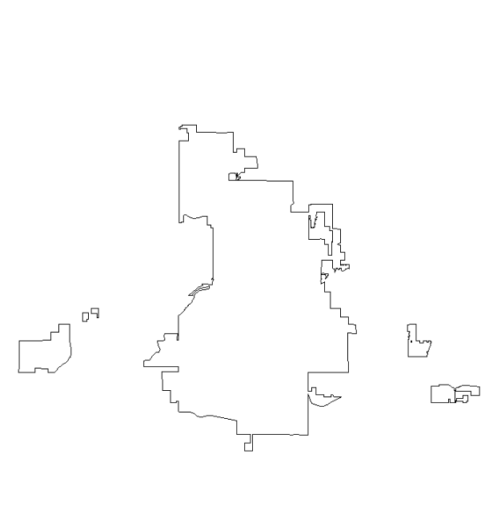
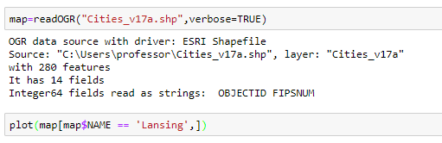
Vector

Slide 5
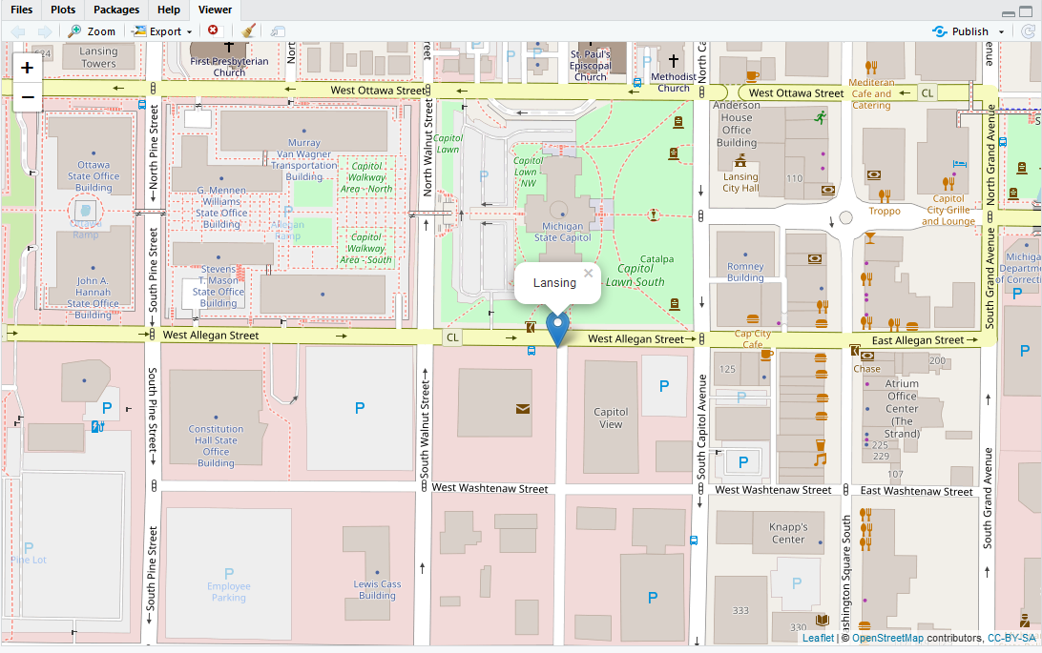
Leaflet

Slide 6
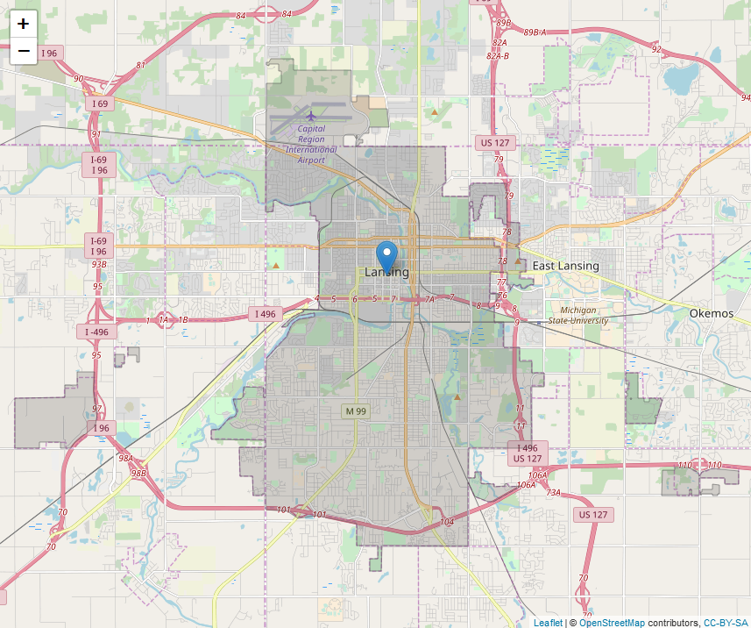
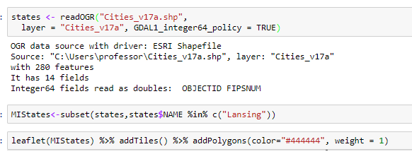
Vector + Leaflet

Slide 7
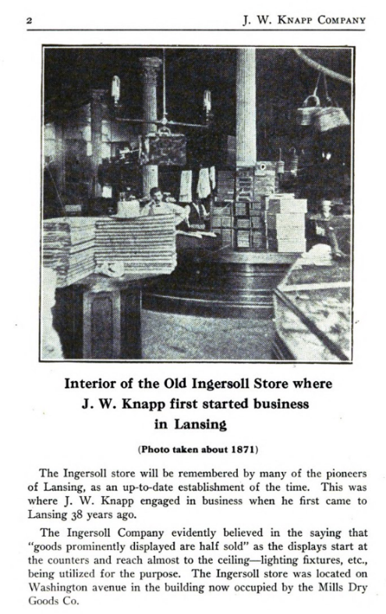
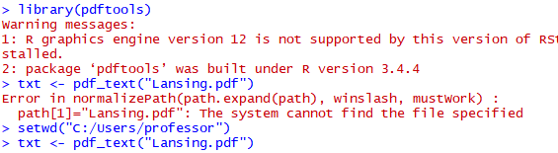
Example: pdfTools
"2 J. W. KNAPP CoMPANY\r\n Interior of the Old Ingersoll Store where\r\n J. W. Knapp
first started business\r\n in Lansing\r\n (Photo taken about 1871)\r\n The Ingersoll store will
be remembered by many of the pioneers\r\nof Lansing, as an up-to-date establishment of the time.
This was\r\nwhere J. W. Knapp engaged in business when he first came to\r\nLansing 38 years ago.\r\n
The Ingersoll Company evidently believed in the saying that\r\n“goods prominently displayed are half sold”
as the displays start at\r\nthe counters and reach almost to the ceiling—lighting fixtures, etc.,\r\n being
utilized for the purpose. The Ingersoll store was located on\r\nWashington avenue in the building now occupied by the Mills Dry\r\nGoods Co.\r\n"

Slide 8

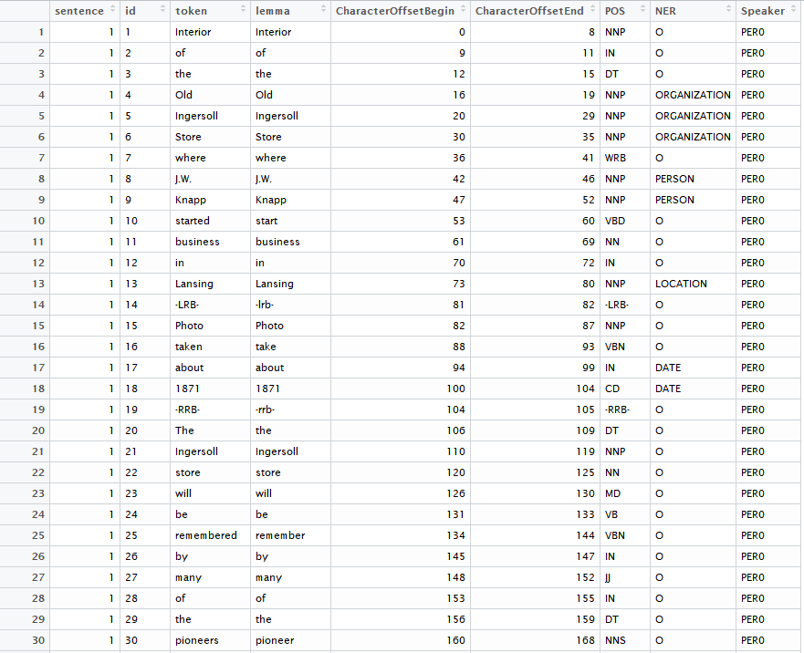
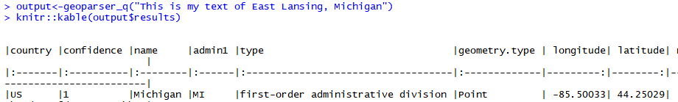
CoreNLP & GeoParser

