Slide 1
glmulti: best subsets model selection Lauren Wisnieski
library(dplyr)
rladies_global %>%
filter(city == 'Your city')

Slide 2
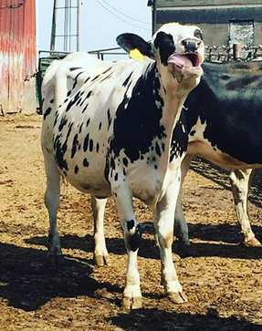
Hello!
I am here because I am using R for my dissertation research.
I study dairy cattle epidemiology in the Comparative Medicine and Integrative Biology program in the vet school

Slide 3
What is best subsets selection?
Automated model selection procedure
Fits all possible models using candidate variable set
Ranks them by Information Criteria (e.g. BIC, AIC)
For generalized linear models, can fit different distributions (e.g. Poisson, binomial)

Slide 4
Why is this useful?
Predictive analytics:
there is likely not one, true “best” model. This can identify a pool of potential models.
model averaging, averaging risk across multiple models to get more accurate risk prediction.
Data reduction:
when you have LOTS of variables, can find the most relevant variables that are most common in the candidate models

Slide 5
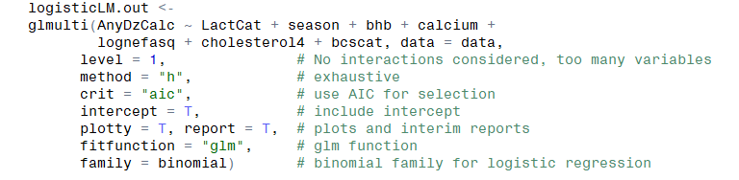
How it works

Slide 6
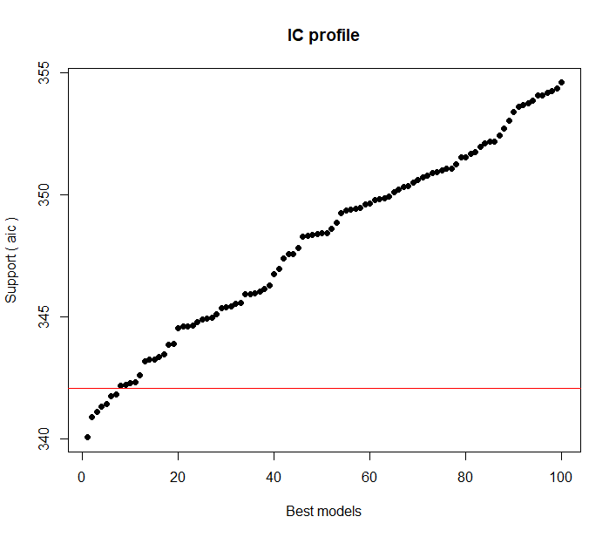
Model averaging: take models within 2 AIC’s of the “best” model and average predictions over these models (I do this in Stata)

Slide 7
Questions??

