Slide 1
Coding Unplugged!!

Slide 2
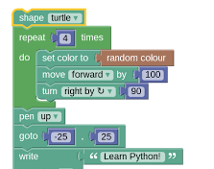


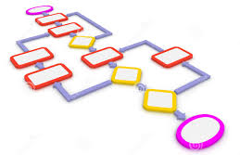
Glossary
Code
Set of instructions
Computer
Processes instructions
Processor
Algorithm
Detailed instructions for doing a task

Slide 3
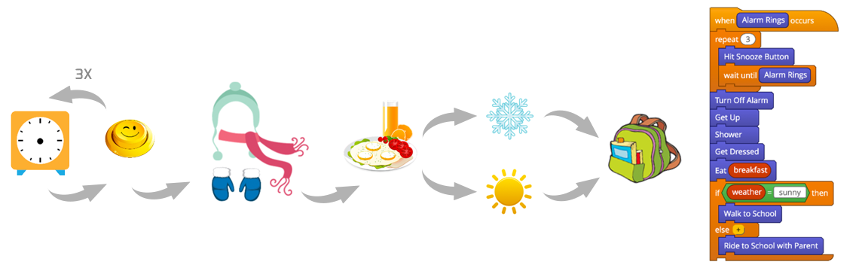
Example of an Algorithm

Slide 4
High Clap

Slide 5
Dab

Slide 6
Star

Slide 7
Body Roll

Slide 8
This Or That

Slide 9
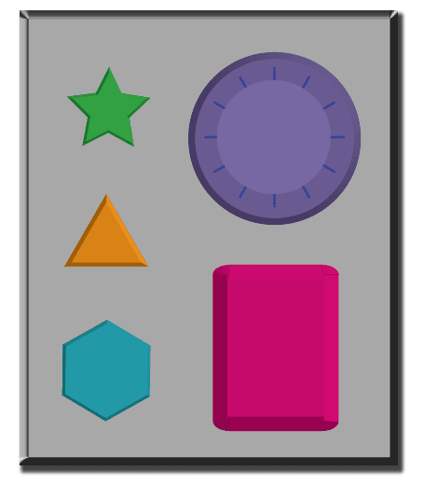

Slide 10
Let’s Create dance sequence!
When (music starts):
Do High Clap
Pseudocode
<sudo>code
Then do Body Roll
Then do This or That
End Dance
This or That Star Dab High Clap Body Roll

Slide 11
Repeat dance While music plays
While (music plays):
Do High Clap
Then do Body Roll
Then do This or That
End Dance
This or That Star Dab High Clap Body Roll

Slide 12
Repeat dance For sometime
For (4 times):
Do High Clap
Then do Body Roll
X4
Then do This or That
End Dance
This or That Star Dab High Clap Body Roll

Slide 13
Repeat dance For sometime (and then change)
When music starts:
For (4 times):
Do High Clap
End High Clap
For (4 times):
Do Body Roll
End Body Roll
For (4 times):
Do This or That
End This or That
End Dance
This or That Star Dab High Clap Body Roll

Slide 14
Change dance IF…
Start Dance
If (chorus):
Do Dab
Else
For (4 times):
Do High Clap
X4
Then do Body Roll
Then do This or That
End sequence
End Dance
This or That Star Dab High Clap Body Roll

Slide 15
Change dance IF…
Start Dance
If (Beginning Dancer):
While (music plays):
Do Dab
End Dab
Else
While (music plays):
Do High Clap
Then do Body Roll
Then do This or That
End sequence
End Dance

Slide 16
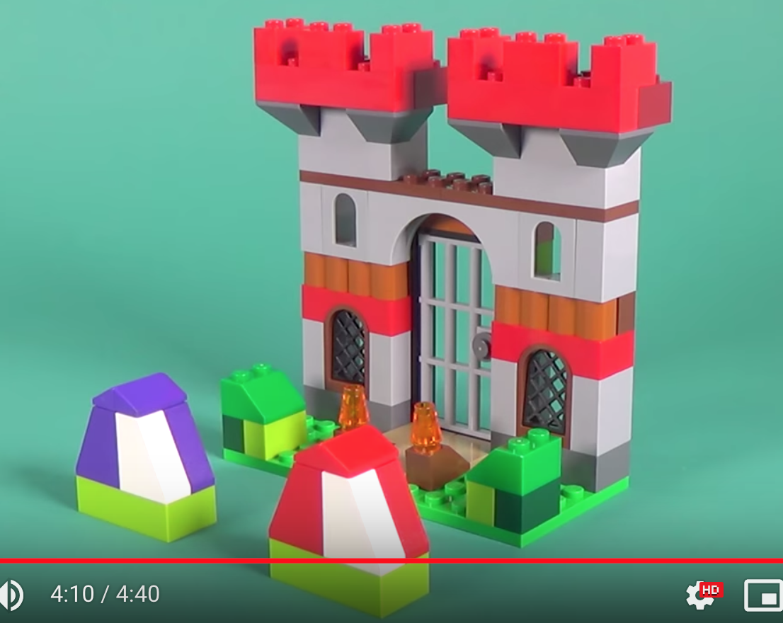
Activity1: Build a Lego Castle
Lesson: Coding is useful for making cool things.
Supplies: 2 people, Legos, screen, paper and pen.
How it works:
One person is the coder and the other is the human computer.
The coder must figure out the instructions for building the castle in the picture.
Without seeing what the computer is doing, the coder gives the “computer” instructions (one at a time) to build the castle.
The computer is behind the screen. It only takes instructions that are written down/spoken by the coder.
The best castle wins!!!

Slide 17
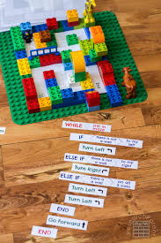
Activity 2: Lego Maze (Work together)
Lesson: Coding is useful for solving problems. Code, should always be tested.
Supplies: 2 people, Legos, maze, code blocks, paper and pen.
How it works:
Work together to build a Lego maze.
Use the code blocks to write instructions for solving the maze.
Test your code: one person calls out the instructions and the other tries to follow them.
Fix any bugs in your code.
Happy De-bugging!!!

Slide 18

Activity 3: Binary Bracelets (Individual)
Lesson: Coding is useful for making beautiful things.
Supplies: bracelet pack, beads
How it works:
Find out the binary code for your initials
Select the combination of (black and white) beads to make your initials.
Remember to use a (green) separator bead between your initials.
Happy crafting!!!

