Slide 1

WSTĘP DO PROGRAMOWANIA DLA TESTERÓW
Wstęp do programowania Java dla testerów
Remigiusz Dudek
Sławomir Radzymiński

Slide 2
About me ☺
Senior Software Engineer in Test
Ocado Technology - Kraków
KraQA
Awesome Testing – www.awesome-testing.com
slawomir.radzyminski@gmail.com

Slide 3
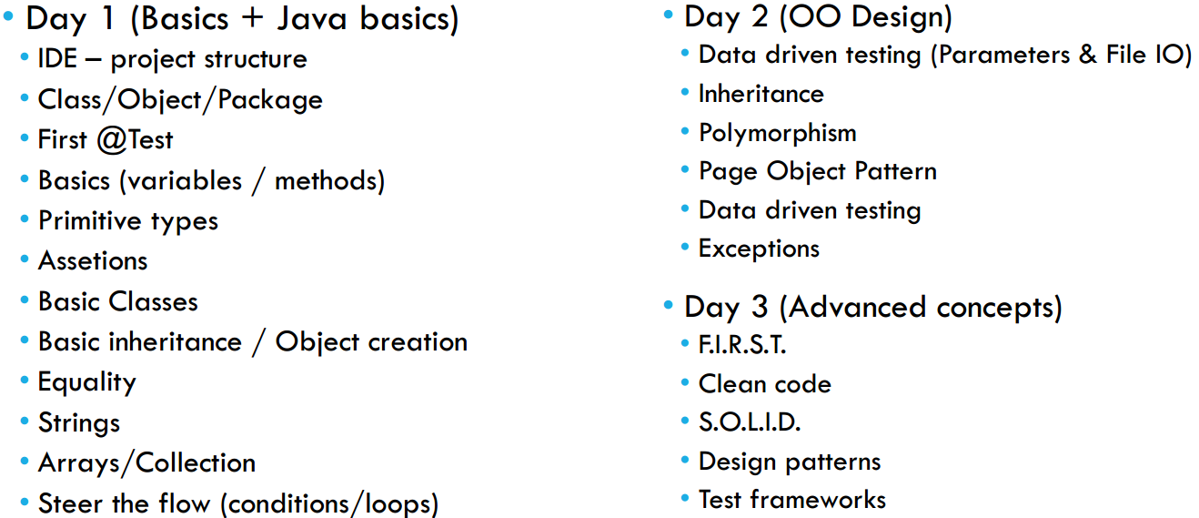
AGENDA

Slide 4
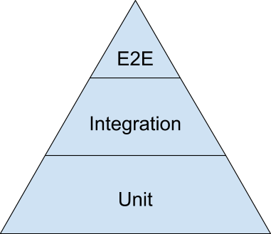
Test Pyramid
Selenium
Rest-Assured
Junit

Slide 5

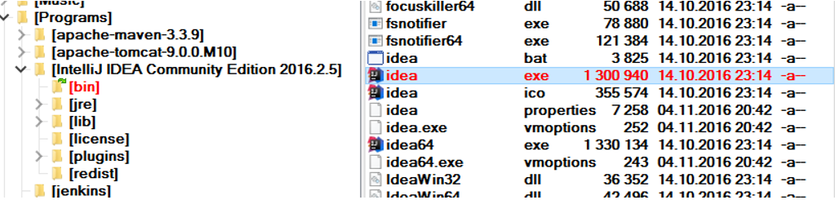
SETUP INTELLIJ
1. Check if you have java JDK installed
2. Copy Vistula-Programs.zip and unzip it
3. Run Intellij

Slide 6
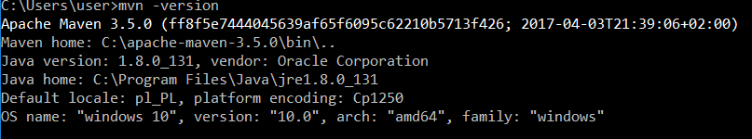
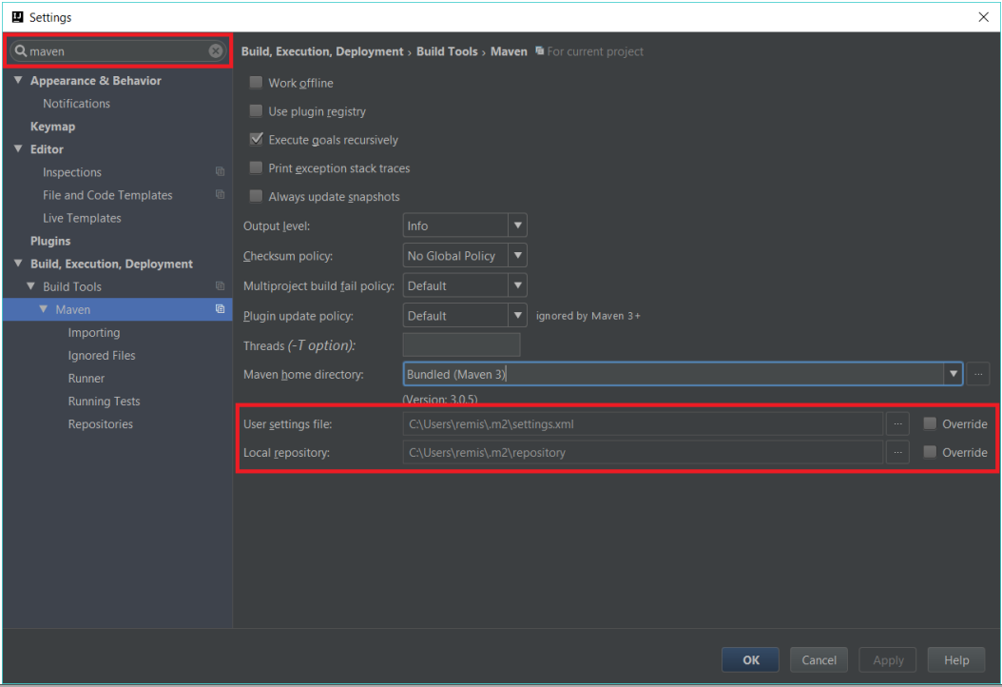
SETUP MAVEN

Slide 7
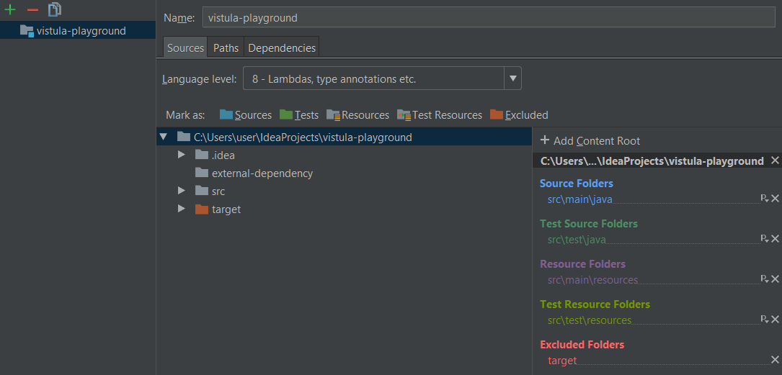
PROJECT STRUCTURE

Slide 8
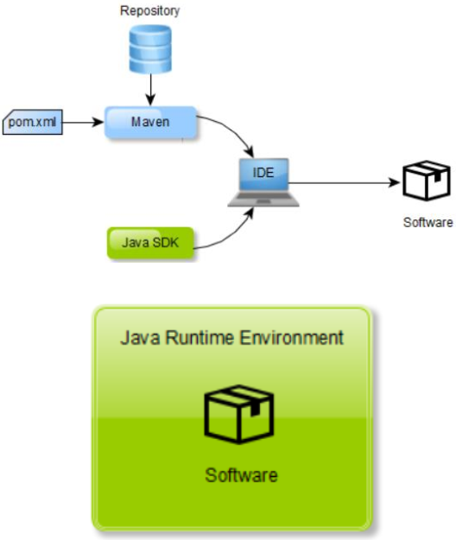
BIG PICTURE
1. What we need to build Java software?
- Something that would change text into runnable code – Java Software Development Kit (SDK)
Something that would give as parts that we can use, so we do not need to create everything from scratch – Maven
- Something that would build a deployable package – Maven
2. How can we tell Maven what are the parts that we need or how to build the package? – pom.xml
3. Wherefrom does Maven take these parts – Repository
4. What do we need to run Java software? – Java Runtime Environment (JRE)

Slide 9
EXCERCISE
1. Create your own project
2. Create following package structure (in test directory)
org.vistula.<your name>
3. Create class VistulaTest

Slide 10
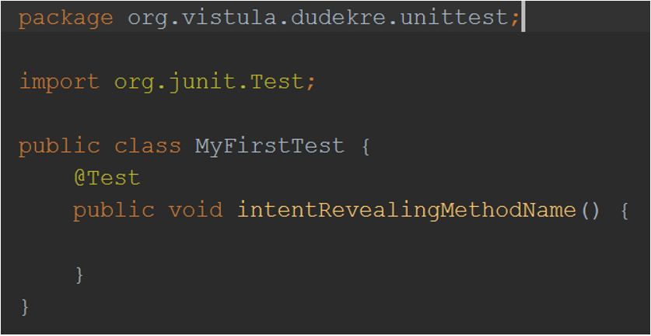
PACKAGE/CLASS/OBJECT
• What is class?
• What is object?
• Naming conventions
• Package
• Class
• Variables
• Methods

Slide 11
EXCERCISE
1. Create @Test printing out
„Hello <your name>”
2. Run the test in Run Window
3. Run the test in Debug Window

Slide 12
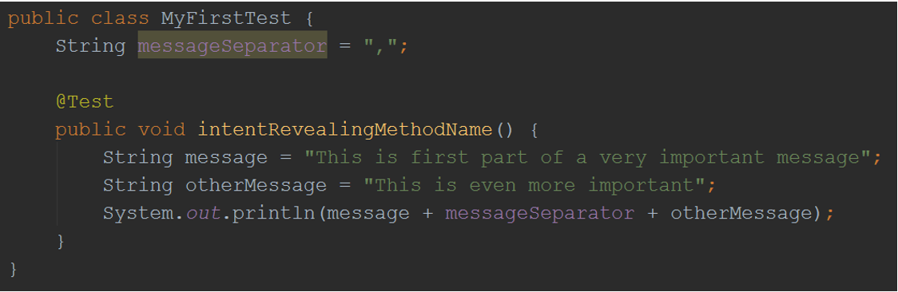
VARIABLES
• Why do we need them?
• Type
• Class/Method variable

Slide 13
EXCERCISE
1. Print the same greeting as previously but this time assign your name to variable
2. Run the test in Run Window
3. Run the test in Debug Window
(do you see any difference?)

Slide 14
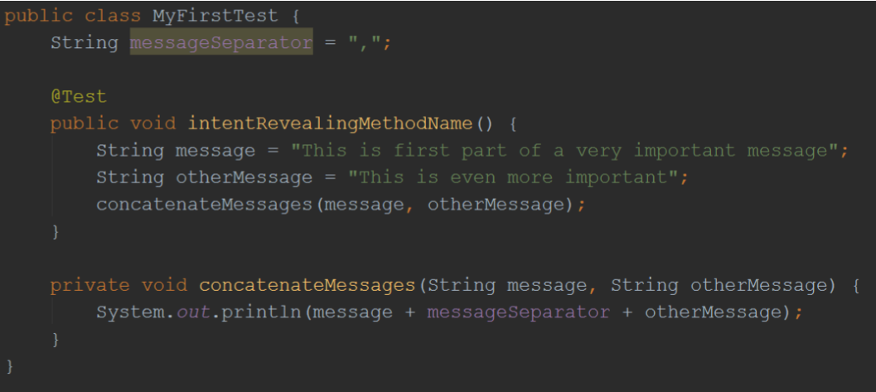
METHODS
• Encapsulation
• Method signature
• Parameters
• Return value

Slide 15
EXCERCISE
1. Extract greeting method taking your name as a parameter
2. Run the test in Run Window
3. Run the test in Debug Window
(do you see any difference?)

Slide 16
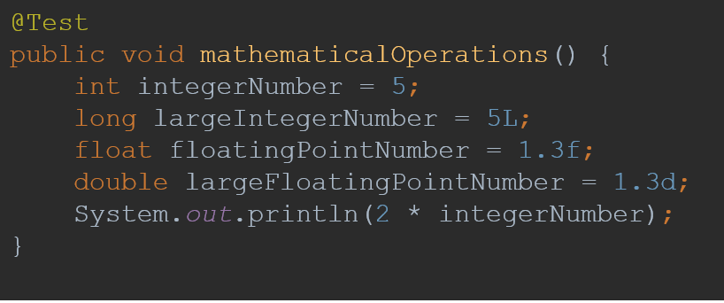
NUMBER VARIABLES
• Number types (int, long, float, double)
• Boxing types
• Mathematical operators ( =, +, -, *, / )
• Dividing integers!
• MAX_VALUE/MIN_VALUE
• Other operators (++, --, +=, -=)
• Basic assertions

Slide 17
EXCERCISE
1. Create a method that takes two parameters and:
- adds them (what is the result of adding different variables types)
- Play with MAX_VALUE, MIN_VALUE
- Divide them (divide different types)
2. Create a test that ensures that method works
3. Run the test in Run Window
4. Run the test in Debug Window
(do you see any difference?)

Slide 18
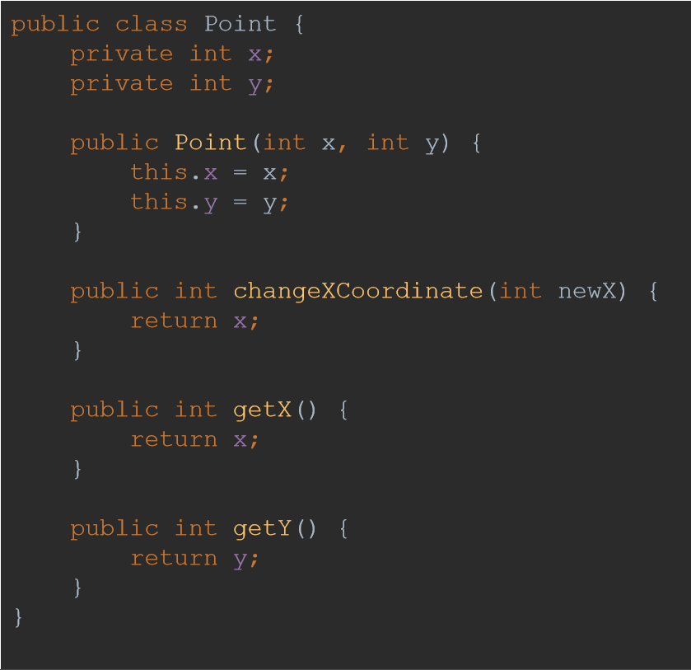
CREATING OBJECTS
1. Encapsulation
Constructor (new keyword, this keyword)
• Default
• Non-default
3. Private/Public access modifier
• Default values of fields
4. Class methods
5. Basic inheritance –
each object in Java is Object

Slide 19
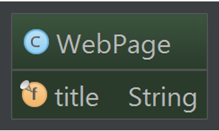
EXCERCISE
1. Create WebPage class that has title attribute
2. The title attribute should be set at construction time
3. Assert that title is correct

Slide 20
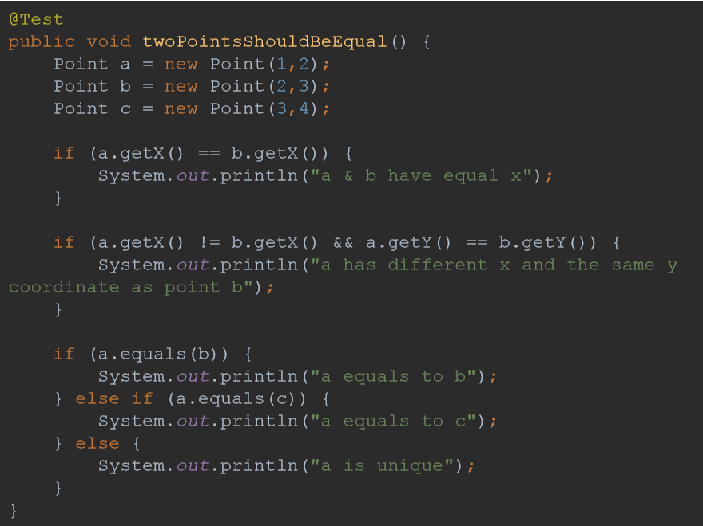
STEERTHE FLOW
1. Conditionals
a) If
b) If / else
c) If /else if / else
2. Operators
a) ==, !=
b) <, >
c) <=, >=
d) &&, ||

Slide 21
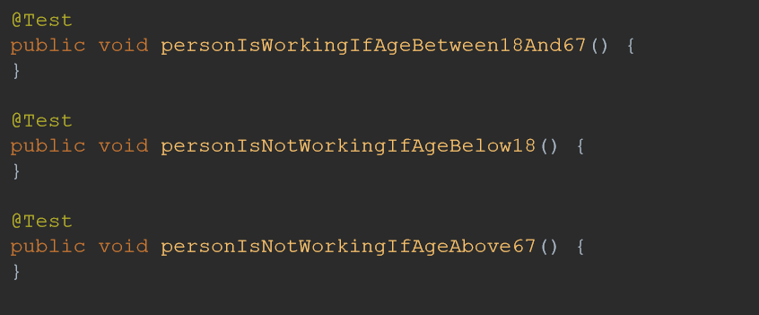
EXCERCISE
1. Create class Person that has attribute age
2. Person should be able to give an answer to a question whether it is working/non-working
a) nonWorking (age below 18 and above 67)
b) Working (age between 18 and 67)

Slide 22
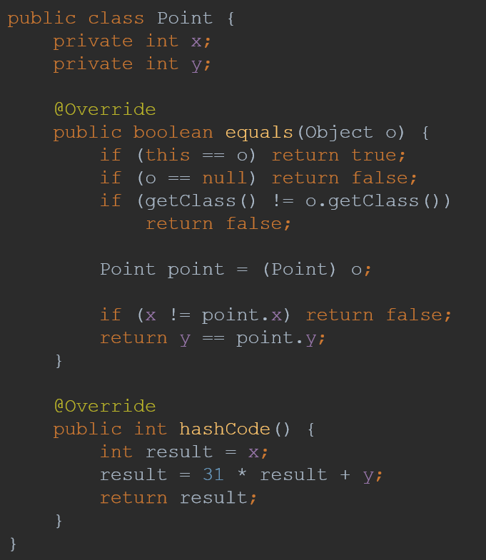
EQUALITY
• Boolean : true / false
• operator == (what a reference is?)
• Equality
• Any object can never be equal to null (what is null !!!)
• Every object is always equal to itself
• When objects are equal their hash is equal
• Two objects with the same hash does not need to be equal

Slide 23
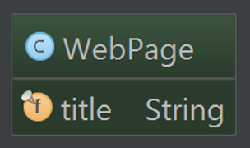
EXCERCISE
1. Make two WebPages equal when their titles are equal
2. Play with == operator

Slide 24
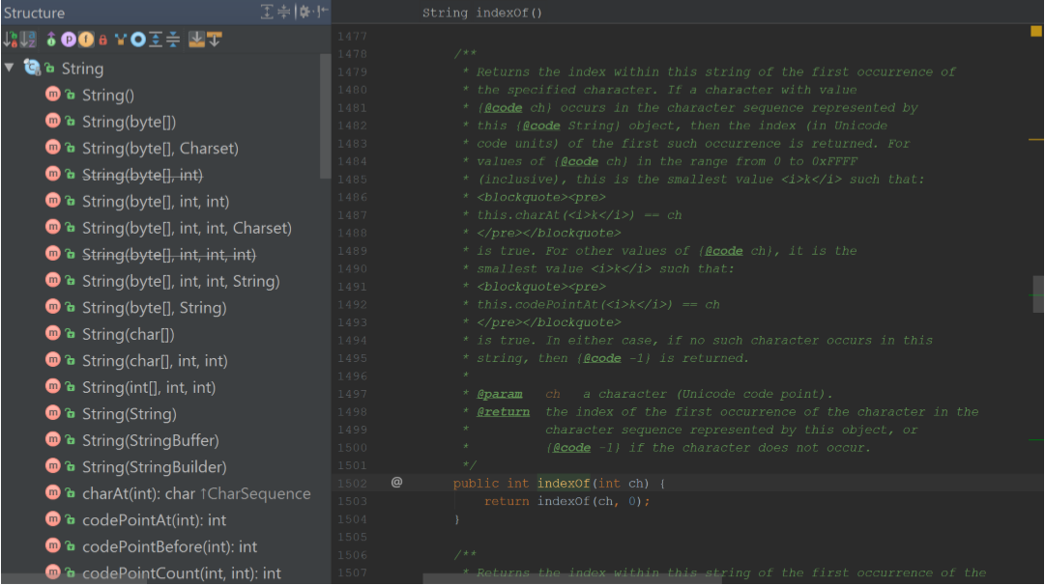
STRING VARIABLES
1. String API
2. Convertions
a) toString()
b) From string

Slide 25
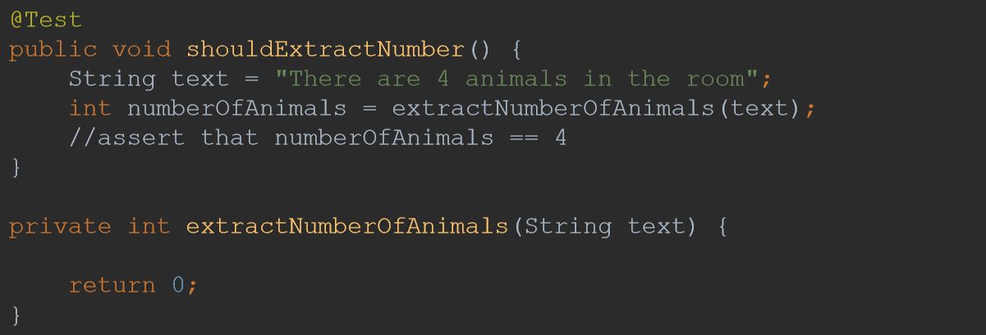
EXCERCISE
1. Create a method that is able to extract numer of animals from text
2. Create a test for the method

Slide 26
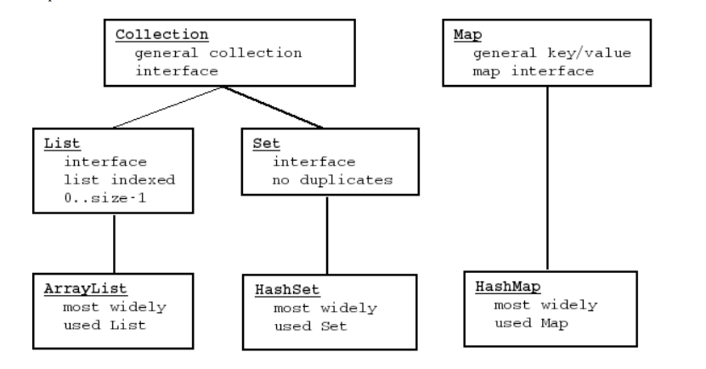
JAVA COLLECTIONS
1. Collections
a) ArrayList
b) HashSet
c) HashMap

Slide 27
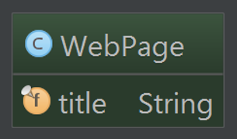
EXCERCISE - ArrayList
1. Create ArrayList of WebPages
2. Assert that list contains
added WebPages
3. Print this list out

Slide 28
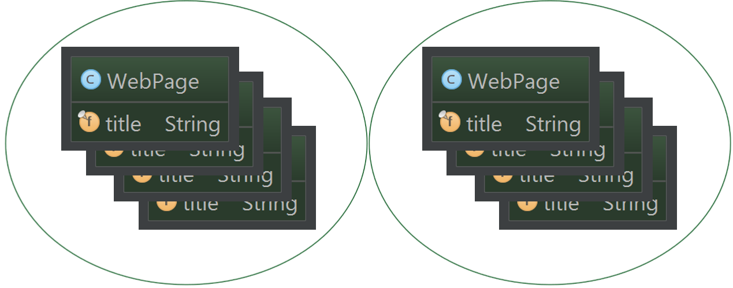
EXCERCISE - HashSet
1. Create HashSet of WebPages – try to add two equal WebPages

Slide 29
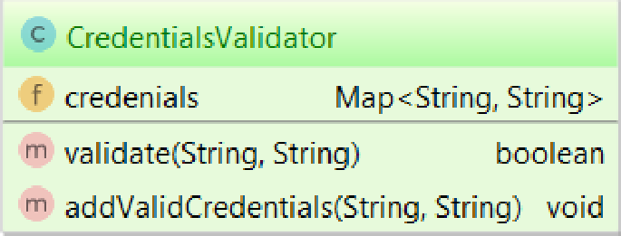
EXCERCISE - HashMap
1. Create and test CredentialsValidator using HashMap

Slide 30
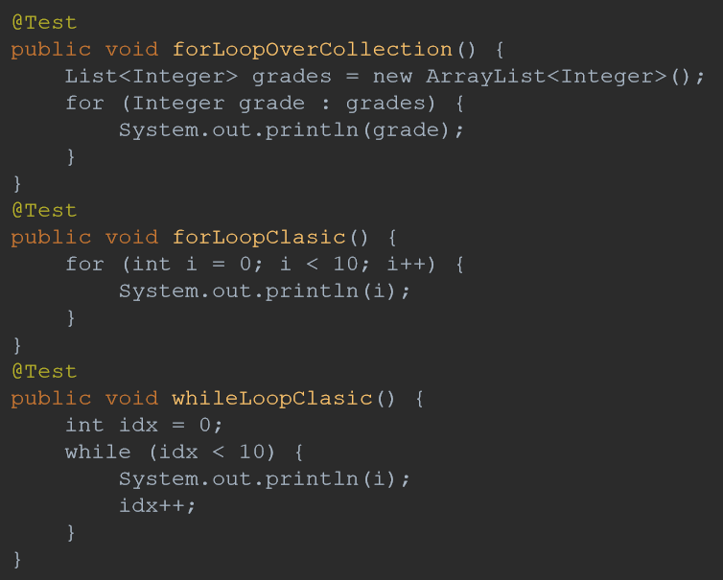
STEERTHE FLOW - LOOPS
1. Loops
a) For
b) While

Slide 31
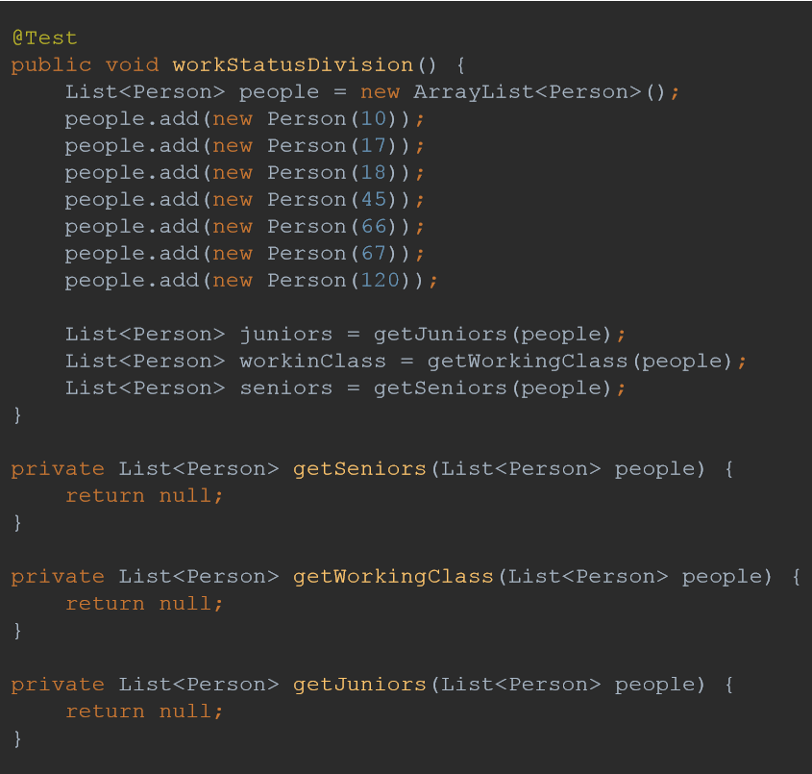
EXCERCISE (P)
1. Create list of Persons with different age (for)
2. Divide this list into three lists (for + if)
a) nonWorking (age below 18)
b) Working (age between 18 and 67)
c) Retired (age above 67)
3. Find first Person with age above 18 (while)

Slide 32
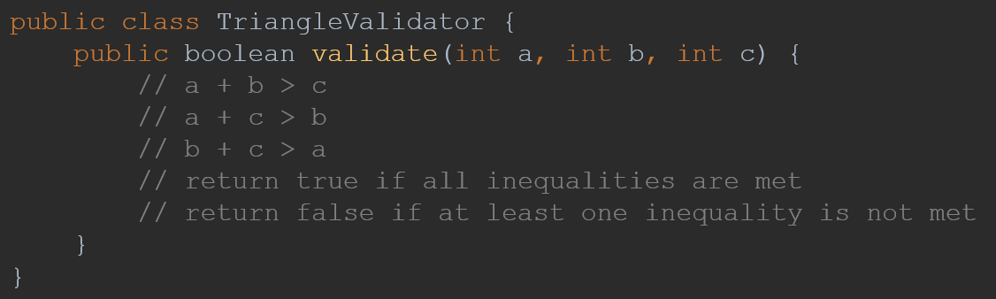
HOMEWORK
1. Create a method that returns n'th element of a fibonacci series (1, 1, 2, 3, 5, 8, …)
2. Write a Triangle class which has method field() returning the field of an triangle
3. Write a TriangleValidator that checks if it is possible to create a triangle using three sides of given length

Slide 33
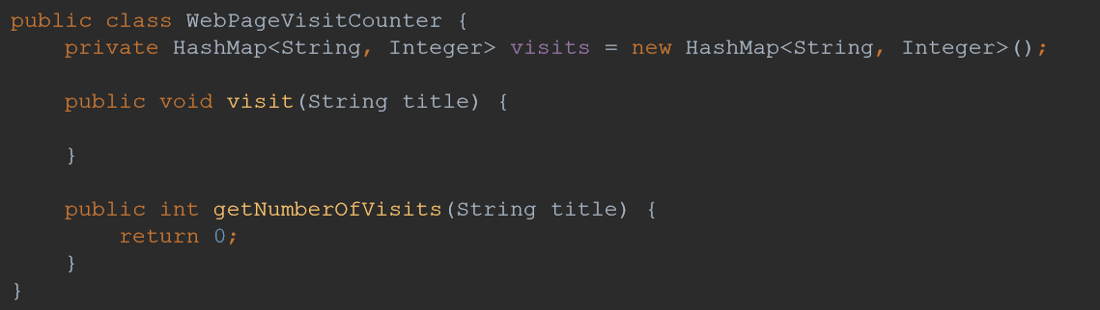
HOMEWORK
4. Create a program that would keep titles of webpages and amount of visits each webpage received
5. Write a program that checks if given word is a palindrome (ex. Kajak, Ala)

Slide 34
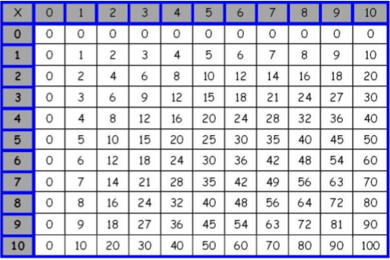
HOMEWORK
6. Create a Rectangle class that is able to calculate field and perimeter
7. Create a PercentGrader class that translates percentage to a grade
a) 95% - 100% - 6
b) 85% - 95% - 5
c) 75% - 85% - 4
d) 65% - 75% - 3
e) 55% - 65% - 2
f) 0% - 55% - 1
8. Write a program that draws multiplication table – no test required

