Slide 1

Chapter 8 The Map ADT
Notes:
‹#›

Slide 2
Chapter 8: The Map ADT
8.1 – The Map Interface
8.2 – Map Implementations
8.3 – Application: String-to-String Map
8.4 – Hashing
8.5 – Hash Functions
8.6 – A Hash-Based Map
8.7 – Map Variations
Notes:
‹#›

Slide 3
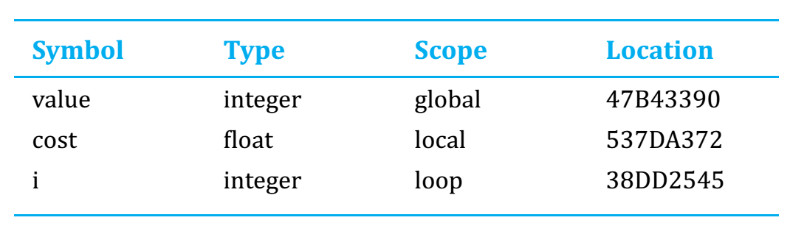
Maps – from symbol tables
The compilers and interpreters translated high-level languages into lower-level languages for machine execution
To support these programs a data structure called a symbol table was devised

Slide 4
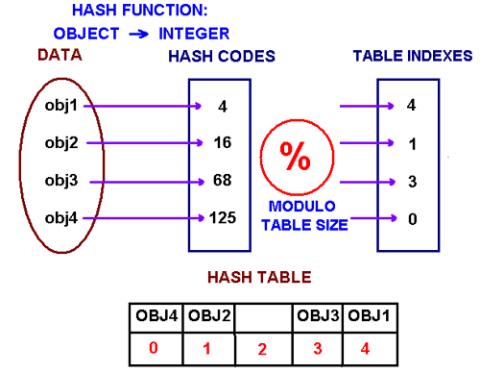
Why Maps?
As you will see, with a well-designed hashing approach the cost to find a key can be O(1)
Non sorted array: O(N)
Sorted array (binary search): log(N)
We can do better if we knew exactly the position of the element we’re searching for
A hash function is a function which when given a key, generates an address in the table.

Slide 5
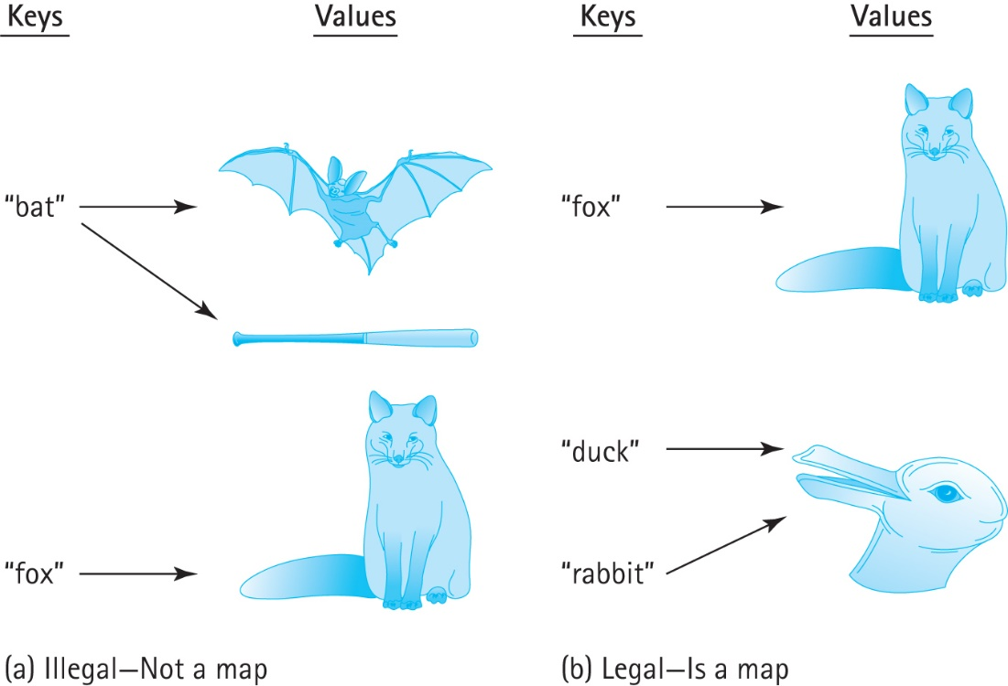
8.1 The Map Interface
Maps associate a key with exactly one value
In other words
a map structure does not permit duplicate keys
but two distinct keys can map onto the same value

Slide 6
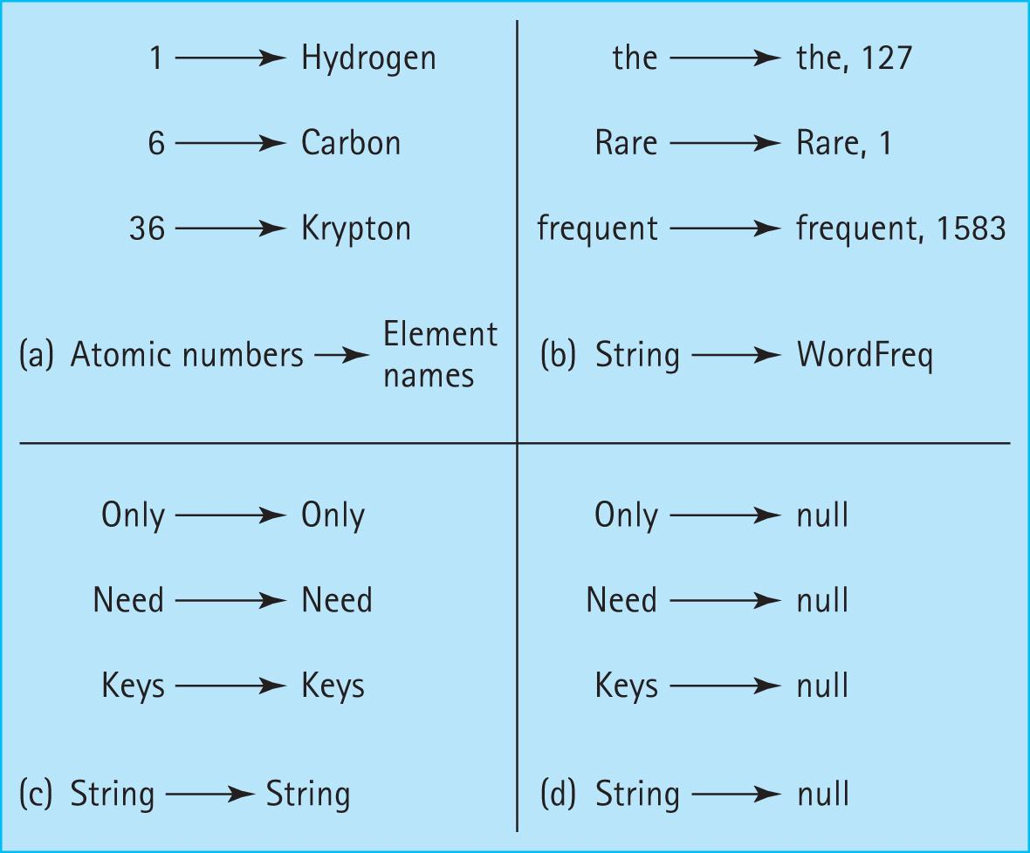
Legal mapping variations

Slide 7
MapInterface
//------------------------------------------------------------------------// MapInterface.java by Dale/Joyce/Weems Chapter 8 //
// A map provides (K = key, V = value) pairs, mapping the key onto
// the value.
// Keys are unique. Keys cannot be null.
//
// Methods throw IllegalArgumentException if passed a null key argument.
//
// Values can be null, so a null value returned by put, get, or remove does
// not necessarily mean that an entry did not exist.
//------------------------------------------------------------------------
//
// . . . continued on next slide

Slide 8
package ch08.maps;
import java.util.Iterator;
public interface MapInterface<K, V> extends Iterable<MapEntry<K,V>>
{
V put(K k, V v);
// If an entry in this map with key k already exists then the value
// associated with that entry is replaced by value v and the original
// value is returned; otherwise, adds the (k, v) pair to the map and
// returns null.
V get(K k);
// If an entry in this map with a key k exists then the value associated
// with that entry is returned; otherwise null is returned.
V remove(K k);
// If an entry in this map with key k exists then the entry is removed
// from the map and the value associated with that entry is returned;
// otherwise null is returned.
//
// Optional. Throws UnsupportedOperationException if not supported.
// Also requires contains(K key), isFull(), isEmpty() and size()
}

Slide 9
Iteration
We require an iteration that returns key-value pairs
The class MapEntry represents the key-value pairs
requires the key and value to be passed as constructor arguments
provides getter operations for both key and value
provides a setter operation for the value
provides a toString

Slide 10
MapExample
Instructors can now discuss and demonstrate the MapExample application found in the ch08.apps package … it uses the ArrayListMap class presented in the next section

Slide 11
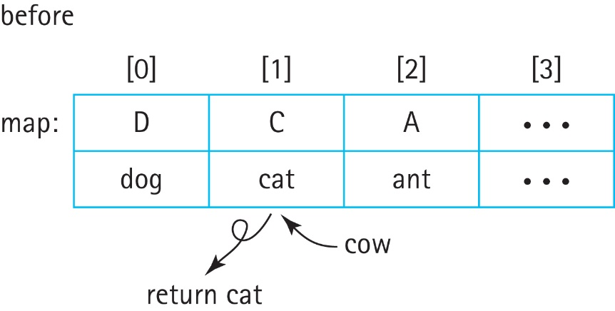
8.2 Map Implementations
Unsorted Array
The put operation creates a new MapEntry object and performs a brute force search (O(N)) of all the current keys in the array to prevent key duplication
If a duplicate key is found, then the associated MapEntry object is replaced by the new object and its value attribute is returned, for example map.put(cow)

Slide 12
Map Implementations
Unsorted Array
Like put, the get, remove, and contains operations would all require brute force searches of the current array contents, so they are all O(N)
Sorted Array
The binary search algorithm can be used, greatly improving the efficiency of the important get and contains operations.
Although it is not a requirement, in general it is expected that a map will provide fast implementation of these two operations.

Slide 13
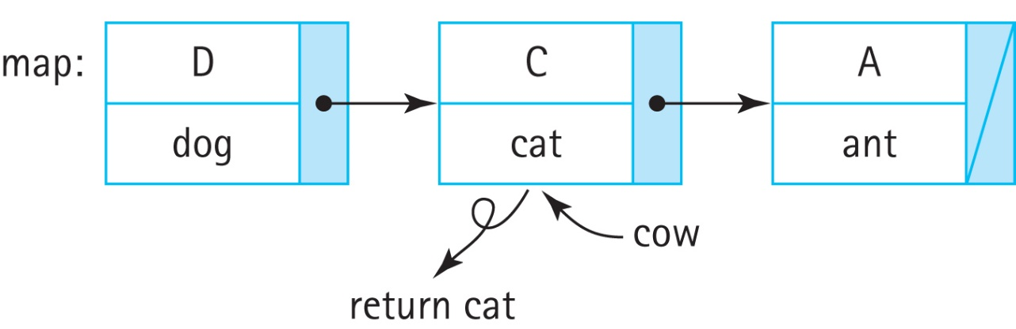
Map Implementations
Unsorted Linked List
Similar to an unsorted array, most operations require brute force search
In terms of space, a linked list grows and shrinks as needed so it is possible that some advantage can be found in terms of memory management, as compared to an array.

Slide 14
Map Implementations
Sorted Linked List
Even though a linked list is kept sorted, it does not permit use of the binary search algorithm as there is no efficient way to inspect the “middle” element.
So there is not much advantage to using a sorted linked list to implement a map, as compared to an unsorted linked list

Slide 15
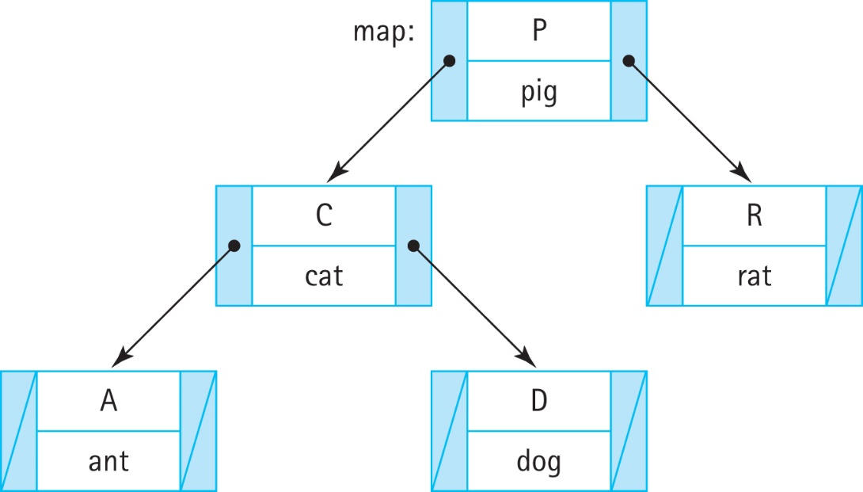
Map Implementations
Binary Search Tree
If a map can be implemented as a balanced binary search tree, then all of the primary operations (put, get, remove, and contains) can exhibit efficiency O(log₂N).

Slide 16
ArrayListMap
Instructors can now discuss the ArrayListMap class found in the ch08.maps package and review the associated notes found on pages 511 and 512

Slide 17
8.3 Application: String-to-String Map
The StringPairApp found in the ch08.apps package reads # separated pairs of strings (key # value) from specified input file and then allows the user to enter keys and reports back to them the associated value if there is one.
It is a short yet versatile application that demonstrates the use of our Map ADT

Slide 18
8.4 Hashing
An efficient approach to implementing a Map
Typically provides O(1) operation implementation
Uses an array (typically called a hash table) to hold the key/value pairs
Hashing involves determining array indices directly from the key of the entry being stored/accessed.

Slide 19
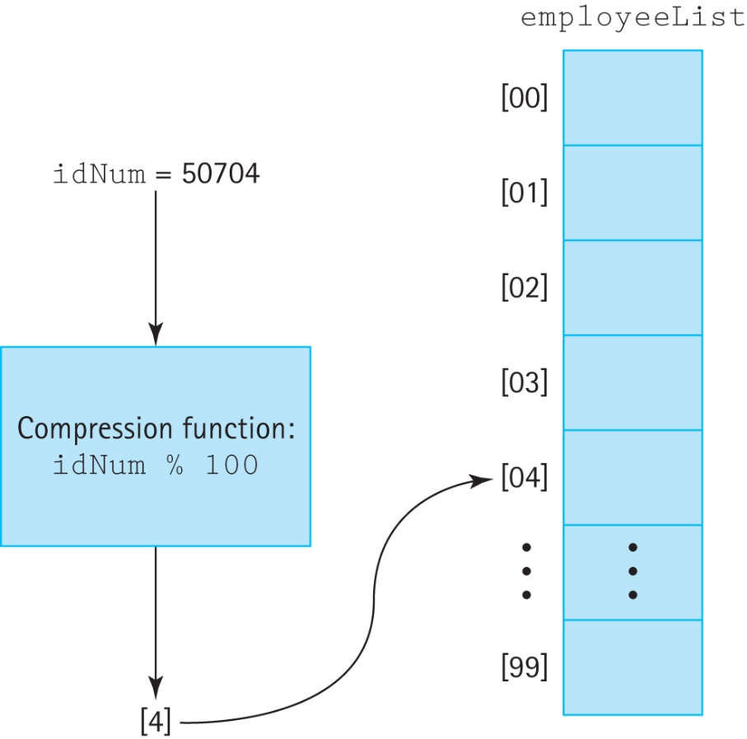
Compression function
If we have a positive integral key, such as an ID number, we can just use the key as the index into the array
If the range of key values is larger than the array we must “compress” the key into a usable index

Slide 20
Collisions
If two keys compress to the same array location we call it a “collision”
minimizing such collisions is the biggest challenge in designing a good hashing system
we cover this in Section 8.5, “Hash Functions.”
In our discussion of collision resolution policies, we will assume
use of an array info to hold the information
the int variable location to indicate an array/hash-table slot.

Slide 21
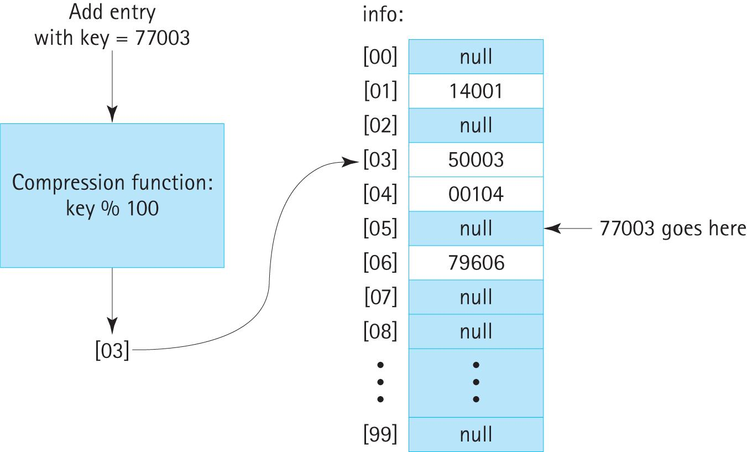
Collision resolution policies
Linear probing: store the colliding entry into the next available space:

Slide 22
Collision resolution policies
Linear probing: store the colliding entry into the next available space:
How do we know whether a hash table slot is “empty”? Assuming we have an array of objects check whether the value of the array slot is null.

Slide 23
Collision resolution policies
Linear probing: store the colliding entry into the next available space:
When searching, entry not there, and table is full, the algorithm will circle forever…
solve this issue by storing the original location returned by the compression function and then discontinuing the search if it returns to that location

Slide 24
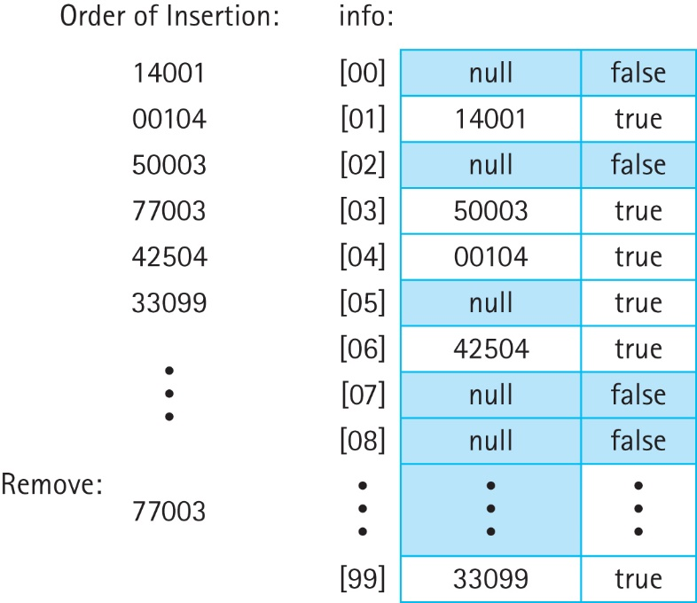
Item Removal
Complicates searching: can not terminate search upon finding a null entry therefore:
use a special value for a removed entry
use a boolean value associated with each hash table slot:
disallow removal

Slide 25
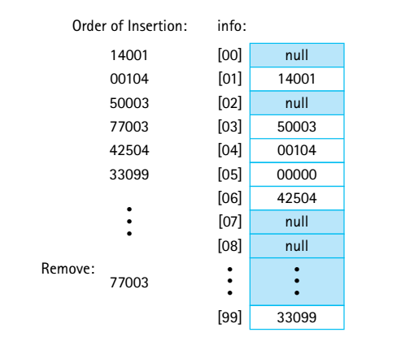
Item Removal
Complicates searching: can not terminate search upon finding a null entry therefore:
use a special value for a removed entry
use a boolean value associated with each hash table slot:
disallow removal

Slide 26
Collision resolution policies
Linear probing approach can lead to inefficient clusters of entries
Quadratic probing: the value added at each step is dependent on how many locations have already been inspected.
The first time it looks for a new location it adds 1 to the original location
the second time it adds 4 to the original location
the third time it adds 9 to the original location
and so on—the i^{th} time it adds i²:

Slide 27
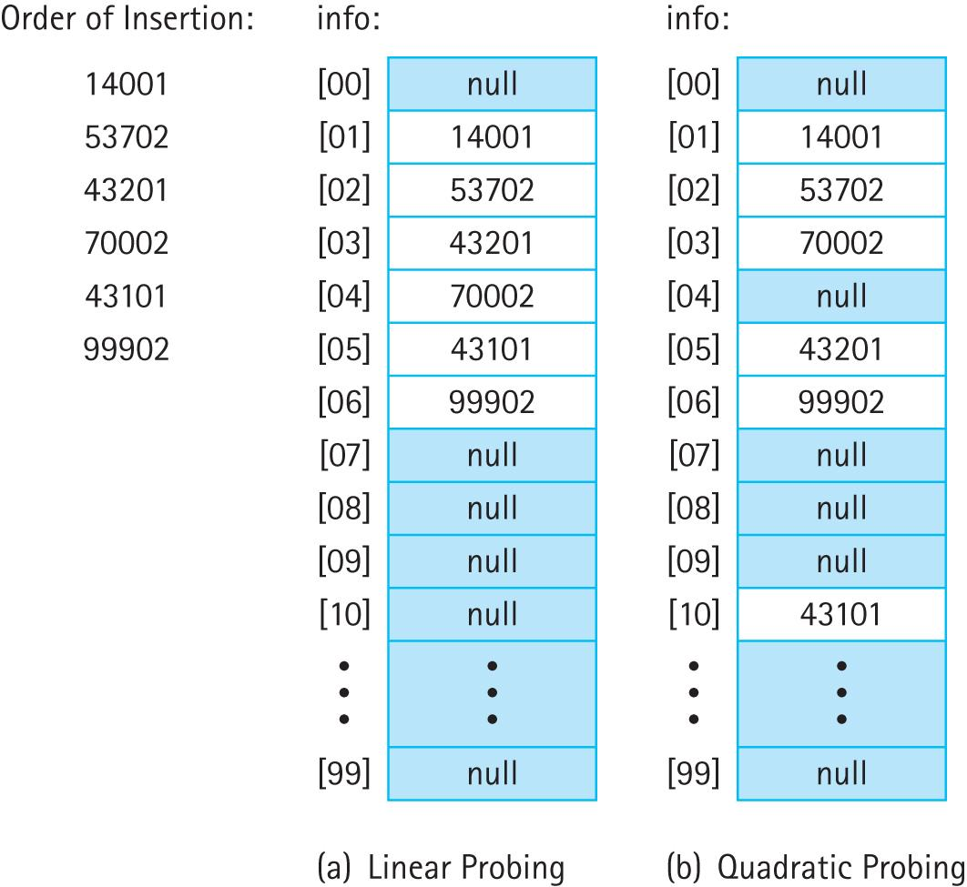
Comparison

Slide 28
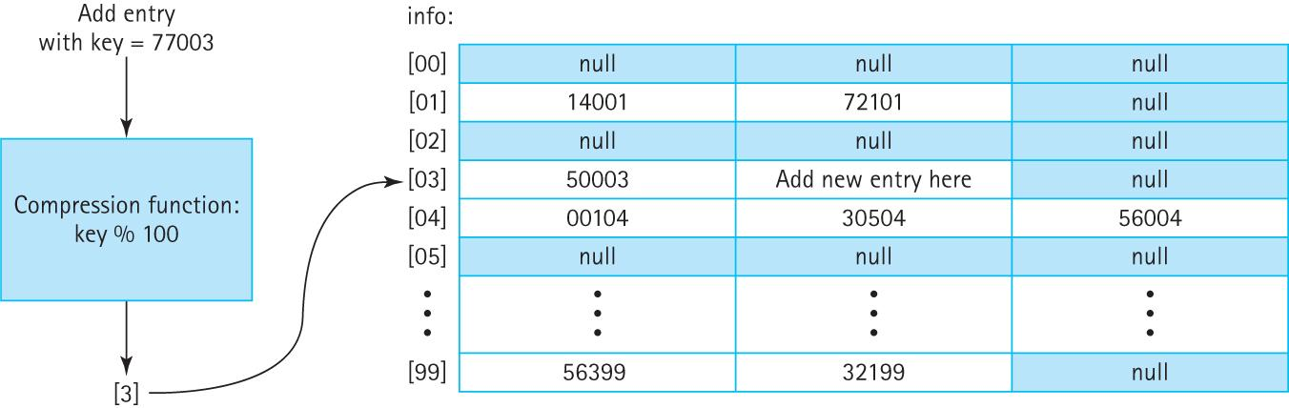
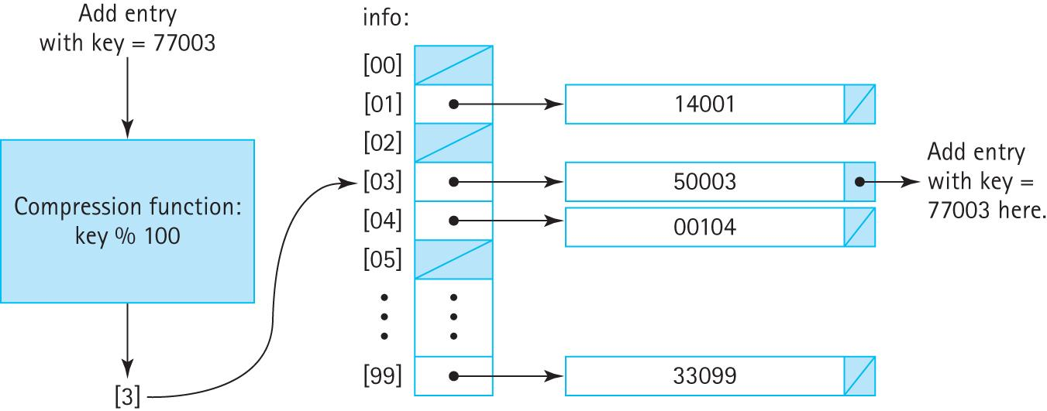
Collision resolution policies Buckets and Chaining

Slide 29
8.5 Hash Functions
To get the most benefit from a hashing system we need for the eventual locations used in the underlying array to be as spread out as possible.
Two factors affect this spread
the size of the underlying array
the set of integral values presented to the compression function

Slide 30
Array Size
space versus time trade-off
hash systems will often monitor their own load—the percentage of array indices being used
Once the load reaches a certain level, for example 75%, the system is rebuilt using a larger array
This approach is often called “rehashing” because after the array is enlarged all of the previous entries have to be reinserted into the new array

Slide 31
The Hash Function
Key information might not be integral.
For example, it is not unusual for a string to be used as a key—perhaps a person’s full name,
the name of a country, a word in a
glossary, an identifier in a computer program, a Web URL, and so on.

Slide 32
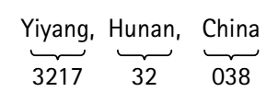
The Hash Function
Even if the key information within a certain domain is integral, it might not be well suited for use as input to the compression function.
If your data set consists of 5,000 cities from China your array will consist of 999 empty slots and one slot, slot [038], that holds a 5,000-entry linked list

Slide 33
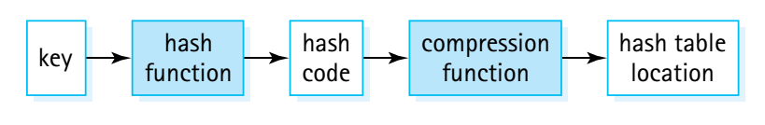
The Hash Function
Solution: add another level of transformation that takes us from key value to the hash table location. The transformation is provided with the hash function, and it produces an integer – hash code.
A good hash function minimizes collisions by generating hash codes, which ultimately lead to a uniform spread of entries throughout the hash table. We say “minimizes collisions” because it is extremely difficult to avoid them completely

Slide 34
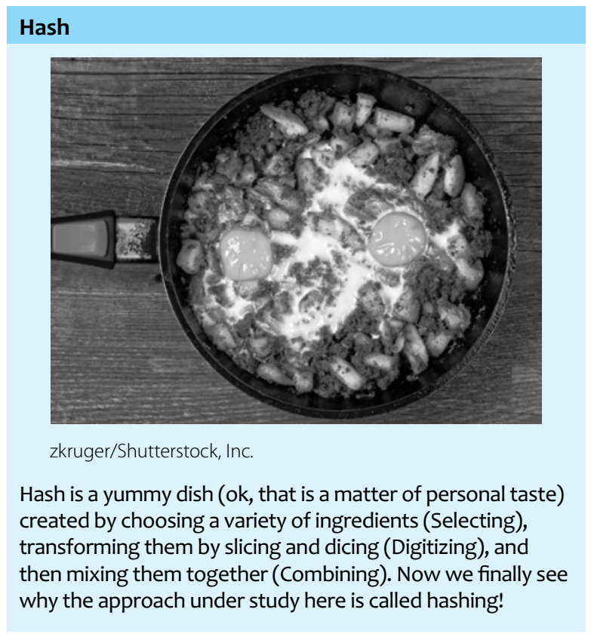

Slide 35
Creating a hash function
Selecting: Identify selected parts of the key – try to use parts that will provide a good variety of results
Digitizing: the selected parts must be transformed to integers
Combining: combine the resultant integers using a mathematical function

Slide 36
Creating a hash function
Selecting: part A = first four digits (the city code), part B = next two digits (the region code), and part C = last three digits (the country code)
Digitizing: The selected parts are all transformed to integers. For the city codes just use the code number, for a string character →underlying character code, and for a pixel → gray scale level or some arithmetic combination of its color codes
Combining: combine the resultant integers using a mathematical function: we might try [(A × C) + B] or [A² + (B × C)]

Slide 37
Considerations
A hash code is not unique. Do not use a hash code as a key.
If a hash function for a string consists of adding together the ASCII code values of its first six characters, then the following two strings hash to the same value:
“listen” and “silent.”

Slide 38
Considerations
If two entries are considered to be equal, then they should hash to the same value.
Storage and retrieval is based on the concept of equality
For example: Gem objects with attributes weight, color, and quality; within our domain two gems are considered equal if they have the same weight and quality. In that case the hash function should not use the color attribute when computing the hash code

Slide 39
Considerations
When defining a hash function, consider the work required to calculate it.
Even if a hash function always produces unique values, it is not a good choice if it takes too long to compute

Slide 40
Considerations
A precise analysis of the complexity of hashing depends on the domain and distribution of keys, the hash function, the size of the table, and the collision resolution policy. In practice it is usually not difficult to achieve close to O(1) efficiency using hashing.

Slide 41
Considerations
Do not overcompensate in terms of calculation efficiency
Suppose your hash table size is 100,000. In as much as ASCII character codes are at most 127 then the maximum hash code you can generate with your mathematical function is 8 × 127 = 1,016. The range of potentially generated values uses only about 1% of the table!
Use more complicated function that produces a wider range of values

Slide 42
Considerations
It is possible to use knowledge of the domain of a required hash function to help you devise a good function, or conversely, to avoid creating a poor function
Not good to only use the country code
www.somebusiness.com
www.someplace.com
www.somesearchengine.com
etc.
Combining characters: every webpage starts with a www

Slide 43
Considerations
Be aware of the range of the compression function
For example, in Java the % operator can return a negative value: −23 % 5 is −3. If % is used for the compression function in a Java implementation, you must ensure that the output from the hash function is nonnegative

Slide 44
Java’s Support for Hashing
The Java Library includes a HashMap class (discussed in Section 8.7) and a HashSet class that use hash techniques to support storing objects
The Java Object class exports a hashCode method that returns an int hash code.
The standard Java hash code for an object is a function of the object’s memory location.
For most applications, hash codes based on memory locations are not usable. Many of the Java classes that define commonly used objects (such as String and Integer), override the Object class’s hashCode method.
If you plan to use hash tables in your programs, you should do likewise.
Notes:
‹#›

Slide 45
Java’s Support for Hashing
In fact, it is good programming practice to always override the equals and hashCode methods together, if you intend to override either one.
It is important that these two methods are consistent with one another.
Notes:
‹#›

Slide 46
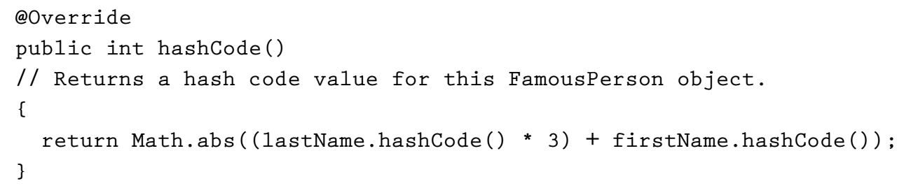
FamousPerson class
The equals method for this class is based on names only, that is two FamousPerson objects are considered equal if and only if both their first and last names are equal
Notes:
‹#›

Slide 47
Complexity
If our hash function is efficient and never produces duplicates, and the hash table size is large compared to the expected number of entries in the collection, then we have reached our goal. In general, this is not the case
As the number of entries approaches the array size, the efficiency of the algorithms deteriorates. This is why the load of the hash table is monitored
Notes:
‹#›

Slide 48
8.6 A Hash-Based Map Hmap.java
is implemented with an internal hash table that uses the hashCode method of the key class
is unbounded
has a default capacity of 1,000 and a default load factor of 75%
does not support the remove operation
is located in the ch08.maps package
is used by the VocDensMeasureHMap application located in the ch08.apps package

Slide 49
8.7 Map Variations
Some programming languages, (e.g., Awk, Haskell, JavaScript, Lisp, MUMPS, Perl, PHP, Python, and Ruby), directly support
Many other languages, including Java, C++, Objective-C, and Smalltalk provide map functionality through their standard code libraries

Slide 50
Maps are known by many names:
Symbol table - one of the first carefully studied and designed data structures, and were related to compiler design
Dictionary - the idea of looking up a word (the key) in a dictionary to find its definition (the value) makes the concept of a dictionary a good fit for maps
Hashes - because a hash system is a very efficient and common way to implement a map, you will sometimes see the two terms used interchangeably
Associative Arrays - You can view a map as an array—one that associates keys with values rather than indices with values.

