Slide 1

Chapter 11 Sorting and Searching Algorithms
Notes:
‹#›

Slide 2
Chapter 11: Sorting and Searching Algorithms
11.1 – Sorting
11.2 – Simple Sorts
11.3 – O(N log₂N) Sorts
11.4 – More Sorting Considerations
11.5 – Searching
Notes:
‹#›

Slide 3
11.1 Sorting
Putting an unsorted list of data elements into order – sorting - is a very common and useful operation
We describe efficiency by relating the number of comparisons to the number of elements in the list (N)
Notes:
‹#›

Slide 4
11.1 Sorting
One reason to keep lists sorted is to facilitate searching; given an appropriate implementation structure, a particular list element can be found faster if the list is sorted
Notes:
‹#›

Slide 5
11.1 Why knowing sorting
Their study provides a good way to learn basic algorithmic and analysis techniques that help form a foundation of problem-solving tools. Studying the fundamentals prepares you for further growth so that eventually you will be able to create your own unique solutions to the unique problems that you are sure to encounter one day
Notes:
‹#›

Slide 6
11.1 How do we measure efficiency of sorting?
Main operation of sorting: compare two elements to see which is smaller
We use the number of required element comparisons as a measure of the efficiency of each algorithm.
For each algorithm we calculate the number of comparisons relative to the size of the list being sorted
Notes:
‹#›

Slide 7
11.1 Compare then swap
In addition to comparing elements, each of our algorithms includes another basic operation: swapping the locations of two elements in the list
The number of element swaps needed to sort a list is another measure of sorting efficiency
Notes:
‹#›

Slide 8
11.1 Space efficiency
Another efficiency consideration is the amount of extra memory space required by an algorithm
The usual time versus space trade-off applies to sorts – more space often means less time, and vice versa
Notes:
‹#›

Slide 9
A Test Harness
To help us test our sorting algorithms we create an application class called Sorts:
The class defines an array values that can hold 50 integers and static methods:
initValues: Initializes the values array with random numbers between 0 and 99
isSorted: Returns a boolean value indicating whether the values array is currently sorted
swap: swaps the integers between values[index1] and values[index2], where index1 and index2 are parameters of the method
printValues: Prints the contents of the values array to the System.out stream; the output is arranged evenly in ten columns
Notes:
‹#›

Slide 10
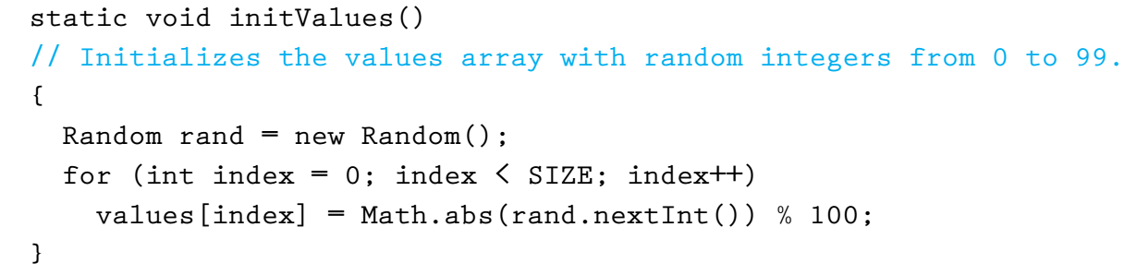
Initialize the array
determines the range of the random numbers
Notes:
‹#›

Slide 11
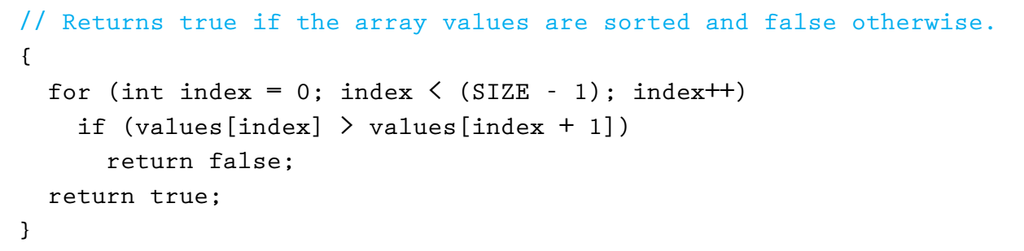
Check if sorted
Notes:
‹#›

Slide 12
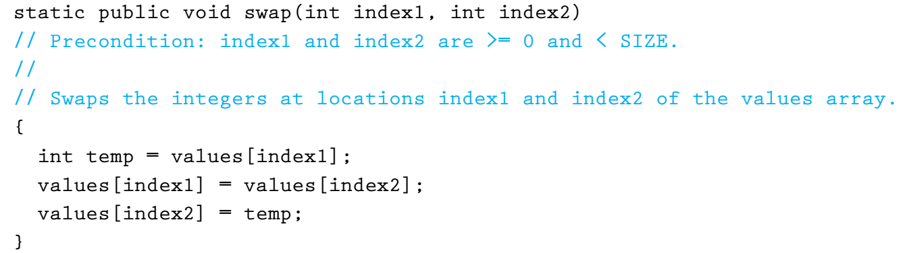
Swap
Why cannot we simply write:
values[index1] = values[index2]
values[index2] = values[index1]
Notes:
‹#›

Slide 13
Example of Sorts main method
public static void main(String[] args) throws IOException
{
initValues();
printValues();
System.out.println("values is sorted: " + isSorted());
System.out.println();
swap(0, 1); // normally we put sorting algorithm here
printValues();
System.out.println("values is sorted: " + isSorted());
System.out.println();
}
Notes:
‹#›

Slide 14
Output from Example
the values array is:
20 49 07 50 45 69 20 07 88 02
89 87 35 98 23 98 61 03 75 48
25 81 97 79 40 78 47 56 24 07
63 39 52 80 11 63 51 45 25 78
35 62 72 05 98 83 05 14 30 23
values is sorted: false
the values array is:
49 20 07 50 45 69 20 07 88 02
89 87 35 98 23 98 61 03 75 48
25 81 97 79 40 78 47 56 24 07
63 39 52 80 11 63 51 45 25 78
35 62 72 05 98 83 05 14 30 23
values is sorted: false
This part varies
for each sample run
This does to, of course
Notes:
‹#›

Slide 15
11.2 Simple Sorts
In this section we present three “simple” sorts
Selection Sort
Bubble Sort
Insertion Sort
Properties of these sorts
use an unsophisticated brute force approach
are not very efficient
are easy to understand and to implement
Notes:
‹#›

Slide 16
Selection Sort
This algorithm was introduced in Section 1.6, "Comparing Algorithms"
If handed a list of names on a sheet of paper and asked to put them in alphabetical order, we might use this general approach:
Select the name that comes first in alphabetical order, and write it on a second sheet of paper.
Cross the name out on the original sheet.
Repeat steps 1 and 2 for the second name, the third name, and so on until all the names on the original sheet have been crossed out and written onto the second sheet.
Notes:
‹#›

Slide 17
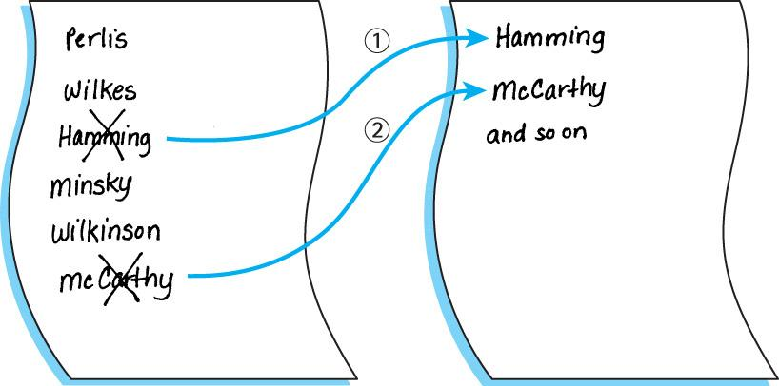
Notes:
‹#›

Slide 18
An improvement
Our algorithm is simple but it has one drawback: It requires space to store two complete lists
Instead of writing the “first” name onto a separate sheet of paper, exchange it with the name in the first location on the original sheet. And so on.
Notes:
‹#›

Slide 19
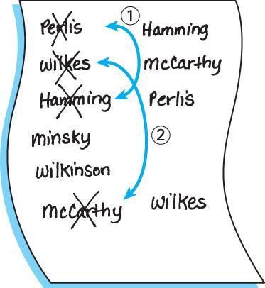
Notes:
‹#›

Slide 20
Selection Sort Algorithm
The last element will always be in order due to swapping,
so no need to sort the last elements
SelectionSort
for current going from 0 to SIZE - 2
Find the index in the array of the smallest unsorted element
Swap the current element with the smallest unsorted one
An example is depicted on the following slide …
Notes:
‹#›

Slide 21
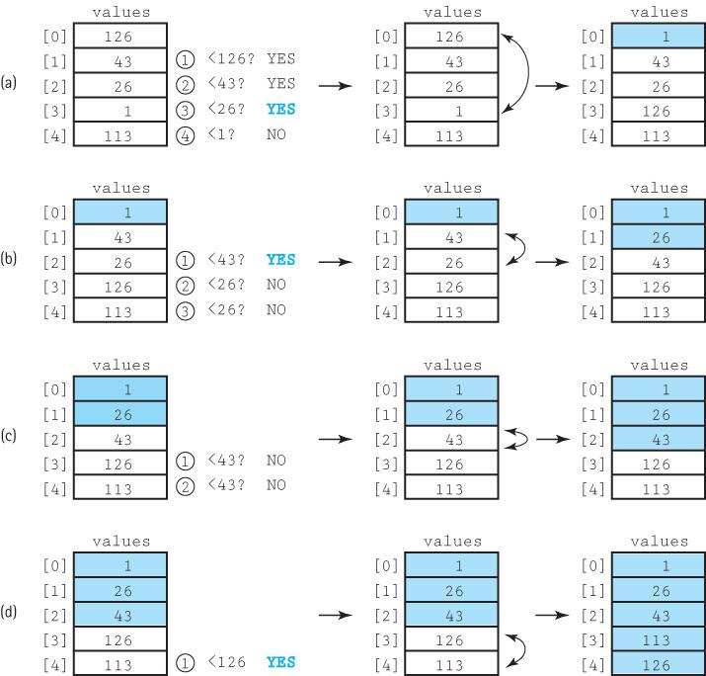
Notes:
‹#›

Slide 22
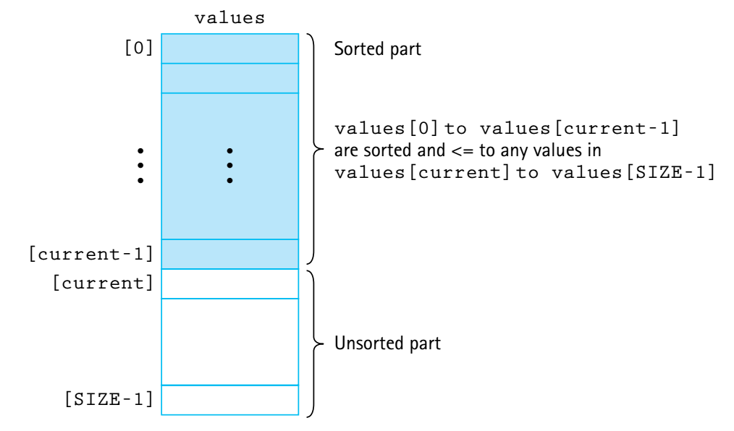
Selection Sort Snapshot
Notes:
‹#›

Slide 23
Selection Sort Code
static int minIndex(int startIndex, int endIndex)
// Returns the index of the smallest value in
// values[startIndex]..values[endIndex].
{
int indexOfMin = startIndex;
for (int index = startIndex + 1; index <= endIndex; index++)
if (values[index] < values[indexOfMin])
indexOfMin = index;
return indexOfMin;
}
static void selectionSort()
// Sorts the values array using the selection sort algorithm.
{
int endIndex = SIZE – 1;
for (int current = 0; current < endIndex; current++)
swap(current, minIndex(current, endIndex));
}
Loops until SIZE - 2
Notes:
‹#›

Slide 24
Testing Selection Sort
The resultant output:
the values array is:
92 66 38 17 21 78 10 43 69 19
17 96 29 19 77 24 47 01 97 91
13 33 84 93 49 85 09 54 13 06
21 21 93 49 67 42 25 29 05 74
96 82 26 25 11 74 03 76 29 10
values is sorted: false
Selection Sort called
the values array is:
01 03 05 06 09 10 10 11 13 13
17 17 19 19 21 21 21 24 25 25
26 29 29 29 33 38 42 43 47 49
49 54 66 67 69 74 74 76 77 78
82 84 85 91 92 93 93 96 96 97
values is sorted: true
The test harness:
initValues();
printValues();
System.out.println("values is sorted: "
+ isSorted());
System.out.println();
selectionSort();
System.out.println("Selection Sort called\n");
printValues();
System.out.println("values is sorted: "
+ isSorted());
System.out.println();
Notes:
‹#›

Slide 25
Selection Sort Analysis
We describe the number of comparisons as a function of the number of elements in the array, i.e., SIZE. To be concise, in this discussion we refer to SIZE as N
The minIndex method is called N - 1 times
Within minIndex, the number of comparisons varies:
in the first call there are N - 1 comparisons
in the next call there are N - 2 comparisons
and so on, until in the last call, when there is only 1 comparison
The total number of comparisons is
(N – 1) + (N – 2) + (N – 3) + ... + 1
= N(N – 1)/2 = 1/2N² – 1/2N
The Selection Sort algorithm is O(N²)
Notes:
‹#›

Slide 26
Number of Comparisons Required to Sort Arrays of Different Sizes Using Selection Sort
Number of Elements Number of Comparisons
10 45
20 190
100 4,950
1,000 499,500
10,000 49,995,000
Notes:
‹#›

Slide 27
Bubble Sort
With this approach the smaller data values “bubble up” to the front of the array …
Each iteration puts the smallest unsorted element into its correct place, but it also makes changes in the locations of the other elements in the array.
The first iteration puts the smallest element in the array into the first array position:
starting with the last array element, we compare successive pairs of elements, swapping whenever the bottom element of the pair is smaller than the one above it
in this way the smallest element “bubbles up” to the top of the array.
The next iteration puts the smallest element in the unsorted part of the array into the second array position, using the same technique
The rest of the sorting process continues in the same way
Notes:
‹#›

Slide 28
Bubble Sort Algorithm
BubbleSort
Set current to the index of first element in the array
while more elements in unsorted part of array
“Bubble up” the smallest element in the unsorted part,
causing intermediate swaps as needed
Shrink the unsorted part of the array by incrementing current
bubbleUp(startIndex, endIndex)
for index going from endIndex DOWNTO startIndex +1
if values[index] < values[index - 1]
Swap the value at index with the value at index - 1
An example is depicted on the following slide …
Notes:
‹#›

Slide 29
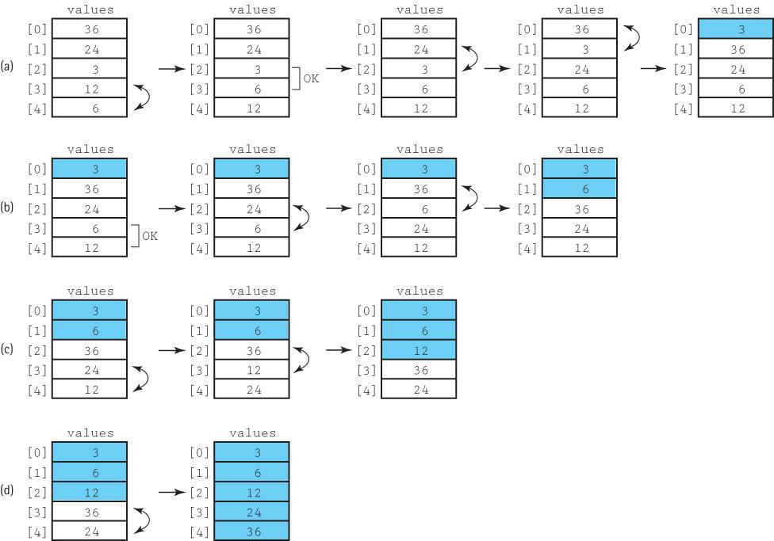
Notes:
‹#›

Slide 30
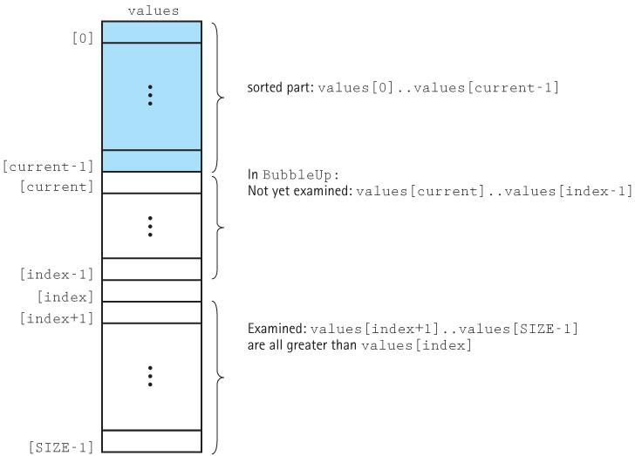
Bubble Sort Snapshot
Notes:
‹#›

Slide 31
Bubble Sort Code
static void bubbleUp(int startIndex, int endIndex)
// Switches adjacent pairs that are out of order
// between values[startIndex]..values[endIndex]
// beginning at values[endIndex].
{
for (int index = endIndex; index > startIndex; index--)
if (values[index] < values[index – 1])
swap(index, index – 1);
}
static void bubbleSort()
// Sorts the values array using the bubble sort algorithm.
{
int current = 0;
while (current < SIZE – 1)
{
bubbleUp(current, SIZE – 1);
current++;
}
}
Notes:
‹#›

Slide 32
Bubble Sort Analysis
Analyzing the work required by bubbleSort is the same as for the selection sort algorithm.
The comparisons are in bubbleUp, which is called N – 1 times.
There are N – 1 comparisons the first time, N – 2 comparisons the second time, and so on.
Therefore, bubbleSort and selectionSort require the same amount of work in terms of the number of comparisons.
The Bubble Sort algorithm is O(N²)
Notes:
‹#›

Slide 33
What if array is already sorted?
Even if the array is already in sorted order when bubbleSort is called, this method continues to call bubbleUp (which changes nothing) N – 1 times
We could quit before the maximum number of iterations if bubbleUp returns a boolean flag, telling us when the array is sorted
Notes:
‹#›

Slide 34
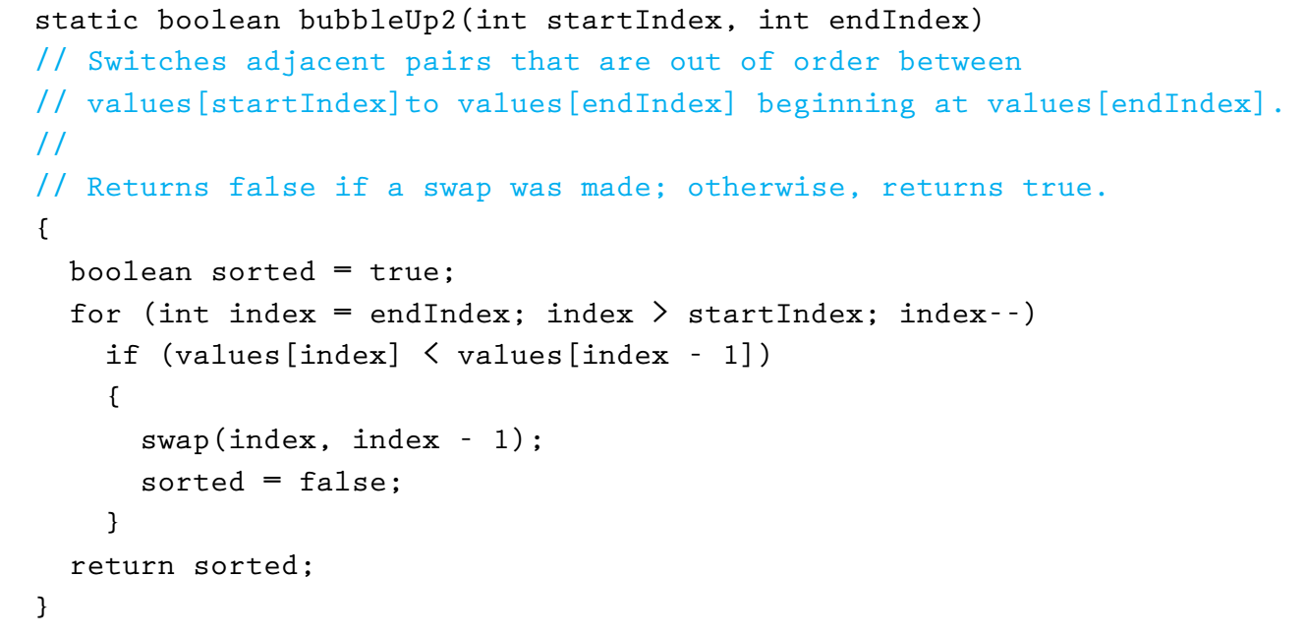
Shorter Bubble Sort
Notes:
‹#›

Slide 35
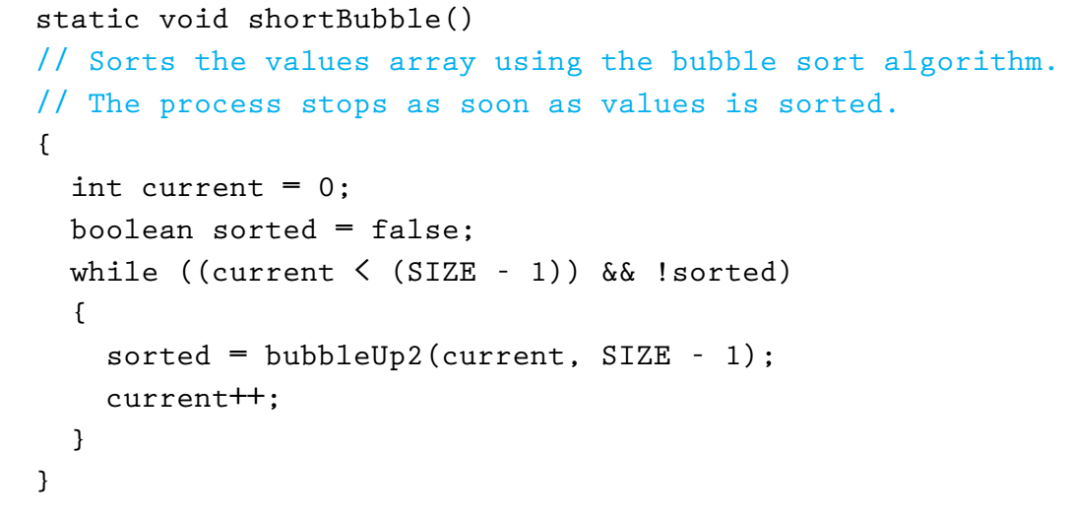
Shorter Bubble Sort
Notes:
‹#›

Slide 36
Bubble Sort Analysis
If the array is already sorted to begin with, one call to bubbleUp tells us so. In this best-case scenario, shortBubble is O(N)
If the original array was sorted in descending order before the call to shortBubble is the worst possible case: shortBubble requires as many comparisons as bubbleSort and
SelectionSort, not to mention the “overhead” - all the extra swaps and setting and resetting the sorted flag
Notes:
‹#›

Slide 37
Insertion Sort
Already described in Section 6.4, “Sorted Array-Based List Implementation,”
Each successive element in the array to be sorted is inserted into its proper place with respect to the other, already sorted elements.
As with the previous sorts, we divide our array into a sorted part and an unsorted part.
Initially, the sorted portion contains only one element: the first element in the array.
Next we take the second element in the array and put it into its correct place in the sorted part; that is, values[0] and values[1] are in order with respect to each other.
Next the value in values[2] is put into its proper place, so values[0]..values[2] are in order with respect to each other.
This process continues until all the elements have been sorted.
Notes:
‹#›

Slide 38
Insertion Sort Algorithm
insertionSort
for count going from 1 through SIZE - 1
insertElement(0, count)
InsertElement(startIndex, endIndex)
Set finished to false
Set current to endIndex
Set moreToSearch to true
while moreToSearch AND NOT finished
if values[current] < values[current - 1]
swap(values[current], values[current - 1])
Decrement current
Set moreToSearch to (current does not equal startIndex)
else
Set finished to true
Notes:
‹#›

Slide 39
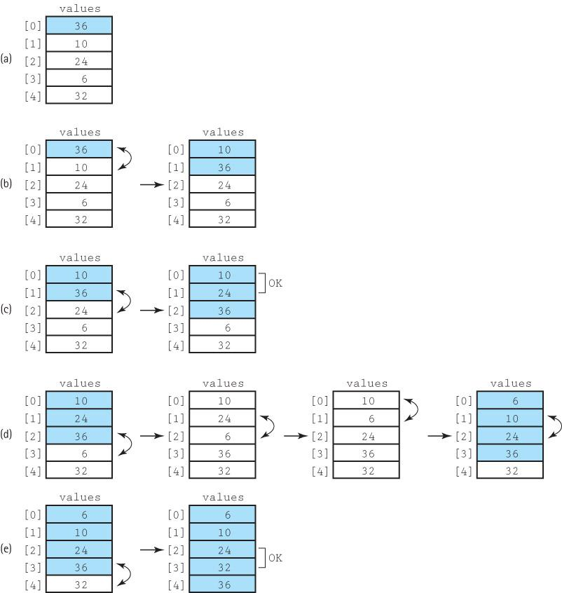
Notes:
‹#›

Slide 40
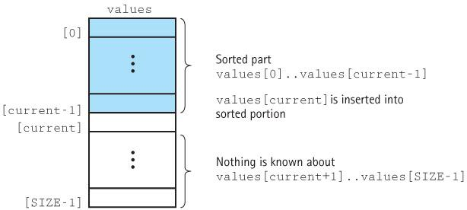
Insertion Sort Snapshot
Notes:
‹#›

Slide 41
Insertion Sort Code
static void insertElement(int startIndex, int endIndex)
// Upon completion, values[0]..values[endIndex] are sorted.
{
boolean finished = false;
int current = endIndex;
boolean moreToSearch = true;
while (moreToSearch && !finished)
{
if (values[current] < values[current – 1])
{
swap(current, current – 1);
current--;
moreToSearch = (current != startIndex);
}
else
finished = true;
}
}
static void insertionSort()
// Sorts the values array using the insertion sort algorithm.
{
for (int count = 1; count < SIZE; count++)
insertElement(0, count);
}
When array already sorted, only one comparison is made. Try tracing insertionSort on 1, 2, 3 elements.
Notes:
‹#›

Slide 42
Insertion Sort Analysis
The general case for this algorithm mirrors the selectionSort and the bubbleSort, so the general case is O(N²) .
But insertionSort has a “best” case: The data are already sorted in ascending order
insertElement is called N times, but only one comparison is made each time and no swaps are necessary.
The maximum number of comparisons is made only when the elements in the array are in reverse order.
Notes:
‹#›

Slide 43
11.3 O(N log₂N) Sorts
O(N²) sorts and are very time consuming for sorting large arrays.
Several sorting methods that work better when N is large are presented in this section.
The efficiency of these algorithms is achieved at the expense of the simplicity seen in the selection, bubble, and insertion sorts.
Notes:
‹#›

Slide 44
The Merge Sort
The sorting algorithms covered in Section 10.2 are all O(N²).
Note that N² is a lot larger than
(1/2N)² + (1/2N)² = 1/2N²
If we can cut the array into two pieces, sort each segment, and then merge the two back together, we should end up sorting the entire array with a lot less work.
Notes:
‹#›

Slide 45
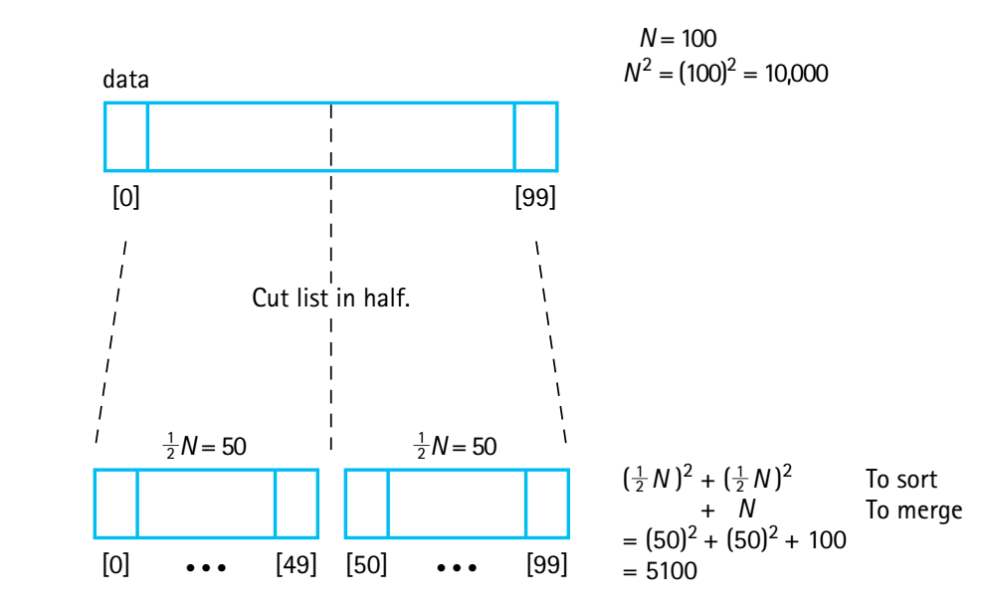
Rationale for Divide and Conquer
Notes:
‹#›

Slide 46
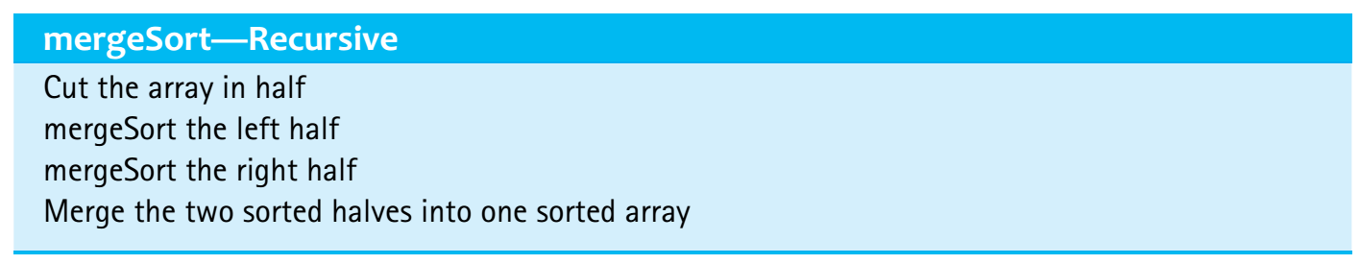
Merge Sort Algorithm
mergeSort
Cut the array in half
Sort the left half
Sort the right half
Merge the two sorted halves into one sorted array
Because mergeSort is itself a sorting algorithm, we might as well
use it to sort the two halves.
We can make mergeSort a recursive method and let it call itself
to sort each of the two subarrays:
Notes:
‹#›

Slide 47
Merge Sort Algorithm
Merging the two halves together is an O(N) task: We merely go through the sorted halves, comparing successive pairs of values (one in each half) and putting the smaller value into the next slot in the final solution. Even if the sorting algorithm used for each half is O(N²), we should see some improvement over sorting the whole array at once
Notes:
‹#›

Slide 48
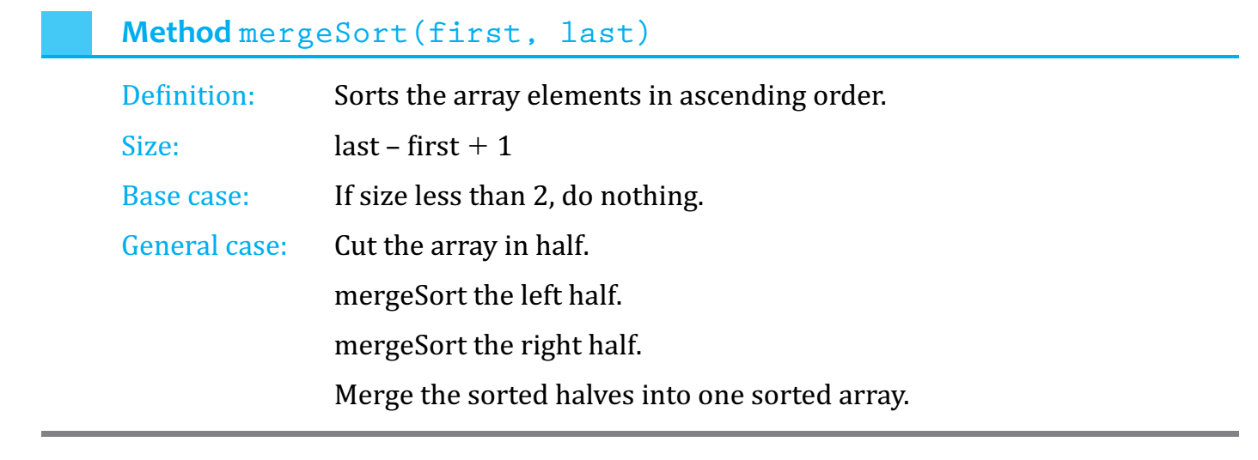
Merge Sort Summary
Notes:
‹#›

Slide 49
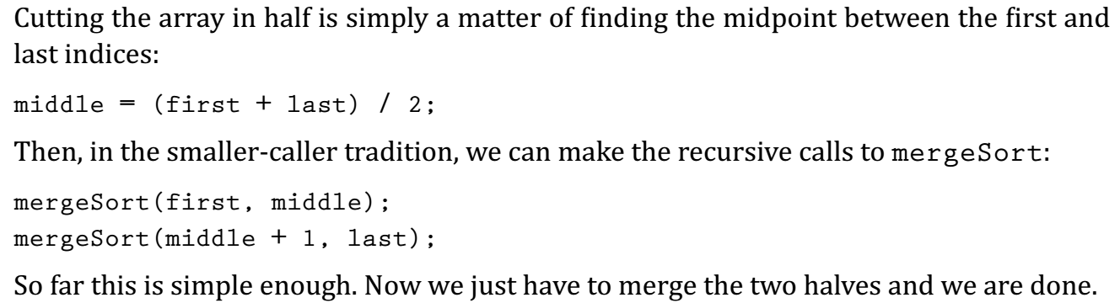
Splitting the array in half
Notes:
‹#›

Slide 50
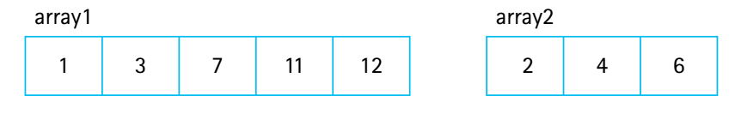
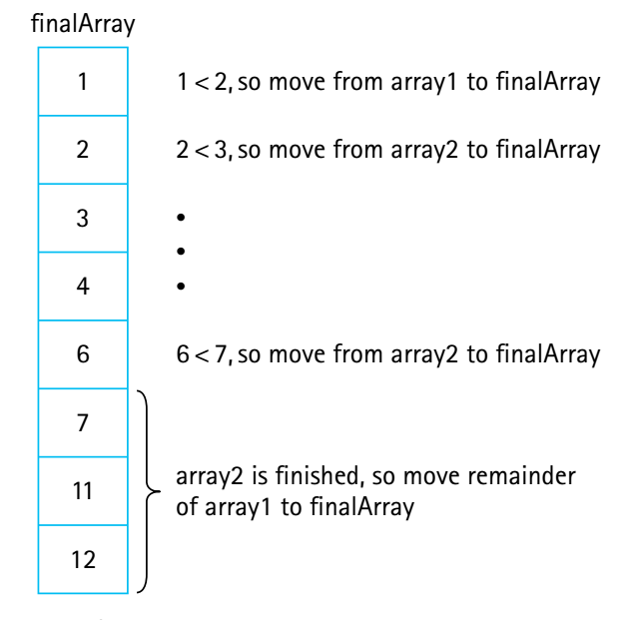
Merging the halves
To merge two sorted arrays, we compare successive pairs of elements, one from each array, moving the smaller of each pair to the “final” array. We can stop when one array runs out of elements, and then move all of the remaining elements from the other array to the final array
Notes:
‹#›

Slide 51
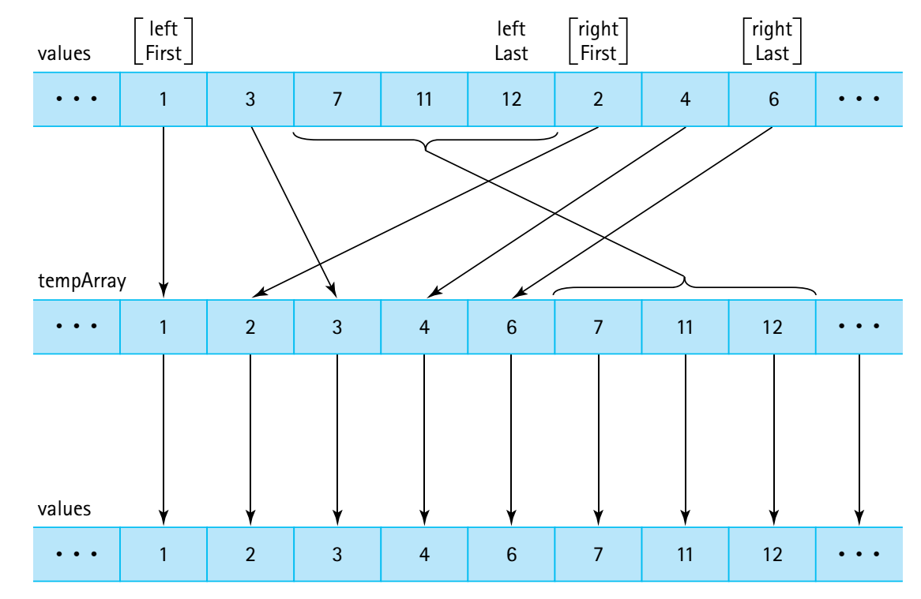
Merging the halves
Notes:
‹#›

Slide 52
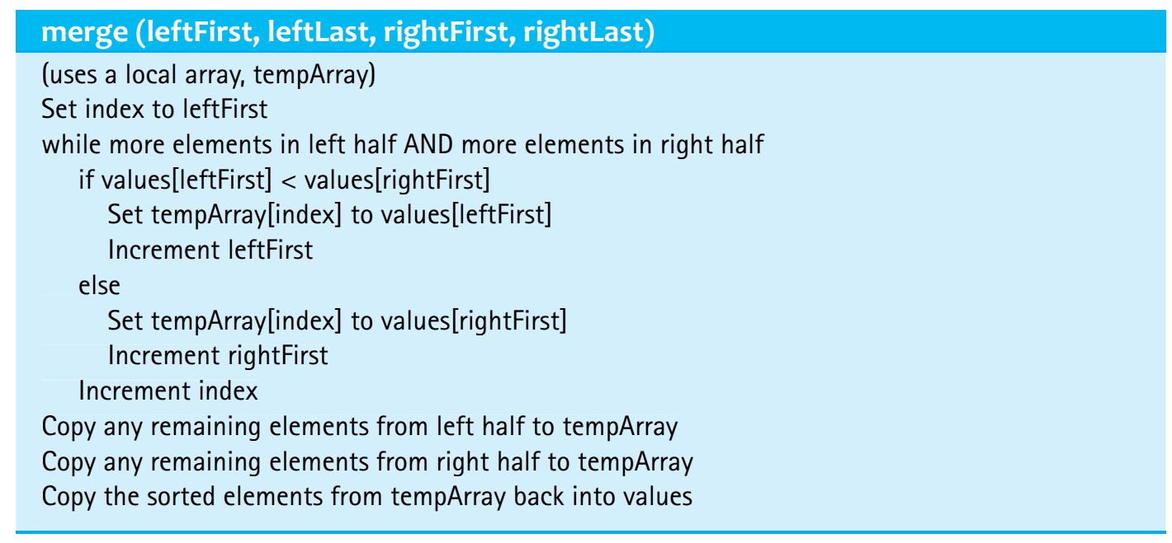
The merge algorithm
Notes:
‹#›

Slide 53
The mergeSort method
The code for merge follows the algorithm on the previous slide.
Merge does most of the work
(see full algorithm for merging in the book or Sorts.java class)
Here is mergeSort:
static void mergeSort(int first, int last)
// Sorts the values array using the merge sort algorithm.
{
if (first < last)
{
int middle = (first + last) / 2;
mergeSort(first, middle);
mergeSort(middle + 1, last);
merge(first, middle, middle + 1, last);
}
}
recursive!
Notes:
‹#›

Slide 54
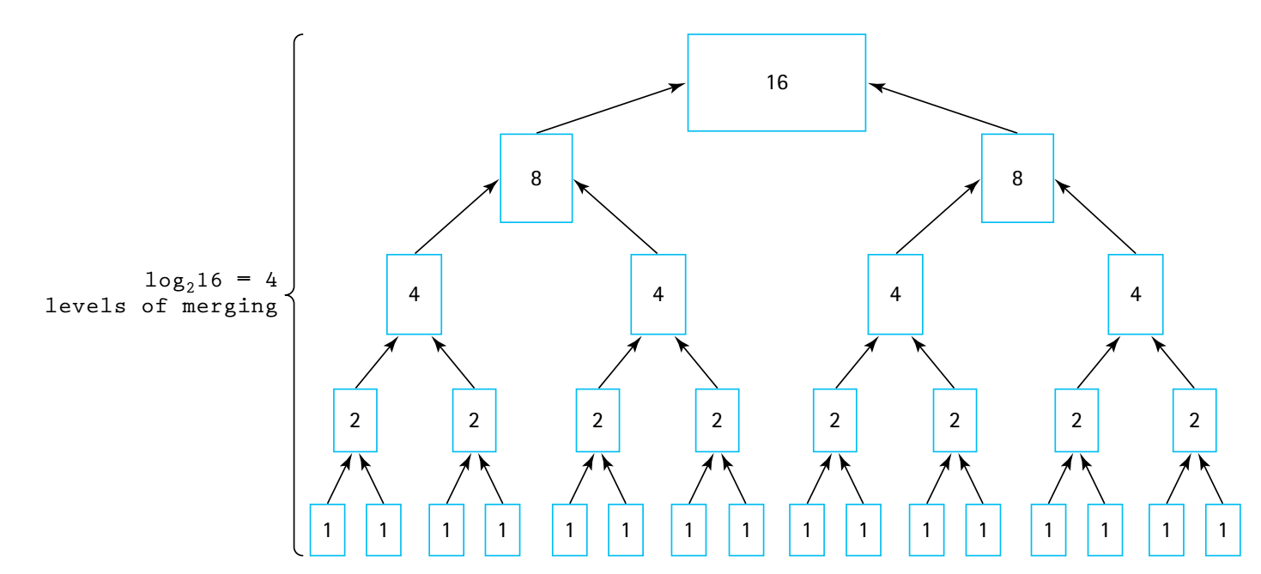
Analysing Merge Sort
Notes:
‹#›

Slide 55
Analyzing Merge Sort
The total work needed to divide the array in half, over and over again until we reach subarrays of size 1, is O(N).
It takes O(N) total steps to perform merging at each “level” of merging.
The number of levels of merging is equal to the number of times we can split the original array in half
If the original array is size N, we have log₂N levels. (This is the same as the analysis of the binary search algorithm in Section 1.6.)
Because we have log₂N levels, and we require O(N) steps at each level, the total cost of the merge operation is: O(N log₂N).
Because the splitting phase was only O(N), we conclude that Merge Sort algorithm is O(N log₂N).
Notes:
‹#›

Slide 56
Analyzing Merge Sort
O(N log₂N)
Each level needs N operations to merge + N operations to split: that is 2N which is O(N)
number of merging levels
Notes:
‹#›

Slide 57
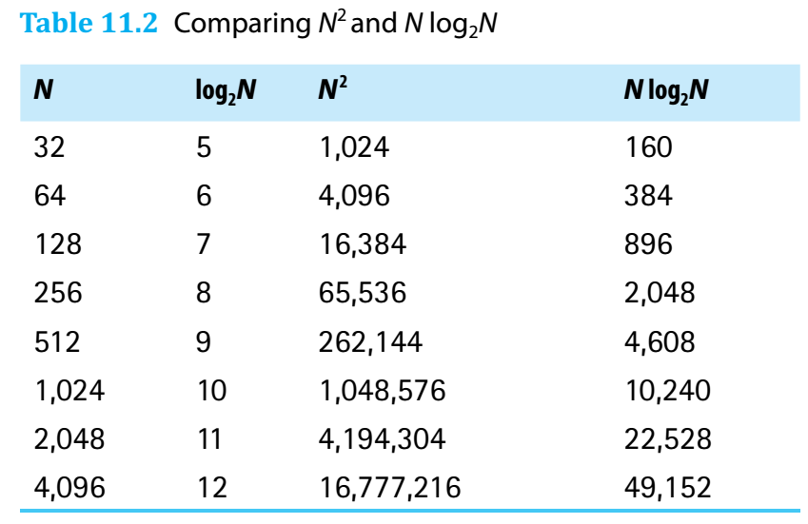
Comparing N² and N log₂ N
Notes:
‹#›

Slide 58
Drawback of Merge Sort
A disadvantage of mergeSort is that it requires an auxiliary array that is as large as the original array to be sorted.
If the array is large and space is a critical factor, this sort may not be an appropriate choice.
Next we discuss two O(N log₂N) sorts that move elements around in the original array and do not need an auxiliary array.
Notes:
‹#›

Slide 59
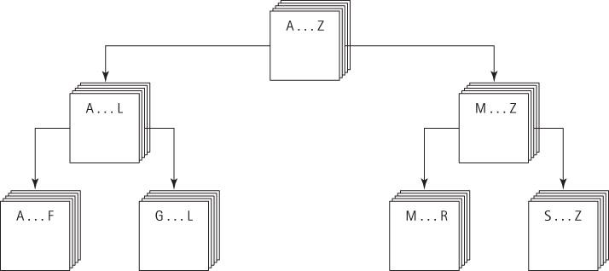
Quick Sort
A divide-and-conquer algorithm
Inherently recursive
At each stage the part of the array being sorted is divided into two “piles”, with everything in the left pile less than everything in the right pile
The same approach is used to sort each of the smaller piles (a smaller case).
This process goes on until the small piles do not need to be further divided (the base case).
Notes:
‹#›

Slide 60

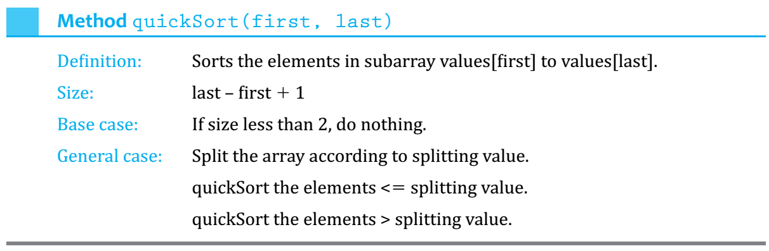
Quick Sort Summary
Notes:
‹#›

Slide 61
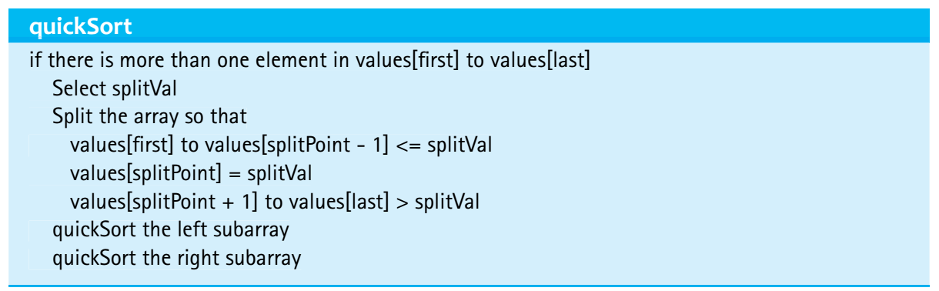
The Quick Sort Algorithm
The algorithm depends on the selection of a “split value”,
called splitVal, that is used to divide the array into two
sub arrays.
How do we select splitVal?
One simple solution is to use the value in values[first]
as the splitting value.
Notes:
‹#›

Slide 62

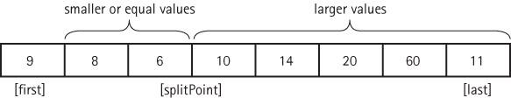
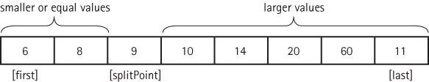
Quick Sort Steps
Notes:
‹#›

Slide 63
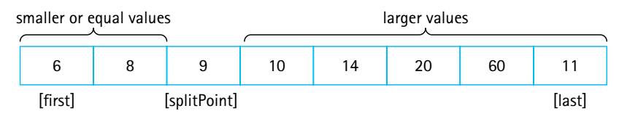
Quick Sort Steps
quickSort(first, splitPoint – 1) sorts the left subarray.
quickSort(splitPoint + 1, last) sorts the right subarray.
Our recursive calls to quickSort use this index (splitPoint) to reduce the size of the problem in the general case.
Notes:
‹#›

Slide 64
Base case
What is the base case?
When the segment being examined holds fewer than two elements, we do not need to go on. In other words, we continue processing as long as first < last
Notes:
‹#›

Slide 65
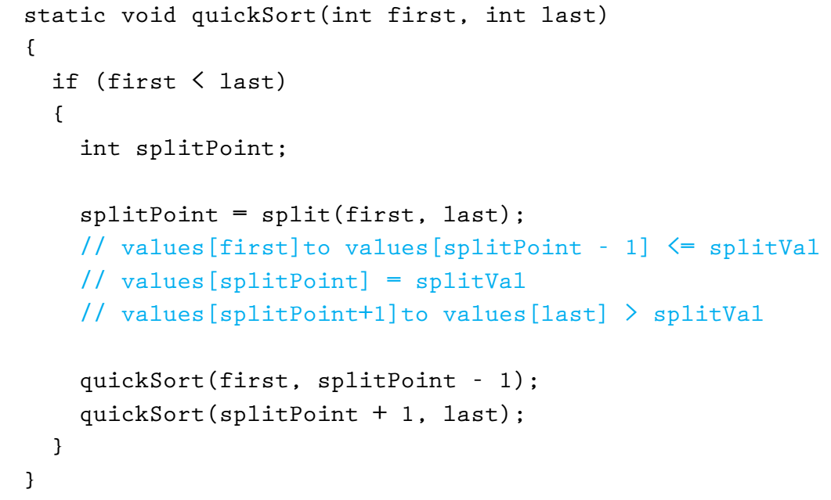
The quickSort method
Notes:
‹#›

Slide 66
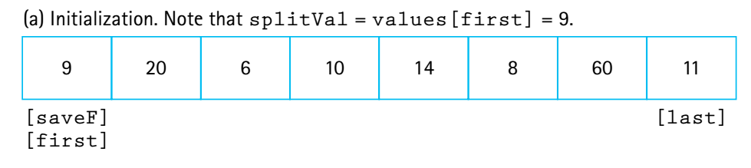
Split operation illustrated
Notes:
‹#›

Slide 67
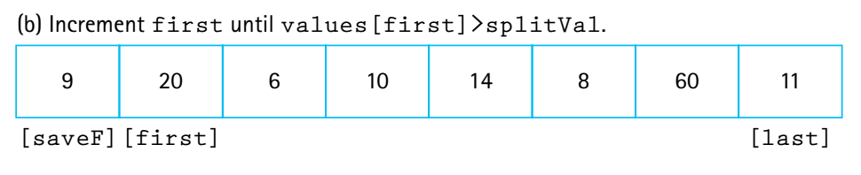
Split operation illustrated
Notes:
‹#›

Slide 68
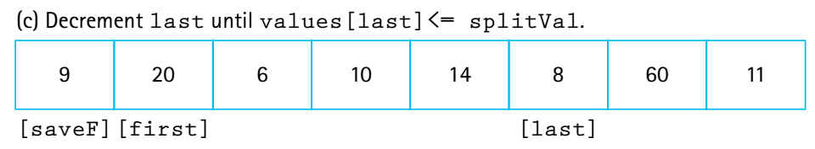
Split operation illustrated
Notes:
‹#›

Slide 69
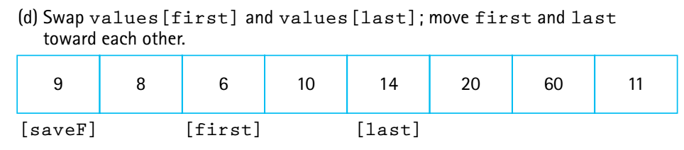
Split operation illustrated
Notes:
‹#›

Slide 70
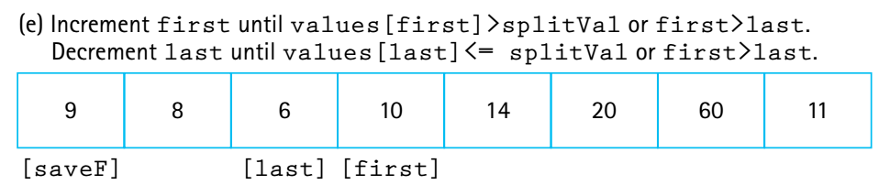
Split operation illustrated
base case
Notes:
‹#›

Slide 71
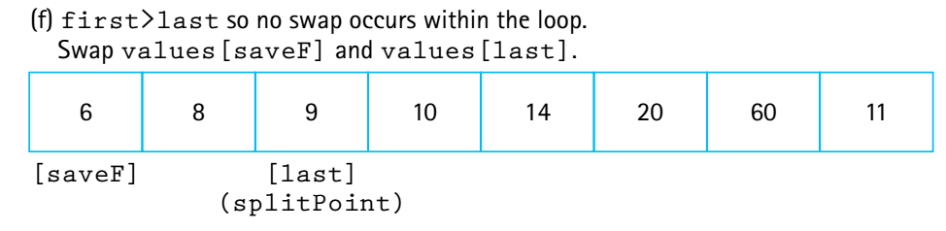
Split operation illustrated
Notes:
‹#›

Slide 72
Analyzing Quick Sort
On the first call, every element in the array is compared to the dividing value (the “split value”), so the work done is O(N).
The array is divided into two sub arrays (not necessarily halves)
Each of these pieces is then divided in two, and so on.
If each piece is split approximately in half, there are O(log₂N) levels of splits. At each level, we make O(N) comparisons.
So Quick Sort is an O(N log₂N) algorithm.
Notes:
‹#›

Slide 73
Drawbacks of Quick Sort
Quick Sort isn’t always quicker.
There are log₂N levels of splits if each split divides the segment of the array approximately in half. As we’ve seen, the array division of Quick Sort is sensitive to the order of the data, that is, to the choice of the splitting value.
If the splits are very lopsided, and the subsequent recursive calls to quickSort also result in lopsided splits, we can end up with a sort that is O(N²).
What about space requirements?
There can be many levels of recursion “saved” on the system stack at any time.
On average, the algorithm requires O(log₂N) extra space to hold this information and in the worst case requires O(N) extra space, the same as Merge Sort.
Notes:
‹#›

Slide 74
Quick Sort
Despite the drawbacks remember that Quick Sort is VERY quick for large collections of random data
Notes:
‹#›

Slide 75
Heap Sort
We already discussed the heap - because of its order property, the maximum value of a heap is in the root node.
Similar to selection sort, but faster because of heap
The general approach of the Heap Sort is as follows:
take the root (maximum) element off the heap, and put it into its place.
reheap the remaining elements. (This puts the next-largest element into the root position.)
repeat until there are no more elements.
For this to work we must first arrange the original array into a heap
Notes:
‹#›

Slide 76
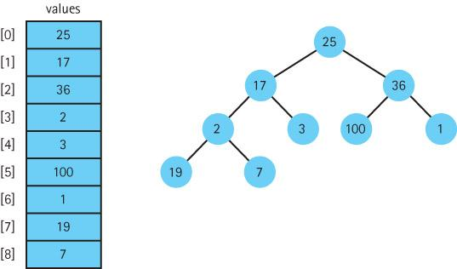
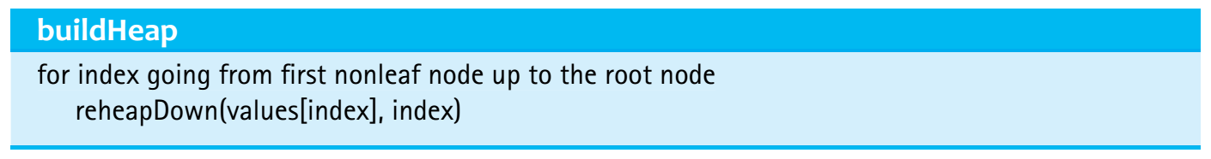
Building a heap
Need to also satisfy the order property of heap!
Notes:
‹#›

Slide 77
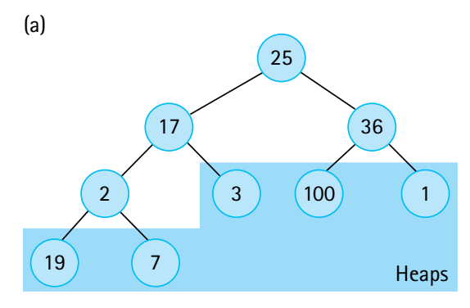
Notes:
‹#›

Slide 78
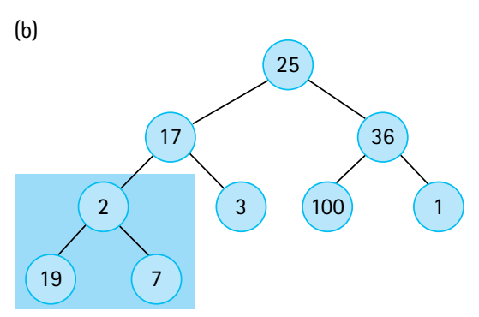
Notes:
‹#›

Slide 79
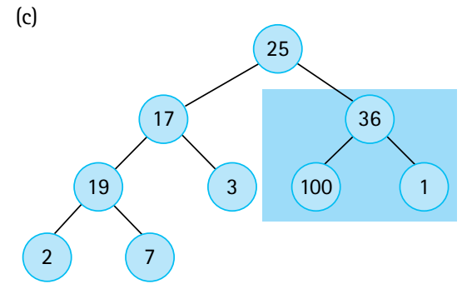
ok
Notes:
‹#›

Slide 80
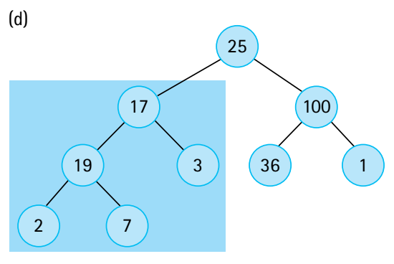
ok
ok
Notes:
‹#›

Slide 81
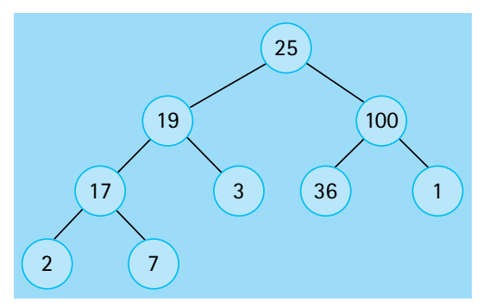
ok
ok
ok
Notes:
‹#›

Slide 82
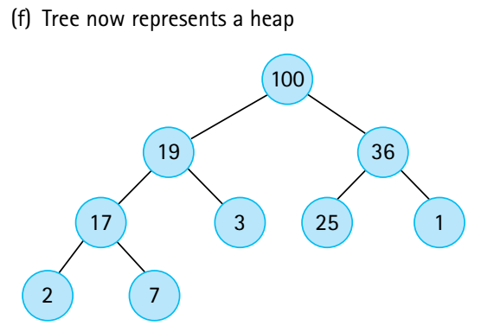
ok
ok
ok
Notes:
‹#›

Slide 83
Analysis of Heap Sort
Consider the sorting loop
it loops through N ─ 1 times, swapping elements and reheaping
the comparisons occur in reheapDown (actually in its helper method newHole)
a complete binary tree with N nodes has O(log₂(N + 1)) levels
in the worst cases, then, if the root element had to be bumped down to a leaf position, the reheapDown method would make O(log₂N) comparisons.
so method reheapDown is O(log2N)
multiplying this activity by the N ─ 1 iterations shows that the sorting loop is O(N log₂N).
Combining the original heap build, which is O(N), and the sorting loop, we can see that Heap Sort requires O(N log₂N) comparisons.
Notes:
‹#›

Slide 84
The Heap Sort
For small arrays, heapSort is not very efficient because of all the “overhead.”
For large arrays, however, heapSort is very efficient.
Unlike Quick Sort, Heap Sort’s efficiency is not affected by the initial order of the elements.
Heap Sort is also efficient in terms of space – it only requires constant extra space.
Heap Sort is an elegant, fast, robust, space efficient algorithm!
Notes:
‹#›

Slide 85
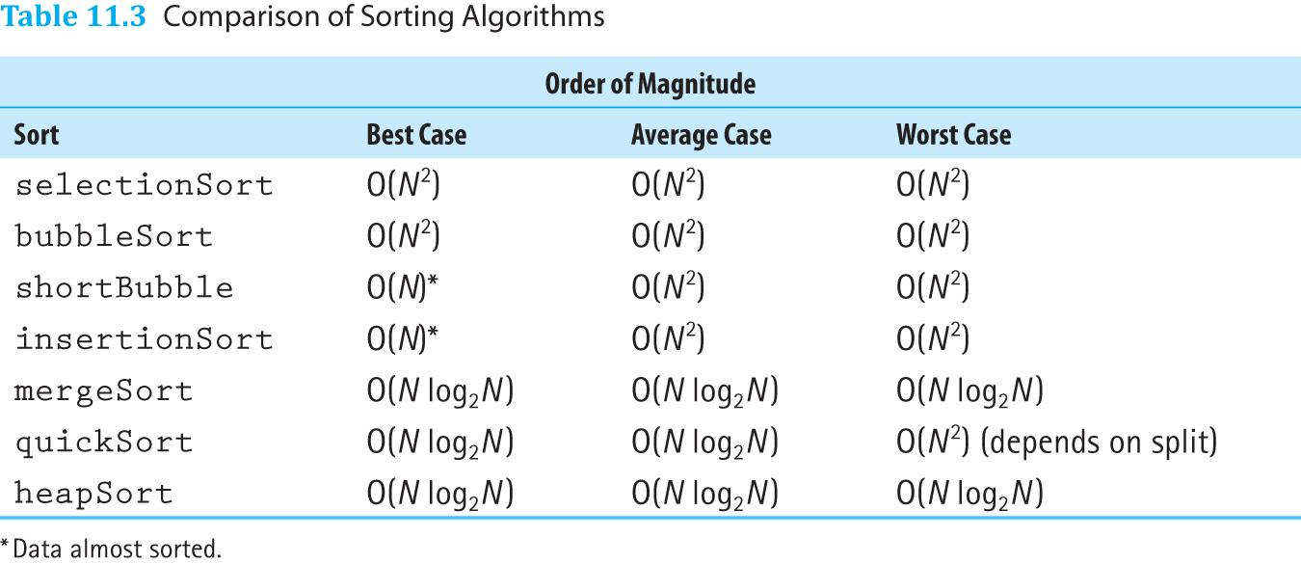
Comparison of Sorting Algorithms

Slide 86
11.4 More Sorting Considerations
In this section we wrap up our coverage of sorting by
revisiting testing
revisiting efficiency
discussing special concerns involved with sorting objects rather than primitive types
considering the “stability” of sorting algorithms
Notes:
‹#›

Slide 87
Testing
To thoroughly test our sorting methods we should
vary the size of the array
vary the original order of the array
Random order
Reverse order
Almost sorted
All identical elements
Notes:
‹#›

Slide 88
Efficiency
When N is small the simple sorts may be more efficient than the “fast” sorts because they require less overhead.
Sometimes it may be desirable, for efficiency considerations, to streamline the code as much as possible, even at the expense of readability. For instance, instead of using a swap method directly, code the swap operation within the sorting method.
Notes:
‹#›

Slide 89
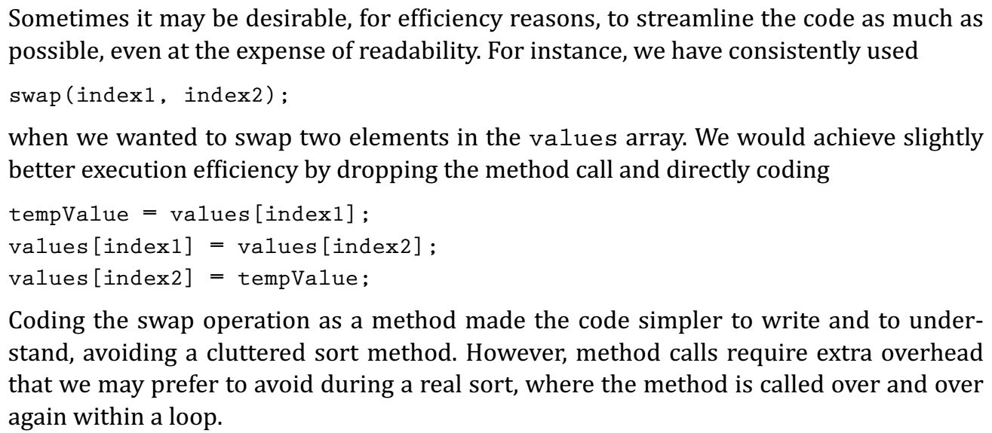
Efficiency
Notes:
‹#›

Slide 90
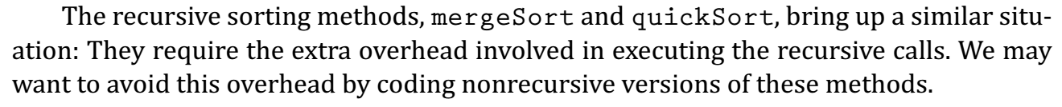
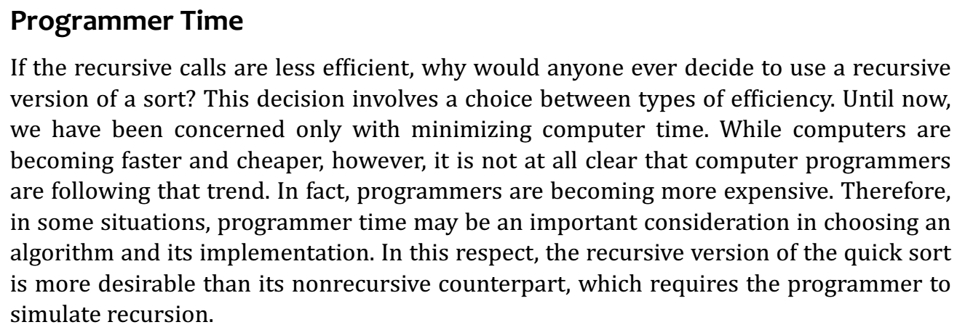
Efficiency
Notes:
‹#›

Slide 91
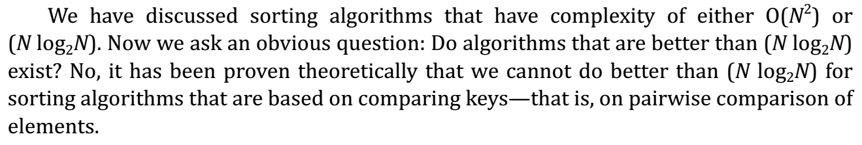
Efficiency: better than O(NlogN)?
Notes:
‹#›

Slide 92
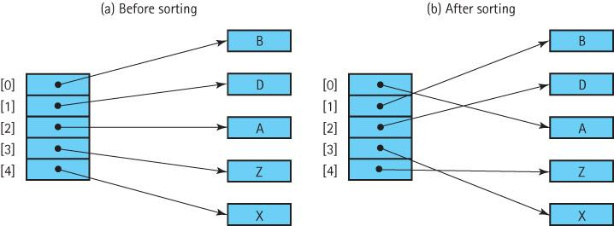
Special Concerns when Sorting Objects
When sorting an array of objects we are manipulating references to the object, and not the objects themselves
Notes:
‹#›

Slide 93

Special Concerns when Sorting Objects
Notes:
‹#›

Slide 94
11.5 Searching
This section reviews material scattered throughout the text related to searching.
Here we bring these topics together to be considered in relationship to each other to gain an overall perspective.
Searching is a crucially important information processing activity. Options are closely related to the way data is structured and organized.
Notes:
‹#›

Slide 95
Sequential Searching
If we want to add elements as quickly as possible to a collection, and we are not as concerned about how long it takes to find them we would put the element
into the last slot in an array-based collection
into the first slot in a linked collection
sorted according to the time of insertion, not value!
To search this collection for the element with a given key, we must use a simple linear (or sequential) search
Beginning with the first element in the collection, we search for the desired element by examining each subsequent element’s key until either the search is successful or the collection is exhausted.
Based on the number of comparisons this search is O(N)
In the worst case we have to make N key comparisons.
On the average, assuming that there is an equal probability of searching for any element in the collection, we make N/2 comparisons for a successful search
Notes:
‹#›

Slide 96
High-Probability Ordering
Sometimes certain collection elements are in much greater demand than others. We can then improve the search:
Put the most-often-desired elements at the beginning of the collection
Using this scheme, we are more likely to make a hit in the first few tries, and rarely do we have to search the whole collection.
If the elements in the collection are not static or if we cannot predict their relative demand, we can
move each element accessed to the front of the collection
as an element is found, it is swapped with the element that precedes it
collections in which the relative positions of the elements are changed in an attempt to improve search efficiency are called self-organizing or self-adjusting collections.
Notes:
‹#›

Slide 97
High-Probability Ordering
Sometimes certain collection elements are in much greater demand than others. We can then improve the search:
Put the most-often-desired elements at the beginning of the collection
Using this scheme, we are more likely to make a hit in the first few tries, and rarely do we have to search the whole collection.
If the elements in the collection are not static or if we cannot predict their relative demand, we can
move each element accessed to the front of the collection
as an element is found, it is swapped with the element that precedes it
collections in which the relative positions of the elements are changed in an attempt to improve search efficiency are called self-organizing or self-adjusting collections.
Notes:
‹#›

Slide 98
Sorted collections
If the collection is sorted, a sequential search no longer needs to search the whole collection to discover that an element does not exist. It only needs to search until it has passed the element’s logical place in the collection—that is, until an element with a larger key value is encountered.
Another advantage of linear searching is its simplicity.
The binary search is usually faster, however, it is not guaranteed to be faster for searching very small collections.
As the number of elements increases, however, the disparity between the linear search and the binary search grows very quickly.
The binary search is appropriate only for collection elements stored in a sequential array-based representation.
However, the binary search tree allows us to perform a binary search on a linked data representation
Notes:
‹#›

Slide 99
Hashing
We end our discussion of search algorithms by pointing out that the hash table approach to storage presented in Sections 4 through 6 of Chapter 8 allows constant search time in many situations.
Notes:
‹#›

