Slide 1
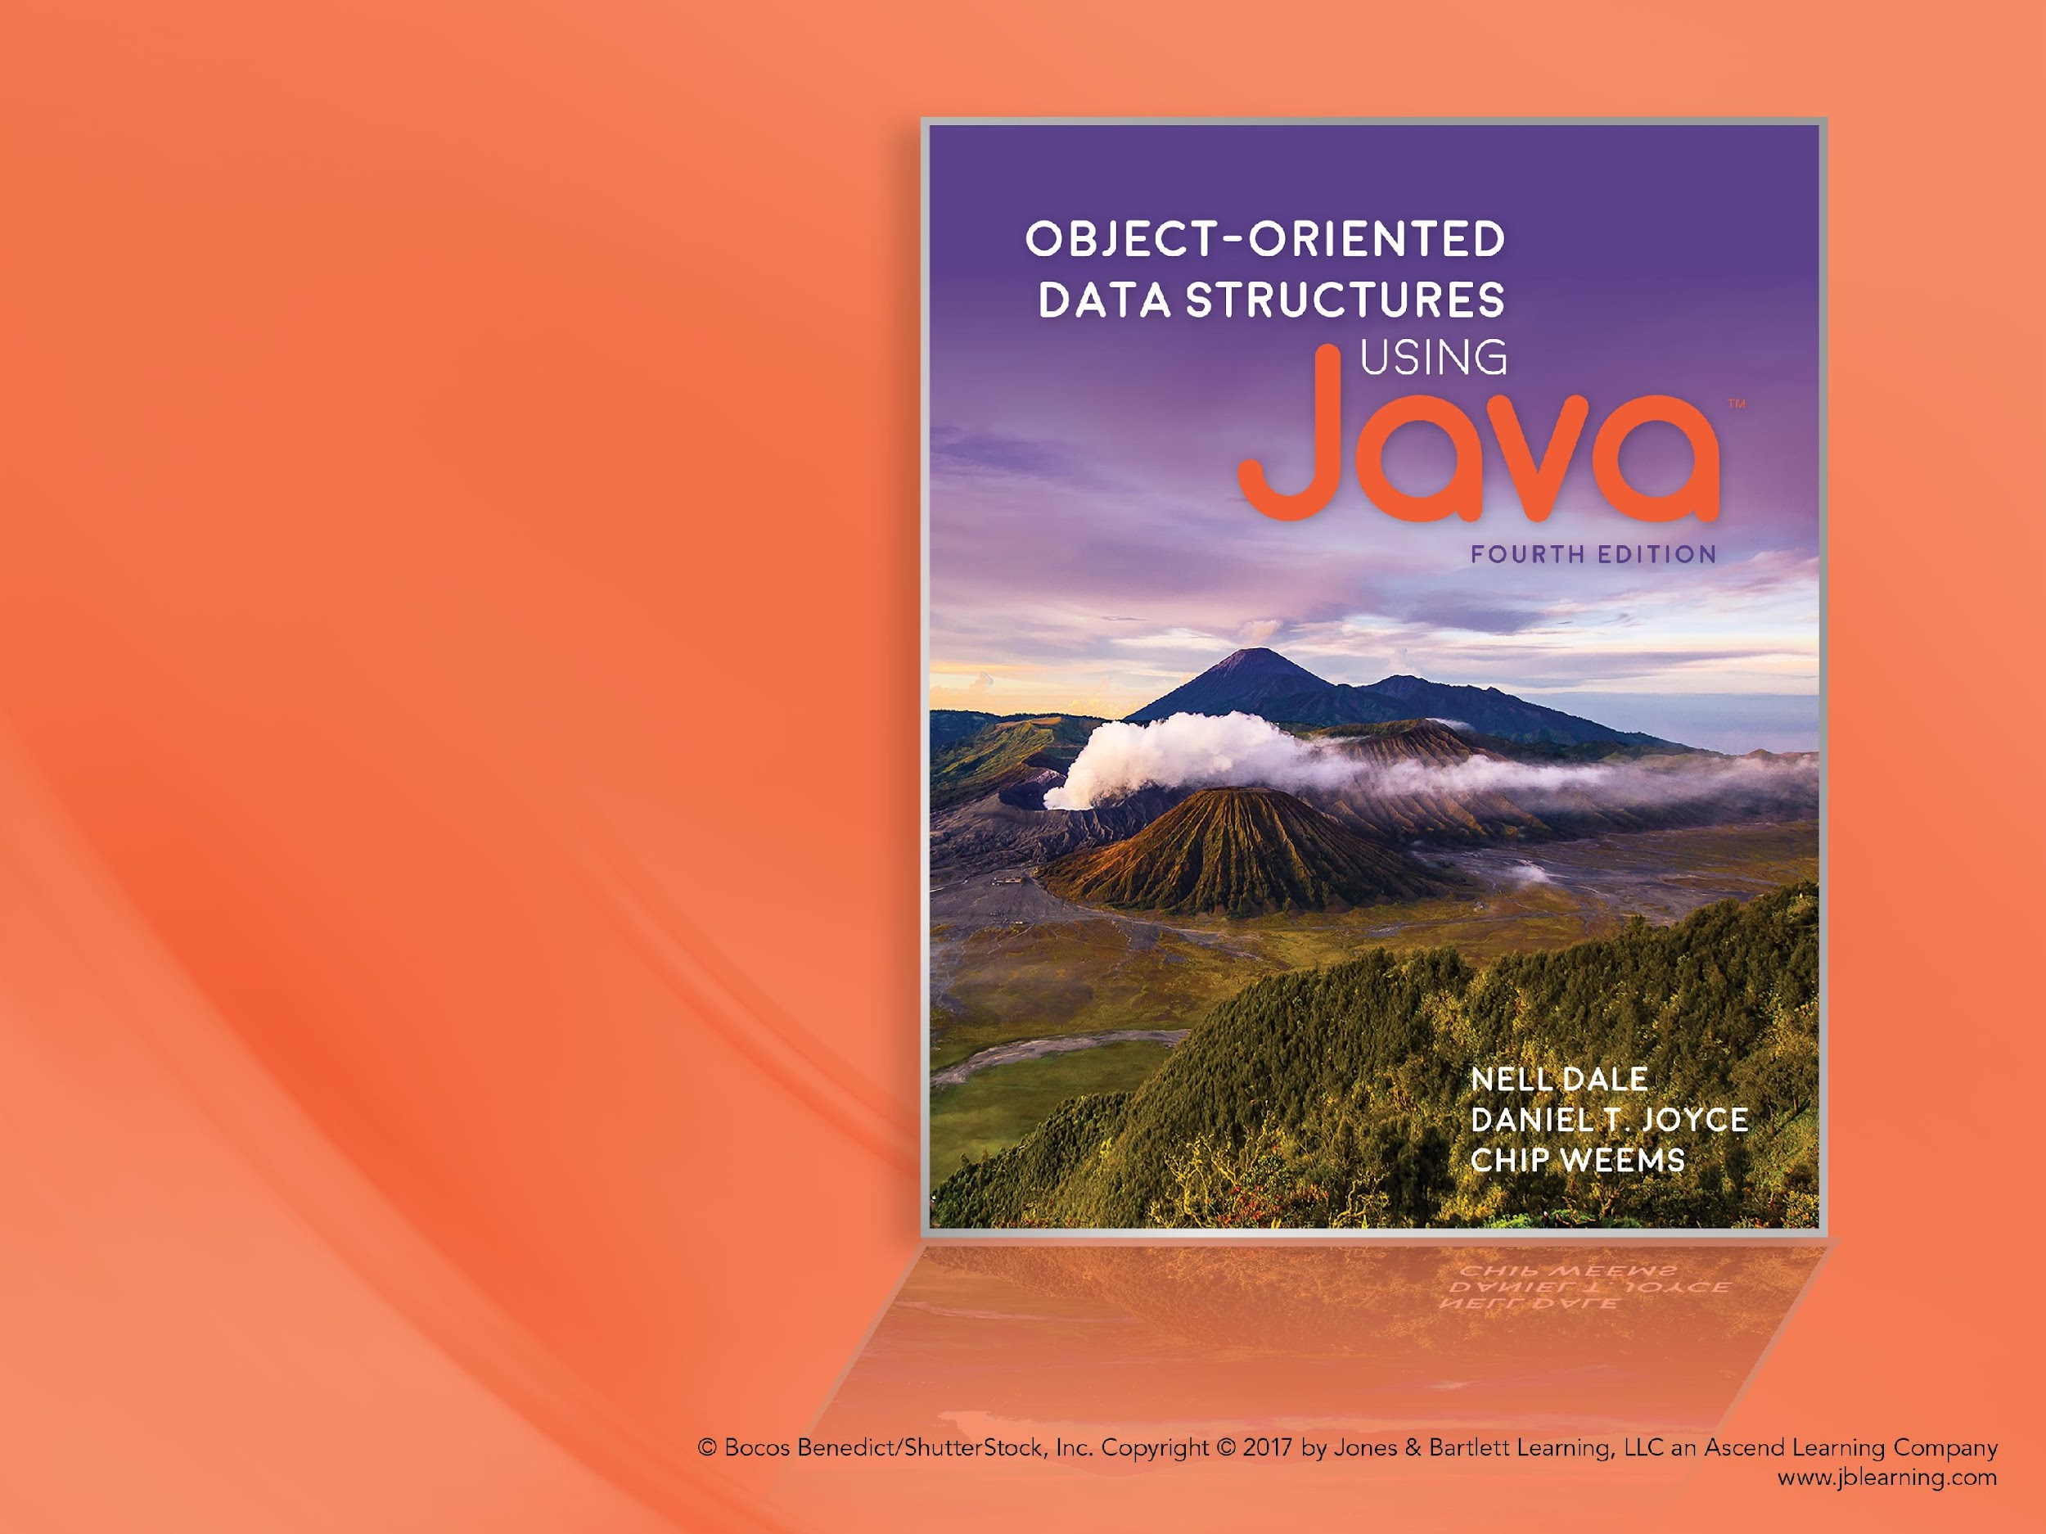
Chapter 3 Recursion
Notes:
‹#›

Slide 2
Chapter 3: Recursion
3.1 – Recursive Definitions, Algorithms
and Programs
3.2 – The Three Questions
3.3 – Recursive Processing of Arrays
3.4 – Recursive Processing of Linked Lists
3.5 – Towers of Hanoi
3.6 – Fractals
3.7 – Removing Recursion
3.8 – Deciding Whether to Use a Recursive Solution
Notes:
‹#›

Slide 3

3.1 Recursive Definitions, Algorithms and Programs
Notes:
‹#›

Slide 4
Recursive Definitions
Recursive definition A definition in which something is defined in terms of smaller versions of itself. For example:
A folder is an entity in a file system which contains a group of files and other folders.
A compound sentence is a sentence that consists of two sentences joined together by a coordinating conjunction.
n! = 1 if n = 0
n x (n – 1)! if n > 0
recursive part of definition
Notes:
‹#›

Slide 5


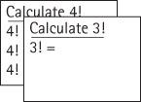
Example: Calculate 4!
= 1 if n = 0
= n x (n – 1)! if n > 0
Notes:
‹#›

Slide 6
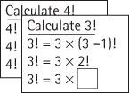
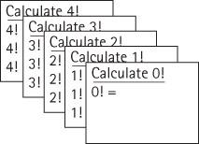
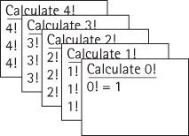
Example: Calculate 4!
. . .
Notes:
‹#›

Slide 7
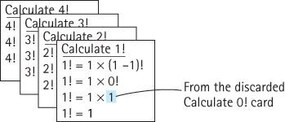
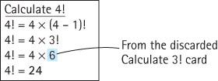
Example: Calculate 4!
. . .
Notes:
‹#›

Slide 8
Recursive Algorithms
Recursive algorithm A solution that is expressed in terms of
smaller instances of itself and
a base case
Base case The case for which the solution can be stated non-recursively
General (recursive) case The case for which the solution is expressed in terms of a smaller version of itself
Notes:
‹#›

Slide 9
Examples of a Recursive Algorithm and a Recursive Program
Factorial (int n)
// Assume n >= 0
if (n == 0)
return (1)
else
return ( n * Factorial ( n – 1 ) )
public static int factorial(int n)
// Precondition: n is non-negative
//
// Returns the value of "n!".
{
if (n == 0)
return 1; // Base case
else
return (n * factorial(n – 1)); // General case
}
Notes:
‹#›

Slide 10
Recursion Terms
Recursive call A method call in which the method being called is the same as the one making the call
Direct recursion Recursion in which a method directly calls itself, like the factorial method.
Indirect recursion Recursion in which a chain of two or more method calls returns to the method that originated the chain, for example method A calls method B which in turn calls method A
Notes:
‹#›

Slide 11
Iterative Solution for Factorial
We have used the factorial algorithm to demonstrate recursion because it is familiar and easy to visualize. In practice, one would never want to solve this problem using recursion, since a straightforward, more efficient iterative solution exists:
public static int factorial(int n)
{
int retValue = 1;
while (n != 0)
{
retValue = retValue * n;
n = n - 1;
}
return(retValue);
}
Notes:
‹#›

Slide 12
3.2 The Three Questions
In this section we present three questions to ask about any recursive algorithm or program.
Using these questions helps us verify, design, and debug recursive solutions to problems.
Notes:
‹#›

Slide 13
Verifying Recursive Algorithms
To verify that a recursive solution works, we must be able to answer “Yes” to all three of these questions:
The Base-Case Question: Is there a nonrecursive way out of the algorithm, and does the algorithm work correctly for this base case?
The Smaller-Caller Question: Does each recursive call to the algorithm involve a smaller case of the original problem, leading inescapably to the base case?
The General-Case Question: Assuming the recursive call(s) to the smaller case(s) works correctly, does the algorithm work correctly for the general case?
We next apply these three questions to the factorial algorithm.
Notes:
‹#›

Slide 14
The Base-Case Question
Factorial (int n)
// Assume n >= 0
if (n == 0)
return (1)
else
return ( n * Factorial ( n – 1 ) )
Is there a nonrecursive way out
of the algorithm, and does the
algorithm work correctly
for this base case?
The base case occurs when n is 0.
The Factorial algorithm then returns the value of 1, which is
the correct value of 0!, and no further (recursive) calls
to Factorial are made.
The answer is yes.
Notes:
‹#›

Slide 15
The Smaller-Caller Question
Factorial (int n)
// Assume n >= 0
if (n == 0)
return (1)
else
return ( n * Factorial ( n – 1 ) )
Does each recursive call to the
algorithm involve a smaller case
of the original problem, leading
inescapably to the base case?
The parameter is n and the recursive call passes the
argument n - 1. Therefore each subsequent recursive call
sends a smaller value, until the value sent is finally 0.
At this point, as we verified with the base-case question,
we have reached the smallest case, and no further
recursive calls are made. The answer is yes.
Notes:
‹#›

Slide 16
The General-Case Question
Factorial (int n)
// Assume n >= 0
if (n == 0)
return (1)
else
return ( n * Factorial ( n – 1 ) )
Assuming the recursive call(s) to the
smaller case(s) works correctly, does
the algorithm work correctly for the
general case?
Assuming that the recursive call Factorial(n – 1) gives us
the correct value of (n - 1)!, the return statement computes
n * (n - 1)!.
This is the definition of a factorial, so we know that the algorithm
works in the general case. The answer is yes.
Notes:
‹#›

Slide 17
Constraints on input arguments
Constraints often exist on the valid input arguments for a recursive algorithm. For example, for Factorial, n must be >= 0.
You can use the three question analysis to determine constraints:
Check if there are any starting argument values for which the smaller call does not produce a new argument that is closer to the base case.
Such starting values are invalid.
Constrain your legal input arguments so that these values are not permitted.
Notes:
‹#›

Slide 18
Steps for Designing Recursive Solutions
Get an exact definition of the problem to be solved.
Determine the size of the problem to be solved on this call to the method.
Identify and solve the base case(s) in which the problem can be expressed non-recursively. This ensures a yes answer to the base-case question.
Identify and solve the general case(s) correctly in terms of a smaller case of the same problem—a recursive call. This ensures yes answers to the smaller-caller and general-case questions.
Notes:
‹#›

Slide 19
3.3 Recursive Processing of Arrays
Many problems related to arrays lend themselves to a recursive solution.
A subsection of an array (a “subarray”) can also be viewed as an array.
If we can solve an array-related problem by combining solutions to a related problem on subarrays, we may be able to use a recursive approach.

Slide 20
Binary Search
Problem: find a target element in a sorted array
Approach
examine the midpoint of the array and compare the element found there to our target element
eliminate half the array from further consideration
recursively repeat this approach on the remaining half of the array until we find the target or determine that it is not in the array

Slide 21
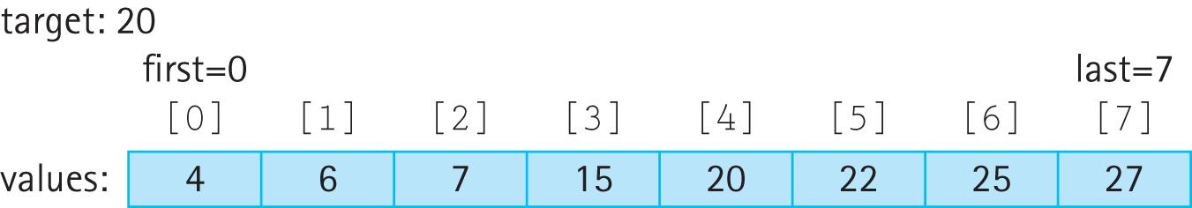
Example
We have a sorted array of int named values of size 8
Our target is 20
Variables first and last indicate the sub-array currently under consideration
Therefore, the starting configuration is:

Slide 22
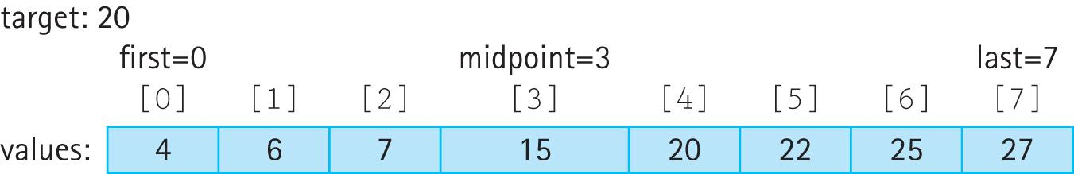
Example
The midpoint is the average of first and last midpoint = (first + last) / 2
Since values[midpoint] is less than target we eliminate the lower half of the array from consideration

Slide 23
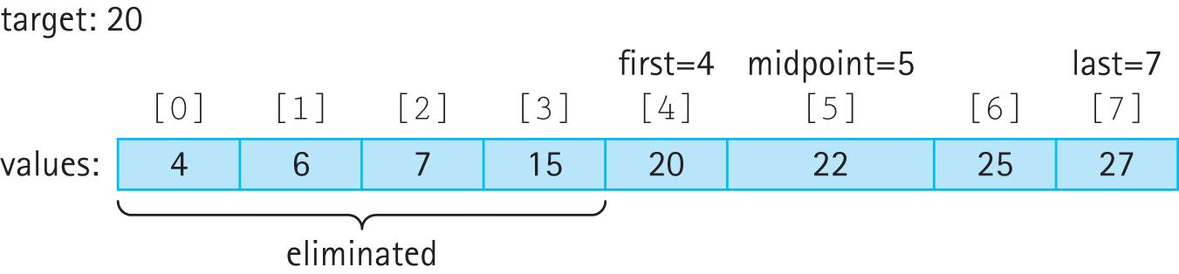
Example
Set first to midpoint + 1 and calculate a new midpoint resulting in
Since values[midpoint] is greater than target we eliminate the upper half of remaining portion of the array from consideration.

Slide 24
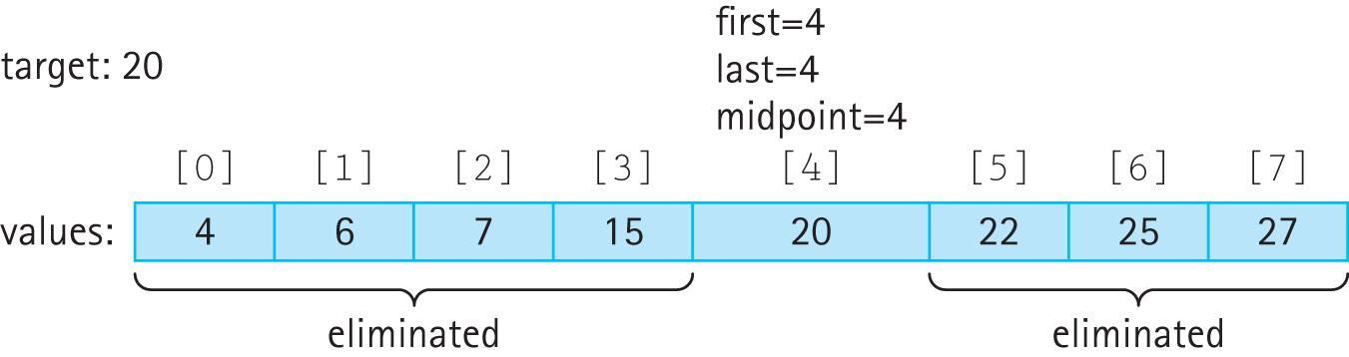
Example
Set last to midpoint - 1 and calculate a new midpoint resulting in
Since values[midpoint]equals target we are finished and return true

Slide 25
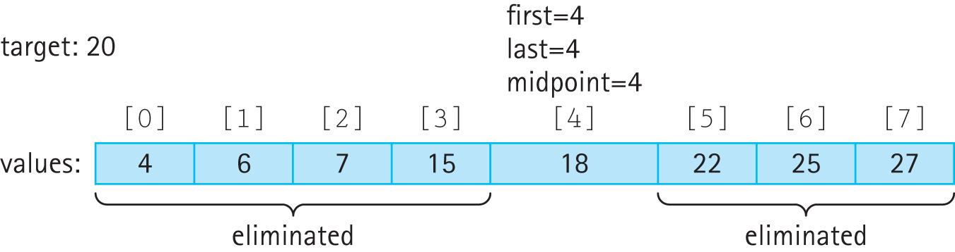
Example – target not in array
Consider the above example again, but this time with 18 replacing 20 as the fifth element of values. The same sequence of steps would occur until at the very last step we have the following:

Slide 26
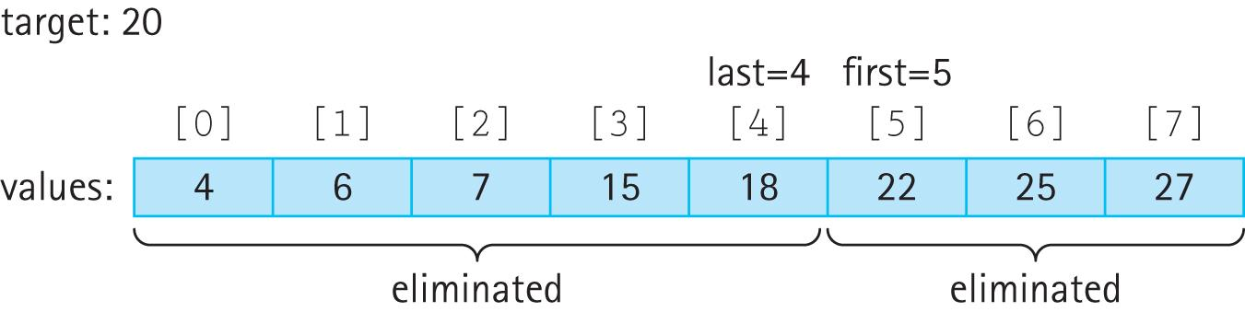
Example – target not in array
Since values[midpoint] is less than target we set first to midpoint + 1:
The entire array has been eliminated (since first > last) and we return false.

Slide 27
Code for the Binary Search
boolean binarySearch(int target, int first, int last)
// Precondition: first and last are legal indices of values
//
// If target is contained in values[first,last] return true
// otherwise return false.
{
int midpoint = (first + last) / 2;
if (first > last)
return false;
else
if (target == values[midpoint])
return true;
else
if (target > values[midpoint])
return binarySearch(target, midpoint + 1, last);
else
return binarySearch(target, first, midpoint - 1);
}
recursive call
recursive call

Slide 28
Activity 1: write code for calculating the sum of elements in array 1) Iterative approach 2) Recursive approach

Slide 29
Activity 2: reference trouble Before we proceed with linked lists, let us revisit a common mistake made with references

Slide 30
3.4 Recursive Processing of Linked Lists
A linked list is a recursive structure
The LLNode class, our building block for linked lists, is a self-referential (recursive) class:
public class LLNode<T>
{
protected T info; // information stored in list
protected LLNode<T> link; // reference to a node
. . .
recursive reference

Slide 31
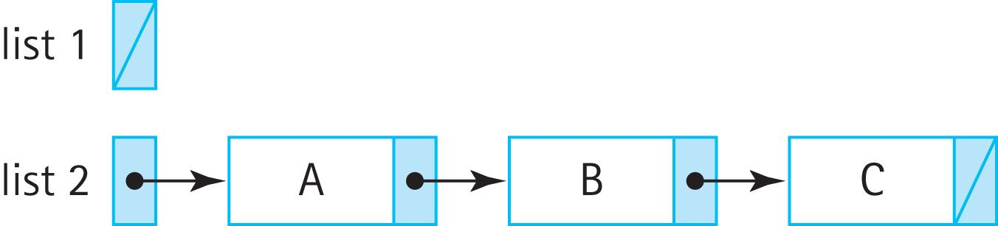
Recursive nature of Linked Lists
A linked list is either empty or consists of a node containing two parts:
information
a linked list
contains info A plus a linked list (B – C)

Slide 32
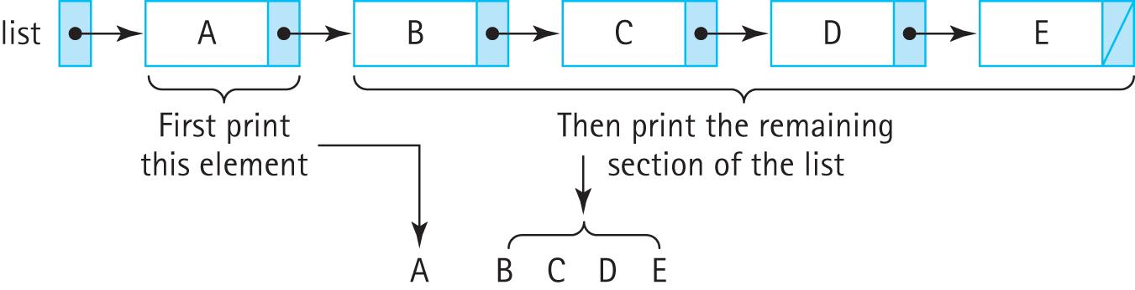
Printing a Linked List Recursively
void recPrintList(LLNode<String> listRef)
{
if (listRef != null)
{
System.out.println(listRef.getInfo());
recPrintList(listRef.getLink());
}
}

Slide 33
Comparison
void recPrintList(LLNode<String> listRef)
{
if (listRef != null)
{
System.out.println(listRef.getInfo());
recPrintList(listRef.getLink());
}
}
void iterPrintList(LLNode<String> listRef)
{
while (listRef != null)
{
System.out.println(listRef.getInfo());
listRef = listRef.getLink();
}
}
Iterative approach is better
but what if you want to print the list in reverse???

Slide 34
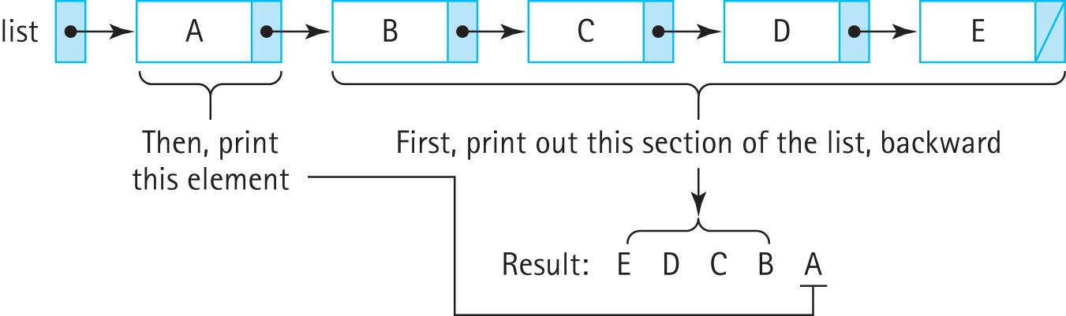
Reverse Printing a Linked List
void recPrintList(LLNode<String> listRef)
{
if (listRef != null)
{
recPrintList(listRef.getLink());
System.out.println(listRef.getInfo());
}
}
Solving this problem iteratively is not easy

Slide 35
Activity 3: add a new node to the end of a linked list Then we will together see how to do it recursively

Slide 36
Transforming a linked list recursively
For example, insert an element at the end of the list
void recInsertEnd(String newInfo, LLNode<String> listRef)
// Adds newInfo to the end of the listRef linked list
{
if (listRef.getLink() != null)
recInsertEnd(newInfo, listRef.getLink());
else
listRef.setLink(new LLNode<String>(newInfo));
}
Although this works in the general case
it does not work if the original list is empty

Slide 37

Problem with the approach
void recInsertEnd(String newInfo, LLNode<String> listRef)
// Adds newInfo to the end of the listRef linked list
{
if (listRef.getLink() != null)
recInsertEnd(newInfo, listRef.getLink());
else
listRef.setLink(new LLNode<String>(newInfo));
}
If we invoke, for example, recInsertEnd(“Z”,myList)
the temporary variable listRef will hold a linked list consisting of “Z” but myList will still be null.

Slide 38
Solution
Rather than return void where we invoke as
recInsertEnd(“Z”, myList)
Need a solution that returns a linked list so we can invoke as
myList = recInsertEnd(“Z”, myList)
This is the only way we can change the value of myList in the case that the list is empty

Slide 39
Solution
LLNode<String> recInsertEnd(String newInfo, LLNode<String> listRef)
// Adds newInfo to the end of the listRef linked list
{
if (listRef != null)
listRef.setLink(recInsertEnd(newInfo, listRef.getLink()));
else
listRef = new LLNode<String>(newInfo);
return listRef;
}
This works in both the general case and
the case where the original list is empty.

Slide 40
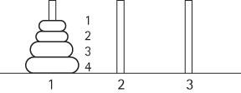
3.5 Towers of Hanoi
Move the rings, one at a time, to the third peg.
A ring cannot be placed on top of one that is smaller in diameter.
The middle peg can be used as an auxiliary peg, but it must be empty at the beginning and at the end of the game.
The rings can only be moved one at a time.
Notes:
‹#›

Slide 41
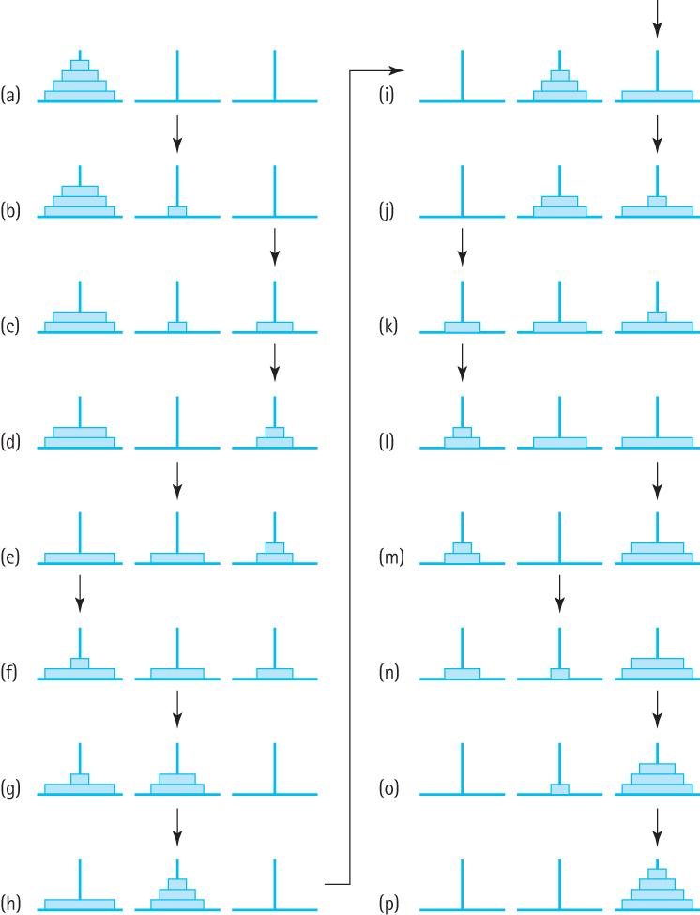
Sample Solution

Slide 42
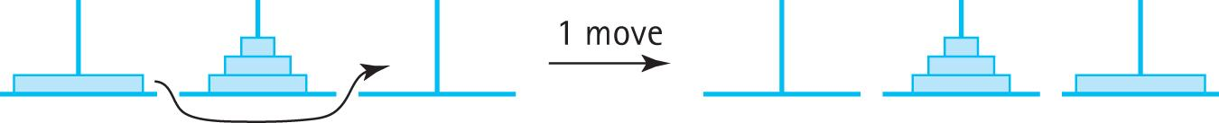
General Approach
To move the largest ring to peg 3, we must move the three smaller rings to peg 2:
Then the largest ring can be moved to peg 3:
And finally the three smaller rings are moved from peg 2 to peg 3:
Notes:
‹#›

Slide 43
Recursion
Can you see that our solution involved solving a smaller version of the problem? We have solved the problem using recursion.
The general recursive algorithm for moving n rings from the starting peg to the destination peg 3 is:
Move n rings from Starting Peg to Destination Peg
Move n - 1 rings from starting peg to auxiliary peg
Move the nth ring from starting peg to destination peg
Move n - 1 rings from auxiliary peg to destination peg
Notes:
‹#›

Slide 44
Recursive Method
public static void doTowers(
int n, // Number of rings to move
int startPeg, // Peg containing rings to move
int auxPeg, // Peg holding rings temporarily
int endPeg ) // Peg receiving rings being moved
{
if (n == 1) // Base case – Move one ring
System.out.println("Move ring " + n + " from peg " + startPeg
+ " to peg " + endPeg);
else
{
// Move n - 1 rings from starting peg to auxiliary peg
doTowers(n - 1, startPeg, endPeg, auxPeg);
// Move nth ring from starting peg to ending peg
System.out.println("Move ring " + n + " from peg " + startPeg
+ " to peg " + endPeg);
// Move n - 1 rings from auxiliary peg to ending peg
doTowers(n - 1, auxPeg, startPeg, endPeg);
}
}
Notes:
‹#›

Slide 45
Code and Demo
Instructors can now walk through the code contained in Towers.java in the ch03.apps package and demonstrate the running program.
Notes:
‹#›

Slide 46
Working through an example
doTowers(3, 1, 2, 3)
1
2
3

Slide 47
Working through an example
doTowers(3, 1, 2, 3)
doTowers(2, 1, 3, 2)
1
2
3

Slide 48
Working through an example
doTowers(3, 1, 2, 3)
doTowers(2, 1, 3, 2)
1
2
3
doTowers(1, 1, 2, 3)
1
2
3

Slide 49
Working through an example
doTowers(3, 1, 2, 3)
doTowers(2, 1, 3, 2)
1
2
3
doTowers(1, 1, 2, 3)
Move 2 to peg #2
1
2
3
1
2
3

Slide 50
Working through an example
doTowers(3, 1, 2, 3)
doTowers(2, 1, 3, 2)
1
2
3
doTowers(1, 1, 2, 3)
Move 2 to peg #2
1
2
3
doTowers(1, 3, 1, 2)
Move 1 to peg #2
1
2
3
1
2
3

Slide 51
Working through an example
doTowers(3, 1, 2, 3)
doTowers(2, 1, 3, 2)
1
2
3
doTowers(1, 1, 2, 3)
Move 2 to peg #2
1
2
3
doTowers(1, 3, 1, 2)
Move 1 to peg #2
1
2
3
Move 3 to peg #3
1
2
3
1
2
3

Slide 52
Working through an example
doTowers(3, 1, 2, 3)
doTowers(2, 1, 3, 2)
1
2
3
doTowers(1, 1, 2, 3)
Move 2 to peg #2
1
2
3
doTowers(1, 3, 1, 2)
Move 1 to peg #2
1
2
3
Move 3 to peg #3
1
2
3
doTowers(2, 2, 1, 3)
1
2
3

Slide 53
Working through an example
doTowers(3, 1, 2, 3)
doTowers(2, 1, 3, 2)
1
2
3
doTowers(1, 1, 2, 3)
Move 2 to peg #2
1
2
3
doTowers(1, 3, 1, 2)
Move 1 to peg #2
1
2
3
Move 3 to peg #3
1
2
3
doTowers(2, 2, 1, 3)
doTowers(1, 2, 3, 1)
1
2
3
Move 1 to peg #1
Move 2 to peg #3
1
2
3
1
2
3

Slide 54
Working through an example
doTowers(3, 1, 2, 3)
doTowers(2, 1, 3, 2)
1
2
3
doTowers(1, 1, 2, 3)
Move 2 to peg #2
1
2
3
doTowers(1, 3, 1, 2)
Move 1 to peg #2
1
2
3
Move 3 to peg #3
1
2
3
doTowers(2, 2, 1, 3)
doTowers(1, 2, 3, 1)
1
2
3
Move 1 to peg #1
Move 2 to peg #3
1
2
3
doTowers(1, 1, 2, 3)
Move 1 to peg #3
1
2
3

Slide 55
3.7 Removing Recursion
We consider two general techniques that are often substituted for recursion
iteration
stacking.
First we take a look at how recursion is implemented.
Understanding how recursion works helps us see how to develop non-recursive solutions.
Notes:
‹#›

Slide 56
Static Storage Allocation
A compiler that translates a high-level language program into machine code for execution on a computer must
Reserve space for the program variables.
Translate the high level executable statements into equivalent machine language statements.
Notes:
‹#›

Slide 57
Example of Static Allocation
Consider the following program:
public class Kids
{
private static int countKids(int girlCount, int boyCount)
{
int totalKids;
. . .
}
public static void main(String[] args)
{
int numGirls; int numBoys; int numChildren;
. . .
}
}
A compiler could create two separate machine code units for this program,
one for the countKids method and one for the main method. Each unit would
include space for its variables plus the sequence of machine language
statements that implement its high-level code.
Notes:
‹#›

Slide 58
Limitations of static allocation
Static allocation like this is the simplest approach possible. But it does not support recursion.
The space for the countKids method is assigned to it at compile time. This works fine when the method will be called once and then always return before it is called again. But a recursive method can be called again and again before it returns. Where do the second and subsequent calls find space for their parameters and local variables?
Therefore dynamic storage allocation is needed.
Notes:
‹#›

Slide 59
Dynamic Storage Allocation
Dynamic storage allocation provides memory space for a method when it is called.
When a method is invoked, it needs space to keep its parameters, its local variables, and the return address (the address in the calling code to which the computer returns when the method completes its execution).
This space is called an activation record or stack frame.
Notes:
‹#›

Slide 60
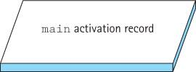
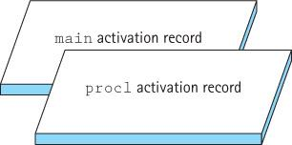
Dynamic Storage Allocation
Consider a program whose main method calls proc1,
which then calls proc2. When the program begins executing,
the “main” activation record is generated:
At the first method call, an activation record is generated for proc1:
Notes:
‹#›

Slide 61
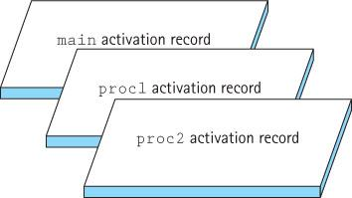
Dynamic Storage Allocation
When proc2 is called from within proc1, its activation record is generated.
Because proc1 has not finished executing, its activation record is still around:
When proc2 finishes executing, its activation record is released:
Notes:
‹#›

Slide 62
Dynamic Storage Allocation
The order of activation follows the Last-In-First-Out rule.
Run-time or system stack A system data structure that keeps track of activation records during the execution of a program
Each nested level of method invocation adds another activation record to the stack. As each method completes its execution, its activation record is popped from the stack. Recursive method calls, like calls to any other method, cause a new activation record to be generated.
Depth of recursion The number of activation records on the system stack, associated with a given a recursive method
Notes:
‹#›

Slide 63
Removing Recursion - Iteration
Suppose the recursive call is the last action executed in a recursive method (tail recursion)
The recursive call causes an activation record to be put on the run-time stack to contain the invoked method’s arguments and local variables.
When this recursive call finishes executing, the run-time stack is popped and the previous values of the variables are restored.
Execution continues where it left off before the recursive call was made.
But, because the recursive call is the last statement in the method, there is nothing more to execute and the method terminates without using the restored local variable values.
In such a case the recursion can easily be replaced with iteration.
Notes:
‹#›

Slide 64
Example of eliminating tail recursion
public static int factorial(int n)
{
if (n == 0)
return 1; // Base case
else
return (n * factorial(n – 1)); // General case
}
Declare a variable to hold the intermediate values; initialize it to the value returned in the base case. Use a while loop so that each time through the loop corresponds to one recursive call. The loop should continue processing until the base case is met:
private static int factorial(int n)
{
int retValue = 1; // return value
while (n != 0)
{
retValue = retValue * n;
n = n - 1;
}
return(retValue);
}
Notes:
‹#›

Slide 65
Remove Recursion - Stacking
When the recursive call is not the last action executed in a recursive method, we cannot simply substitute a loop for the recursion.
In such cases we can “mimic” recursion by using our own stack to save the required information when needed, as shown in the Reverse Print example on the next slide.
Notes:
‹#›

Slide 66
Remove Recursion - Stacking
static void iterRevPrintList(LLNode<String> listRef)
// Prints the contents of the listRef linked list to standard output
// in reverse order
{
StackInterface<String> stack = new LinkedStack<String>();
while (listRef != null) // put info onto the stack
{
stack.push(listRef.getInfo());
listRef = listRef.getLink();
}
// Retrieve references in reverse order and print elements
while (!stack.isEmpty())
{
System.out.println(stack.top());
stack.pop();
}
}
Notes:
‹#›

Slide 67
3.6 Deciding Whether to Use a Recursive Solution
In this section we consider factors used in deciding whether or not to use a recursive solution to a problem.
The main issues are the efficiency and the clarity of the solution.
Notes:
‹#›

Slide 68
Efficiency Considerations
Recursion Overhead
A recursive solution usually has more “overhead” than a non-recursive solution because of the number of method calls
time: each call involves processing to create and dispose of the activation record, and to manage the run-time stack
space: activation records must be stored
Inefficient Algorithms
Another potential problem is that a particular recursive solution might just be inherently inefficient. This can occur if the recursive approach repeatedly solves the same sub-problem, over and over again
Notes:
‹#›

Slide 69
Clarity
For many problems, a recursive solution is simpler and more natural for the programmer to write. The work provided by the system stack is “hidden” and therefore a solution may be easier to understand.
Compare, for example, the recursive and nonrecursive approaches to printing a linked list in reverse order that were developed previously in this chapter. In the recursive version, we let the system take care of the stacking that we had to do explicitly in the nonrecursive method.
Notes:
‹#›

