Slide 1

Chapter 7 The Binary Search Tree ADT
Notes:
‹#›

Slide 2
Chapter 7: The Binary Search Tree ADT
7.1 – Trees
7.2 – Binary Search Trees
7.3 – The Binary Search Tree Interface
7.4 – The Implementation Level: Basics
7.5 – Iterative Versus Recursive Method Implementations
7.6 – The Implementation Level: Remaining Observers
7.7 – The Implementation Level: Transformers
7.8 – Binary Search Tree Performance
7.9 – Application: Word Frequency Counter
7.10 – Tree Variations
Notes:
‹#›

Slide 3
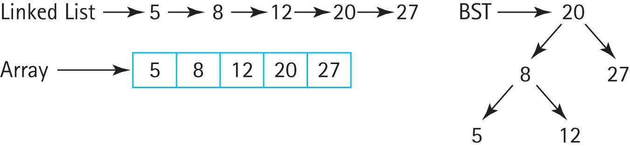
Binary Search Tree
When maintaining a sorted list
Linked List requires O(N) find location, O(1) insertion
Sorted-Array requires O(log₂N) find location, O(N) insertion
Binary Search Tree, in general allows O(log₂N) find location , O(1) insertion
Can we combine the fast search of the array with the fast insertion of the linked list?

Slide 4
Binary Search Tree
A binary search tree is a special case of a more general data structure, the tree.
Many variations of the tree structure exist.

Slide 5
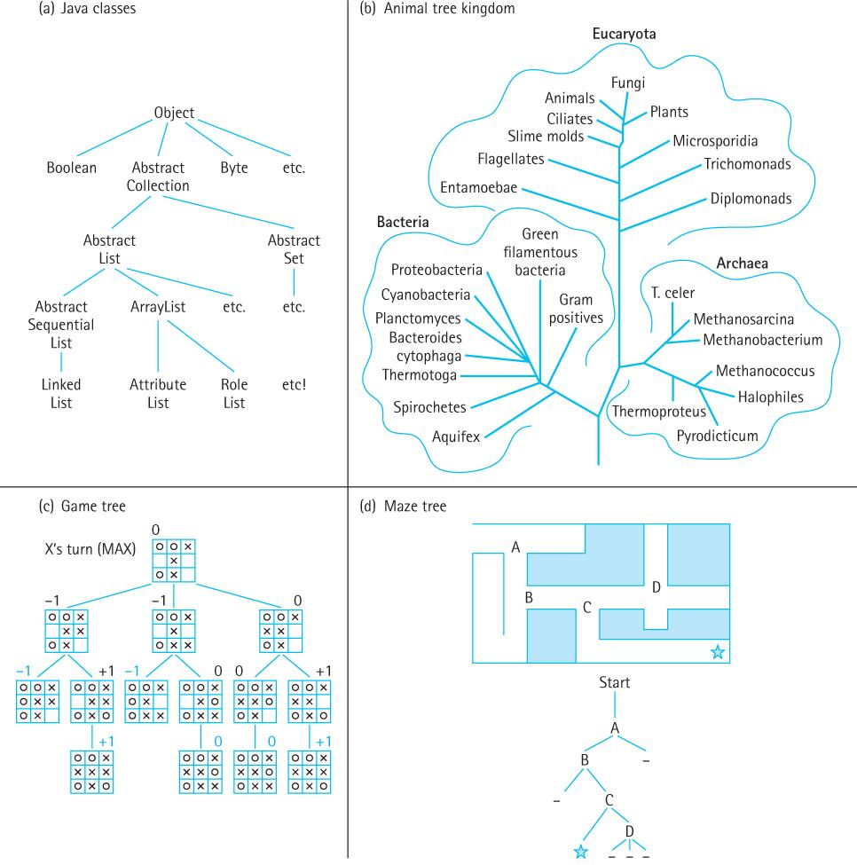
7.1 Trees
A tree is a nonlinear structure in which each node is capable of having many successor nodes, called children.
Trees are useful for representing lots of varied relationships among data items.
Notes:
‹#›

Slide 6
Definitions
Tree A structure with a unique starting node (the root), in which each node is capable of having multiple successor nodes (its children), and in which a unique path exists from the root to every other node.
Root The top node of a tree structure; a node with no parent
Parent node The predecessor node of a node is its parent
Subtree A node and all of its descendants form a subtree rooted at the node
Notes:
‹#›

Slide 7
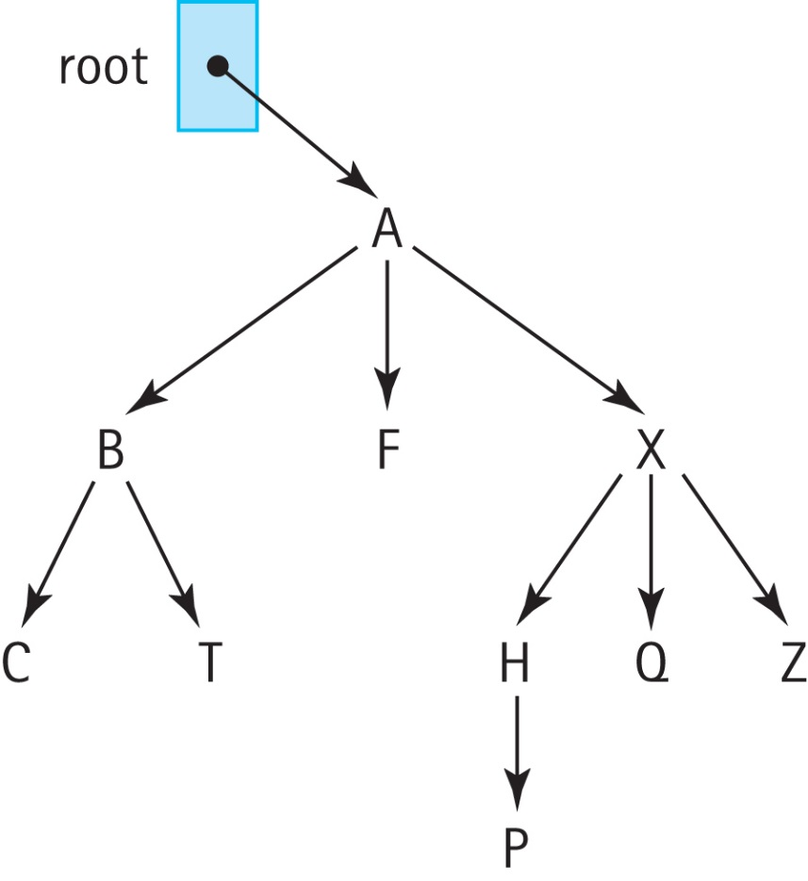
Examples
The root is A
The children of A are B, F, and X
The parent of Q is X
The leftmost subtree of X contains H and P

Slide 8
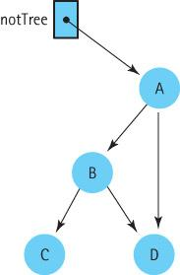
Tree requirements
A tree’s subtrees must be disjoint:
there is a unique path from the root of a tree to any other node of the tree
Not a Tree →
Notes:
‹#›

Slide 9
Tree requirements
A tree’s subtrees must be disjoint:
there is a unique path from the root of a tree to any other node of the tree
Not a Tree →
Notes:
‹#›

Slide 10
Tree requirements
A node can have many children but only a single parent.
In fact, every node (except the root) must have a single parent.
Notes:
‹#›

Slide 11
Definitions
Ancestor A parent of a node, or a parent of an ancestor
Descendant A child of a node, or a child of a descendant
Leaf A node that has no children
Interior node A node that is not a leaf
Siblings Nodes with the same parent
Notes:
‹#›

Slide 12
Examples
The ancestors of P are H, X, and A
The descendants of X are H, Q, Z, and P
The leaf nodes are C, T, F, P, Q, and Z
The interior nodes are A, B, X
The siblings of B are F and X

Slide 13
Definitions
Level The level of a node is its distance from the root (the number of connections between itself and the root)
Height The maximum level of the tree
Notes:
‹#›

Slide 14
Examples
The level of A is 0
The level of P is 3
The height of the tree is 3

Slide 15
Traversing a tree
To traverse a linear linked list, we set a temporary reference to the beginning of the list and then follow the list references from one node to the other, until reaching a node whose reference value is null.
To traverse a tree, we initialize our temporary reference to the root of the tree. But where do we go from there?

Slide 16
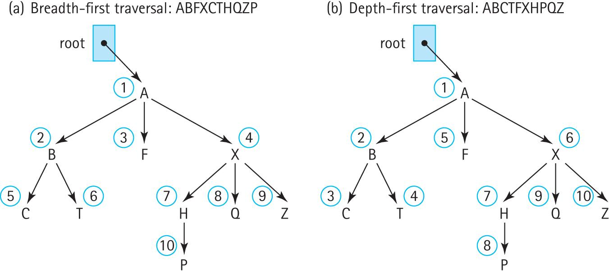
Breadth-First Traversal
Also called “level-order traversal”
A B F X C T H Q Z P

Slide 17

Breadth-First Traversal(root)
Instantiate a queue of nodes
if (root is not null)
{
queue.enqueue(root)
while (!queue.isEmpty())
{
node = queue.dequeue()
Visit node
Enqueue the children of node
(from left to right) into queue
}
}

Slide 18
<A>

Slide 19
<A>
<B, F, X>

Slide 20
<A>
<B, F, X>
<F, X, C, T>

Slide 21
<A>
<B, F, X>
<F, X, C, T>
<X, C, T>

Slide 22
<A>
<B, F, X>
<F, X, C, T>
<X, C, T>

Slide 23
<A>
<B, F, X>
<F, X, C, T>
<X, C, T>
<C, T, H, Q, Z>

Slide 24
<A>
<B, F, X>
<F, X, C, T>
<X, C, T>
<C, T, H, Q, Z>
<T, H, Q, Z>

Slide 25
<A>
<B, F, X>
<F, X, C, T>
<X, C, T>
<C, T, H, Q, Z>
<T, H, Q, Z>
<H, Q, Z>

Slide 26
<A>
<B, F, X>
<F, X, C, T>
<X, C, T>
<C, T, H, Q, Z>
<T, H, Q, Z>
<H, Q, Z>
<Q, Z, P>

Slide 27
<A>
<B, F, X>
<F, X, C, T>
<X, C, T>
<C, T, H, Q, Z>
<T, H, Q, Z>
<H, Q, Z>
<Q, Z, P>
<Z, P>

Slide 28
<A>
<B, F, X>
<F, X, C, T>
<X, C, T>
<C, T, H, Q, Z>
<T, H, Q, Z>
<H, Q, Z>
<Q, Z, P>
<Z, P>
<P>

Slide 29
<A>
<B, F, X>
<F, X, C, T>
<X, C, T>
<C, T, H, Q, Z>
<T, H, Q, Z>
<H, Q, Z>
<Q, Z, P>
<Z, P>
<P>

Slide 30
Depth-First Traversal
A B C T F X H P Q Z

Slide 31
Depth-First Traversal(root)
Instantiate a stack of nodes
if (root is not null)
{
stack.push(root)
while (!stack.isEmpty())
{
node = stack.top()
stack.pop()
Visit node
Push the children of node
(from right to left) onto queue
}
}
Activity:
Try to draw the traversal and stack
as we did for breadth-first!

Slide 32
<A>
<B, F, X>
<C, T, F, X>
<T, F, X>
<F, X>
<X>
<H, Q, Z>
<P, Q, Z>
<Q, Z>
<Z>
<>

Slide 33
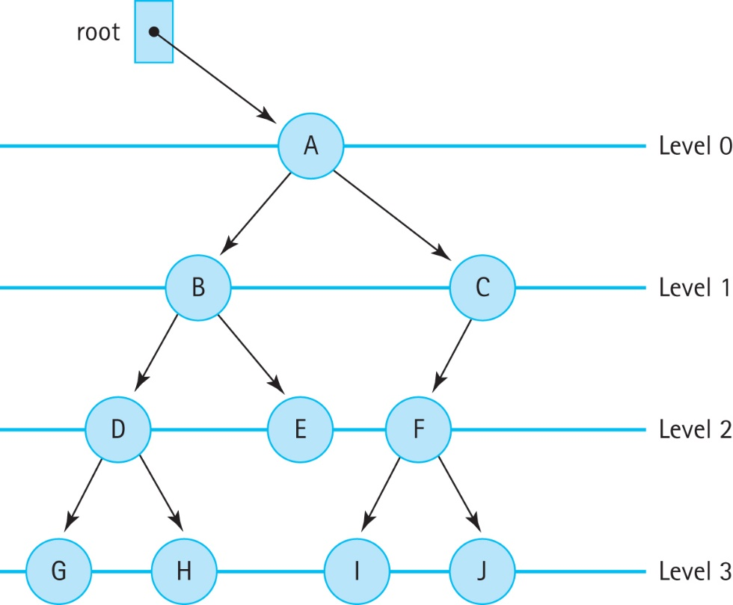
7.2 Binary Trees
Binary tree A tree in which each node is capable of having two child nodes, a left child node and a right child node
A Binary Tree
Notes:
‹#›

Slide 34
7.2: A Binary Tree: Levels
The maximum number of nodes at any
level N is 2^{N}
Often, however, levels do
not contain the maximum number of nodes
Notes:
‹#›

Slide 35
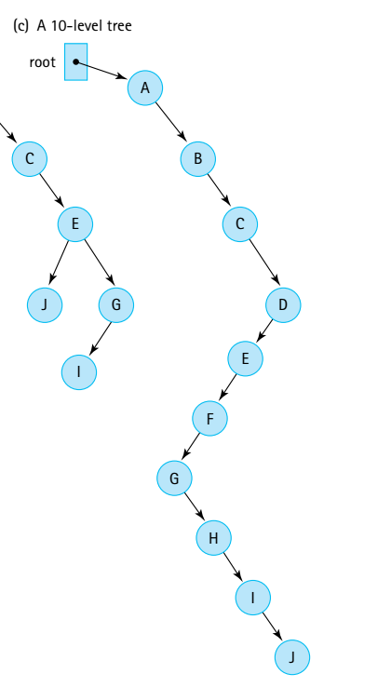
7.2: A Binary Tree: Levels
The maximum levels in a binary tree with N nodes is N
The minimum number levels in a binary tree with N nodes is log₂N + 1
Notes:
‹#›

Slide 36
7.2: A Binary Tree: Height
The height of a tree is the critical factor in determining the efficiency of
searching elements.
If tree is of minimum height its structure supports O(log₂N) access to any element!
To access J
O(N)
Notes:
‹#›

Slide 37
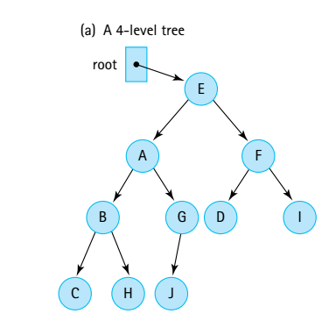
7.2: A Binary Tree: Searching for an element
If searching for G, we need to traverse the entire tree (e.g., breadth-first search) which is O(N) operation. There is not particular order. Hence, in the following slides we introduce the so-called binary search tree property.
Notes:
‹#›

Slide 38
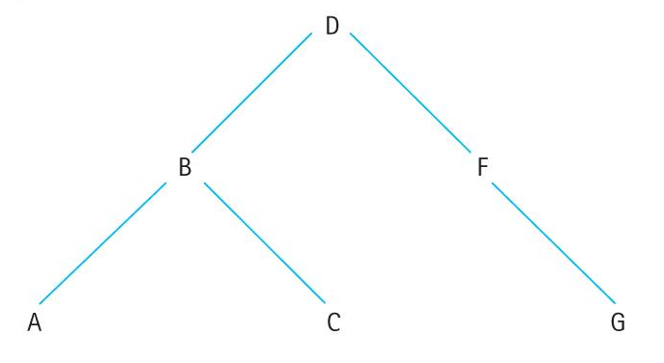
Binary search trees
A binary tree in which the key value in any node
is greater than or equal to the key value in its left child and any of its descendants (the nodes in the left subtree)
is less than the key value in its right child and any of its descendants (the nodes in the right subtree)
We call this the “binary search tree” property
Why? To support O(log(N)) access!
Notes:
‹#›

Slide 39
Binary Tree Traversals
Preorder traversal: Visit the root, visit the left subtree, visit the right subtree:
D B A C F G
Inorder traversal: Visit the left subtree, visit the root, visit the right subtree:
A B C D F G
Postorder traversal: Visit the left subtree, visit the right subtree, visit the root:
A C B G F D
Notes:
‹#›

Slide 40
Binary Tree Traversals
Preorder traversal: identical to depth-first. Duplicate the binary tree
Inorder traversal: this type of traversal would be useful when we need to access the elements in ascending key order
Postorder traversal: starts at the leaves and works backwards toward the root, it can be used to delete the tree, node by node, without losing access to the rest of the tree while doing so
Notes:
‹#›

Slide 41
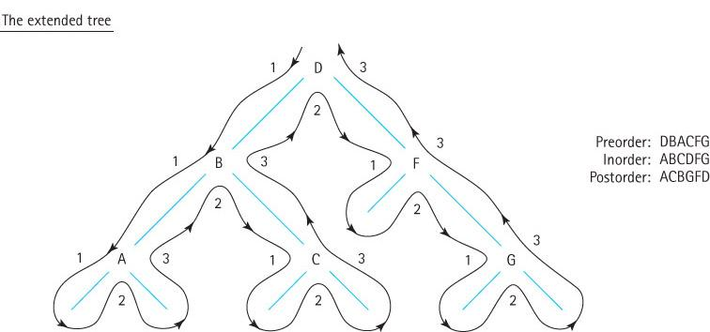
Visualizing Binary Tree Traversals
Notes:
‹#›

Slide 42
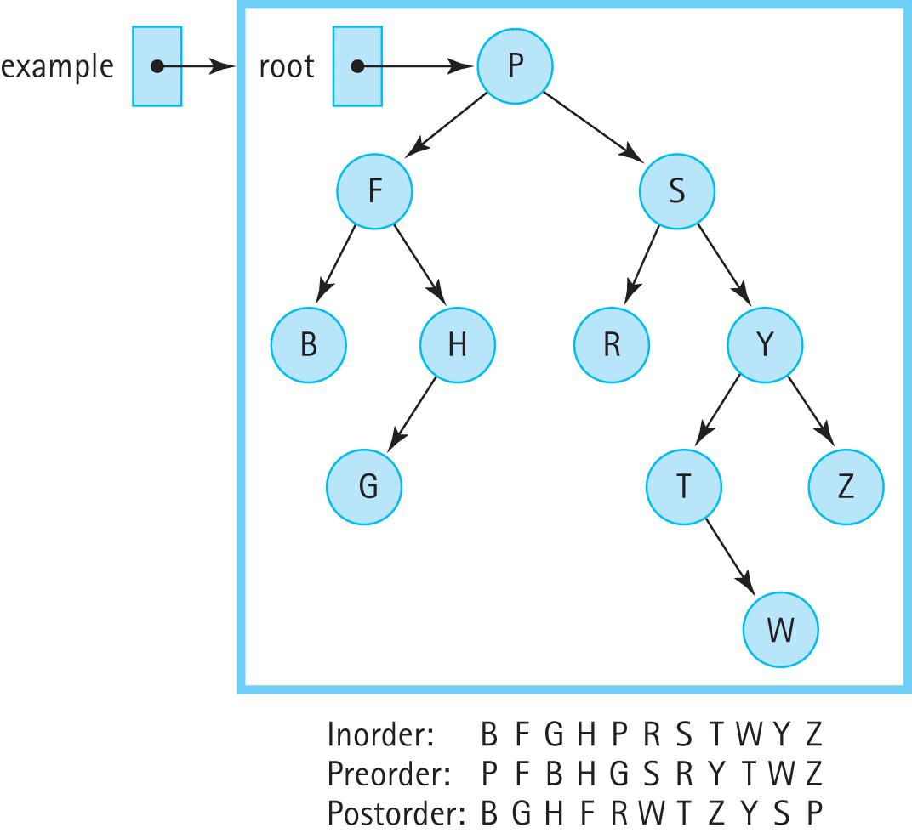
Three Binary Tree Traversals
Notes:
‹#›

Slide 43
7.3 – The Binary Search Tree Interface
Our binary search trees
are similar to the sorted lists of Chapter 6
implement this text’s CollectionInterface
implement the Java Library’s Iterable interface
are unbounded, allow duplicate elements, and disallow null elements
support max and min operations
support preorder, inorder, and postorder traversals
Notes:
‹#›

Slide 44
package ch07.trees;
import ch05.collections.CollectionInterface;
import java.util.Iterator;
public interface BSTInterface<T> extends CollectionInterface<T>,
Iterable<T>
{
// Used to specify traversal order.
public enum Traversal {Inorder, Preorder, Postorder};
T min();
// If this BST is empty, returns null;
// otherwise returns the smallest element of the tree.
T max();
// If this BST is empty, returns null;
// otherwise returns the largest element of the tree.
public Iterator<T> getIterator(Traversal orderType);
// Creates and returns an Iterator providing a traversal of a "snapshot“
// of the current tree in the order indicated by the argument.
}
!!!
This is not part of Iterable interface!
It’s our own method!
Notes:
‹#›

Slide 45
package ch07.trees;
import ch05.collections.CollectionInterface;
import java.util.Iterator;
public interface BSTInterface<T> extends CollectionInterface<T>,
Iterable<T>
{
// Used to specify traversal order.
public enum Traversal {Inorder, Preorder, Postorder};
T min();
// If this BST is empty, returns null;
// otherwise returns the smallest element of the tree.
T max();
// If this BST is empty, returns null;
// otherwise returns the largest element of the tree.
public Iterator<T> getIterator(Traversal orderType);
// Creates and returns an Iterator providing a traversal of a "snapshot“
// of the current tree in the order indicated by the argument.
}
!!!
Enumeration: represent a group of named constants in a programming language
Notes:
‹#›

Slide 46
package ch07.trees;
import ch05.collections.CollectionInterface;
import java.util.Iterator;
public interface BSTInterface<T> extends CollectionInterface<T>,
Iterable<T>
{
// Used to specify traversal order.
public enum Traversal {Inorder, Preorder, Postorder};
T min();
// If this BST is empty, returns null;
// otherwise returns the smallest element of the tree.
T max();
// If this BST is empty, returns null;
// otherwise returns the largest element of the tree.
public Iterator<T> getIterator(Traversal orderType);
// Creates and returns an Iterator providing a traversal of a "snapshot“
// of the current tree in the order indicated by the argument.
}
!!!
Enumeration: represent a group of named constants in a programming language
This is not part of Iterable interface!
It’s our own method!
Notes:
‹#›

Slide 47
Iteration
In addition to the getIterator method, a class that implements the BSTInterface must provide a separate iterator method, because BSTInterface extends Iterable.
This method should return an Iterator that provides iteration in the “natural” order of the tree elements.
For most applications this would be an inorder traversal, and we make that assumption in our implementation.

Slide 48
Iteration
We intend the iterators created and returned by getIterator and iterator to provide a snapshot of the tree as it exists at the time the iterator is requested.
They represent the state of the tree at that time and subsequent changes to the tree should not affect the results returned by the iterator’s hasNext and next methods.
Our iterators will throw an UnsupportedOperationException if remove is invoked.

Slide 49
Example Application
Instructors can review and demonstrate the application BSTExample found in the ch07.apps package
This application demonstrates the use of iterators with our binary search tree

Slide 50
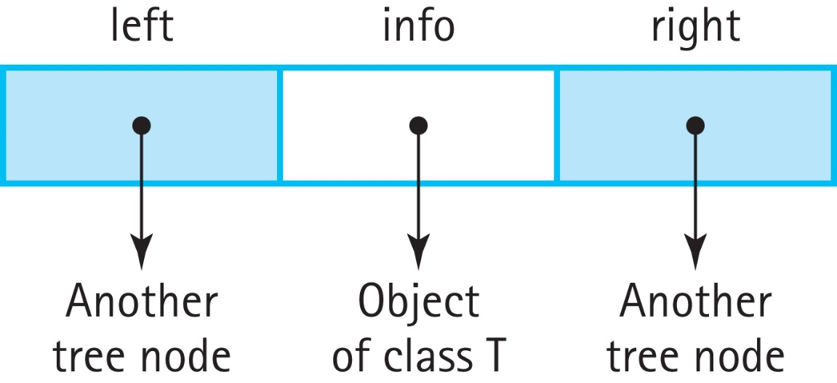
7.4 The Implementation Level: Basics
We define BSTNode.java in our support package to provide nodes for our binary search trees
Visually, a BSTNode object is:
Notes:
‹#›

Slide 51
BSTNode.java
instance variables:
private T info; // The info in a BST node
private BSTNode<T> left; // A link to the left child node
private BSTNode<T> right; // A link to the right child node
Constructor:
public BSTNode(T info)
{
this.info = info;
left = null;
right = null;
}
Plus it includes the standard setters and getters
Notes:
‹#›

Slide 52
Beginning of BinarySearchTree.java
package ch07.trees;
import java.util.*; // Iterator, Comparator
import ch04.queues.*;
import ch02.stacks.*;
import support.BSTNode;
public class BinarySearchTree<T> implements BSTInterface<T>
{
protected BSTNode<T> root; // reference to the root of this BST
protected Comparator<T> comp; // used for all comparisons
protected boolean found; // used by remove
. . .
Notes:
‹#›

Slide 53
The Constructors
public BinarySearchTree()
// Precondition: T implements Comparable
// Creates an empty BST object - uses the natural order of elements.
{
root = null;
comp = new Comparator<T>()
{
public int compare(T element1, T element2)
{
return ((Comparable)element1).compareTo(element2);
}
};
}
public BinarySearchTree(Comparator<T> comp)
// Creates an empty BST object - uses Comparator comp for order of elements.
{
root = null;
this.comp = comp;
}
. . .
Notes:
‹#›

Slide 54
Example Observer methods
public boolean isFull()
// Returns false; this link-based BST is never full.
{
return false;
}
public boolean isEmpty()
// Returns true if this BST is empty; otherwise, returns false.
{
return (root == null);
}
public T min()
// If this BST is empty, returns null;
// otherwise returns the smallest element of the tree.
{
if (isEmpty())
return null;
else
{
BSTNode<T> node = root;
while (node.getLeft() != null)
node = node.getLeft();
return node.getInfo();
}
}
Notes:
‹#›

Slide 55
7.5 Iterative versus Recursive Method Invocations
Trees are inherently recursive; a tree consists of subtrees
In this section we look at recursive and iterative approaches to the size method
We then discuss the benefits of recursion versus iteration for this problem
Notes:
‹#›

Slide 56
Recursive Approach
We create a public method, size, that calls a private recursive method, recSize and passes it a reference to the root of the tree.
public int size()
// Returns the number of elements in this BST.
{
return recSize(root);
}
We design the recSize method to return the number of nodes in the subtree referenced by the argument passed to it.
Note that the number of nodes in a tree is:
1 + number of nodes in left subtree + number of nodes in right subtree
Notes:
‹#›

Slide 57
recSize Algorithm Version 1
recSize(node): returns int
if (node.getLeft( ) is null) AND (node.getRight( ) is null)
return 1
else
return 1 + recSize(node.getLeft( )) + recSize(node.getRight( ))
The corresponding method would crash when we try to access node.getLeft when node is null.
Notes:
‹#›

Slide 58
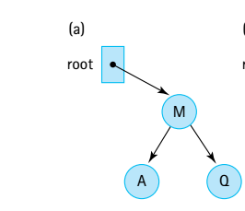
recSize Algorithm Version 1
recSize(node): returns int
if (node.getLeft( ) is null) AND (node.getRight( ) is null)
return 1
else
return 1 + recSize(node.getLeft( )) + recSize(node.getRight( ))
recSize(reference to M (root))
Notes:
‹#›

Slide 59
recSize Algorithm Version 1
recSize(node): returns int
if (node.getLeft( ) is null) AND (node.getRight( ) is null)
return 1
else
return 1 + recSize(node.getLeft( )) + recSize(node.getRight( ))
recSize(reference to M (root))
Condition not met:
Return 1 + recSize(ref to A) + recSize(ref to Q)
Notes:
‹#›

Slide 60
recSize Algorithm Version 1
recSize(node): returns int
if (node.getLeft( ) is null) AND (node.getRight( ) is null)
return 1
else
return 1 + recSize(node.getLeft( )) + recSize(node.getRight( ))
recSize(reference to M (root))
Condition not met:
return 1 + recSize(ref to A) + recSize(ref to Q)
recSize(ref to A) – condition met return 1
Condition met return 1
Notes:
‹#›

Slide 61
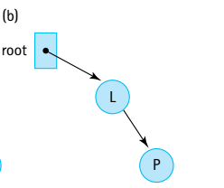
recSize Algorithm Version 1
recSize(node): returns int
if (node.getLeft( ) is null) AND (node.getRight( ) is null)
return 1
else
return 1 + recSize(node.getLeft( )) + recSize(node.getRight( ))
recSize(reference to L (root))
Condition not met; do the general case
return 1 + recSize(null) + recSize(ref to P)
Notes:
‹#›

Slide 62
recSize Algorithm Version 1
recSize(node): returns int
if (node.getLeft( ) is null) AND (node.getRight( ) is null)
return 1
else
return 1 + recSize(node.getLeft( )) + recSize(node.getRight( ))
recSize(reference to L (root))
Condition not met; do the general case
return 1 + recSize(null) + recSize(ref to P)
Null pointer exception at node.getLeft( )
Notes:
‹#›

Slide 63
recSize Algorithm Version 2
recSize(node): returns int Version 2
if (node is null)
return 0
else
if (node.getLeft() is null) AND (node.getRight() is null)
return 1
else
return 1 + recSize(node.getLeft()) + recSize(node.getRight())
Works, but can be simplified. There is no need to make the leaf node a special case – it would also be handled properly by the final else clause
Notes:
‹#›

Slide 64
recSize Algorithm Version 3
recSize(node): returns int Version 3
if node is null
return 0
else
return 1 + recSize(node.getLeft( )) + recSize(node.getRight( ))
Works and is “simple”.
This example illustrates two important points about recursion with trees:
always check for the empty tree first
leaf nodes do not need to be treated as separate cases.
Notes:
‹#›

Slide 65
recSize Algorithm Version 3
recSize(node): returns int Version 3
if node is null
return 0
else
return 1 + recSize(node.getLeft( )) + recSize(node.getRight( ))
recSize(ref to M)
return 1 + recSize(ref to A) + recSize(ref to Q)
return 1 + recSize(null) + recSize(null)
Notes:
‹#›

Slide 66
recSize Algorithm Version 3
recSize(node): returns int Version 3
if node is null
return 0
else
return 1 + recSize(node.getLeft( )) + recSize(node.getRight( ))
recSize(ref to M)
return 1 + recSize(ref to A) + recSize(ref to Q)
return 1 + recSize(null) + recSize(null)
return 0
Notes:
‹#›

Slide 67
recSize Algorithm Version 3
recSize(node): returns int Version 3
if node is null
return 0
else
return 1 + recSize(node.getLeft( )) + recSize(node.getRight( ))
recSize(ref to M)
return 1 + recSize(ref to A) + recSize(ref to Q)
return 1 + recSize(null) + recSize(null)
return 0
return 0
Notes:
‹#›

Slide 68
recSize Algorithm Version 3
recSize(node): returns int Version 3
if node is null
return 0
else
return 1 + recSize(node.getLeft( )) + recSize(node.getRight( ))
recSize(ref to M)
return 1 + recSize(ref to A) + recSize(ref to Q)
return 1 + recSize(null) + recSize(null)
return 0
return 0
return 1 + recSize(null) + recSize(null)
return 0
return 0
Notes:
‹#›

Slide 69
recSize Algorithm Version 3
recSize(node): returns int Version 3
if node is null
return 0
else
return 1 + recSize(node.getLeft( )) + recSize(node.getRight( ))
recSize(ref to M)
return 1 + recSize(ref to A) + recSize(ref to Q)
return 1 + recSize(null) + recSize(null)
return 0
return 0
return 1 + recSize(null) + recSize(null)
return 0
return 0
Notes:
‹#›

Slide 70
The recSize Code
private int recSize(BSTNode<T> node)
// Returns the number of elements in subtree rooted at node.
{
if (node == null)
return 0;
else
return 1 + recSize(node.getLeft()) + recSize(node.getRight());
}
Notes:
‹#›

Slide 71
Iterative Version
We use a stack to hold nodes we have encountered but not yet processed
We must be careful that we process each node in the tree exactly once. We follow these rules:
Process a node immediately after removing it from the stack.
Do not process nodes at any other time.
Once a node is removed from the stack, do not push it back onto the stack.
Notes:
‹#›

Slide 72
Code for the iterative approach
public int size()
// Returns the number of elements in this BST.
{
int count = 0;
if (root != null)
{
LinkedStack<BSTNode<T>> nodeStack = new LinkedStack<BSTNode<T>> ();
BSTNode<T> currNode;
nodeStack.push(root);
while (!nodeStack.isEmpty())
{
currNode = nodeStack.top();
nodeStack.pop();
count++;
if (currNode.getLeft() != null)
nodeStack.push(currNode.getLeft());
if (currNode.getRight() != null)
nodeStack.push(currNode.getRight());
}
}
return count;
}
Notes:
‹#›

Slide 73
Recursion or Iteration?
Is the depth of recursion relatively shallow? Yes
Is the recursive solution shorter or clearer than the nonrecursive version? Yes
Is the recursive version much less efficient than the nonrecursive version? No
This is a good use of recursion.
Notes:
‹#›

Slide 74
7.6 The Implementation Level: Remaining Operations
In this section, we use recursion to implement the remaining Binary Search Tree operations
contains
get
add
remove
iterator
getIterator
Notes:
‹#›

Slide 75
The contains operation
We implement contains using a private recursive method called recContains which
is passed the target we are searching for and a node representing the root of the subtree in which to search
has two base cases
if node is null returns false
if node contains target returns true
has two recursive cases
one searches the left subtree of node
one searches the right subtree of node
Notes:
‹#›

Slide 76
The contains method
public boolean contains (T target)
// Returns true if this BST contains a node with info i such that
// comp.compare(target, i) == 0; otherwise, returns false.
{
return recContains(target, root);
}
private boolean recContains(T target, BSTNode<T> node)
// Returns true if the subtree rooted at node contains info i such that
// comp.compare(target, i) == 0; otherwise, returns false.
{
if (node == null)
return false; // target is not found
else if (comp.compare(target, node.getInfo()) < 0)
return recContains(target, node.getLeft()); // Search left subtree
else if (comp.compare(target, node.getInfo()) > 0)
return recContains(target, node.getRight()); // Search right subtree
else
return true; // target is found
}
Notes:
‹#›

Slide 77
The get method is similar
public T get(T target)
// Returns info i from node of this BST where comp.compare(target, i) == 0;
// if no such node exists, returns null.
{
return recGet(target, root);
}
private T recGet(T target, BSTNode<T> node)
// Returns info i from the subtree rooted at node such that
// comp.compare(target, i) == 0; if no such info exists, returns null.
{
if (node == null)
return null; // target is not found
else if (comp.compare(target, node.getInfo()) < 0)
return recGet(target, node.getLeft()); //get from left subtree
else
if (comp.compare(target, node.getInfo()) > 0)
return recGet(target, node.getRight()); //get from right subtree
else
return node.getInfo(); // target is found
}
Notes:
‹#›

Slide 78
Iteration: Review of Traversal Definitions
Preorder traversal: Visit the root, visit the left subtree, visit the right subtree
Inorder traversal: Visit the left subtree, visit the root, visit the right subtree
Postorder traversal: Visit the left subtree, visit the right subtree, visit the root
Notes:
‹#›

Slide 79
the getIterator method
client passes getIterator an argument indicating one of the three traversal orders
getIterator creates the appropriate iterator and returns it by traversing the tree in the desired order and building a queue of Ts
It then creates an iterator using the anonymous inner class approach
returned iterator represents a snapshot of the tree at the time getIterator is invoked and does not support remove

Slide 80
public Iterator<T> getIterator(BSTInterface.Traversal orderType)
{
final LinkedQueue<T> infoQueue = new LinkedQueue<T>();
if (orderType == BSTInterface.Traversal.Preorder)
preOrder(root, infoQueue);
else if (orderType == BSTInterface.Traversal.Inorder)
inOrder(root, infoQueue);
else if (orderType == BSTInterface.Traversal.Postorder)
postOrder(root, infoQueue);
return new Iterator<T>()
{
public boolean hasNext()
{
return !infoQueue.isEmpty();
}
public T next()
{
if (!hasNext())
throw new IndexOutOfBoundsException("illegal invocation of next …
return infoQueue.dequeue();
}
public void remove()
{
throw new UnsupportedOperationException("Unsupported remove attempted …
}
};
}

Slide 81
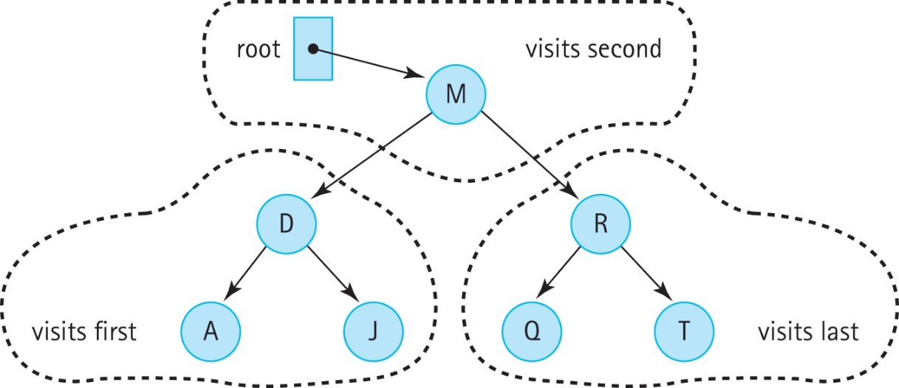
InOrder traversal
private void inOrder(BSTNode<T> node, LinkedQueue<T> q)
// Enqueues the elements from the subtree rooted at node into q in inOrder.
{ if (node != null)
{
inOrder(node.getLeft(), q);
q.enqueue(node.getInfo());
inOrder(node.getRight(), q);
} }

Slide 82
preOrder and postorder traversals
private void preOrder(BSTNode<T> node, LinkedQueue<T> q)
{
if (node != null)
{
q.enqueue(node.getInfo());
preOrder(node.getLeft(), q);
preOrder(node.getRight(), q);
}
}
private void postOrder(BSTNode<T> node, LinkedQueue<T> q)
{
if (node != null)
{
postOrder(node.getLeft(), q);
postOrder(node.getRight(), q);
q.enqueue(node.getInfo());
}
}

Slide 83
7.7 The Implementation Level: Transformers
To complete our implementation of the Binary Search Tree ADT we need to create the transformer methods add and remove.
These are the most complex operations.
We use a similar approach as used in the subsection “Transforming a Linked List” in Section 3.4, “Recursive Processing of Linked Lists”

Slide 84
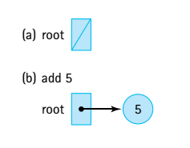
The add operation
A new node is always inserted into its appropriate position in the tree as a leaf
Add 5
Notes:
‹#›

Slide 85
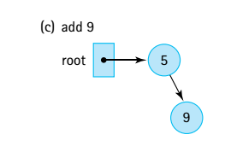
The add operation
A new node is always inserted into its appropriate position in the tree as a leaf
Add 9
Notes:
‹#›

Slide 86
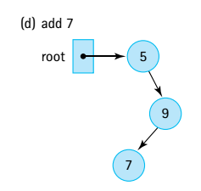
The add operation
A new node is always inserted into its appropriate position in the tree as a leaf
Add 7
Notes:
‹#›

Slide 87
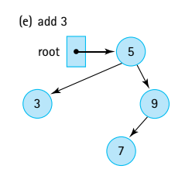
The add operation
A new node is always inserted into its appropriate position in the tree as a leaf
Add 3
Notes:
‹#›

Slide 88
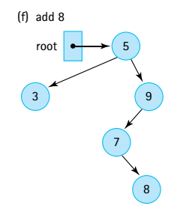
The add operation
A new node is always inserted into its appropriate position in the tree as a leaf
Add 8
Notes:
‹#›

Slide 89
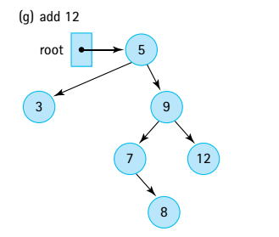
The add operation
A new node is always inserted into its appropriate position in the tree as a leaf
Add 12
Notes:
‹#›

Slide 90
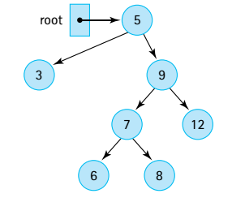
The add operation
A new node is always inserted into its appropriate position in the tree as a leaf
Add 6
Notes:
‹#›

Slide 91
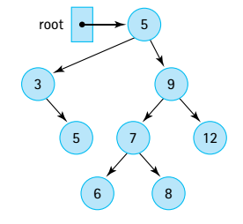
The add operation
A new node is always inserted into its appropriate position in the tree as a leaf
?
Next: Adding 20, where will it go? Draw it!
Notes:
‹#›

Slide 92
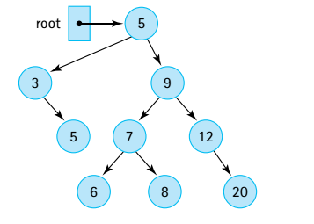
The add operation
A new node is always inserted into its appropriate position in the tree as a leaf
Next: Adding 20, where will it go? Draw it!
Notes:
‹#›

Slide 93
The add operation
The add method invokes the recursive method, recAdd, and passes it the element to be added plus a reference to the root of the tree.
public boolean add (T element)
// Adds element to this BST. The tree retains its BST property.
{
root = recAdd(element, root);
return true;
}
The call to recAdd returns a BSTNode. It returns a reference to the new tree, that is, to the tree that includes element. The statement
root = recAdd(element, root);
can be interpreted as “Set the reference of the root of this tree to the root of the tree that is generated when element is added to this tree.”
Notes:
‹#›

Slide 94
The add method
private BSTNode<T> recAdd(T element, BSTNode<T> node)
// Adds element to tree rooted at node; tree retains its BST property.
{
if (node == null)
// Addition place found
node = new BSTNode<T>(element);
else if (element.compareTo(node.getInfo()) <= 0)
node.setLeft(recAdd(element, node.getLeft())); //Add in left subtree
else
node.setRight(recAdd(element, node.getRight())); //Add in right subtree
return node;
}
public boolean add (T element)
// Adds element to this BST. The tree retains its BST property.
{
root = recAdd(element, root);
return true;
}
Notes:
‹#›

Slide 95
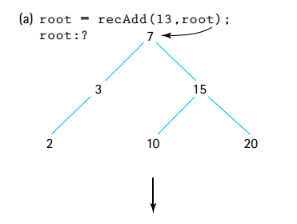
Notes:
‹#›

Slide 96
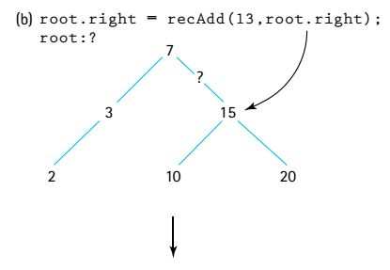
Notes:
‹#›

Slide 97
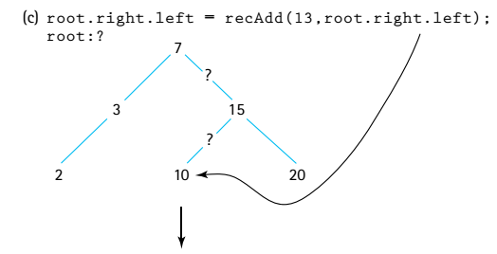
Notes:
‹#›

Slide 98
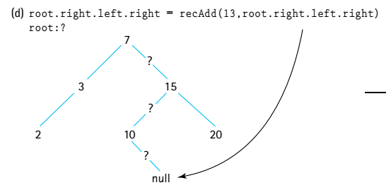
Notes:
‹#›

Slide 99
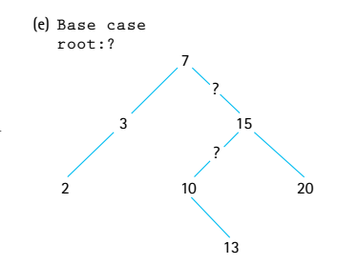
Notes:
‹#›

Slide 100
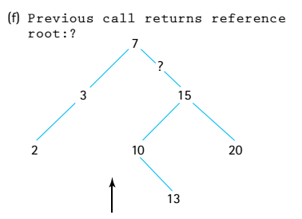
Notes:
‹#›

Slide 101
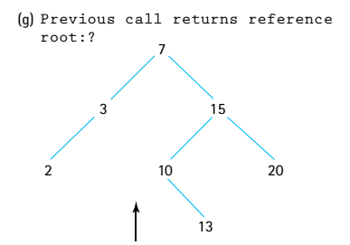
Notes:
‹#›

Slide 102
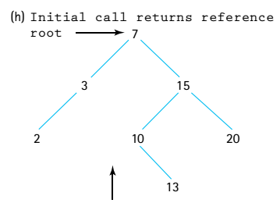
Notes:
‹#›

Slide 103
The remove Operation
The most complicated of the binary search tree operations.
We must ensure when we remove an element we maintain the binary search tree property.
You don’t need to know how to implement this operation but you should know
how to remove elements from a tree conceptually
Notes:
‹#›

Slide 104
The code for remove:
The set up for the remove operation is the same as that for the add operation.
The private recRemove method is invoked from the public remove method with arguments equal to the target element to be removed and the root of the tree to remove it from.
The recursive method returns a reference to the revised tree
The remove method returns the boolean value stored in found, indicating the result of the remove operation.
public boolean remove (T target)
// Removes a node with info i from tree such that
// comp.compare(target,i) == 0 and returns true;
// if no such node exists, returns false.
{
root = recRemove(target, root);
return found;
}
Notes:
‹#›

Slide 105
The recRemove method
private BSTNode<T> recRemove(T target, BSTNode<T> node)
// Removes element with info i from tree rooted at node such that
// comp.compare(target, i) == 0 and returns true;
// if no such node exists, returns false.
{
if (node == null)
found = false;
else if (comp.compare(target, node.getInfo()) < 0)
node.setLeft(recRemove(target, node.getLeft()));
else if (comp.compare(target, node.getInfo()) > 0)
node.setRight(recRemove(target, node.getRight()));
else
{
node = removeNode(node);
found = true;
}
return node;
}
Notes:
‹#›

Slide 106
Three cases for the removeNode operation
Removing a leaf (no children): removing a leaf is simply a matter of setting the appropriate link of its parent to null.
Removing a node with only one child: make the reference from the parent skip over the removed node and point instead to the child of the node we intend to remove
Removing a node with two children: replaces the node’s info with the info from another node in the tree so that the search property is retained - then remove this other node
Notes:
‹#›

Slide 107
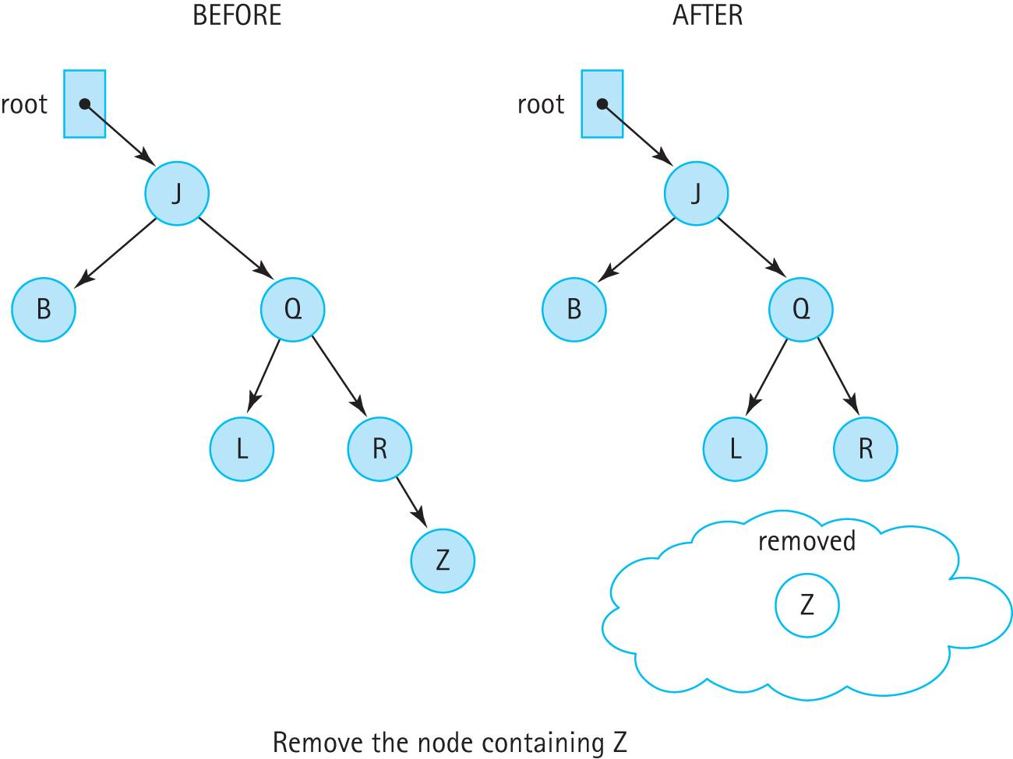
Removing a Leaf Node
set the appropriate link of its parent to null
Notes:
‹#›

Slide 108
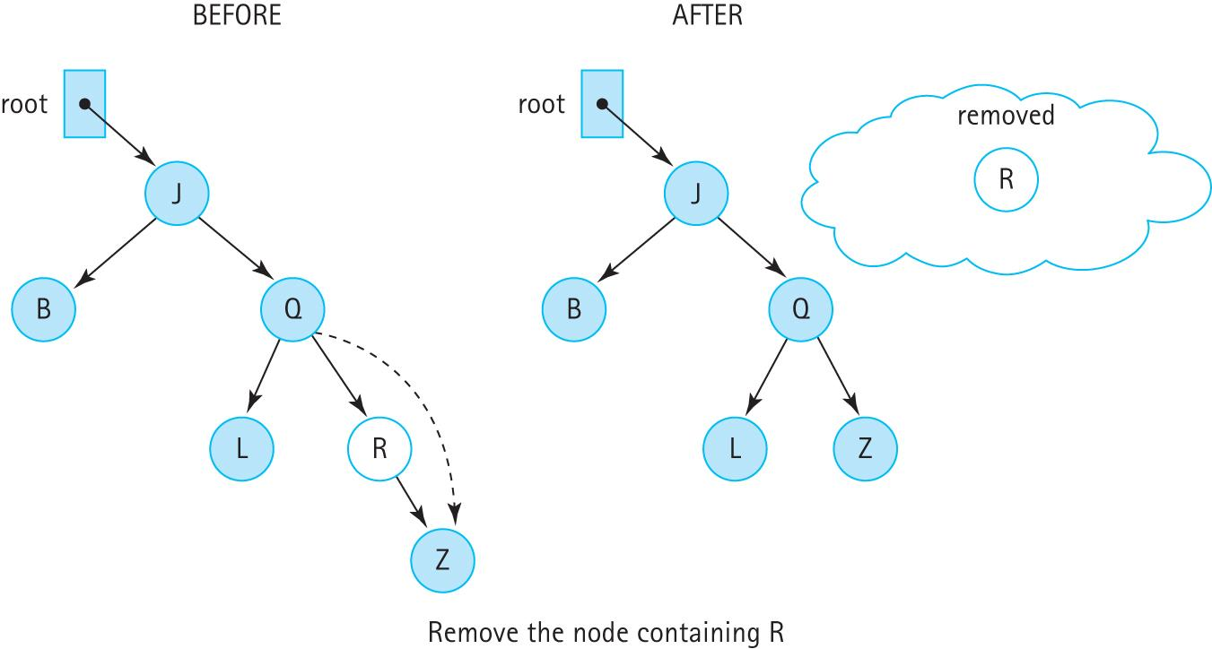
Removing a node with one child
make the reference from the parent skip over the removed node and point instead to the child of the node being removed
Notes:
‹#›

Slide 109
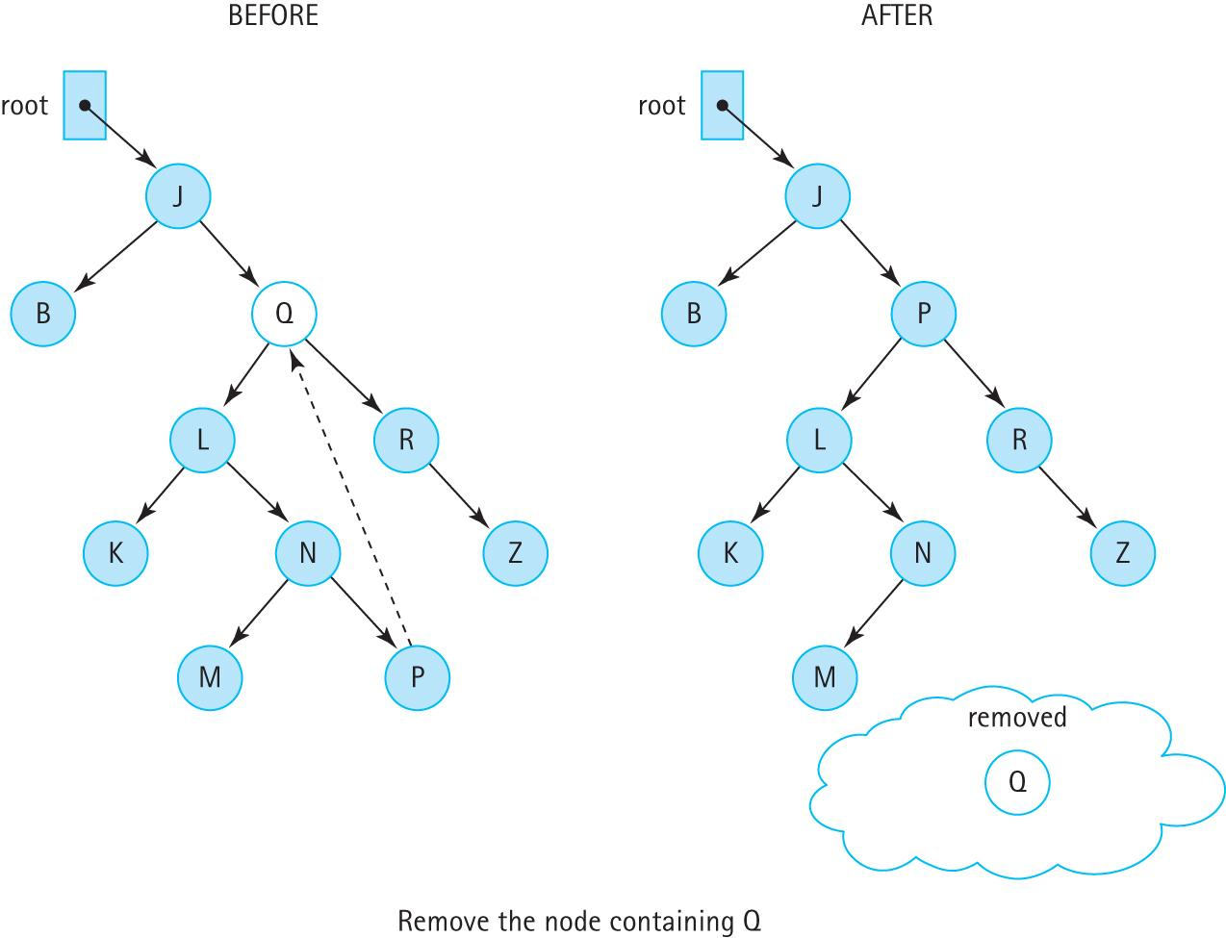
Removing a Node With Two Children
Notes:
‹#›

Slide 110
The Remove Node Algorithm
removeNode (node): returns BSTNode
if (node.getLeft( ) is null) AND (node.getRight( ) is null)
return null
else if node.getLeft( ) is null
return node.getRight( )
else if node.getRight( ) is null
return node.getLeft( )
else
Find predecessor
node.setInfo(predecessor.getInfo( ))
node.setLeft(recRemove(predecessor.getInfo( ), node.getLeft( )))
return node
remove a leaf
Note: We can remove one of the tests if we notice that the action taken when the left child reference is null also takes care of the case in which both child references are null. When the left child reference is null, the right child reference is returned. If the right child reference is also null, then null is returned, which is what we want if they are both null.
Notes:
‹#›

Slide 111
The removeNode method
private BSTNode<T> removeNode(BSTNode<T> node)
// Removes the information at node from the tree.
{
T data;
if (node.getLeft() == null)
return node.getRight();
else if (node.getRight() == null)
return node.getLeft();
else
{
data = getPredecessor(node.getLeft());
node.setInfo(data);
node.setLeft(recRemove(data, node.getLeft()));
return node;
}
}
Note: we don’t use the condition
if (node.getLeft( ) is null) AND (node.getRight( ) is null)
return null
The code will work fine without it. Do
you see why?
Go to the left subtree and find the max there
Notes:
‹#›

Slide 112
The getPredecessor method
The logical predecessor is the maximum value in node’s left subtree.
The maximum value in a binary search tree is in its rightmost node.
Therefore, given node’s left subtree, we just keep moving right until the right child is null.
When this occurs, we return the info reference of the node.
private T getPredecessor(BSTNode<T> subtree)
// Returns the information held in the rightmost node of subtree
{
BSTNode temp = subtree;
while (temp.getRight() != null)
temp = temp.getRight();
return temp.getInfo();
}
Notes:
‹#›

Slide 113
What you need to know?
How does add/remove work conceptually (given a tree you should be able to draw a new tree when an element is added/removed).
What are the special cases you need to consider when implementing these methods? For example, is it full, do we remove a leaf or an internal node. You are able to explain the pseudo-code.
You are able to specify the order of visited nodes with different traversals (breadth-first, depth-first, inorder, preorder, postorder).
Notes:
‹#›

Slide 114
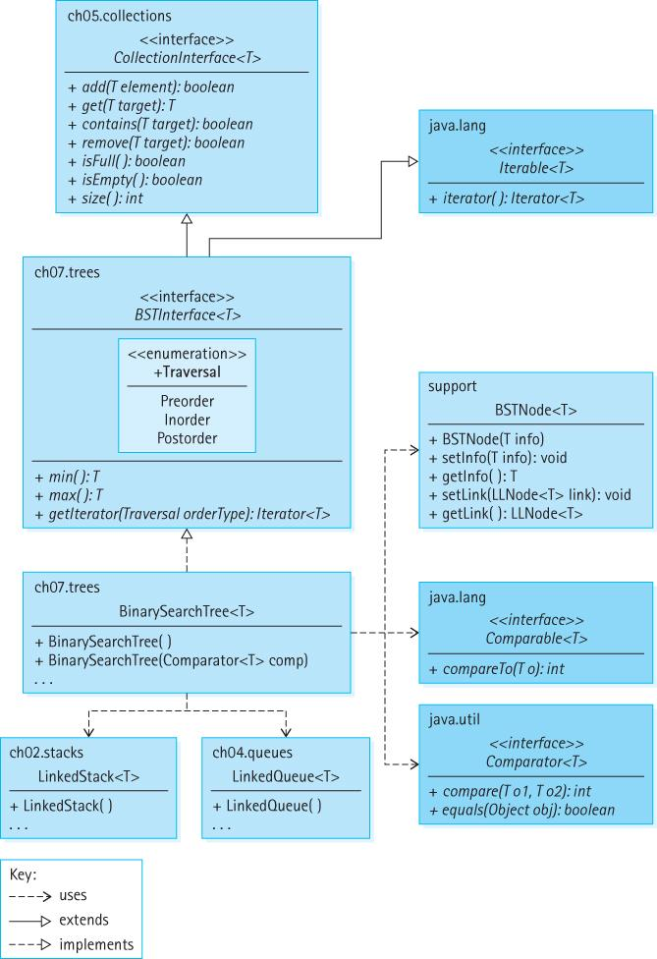
Our Binary Search Tree Architecture

Slide 115
7.8 Binary Search Tree Performance
A binary search tree is an appropriate structure for many of the same applications discussed previously in conjunction with sorted lists.
Similar to a sorted array-based list, it can be searched quickly, using a binary search.
Similar to a linked list, it allows insertions and removals without having to move large amounts of data.
There is a space cost - the binary search tree, with its extra reference in each node, takes up more memory space than a singly linked list.
Notes:
‹#›

Slide 116
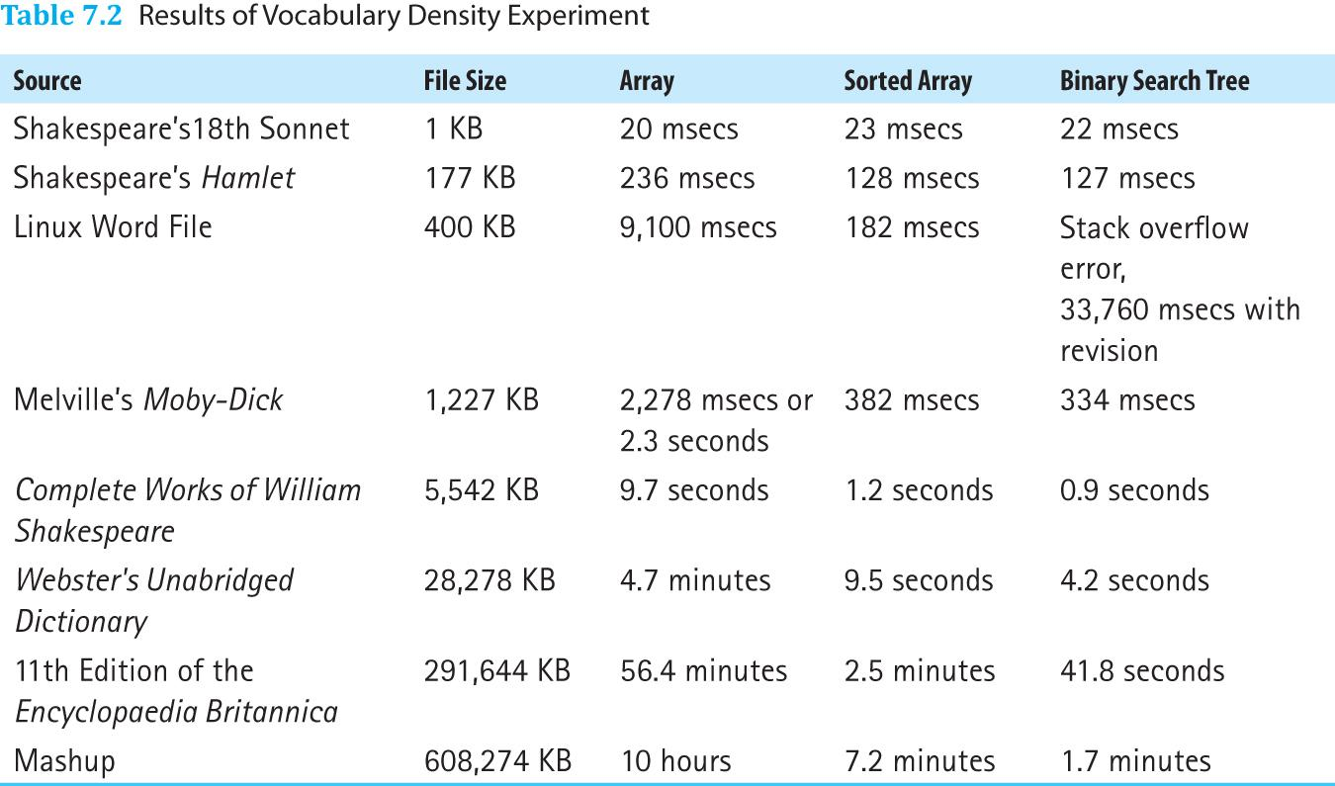
Text Analysis Experiment Revisited
Notes:
‹#›

Slide 117
Text Analysis Experiment Revisited
Due to operation complexity, performance gains from the binary search tree are only clearly evident as the size of the file increases.
The table also reveals a serious issue when the binary search tree structure is used for the Linux Word file. The application bombs—it stops executing and reports a “Stack overflow error.”
The problem is that the underlying tree is completely skewed.

Slide 118
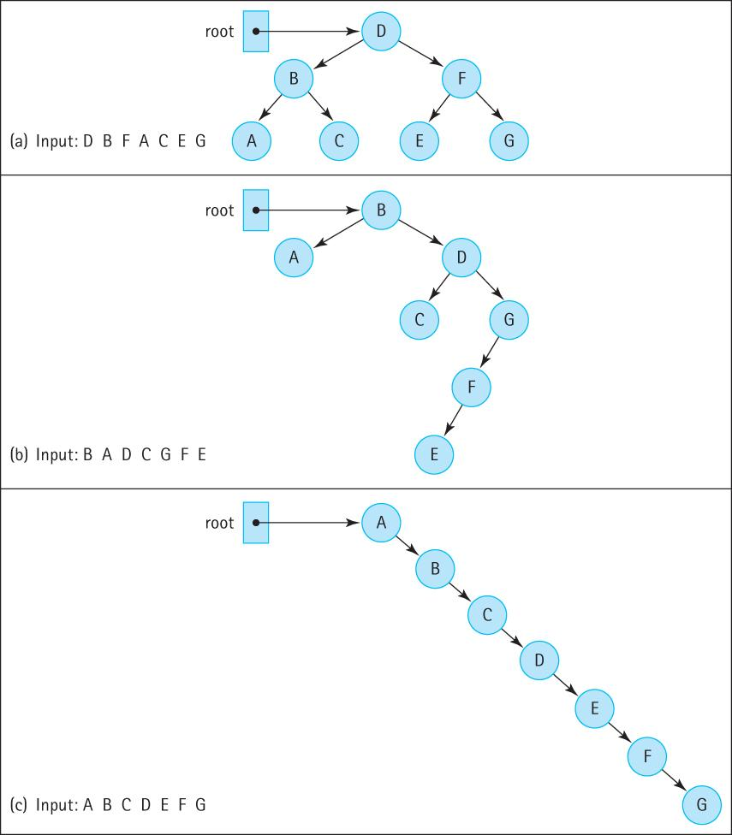
Insertion Order and Tree Shape
Linux Word
File is like this →

Slide 119
Balancing a Binary Search Tree
A beneficial addition to our Binary Search Tree ADT operations is a balance operation
The specification of the operation is:
public balance();
// Restructures this BST to be optimally balanced
It is up to the client program to use the balance method appropriately
Notes:
‹#›

Slide 120
Our Approach
Basic algorithm:
Save the tree information in an array
Insert the information from the array back into the tree
The structure of the new tree depends on the order that we save the information into the array, or the order in which we insert the information back into the tree, or both
We save the information “in order” so that the array is sorted
Notes:
‹#›

Slide 121
To Ensure a Balanced Tree
Even out as much as possible, the number of descendants in each node’s left and right subtrees
First insert the “middle” item of the inOrder array
Then insert the left half of the array using the same approach
Then insert the right half of the array using the same approach
Notes:
‹#›

Slide 122
Balance
Iterator iter = tree.getIterator(Inorder )
int index = 0
while (iter.hasnext())
array[index] = iter.next( )
index++
tree = new BinarySearchTree()
tree.InsertTree(0, index - 1)
InsertTree(low, high)
if (low == high) // Base case 1
tree.add(array[low])
else if ((low + 1) == high) // Base case 2
tree.add(array[low])
tree.add(array[high])
else
mid = (low + high) / 2
tree.add(array[mid])
tree.InsertTree(low, mid – 1)
tree.InsertTree(mid + 1, high)
Our Balance Tree Algorithm
Inorder traversal of our tree (sorted elements)
Notes:
‹#›

Slide 123
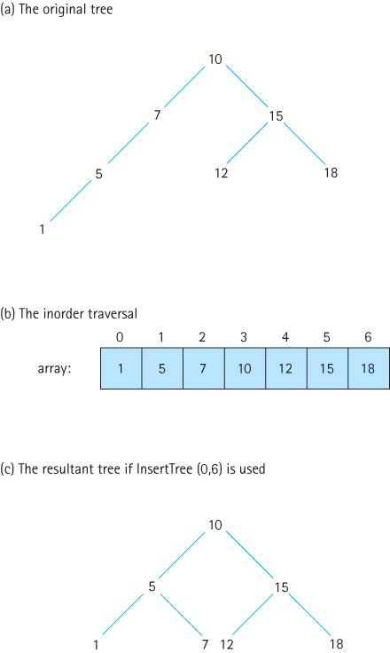
Using recursive insertTree
Notes:
‹#›

Slide 124
7.9 Application: Word Frequency Counter
In this section we develop a word frequency counter that uses our binary search tree
Read a text file and generate an alphabetical listing of the unique words, along with a count of how many times each word occurs
We allow users to specify a minimum word size and a minimum frequency count
Present a few summary statistics

Slide 125
package support;
import java.text.DecimalFormat;
public class WordFreq implements Comparable<WordFreq>
{
private String word; private int freq;
DecimalFormat fmt = new DecimalFormat("00000");
public WordFreq(String newWord)
{
word = newWord; freq = 0;
}
public String getWordIs(){return word;}
public int getFreq(){return freq;}
public void inc() { freq++; }
public int compareTo(WordFreq other)
{
return this.word.compareTo(other.word);
}
public String toString()
{
return(fmt.format(freq) + " " + word);
}
}
The WordFreq Class

Slide 126
The Application
Scans the input file for words, and after reading a word, it checks to see if a match is already in the tree, and if not it inserts a WordFreq object that holds the word and a frequency count of 1
If the word is already in the tree, increment the frequency associated with the word

Slide 127
Algorithm to process a word
wordToTry = new WordFreq(word)
wordInTree = tree.get(wordToTry)
if (wordInTree != null)
wordInTree.inc()
else
wordToTry.inc() // to set its frequency to 1
tree.add(wordToTry);

Slide 128
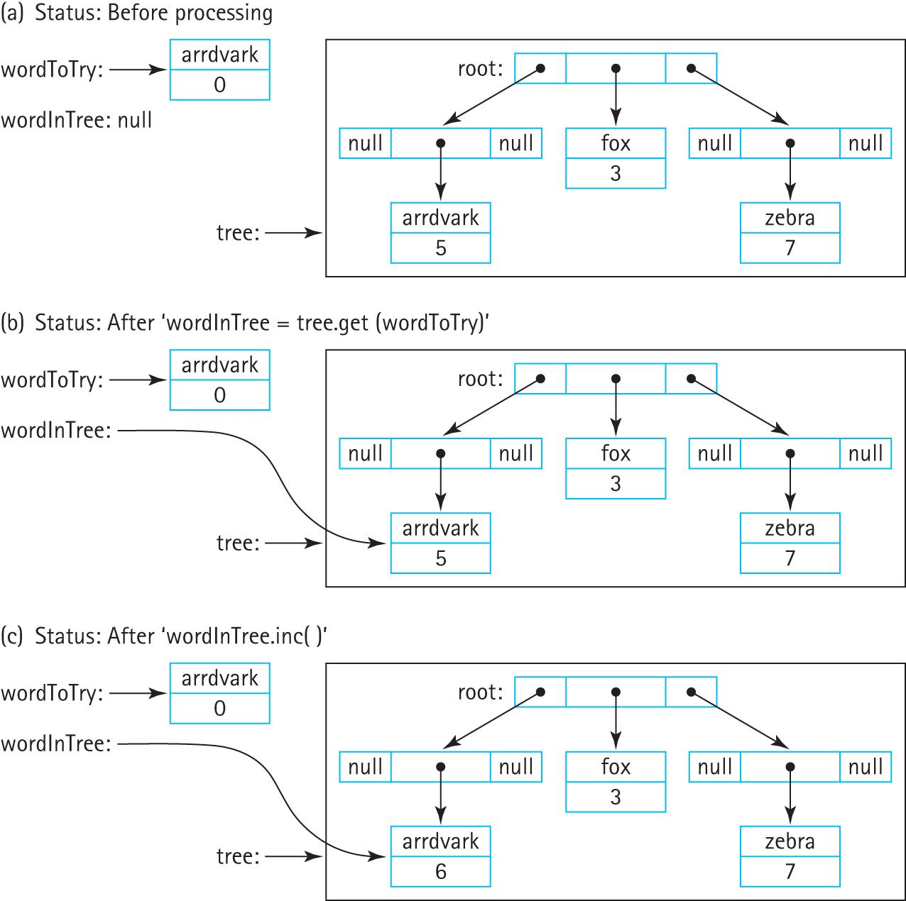
Processing a word
Notes:
‹#›

Slide 129
The Application
Instructors can now review the code and demonstrate/discuss the application.

Slide 130
7.10 Tree Variations
Trees can be binary, trinary (up to three children per node), n-ary (up to n children per node), alternating ary, balanced, not balanced, partially balanced, self-adjusting, and store information in their nodes or their edges or both.
The Java Library does not include a general tree structure and neither do most textbooks.
Often with trees we let the specific target application dictate the definition, assumptions, rules, and operations associated with a specific implementation.

Slide 131
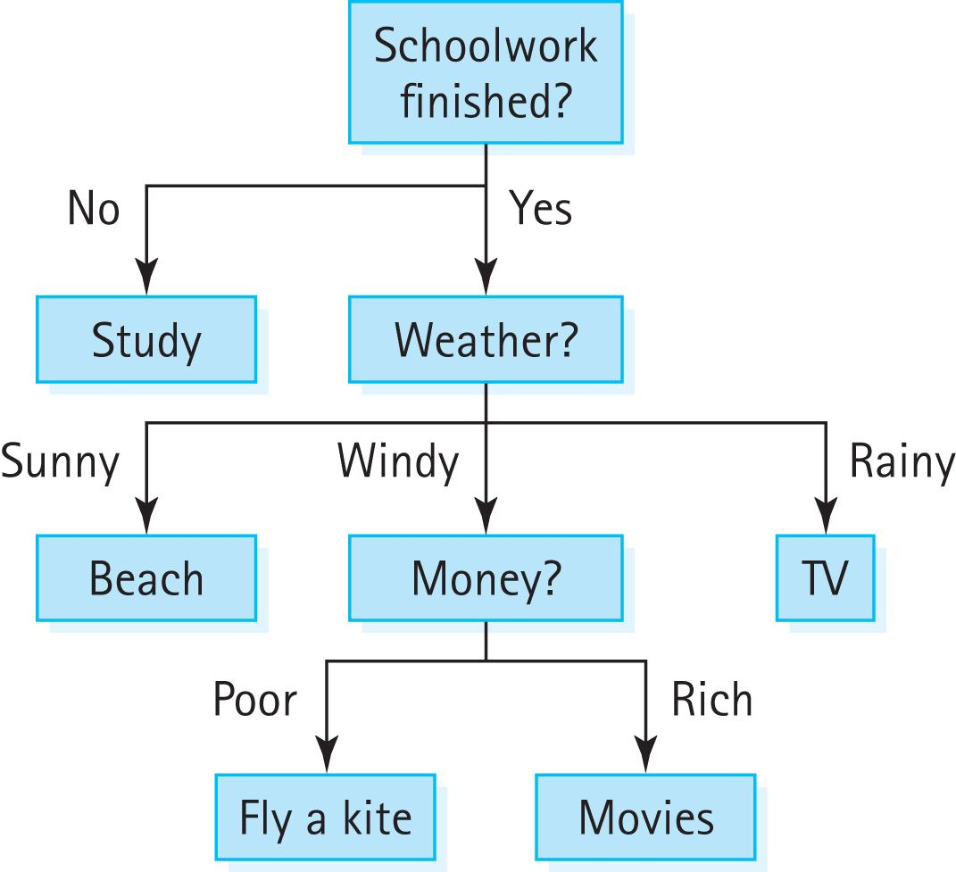
Application-Specific Variations
Decision Trees:

Slide 132
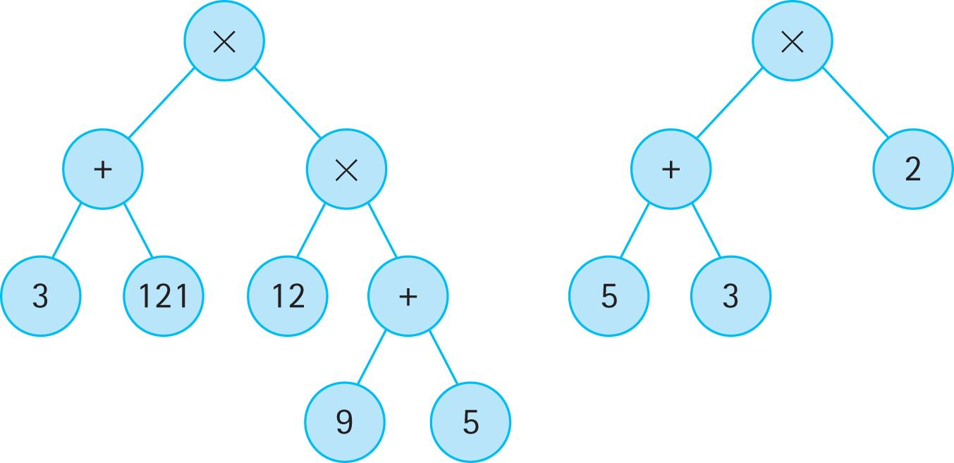
Application-Specific Variations
Expression/Parse Trees:

Slide 133
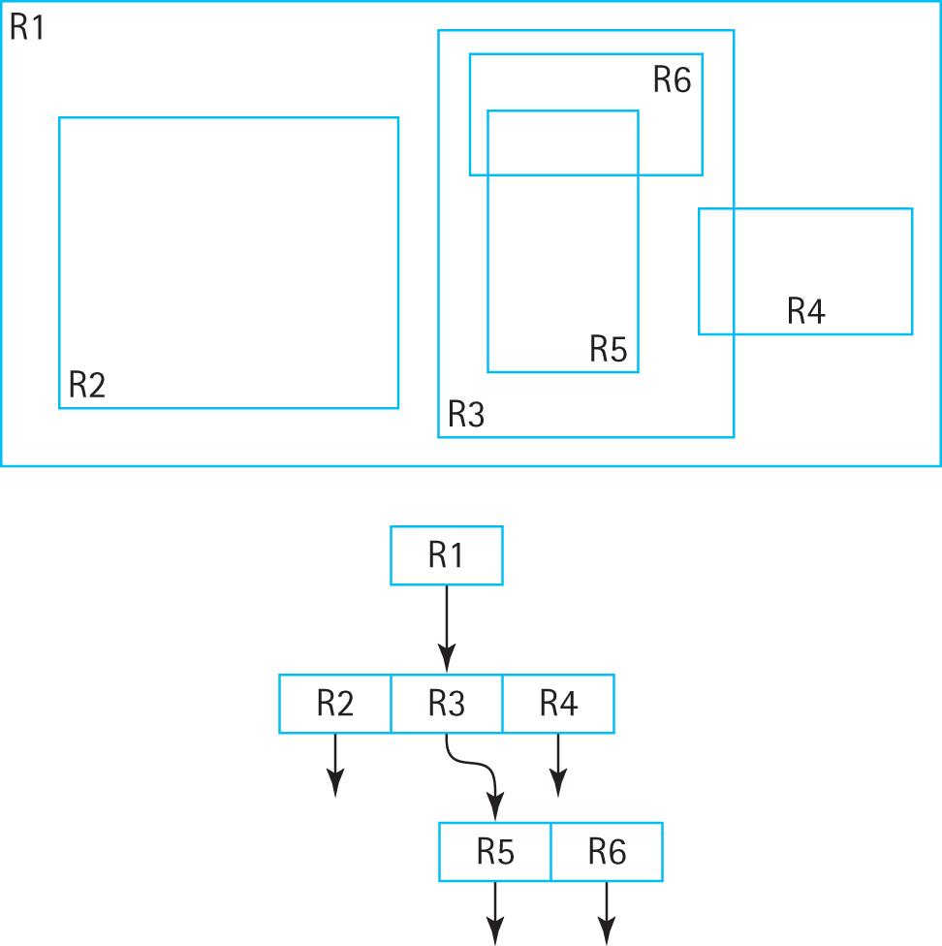
Application-Specific Variations
R Trees:

Slide 134
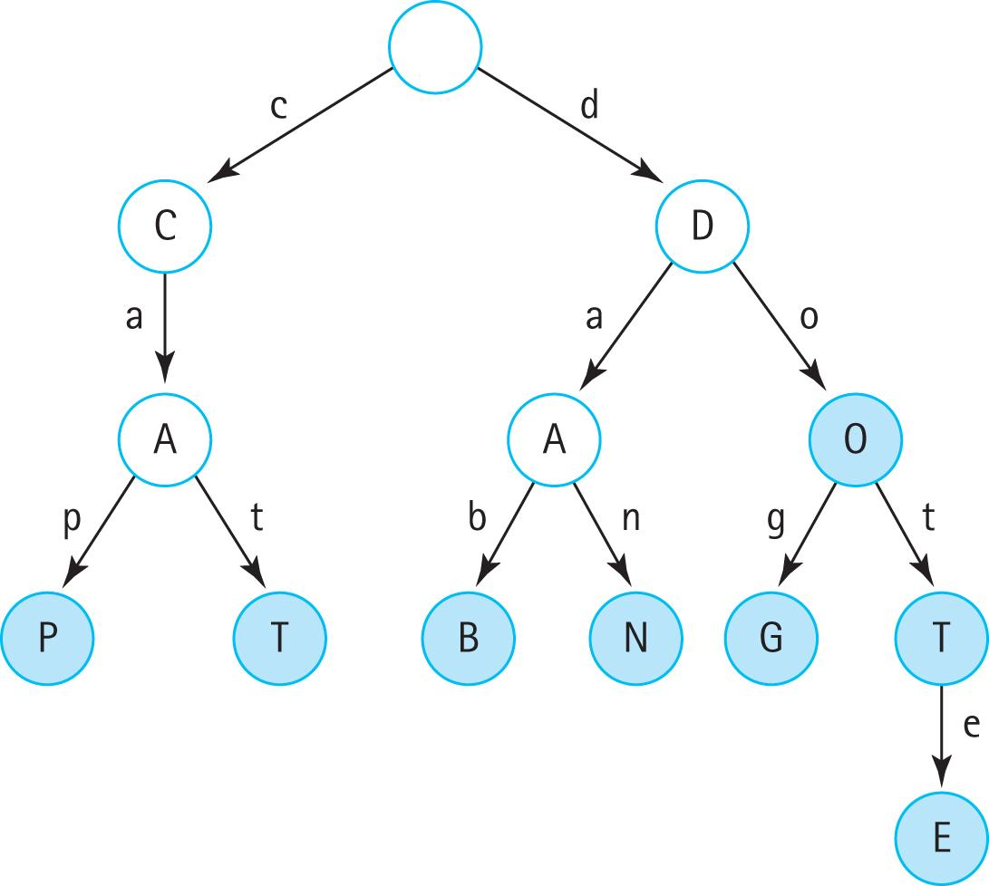
Application-Specific Variations
Tries/Prefix
Trees:

Slide 135
Balanced Search Trees
The Binary Search Tree ADT presented in this chapter is an excellent collection structure for holding “random” data, but suffers from one major weakness—it can become unbalanced.
Many search tree variations have been invented to address this weakness, each in turn with their own strengths and weaknesses.

Slide 136
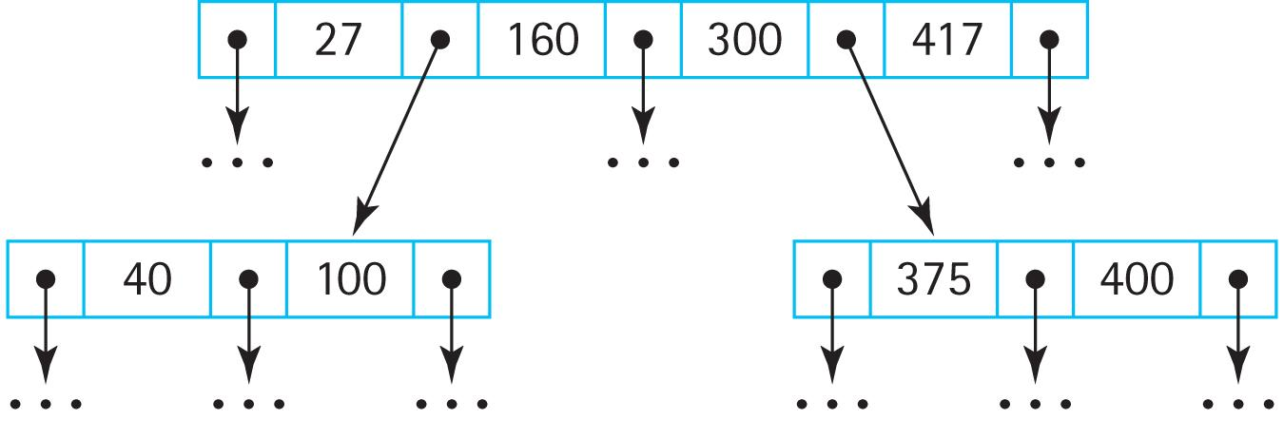
Balanced Search Trees
B-Trees: a search tree that allows internal nodes to hold multiple values and have multiple children

Slide 137
Balanced Search Trees
B-Tree Variants: A popular variant of the B-Tree is the 2-3-4 tree, where nodes are constrained to hold 1, 2, or 3 values and therefore have 2, 3, or 4 subtrees (thus the name of the tree)
Searching, insertion, and removal of information is always O(log₂N) and the amount of work required to process the information within any node is constant.

Slide 138
Balanced Search Trees
A 2-3-4 tree can be implemented using a binary tree structure called a red-black tree. In this structure nodes are “colored” either red or black (each node must hold an extra boolean value that indicates this information). The color of a node indicates how its value fits into the corresponding 2-3-4 tree.
The Java Library includes two important classes that use tree implementations. The Java TreeMap class supports maps (see Chapter 8) and the Java TreeSet class supports sets (see Section 5.7, “Collection Variations”). In both cases the internal representation is a red-black tree.

Slide 139
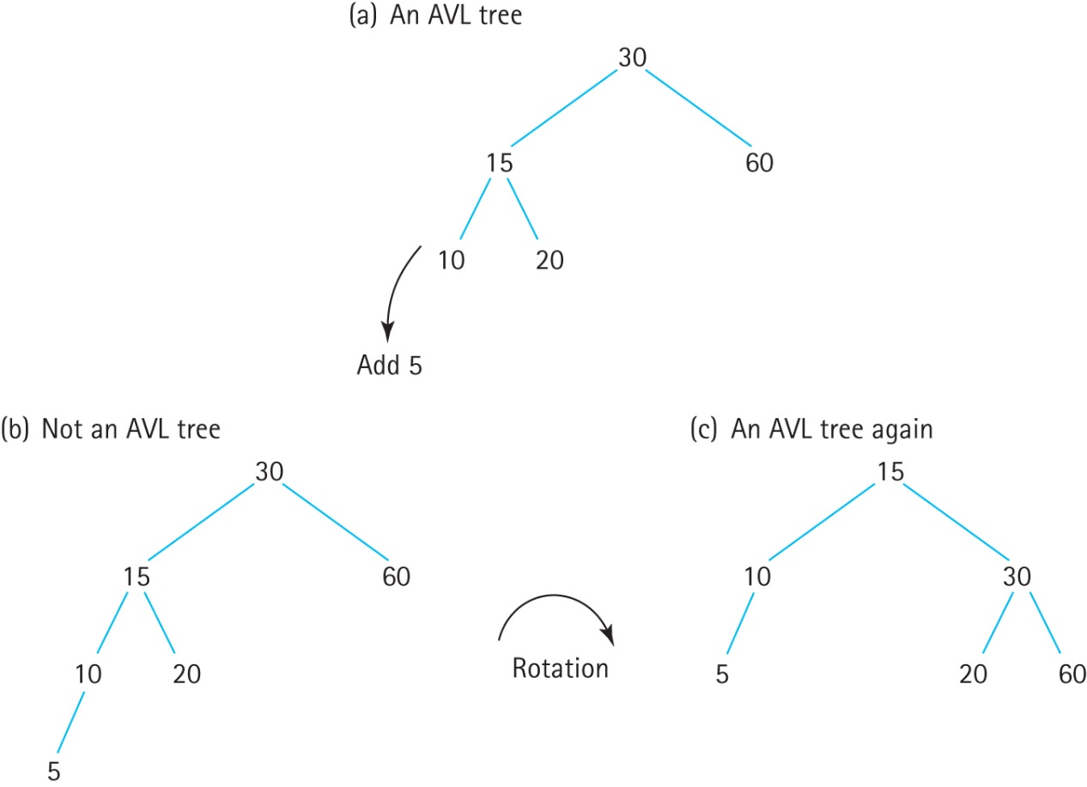
Balanced Search Trees
AVL Trees: the difference in height between a node’s two subtrees can be at most 1.
During addition and removal of nodes extra work is required to ensure the tree remains balanced.

