Slide 1
Bayesian Inference
Module 3, Lesson 2

Slide 2
Conjugate Priors
Shahrzad Jamshidi, PhD

Slide 3
Last Time
Nuisance parameters
Simulations of normal models where both mean and variance are unknown

Slide 4
Objectives
Analyze normal data using conjugate and semi-conjugate prior distributions.
Understand and apply the multivariate normal model with known variance.
Analyze multivariate normal data with unknown mean and variance.

Slide 5

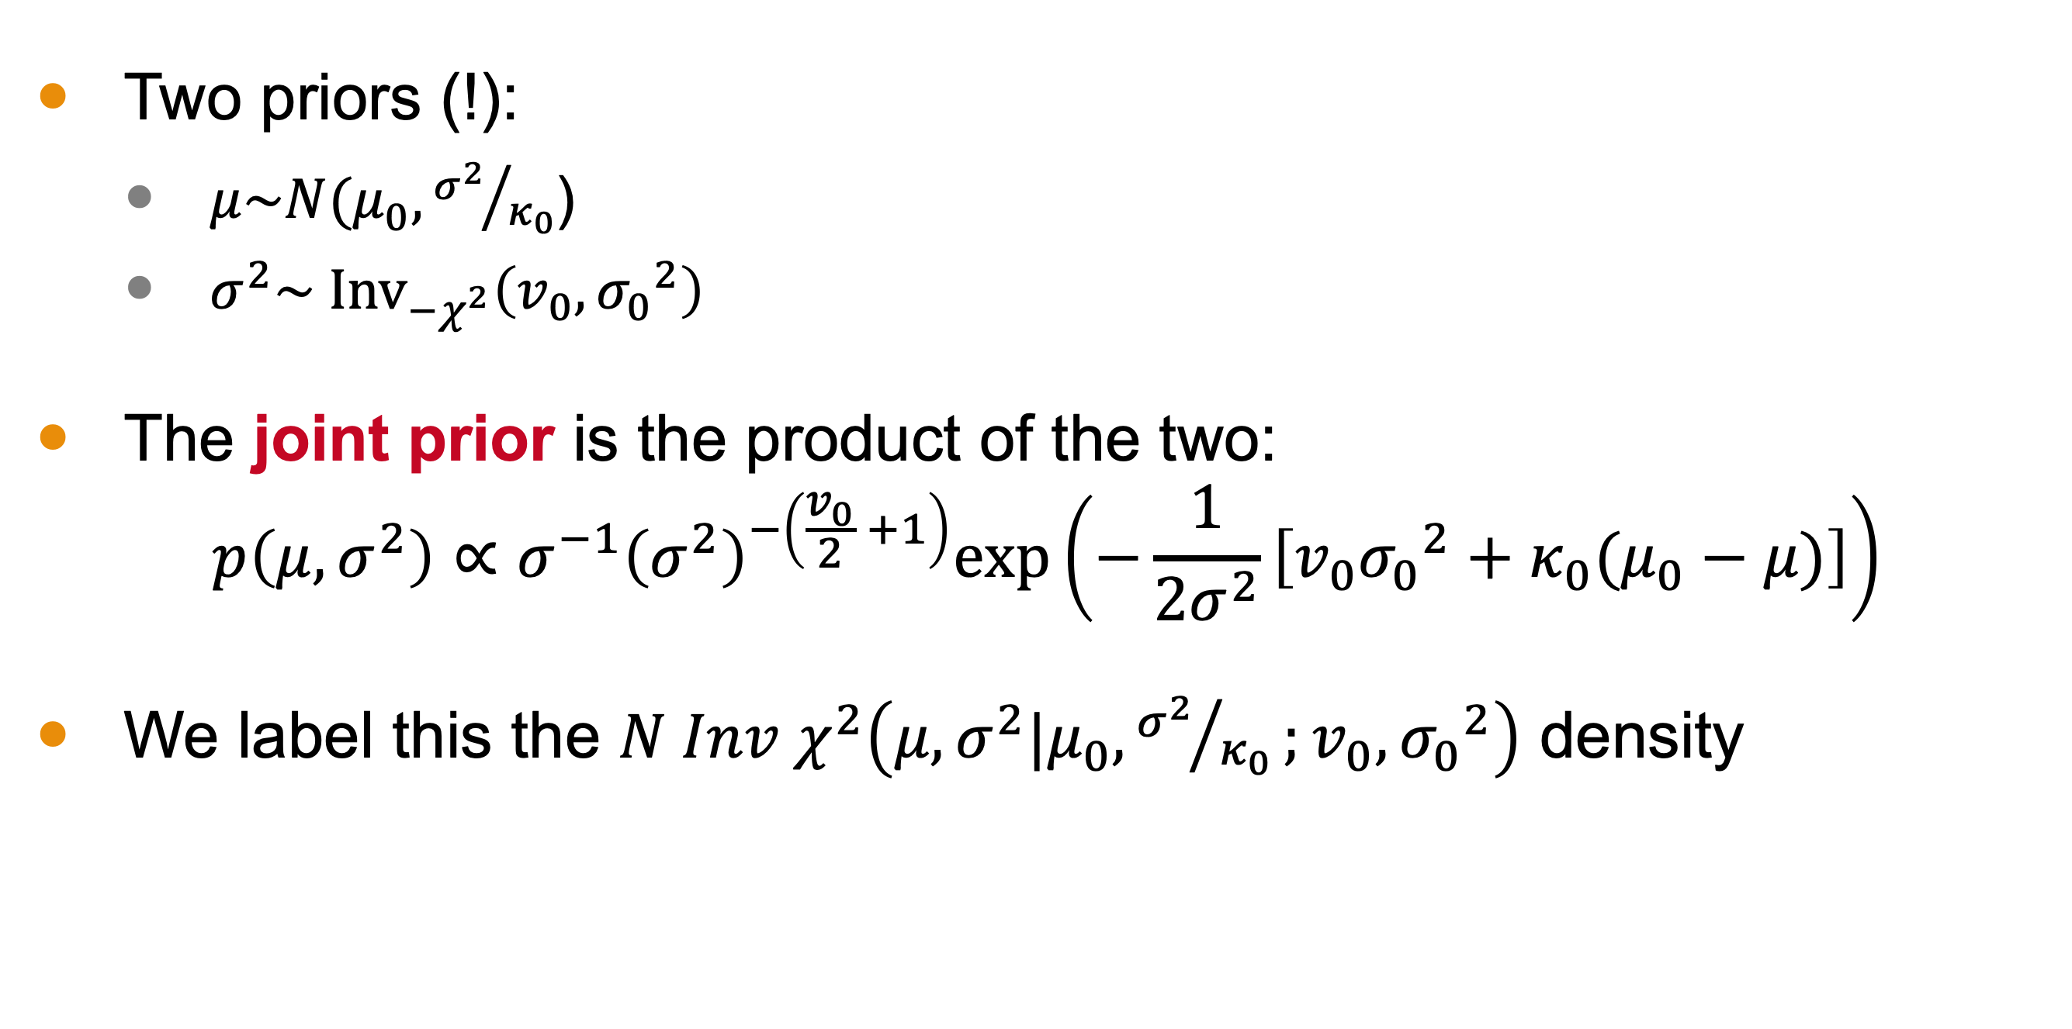

Conjugate Prior Distribution
Two priors (!):
$μ\sim N(μ_{0},{σ^{2}}/{κ_{0}}$)
$σ^{2}\sim {\text{Inv}}_{−χ^{2}}\left(v_{0}, {σ_{0}}^{2}\right)$
The joint prior is the product of the two:
$$p\left(μ,σ^{2}\right)∝σ^{−1}{\left(σ^{2}\right)}^{−\left(\frac{v_{0}}{2} +1\right)}\text{exp}\left(−\frac{1}{2σ^{2}}\left[v_{0}{σ_{0}}^{2}+κ_{0}(μ_{0}−μ)\right]\right)$$
We label this the $N Inv χ^{2}\left(μ,σ^{2}|μ_{0},{σ^{2}}/{κ_{0}};v_{0}, {σ_{0}}^{2}\right)$ density
Scale for $μ$
Scale for $σ^{2}$
Location
D o F

Slide 6
(board example inserted here)
Notes:
Solving for the posterior distribution

Slide 7
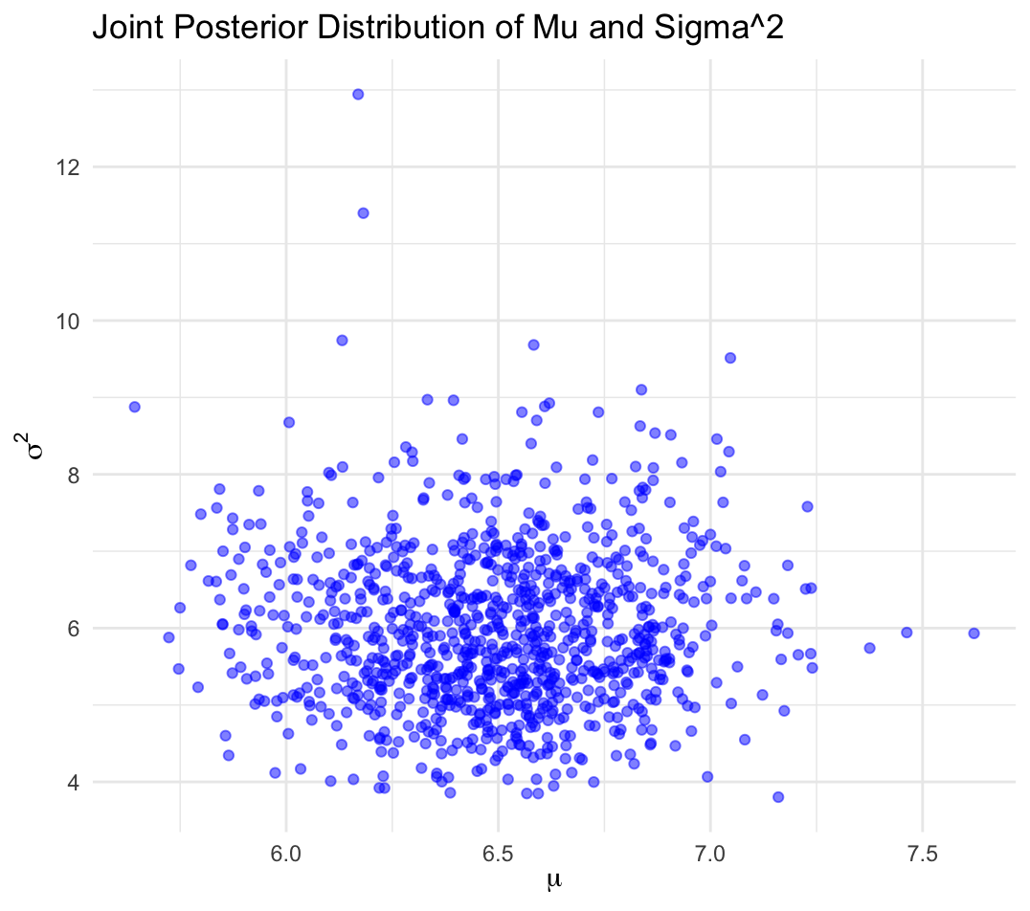
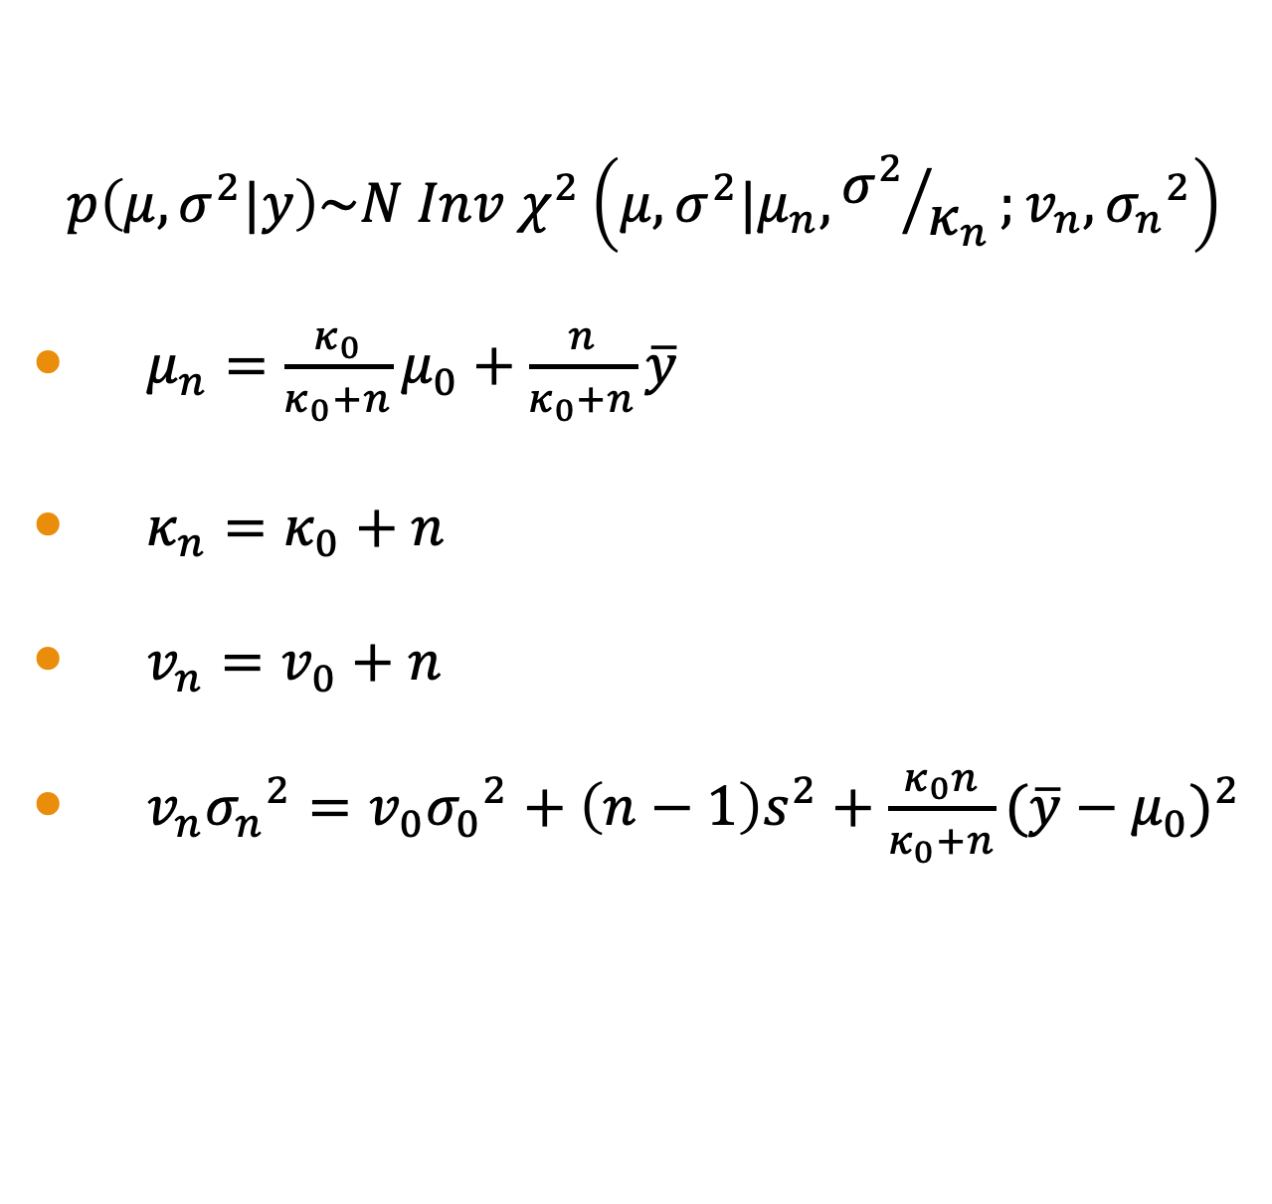
Conjugate Posterior
$$p\left(μ,σ^{2}|y\right)\sim N Inv χ^{2}\left(μ,σ^{2}|μ_{n},{σ^{2}}/{κ_{n}};v_{n}, {σ_{n}}^{2}\right)$$
$μ_{n}=\frac{κ_{0}}{κ_{0}+n}μ_{0}+\frac{n}{κ_{0}+n}\overline{y}$
$κ_{n}=κ_{0}+n$
$v_{n}=v_{0}+n$
$v_{n}{σ_{n}}^{2}=v_{0}{σ_{0}}^{2}+\left(n−1\right)s^{2}+\frac{κ_{0}n}{κ_{0}+n}{(\overline{y}−μ_{0})}^{2}$

Slide 8
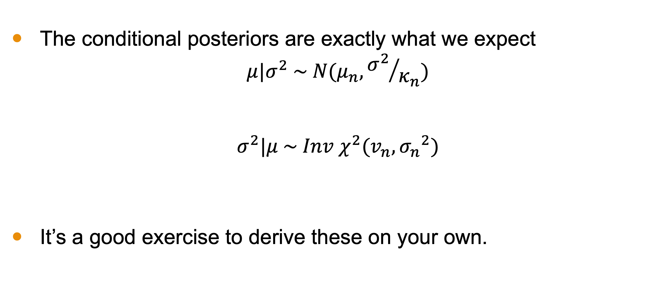
Exercise: Conditional Posteriors
The conditional posteriors are exactly what we expect
$$μ|σ^{2} \sim N(μ_{n},{σ^{2}}/{κ_{n}})$$
$$σ^{2}|μ \sim Inv χ^{2}(v_{n}, {σ_{n}}^{2})$$
It’s a good exercise to derive these on your own.

Slide 9
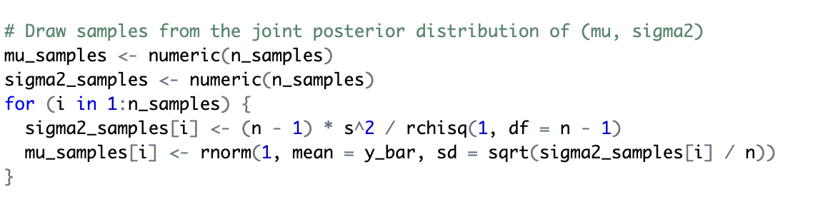
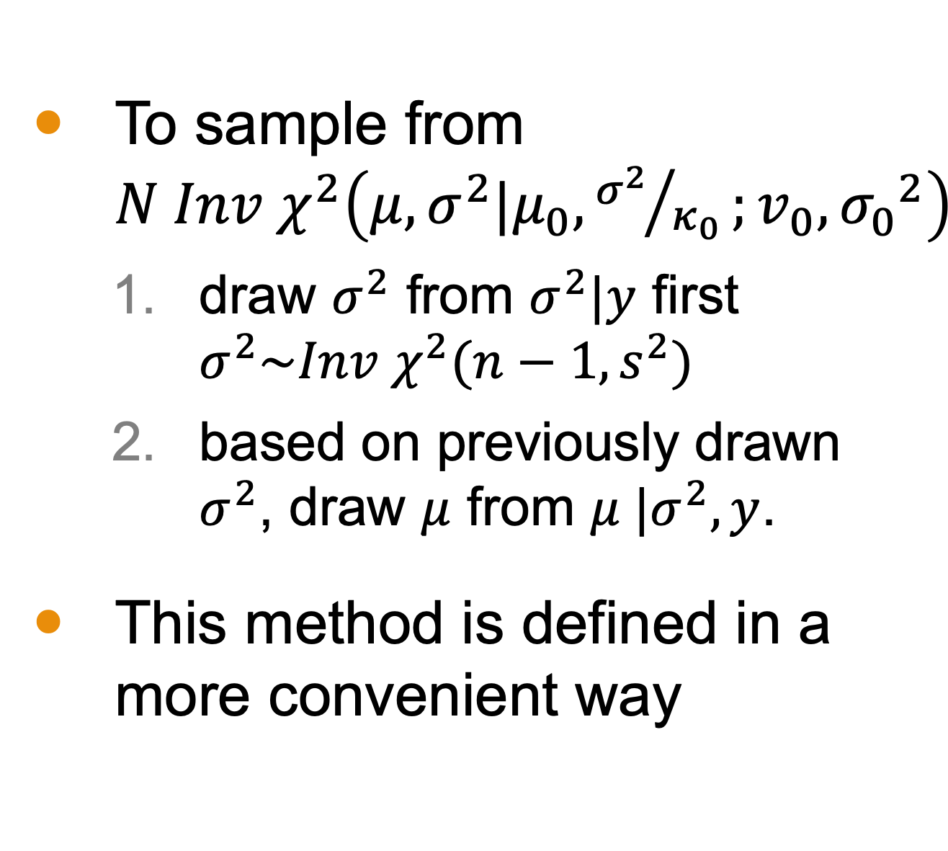
Sampling
To sample from $N Inv χ^{2}\left(μ,σ^{2}|μ_{0},{σ^{2}}/{κ_{0}};v_{0}, {σ_{0}}^{2}\right)$
draw $σ^{2}$ from $σ^{2}|y$ first $σ^{2}\sim Inv χ^{2}(n−1,s^{2})$
based on previously drawn $σ^{2}$, draw $μ$ from $μ |σ^{2},y$.
This method is defined in a more convenient way

Slide 10
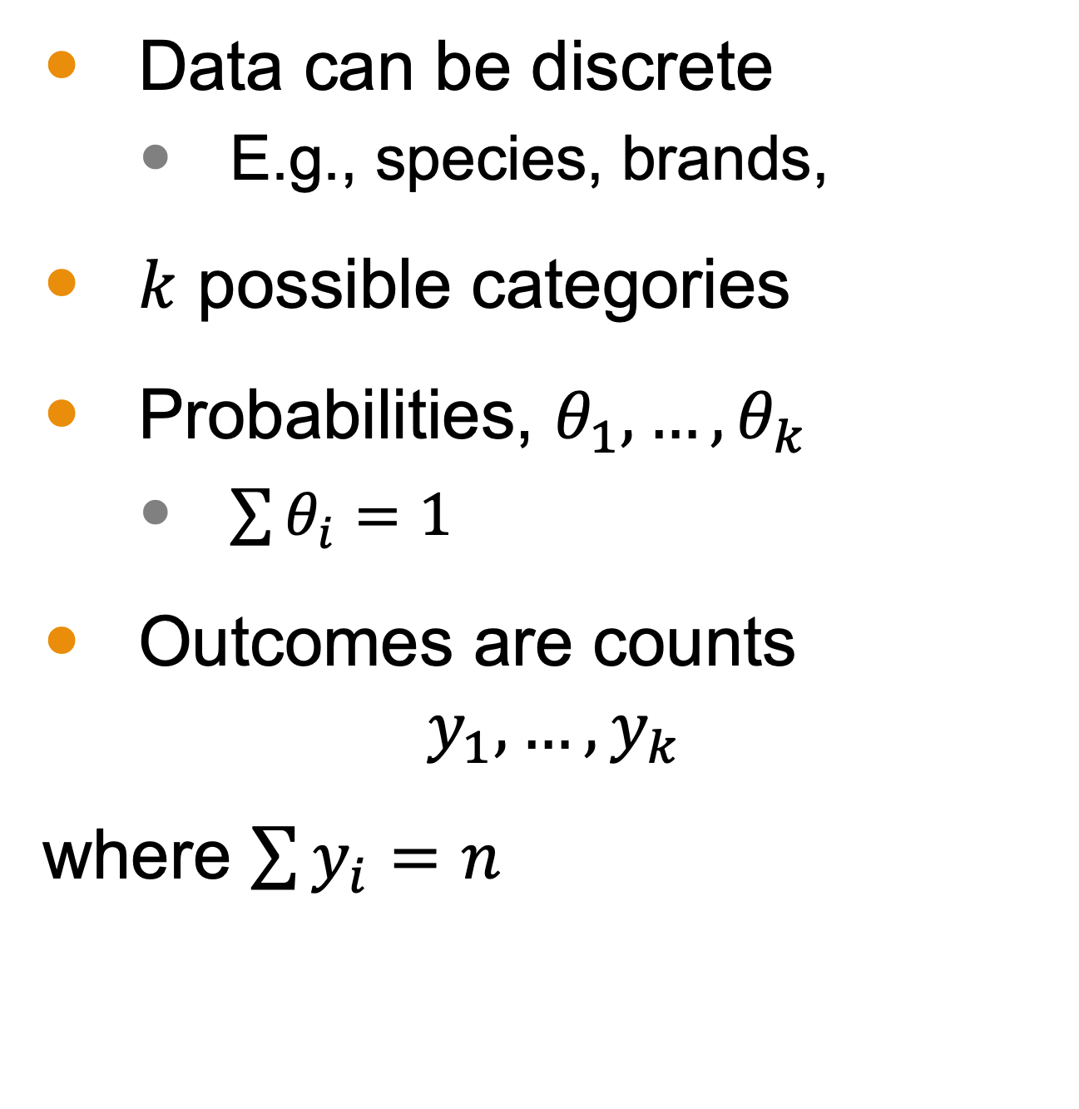
Categorical Data
Data can be discrete
E.g., species, brands,
$k$ possible categories
Probabilities, $θ_{1},…,θ_{k}$
$\sum{θ_{i}}=1$
Outcomes are counts
$$y_{1},…,y_{k}$$
where $\sum{y_{i}}=n$
Category-based image

Slide 11
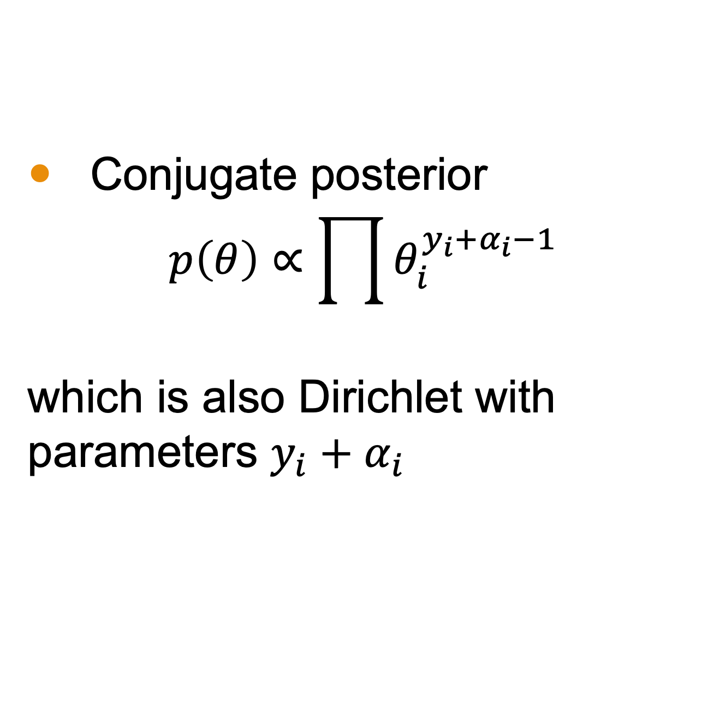
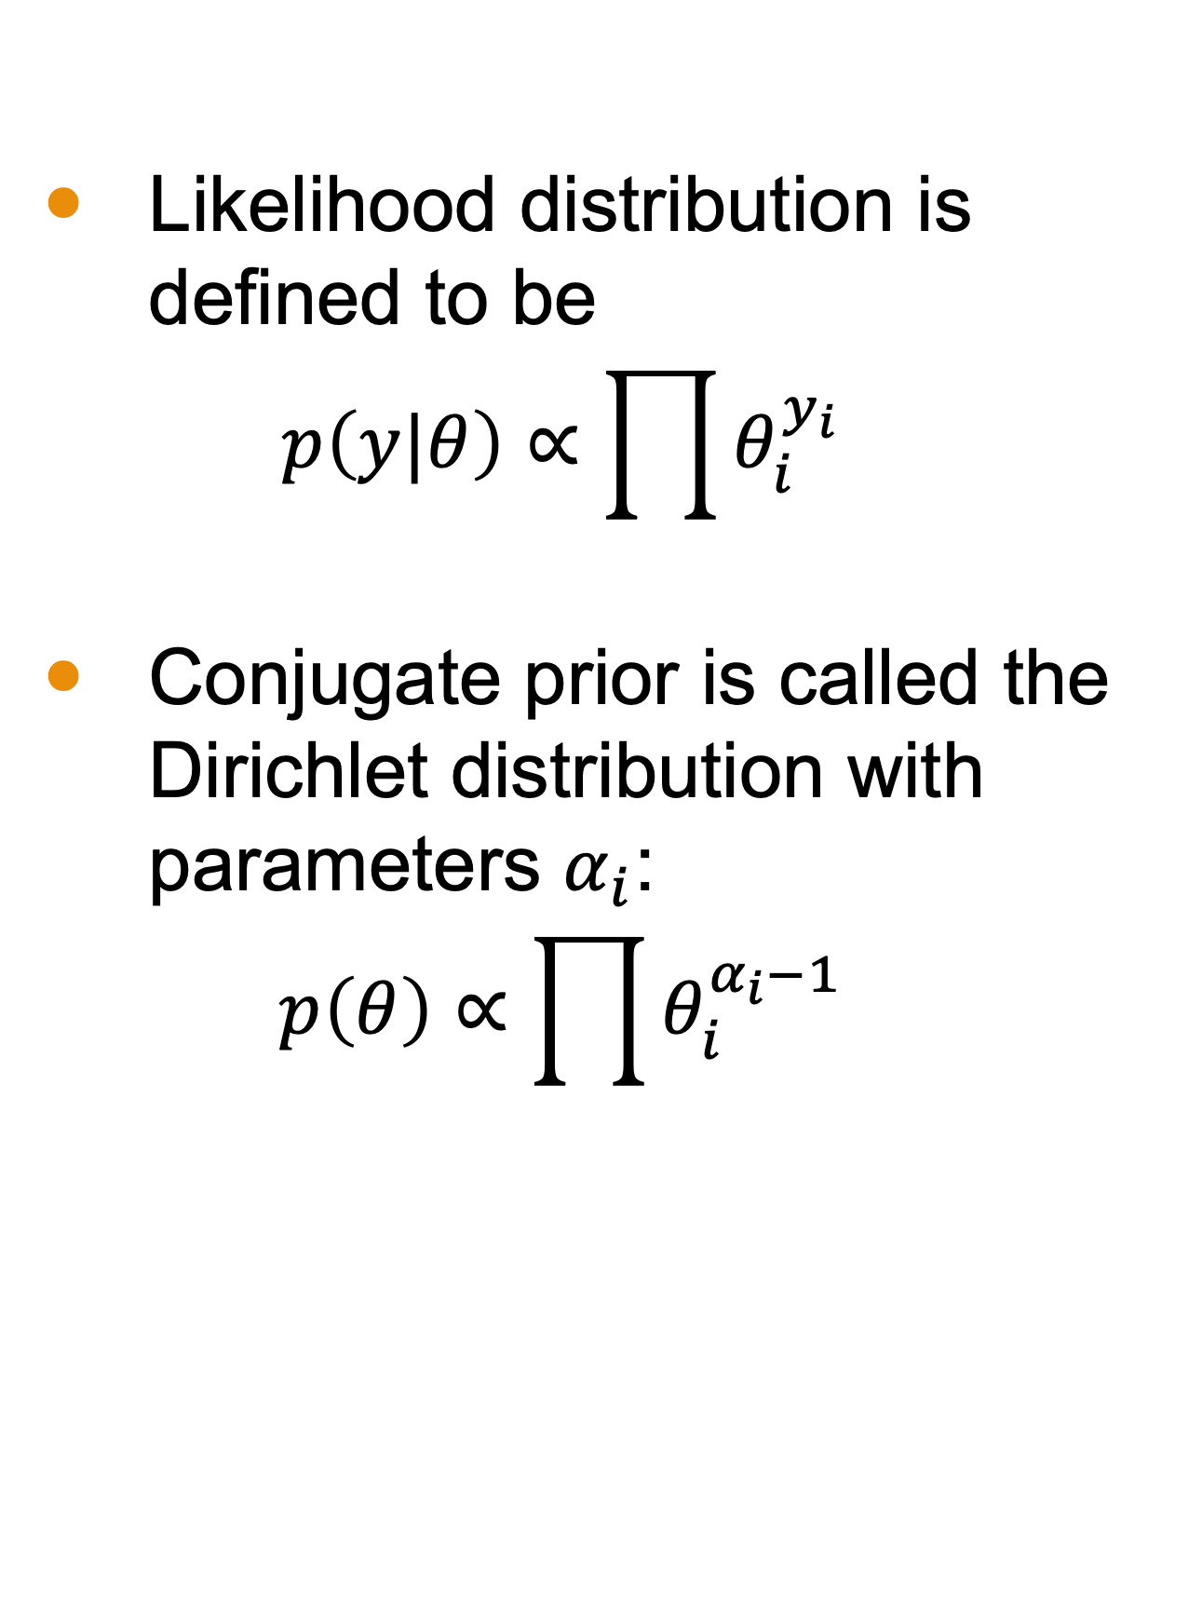
Multinomial Model for Categorical Data
Likelihood distribution is defined to be $p\left(y|θ\right)∝\prod{θ_{i}^{y_{i}}}$
Conjugate prior is called the Dirichlet distribution with parameters $α_{i}$: $p\left(θ\right)∝\prod{θ_{i}^{α_{i}−1}}$
Conjugate posterior
$$p\left(θ\right)∝\prod{θ_{i}^{{y_{i}+α}_{i}−1}}$$
which is also Dirichlet with parameters ${y_{i}+α}_{i}$

Slide 12

Example: Ice Cream
Suppose a survey was conducted to determine the favorite ice cream flavor among three options: Vanilla, Chocolate, and Strawberry. Out of 1000 respondents:
450 preferred Vanilla
300 preferred Chocolate
250 preferred Strawberry
We want to estimate the difference in proportions between those who prefer Vanilla and those who prefer Chocolate.
Microsoft Stock Images

Slide 13
(board example inserted here)
Notes:
Computation

Slide 14
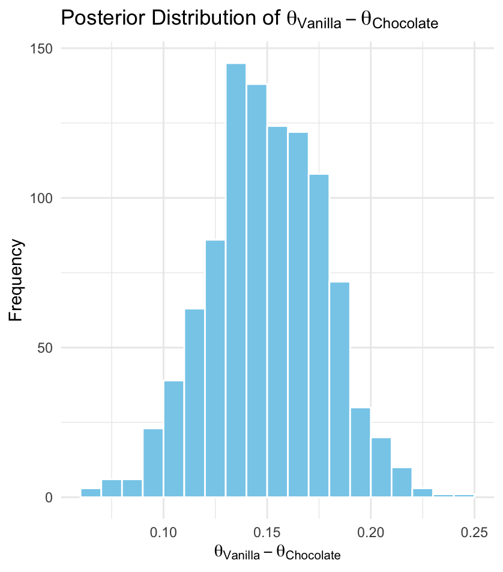
Example Distribution
Estimated probability that Vanilla has more support than Chocolate: >99%

Slide 15
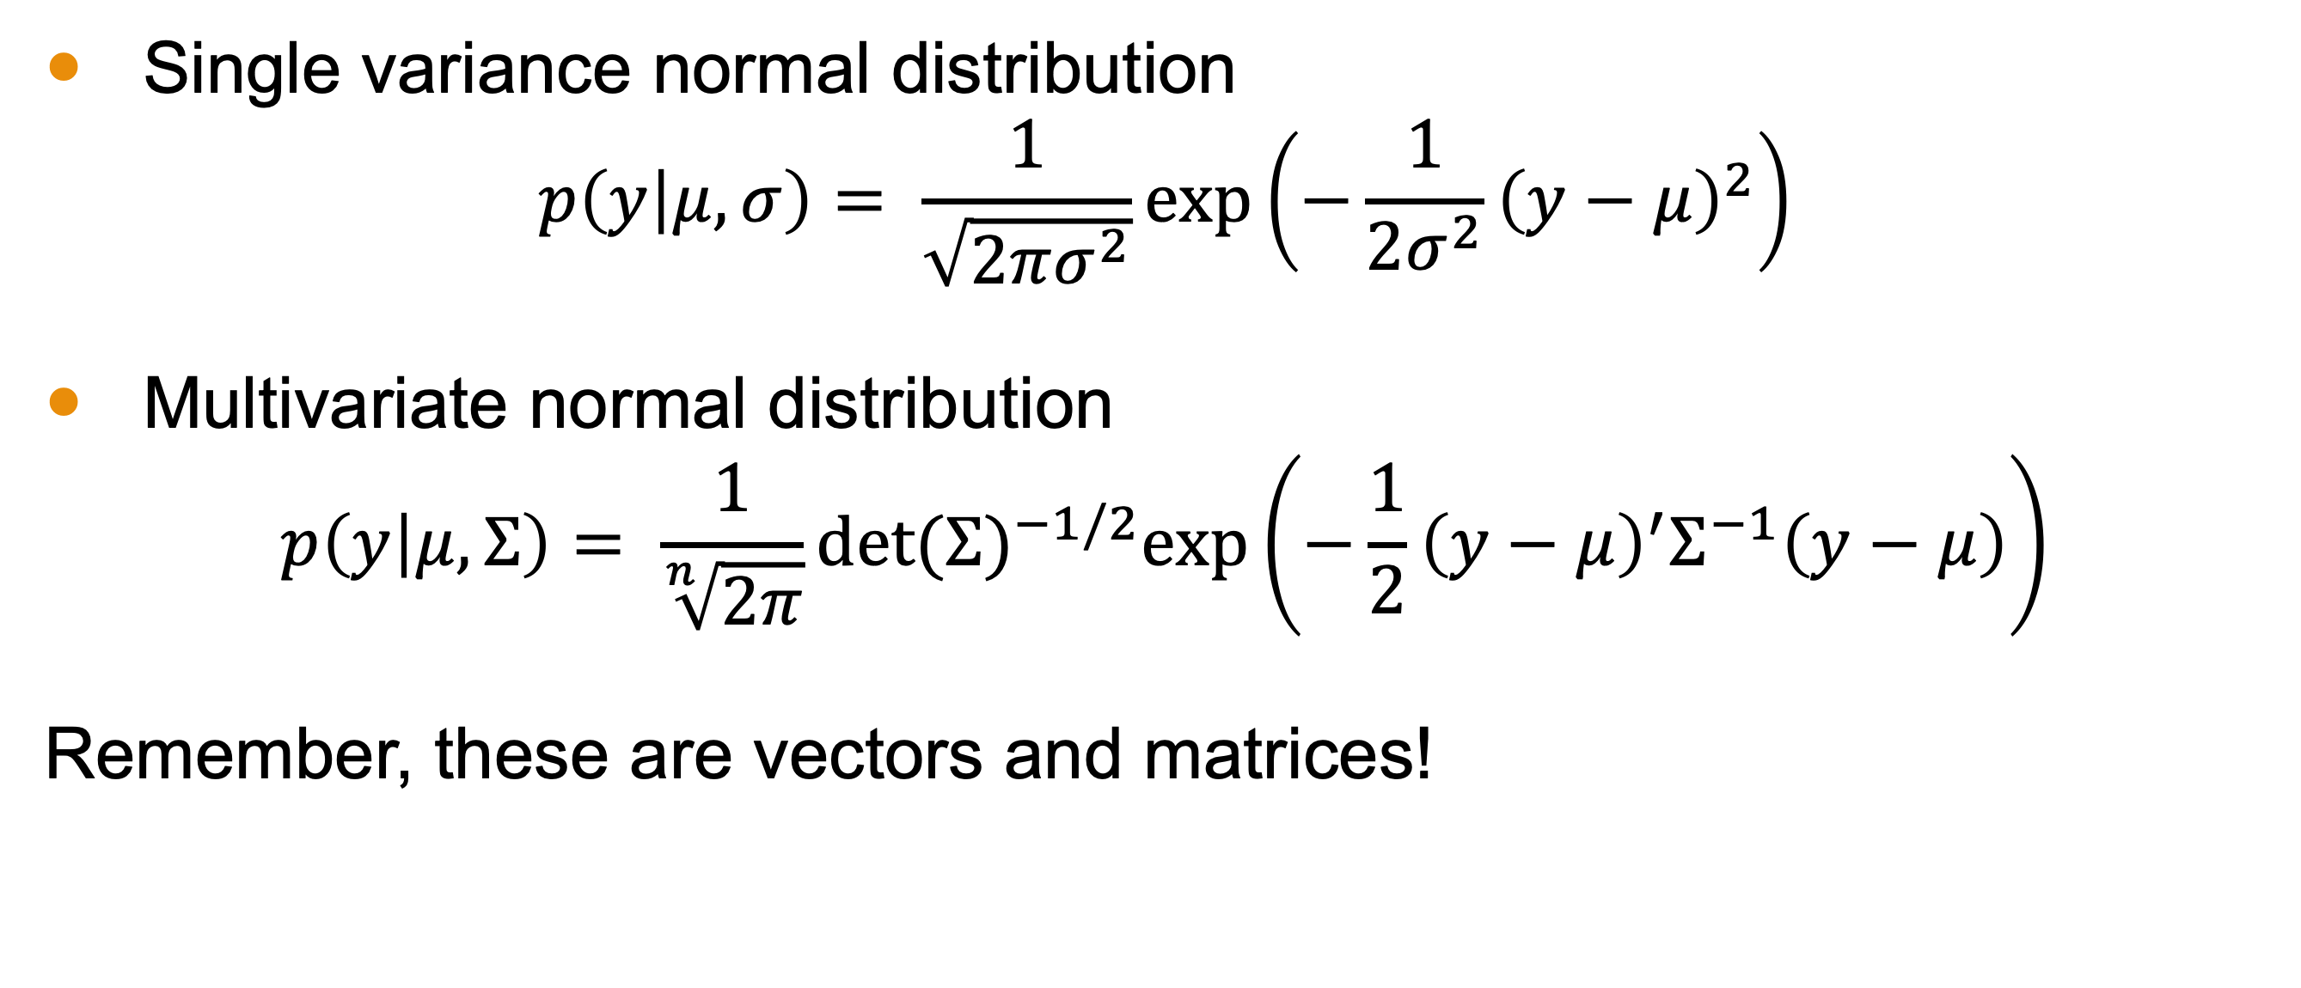
Multivariate Normal Distribution
Single variance normal distribution
$$p\left(y | μ,σ\right)= \frac{1}{\sqrt{2πσ^{2}}}exp\left(−\frac{1}{2σ^{2}}{\left(y−μ\right)}^{2}\right)$$
Multivariate normal distribution
$$p\left(y | μ,Σ\right)= \frac{1}{\sqrt[n]{2π}}{det⁡(Σ)}^{−1/2}exp\left(−\frac{1}{2}{\left(y−μ\right)}^{′}Σ^{−1}\left(y−μ\right)\right)$$
Remember, these are vectors and matrices!

Slide 16
(board example inserted here)
Notes:
Example with vectors and matrices

Slide 17
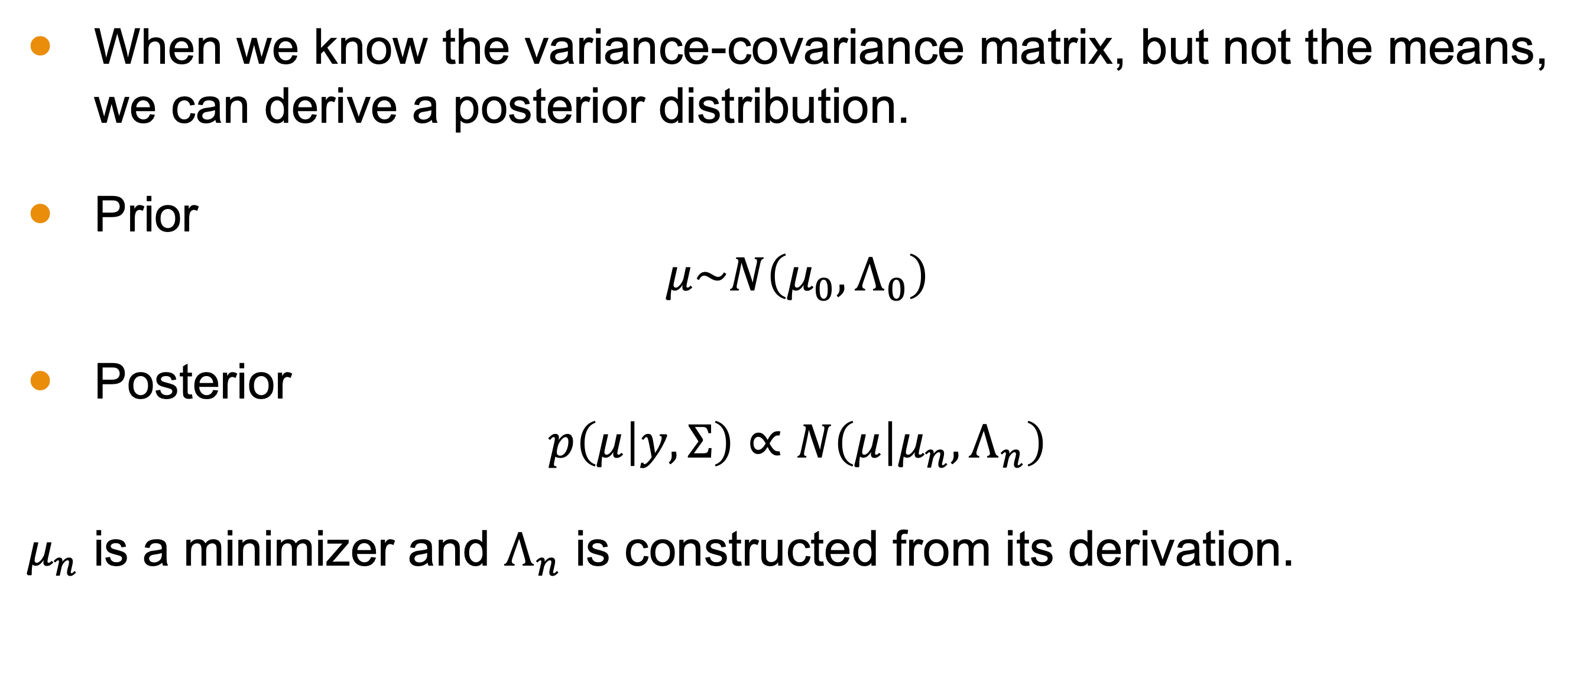

Case 1: Unknown $μ$ and Known $Σ$
When we know the variance-covariance matrix, but not the means, we can derive a posterior distribution.
Prior
$$μ\sim N\left(μ_{0},Λ_{0}\right)$$
Posterior
$$p\left(μ | y,Σ\right)∝N\left(μ | μ_{n},Λ_{n}\right)$$
$μ_{n}$ is a minimizer and $Λ_{n}$ is constructed from its derivation.

Slide 18
(board example inserted here)
Notes:
Derivation of posterior and discussion of minimization

Slide 19
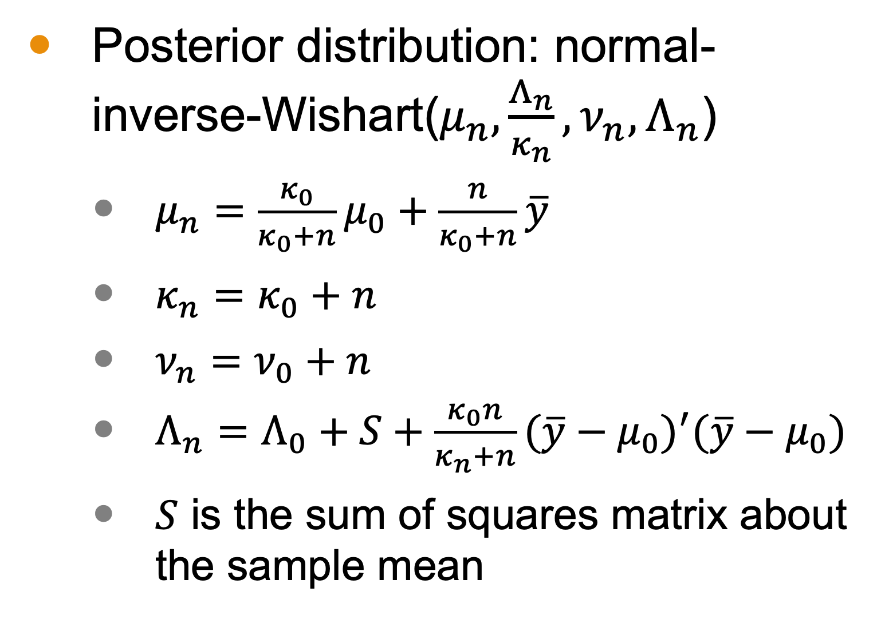
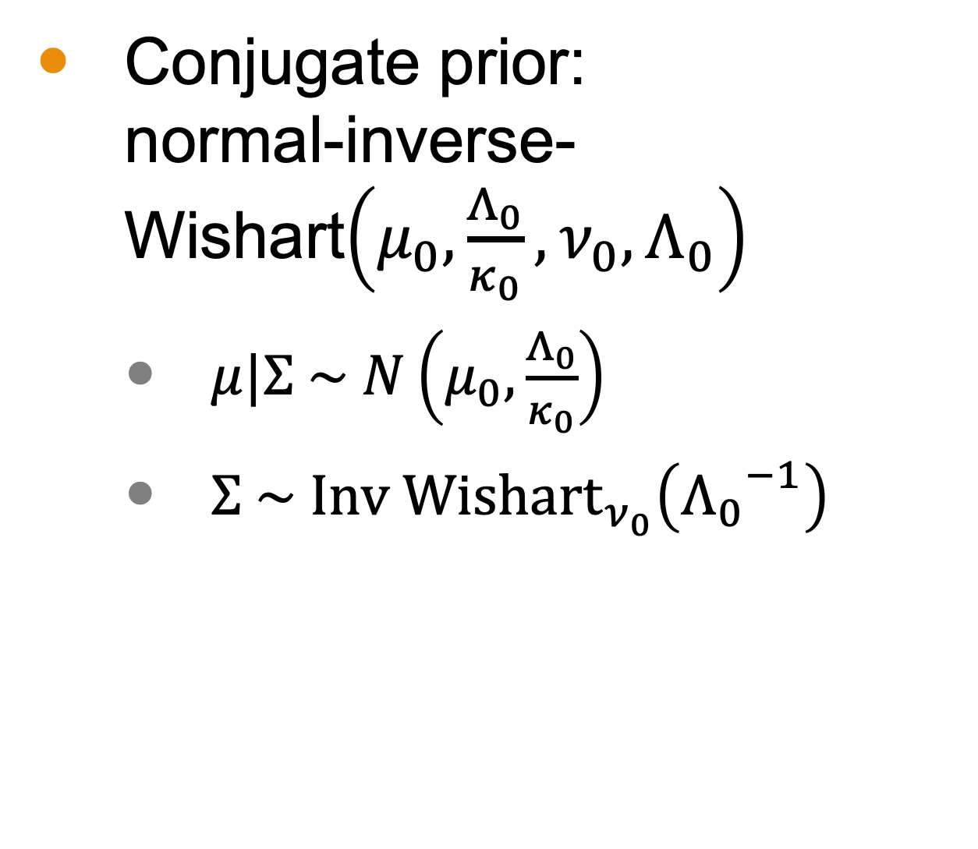

Case 2: Unknown $μ$ and Unknown $Σ$
Conjugate prior: normal-inverse-Wishart$\left(μ_{0},\frac{Λ_{0}}{κ_{0}},ν_{0},Λ_{0}\right)$
$μ|Σ \sim N\left(μ_{0},\frac{Λ_{0}}{κ_{0}}\right)$
$Σ \sim {\text{Inv} \text{Wishart}}_{ν_{0}}\left({Λ_{0}}^{−1}\right)$
Posterior distribution: normal-inverse-Wishart($μ_{n},\frac{Λ_{n}}{κ_{n}},ν_{n},Λ_{n}$)
$μ_{n}=\frac{κ_{0}}{κ_{0}+n}μ_{0}+\frac{n}{κ_{0}+n}\overline{y}$
$κ_{n}=κ_{0}+n$
$ν_{n}=ν_{0}+n$
$Λ_{n}=Λ_{0}+S+\frac{κ_{0}n}{κ_{n}+n}{(\overline{y}−μ_{0})}^{′}(\overline{y}−μ_{0})$
$S$ is the sum of squares matrix about the sample mean

Slide 20
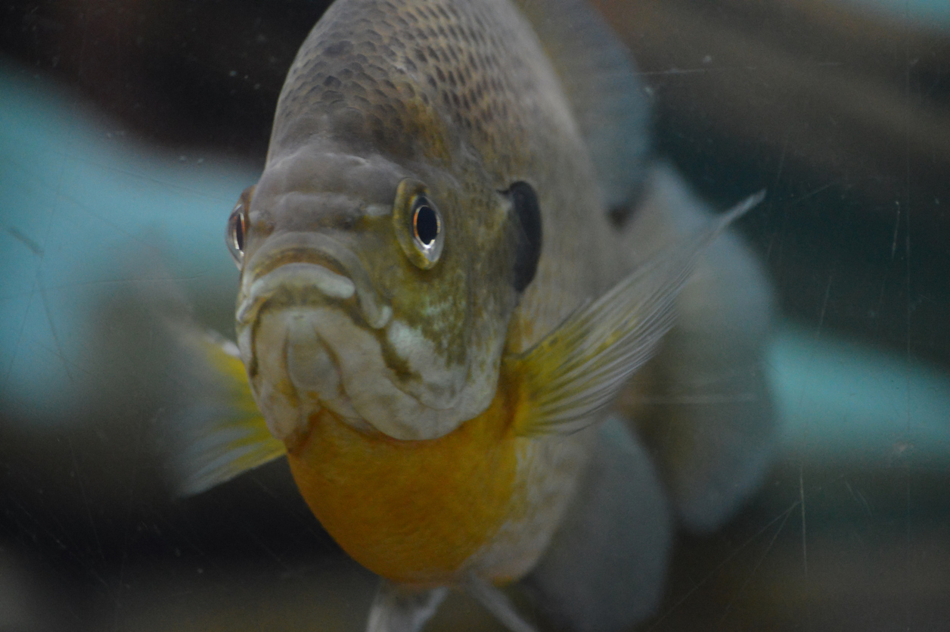
Case 2 Example: Fish
Suppose we are interested in estimating the mean (μ) of a normal distribution representing the length of a particular species of fish, Telmatochromis temporalis, in Lake Tanganyika in East Africa.
iStock-918633154 Credit - Trek13

Slide 21
Case 2 Example: Fish
Scientists have observed that the species consists of two ectomorphs: a big one that lives in the rocky shoreline and a small one that lives among the shells in the sand.
Assume prior studies indicate that the first population has a mean around 2 cm with high confidence, and the second population has a mean around 5 cm with moderate confidence.

Slide 22
(board example inserted here)
Notes:
Fish example

Slide 23
Next Time
More on multivariate simulation

