Slide 1
Bayesian Inference
Module 6, Lesson 2
Notes:
Welcome to lesson 2 of module 6 on Bayesian Inference

Slide 2
Simulation Techniques for Bayesian Inference
Shahrzad Jamshidi, PhD
Notes:
In this lesson, we will discuss simulation techniques for Bayesian inference.

Slide 3
Last Time
Numerical Methods and Approximations in Bayesian Computation
Notes:
Last time, we discussed numerical methods and approximations in Bayesian computation.

Slide 4
Objectives
Learn about various posterior simulation techniques.
Understand and apply direct simulation, rejection sampling, and importance sampling.
Notes:
By the end of this lesson, you will
Learn about the various posterior simulation techniques.
Understand and apply direct simuation, rejection sampling, and implortance samping.

Slide 5
Topics to Review
Hierarchical Models
The CDF function
Sampling
Probability density functions
Notes:
Some topics to review for this lesson include
Hierarchical models
The cdf function
Sampling
And the probability density function.

Slide 6
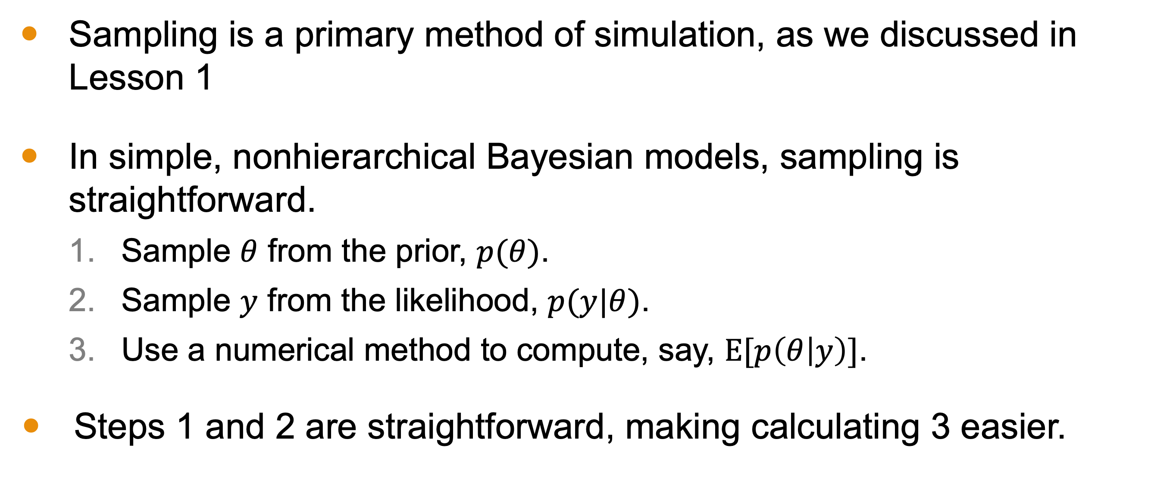
Direct Simulation: Simple Case
Sampling is a primary method of simulation, as we discussed in Lesson 1
In simple, nonhierarchical Bayesian models, sampling is straightforward.
Sample $θ$ from the prior, $p(θ)$.
Sample $y$ from the likelihood, $p(y|θ)$.
Use a numerical method to compute, say, $E[p\left(θ | y\right)]$.
Steps 1 and 2 are straightforward, making calculating 3 easier.
Notes:
Sampling is a primary method of simulation. In simple nonhierarchical Bayesian models, sampling involves drawing from the prior and likelihood distributions and then using numerical methods to compute posterior estimates. This process is straightforward in simple cases.

Slide 7
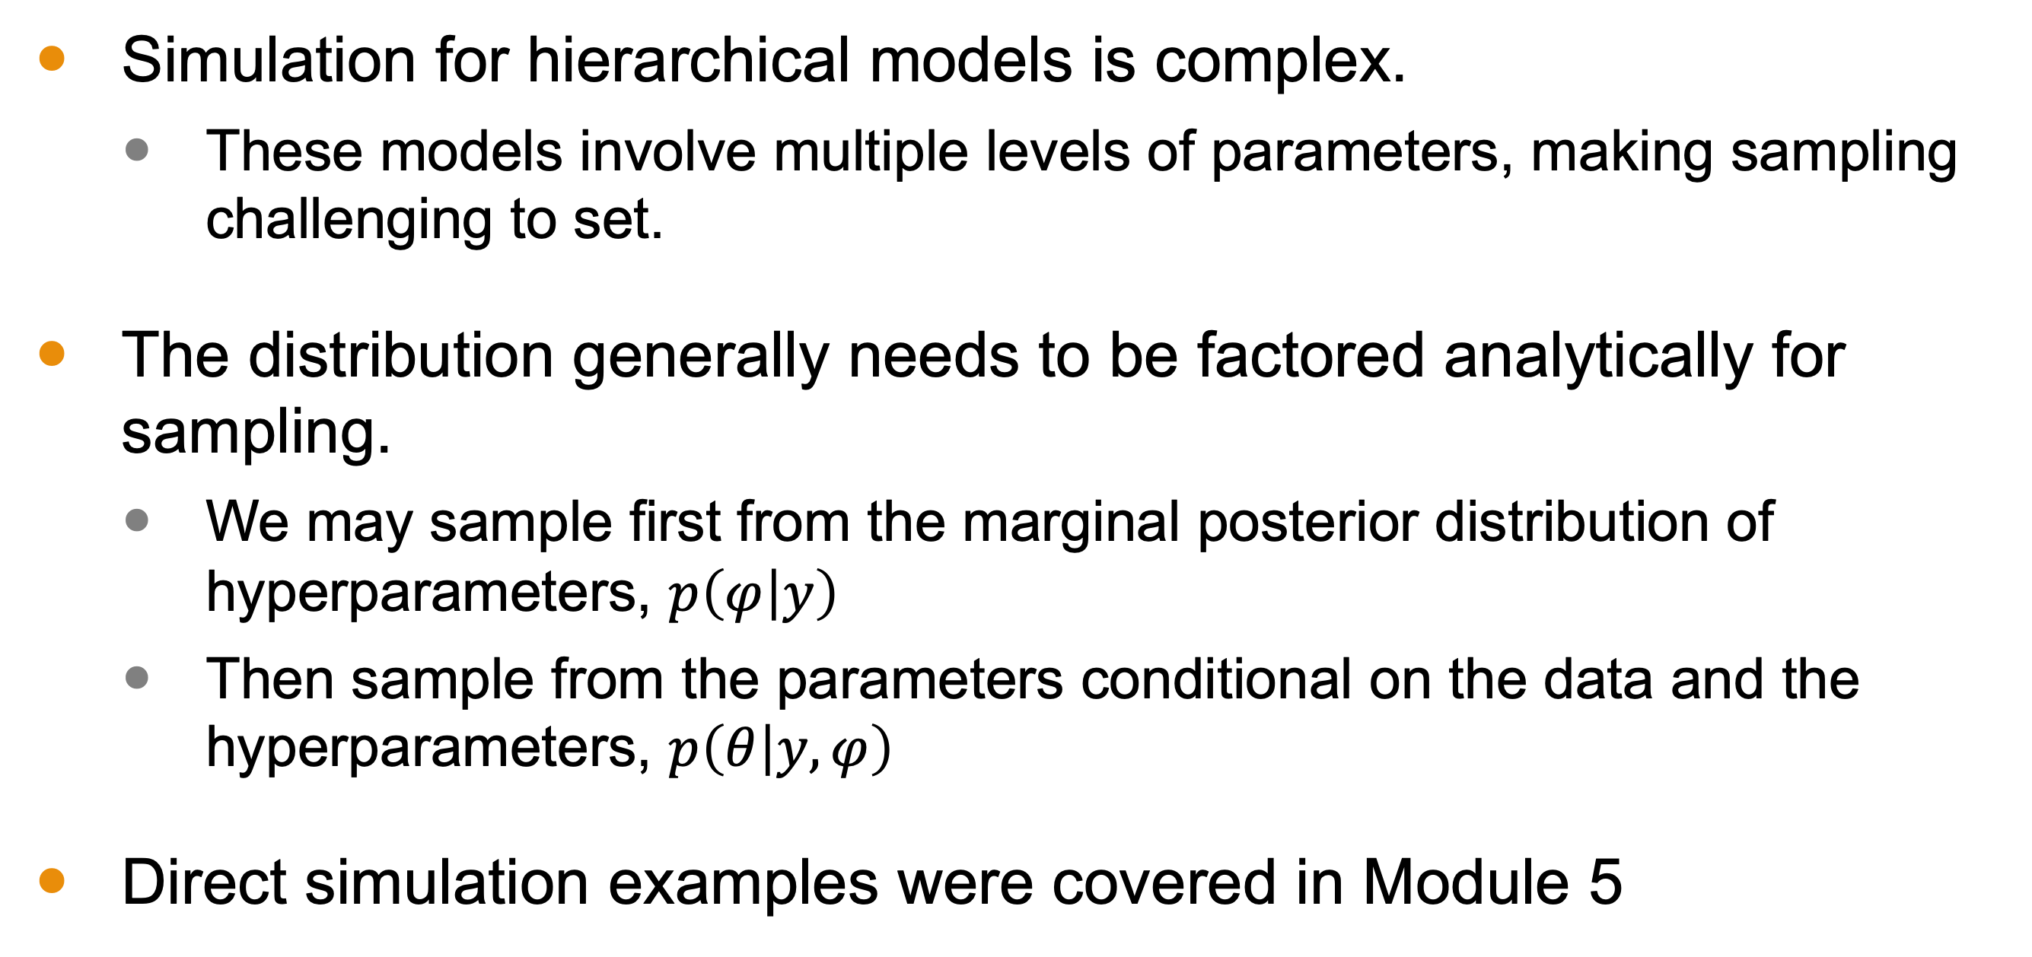
Direct Simulation: Complex Cases
Simulation for hierarchical models is complex.
These models involve multiple levels of parameters, making sampling challenging to set.
The distribution generally needs to be factored analytically for sampling.
We may sample first from the marginal posterior distribution of hyperparameters, $p\left(φ | y\right)$
Then sample from the parameters conditional on the data and the hyperparameters, $p\left(θ | y,φ\right)$
Direct simulation examples were covered in Module 5

Slide 8
Sampling
Regardless, draws from distributions are generally required in both cases.
Here, we discuss methods to draw a single sample.
One can then repeat the sample draws as needed.
Note: sometimes drawing multiple samples at once is more efficient.
This happens with multivariate normal distributions
This is because the draws are computationally expensive as they require factorizing the covariance matrix
Notes:
Regardless, draws from distributions are generally required in both cases.
Here, we discuss methods to draw a single sample.
One can then repeat the sample draws as needed.
Note: sometimes drawing multiple samples at once is more efficient.
This happens with multivariate normal distributions
This is because the draws are computationally expensive as they require factorizing the covariance matrix. If we draw many samples at once, we need only compute this factorization once, rather than each time a sample is drawn. The textbook references ”the Cholesky” factor and this is what it is refering to.

Slide 9
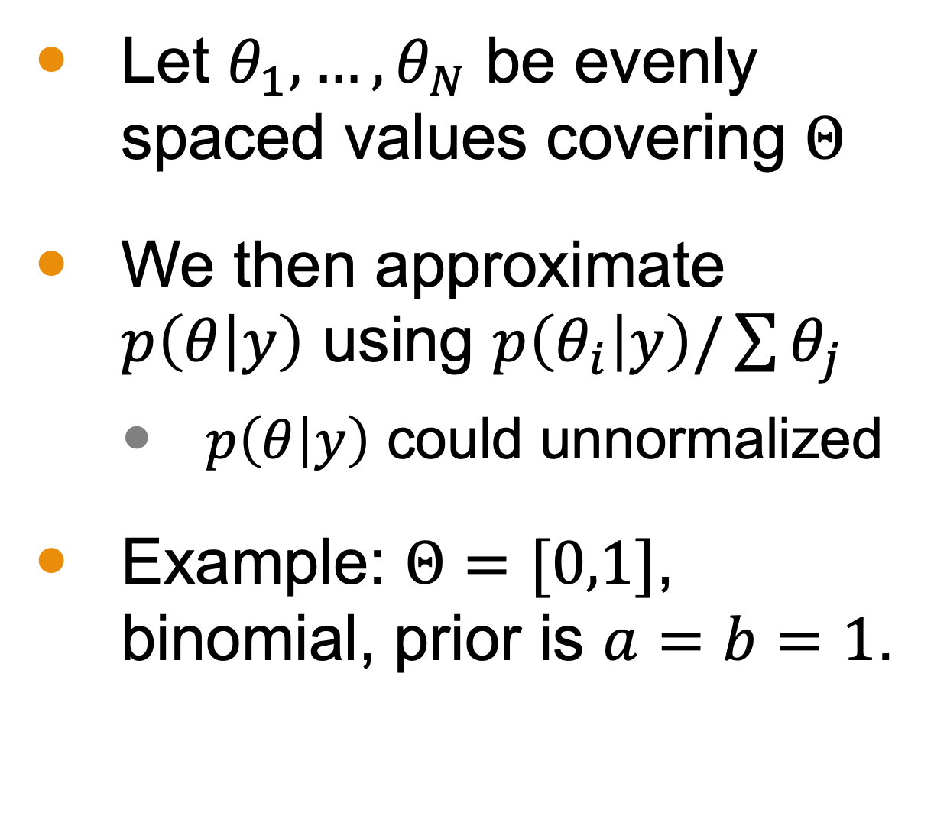
Direct Approximation Using a Grid
Let $θ_{1},…,θ_{N}$ be evenly spaced values covering $Θ$
We then approximate $p\left(θ | y\right)$ using $p\left(θ_{i} | y\right)/\sum{θ_{j}}$
$p\left(θ | y\right)$ could unnormalized
Example: $Θ=[0,1]$, binomial, prior is $a=b=1$.

Slide 10
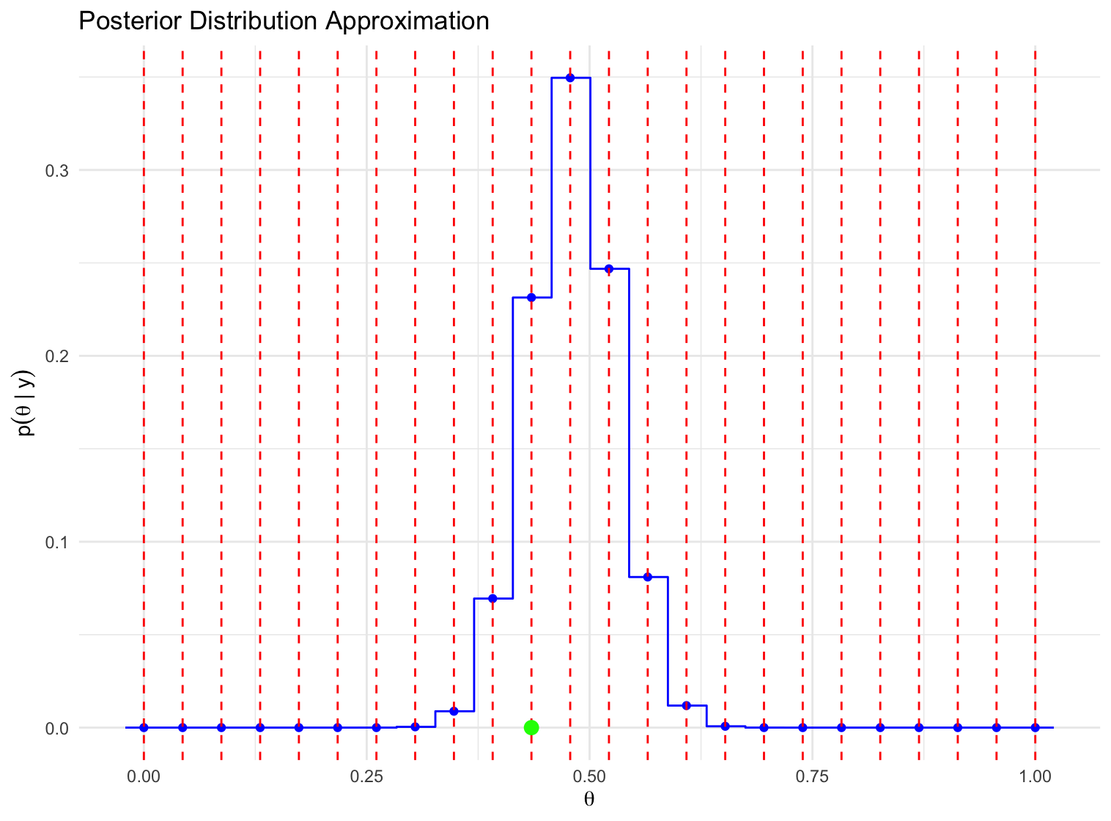
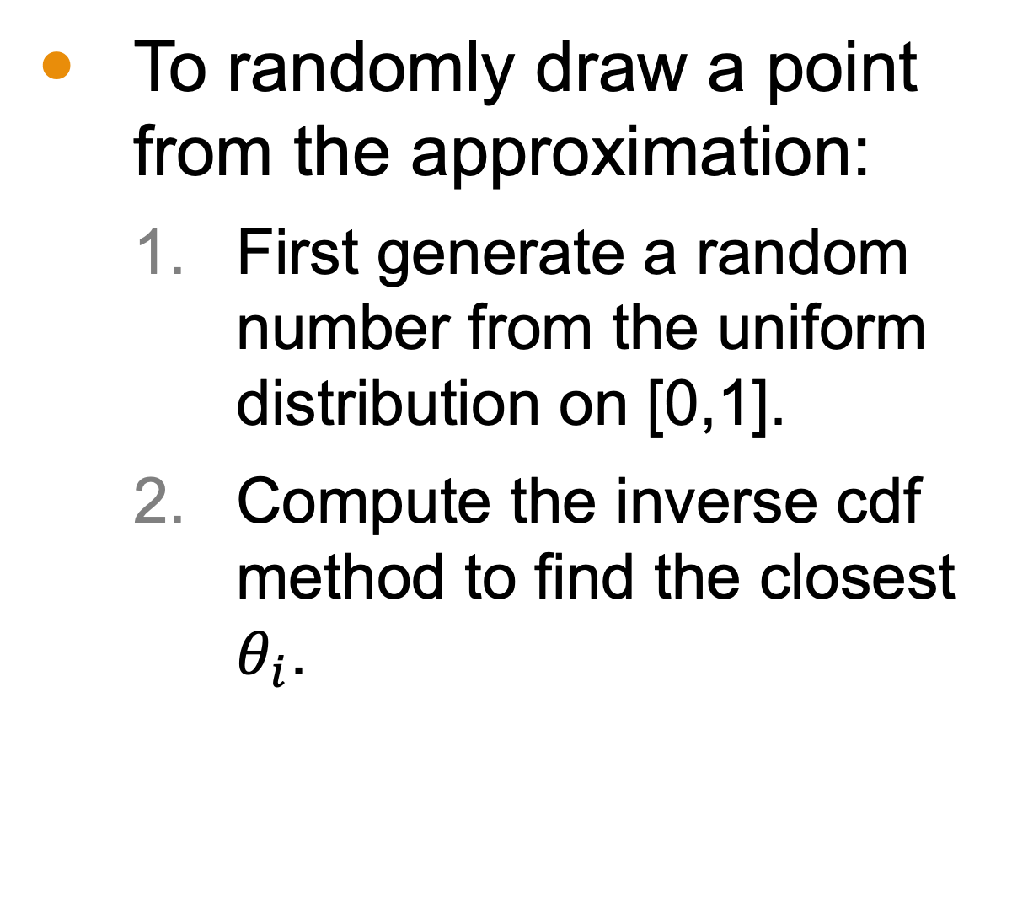
Drawing from this Approximation
To randomly draw a point from the approximation:
First generate a random number from the uniform distribution on [0,1].
Compute the inverse cdf method to find the closest $θ_{i}$.

Slide 11
(board example inserted here)
Notes:
M6L21InverseCDF

Slide 12
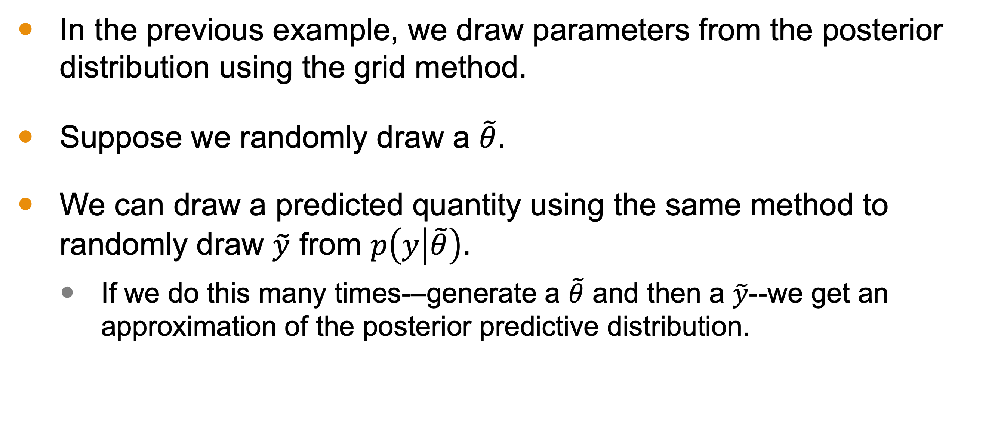
Simulating from Predictive Distributions
In the previous example, we draw parameters from the posterior distribution using the grid method.
Suppose we randomly draw a $\tilde{θ}$.
We can draw a predicted quantity using the same method to randomly draw $\tilde{y}$ from $p\left(y | \tilde{θ}\right)$.
If we do this many times-–generate a $\tilde{θ}$ and then a $\tilde{y}$--we get an approximation of the posterior predictive distribution.

Slide 13
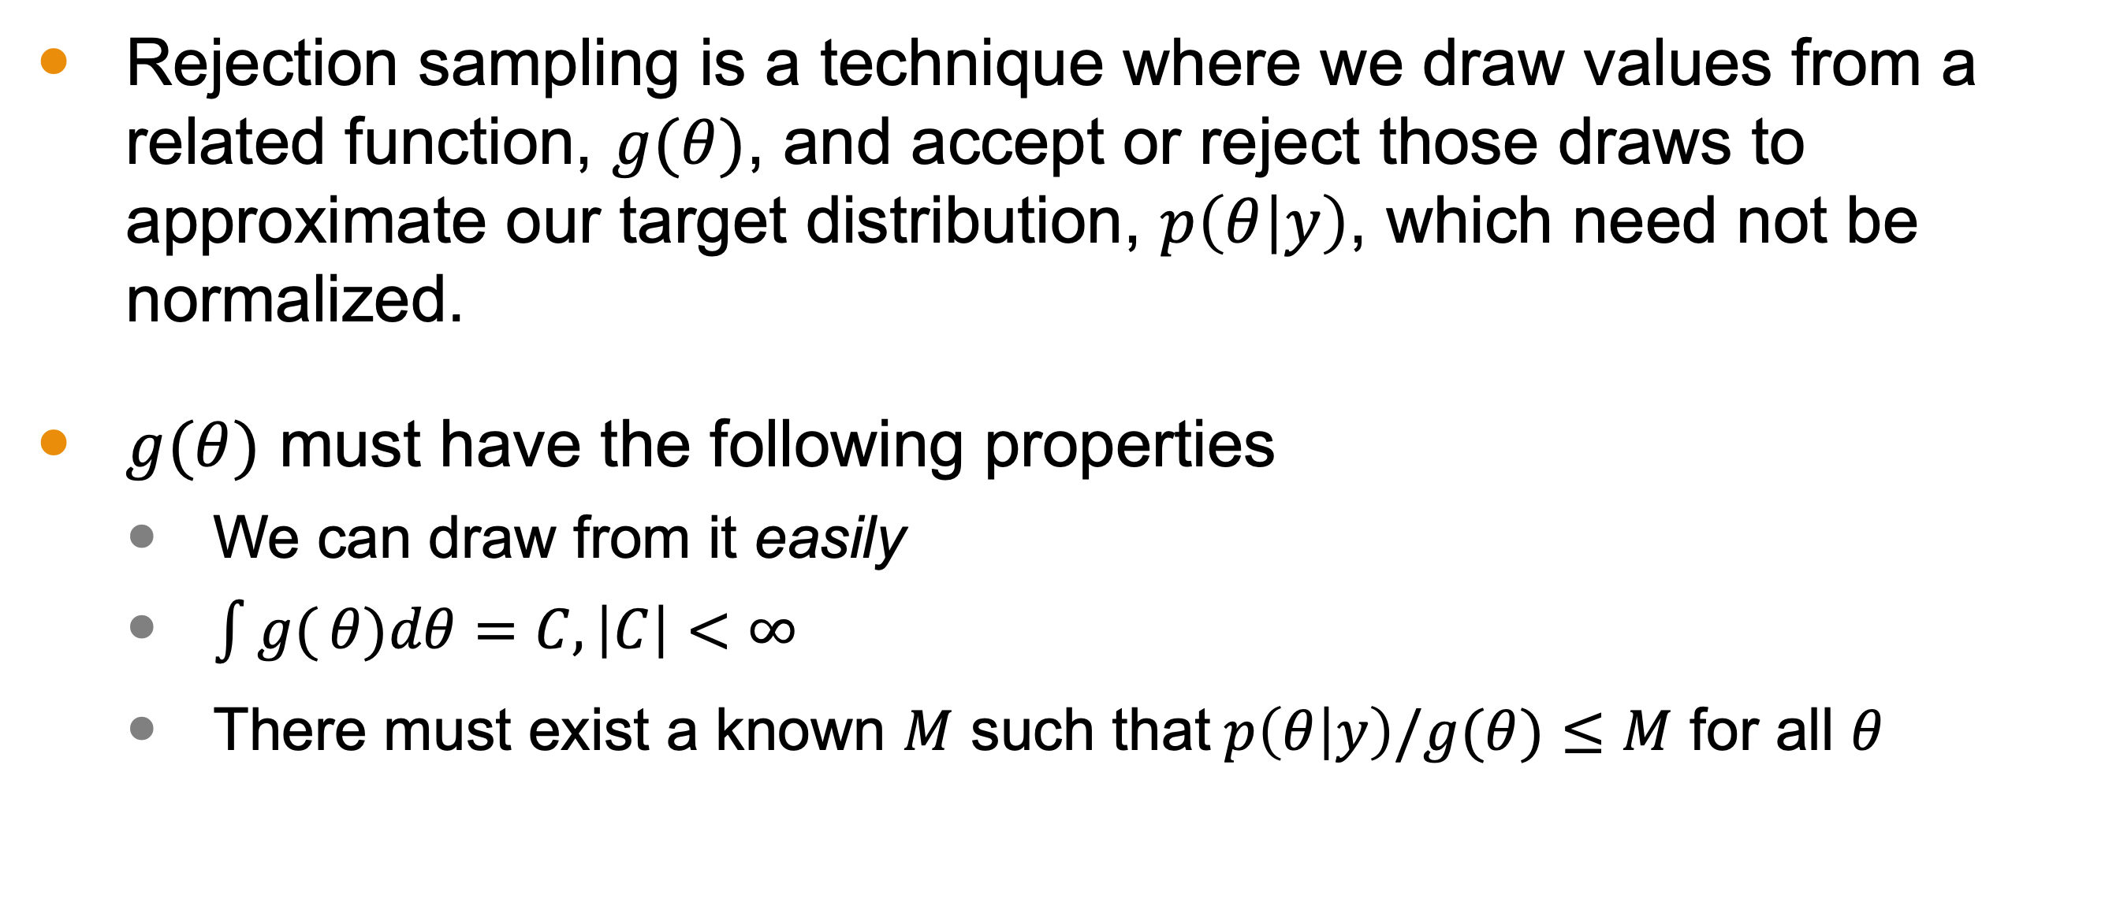
Rejection Sampling
Rejection sampling is a technique where we draw values from a related function, $g(θ)$, and accept or reject those draws to approximate our target distribution, $p\left(θ | y\right)$, which need not be normalized.
$g(θ)$ must have the following properties
We can draw from it easily
$\int{g(}θ)dθ=C, \left|C\right|<∞$
There must exist a known $M$ such that$p\left(θ | y\right)/g(θ)≤M$ for all $θ$
Notes:
Rejection sampling is a technique where we draw values from a related function, $g(θ)$, and accept or reject those draws to approximate our target distribution, $p\left(θ | y\right)$.Conceptually, it is like guessing what a person looks like that you’ve never seen before after you met their parents.
In order for this to work, $g(θ)$ must
Be a function for which we can easily generate values because, presumeably, this is why you are doing this method instead of drawing directly from your target distribution!
Integrate to a finite value, but it doesn’t need to be to 1.
And the ratio of the target distribution to the related function g needs to be bounded for all choice of theta.

Slide 14
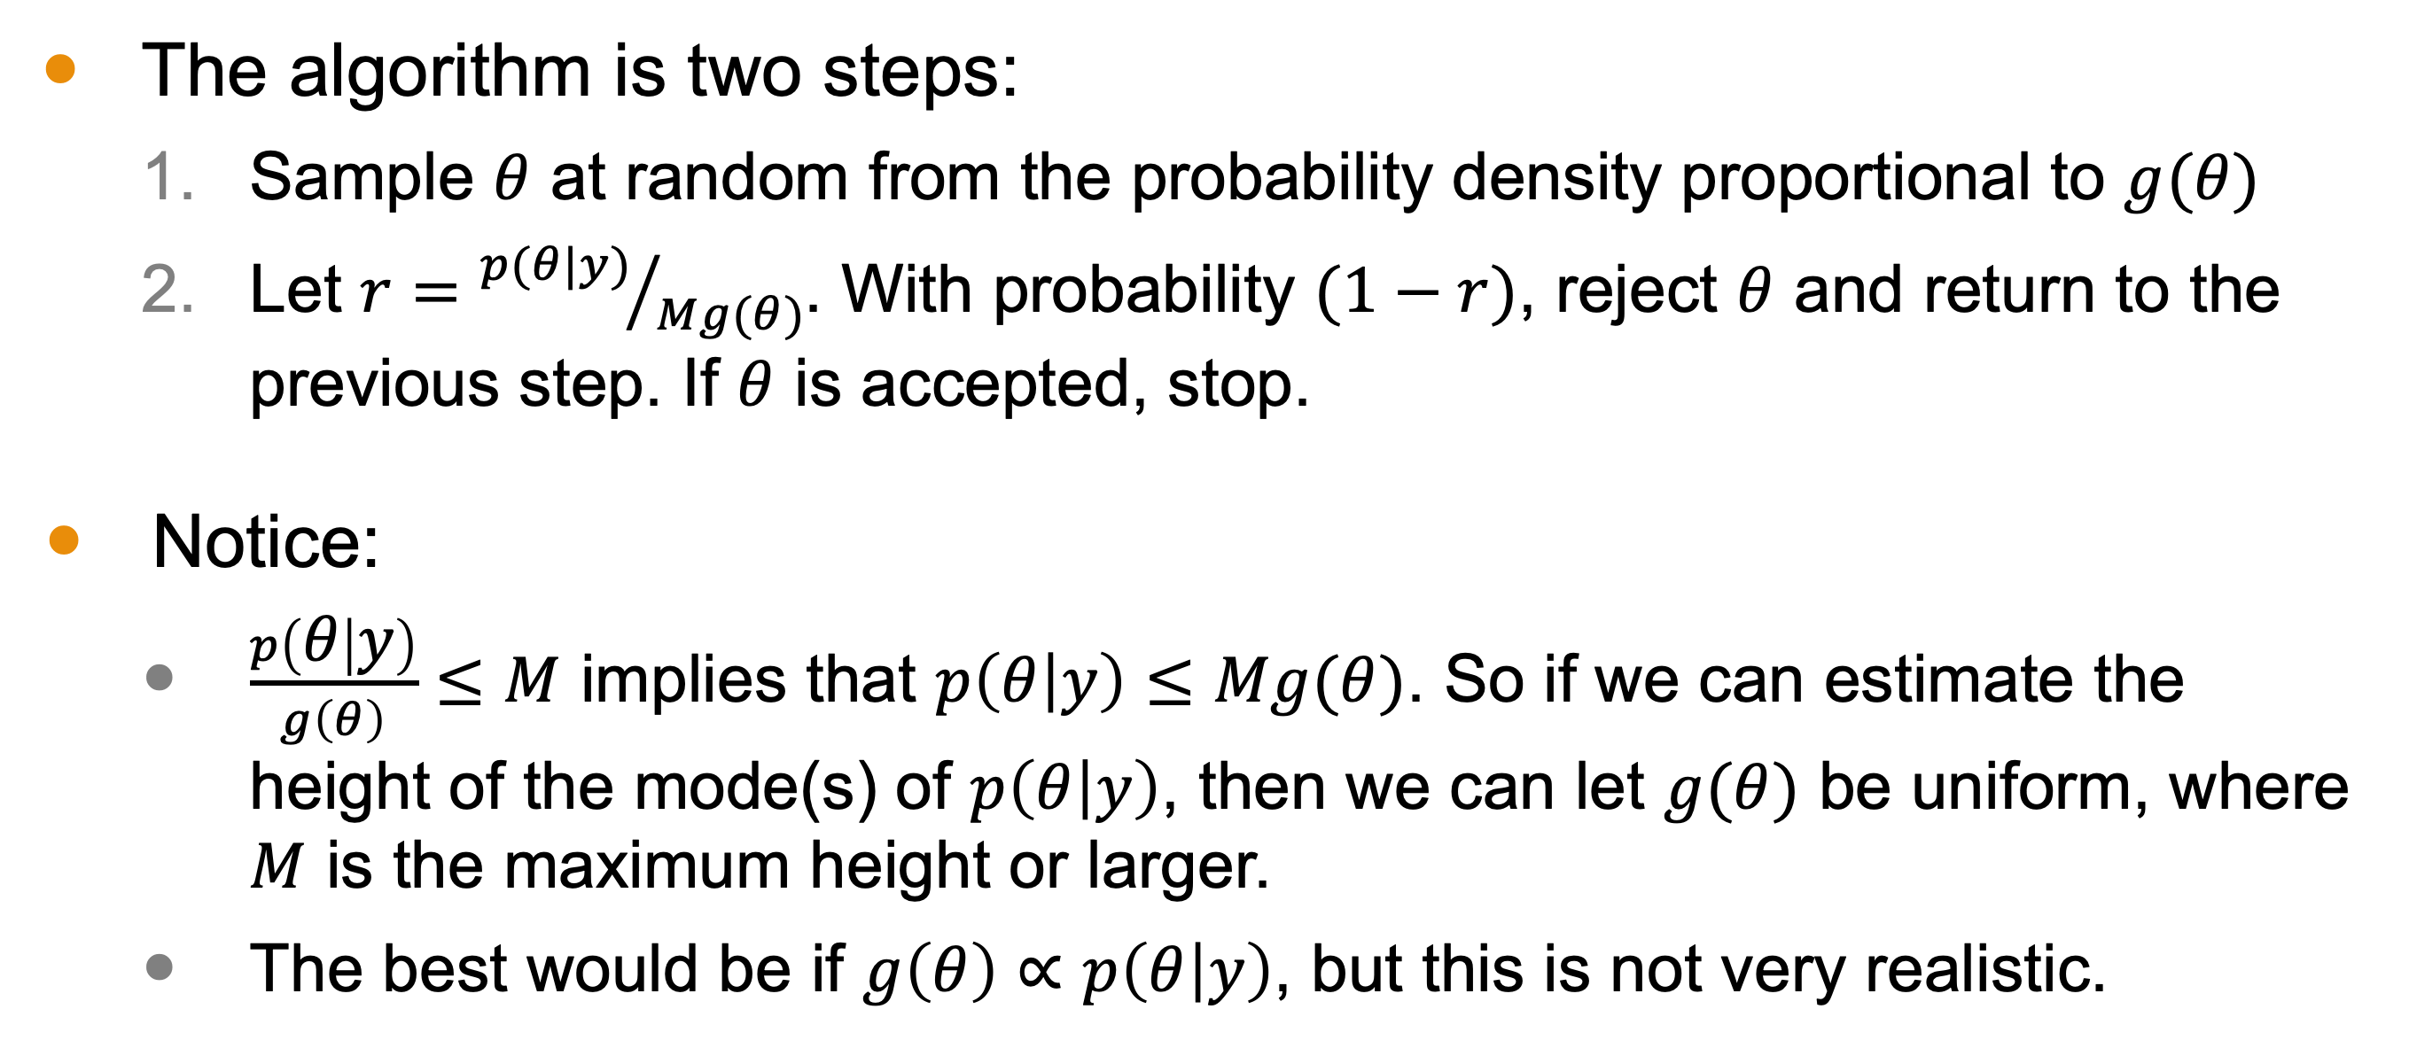
Rejection Sampling Algorithm
The algorithm is two steps:
Sample $θ$ at random from the probability density proportional to $g(θ)$
Let $r={p(θ|y)}/{Mg(θ)}$. With probability $(1−r)$, reject $θ$ and return to the previous step. If $θ$ is accepted, stop.
Notice:
$\frac{p\left(θ | y\right)}{g\left(θ\right)}≤M$ implies that $p\left(θ | y\right)≤Mg(θ)$. So if we can estimate the height of the mode(s) of $p\left(θ | y\right)$, then we can let $g(θ)$ be uniform, where $M$ is the maximum height or larger.
The best would be if $g\left(θ\right)∝p\left(θ | y\right)$, but this is not very realistic.

Slide 15
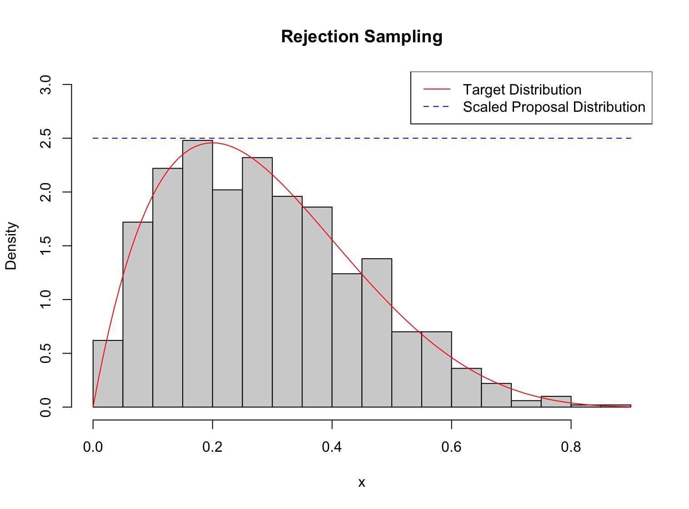
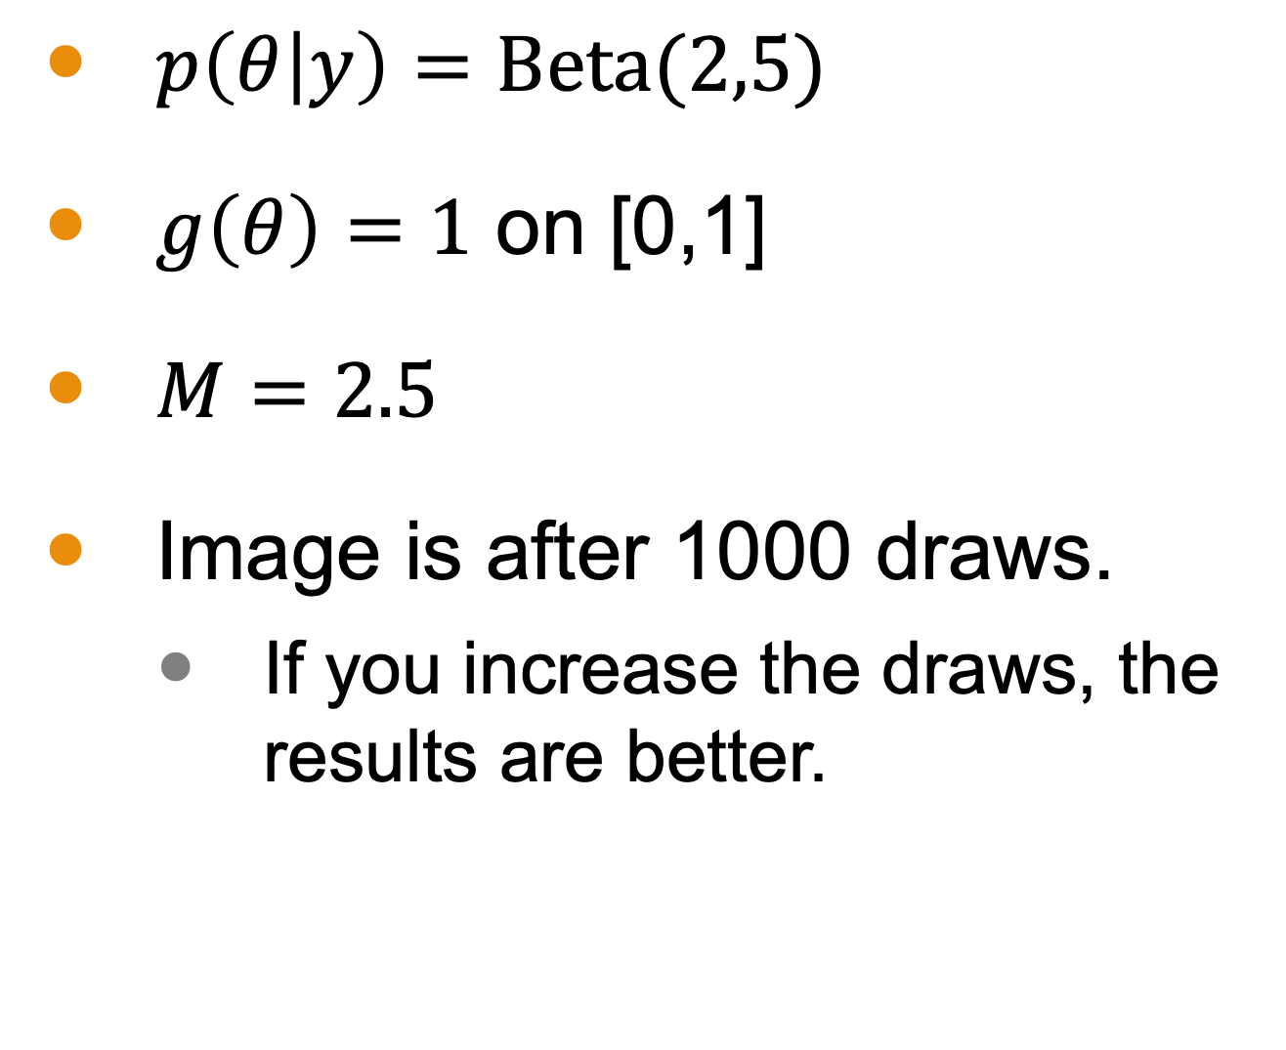
Example of Rejection Sampling
$p\left(θ | y\right)=Beta(2,5)$
$g\left(θ\right)=1$ on [0,1]
$M=2.5$
Image is after 1000 draws.
If you increase the draws, the results are better.
Notes:
So here we compute a simple example where the target distribution is the Beta distribution with parameters 2 and 5.
We use the trick of a uniform distribution
With M=2.5 since I happen do know that that is the maximum.
And after 1000 samples, we get the depicted distribution. If you look at the code, however, and increase the samples to 3000, you will get a better approximation

Slide 16

Remarks on Rejection Sampling
It’s important to emphasize that I need to be able to compute $p\left(θ | y\right)$ to use this technique.
This technique is to draw values of $θ$ with the probability defined by $p\left(θ | y\right)$, which might be hard to do.

Slide 17
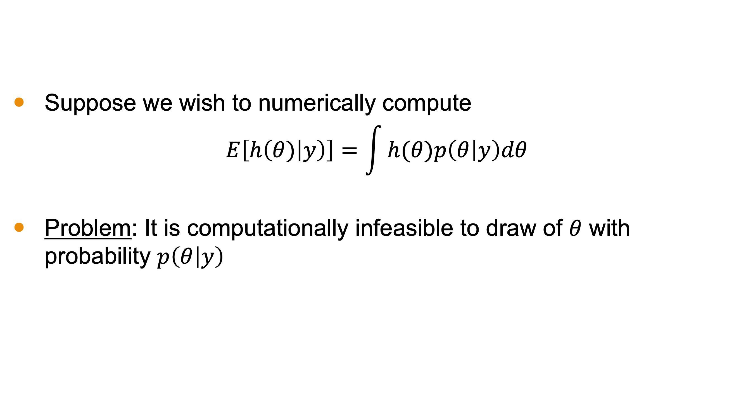
Importance Sampling Motivation
Suppose we wish to numerically compute $E\left[h\left(θ) | y\right)\right]=\int{h(θ)p\left(θ | y\right)dθ}$
Problem: It is computationally infeasible to draw of $θ$ with probability $p\left(θ | y\right)$

Slide 18
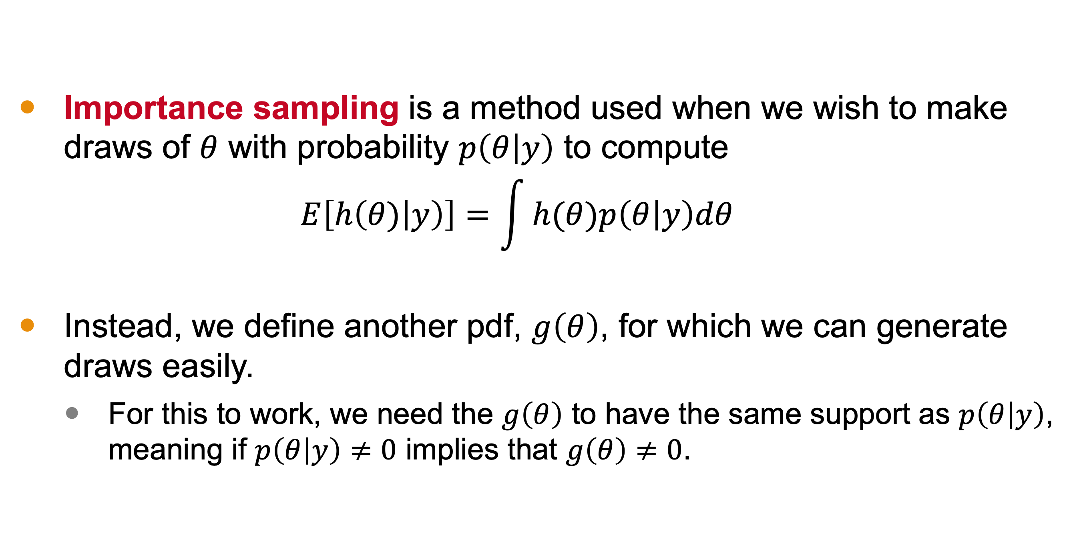
Importance Sampling
Importance sampling is a method used when we wish to make draws of $θ$ with probability $p\left(θ | y\right)$ to compute $E\left[h\left(θ) | y\right)\right]=\int{h(θ)p\left(θ | y\right)dθ}$
Instead, we define another pdf, $g\left(θ\right)$, for which we can generate draws easily.
For this to work, we need the $g\left(θ\right)$ to have the same support as $p\left(θ | y\right)$, meaning if $p\left(θ | y\right)≠0$ implies that $g\left(θ\right)≠0$.

Slide 19
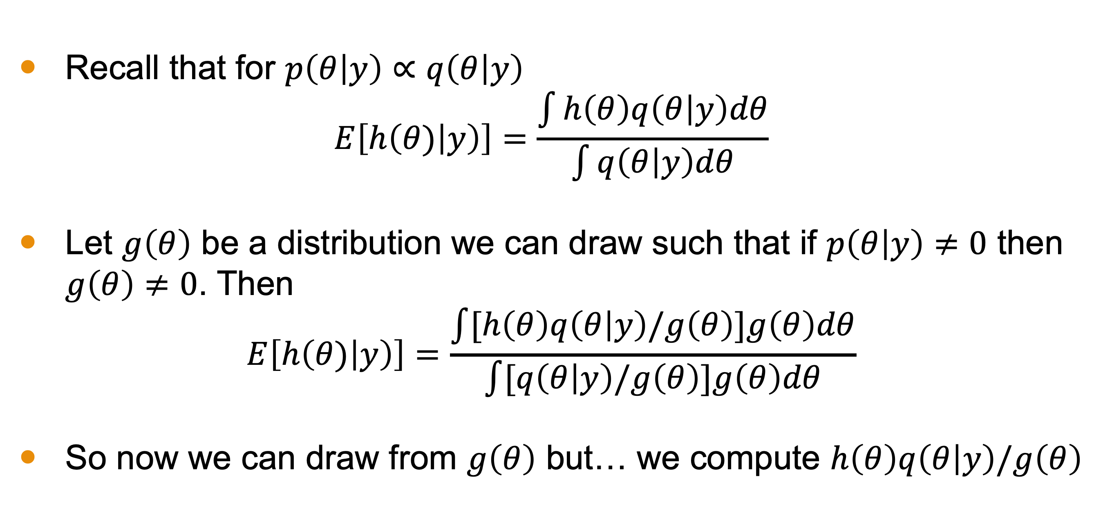
Importance Sampling Idea
Recall that for $p\left(θ | y\right)∝q\left(θ | y\right)$
$$E\left[h\left(θ) | y\right)\right]=\frac{\int{h\left(θ\right)q\left(θ | y\right)dθ}}{\int{q\left(θ | y\right)dθ}}$$
Let $g\left(θ\right)$ be a distribution we can draw such that if $p\left(θ | y\right)≠0$ then $g\left(θ\right)≠0$. Then
$$E\left[h\left(θ) | y\right)\right]=\frac{\int{[h\left(θ\right)q\left(θ | y\right)/g\left(θ\right)]g\left(θ\right)dθ}}{\int{[q\left(θ | y\right)/g\left(θ\right)]g\left(θ\right)dθ}}$$
So now we can draw from $g\left(θ\right)$ but… we compute $h\left(θ\right)q\left(θ | y\right)/g\left(θ\right)$

Slide 20
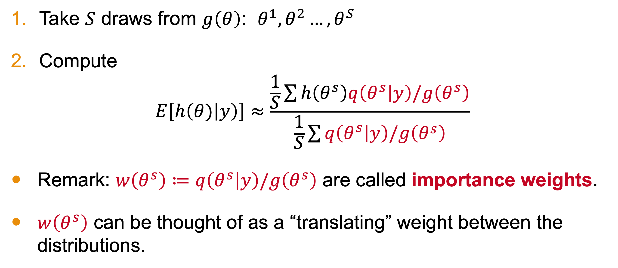
Importance Sampling Technique
Take $S$ draws from $g\left(θ\right)$: $θ^{1},θ^{2}…,θ^{S}$
Compute
$$E\left[h\left(θ) | y\right)\right]≈\frac{\frac{1}{S}\sum{h\left(θ^{s}\right)q\left(θ^{s} | y\right)/g\left(θ^{s}\right)}}{\frac{1}{S}\sum{q\left(θ^{s} | y\right)/g\left(θ^{s}\right)}}$$
Remark: $w\left(θ^{s}\right)≔q\left(θ^{s} | y\right)/g\left(θ^{s}\right)$ are called importance weights.
$w\left(θ^{s}\right)$ can be thought of as a “translating” weight between the distributions.

Slide 21
Sampling-Importance Resampling (SIR)
Sampling-Importance Resampling (SIR) is another method of drawing from a distribution numerically.
It adds a resampling step to importance sampling to generate a set of samples that more accurately represent the target distribution.

Slide 22
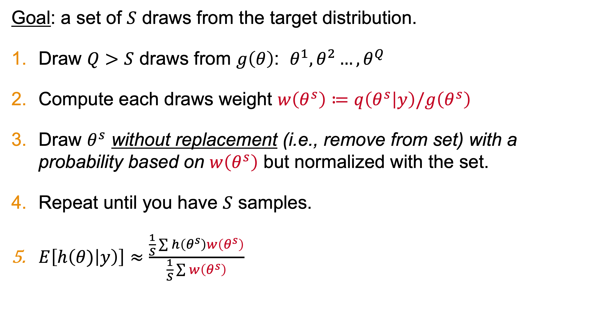
SIR Technique
Goal: a set of $S$ draws from the target distribution.
Draw $Q>S$ draws from $g\left(θ\right)$: $θ^{1},θ^{2}…,θ^{Q}$
Compute each draws weight $w\left(θ^{s}\right)≔q\left(θ^{s} | y\right)/g\left(θ^{s}\right)$
Draw $θ^{s}$ without replacement (i.e., remove from set) with a probability based on $w\left(θ^{s}\right)$ but normalized with the set.
Repeat until you have $S$ samples.
$E\left[h\left(θ) | y\right)\right]≈\frac{\frac{1}{S}\sum{h\left(θ^{s}\right)w\left(θ^{s}\right)}}{\frac{1}{S}\sum{w\left(θ^{s}\right)}}$

Slide 23
Importance of Simulations: Visualization
Bayesian inferences are typically summarized by random draws from the posterior distribution of model parameters.
Percentiles (e.g., 2.5%, 25%, 50%, 75%, and 97.5%) of the posterior distribution of univariate estimands are reported to convey the shape of the distribution.
For two or three dimensions, scatterplots, contour plots, or more sophisticated graphical techniques can be used to examine the posterior distribution.

Slide 24
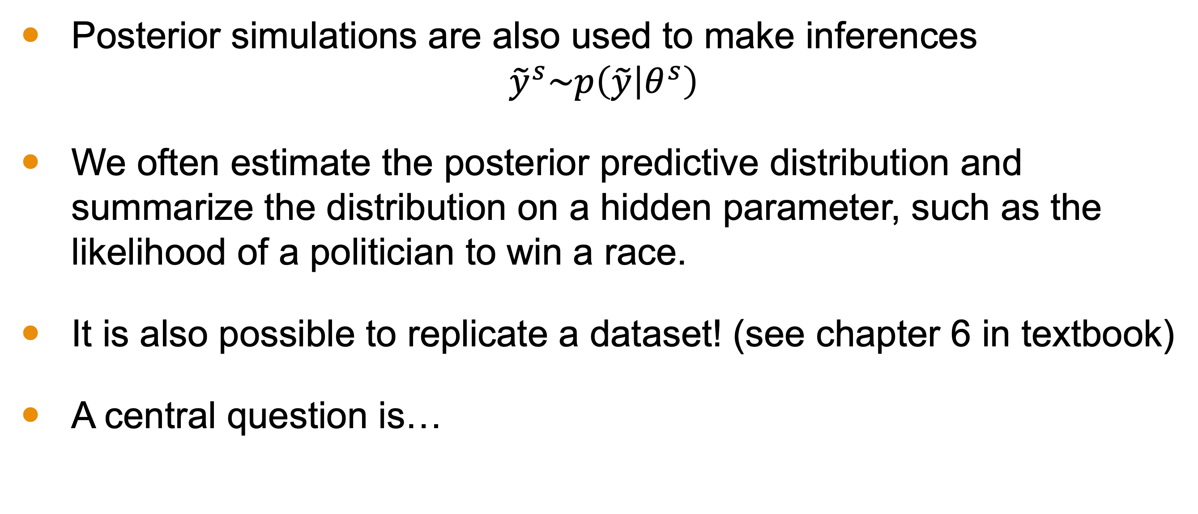
Importance of Simulations: Prediction & Data
Posterior simulations are also used to make inferences
$${\tilde{y}}^{s}\sim p\left(\tilde{y} | θ^{s}\right)$$
We often estimate the posterior predictive distribution and summarize the distribution on a hidden parameter, such as the likelihood of a politician to win a race.
It is also possible to replicate a dataset! (see chapter 6 in textbook)
A central question is…

Slide 25
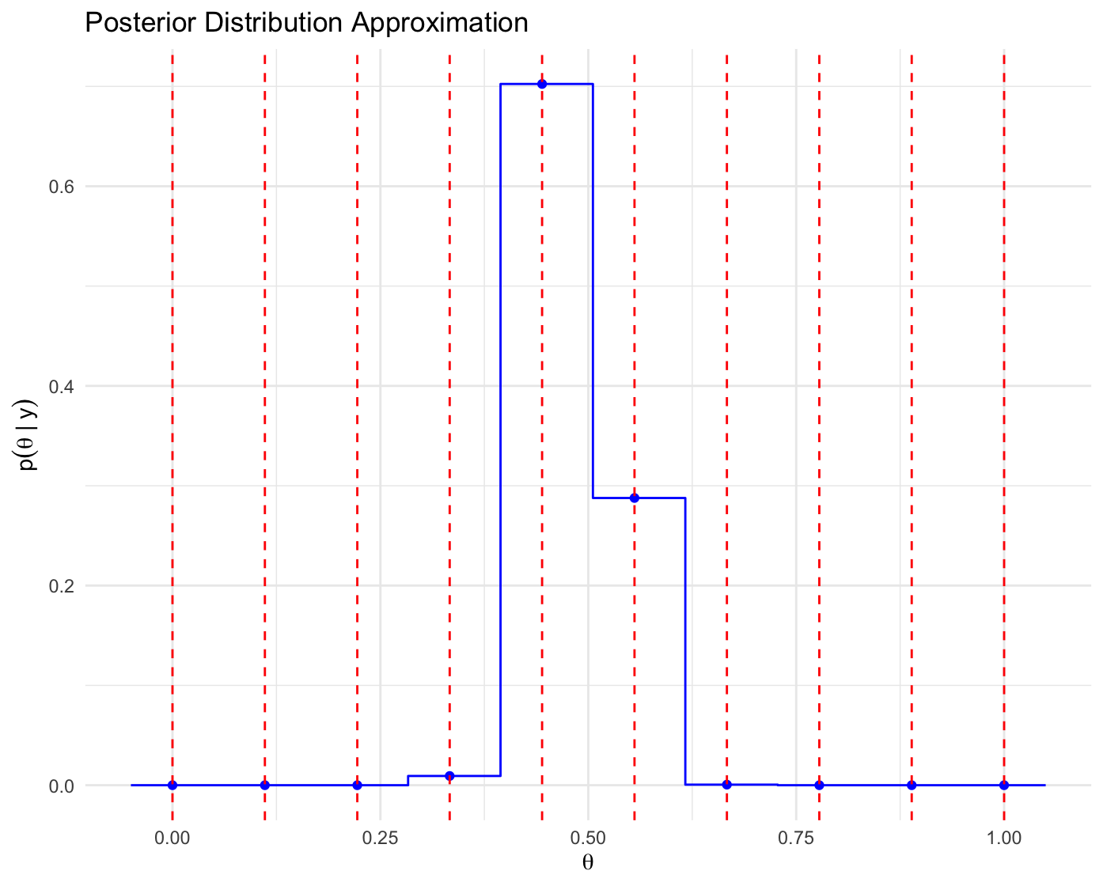
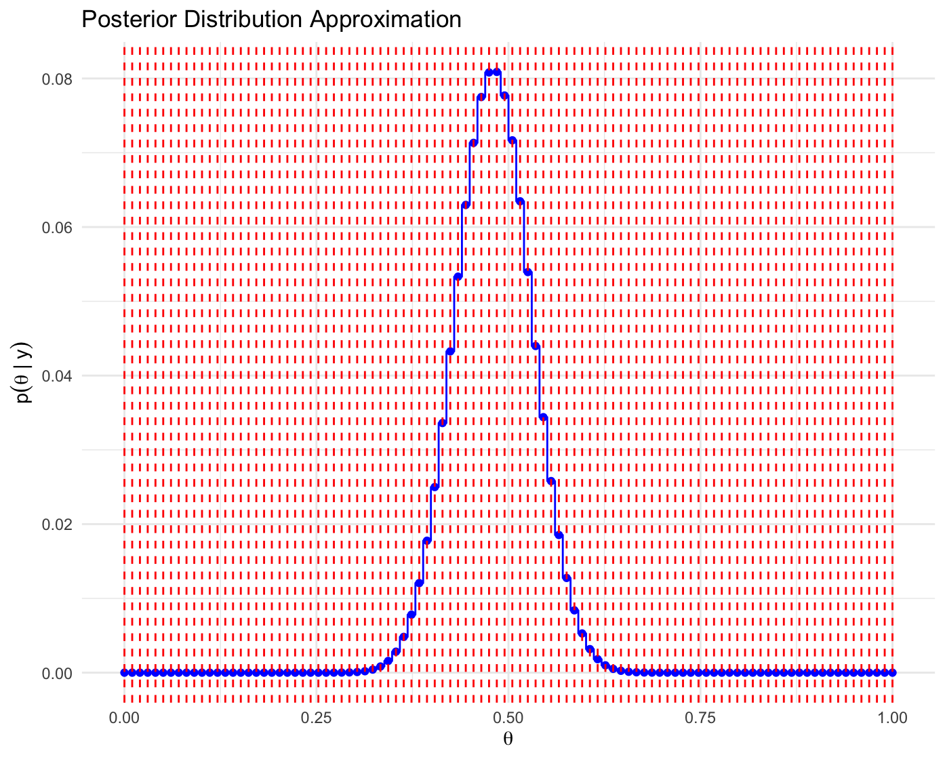
How Many Samples are Enough?
10
100

Slide 26
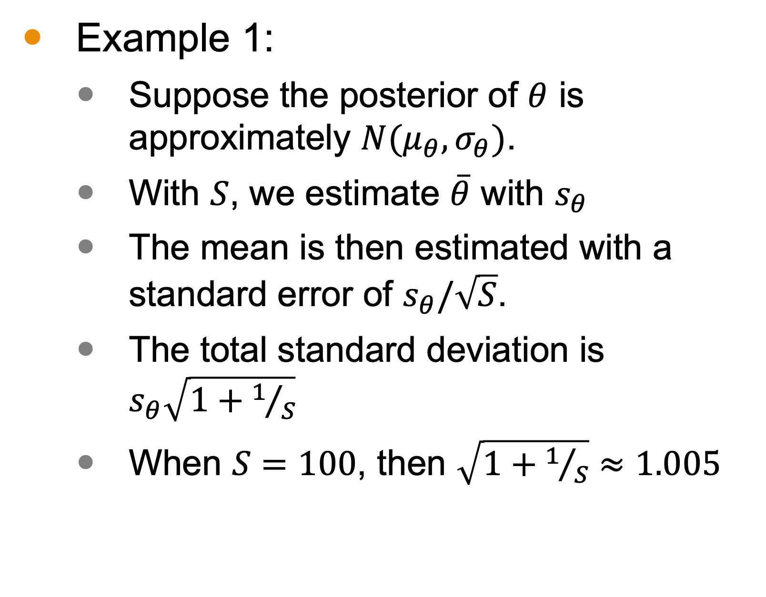
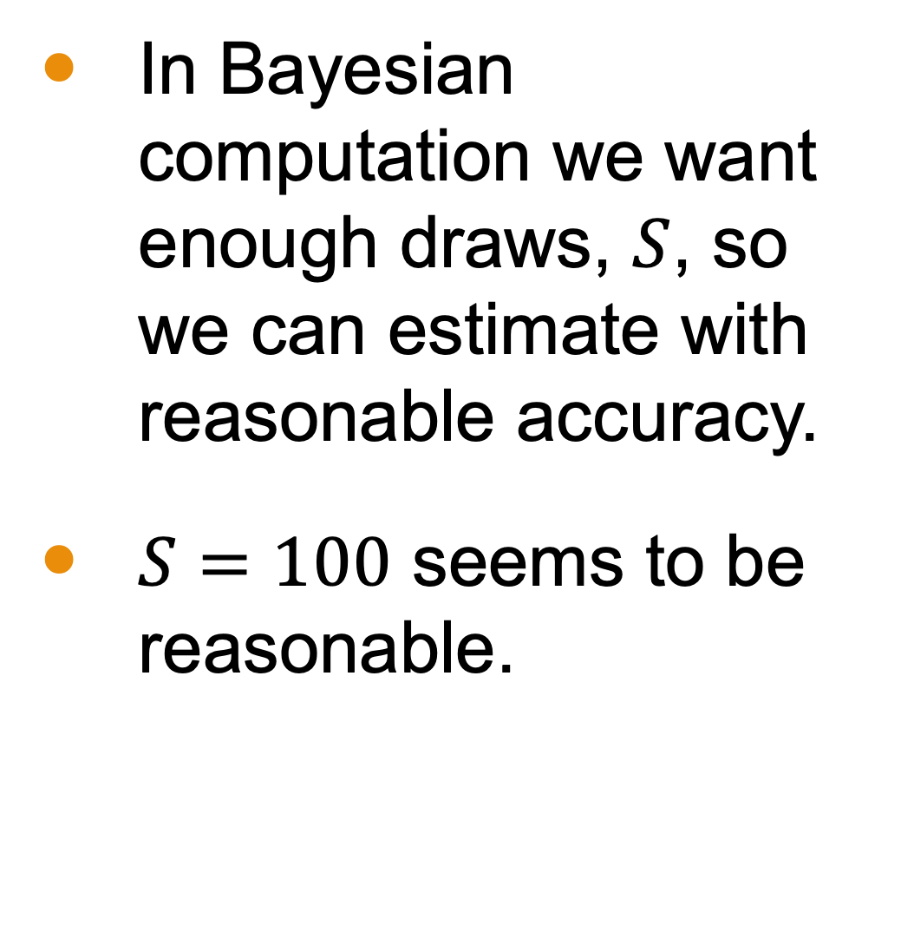
The Number of Samples for Mean Estimation
In Bayesian computation we want enough draws, $S$, so we can estimate with reasonable accuracy.
$S=100$ seems to be reasonable.
Example 1:
Suppose the posterior of $θ$ is approximately $N(μ_{θ},σ_{θ})$.
With $S$, we estimate $\overline{θ}$ with $s_{θ}$
The mean is then estimated with a standard error of $s_{θ}/\sqrt{S}$.
The total standard deviation is $s_{θ}\sqrt{1+1/S}$
When $S=100$, then $\sqrt{1+1/S}≈1.005$

Slide 27
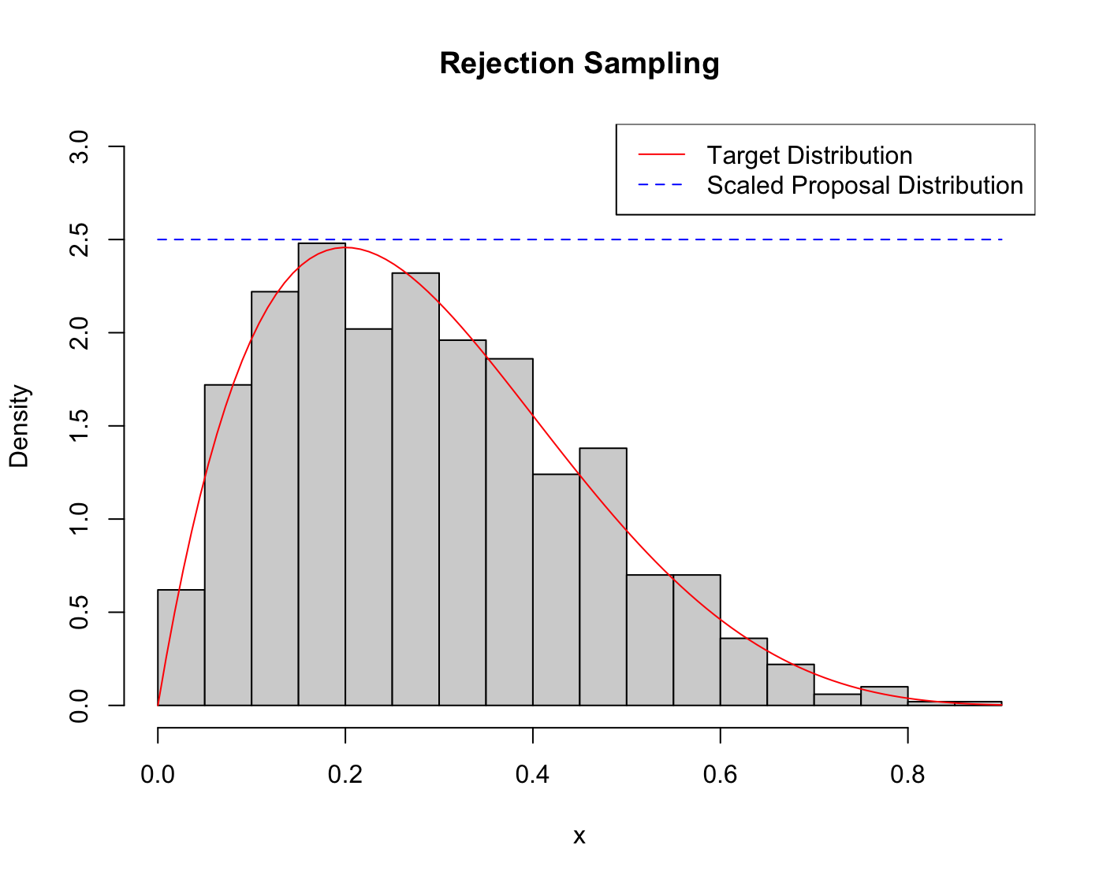

How Many Samples are Enough?
1000
2500
Notes:
Here we see two distributions. Which one looks like a better approximation.
The one on the left is made up of 1000 samples.
The one on the right is 2500 samples.

Slide 28
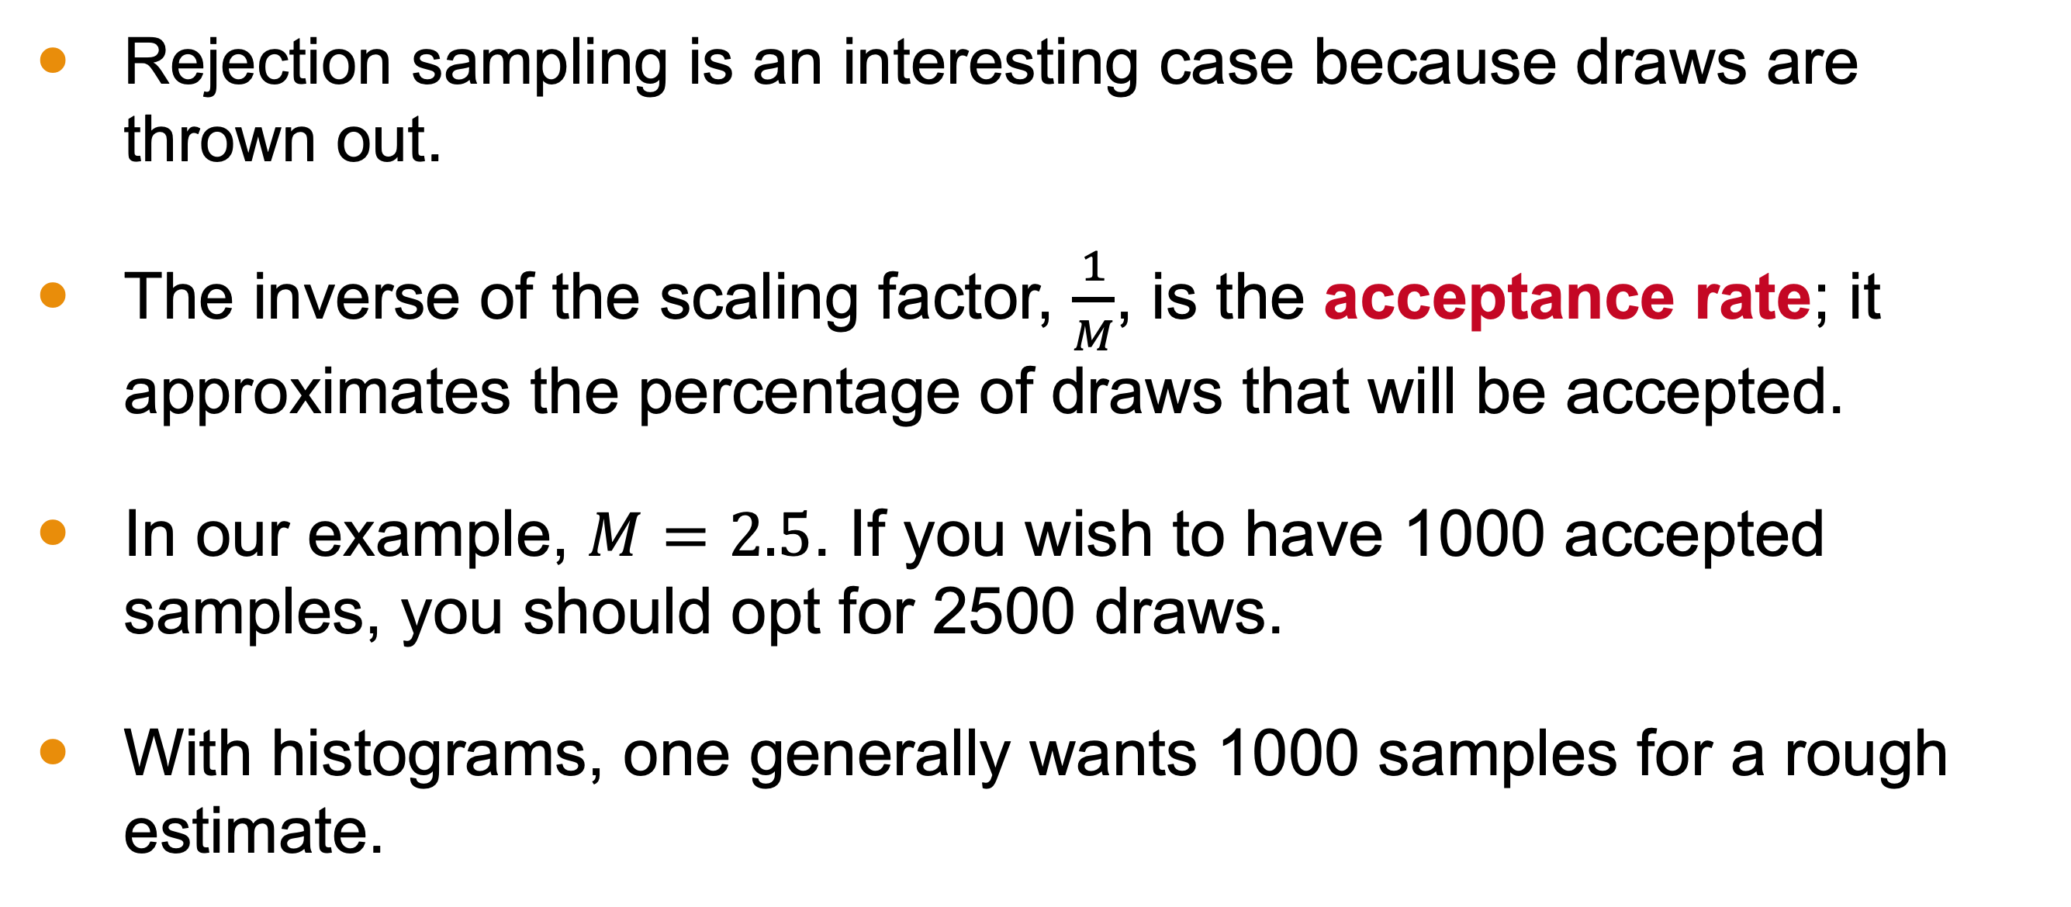
Rejection Sampling Numbers
Rejection sampling is an interesting case because draws are thrown out.
The inverse of the scaling factor, $\frac{1}{M}$, is the acceptance rate; it approximates the percentage of draws that will be accepted.
In our example, $M=2.5$. If you wish to have 1000 accepted samples, you should opt for 2500 draws.
With histograms, one generally wants 1000 samples for a rough estimate.
Notes:
Rejection sampling is an interesting case because draws are thrown out.
The inverse of the scaling factor, $\frac{1}{M}$, is the acceptance rate; it approximates the percentage of draws that will be accepted.
In our example, $M=2.5$. If you wish to have 1000 accepted samples, you should opt for 2500 draws.
With histograms, one generally wants 1000 samples for a rough estimate.

Slide 29
Next Time
Advanced Markov Chain Methods for Bayesian Computation

