Slide 1
Baseball Analytics
Jordan Rivera

Slide 2
Old Scouting Theory vs. New Scouting Theory
Old Scouting Theory
Five tools: hitting, power-hitting, speed, fielding, throwing
Originated in 1950s – scouting reports were short and were not graded on numeric basis
In the 1990s, the 20-80 scale was introduced
New Scouting Theory
Originated with Bill James, who introduced sabermetrics
Uses analytics and data to evaluate players
Caught on in the early 2000s, when Billy Beane constructed an A’s team using these principles – “Moneyball”
Today, MLB continues to shift away from Old Scouting Theory and towards New Scouting Theory

Slide 3
Moneyball Theory
Using statistics and data analysis, small market teams can compete by buying assets undervalued by other teams and selling ones that are overvalued by other teams
Key statistics: OBP and SLG – from 1999-2003, OBP was a significant predictor of wins, but not individual player salaries
Old stats that designated as overvalued: batting average, RBIs, stolen bases
Billy Beane used Bill James’ theory of sabermetrics to develop a new strategy of building an Oakland A’s team that had the third lowest payroll in the league
In 2002, implemented this new strategy amidst backlash, but the A’s went on to win 20 games in a row, win 103 games overall, and finish 1st in their division
Impact: more and more teams began to follow in Beane’s footsteps

Slide 4
Today
The stats valued by the Moneyball Theory have become more valued – OBP, for example, is no longer undervalued
Small market teams need to stay ahead of the curve and find the “next” Moneyball Theory
General managers and baseball analysts continue to search for new metrics that could correlate with player value
Technology has allowed for new metrics that are starting to have a similar impact as the Moneyball Theory

Slide 5
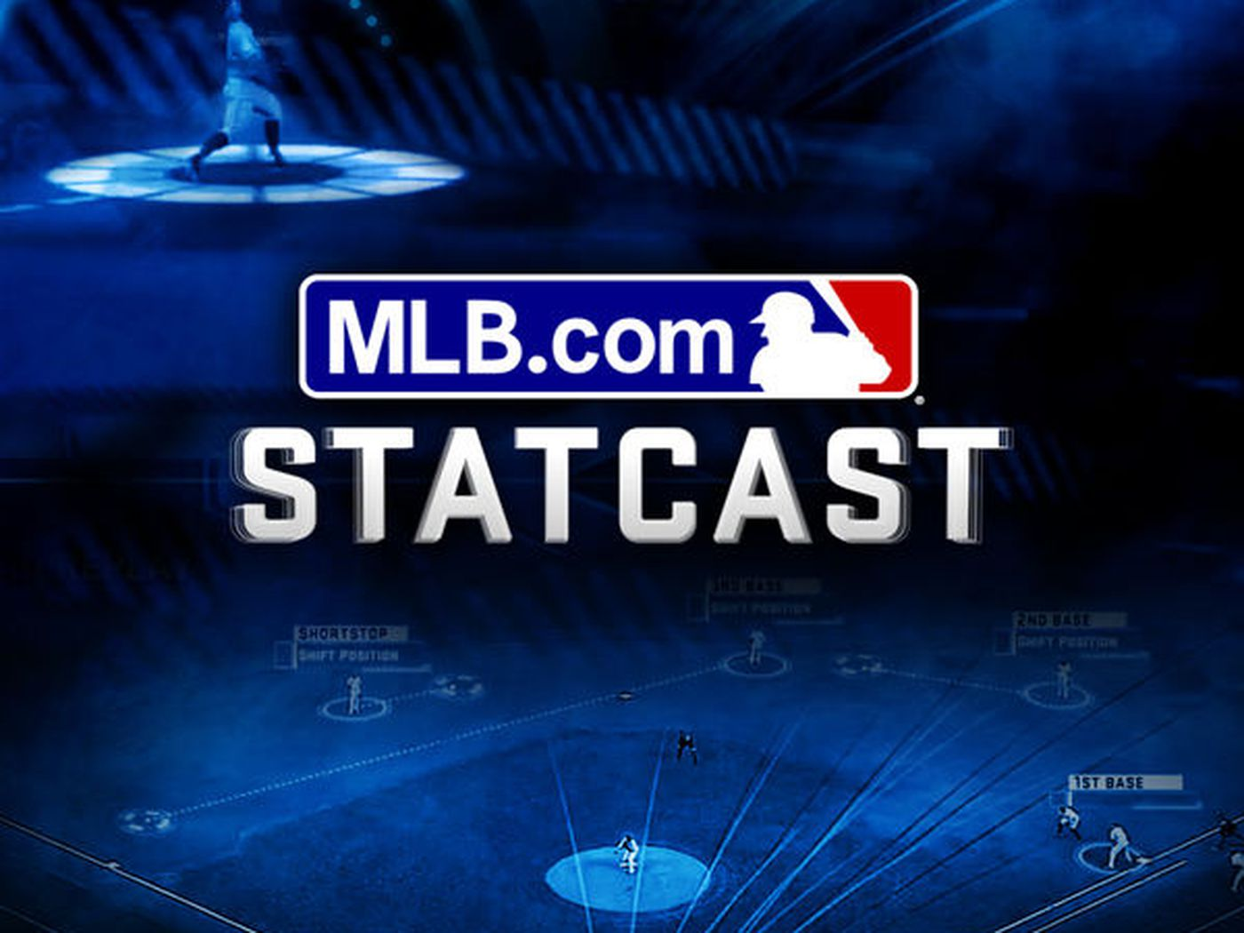

Technology
Statcast
Introduced to all 30 MLB stadiums in 2015
Multi-camera plus radar system that analyzes player and ball movements
Makes high accuracy measurements
Has allowed for new statistics/information: spin rates, launch angles, exit velocities, etc.
Baseball Savant
Online database
Includes Statcast metrics, advanced statistics, player matchups, visuals, probabilities
Demonstrates the multitude of ways that the Statcast data can be applied and visualized

Slide 6
Important Hitting Metrics
wOBA: weighted on-base average, designed to measure a player’s overall offensive contribution per plate appearance (weighted so it scales to OBP)
wRC+: weighted runs created, designed to measure a player’s total offensive value (weighted such that 100 is league average)
ISO: isolated power, sabermetric computation designed to measure raw power
BABIP: batting average on balls in play
WAR: wins above replacement, developed to sum up a player’s total contribution to their team
Exit velocity: velocity of ball as it leaves bat
Launch angle: vertical angle at which the bat leaves the ball
Barrels: batted ball events whose comparable hit types (in terms of exit velocity and launch angle) that have led to a minimum .500 BA and 1.500 SLG

Slide 7
My Goal
Identify every MLB hitter who played between 2016-2019
Pull their career statistics (specifically their player value batting table) from Baseball-Reference.com
Do a comprehensive search through all the seasons for each of the players and identify whether each season would be considered a “breakout season” according to a certain set of criteria
Analyze the breakout seasons and the year prior to the breakout season using advanced metrics from Baseball Savant, try to identify trends
From these trends, form a strategy for identifying future breakout players and find current undervalued MLB players to hypothetically acquire

Slide 8
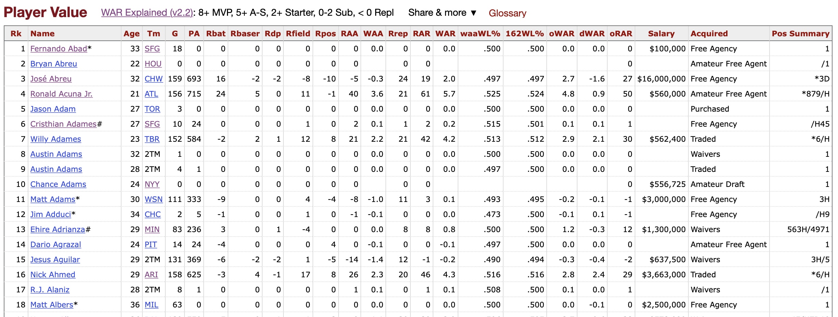
Step 1: Scrape hyperlinks from Baseball-Reference using R
Approximately 1,400 players per year – stored all of the hyperlinks in a list
Removed links that weren’t players
Removed duplicate hyperlinks
Code often took hours to run and debug, also had to teach myself how to scrape HTML – great learning experience!

Slide 9
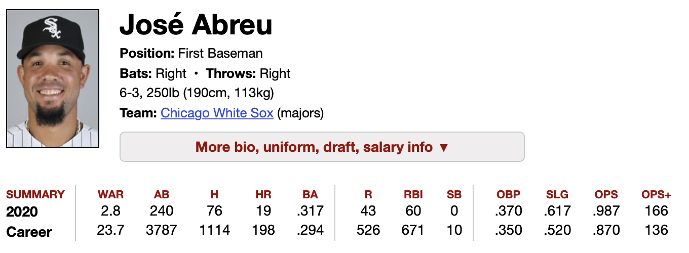
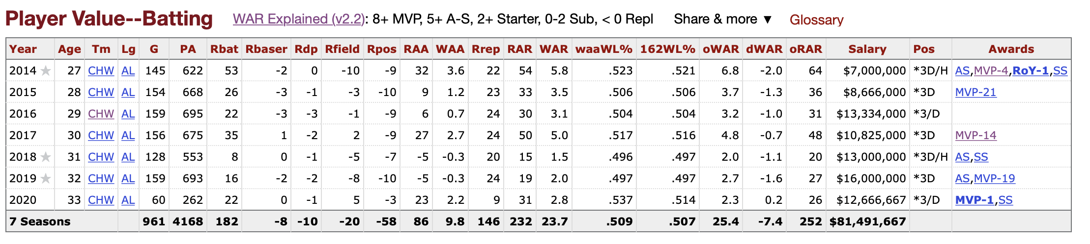
Step 2: Scrape data from Baseball-Reference
From list of hyperlinks, scraped three things from each of the player’s webpages:
Their name
Their position
Player Value Batting table
Converted list of hyperlinks to a data frame, added each player’s position to the data frame, then removed all pitchers (of the 2,228 players, 1,247 were pitchers)
Created a new master list of all 981 hitters, each element of the list was named using the player’s name and stored a data frame that was created from their player value batting table

Slide 10
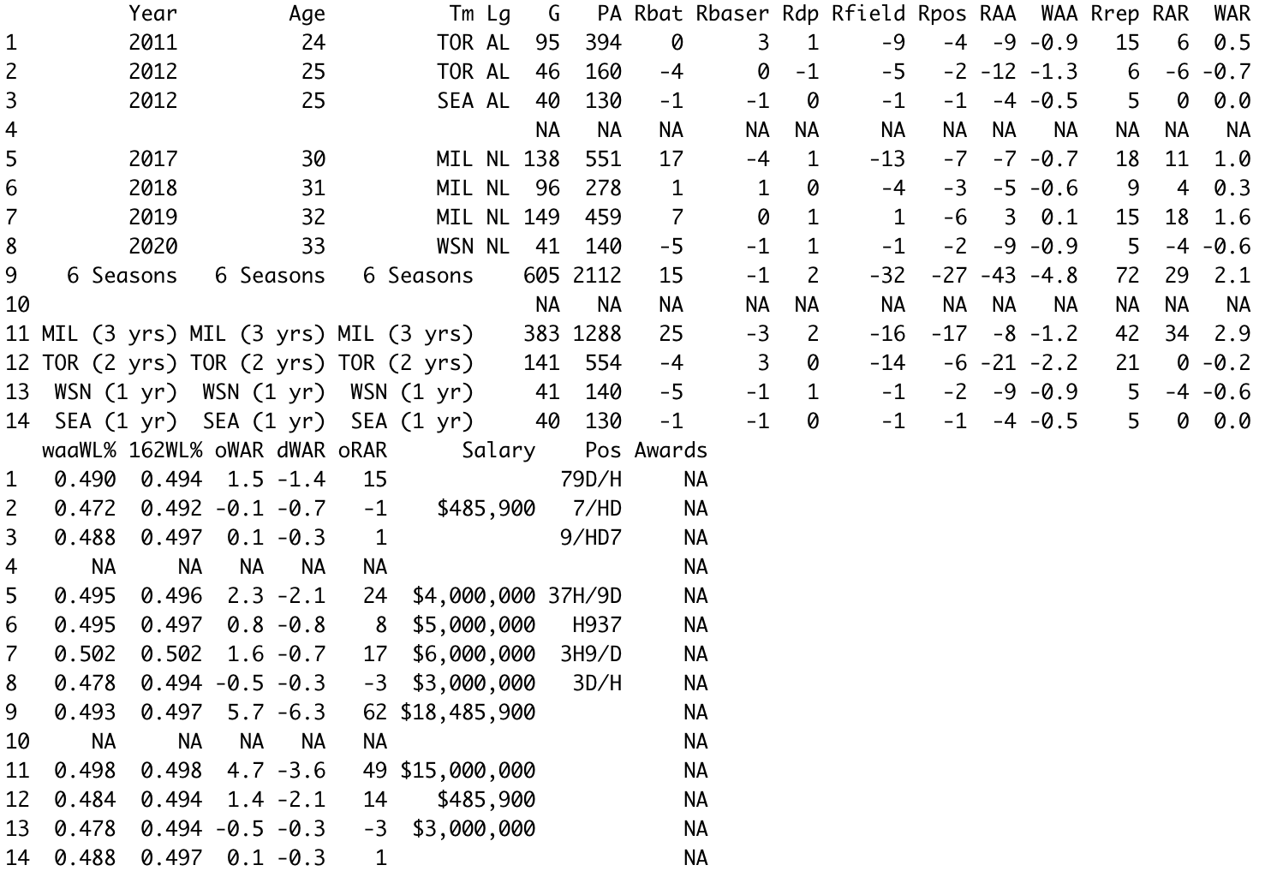
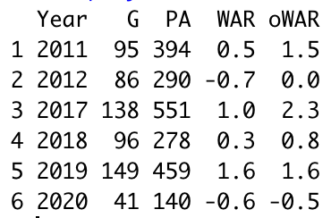
Step 3: Modify list in R to make data frames more readable, ready for analyzing
Deleted summary rows, unwanted columns
Merged rows together if from the same season
Deleted empty rows where player did not play

Slide 11
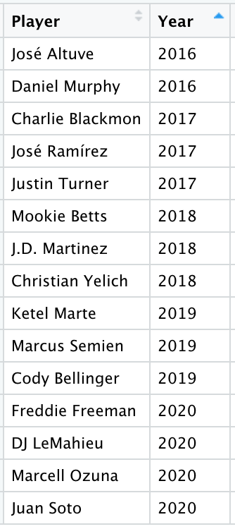
Step 4: Filter through every season from every player and identify breakout seasons
My criteria for a breakout season:
oWAR >= 2.5
oWAR/162 games >= 6.4
oWAR/162 games >= 1.8 x Career oWAR/162 games at that point in career
Occurred in 2016 or later
Played >=200 games prior to breakout
Had not experienced a breakout season before
Of the 5,817 seasons I analyzed, 15 seasons met this criteria

Slide 12
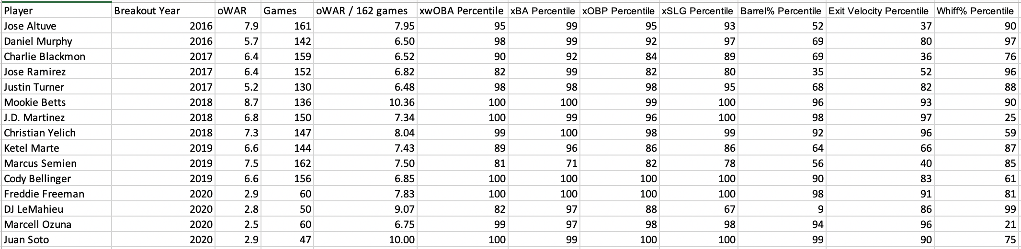
Step 5: Analyze the 15 breakout seasons and the year prior to breakout
Pulled advanced metrics from Baseball Savant
Did this manually as there were only 15 seasons
In the future, I could expand the number of breakout seasons to be analyzed by changing the criteria, then write a script that would scrape the advanced metrics from Baseball Savant, like how I did for Baseball-Reference

Slide 13
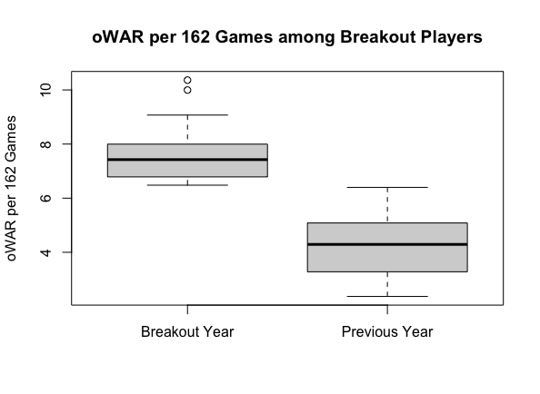
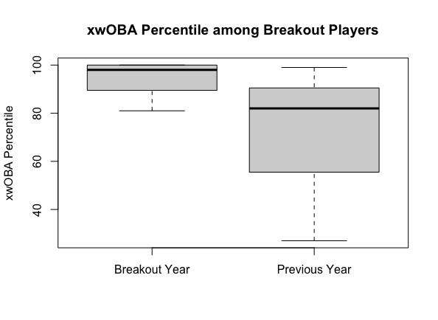
What I Found
While there was a significant difference between oWAR rate in breakout year vs previous year, the difference for xwOBA was not as significant
High xwOBA could be a predictor

Slide 14
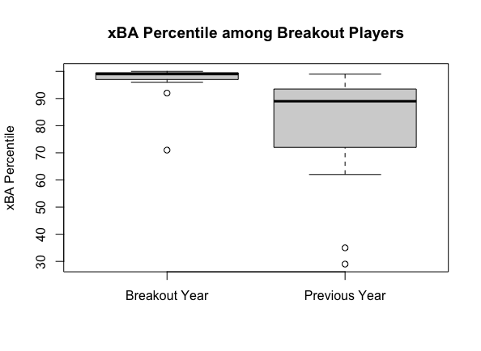
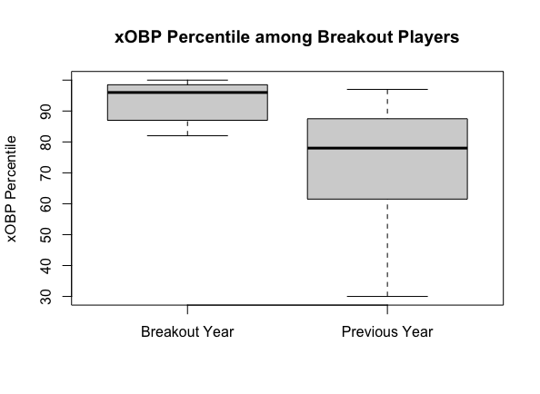
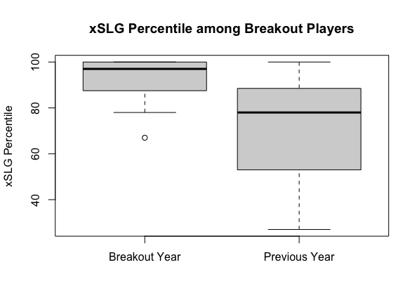
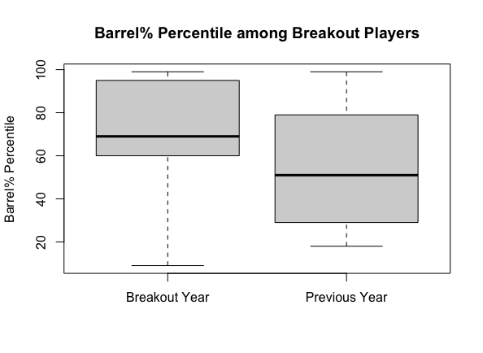
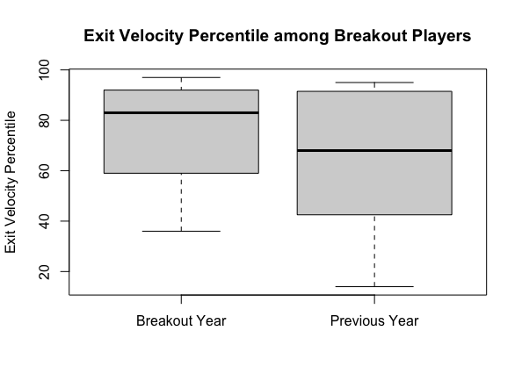
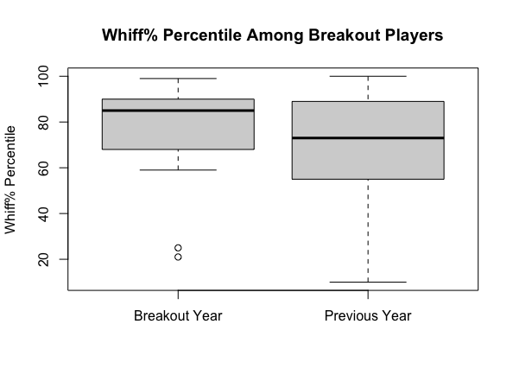
Other Advanced Metrics
While there are differences between breakout year & previous year, advanced metrics don’t show as vast of a difference – these could be predictors

Slide 15
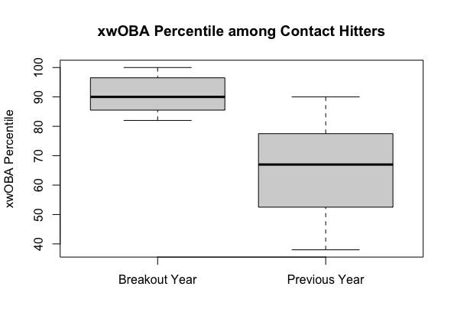
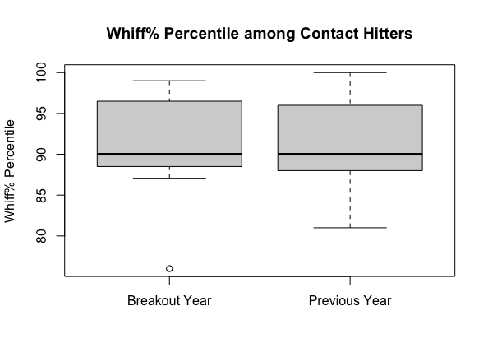
Examining Subsets of Breakout Players
Contact Hitters: breakout players who were in top 20% contact rate the year before breakout

Slide 16
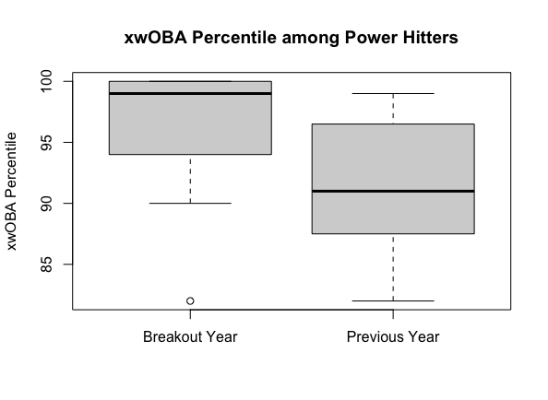
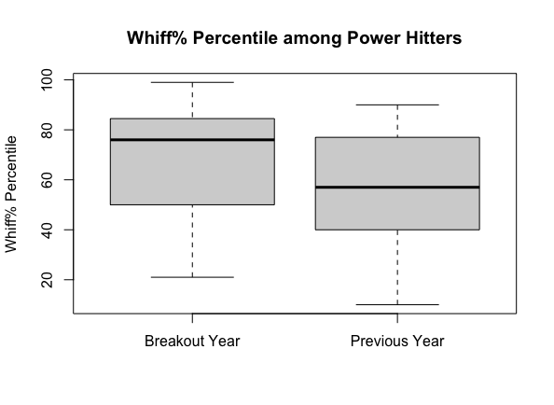
Examining Subsets of Breakout Players
Power Hitters: breakout players who had a SLG in top 20% the year before breakout

Slide 17
Other Trends
The season before their breakout, every breakout player scored in the 70th percentile or higher for at least one of the following three categories:
SLG
Exit Velocity
Whiff%
In general, Barrel% improved more than Exit Velocity
Barrel: batted ball event whose comparable hit types (in terms of exit velocity and launch angle) that have led to a minimum .500 BA and 1.500 SLG
So hitters who already hit the ball hard experienced more favorable launch angles in their breakout year – could be due to swing mechanics

Slide 18
Potential Breakout Candidates for 2021
High xwOBA
Garrett Cooper (xwOBA Percentile: 89)
Will Smith (95)
Travis d’Arnaud (90)
High Contact Rates
Tommy La Stella (Whiff% Percentile: 99)
David Fletcher (100)
Nick Solak (84)
Wilmer Flores (89)
High Power and Exit Velocity Rates
Teoscar Hernandez (SLG Percentile: 97, xwOBA Percentile: 94, EV Percentile: 98)
Wil Myers (95, 93, 82)
Jesse Winker (89, 95, 90)

Slide 19
Thank you!

