Slide 1

Using Predictive Modelling to Uncover Insights:
Loyalty Points, Customer Segmentation, and Sentiment Analysis

Slide 2
What You Wanted To Know
1. How customers engage with and accumulate loyalty points and whether loyalty points are an important metric.
2. Whether descriptive statistics can provide insights into the suitability of the loyalty points data for predictive modelling.
3. How customers can be segmented into groups.
4. How text data from customer reviews can be useful to the business.

Slide 3



Inform marketing campaigns
Make improvements to the business
Improve sales performance

Slide 4


Context of the problem
As competition increases, consumers expect more of loyalty programs and now want more personalised rewards.
https://www.bcg.com/publications/2024/loyalty-programs-customer-expectations-growing?utm_source
Up to 98% of consumers read reviews before purchasing a product.
https://www.forbes.com/councils/forbesbusinessdevelopmentcouncil/2024/07/11/how-reviews-and-ratings-affect-clients-buying-decisions/?utm_source
Negative reviews can have a big impact:
In the research paper, “The Impact of Online Reviews on Consumers’ Purchasing Decisions”, results showed that “consumers attention to negative comments was significantly greater than that to positive comments.”
https://pmc.ncbi.nlm.nih.gov/articles/PMC9216200/?utm_source
For most companies, the ability to maintain long term relationships with customers who repeatedly buy products is crucial for business growth.
https://www.sciencedirect.com/science/article/abs/pii/S0148296320306275

Slide 5

Why use predictive models?
1. We can predict the loyalty of a customer given their demographics or spending scores enabling you to target marketing towards certain groups of customers.
2. Provide personalised marketing and rewards to customers who fit into certain spending groups.
3. Better understand customer sentiment to identify which customers to target to improve their perception of Turtle Games.

Slide 6
Question 1:
Is the loyalty points data useful and what insights can it provide about customer loyalty behaviour?
Question 2:
How can customers be segmented into groups?
Question 3:
What insights can be gained by analysing customer sentiment from reviews?

Slide 7
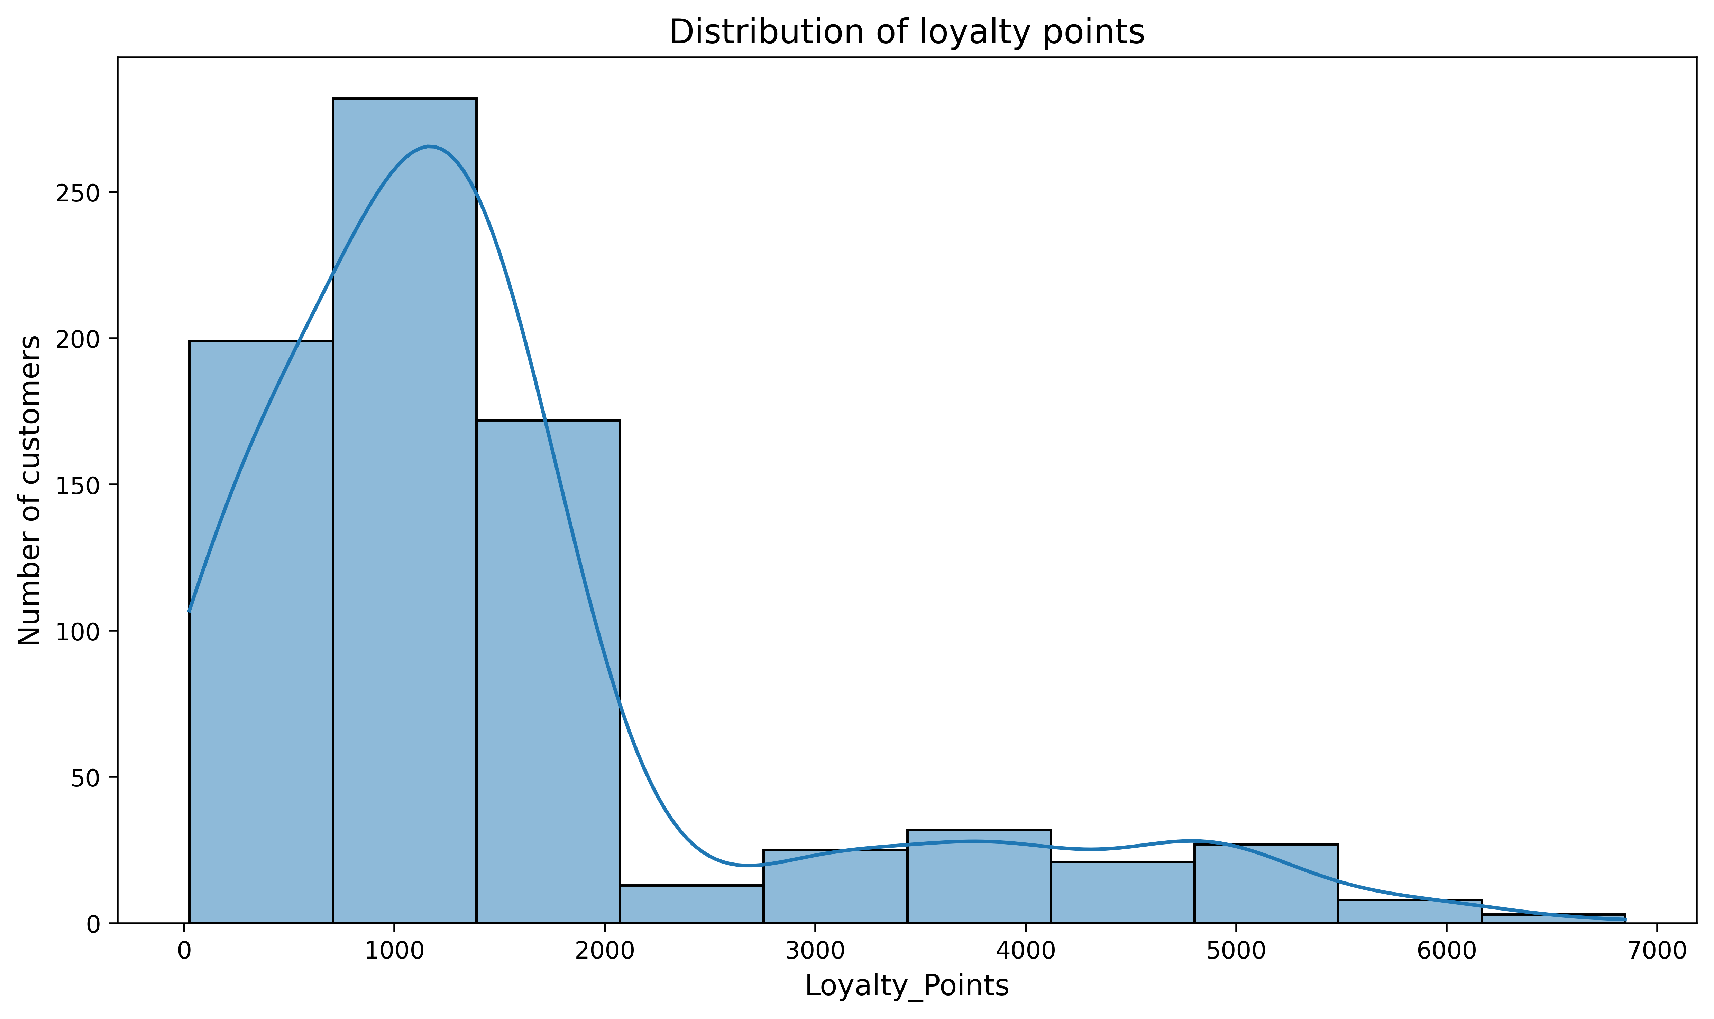
The distribution of loyalty points is very skewed.
Most customers have loyalty points less than 2000.
Descriptive statistics
Highly skewed
Not normally distributed
The median is 1187 but the range is 6822.
Only a small amount of your customers have higher loyalty points
But we can still create useful predictive models!

Slide 8
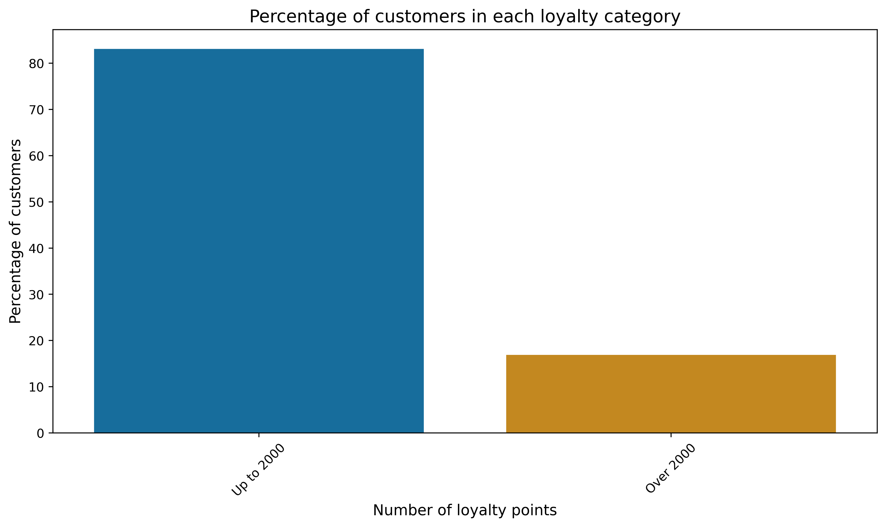
The distribution of loyalty points is very skewed.
Most customers have loyalty points less than 2000.
83%
17%

Slide 9
2. Linear models are overall a poor fit for loyalty points data
They capture some patterns but fail to generalise across all the data.
What don’t we want to see in a linear model?
Large residuals (when the difference between the actual and predicted values is large)
Measured using RMSE.

Slide 10
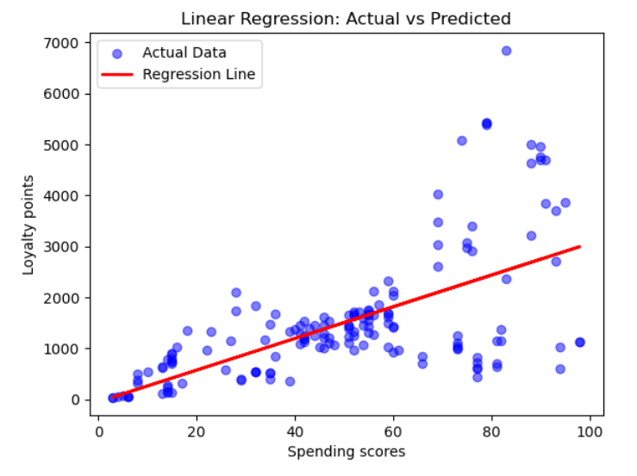
2. Linear models are overall a poor fit for loyalty points data
They capture some patterns but fail to generalise across all the data.
There is a positive correlation between spending scores and loyalty points
As spending scores increase, loyalty points tend to increase.

Slide 11
2. Linear models are overall a poor fit for loyalty points data
They capture some patterns but fail to generalise across all the data.
Low spending scores = Small residuals
High spending scores = Large residuals so poorly predicts loyalty points
RMSE = 1005
VERY BIG!

Slide 12
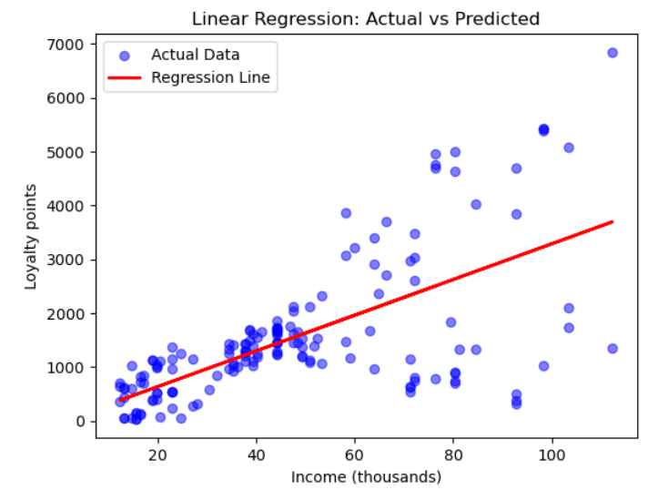
2. Linear models are overall a poor fit for loyalty points data
They capture some patterns but fail to generalise across all the data.
There is a positive correlation between income and loyalty points
As income increase, loyalty points tend to increase.

Slide 13
2. Linear models are overall a poor fit for loyalty points data
They capture some patterns but fail to generalise across all the data.
Low income = Small residuals
High income= Large residuals so poorly predicts loyalty points
RMSE = 1002
VERY BIG!

Slide 14
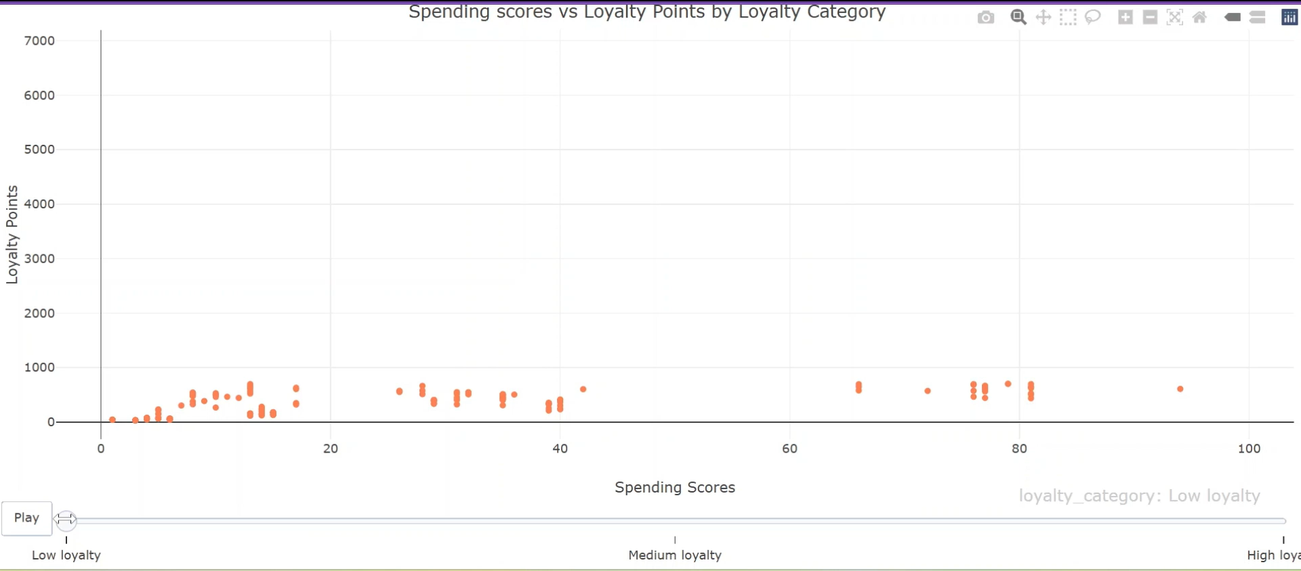
3. High loyalty only occurs when spending scores are high
But a high spending scores doesn’t guarantee high loyalty

Slide 15
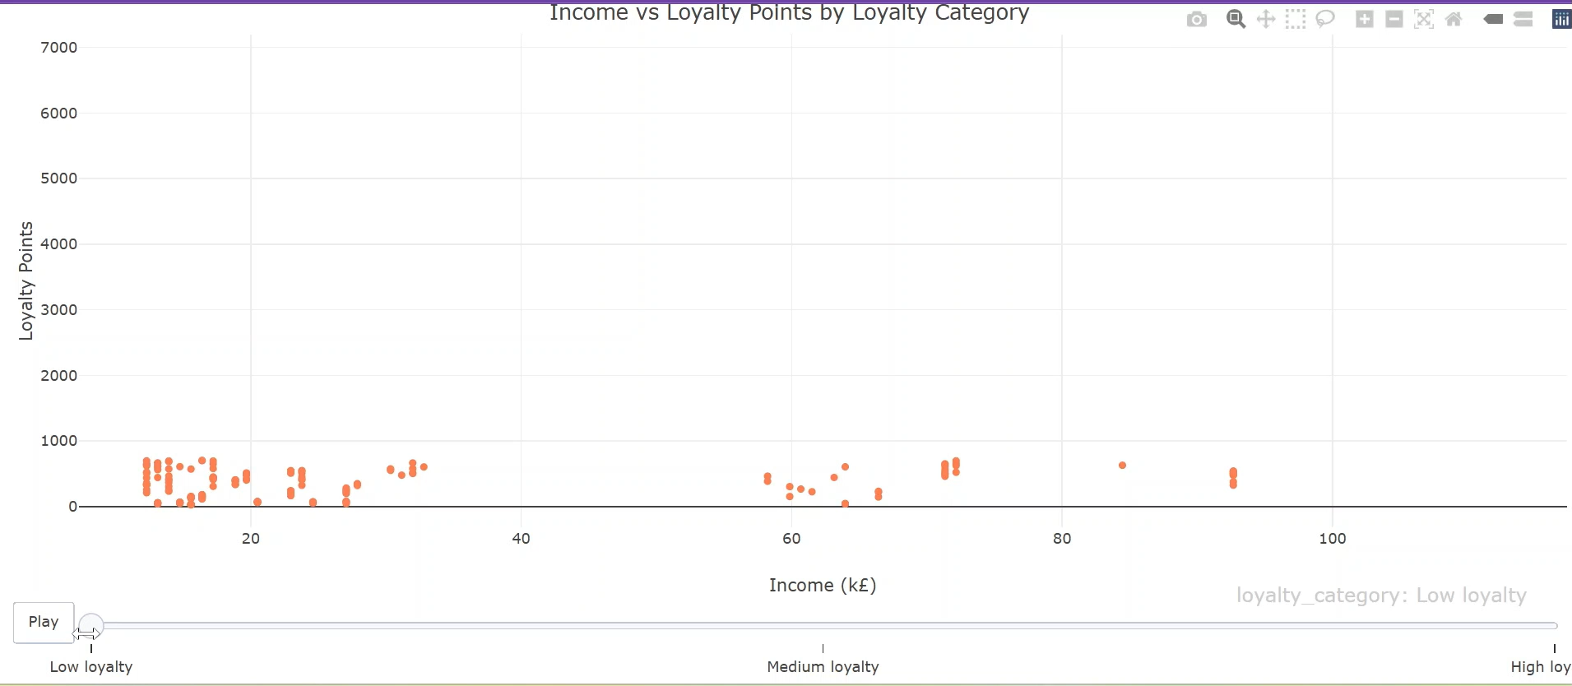
4. High loyalty only occurs when income is high
But a high income doesn’t guarantee high loyalty

Slide 16
5. Classification models worked better on the loyalty points data that linear models
Using logistic regression to build a model to predict which loyalty points category customers fall into.
New customer A
Medium loyalty
High loyalty
New customer B
Low loyalty

Slide 17
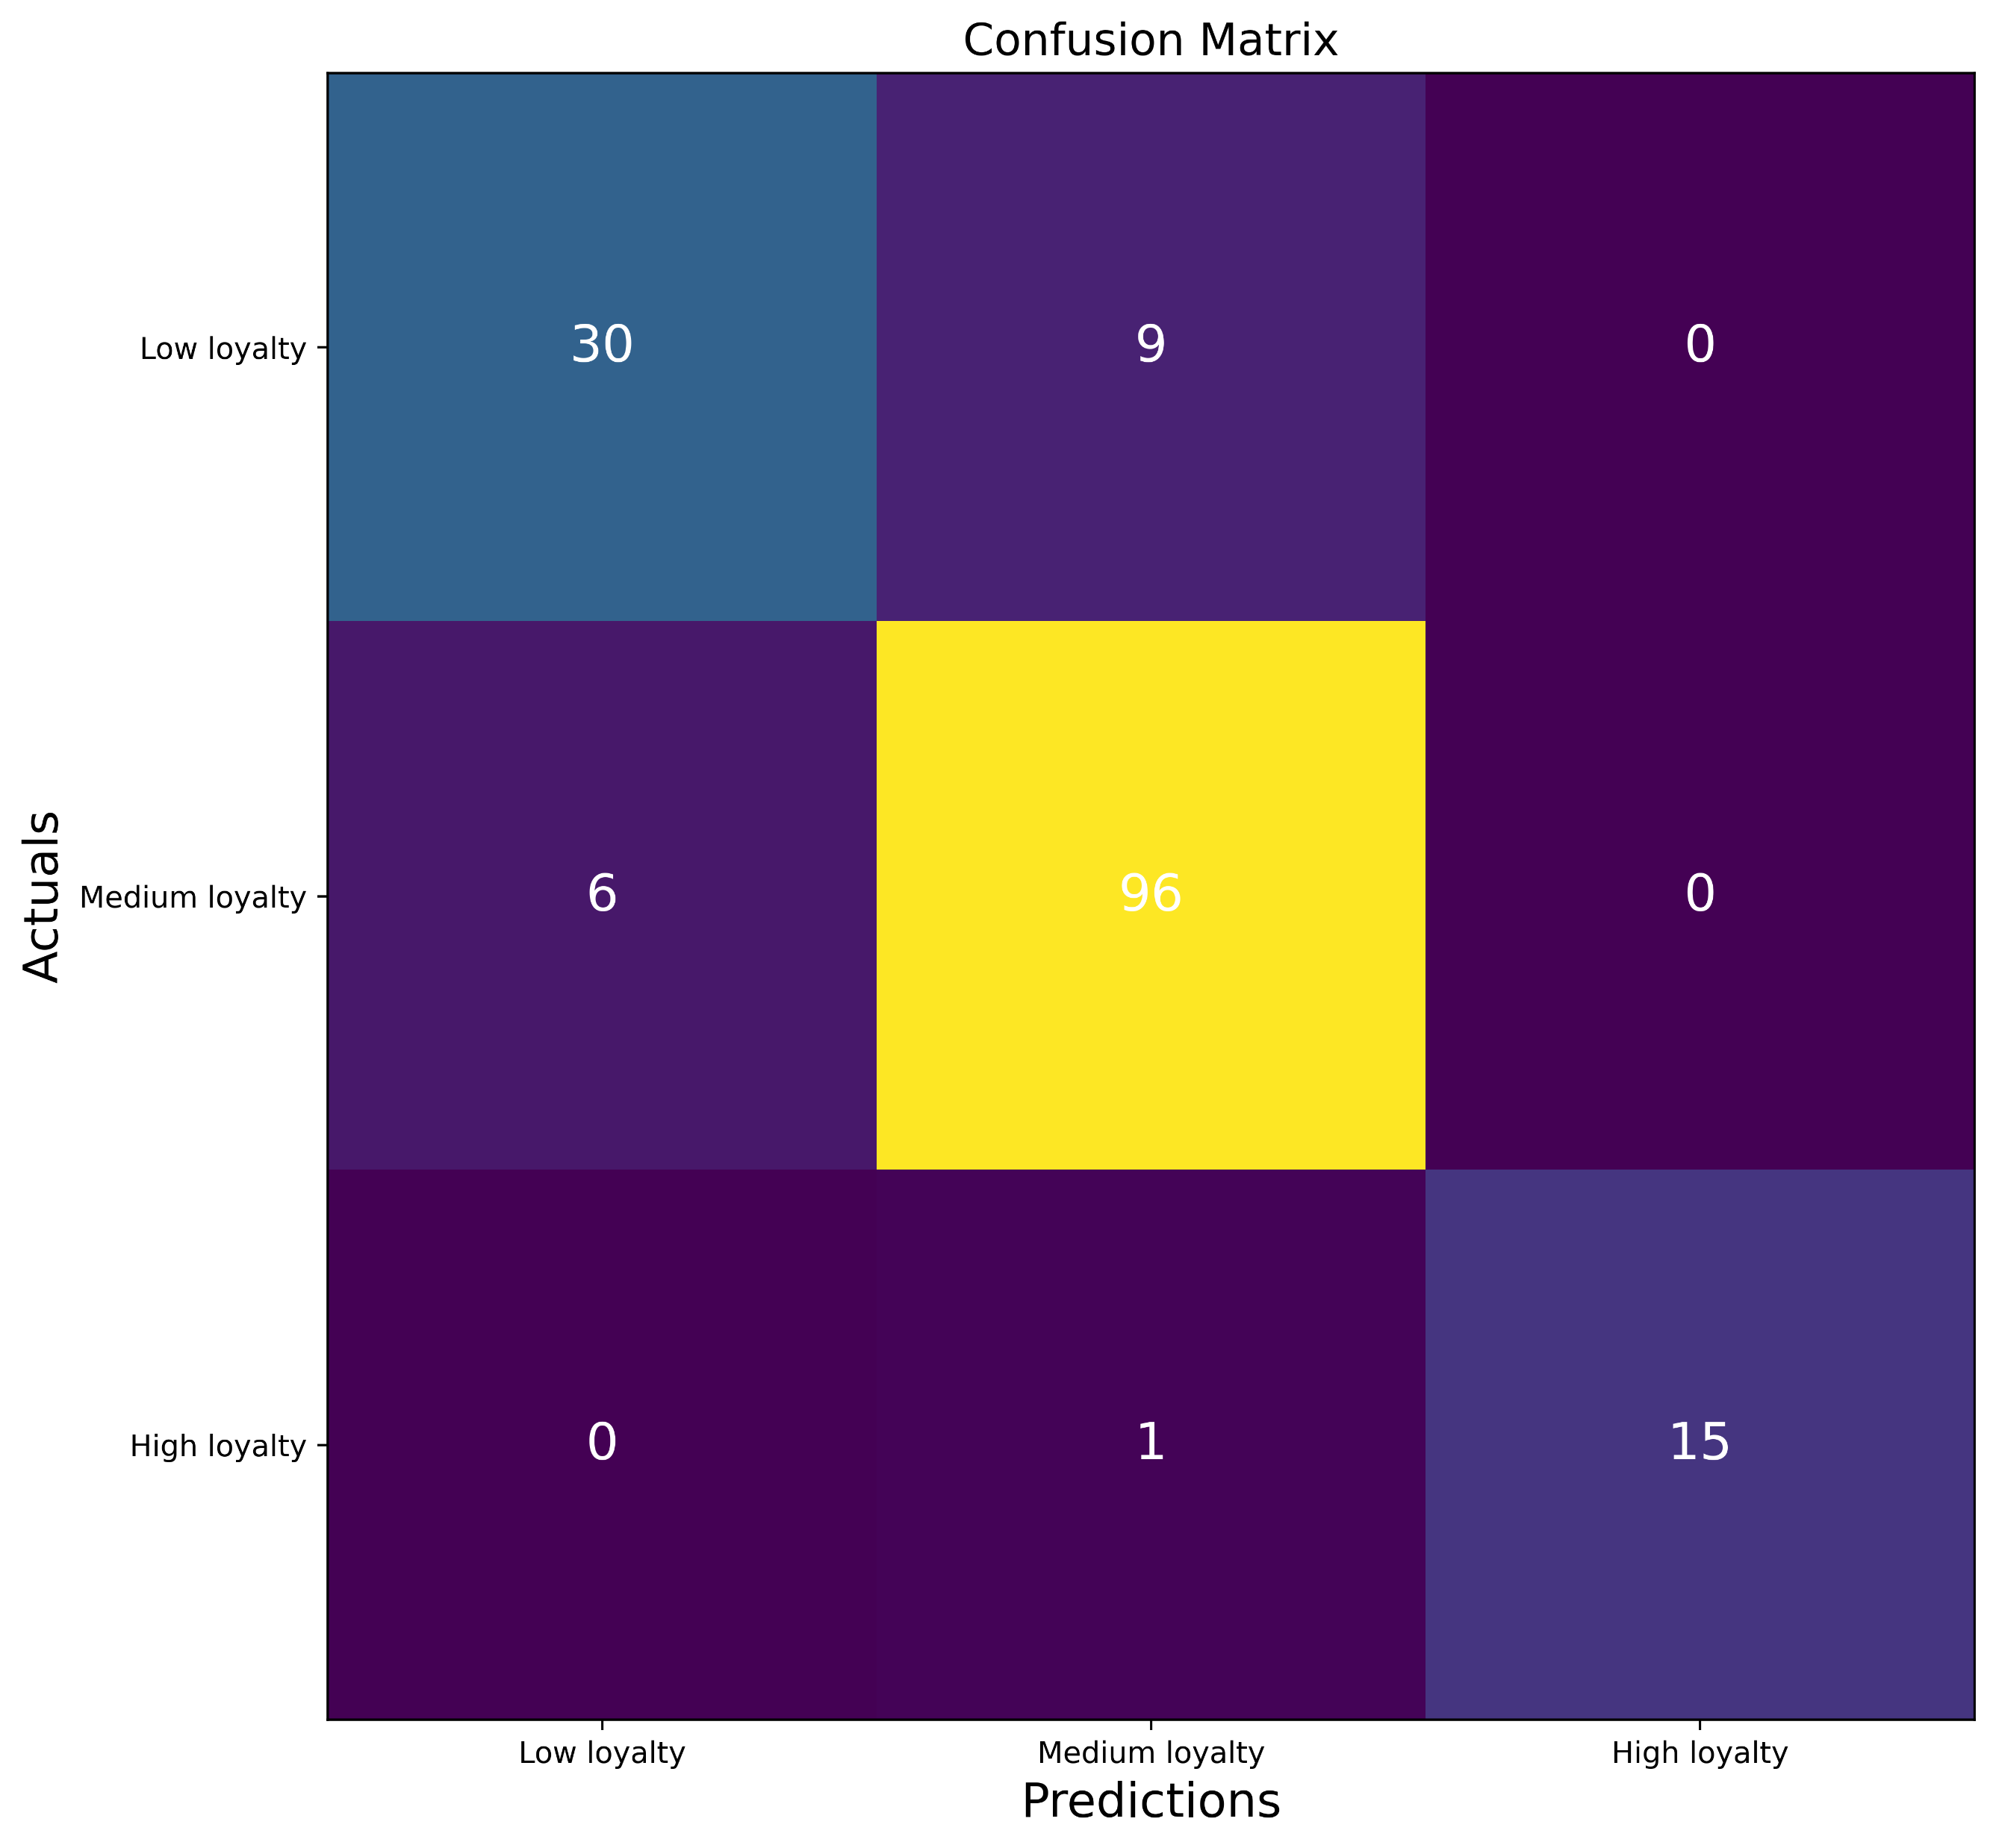
5. Classification models worked better on the loyalty points data that linear models
High accuracy of predictions
Low loyalty accuracy = 30/36 = 83%
Medium loyalty accuracy = 96/106 = 91%
High loyalty accuracy = 15/15 = 100%

Slide 18
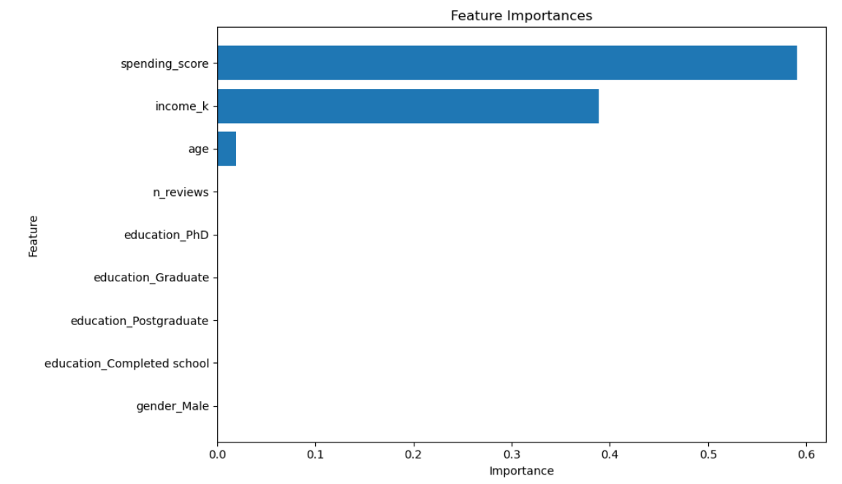
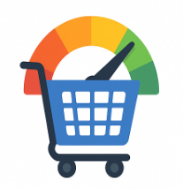
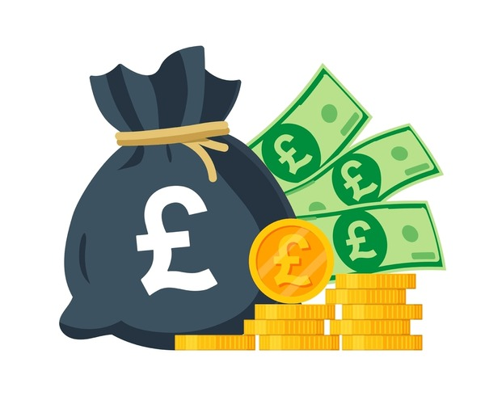

6. Spending scores and income were consistently the strongest predictors of loyalty points with age having a minor influence.

Slide 19
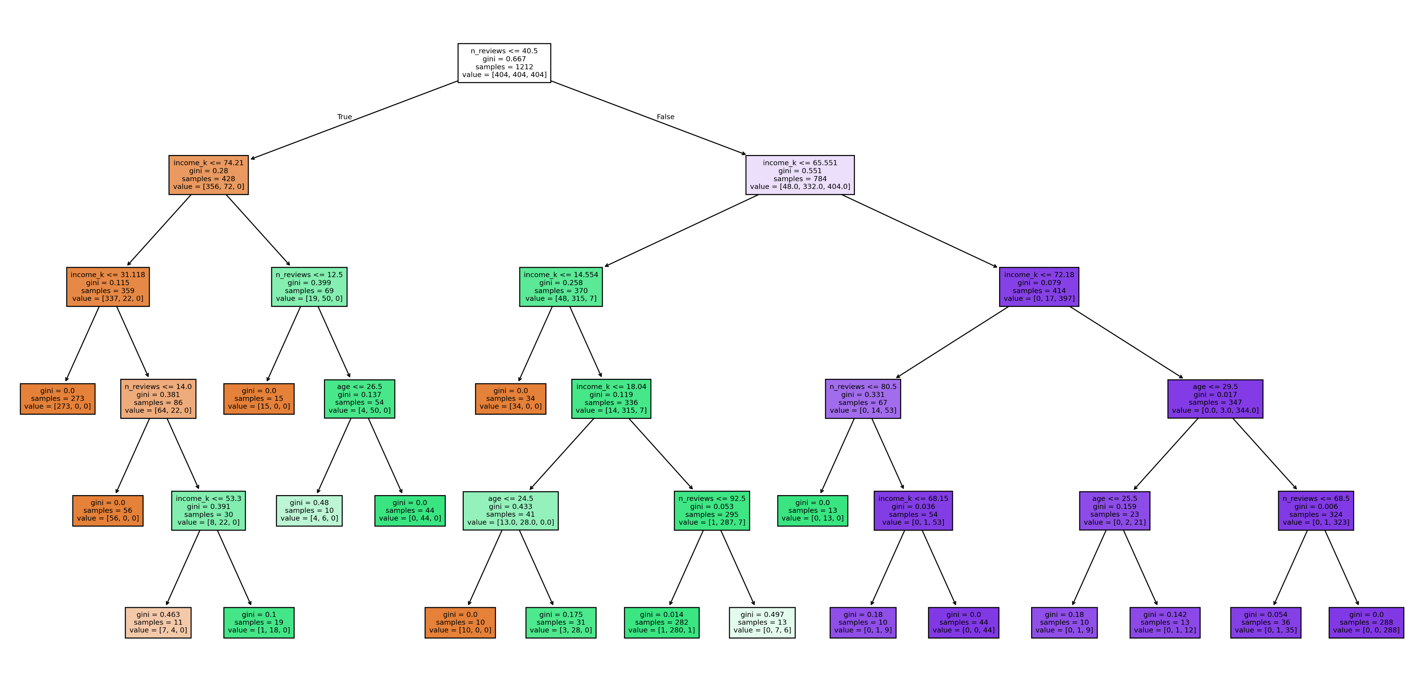
5. Classification models worked better on the loyalty points data that linear models
Decision tree – accuracy 92%
High loyalty
Medium loyalty
Low loyalty

Slide 20
Lower spending scores and income
Higher spending scores and income
High loyalty
Medium loyalty
Low loyalty

Slide 21
6. Customers with high loyalty tend to have both a high spending score and a high income
Interpretation of the decision tree
+
Frequently
+

Slide 22
Summary of key insights from question 1
1. Most customers have fewer than 2000 loyalty points and few customers have high loyalty points.
2. Spending scores and income are the strongest predictors of loyalty.
3. High income and spending scores tend to lead to high loyalty BUT on their own don’t necessarily lead to high loyalty.

Slide 23
Question 1:
Is the loyalty points data useful and what insights can it provide about customer loyalty behaviour?
Question 2:
How can customers be segmented into groups?
Question 3:
What insights can be gained by analysing customer sentiment from reviews?

Slide 24
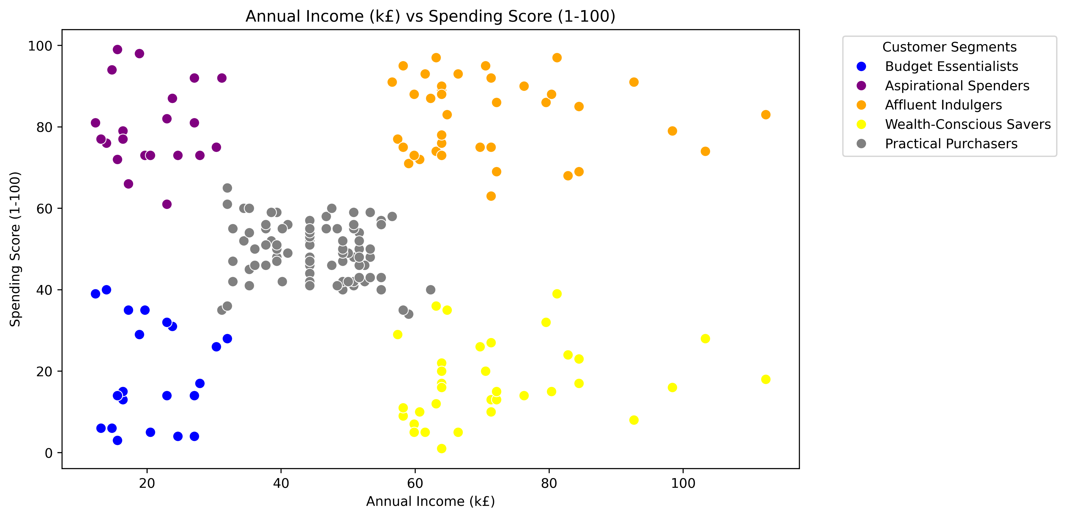
Using clustering, we can segment customers into 5 distinct groups
You can target marketing at these groups

Slide 25
Affluent indulgers:
High income, high spending score
Focus on marketing high value, luxury items as well as providing them with incentives to stay as they will bring in lots of revenue. Consider providing them with premium access to certain items if they accumulate a high number of loyalty points.

Slide 26
Question 1:
Is the loyalty points data useful and what insights can it provide about customer loyalty behaviour?
Question 2:
How can customers be segmented into groups?
Question 3:
What insights can be gained by analysing customer sentiment from reviews?

Slide 27
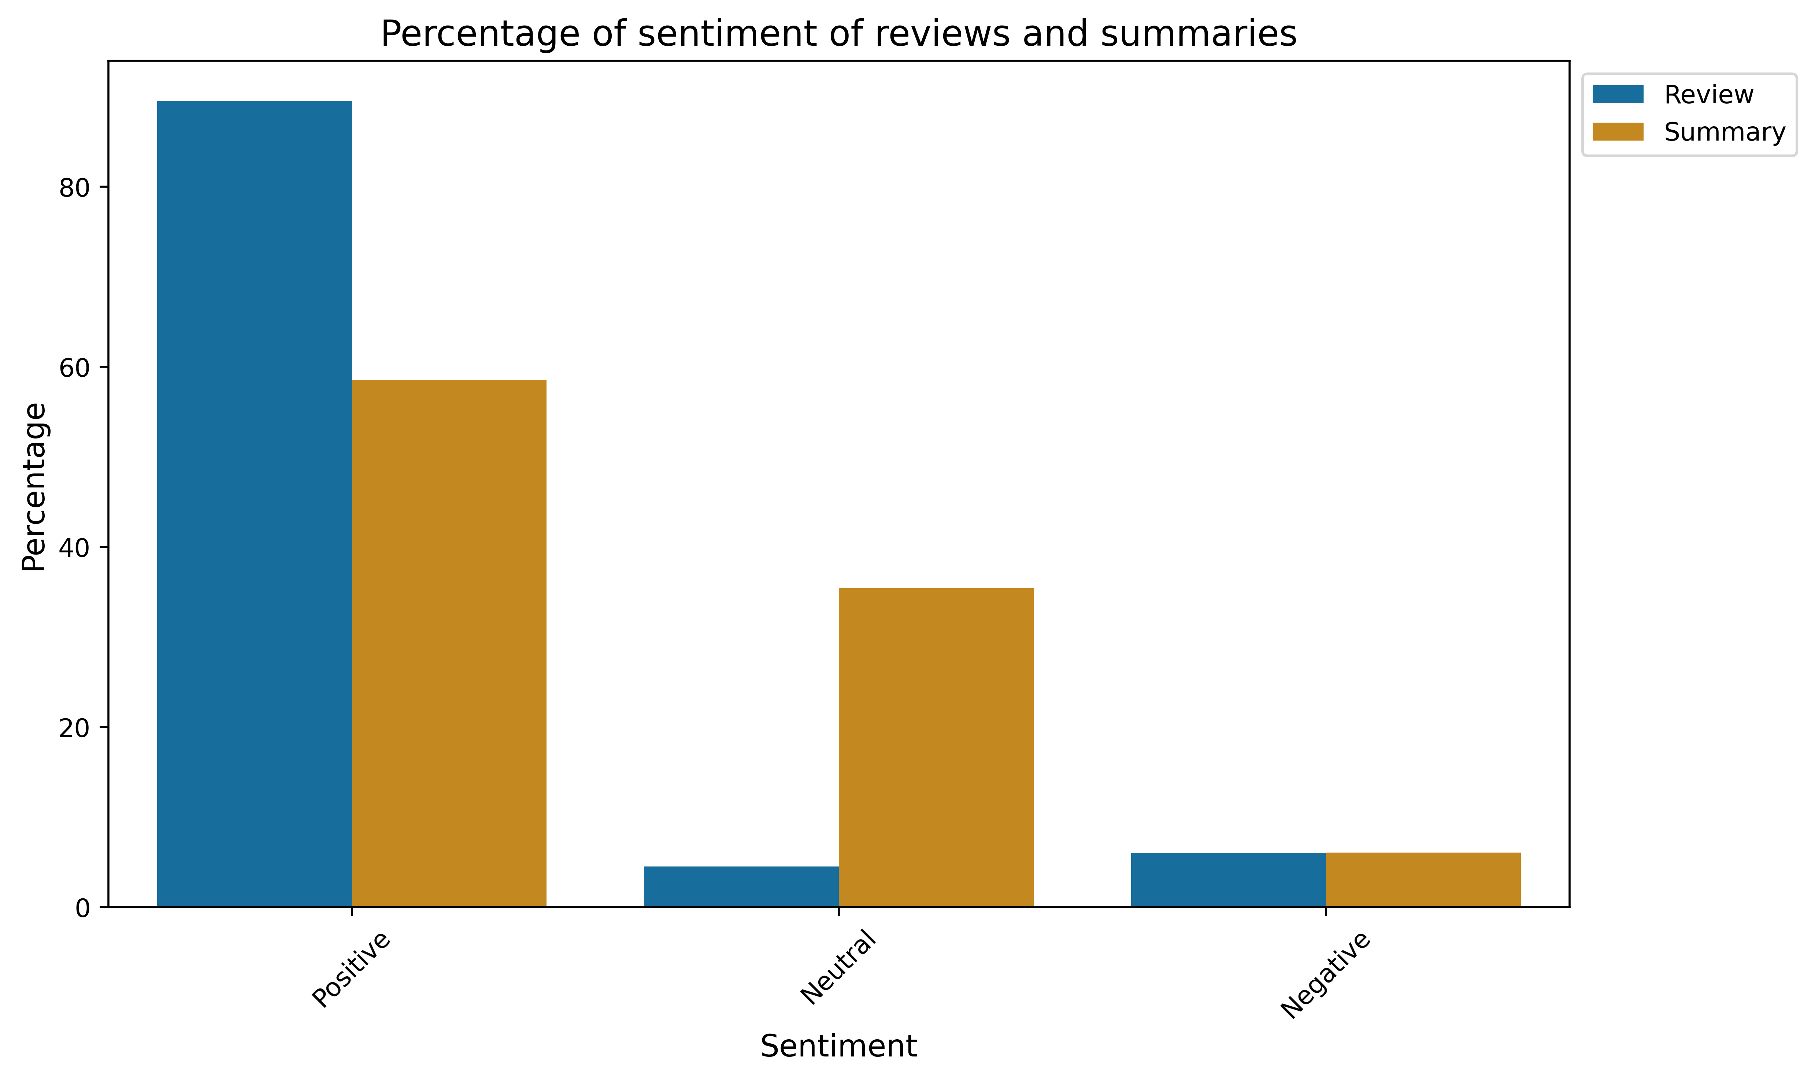
Different sentiments for “reviews” and “summaries”
There was a large difference in the number of positive and neutral reviews between the “reviews” and the “summaries”
I decided to use the “reviews” rather than the “summaries” as summaries might miss important nuance that was in the reviews.

Slide 28
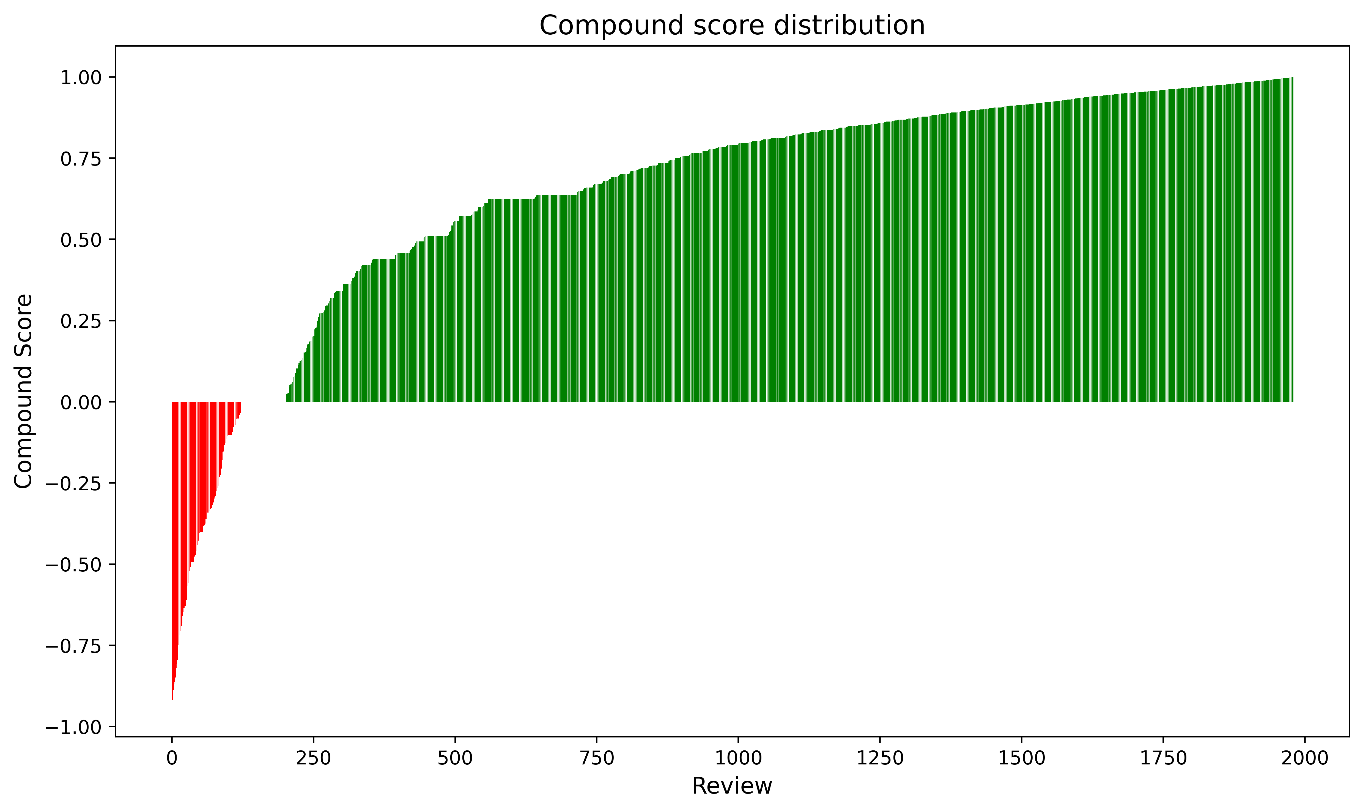
Most reviews are positive
90% of reviews are positive
4% of reviews are neutral
6% of reviews are negative

Slide 29
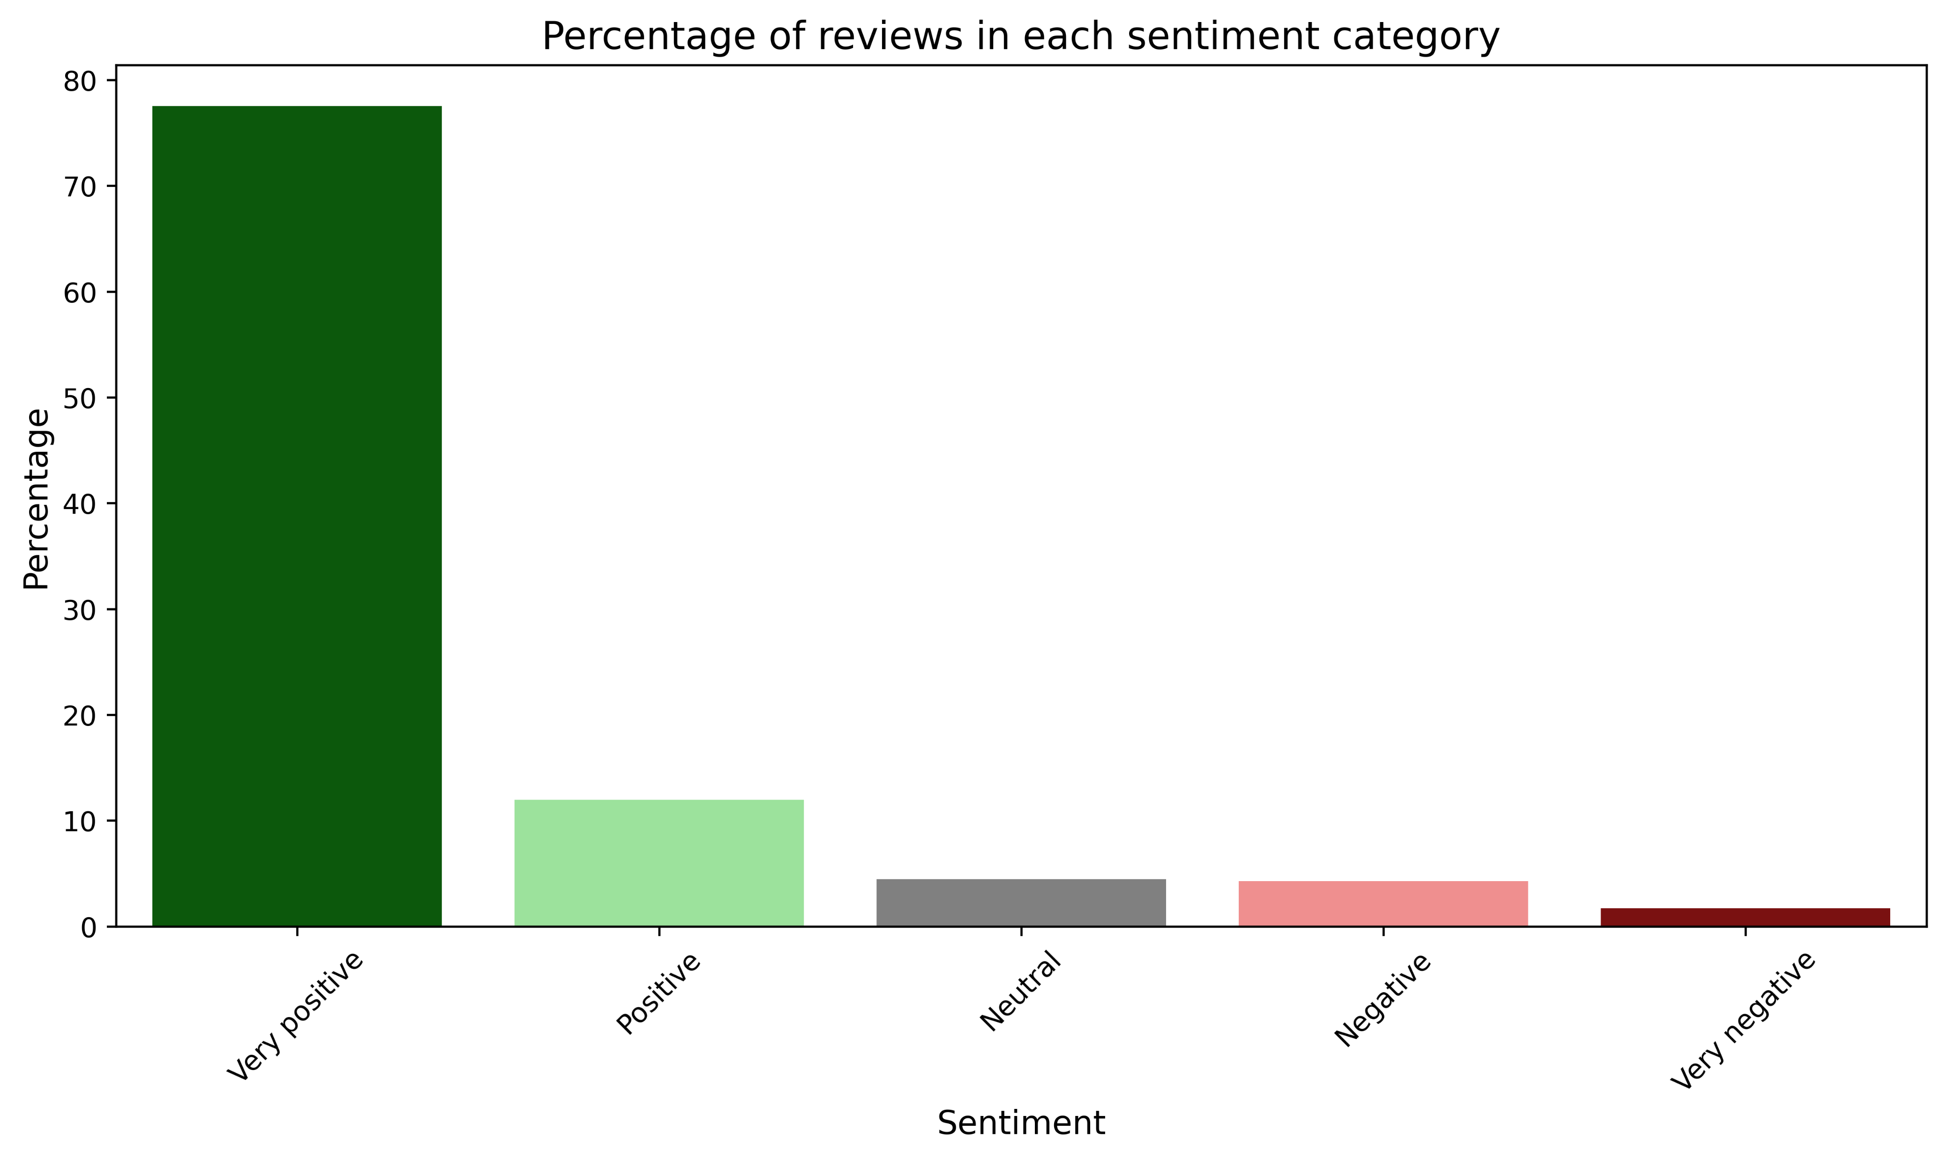
Most reviews are very positive
78%
2%

Slide 30
Accuracy of this sentiment analysis
Approximately 80% accuracy
…refocusing the mind during pain due to illness and disease. My teenage son has suffered a condition that causes him intermittent pain, anxiety and distress. I am continually looking for something to occupy his attention during such painful times…
This review is classified as very negative but it’s actually very positive.

Slide 31
1. High loyalty only occurs when income or spending scores are high. However, a high income or spending score alone does not guarantee high loyalty.
2. Spending scores and income are the strongest predictors of loyalty points, with age having a minor influence.
Key insights
3. Customers can be segmented into five distinct groups based on their spending score and income.
4. Review sentiment is mostly positive, with 90% of reviews classified as positive and 78% as very positive.

Slide 32
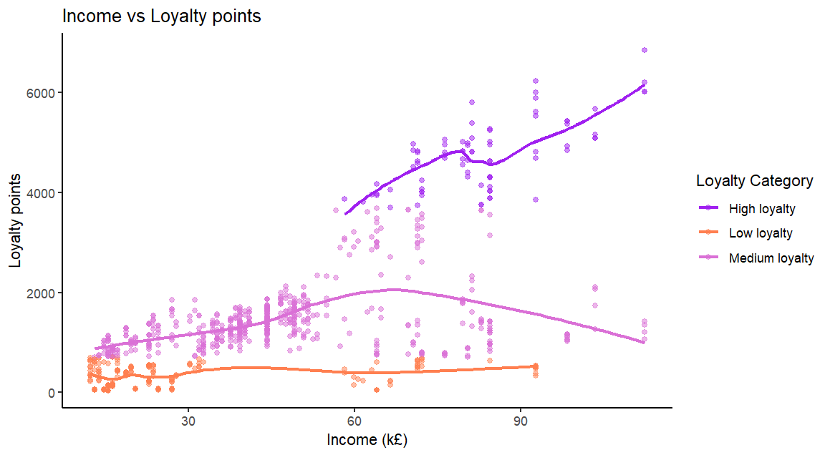
Recommendation 1: Target high income customers in marketing campaigns…
…as only those with a high income have high loyalty so these are the customers you want to be attracting to Turtle Games the most.
The marketing could encourage high value spending from current customers and encourage them to remain highly loyal. Particularly focus on retaining the “Affluent Indulgers” who already spend more
For those who have high income but low spending, these customers could have the potential to be highly loyal and therefore perhaps spend more. Consider using surveys to better understand their product preferences and advertise these products to them.

Slide 33
Recommendation 2: Use the five customer segments to create targeted marketing strategies
These marketing strategies should encourage continued purchases and increasing loyalty by utilising tailored adverts and loyalty programs.
As competition increases, consumers expect more of loyalty programs and now want more personalised rewards.
https://www.bcg.com/publications/2024/loyalty-programs-customer-expectations-growing?utm_source

Slide 34
Recommendation 3: Prioritise gathering feedback from customers who have written negative reviews, particularly those with a high income.
Although most review sentiments are positive, negative reviews can negatively impact sales. High income customers are more likely to be highly loyal customers so gather feedback from them if they’ve written negative reviews through surveys or follow-up calls to understand their concerns.
Provide meaningful incentives, such as discounts or complimentary gifts, along with flexible return options to rebuild trust and encourage repeat purchases.

Slide 35
Limitations and missing data
The analysis was constrained by missing data which limits the strength of conclusions and recommendations. Recommended data for further analysis includes:
Customers who didn’t write reviews.
Finding out If customers can spend loyalty points as then loyalty points might not necessarily correlate with the amount of loyalty to the company.
How long the customers have been with the company, how many products they’ve purchased, and when they bought these products. This could allow for a more accurate picture of customer loyalty. For example, a long-term customer with sporadic purchases may have higher loyalty points but lower actual loyalty to the company than a new, frequent buyer.

Slide 36
Q & A

