Slide 1


Slide 2
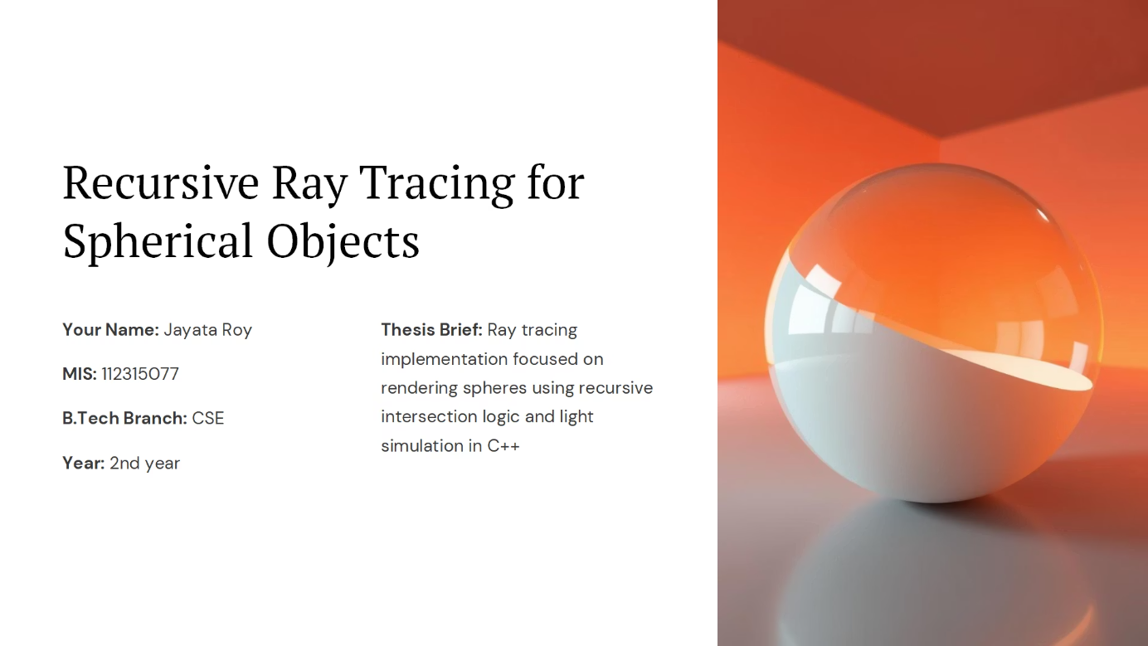

Slide 3
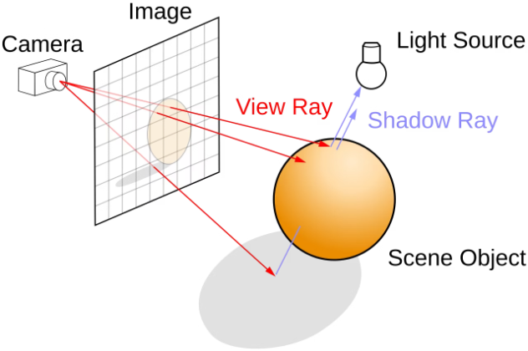
Ray tracing methodology: -
Viewport Definition:
A viewport is a window to our 3D world on the 2D screen that is divided into pixel sized regions.
Ray Generation:
A ray is cast from the virtual camera for each pixel in order to calculate the scenery.
Intersection Testing:
The ray is checked against objects to find the closest intersection.
Color Determination at the Intersection:
Direct Lighting: Calculating light reaching the point.
Recursion:
Reflection & Refraction: Simulating mirrors and transparent surfaces.
Shadows: Determining if light is blocked.
Modeling light bouncing for realism. A ray is never absorbed by any medium, it is always partially reflected back so we factor in that using recursion.
Image Formation:
Colors for all pixels are computed and saved as an image. PPM image format is used in this project for convenience.

Slide 4
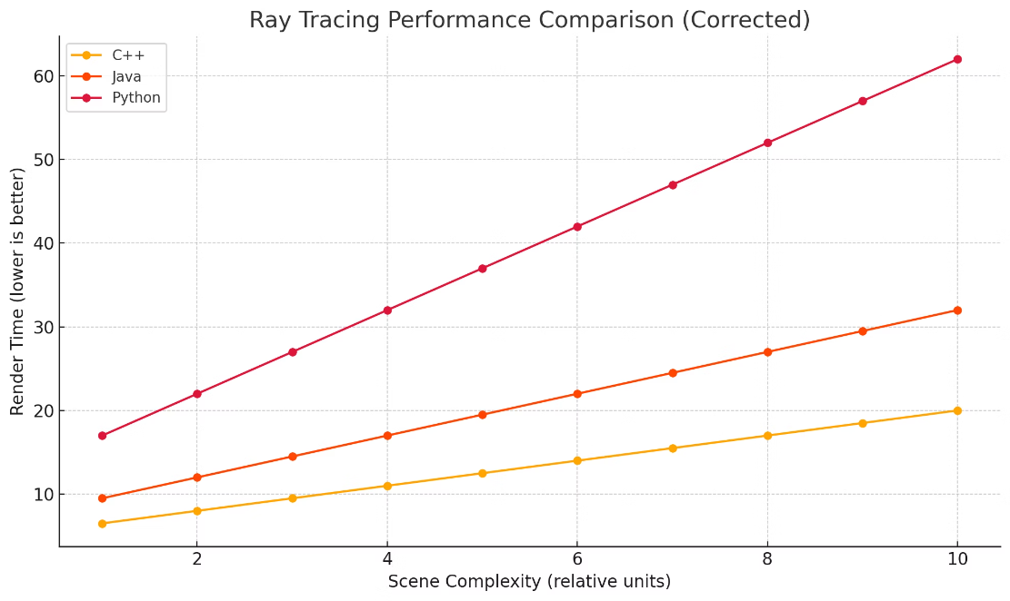
C++ Supremacy

Slide 5
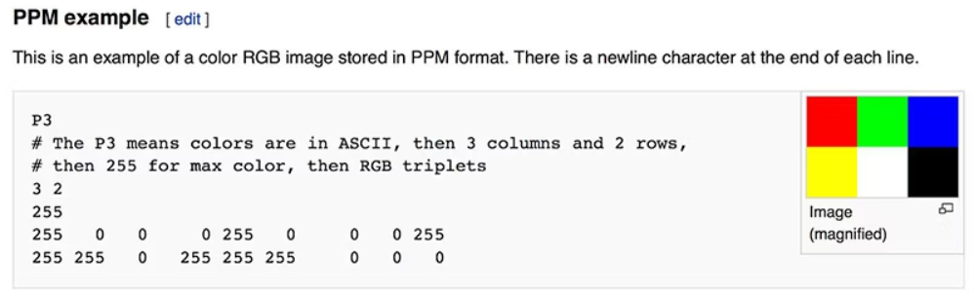
PPM and Images in general
A digital image is a binary representation of visual data, it can be saved in modern systems in different formats such as PPM, JPEG, PNG, SVG etc.
The above is how a PPM image is represented. Other than the format of an image which is more of a storage format but when we are generating an image we need to determine how many pixels the image will hold. The dimensions and the aspect ratio define these.

Slide 6
What are Pixels & Viewport?
Pixels: Pixels are the smallest indivisible unit of a digital image, they hold the primary color information in an array in the form of (R, G, B). The pixels are squares holding information of one color only, the number of pixels are defined by the aspect ratio and image width. The defining code is: -
auto aspect_ratio = 16.0 / 9.0;
int image_width = 400;
// Calculate the image height, and ensure that it's at least 1.
int image_height = int(image_width / aspect_ratio);
image_height = (image_height < 1) ? 1 : image_height;
Viewports: A window into the 3D world, the image was a represenation of the viewport using pixels. The viewport's dimensions are real world values and every pixel holds a certain space in the viewport so that it is fundamentally trackable. The defining code is: -
// Viewport widths less than one are ok since they are real valued.
auto viewport_height = 2.0;
auto viewport_width = viewport_height * (double(image_width)/image_height);

Slide 7
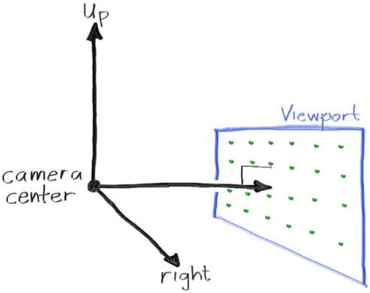
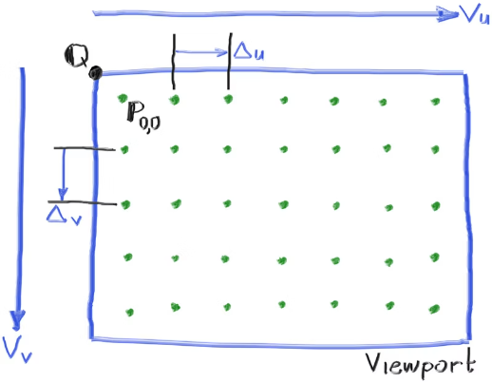
More On Viewport
We will place the camera at the coordinate (0, 0, 0) and the view port would be having the centre at (0, 0, -1) for simplicity.
We take 2 vectors, U and V. U has a span of (Image Width , 0, 0) and V has a span of (0, -Image height, 0) which dictate where the borders of the viewports end. The smaller vectors Δu and Δv are the distance between 2 pixel centres in viewport units.

Slide 8
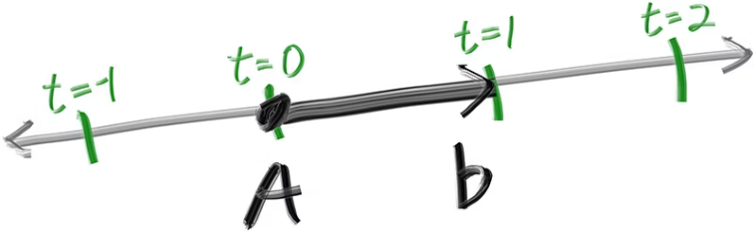


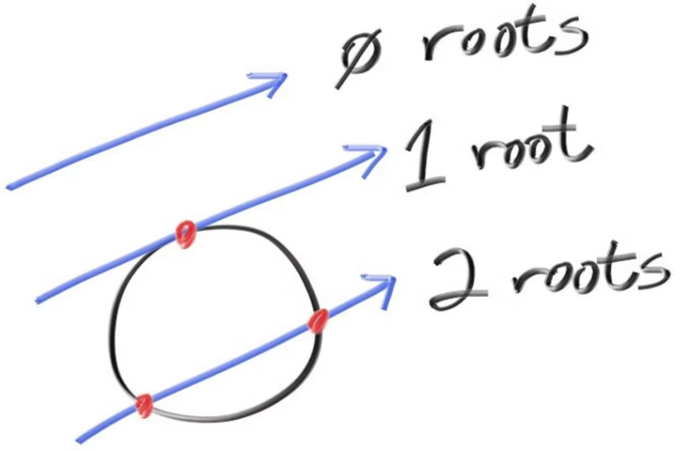

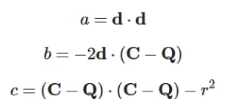
Ray Generation & Intersection Testing
Ray representation: -
A is the ray origin and b is the ray direction. The ray parameter (t) is a real number. Different values of 't' will progress the ray in either direction. P(t) is the final head of the ray after progressing 't' units.
Ray Intersection Calculation: -
C is the sphere centre and P is the point on which any incoming ray will fall. We will next calculate on which pixels of our viewport has rays which start from centre and fall on point P.
Expanding the above further and solving it using quadratic formulae we finally find the points which are intersecting the body of the spheres.

Slide 9

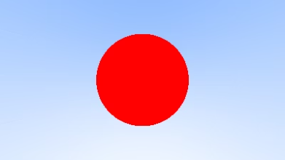
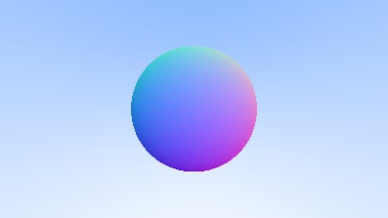
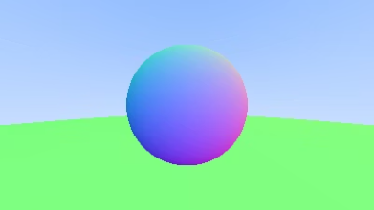
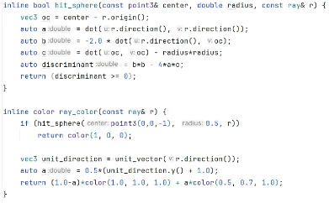


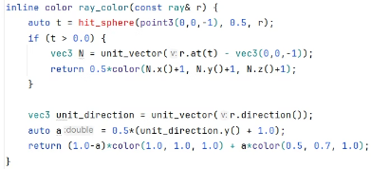
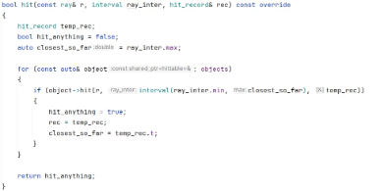
Forming our World
Linear Interpolation Only
Introducing a Sphere
Sphere colored using Normals
Introducing multiple spheres
We form a gradient on the viewport using each ray from the camera. We take the 'y' coordinate, scale it to (0, 1) and then use it as
We introduce if-else so that whenever we hit a sphere we go on and shade it to the pure color red denoted by (1.0, 0, 0).
Based on each normal vector from centre where our rays hit the sphere we can shade the spheres too, which will be unique too helping us differntiating between different objects.
We start handling which ray hits which sphere and finding out superimposition using the closest object intersected so far.

Slide 10
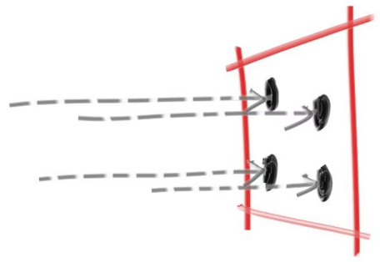
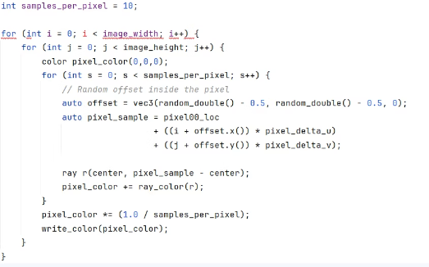
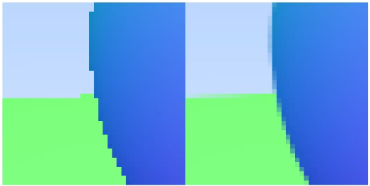
Anti - Aliasing
Rendered images often show jagged “stair-step” edges, known as aliasing. This happens because a single ray per pixel (point sampling) misses the continuous nature of real-world images, which have infinite resolution.
To fix this, we use anti-aliasing by sampling multiple rays within each pixel’s area, capturing variations in light from surrounding points. Averaging these samples approximates how a real camera or eye perceives blended edges, producing smoother, more realistic images.
The implementation side of this would be that first we will go to a pixel centre, then we will form a unit directional square with origin at that centre and then sample 10 different random points in that square and finally average it.
Pre v/s Post results
Representation of random sampling as a differential approach to point sampling.
The implementation.

Slide 11
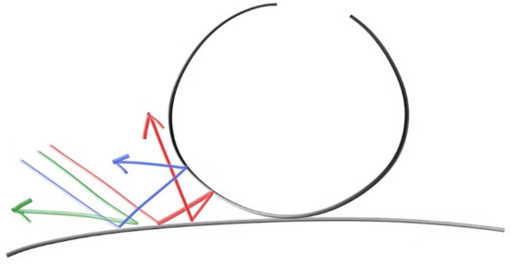
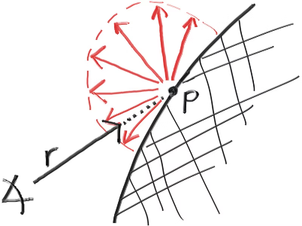
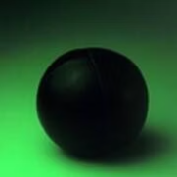
Introducing Materials (Diffused Reflective Surfaces)
Diffuse reflection is the reflection of light from a surface such that a ray incident on the surface is scattered at many angles rather than at just one angle as in the case of specular reflection (As in the case of mirrors where angle of incedence equals the angle of reflection).
An ideal diffuse reflecting surface is said to exhibit Lambertian reflection, meaning that there is equal luminance when viewed from all directions lying in the half-space adjacent to the surface.
Diffuse objects that don’t emit their own light merely take on the color of their surroundings, but they do modulate that with their own intrinsic color. Light that reflects off a diffuse surface has its direction randomized, so, if we send three rays into a crack between two diffuse surfaces they will each have different random behavior:
Red ball in green walled room
White light (1, 1, 1) falls on green wall first which is a diffused surface and absorbs other components than the green due which is wholly reflected back which is why the wall appears gree. Since no red component in secondary reflected light the ball absorps the green components and becomes a black mass.
Randomized behavior
Lambertian reflection for simplicity
For simplicity we assumed lambertian reflection so as such we need to sample random rays reflected in the outer hemiphere centred at the point where the incident ray hit.

Slide 12
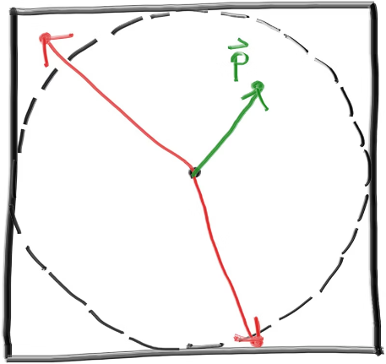
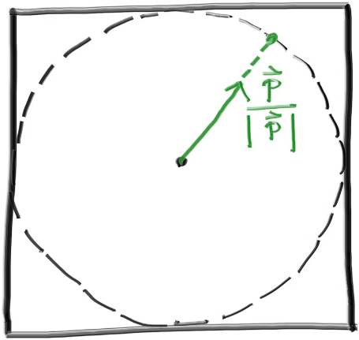
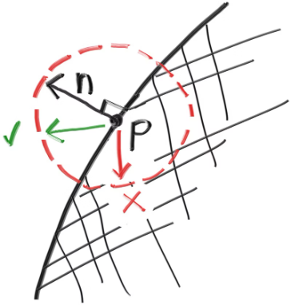
Diffuse Objects (Randomized reflection handling)
Methodology: -
Generate a random vector inside the unit sphere
Normalize this vector to extend it to the sphere surface
Invert the normalized vector if it falls onto the wrong hemisphere
The normal vector tells us which hemisphere we need (dot product if +ve then correct otherwise flip vector generated).
Two vectors were rejected before finding a good one (pre-normalization).
The accepted random vector is normalized to produce a unit vector.

Slide 13
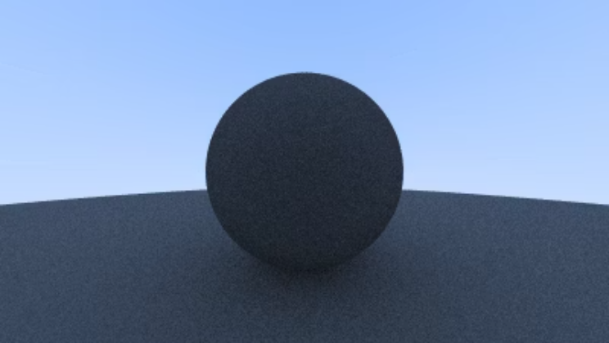
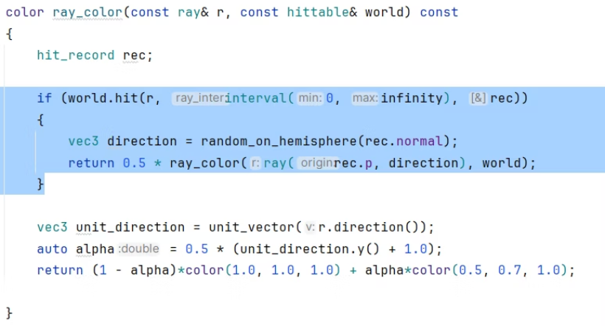
Diffused Implementation
As a first try we will set every object hit to behave like a diffused object which absorps 50% of the light incident on.
Code snippet: -
First render of a diffuse sphere

Slide 14
Work In Progress
The following functionalities are still underway in the project and shall be completed soon: -
Optimizing lambertian reflected rays, fixing shadow acne and gamma correction
Metals, scattering and reflection
Dielectrics and refraction
Real time camera positioning
Realtime zoom and focus
Rendering non solids like vapour, smokes, gaseous fluids.
Noise reduction

