Slide 1
Next-generation Operating Systems Lab
Set Samsung Printer as Default in Ubuntu
Wan Oh
CHANGWON NATIONAL UNIVERSITY

Slide 2
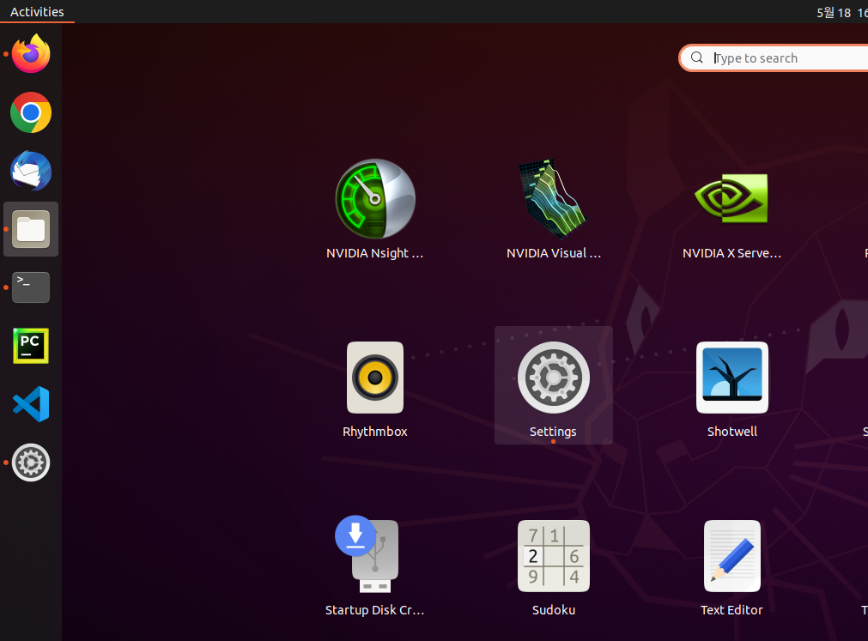
Print Setup
Press shortcut button “Settings” in Activities

Slide 3
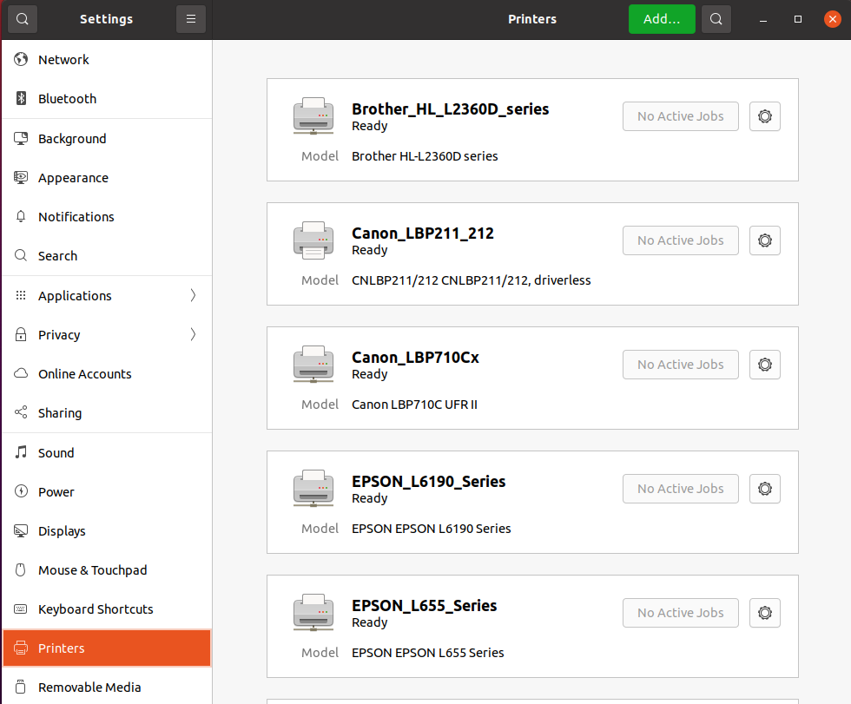
Print Setup
Press category “Printers”, and then press button “Add…”

Slide 4
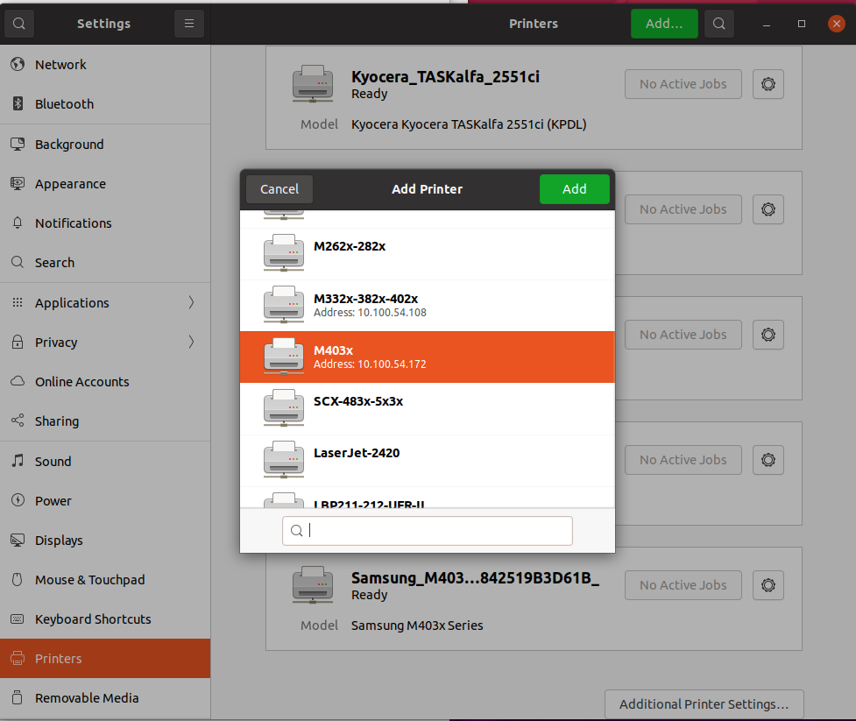
Print Setup
Find “M403x” and then select it
Its IP address must be ‘10.100.54.172’
You must to update this page if IP address and printer name is changed
Press button “Add”

Slide 5
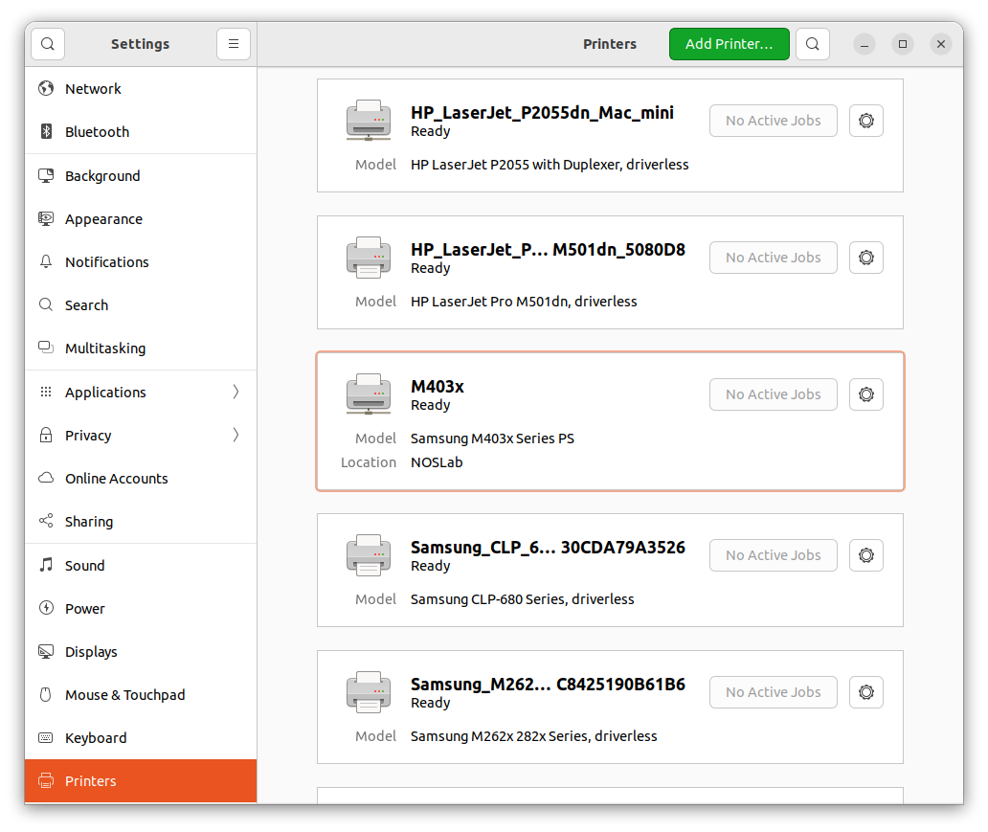
Print Setup
Now you can find ‘M430x’ in your Printers available to use
Select it and press button shape of “gear”

Slide 6
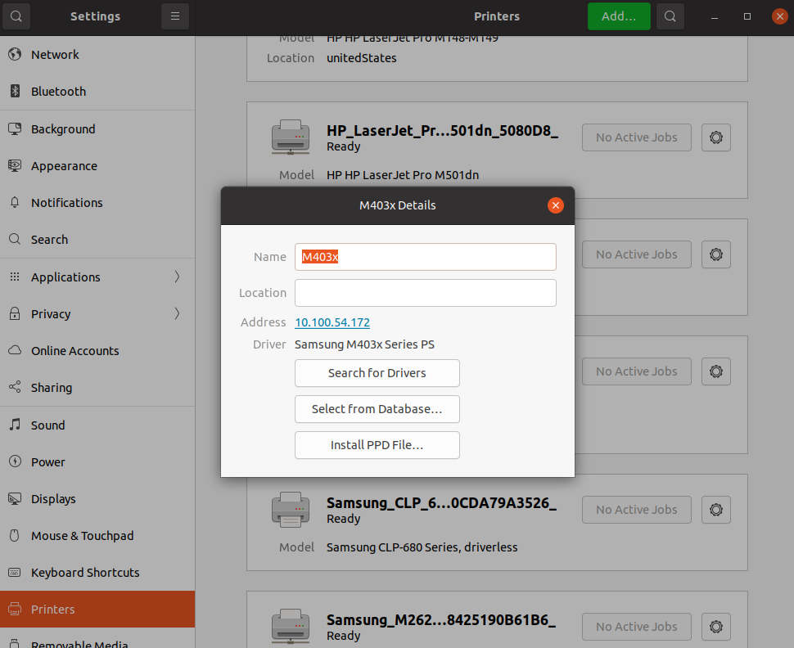
Print Setup
You can see the same image below and must to check whether Driver is ‘Samsung M403x Series PS’. If not, you must to configure M403x Print as manual

Slide 7
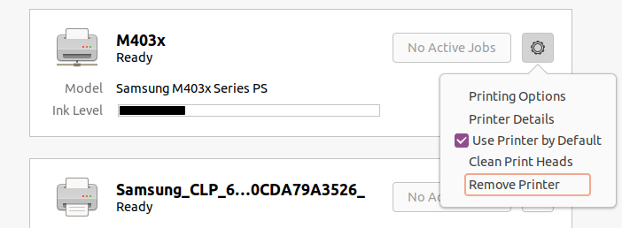
Print Setup
Finally, press check button of ‘Use Printer by Default'

Slide 8
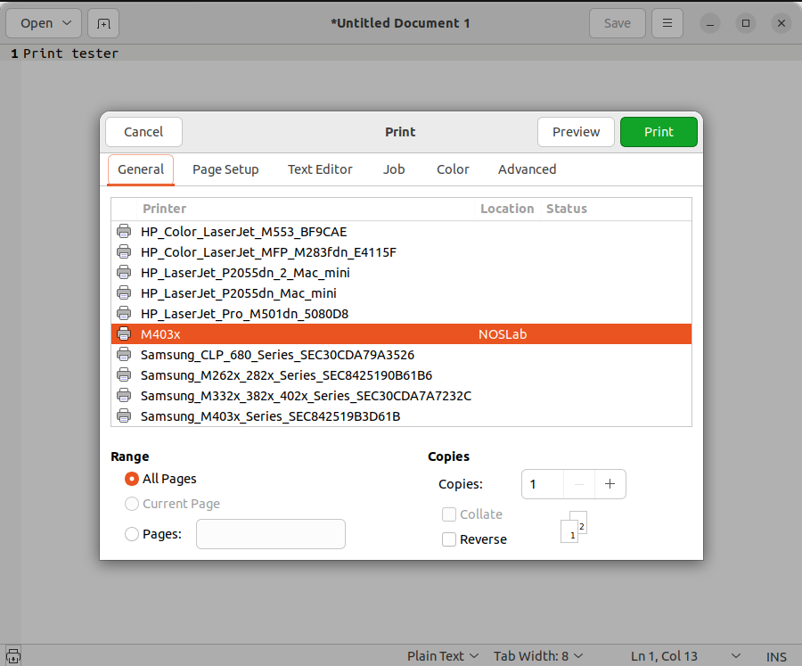
Print Setup
Now you can see M403x when you try to print anything via your applications in Ubuntu
For example, you can refer the image below

Slide 9
Print Setup
Please let me know if you have any issues or question once trying to setup printer in ubuntu
Also you can fix any defects in this presentation

