Slide 1
2017 IEEE Communication Magazine
IEE 802.11ax: Highly Efficient WLANs for
Intelligent Information Infrastructure
D. Deng, Y. Lin, X. Yang, J. Zhu, Y. Li, J. Luo and K. Chen
CHANGWON NATIONAL UNIVERSITY

Slide 2
Introduction
The world is experiencing extreme urbanization
Wi-Fi Internet connections and hotspots to operate, significant growth
Devices requires further technological break-throughs to meet the needs of high-density service
Wi-Fi(IEEE 802.11) plays a critical role in the infrastructure of cities
However, it has been 20 years since the first technical approval of the IEEE 802.11
Highly efficient WLANs are therefore very much wanted to serve for future human society.

Slide 3
Introduction
A new technology paradigm arises to revolutionize WLAN technology for UX
Focusing on the performance metrics of multi-user on delay, latency and throughput
IEEE Standard Association approved IEEE 802.11ax in March 2014
IEEE 802.11ax define standardized modifications to both the IEEE 802.11 physical (PHY) layer and medium access control (MAC) layer for high-efficiency operation
Goal is to provide a better UX by improving by least 4 times the throughput per user
In densely deployed environments

Slide 4
Introduction
Key features
Orthogonal frequency-division multiple access(OFDMA)
Downlink / uplink multi-user multiple-input multiple-output
Spatial reuse
Trigger frame
OFDMA random access
Power saving with target wake time
Station-to-station operation

Slide 5
Introduction
This paper provide a brief overview of important PHY advancements in IEEE 802.11ax
Key technologies proposed for IEEE 802.11ax MAC to improve the efficiency of high density WLAN

Slide 6
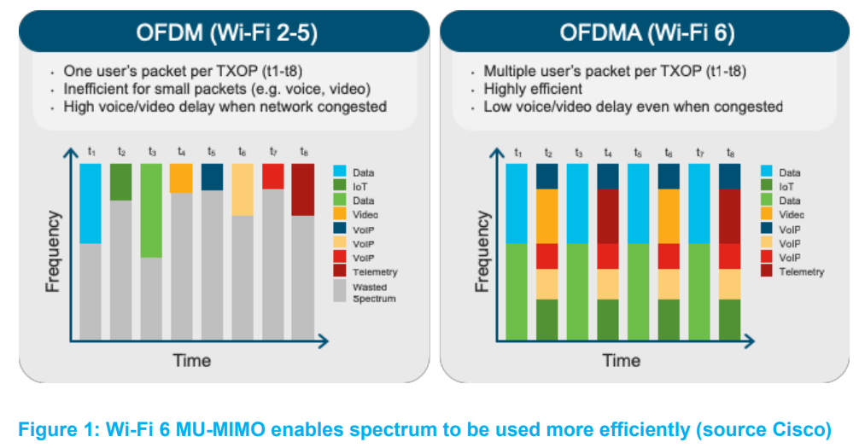
IEEE 802.11ax PHY
IEEE 802.11ax employs multi-user technology as PHY layer transmission in both up-link and down-link to serve more users at the same time.
Multi-user technology
OFDMA: allowing simultaneous access to radio resource.
Multiple user
Multiple input/output
https://wballiance.com/wp-content/uploads/2019/07/Wi-Fi-6-Deployment-Guidelines-and-Scenarios-V1.0.pdf

Slide 7
OFDMA PHY
OFMAD employs multiple subcarriers
Subcarriers are divided into multiple groups
Each group is referred to as resource unit(RU)
RUs are allocated to multiple mobile stations according to their channel conditions and requirments
OFDMA reduces preamble and channel access overhead by distributing across several users
Provide additional efficiency gain by assigning each user an RU

Slide 8
OFDMA PHY
Access point may increase the power on some RU for maximize DL(downlink) throughput
Typically, STAs have lower output transmit power than APs
Power asymmetry reduces the UL(uplink) throughput
UL OFDMA can be used to compensate for such power asymmetry

Slide 9
Numerology and tone plan
In order to better serve OFDMA feature,
The subcarrier spacing should be as small as possible to minimize the relative guard overhead
Provide better frequency selective gain
IEEE 802.11ax supports 0.8us, 1.6us and 3.2us guard interval duration
Cover a range of delay spread for indoor and outdoor channel

Slide 10
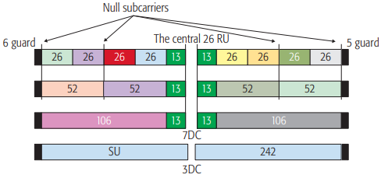
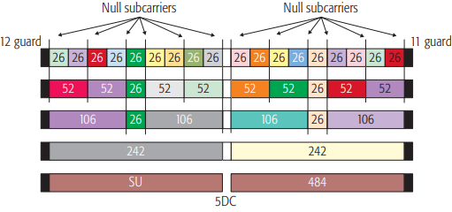
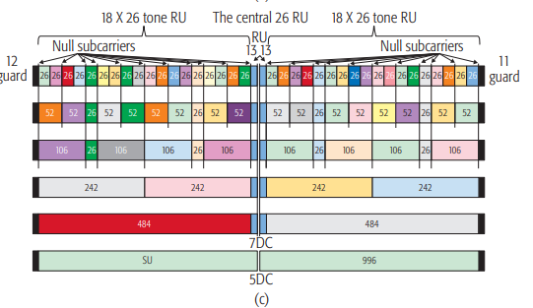
Numerology and tone plan
IEEE 802.11ax defined for DL/UL transmission: 26-tone(subcarrier) RU ~ 2*996-tone RU
IEEE 802.11ax support 20, 40 and 80MHz bandwidth
80 + 80MHz(non-contiguous) and 160MHz is also selectively available
RU location in 20MHz
RU location in 40MHz
RU location in 80MHz

Slide 11
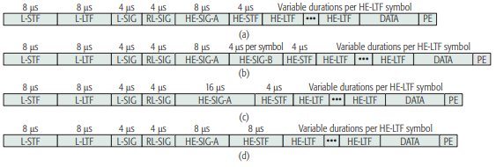
IEEE 802.11ax PPDU format
Four IEEE 802.11ax physical layer convergence protocol data unit(PPDU) format are defined
Single-user PPDU(HE SU PPDU), HE: high efficiency
Multi-user PPDU(HE MU PPDU)
HE trigger-based PPDU
Extended range transmission PPDU(HE ER SU PPDU)

Slide 12
Preamble puncturing
In IEEE 802.11ax, 20 MHz, 40 MHz, 80 MHz, and 160 (80+80) MHz are supported in 5 GHz band
However real deployment 80 MHz and 160 MHz bandwidth channels may not be realistic to use
Unlicensed spectrum in 5GHz is not contiguous
Since the transmit power regulations are different in each band, for a BSS* that needs high transmit power the number of channels is further reduced.
Radar spectrum overlaps with part of 5 GHz unlicensed spectrum, the channel cannot be used when radar signal is detected.
The deployment of legacy APs operating at narrowband makes it hard for the AP to find a clear 80 MHz or 160 MHz bandwidth channel.
*Basic service set

Slide 13
Preamble puncturing
IEEE 802.11ax support preamble puncturing that allowing an AP to transmit an HE MU PPDU in punctured 80 or 160 (80+80) MHz format when part of the 20 MHz sub-channel(s) in secondary channels of the channel bandwidth is busy.
Preamble puncturing is designed to enhance the channel utilization for the dense AP

Slide 14
DL/UL MU-MIMO
IEEE 802.11ax introduces UL MU-MIMO, which improves the aggregate throughput of an IEEE 802.11ax network by parallelization of multiple transmissions on the UL
Both DL and UL MU-MIMO transmissions are supported on portions of the PPDU bandwidth
MU-MIMO support for up to eight users with up to four space-tine streams per user with the total number of space-time streams not exceeding eight.

Slide 15
IEEE 802.11ax MAC
IEEE 802.11ax MAC design due to the multiple users sharing a frequency carrier/band, resulting in a new technology challenge in carrier sense
The basic idea is to leverage the concept of four way handshaking by establishing a trigger frame to allow efficient operation of multiuser PHY.

Slide 16
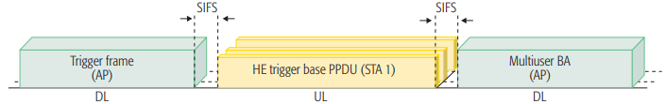
UL MU procedure
UL MU transmissions leverage a new control frame called a trigger frame
AP sends a trigger frame to multiple STAs to trigger them to transmit frames in MIMO
After receiving the trigger frame and ensuring that it is one of the target STAs
Each of the triggered STAs needs to complete the following in a fixed time slot

