Slide 1
Reviewer’s comments
for submitted paper
Jinseo Choi
CHANGWON NATIONAL UNIVERSITY

Slide 2
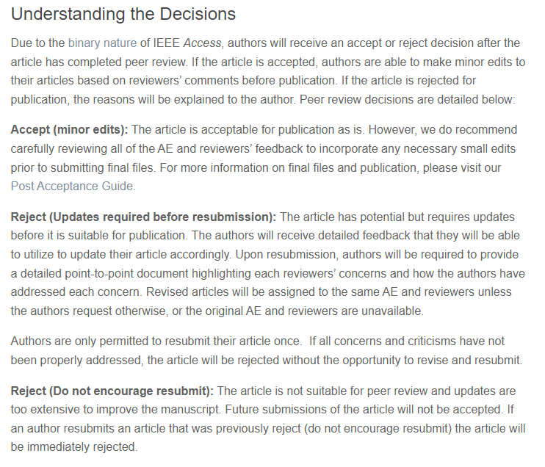
Submission result
Reviewer1 : Reject(updates required before resubmission)
Reviewer2 : Reject(updates required before resubmission)
Reviewer2 proposed that the paper is accepted with major revision.
We have 1 chance to resubmission

Slide 3
Reviewer1’s comments
Does the paper contribute to the body of knowledge? : Yes (WIP)
But it is essential for the authors to showcase their novelty.
As of now, the authors have implemented the ol.data and done subsequent analysis using this feature
Novelty를 강조하기 위해 제안기법이 추가적인 환경 세팅 없이 적용할 수 있음(범용성)을 강조
Is the paper technically sound? : Yes (OK)
It is in terms go analysis using ol.data. I strongly suggest the authors to come up with their flowchart to showcase their methodology which particularly highlights the novelty
ol.data novelty(overlap)를 강조하기 위한 flow는 이미 존재(Figure 3)
ol.data 세부적인 실행흐름에 대한 그림을 추가

Slide 4
Reviewer1’s comments
Flow chart 제안
Data load
Train Prep.
Training
Model copy
Valid. prep.
Valid. prep.
Valid. prep.
Train Prep.
Valid.
Valid.
Valid.
Training
Loss/Accuracy

Slide 5
Im.data figure
Convert to tensor
Reshape
Shuffle
Batch
Data-load
Preprocessing
Preprocessing
Loss
accuracy
CPU
Training
Validation
(Forward pass only)
Epoch
GPU
Forward
pass
Backward
pass
Weight
update

Slide 6


Reviewer1’s comments
Flow chart 제안
Valid.
prep.
Validation
Loss
Acc.
No
Valid.
Data load
Train
prep.
Train
${Epoch}_{n}$> 0
if
$${Epoch}_{n−1}$$
Model
copy
Yes
Yes
Valid.
prep.
Valid.
Loss
Acc.
Complete
Valid.
No

Slide 7
Reviewer1’s comments
Next Epoch
Data load
Train
preprocessing
Train
Validation
preprocessing
Validation
Loss/Acc.
Next Epoch
Valid.
Data load
Train
preprocessing
Train
Model
copy
Validation
Prep.
Valid.
Loss/Acc.
Valid.

Slide 8


Reviewer1’s comments
Figure
Next Epoch
Data load
Train
preprocessing
Train
Validation
preprocessing
Validation
Loss/Acc.
(a) Original training-validation flow
Next Epoch
Data load
Train
preprocessing
Train
Model
copy
Train
Prep.
Train
Valid.
prep.
Valid.
Loss/Acc.
$${Epoch}_{n}$$
Parallel processing
$${Epoch}_{n+1}$$
(b) ol.data training-validation flow

Slide 9


Reviewer1’s comments
Data load
Train
preprocessing
$${Thread}_{1}$$
Train
Train Preprocessing
Train
Model
copy
$${Thread}_{n}$$
Validation
preprocessing
Validation
Loss
Acc.
Figure

Slide 10
Convert to tensor
Reshape
Shuffle
Batch
Data-load
Preprocessing
Preprocessing
Loss
accuracy
CPU
Training
Validation
(Forward pass only)
Epoch
GPU
Forward
pass
Backward
pass
Weight
update

Slide 11
Convert to tensor
Reshape
Shuffle
Batch
: idle
(1)
Data-load
(2)
Preprocessing
(4)
Preprocessing
Loss
accuracy
Im.data figure
CPU
(3)
Training
(5)
Validation
(Forward pass)
Epoch
GPU
Forward
pass
Backward
pass
Weight
update
11

Slide 12
Reviewer1’s comments
Is the subject matter presented in a comprehensive manner? : No (OK)
Can the authors summarise the findings of the literature review in tabulated form showcasing advantages and disadvantages of existing techniques?
기존 기술에 대한 리뷰(논문)를 찾아 장단점을 table 형식으로 요약
기존 Overlap관련 연구들은 제안기법과 실험환경이 달라(단일 GPU vs GPU cluster), 본 논문의 scope을 벗어날 가능성이 있음
Numpy와 tf.data의 장단점을 요약
I suggest the authors to incorporate the pseudocode for the overlapping process of training and validation.
제안기법을 pseudocode로 작성
Pseudocode 대신 ol.data 실행흐름에 대한 그림으로 대체

Slide 13
Reviewer1’s comments
Comparing Table
 | Numpy | tf.data | ol.data
Dataset iterable | O | O | O
Multi-thread configurable | X | O | O
Auto data shape align | X | O | O
Data preprocessing support | X | O | O
Validation parallelism | X | X | O
Process overlap | X | X | O

Slide 14
Reviewer1’s comments
Are the references provided applicable and sufficient? : Yes
No commentary
Are the references that are not appropriate for the topic being discussed? : No
No commentary

Slide 15

Reviewer2’s comments
The affiliations 1 and 2 are the same (OK)
2번 각주 삭제, 1번 각주만 유지, 1번 각주를 두번 사용하도록 수정
다른 논문 예시

Slide 16
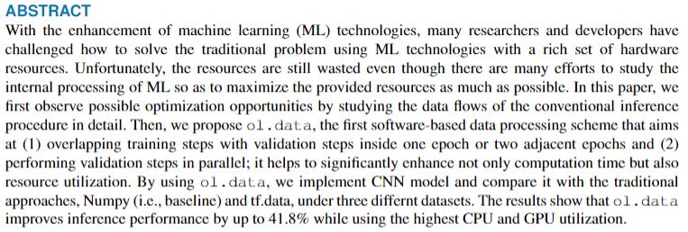
Reviewer2’s comments
What is ‘CNN’ mention in Abstract? (WIP)
1안: CNN(Convolution Neural Network)으로 수정
2안: CNN → Image classification model(e.g. CNN)으로 수정

Slide 17
Reviewer2’s comments
The citations in “sufficiently utilize the hardware resources [1], [3], [17]-[22]” are improper; citing so many propers once in not professional (OK)
해당 문장과 관련된 인용논문 수를 줄일 경우
[1]: Octo(link): 모바일 디바이스 training을 위해 데이터 자료형을 양자화(float →int)하여 실현 → inference 를 H/W logic으로 offload 했다고 보기 어렵다고 생각됨
[3]: HetPipe(link): 모델 분산+데이터분산 병렬처리를 통합(overlap 적용) → H/W logic을 직접 변경하지 않음
[17]: MnnFast(link): FPGA를 사용하여 large-scale memory neural network(RNN)을 위한 H/W 아키텍쳐 제안 → 적합
[18]: Processing-in-Memory for Energy-efficient Neural Network Training(link): 훈련 성능개선 PIM H/W 아키텍쳐 제안 → 적합
[19]: ZeRO-Offload(link): large-scale model inference 성능향상을 위해 data를 CPU로 offload하여 수행 → H/W logic을 직접 변경하지 않음
[20]: Scalable Multi-FPGA Acceleration for Large RNNs with Full Parallelism Levels(link): FPGA를 사용하여 H/W 아키텍쳐 제안 → 적합
[21]: FlashNeuron(link): 대규모 모델 학습을 위한 GPU-NVMeSSD Peer-to-Peer Direct Storage Access 레이어, GPU-NVMe SSD PCI-e 다이렉트 채널 제안 → kernel-level logic 변경(H/W logic을 직접 변경?)

Slide 18

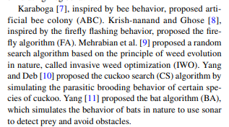
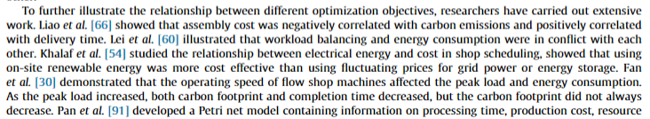
Reviewer2’s comments
When reviewing the related work, the sentence, “Ren et. al. focused on GPU-CPU hybrid training technology that offloads data to reduce the amount of data movement to/from GPU[20]” is improper. You can find the similar sentence in the following website that can help you how to review your work.
https://www.sciencedirect.com/science/article/pii/S0020025521013438
https://link.springer.com/article/10.1007/s11831-021-09562-1
관련연구 서술 시, <저자>[인용정보] <요약내용> 순으로 서술됨 해당 format으로 변경 (OK)
For example, Ren [19], focused on GPU-CPU hybrid training technology(중략)

Slide 19
Reviewer2’s comments
The “Kwon et al. introduced the prototype of the multi-FPGA acceleration for large-scale RNNs [21]” has the same problem with before; (OK)
이전 슬라이드와 동일
<저자>[인용정보] <요약내용> 순으로 format 변경

Slide 20
Reviewer2’s comments
Use “Fig. 1” or “Figure 1” instead of both. (OK)
Figure1, Fig.1 포맷을 혼용불가, Figure 또는 Fig. 만 사용
The usage of “Fig. 2(a) and Fig. 2(b)” in “Unfortunately, as shown in Fig. 2(a) and Fig. 2(b)” is wrong; (OK)
Fig. 2(a) and Fig. 2(b) → Figure 2(a) and Figure 2(b)
The usage of “Fig. 2(c) and Fig. 2(d)” in “Meanwhile, utilization of GPU shows better than that of CPU but reveals dramatic fluctuations (see Fig. 2(c) and Fig. 2(d))” is wrong; (OK)
Fig. 2(c) and Fig. 2(d) → Figure 2(c) and Figure 2(d)

Slide 21
Reviewer2’s comments
For “TABLE 1: Hardware and software environment”, use “TABLE I” instead of “TABLE 1” according to IEEE template; (OK)
로마자로 변경

Slide 22
Reviewer2’s comments
The usage of “Fig. 4 and Fig. 5” in “Fig. 4 and Fig. 5 illustrate how much ol.data and tf.data” is wrong;
12번 슬라이드와 동일, Fig.4 and Fig.5 → Figure 4 and Figure 5 (OK)
The “Fig. 8 and Fig. 9 show our empirical results” has the same problem with before;
Fig.8 and Fig.9 → Figure 8 and Figure 9 (OK)
The “Fig. 10 and Fig. 11 present model loss and accuracy” has the same problem with before;
Fig.10 and Fig.11 → Figure 10 and Figure 11 (OK)

Slide 23
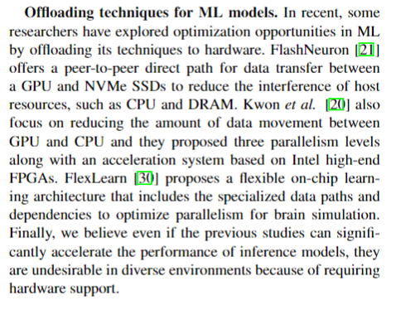
Reviewer2’s comments
The sentence, “Ren et al. [21] also focus on reducing the amount of data movement between”, is wrong; (OK)
관련연구 서술 시, <저자>[인용정보] <요약내용> 순으로 서술됨 해당 format으로 변경
(제출버전 확인 필요)
The “FlexLearn [17] proposes a flexible on-chip learning architecture that includes the specialized data paths and” has the same problem with before; (OK)
관련연구 서술 시, <저자>[인용정보] <요약내용> 순으로 서술됨 해당 format으로 변경

Slide 24
Reviewer2’s comments
Except the methods used in the paper, some of the most representative computational intelligence algorithms can be used to solve the problems, like monarch butterfly optimization (MBO), earthworm optimization algorithm (EWA), elephant herding optimization (EHO), moth search (MS) algorithm, Slime mould algorithm (SMA), hunger games search (HGS), Runge Kutta optimizer (RUN), colony predation algorithm (CPA), and Harris hawks optimization (HHO). These must be clearly pointed out in Section Conclusion. (WIP)
위에서 제시한 알고리즘은 자연현상에서 기인하여 수학적인 방법으로 모델링된 최적화 알고리즘으로 보인다.
Reviewer는 이러한 알고리즘들이 Conclusion section에서 명확하게 지적되어야 한다고 언급한 것으로 보아, 위 알고리즘과 본 연구에서 제안하는 기법의 비교를 의미하는 것으로 보인다.
하지만 본 제안기법은 기존 처리방식을 병렬화 하는 시스템 구조 개선 관점으로 보는 것이 적절하므로 위 알고리즘의 언급은 불필요 할 것으로 생각된다.
제안기법에서 위 알고리즘 도입으로 추가적인 성능개선의 여기 있음을 보이는 future work 개념으로 추가

Slide 25
Reviewer2’s comments
The journal name in Ref. [8], “Advances in neural information processing systems”, is wrong. Remove the similar problems in the paper. (OK)
For Ref. [10], list all the authors instead of only listing the first author and using “et al.” to representing other authors. (OK)
The journal name in Ref. [24], “Proceedings of the national academy of sciences”, is wrong. Remove the similar problems in the paper. (OK)
저자정보 format 통일, 재확인
컨퍼런스, 저널정보, format 재확인

