Slide 1
IEEE ICC’13
Evaluation of the Minstrel Rate Adaptation Algorithm in IEEE 802.11g WLANs
Dong Xia, Jonathan Hart, Qiang Fu
CHANGWON NATIONAL UNIVERSITY

Slide 2
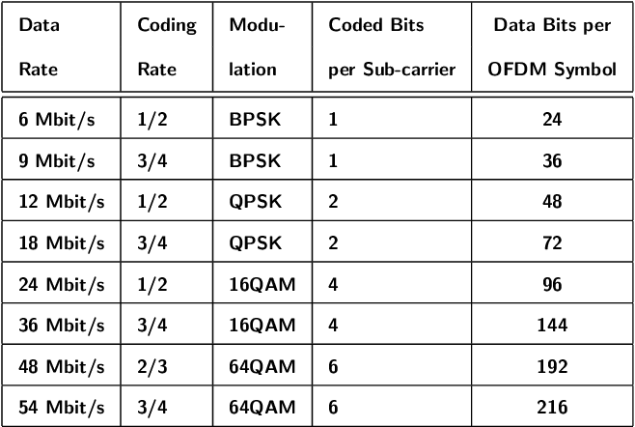
Introduction
IEEE 802.11 standards specify multiple data rates
Data rate depending on the modulation and coding scheme used at physical layer
High data rate: fast data transmission, high bit error occurrence probability
Low data rate: longer data transmission, low bit error occurrence probability
Both are also affected by channel condition
IEEE 802.11g Data Rates Specifications,
Mikulka, Jan and Stanislav Hanus. “IEEE 802.11g baseband physical layer simulation.” (2007).

Slide 3
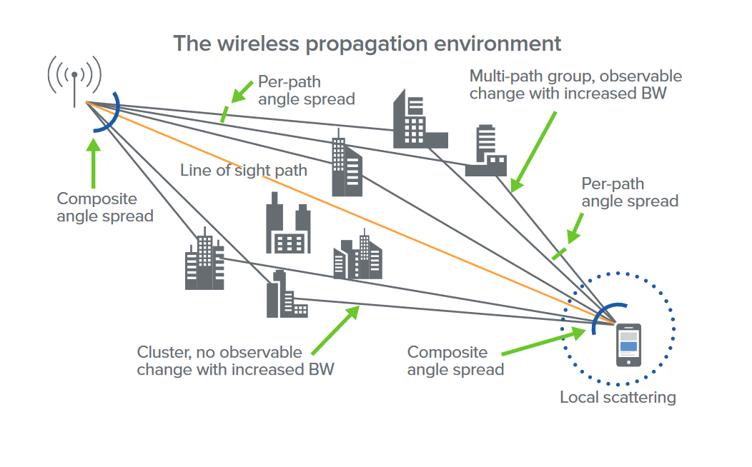
Introduction
Wireless channel is extremely variable
Channel condition can be affected by a number of different factor
Signal interference, multi-path fading, attenuation
Rate adaptation is crucial to wireless network performance
Data rate optimization problem
Fast data transmission, low bit error considering
the channel conditions
https://www.everythingrf.com/community/what-is-signal-fading

Slide 4
Introduction
A lot of research has been done for the effective data rate adaptation algorithm.
RRAA, ARF, AARF, WOOF, etc.
Minstrel is a recently-developed adaptation algorithm
Performance evaluations of Minstrel are scares
This paper present analysis the performance of Minstrel in real-world IEEE 802.11g

Slide 5




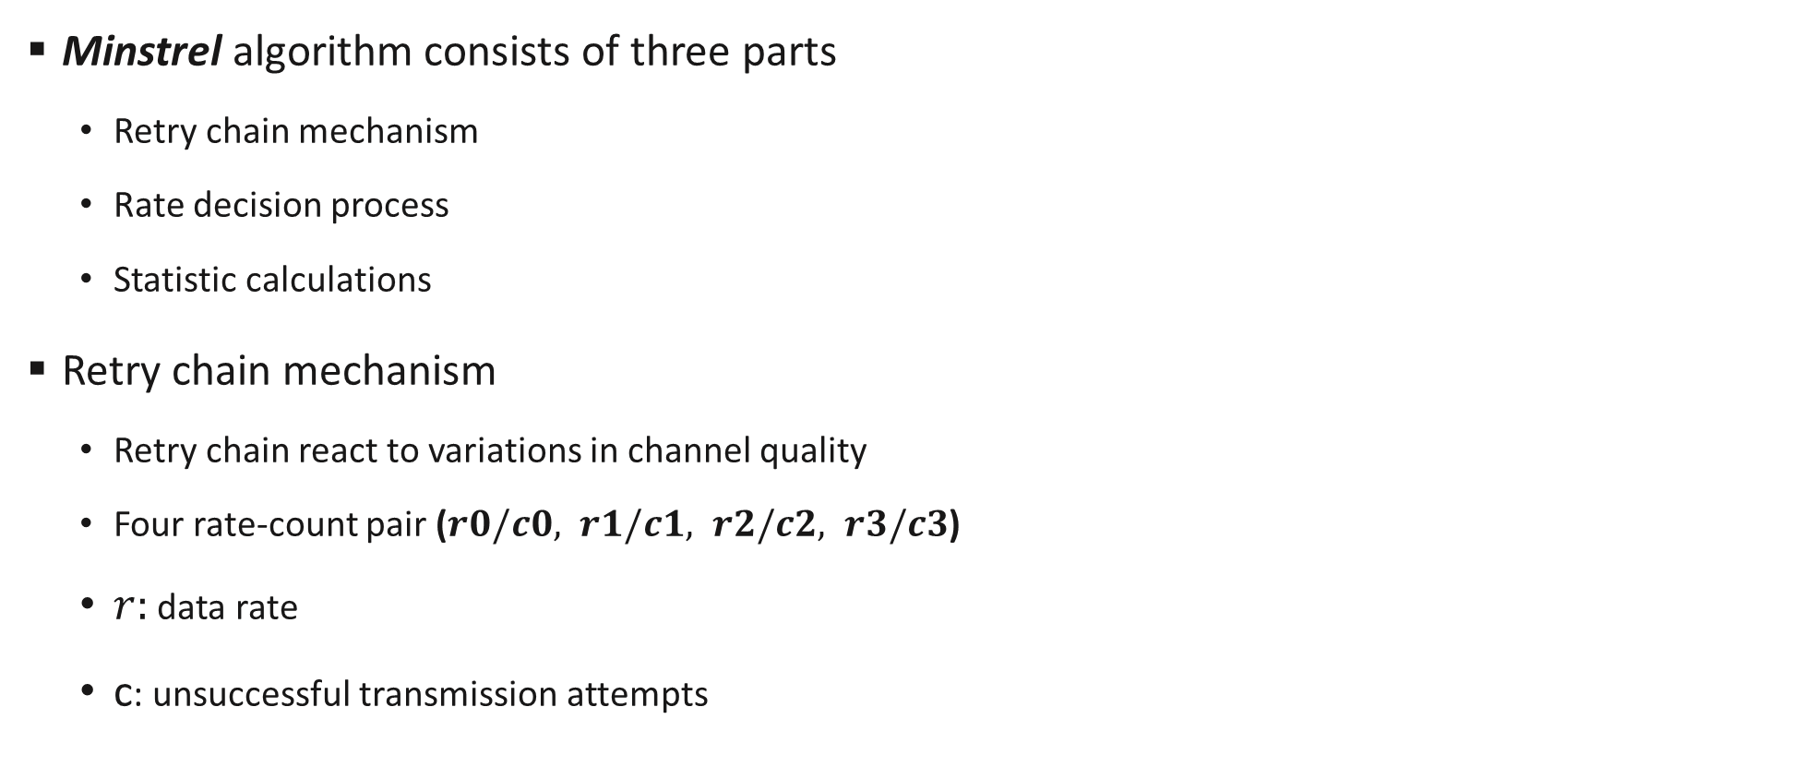







Minstrel algorithm
Minstrel algorithm consists of three parts
Retry chain mechanism
Rate decision process
Statistic calculations
Retry chain mechanism
Retry chain react to variations in channel quality
Four rate-count pair ($r0/c0, r1/c1, r2/c2, r3/c3$)
$r:$ data rate
c: unsuccessful transmission attempts
AP
Sender
Receiver
If transmission fail
High
Transmission speed
$$r0$$
$$c0$$
$r$1
$c$1
1st retransmission attempt
$r$2
$c$2
2nd retransmission attempt
$r$3
$c$3
3rd retransmission attempt
High
Transmission stability
How to determine $r$-value?

Slide 6
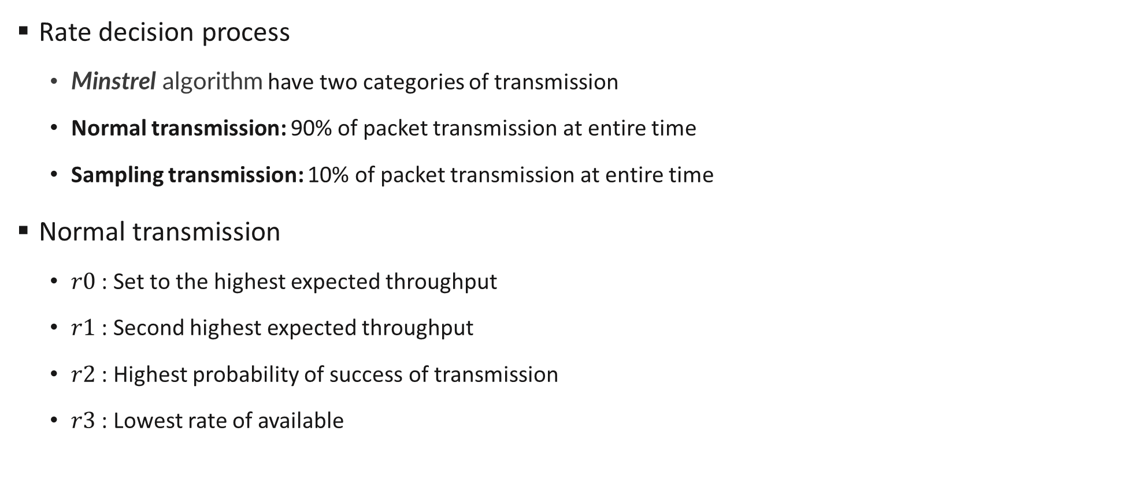
Minstrel algorithm
Rate decision process
Minstrel algorithm have two categories of transmission
Normal transmission: 90% of packet transmission at entire time
Sampling transmission: 10% of packet transmission at entire time
Normal transmission
$r0$: Set to the highest expected throughput
$r1$ : Second highest expected throughput
$r2$ : Highest probability of success of transmission
$r3$ : Lowest rate of available

Slide 7
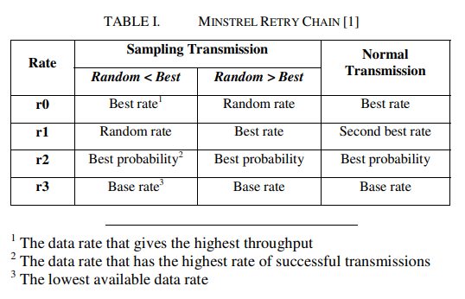
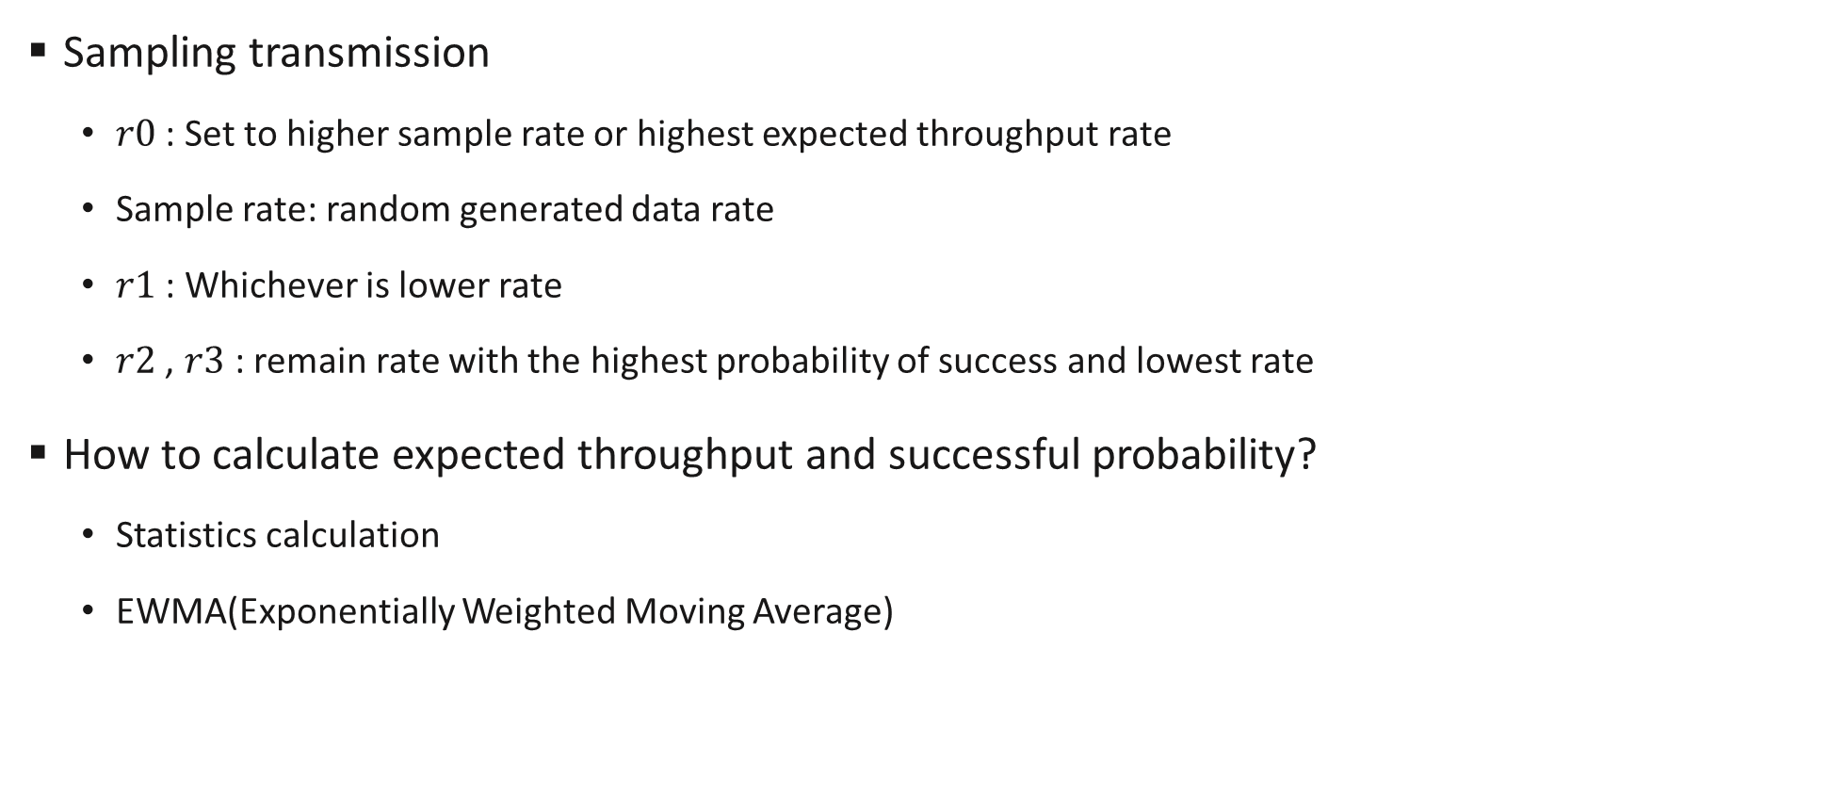
Minstrel algorithm
Sampling transmission
$r0$: Set to higher sample rate or highest expected throughput rate
Sample rate: random generated data rate
$r1$ : Whichever is lower rate
$r2$ , $r3$ : remain rate with the highest probability of success and lowest rate
How to calculate expected throughput and successful probability?
Statistics calculation
EWMA(Exponentially Weighted Moving Average)

Slide 8
Minstrel algorithm
Statistics calculation
Minstrel maintains the probability and expected throughput for each data rate as EWMA
Probability is used to estimate the throughput
Throughput expectation of each rate recalculated per 100ms (sampling window)

Slide 9

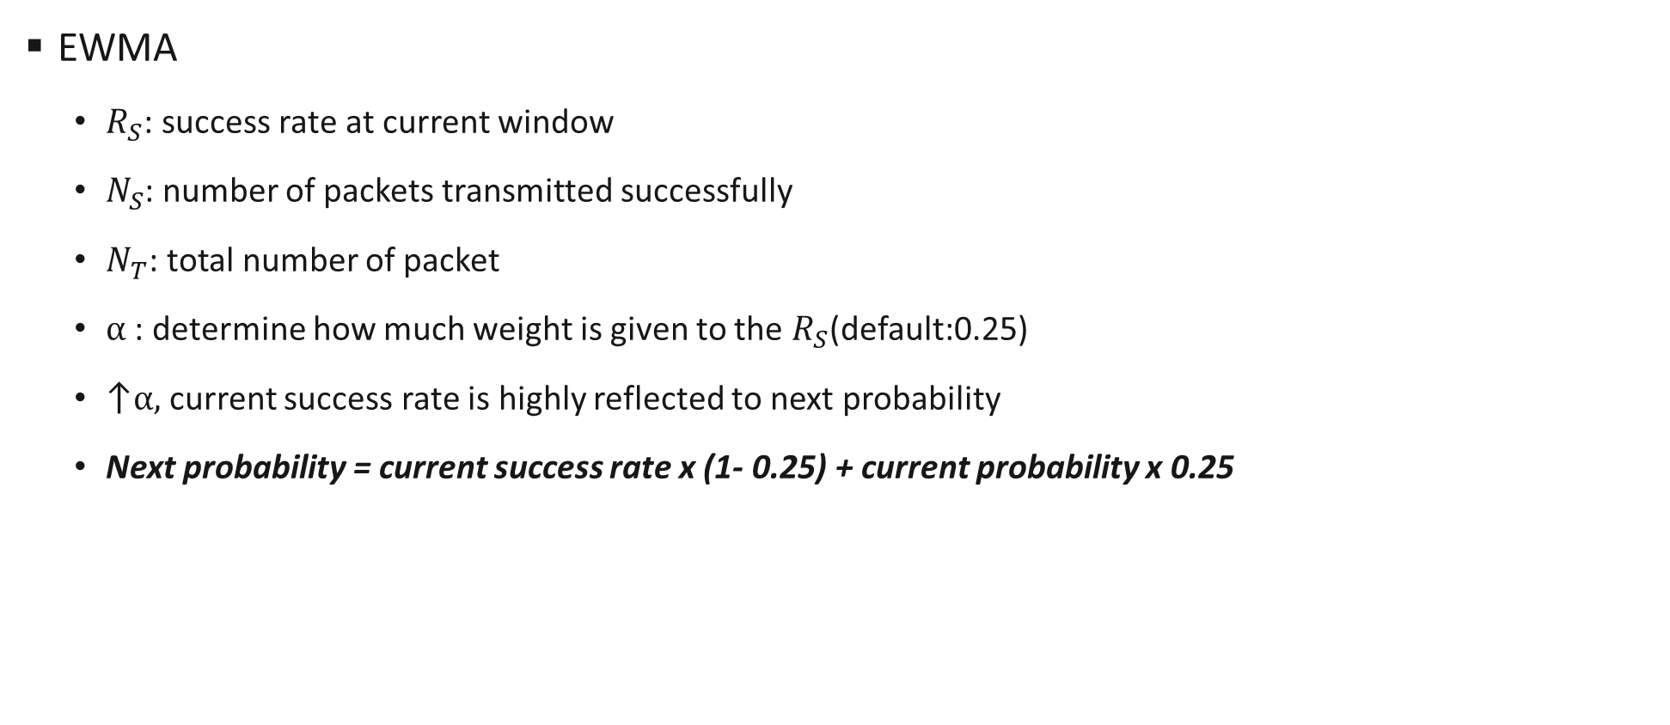
Minstrel algorithm
EWMA
$R_{S}$: success rate at current window
$N_{S}$: number of packets transmitted successfully
$N_{T}$: total number of packet
$α$ : determine how much weight is given to the $R_{S}$(default:0.25)
↑$α,$current success rate is highly reflected to next probability
Next probability = current success rate x (1- 0.25) + current probability x 0.25

Slide 10


Minstrel algorithm
Throughput expectation
$B:$ number of byte, raw throughput of rate
Success probability x (/t)

Slide 11
Minstrel algorithm
Calculate each rate’s throughput expectation per 100ms
In sampling transmission, random rate is also calculated
throughput expectation comparing
As rate select policy, r0 ~ r3 rates are selected

Slide 12
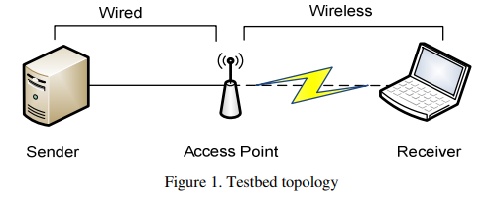
Evaluation
Testbed
Send UDP traffic from the sender PC to a laptop receiver
AP used 802.11g mode
Comparing case
Fixed data rate
Minstrel
Send UDP traffic using iperf

Slide 13
Evaluation
Test case
Static channel: static channel quality
Rapid channel variation: channel quality will jump from good to poor quickly
Gradual channel variation: channel quality will change gradually
Channel quality can control by AP’s transmission power(mW)

Slide 14
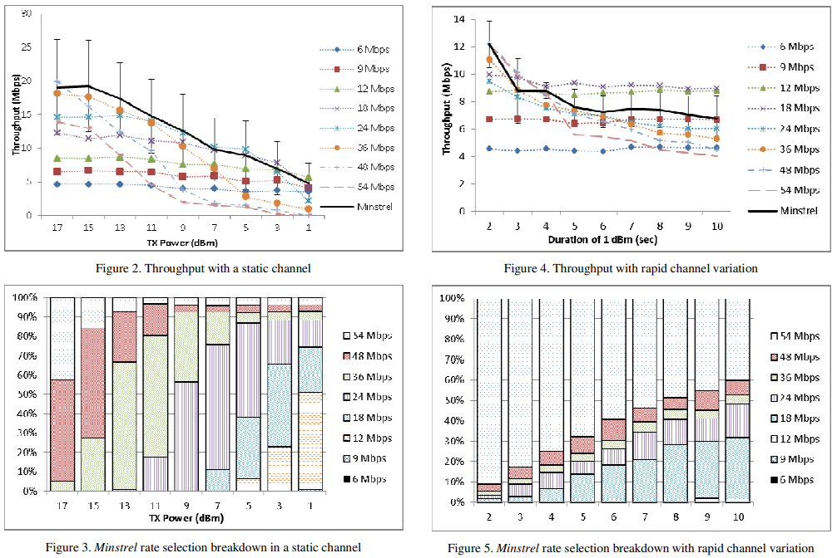
Result
Rate selection breakdown

Slide 15
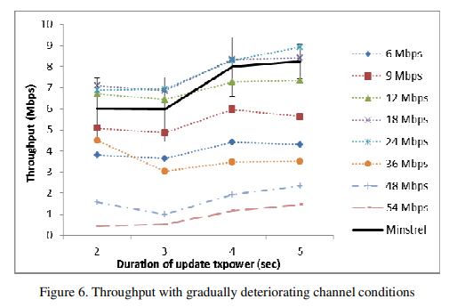
Result
Rate selection breakdown

