Slide 1
Research Briefing
Jinseo Choi
CHANGWON NATIONAL UNIVERSITY

Slide 2
Contents
Optimization Machine learning process by parallelism
P&ID object detection

Slide 3
Contents
Optimization Machine learning process by parallelism
P&ID object detection

Slide 4
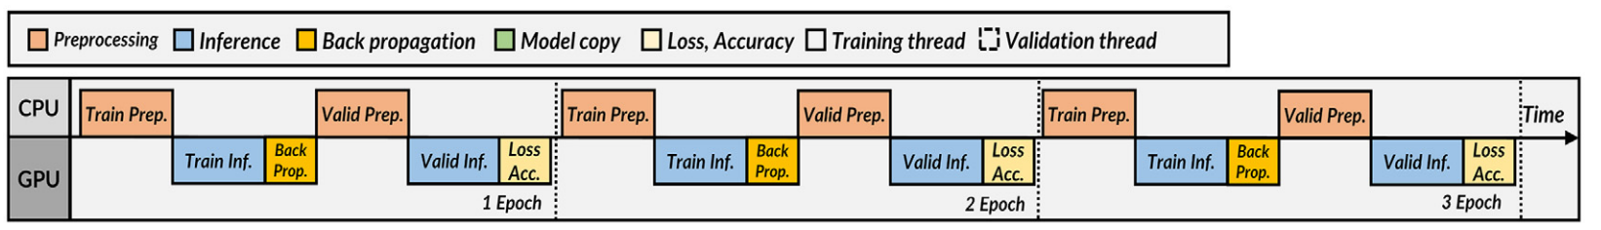
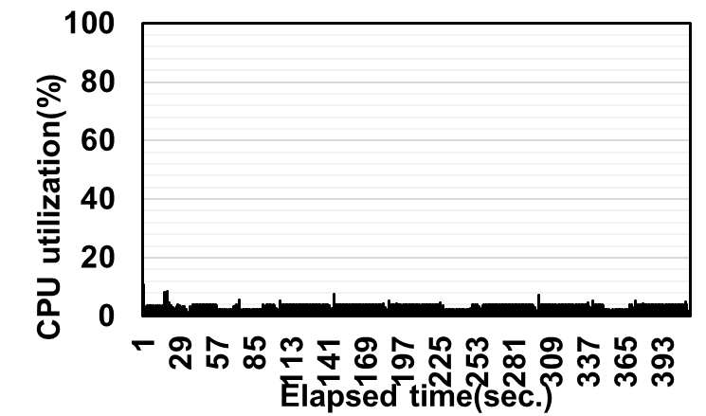
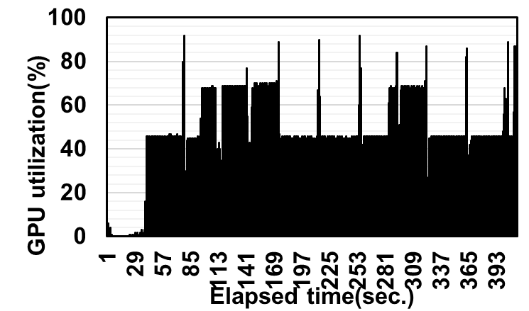
Problem
Conventional Deep learning process shows poor system resource utilization
This is because sequential processing
CPU utilization
GPU utilization
Utilization is unstable

Slide 5
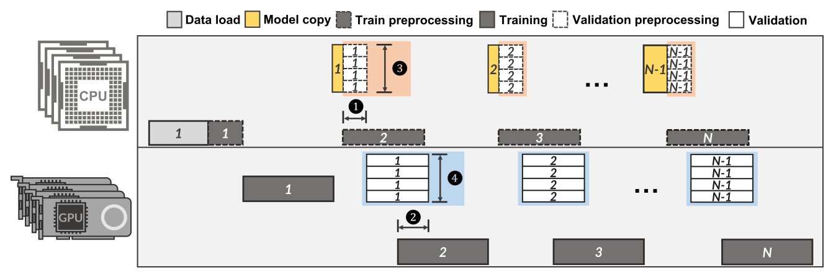
Process overlap & parallelism
We analyzed conventional process and select overlapped section
Validation have been overlapped with training processing
Validation preprocessing also have been parallel processing

Slide 6
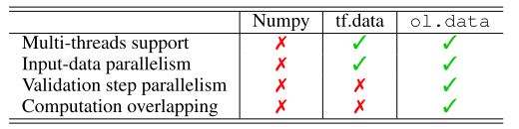
Evaluation
Evaluation DNN model
CNN based image classification model(10 class)
Dataset
MNIST, Fashion MNIST(100MB)
EMNIST(2GB)
Comparison target
ol.data : proposed scheme
Numpy
tf.data: Tensorflow data pipeline API

Slide 7
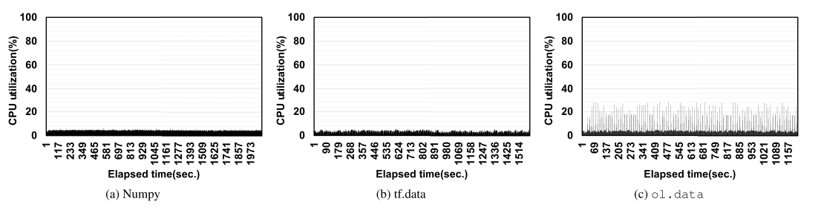
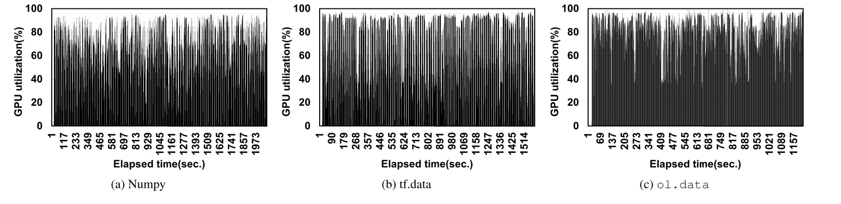
Evaluation
Comparison of CPU/GPU utilization
ol.data increases the utilization of CPU and GPU by up to 75.7% and 38.7%

Slide 8
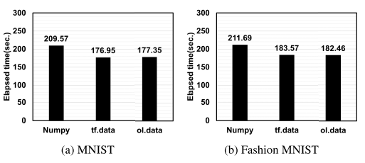
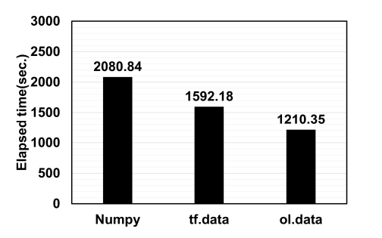
Evaluation
Comparison of model training time
ol.data reduces the inference time by up to 41.8%
EMNIST

Slide 9
Contents
Optimization Machine learning process by parallelism
P&ID object detection

Slide 10
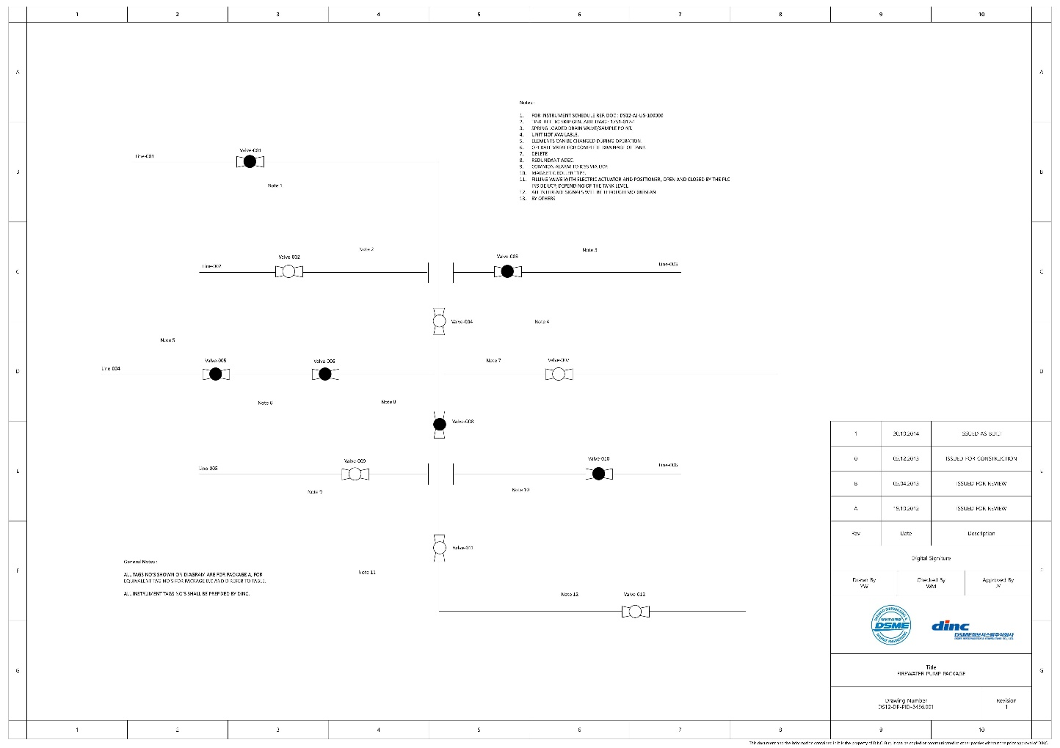
P&ID
Piping & instrumentation diagram
Representing the relationship between equipment
P&ID components
Mechanical machinery named and list
Process piping, sizes and identification
Valves, vent identification
Etc.

Slide 11
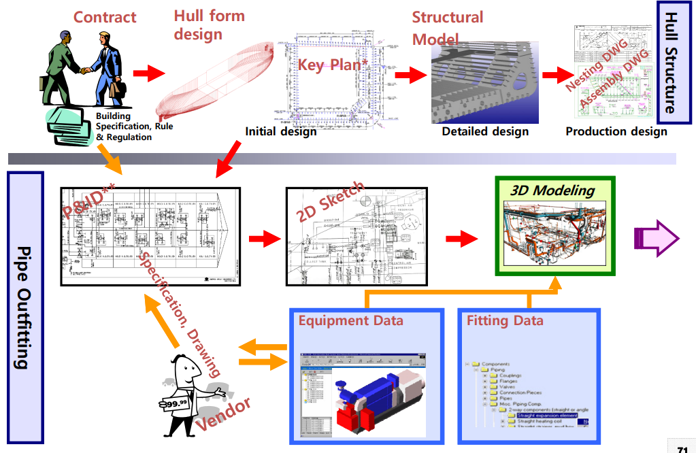
Pipe Outfitting Workflow in Shipbuilding
2D sketch and 3D Modeling for pipe outfitting is generated by referencing P&ID
P&ID is also used as a reference for the operation or maintenance of the facility.
P&ID is continuously used!
Seoul National University Open Courseweare, Design Theories of Ship and Offshore Plant, Myung-Il Roh,
https://ocw.snu.ac.kr/sites/default/files/NOTE/07-DTSOP-Outfitting%20Design(171130).pdf

Slide 12
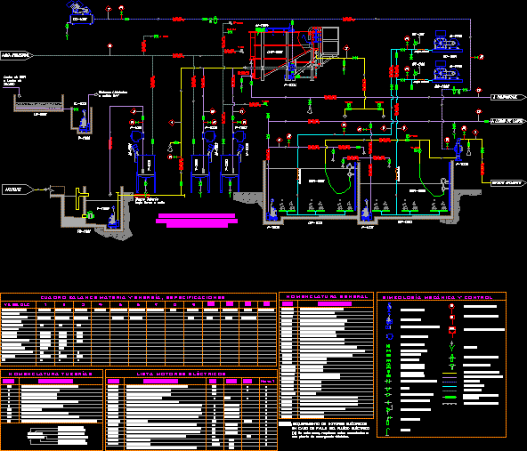
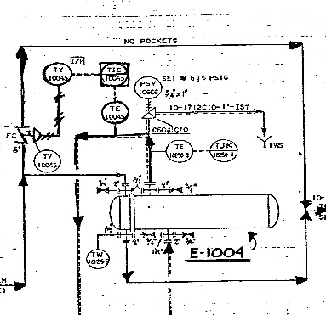

Problem
Most engineering, procurement and construction(EPC) companies use digital P&ID
However, P&ID provided by the manufacturers are in an image format in many cases
And in case of aging plant that have been operation for a long time
A large amount of P&IDs are stored in image format
Making digitization for these image-format P&IDs necessary & time consuming
Time consuming task
Manual digitization
Programmable format P&ID
.pdf, .jpeg format P&ID

Slide 13
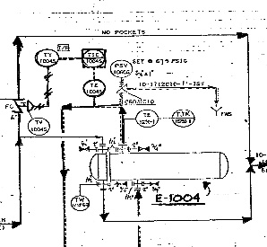
DNN based P&ID object detection
We propose automatic P&ID digitization method based on deep learning technique
The components of P&ID can be divided into three categories
Proposed method
Text: symbol serial number, line number
Symbol: valve, vent, pump, etc.
Line
Object filter
Object detector
Symbol text location
Symbol detection
DNN based on OCR
Association
Text location detection
Line text location
Line detection
Text extraction
Generate
Data structure
P&ID image

Slide 14
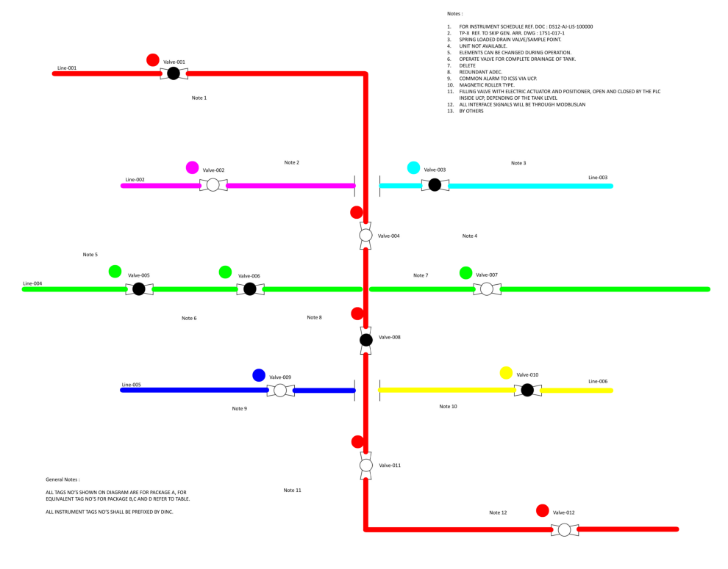
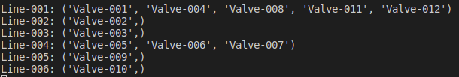
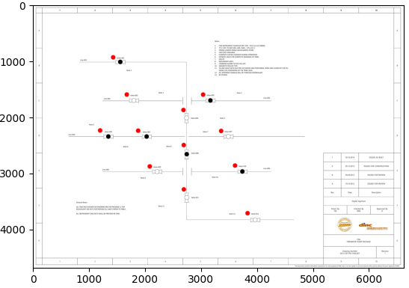
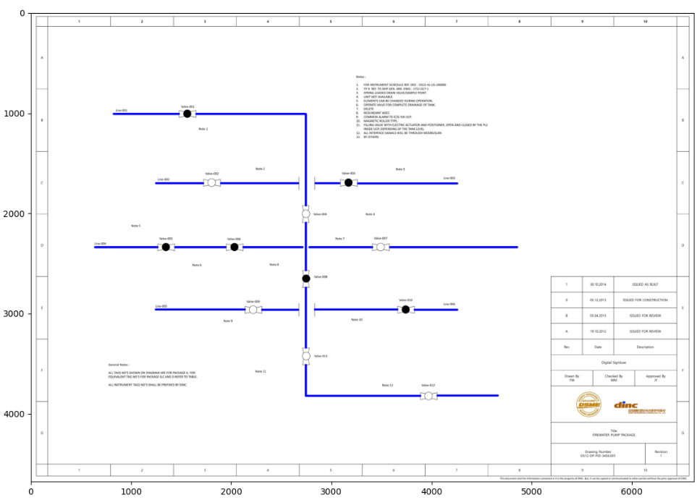
P&ID detection result
Text location detect & Text extraction: Tesseract-OCR
Collect raw information of P&ID
Symbol & Line detection : Hough transform, Pixel coordinate calculation
Symbol-Line association
Generate data structure
Object location detection
Line detection
Dictionary List
Symbol List
- Key -
- Key -
Lineinfo
“Line-001”
Name
“Valve-001”
Cordinate
[x1,y1,x2,y2],…
Lineinfo
“Line-001”
Cordinate
[x1,y1,x2,y2]
Line Dictionary
…
Symbol Dictionary
…
- Key -
- Key -
Lineinfo
“Line-002”
Name
“Valve-002”
Cordinate
[x1,y1,x2,y2],…
Lineinfo
“Line-002”
Cordinate
[x1,y1,x2,y2]

Slide 15
Future works
Writing journal of KIISE(WIP)
Performance optimization

