Slide 1
MICRO’16
Perceptron Learning for Reuse Prediction
Elvira Teran, Zhe Wang, Daniel A. Jimenez
CHANGWON NATIONAL UNIVERSITY

Slide 2
Perceptron Learning
Perceptrons
A simple model of neurons in neural networks
Online training
Output – the dot product of the weights and a vector of inputs
In the paper, they do not actually use perceptron.
Use the perceptron learning algorithm
Use perceptrons to make prediction for LLC cache replacement.

Slide 3
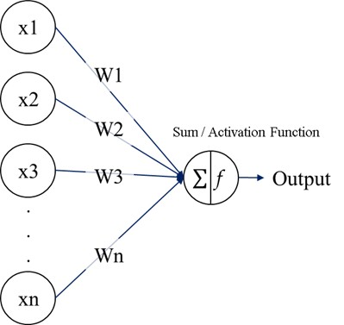
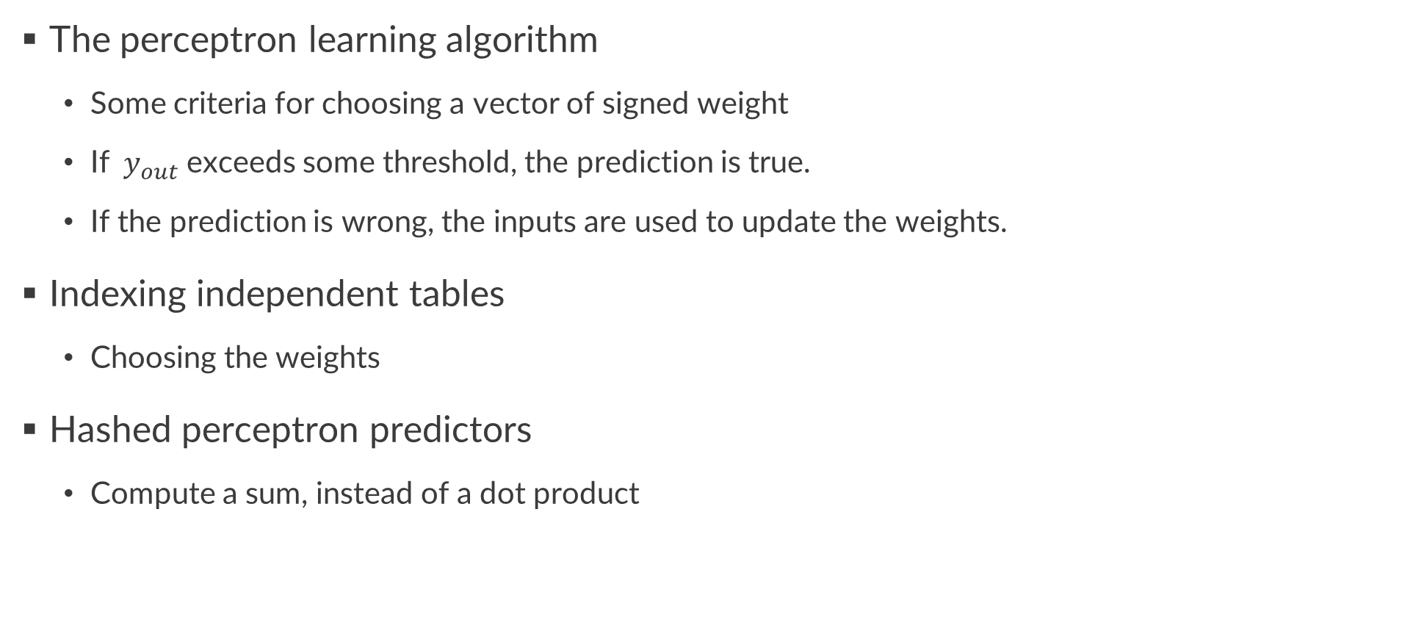
Perceptron Learning
The perceptron learning algorithm
Some criteria for choosing a vector of signed weight
If$y_{out}$ exceeds some threshold, the prediction is true.
If the prediction is wrong, the inputs are used to update the weights.
Indexing independent tables
Choosing the weights
Hashed perceptron predictors
Compute a sum, instead of a dot product

Slide 4
Contributions
Perceptron learning can improve accuracy of reuse prediction
With combine multiple inputs
Outperforming the SOTA policies for both single and multiprogrammed workloads
More than doubles cache efficiency over the LRU
Evaluates with considering prefetching

Slide 5
Features
The trace of memory access instructions
Keep tracks of recent PCs accessing the LLC
The PC of the memory instruction
The succinct proxy of the block
Bits from the memory address
The page number or tag
A compressed representation
Time/reference count

Slide 6
The Main Idea
Each feature is indexed a distinct table.
If the sum exceeds some threshold, the prediction is “not to be reused”
Sampler for updating the predictor
The prediction is incorrect, then the weights are decremented on an access

Slide 7
The Main Idea
Combining features by summing weights
Avoid destructive interference and exponential blowup
Using the perceptron update rule
The predictor adapt to changes in program behavior.

Slide 8
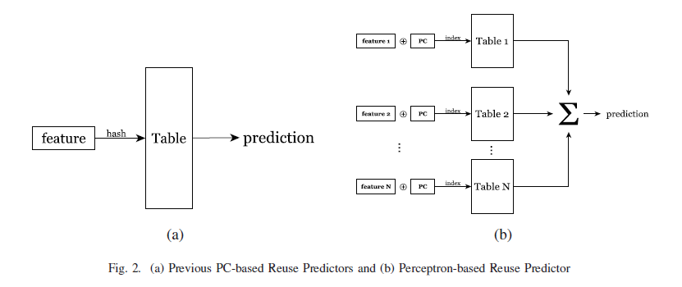
The Main Idea
The recent reuse predictors (SDBP, SHiP)
A single feature

Slide 9
The Main Idea
The perceptron-based reuse predictor
Each feature is hashed
XORed with the PC to index a separate table
Discovers correlation and ignores the lack of correlation

Slide 10
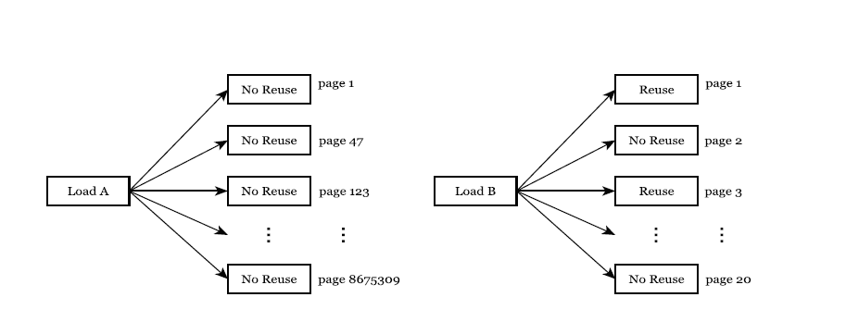
Example
Load A - predicted well by a PC-based predictor
Load B – predicted well by a page-based predictor
Perceptron learning separates the two features into two different tables.

Slide 11
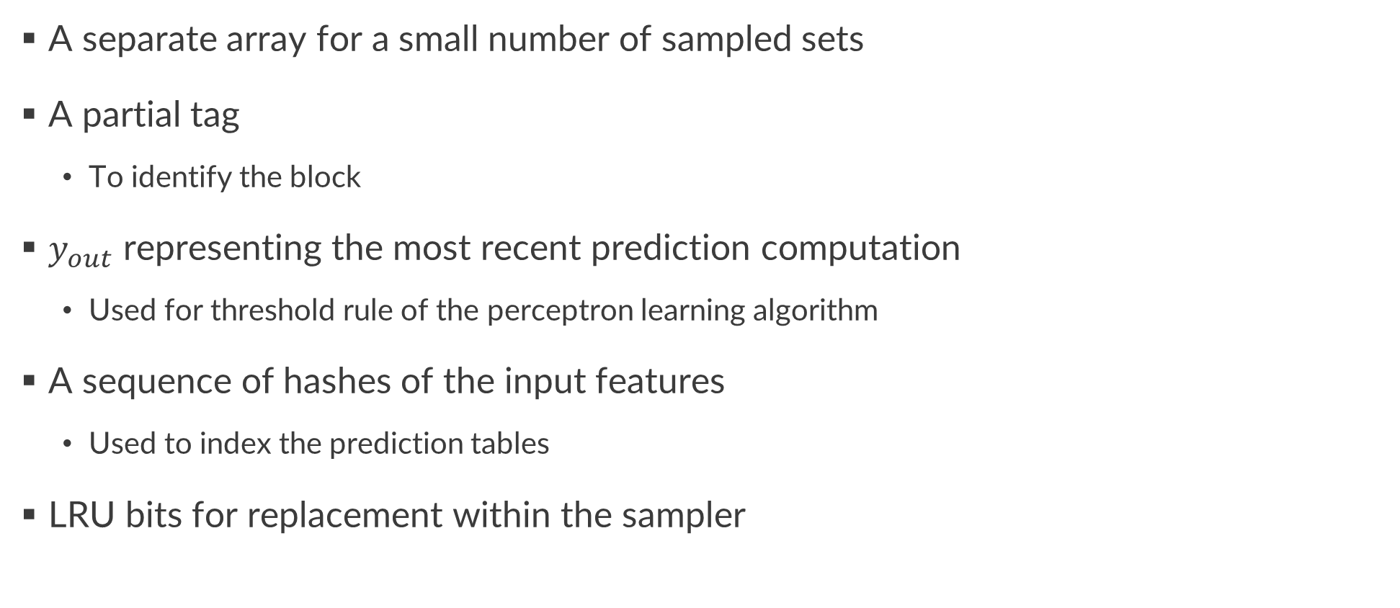
Training with a Sampler
A separate array for a small number of sampled sets
A partial tag
To identify the block
$y_{out}$ representing the most recent prediction computation
Used for threshold rule of the perceptron learning algorithm
A sequence of hashes of the input features
Used to index the prediction tables
LRU bits for replacement within the sampler

Slide 12
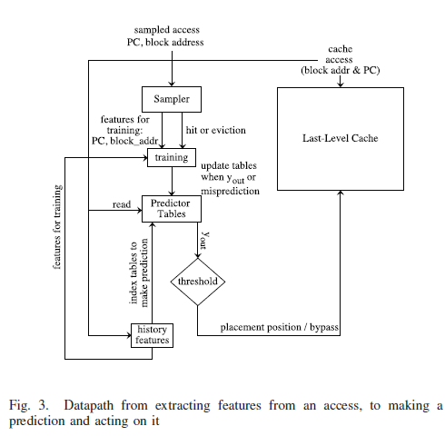
Predictor Organization
A set of tables, one per input feature
Each table with 256 entries of 6-bit signed
weights

Slide 13
Making a Prediction
When there is an access to the LLC
When an incoming block is considered for placement in the LLC
Each cache block with its most recent reuse prediction used to drive the replacement policy

Slide 14
Training the predictor
When there is a replacement in the sampler,
The eviction of the LRU entry shows it is unlikely to be reused.
When a sampled entry is accessed,
The current set of features is correlated with reuse.
The predictor learns from these evidences.

Slide 15
A Replacement and Bypass Optimization
Tree-based PseudoLRU as the default replacement policy
When a block is hit in the LLC,
The predictor is consulted using the current vector of features.
When there is a miss in the LLC,
The predictor is consulted to predict whether the incoming block will have reuse.
If it is predicted to have reuse, a replacement candidate is chosen.
The set searched for a block predicted not to have reuse.
Otherwise, the block chosen by the PseudoLRU policy evicted.

Slide 16
Prefetches
When the hardware prefetcher attempts to bring a block,
The predictor makes a reuse prediction for that block.
A single fake address is used for all prefetches for hashing

Slide 17
Methodology
Performance models
An in-house simulator
32KB 8-way L1 cache
256KB 8-way L2 cache
200 cycles DRAM latency
An out-of-order 4-wide 8-stage pipeline with a 128-entry instruction window.
4MB L3 cache for single-thread simulations
16MB L3 cache for multi-core simulations
A stream prefetcher

Slide 18
Methodology
Workloads
The 29 SPEC CPU 2006 benchmarks
SimPoint to identify up to 6 segments of one billion instructions

Slide 19
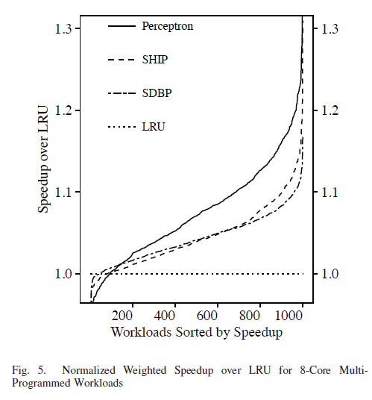
Results
Multi-Core Results
Performance
The weighted speedup
Mean
Perceptron : 7.4%
SDBP : 4.3%
SHiP : 4.4%

Slide 20
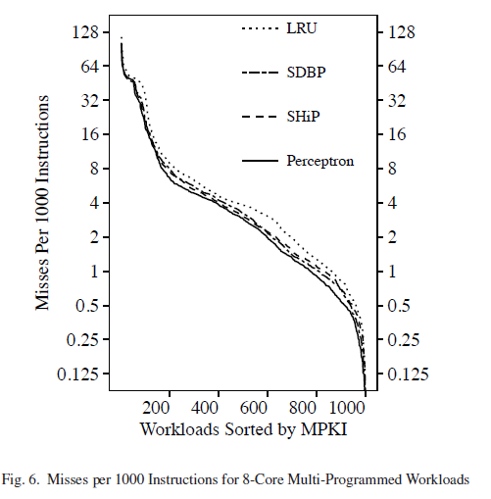
Results
Multi-Core Results
Miss
y-axis : log scale
Mean (percentage over LRU)
Perceptron : 7.2MPKI
LRU : 9.4MPKI
SDBP : 7.8MPKI
SHiP : 7.6MPKI

Slide 21
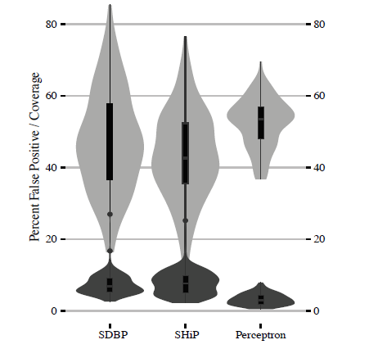
Results
Without Prefetching
Accuracy
Coverage (Lighter)
The percentage of all predictions
for which a block is not to be reused
False positive (Darker)
The potential cache misses
The coverage of perceptron is higher.
The false positive of perceptron is lower.

Slide 22
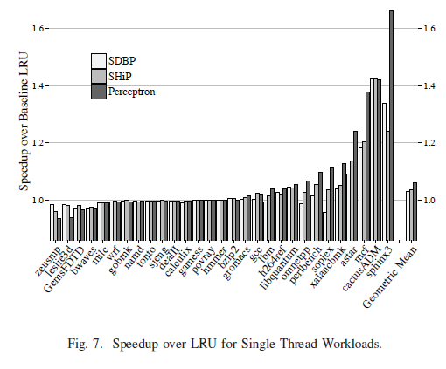
Results
Single-Core Results
Performance
Single-thread speedup
Mean (percentage over LRU)
Perceptron : 6.1%
SDBP : 3.5%
SHiP : 3.8%

Slide 23
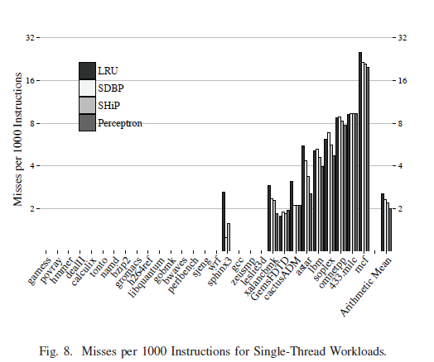
Results
Single-Core Results
Miss
4MB LLC
y-axis : log scale
The average MPKI figures are low
Most of the benchmarks fit working sets
into a 4MB cache.

Slide 24
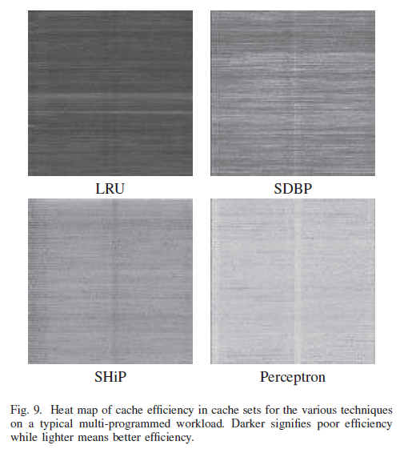
Results
Cache Efficiency
The fraction of time that a given cache block is live
Lighter means better efficiency

Slide 25
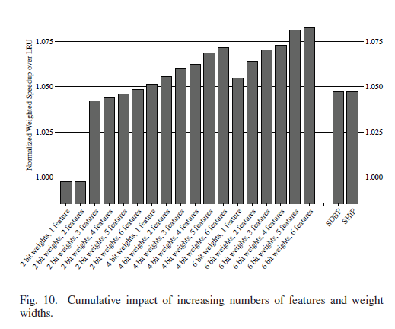
Results
Analysis
Perceptron learning improves accuracy over previous techniques.
Wider weights and more features allow more correlations to be find.

Slide 26
Conclusion
Finding independent correlations between multiple features
Better than previous work
The complexity is not worse

