Slide 1
MICRO’16
Perceptron Learning for Reuse Prediction
Elvira Teran, Zhe Wang, Daniel A. Jimenez
CHANGWON NATIONAL UNIVERSITY

Slide 2
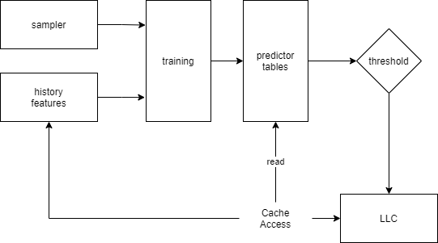
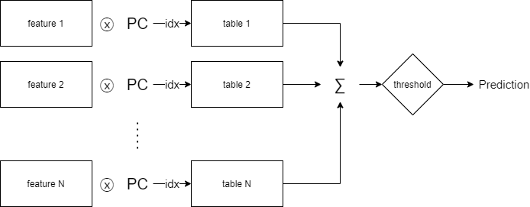
Idea Summary
Perceptron-based predictor
Using multiple features as independent tables
Perceptron-based predictor
Datapath

Slide 3
Strength & Weakness
Strength
Using perceptron learning algorithm to make online predictor
Weakness
Feature의 개수에 따른 accuracy에 대한 분석은 있었는데,
어느 feature 조합이 어느 정도 성능을 내는데 영향을 끼치는지에 대한 분석도 있었으면 좋겠음.

