Slide 1
ICCAD’20
MLCache: A space-Efficient Cache Scheme based on Reuse Distance and Machine Learning for NVMe SSDs
Weiguang Liu, Jinhua Cui, Junwei Liu, and Laurence T. Yang
CHANGWON NATIONAL UNIVERSITY

Slide 2
NVMe
A promising solution to replace the conventional SATA in modern SSDs
Modern NVMe SSDs provide the diverse multiple streams on the cache.
MLCache is a space-efficient shared cache management scheme for NVMe SSDs.

Slide 3
Cache scheme
In previous study,
A global shared cache
Simple and convenient, but it fails to deal with the phenomenon of performance interference.
A statically partitioned cache
Avoiding performance interference, but the valuable cache resource may be underutilized.
Partitioned cache space is inflexible.
MLCache
Use artificial neural network to learn and predict the optimal cache space allocation scheme
A solution to dynamically divide the cache space

Slide 4
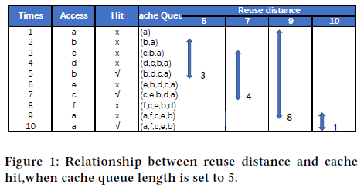
Reuse distance
The cache hits mainly depend on the relationship between the requested reuse distance and the cache size
Sub-problems
How to obtain the reuse distance and relative frequency of each stream request
How to build a model based on quantified locality and frequency to obtain the optimal solution

Slide 5
Artificial neural networks
ANN can automatically learn to approximate the target model
MLCache use artificial neural networks to model cache allocation based on reuse distance

Slide 6
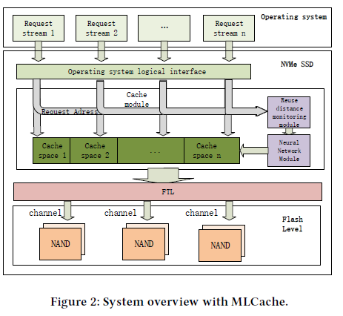
MLCache architecture
Reuse distance monitoring module
Continuously monitor each stream’s request address
Analyze the reuse distance and relative frequency
Neural network module
Input: the reuse distance and relative frequency
Output: the allocated space of each stream
Can get a space-efficient cache scheme

Slide 7
MLCache
MLCache solves two problems:
How to describe the reused distance distribution of the stream to form input data
How to predict the optimal allocation scheme based on the data obtained in the first problem

Slide 8
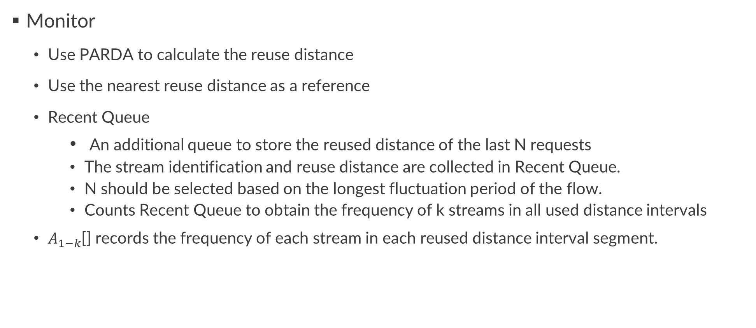
MLCache
Monitor
Use PARDA to calculate the reuse distance
Use the nearest reuse distance as a reference
Recent Queue
An additional queue to store the reused distance of the last N requests
The stream identification and reuse distance are collected in Recent Queue.
N should be selected based on the longest fluctuation period of the flow.
Counts Recent Queue to obtain the frequency of k streams in all used distance intervals
$A_{1−k}$[] records the frequency of each stream in each reused distance interval segment.

Slide 9
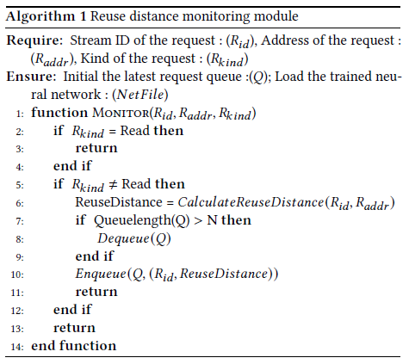
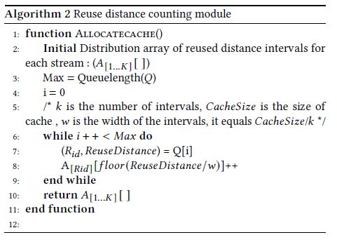
MLCache
The algorithm flow of the reuse distance module

Slide 10
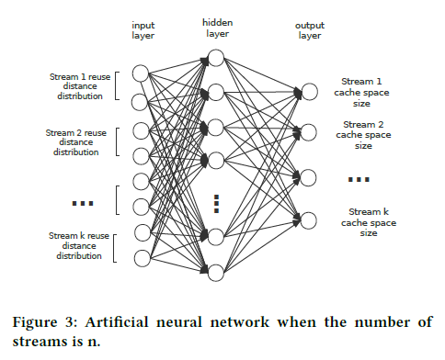
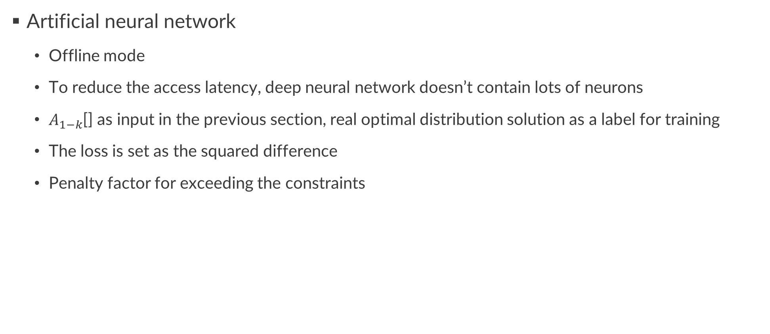
MLCache
Artificial neural network
Offline mode
To reduce the access latency, deep neural network doesn’t contain lots of neurons
$A_{1−k}$[] as input in the previous section, real optimal distribution solution as a label for training
The loss is set as the squared difference
Penalty factor for exceeding the constraints

Slide 11
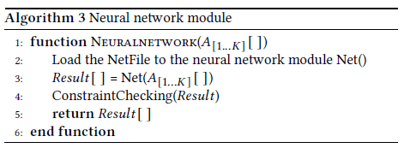
MLCache
The algorithm of the neural network module

Slide 12
MLCache
The cache module changes the space size according to the optimal allocation scheme.
For the expanded cache size,
The capacity of the stream directly set to the allocated size
For the reducing cache size,
Using LRU method to evict
Evict one cache page at a time until the cache size of the stream reaches the size
Allocate according to the equal space distribution for abnormal allocations

Slide 13
MLCache
Overhead analysis
Space overhead
The maximum space complexity of PARDA is O(M)
The Recent Queue only use 1 byte to for stream id and 2 bytes for reuse distance
The space occupied by the reused distance distribution can’t exceed 2KB
Computation overhead
The time complexity of the reuse distance is O(log M)
The neural network is trained offline, and the neural network is used for calculation at the end of a period, so the delay caused by the overhead is small

Slide 14
Experiment
Trace-driven SSD simulator, MQSim
256GB capacity NVMe flash-based SSD
Supports up to 8 streams for simultaneous reading and writing
Use different cache capacities to simulate scenarios
260 pages in the 4-streams
680 pages in the 8-streams

Slide 15
Experiment
Using 16 real enterprise server traces
Using 2 streams, 4 streams, 8 streams for testing
¼ of real traces, and added synthetic traces
Calculate the optimal solution through the simulator
In the experiments, following schemes are implemented
Evenly partition (baseline)
MLCache
Discrete optimal partition (ideal)

Slide 16
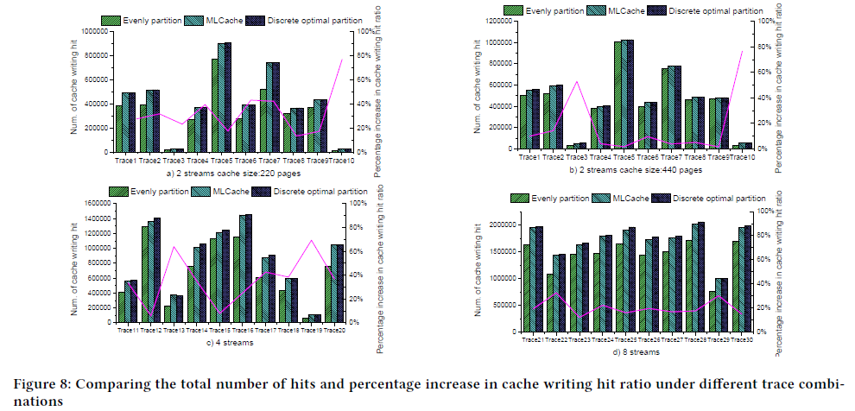
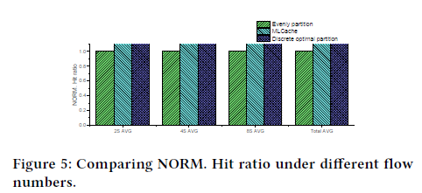
Experimental Results
Hit ratio

Slide 17
Experimental Results
Hit ratio
MLCache is suitable for different capacities.
The effect of improving the hit rate is more obvious when the cache capacity is scarce.
The improvement of the cache hit comes from:
Request local changes
Changes in the size of the cache space
All traces have a larger improvement in hit rate compared to baseline.
All are close to discrete optimal partition.
The smaller the number of streams, the more the MLCache approaches the optimal solution.

Slide 18
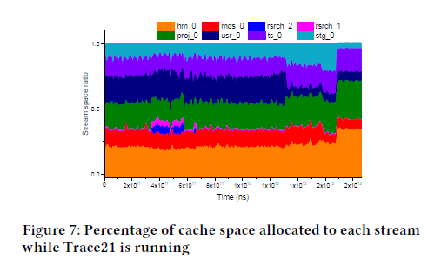
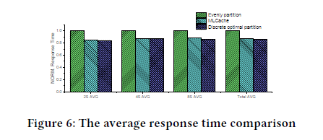
Experimental Results
Response time
MLCache can effectively dynamically allocate the optimal cache space for each stream.

Slide 19
Conclusion
MLCache allocates efficient cache space for each I/O queue independently according to the reuse distance distribution and relative request frequency.
MLCache is 96% similar to the ideal model.

