Slide 1
MICRO-52
Applying Deep Learning to the Cache Replacement Problem
Zhan Shi, Xiangru Huang, Akanksha Jain, Calvin Lin
CHANGWON NATIONAL UNIVERSITY

Slide 2
Introduction
Why are deep learning models ill suited for use in hardware predictors?
Require enormous resources to train
So, the training is performed offline but,
Computer programs exhibit time-varying phase behavior
The behavior of one program can differ wildly from that of another.
Too large to be implemented on a chip to make predictions
Slow

Slide 3
Introduction
In this paper,
Design A RNN model that is trained offline for individual programs.
Interpret this offline model to reveal an important insight that is useful for cache designer.
Use this insight to design a simple online model that matches the offline model’s accuracy with orders of magnitude lower cost.

Slide 4
Introduction
Formulate cache replacement as a sequence labeling problem
A binary label that indicates whether the accessed data should be cached or not
Belady’s MIN algorithm to provide oracle labels for the training data
LSTM and attention mechanism
Support vector machine

Slide 5
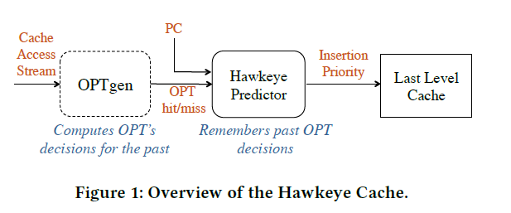
Hawkeye
Cache replacement as a supervised learning problem
A predictor is trained from the optimal caching solution for past cache accesses
OPTgen
Simulates the optimal solution’s behavior to produce training labels
Hawkeye Predictor
A binary classifier to predict whether data loaded by a memory access is likely to be cashed or not

Slide 6
Recurrent Neural Networks
Sequential prediction problems (NLP and speech recognition)
Use their internal hidden states to process a sequence, that the hidden states depends on the previous hidden state and the current input
LSTM
Designed to learn long, complex patterns within a sequence

Slide 7
Attention mechanisms
Enable a sequence model to focus its attention on certain inputs
used to learn the correlation between a source and a target

Slide 8
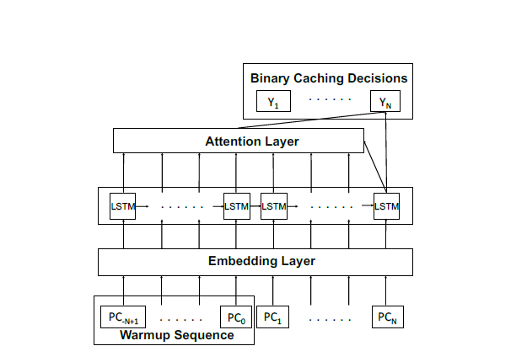
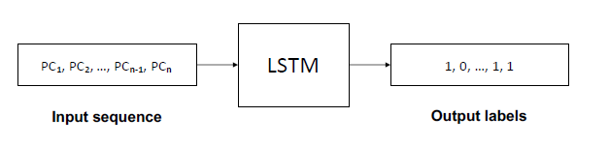
LSTM with scaled attention
Predict whether the corresponding load should be cached or not
Three layers – an embedding layer, a 1-layer LSTM, a scaled dot-product attention layer

Slide 9
LSTM with scaled attention
Preprocess the trace by slicing it into fixed-length sequences of length 2N
Overlap consecutive sequences by half of the sequence length N
The first half of each sequence is thus a warmup sequence that provides context for the predictions of the second half of the sequence.

Slide 10
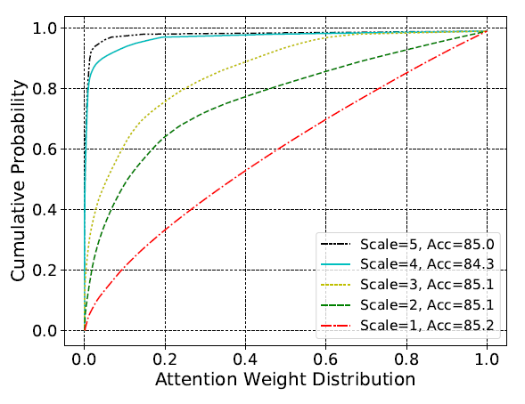
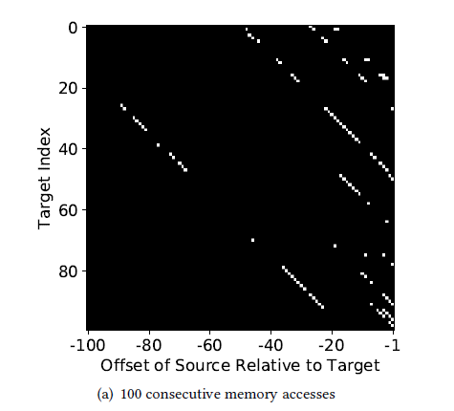
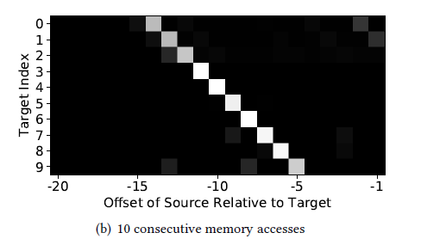
Insights from the LSTM model
The model benefits from a long history of past PCs
A moderate increase in the scaling factor forces sparsity in the attention weight vectors but has minimal influence on accuracy.
The model can achieve good accuracy by attending to just a few sources

Slide 11
Insights from the LSTM model
The optimal caching decisions depend not on the order of the sequence but on the presence of important PCs.
Prediction accuracy is largely insensitive to the order of the sequences.
Caching can be simplified from a sequence labeling problem to a binary classification problem.

Slide 12
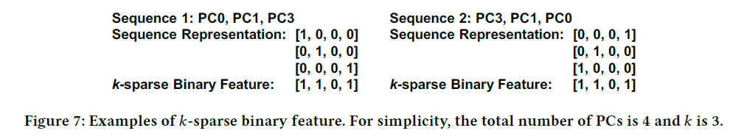
Integer SVM
It is possible to substitute the LSTM with a simpler model.
Simplify input feature representation to remove duplicate PCs and to forego ordering information
Feature can capture an effective history length of 30 PCs with fewe history elements.
Design k-sparse binary feature to represent PCs of a memory access sequence

Slide 13
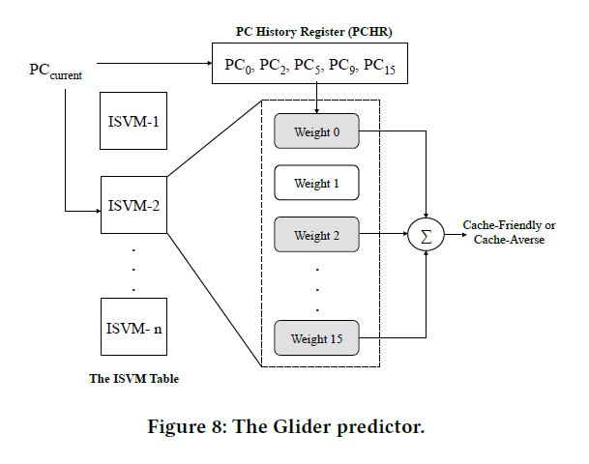
Hardware design
PC History Register
Maintains an unordered list of the last 5 PCs seen by each core
A small LRU cache that tracks the 5 most recent PCs
ISVM table
Tracks the weights of each PC’s ISVM
Each PC’s ISVM consists of 16 weights for different
possible PCs in the history register.

Slide 14
Training
Glider is trained based on the behavior of a few sampled sets.
Retrieves the weights corresponding to the current PC and the PCHR
The weights are incremented by 1 if OPTgen determines
Dynamically selects among a fixed set of thresholds

Slide 15
Prediction
If the summation of the weights is greater or equal to a threshold,
Cache-friendly
Insert it with high priority
If the summation of the weights is less than 0,
Cache-averse
Insert it with low priority
Else (between 0 and 60),
Cache-friendly
Insert it with medium priority

Slide 16
Evaluation
Compare ISVM against LSTM (offline setting)
Compare Glider against Hawkeye, SHiP++, and MPPPB (online setting)
Simulator – the simulation framework released by CRC2
Based on ChampSim
4-wide out-of-order processor with 8-stage pipline, a 128-entry reorder buffer, a three-level cache hierarchy

Slide 17
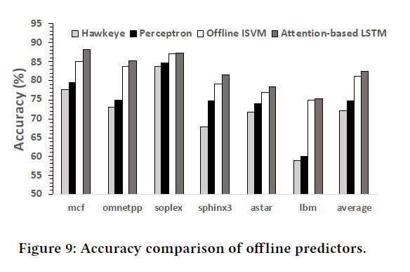
Comparison of offline models
Attention-based LSTM improves accuracy by 10.4% over the Hawkeye.
Offline ISVM improves accuracy by 9.1% over the Hawkeye.

Slide 18
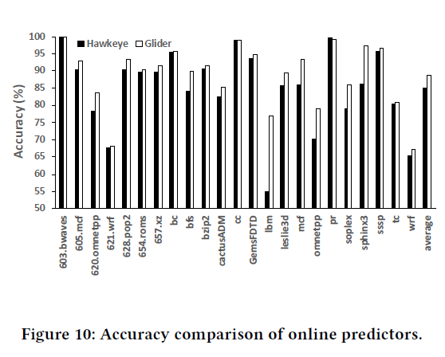
Comparison of online models
Glider is more accurate than state-of-the-art online models. (88.8% vs. 84.9%)
On the subset of benchmarks, the accuracy improves from 73.5% to 82.4% - similar to the offline improvements from 72.2% to 81.2%

Slide 19
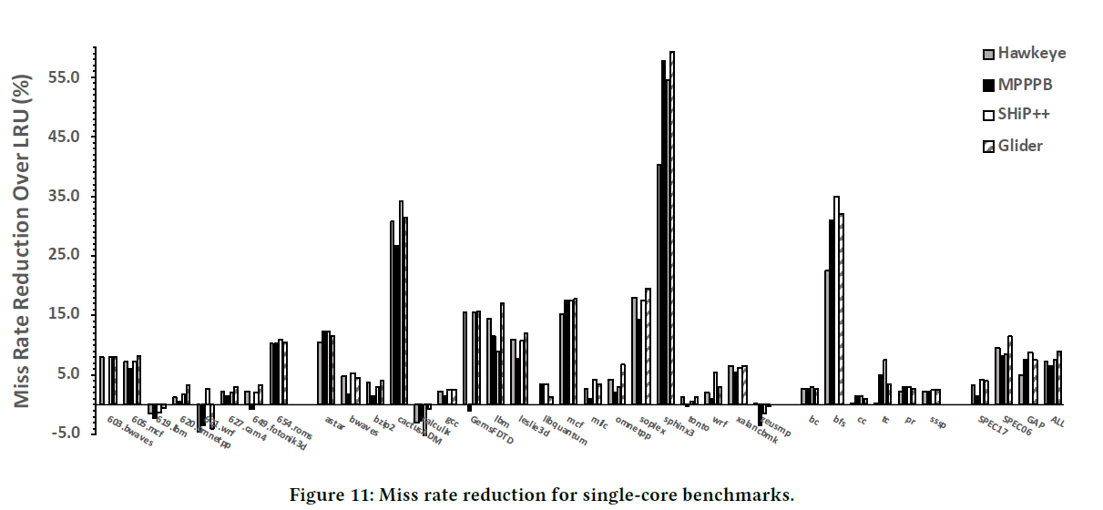
Comparison of online models
Single-core performance
Glider significantly reduces the LLC miss rate in comparison with the three replacement policies.
Average miss reduction of 8.9% on the 33 memory-intensive benchmarks

Slide 20
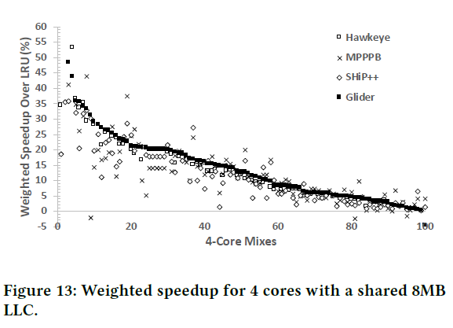
Comparison of online models
Multi-core performance
Glider performs well on a 3-core system as it improves performance by 14.7%

Slide 21
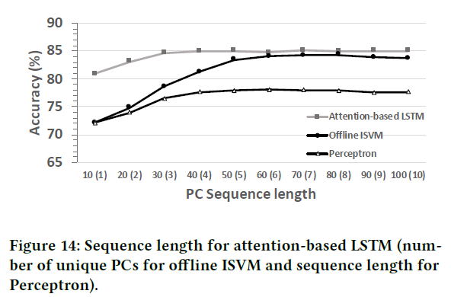
Comparison of online models
Effective sequence length

Slide 22
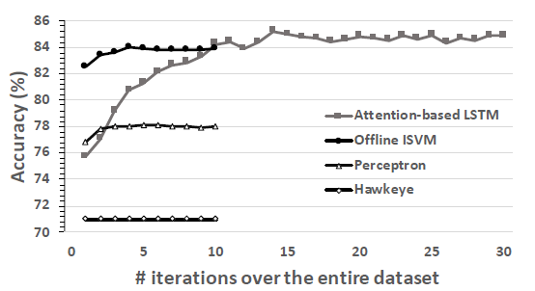
Practicality of Glider vs. LSTM
Hardware budget
Glider’s total hardware budget is 61.6KB
The attention-based LSTM model is at least 3 orders of magnitude mor expensive
Convergence rate
LSTM takes 10-15 iterations to converge
Perceptron and Hawkeye, converge fast but have the limited accuracy

Slide 23
Practicality of Glider vs. LSTM
On the practicality of deep learning for caching,
The model size of the attention-based LSTM is at least 1MB
LSTM typically requires floating-point operations.
The LSTM needs to be pre-trained offline.
Deep learning models are still not ready for direct use in hardware predictors.

Slide 24
Learning High-level program semantics
Attention-based LSTM can learn high-level program semantics.
The model discovers that certain types of network messages tend to cache-friendly or not by distinguishing the different control-flow paths for different types of messages.

Slide 25
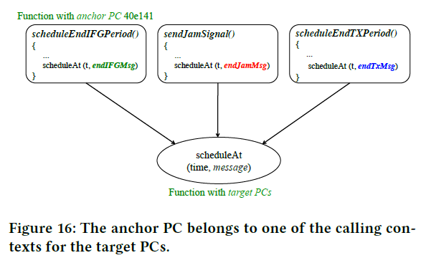
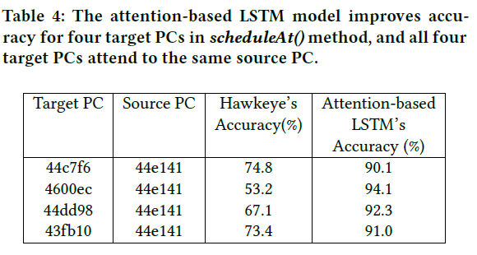
Learning High-level program semantics
scheduleAt() method
To schedule incoming messages at a given time t
The model discovered that the endIFGMsg object has better cache locality than endJamSignal and endTxMsg objects.

Slide 26
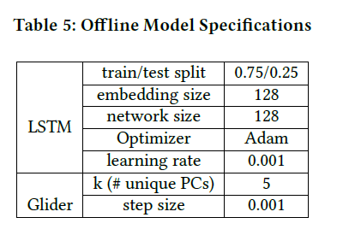

Model specification
The step size n of offline ISVM is considered from 0.0001 to 1(0.0001, 0.0005, …)
For Glider, the update threshold is $\frac{1}{n}$ with fixed step size 1. no decay.

Slide 27
Conclusion
This paper has presented a new cache replacement policy using SVM to outperform the SOTA.
The approach in designing Glider suggests the effectiveness of simple models.
The insights and techniques presented in this paper can inspire the design of similar solutions for other tasks.

