Slide 1
DATE’20
Frequent Access Pattern-based Prefetching Inside of Solid-State Drives
Xiaofei Xu, Zhigang Cai, Jianwei Liao, Yutaka Ishiaka
CHANGWON NATIONAL UNIVERSITY

Slide 2
Data prefetching
Data prefetching is for reducing the overhead of read operations
Previous prefetch scheme involved with the OS layer
Damage compatibility and transparency
Previous prefetch scheme inside SSDs
Confined limited resources
For only a few application scenarios

Slide 3
Data prefetching
Prefetching inside SSDs
OS-independence
Transparency
The division of write/read cache should depend on real-time workloads

Slide 4
This paper,
A frequent access pattern-based prefetching scheme
An adaptive cache management policy
Separately buffering the write data and the prefetched data in SSDs
Based on I/O workloads characteristics

Slide 5
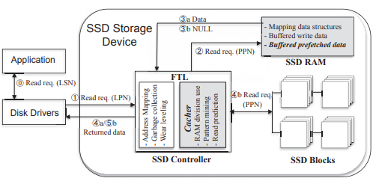
System architecture
Cacher at FTL
RAM division
Pattern mining
Read prediction
Default garage collection policy & wear-leveling policy

Slide 6
Pattern-based prefetching
Identifying and modeling frequent access patterns
FP-Growth algorithm
A set of logical addresses of requests
A, B, C, D
B, C, D, E
B, C, E
A, C
{B, C, D}
Union
{B, C, D, E}
{B, C, E}
B, C, D : 2
B, C, E : 2
A, C : 2

Slide 7
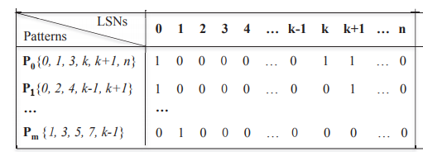
Pattern-based prefetching
Pattern matching for data prefetching
A matrix to reflect the relationship between the logical sector numbers and the patterns
The prefetching trigger condition is about more than a half of LSNs accessed
Example
0, k, k+1 were requested

Slide 8
Adaptive cache management
Adaptively separate the cache for written/prefetched data
Dynamically adjust cache use on the several factors
The numbers of read and write requests
The size of read and write space
The numbers of read and write hits in cache
in the previous time window

Slide 9


Adaptive cache management
Determine the prefetch enabled or nots
If τ >= predefined value, the prefetch disabled
Calculate the ratio of SSD cache for holding the prefetched data
LRU for ejecting a corresponding page of data

Slide 10
Experiment setup
SSDsim
4 disk traces from Microsoft Research Cambridge traces
Schemes
Baseline(no prefetching)
Lynx
Resource-Optimized Prefetching(ROP)
Pattern (proposed scheme)

Slide 11
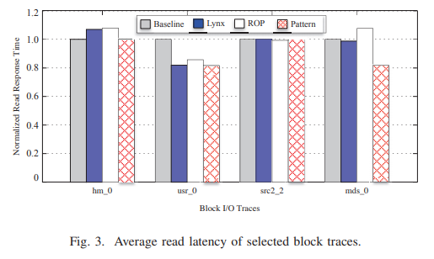
Read response time
Pattern can reduce the read latency
Hm_0
All prefetching scheme is worse than baseline
60.1% hot read addresses = hot write addresses
Many small read requests less than the prefetching unit
Pattern is similar to baseline

Slide 12
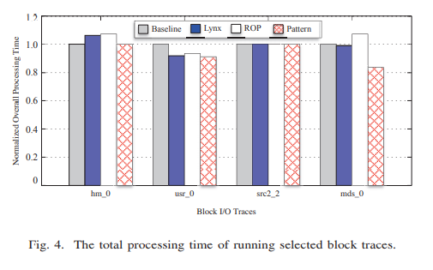
Overall I/O time
Prefetching must place negative effect to the performance of write data
The overall I/O time shows effectiveness of prefetching
Pattern outperforms others excluding hm_0

Slide 13
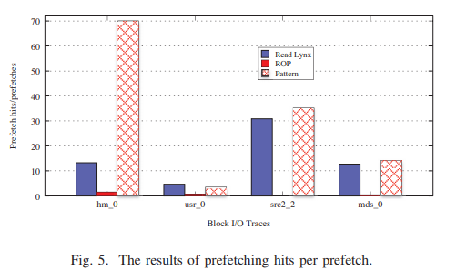
Prefetching hit per prefetch
Patterns yields the best outcomes

Slide 14
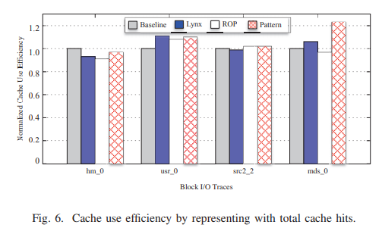
Cache use efficiency
(the total read hits) * (the read time – the read hit time) + (the total write hits) * (the write time – the write hit time)
The proposed scheme improve cache use efficiency by up to 21.1%

Slide 15
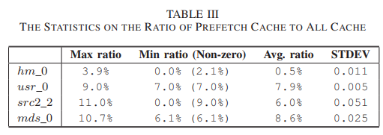
Analysis on adaptive cache partition
Lynx, ROP
a fixed 8% cache for buffering the prefetched data
Proposed scheme takes advantage of different ratios for different traces

Slide 16
Summary
The proposed scheme can cause a higher accuracy in forecasting
by avoiding unnecessary prefetching operations
Adaptive cache management scheme dynamically adjust the cache partition
to boost the efficiency of cache use
The proposed scheme reduce the time required by prefetching

Slide 17
Conclusions
An OS-independent data prefetching mechanisms for SSDs
The proposed scheme can reduce I/O response time by up to 9.1% on average
The adaptive cache partition policy can enhance the cache use efficiency by up to 21.1%

