Slide 1


Towards Better Understanding of Black-box Auto-Tuning: A Comparative Analysis for Storage Systems
2018 USENIX Annual Technical Conference
Zhen Cao¹, Vasily Tarasov², Sachin Tiwari¹, and Erez Zadok¹
¹Stony Brook University; ²IBM Research – Almaden;

Slide 2
Outline
Introduction
Background
Experiment Settings
Evaluations
Related Work
Conclusions & Future Work

Slide 3
Motivation
Why tuning storage systems?
Slow storage impacts I/O bound workloads
Default settings are sub-optimal
Tuning can provide significant gains
9× [FAST’10]
Manual tuning is intractable
Auto-tuning storage systems
Black-box optimization is promising
Lack of comparison of techniques
Lack of understanding

Slide 4
Contributions
First comparative study on auto-tuning storage systems
5 techniques
Various aspects
Cumulative & instantaneous throughput
Impacts of hyper-parameters
Explanations on evaluation results
From storage perspective
Future Goal: complete solution to tune storage systems

Slide 5
Outline
Introduction
Background
Experiment Settings
Evaluations
Related Work
Conclusions & Future Work

Slide 6
Concepts
Storage system
File system, underlying storage hardware and any layers between them
Parameters
Configurable options
E.g., file-system block size
Parameter values
E.g., 1K, 2K, 4K (Ext4 block size)
Configuration
Combination of parameter values
E.g., [Ext4, 4K, data=ordered]
Parameter space
All possible configurations
Hyper-parameter

Slide 7
Challenges
Manual Tuning Inefficient
Vast parameter space
Ext4: 59 parameters, 10³⁷ configs
Devices, Layers
Distributed, large-scale
Discrete and non-numeric
Gradient Unavailable
Linux I/O scheduler: noop, cfq, deadline
Non-linearity
Sensitivity to environment
Hardware & workloads

Slide 8
Inapplicable Methods
Control Theory
Unstable in controlling non-linear systems
Supervised Machine Learning
Long training phase
High-quality training data
Inapplicable or inefficient to serve as the core auto-tuning algorithm
Could be helpful as a supplement

Slide 9
Black-box Optimization
Successfully applied in auto-tuning system configurations
Examples
Genetic Algorithms (GA)
Simulated Annealing (SA)
Bayesian Optimization (BO)
Obliviousness to system’s internals
evaluate
Configuration
Evaluation Results
select

Slide 10
Key Factors
Fitness: optimization objective(s)
Throughput, latency, energy, …
Complex cost functions
Exploration
Search the unvisited area (e.g., randomly)
Exploitation
Utilize neighborhood or history
History
How much past data is kept and used for exploration/exploitation

Slide 11
Applied Methods
Simulated Annealing (SA)
Genetic Algorithms (GA)
Deep Q-Network (DQN)
Bayesian Optimization (BO)
Random Search (RS)
Random selection without replacement

Slide 12
Simulated Annealing

Slide 13
Genetic Algorithms
Inspired by natural evolution
Concepts
Gene: file system, block size, …
Allele: Ext4, XFS, Btrfs, …
Chromosome: configuration
Population: set of configurations
Selection
History
Genetic operators
Crossover
Mutation
Exploitation vs. Exploration

Slide 14
Reinforcement learning
Inspired by behaviorist psychology
Concepts
State: configurations
Actions: change to a different configuration
Rewards: differences in evaluation results
Value function
Tabular form
Deep learning – Deep Q-Networks

Slide 15
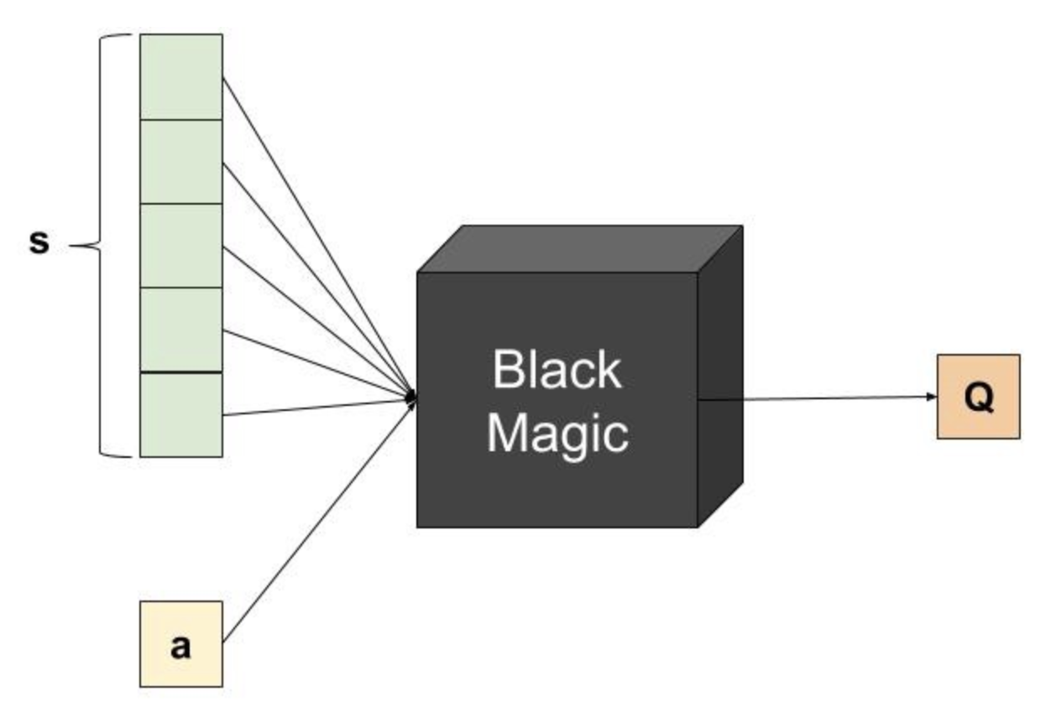
Deep Q-Networks

Slide 16
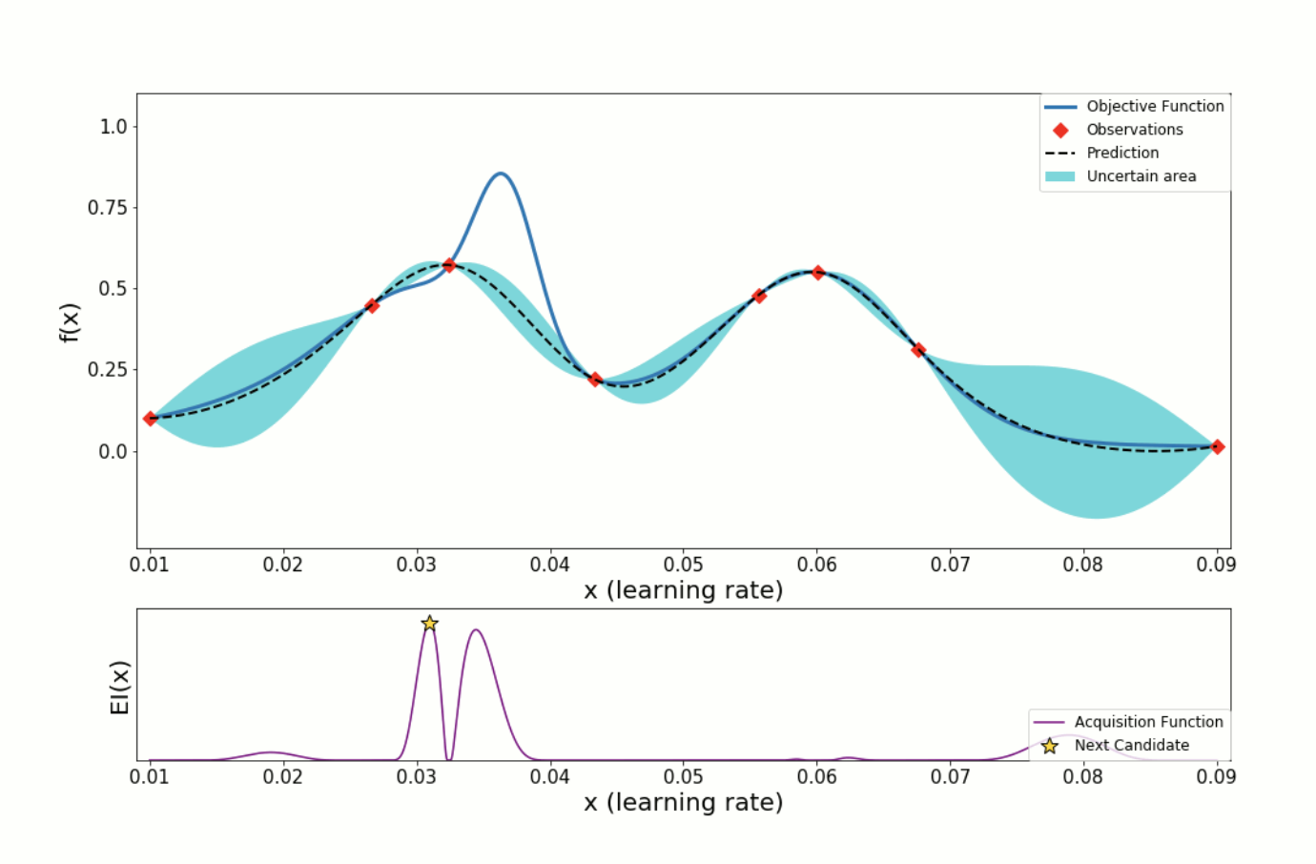
Bayesian Optimization

Slide 17
Outline
Introduction
Background
Experiment Settings
Evaluations
Related Work
Conclusions & Future Work

Slide 18
Experimental Setup
Hardware
M1: 2 Intel Xeon single-core 2.8GHz CPU, 2G RAM, 73GB Seagate SCSI drive
M2: 1 Intel Xeon quad-core 2.4GHz CPU, 24G RAM, 4 drives (SAS-HDD 500GB, SAS-HDD 146GB, 1 SATA-HDD, SSD)
Filebench
Macro-workloads: fileserver, mailserver, webserver, dbserver
Default working set size

Slide 19
Experiment Setup (cont.)
Search spaces
Storage V1
File system, inode size, block size, block group, journal options, mount options, special options
Storage V2
V1 + I/O scheduler
6,222 configurations
Methodology
Exhaustive Search
Storage V2: 4 workloads × 4 devices
3+ runs for each configuration
Collected over 2+ years
Simulate auto-tuning algorithms

Slide 20
Outline
Introduction
Background
Experiment Settings
Evaluations
Related Work
Conclusions & Future Work

Slide 21


Best Throughput
Best
Throughput (kops/s)
18.7
18
17
GA SA BO DQN
RS
16
15.2
M2-Mailserver-HDD3
0
1
2 3
Time (hrs)
4
5

Slide 22


Success rate for finding near-optimal configurations
Near-optimal configuration: one with throughput higher than 99% of the global optimal value.
Percentage of Runs
GA SA
M2-Fileserver-HDD3
100%
BO
80% DQN
60%
40%
20%
RS
0
1
2 3
Time (hrs)
4
5

Slide 23
Instant Throughput
15
10
5
15
10
5
15
10
5
15
10
5
15
10
5
RS
Throughput (kops/s)
SA
GA
DQN
BO
M2-Mailserver-HDD3
0
1
2 3
4
5
Time (hrs)

Slide 24
Genetic Algorithm (GA) Diversity

Slide 25
Correlation Analysis
Correlation analysis
Ordinary Least Squares (OLS)
Example: block size and journal option are the most correlated Ext4 parameter (Fileserver, SSD)
Explanations on evaluation results
GA and BO can identify important parameters through “history”
SA keeps no “history”; thus performs poorly
DQN spends too much time on exploration
Random Search
Near-optimal configurations take up 4.5% of the whole search space (M2, Mailserver, HDD).

Slide 26
Outline
Introduction
Background
Experiment Settings
Evaluations
Related Work
Conclusions & Future Work

Slide 27
Related Work
Auto-tuning storage
Storage system design (bin-packing heuristics) [Alvarez et al.]
Data recovery scheduling (GA) [Keeton et al.]
HDF5 optimization (GA) [Behzad et al.]
Lustre optimization (DQN) [Li et al.]
Auto-tuning other systems
Database [Alipourfard et al.]
Cloud VMs [Aken et al.]

Slide 28
Outline
Introduction
Background
Experiment Settings
Evaluations
Related Work
Conclusions & Future Work

Slide 29
Conclusions & Contributions
First comparative analysis on 5 techniques on auto-tuning storage systems
Efficiency on finding near-optimal configurations
Instant throughput
Provide insights from storage perspective
Importance of parameters
E.g., impact of mutation rates on convergence
Valuable datasets
Will release to public

Slide 30
Future Work
More complex workloads and search spaces
Hyper-parameter tuning
More sophisticated auto-tuning
E.g., penalty functions to cope with costly parameter changes

Slide 31


Towards Better Understanding of Black-box Auto-Tuning: A Comparative Analysis for Storage Systems
Zhen Cao, Vasily Tarasov, Sachin Tiwari, and Erez Zadok

