Slide 1
SOSP’91
The Design and Implementation of a Log-Structured File System
Mendel Rosenblum, John K. Ousterhout
CHANGWON NATIONAL UNIVERSITY

Slide 2
Introduction
“write” is important for storage performance
Log
A sequential structure contains all new information
Increases write performance
Segments
Segment cleaner
Sprite LFS

Slide 3
Background
Technology
Processors
speed is increasing
Disk
The rate of improvement is slower than for CPU speed
Main memory
Writes – disk traffic
Workloads
Office and Engineering applications
accesses to small files
Small random I/O
LFS focus on small-file accesses

Slide 4
Background
Problems with existing file systems
Spreading information
Too many small accesses
Overhead for seeking
Synchronous meta data writes
For workloads with many small files, the disk traffic is dominated by the synchronous metadata writes

Slide 5
Log-structured file systems
Sequential writes only
How to retrieve information from the log
How to manage the free space on disk

Slide 6
File location and reading
Inode
File’s attributes, disk addresses
Unix FFS
Fixed location inode
Sprite LFS
inode map

Slide 7
File location and reading
Inode map
Contains current location of each inode
Fixed checkpoint region identifies the location of inode map
Compact: rarely require disk accesses

Slide 8
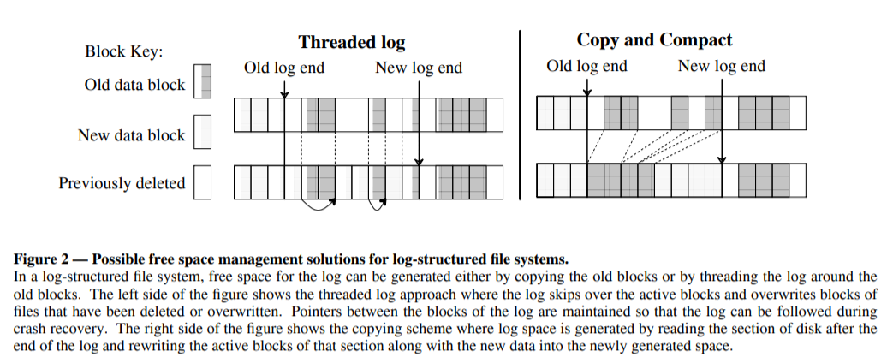
Free space management: segments
Threading
Copying
Sprite LFS uses a combination of threading and copying

Slide 9
Segment cleaning mechanism
The process of copying live data out of segment
Three-step
Read segments into memory
Identify the live data
Write the live data back to a smaller number of clean segments

Slide 10
Segment cleaning mechanism
Segment summary block
Identifies each piece of information that is written in the segment
The file number & block number
Distinguish live blocks
Liveness – checking the file’s inode or indirect block
Sprite LFS – UID
No free-block list or bitmap

Slide 11
Segment cleaning policies
When should the segment cleaner execute?
Continuously in background / only at night / only the disk exhausted
How many segments should it clean at a time?
Which segment should be cleaned?
How should the live blocks be grouped when they are written out?
Enhance the locality of future reads (e.g., same directory together)
Age sort

Slide 12
Segment cleaning policies
Start: the number of clean segments < start_threshold
Threshold = typically a few tens of segments
Cleans a few tens of segments at a time
Cleans until: the number of clean segments > stop_threshold
Not sensitive to the threshold value

Slide 13
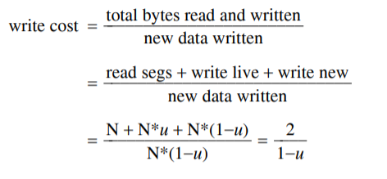
Segment cleaning policies
Write cost
Average amount of time the disk is busy per byte of new data written
1.0: perfect. Full disk bandwidth & no cleaning overhead
10: only 1/10 of disk bandwidth is for writing new data

Slide 14
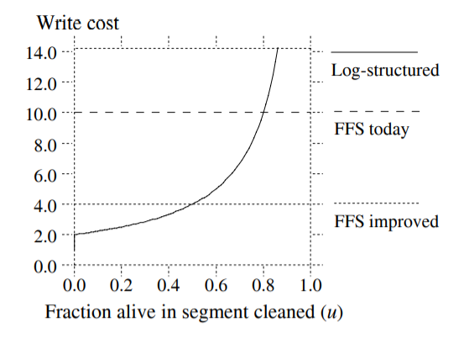
Segment cleaning policies
Write cost
Must have a utilization of less than .8 to outperform FFS
Must have a utilization of less than .5 to outperform improved FFS

Slide 15
Segment cleaning policies
Can be improved by reducing the overall utilization of the disk space
Cost-performance tradeoff
Bimodal segment distribution
High performance at low cost

Slide 16
Simulation results
Simulator for analyzing different cleaning policies
Pseudo random access patterns - uniform, hot-and-cold
Constant disk capacity utilization
No read traffic

Slide 17
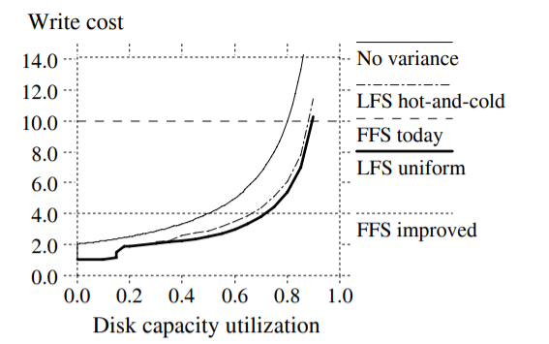
Simulation results
LFS uniform
Greedy policy
Writing out without reorganization
LFS hot-and-cold
The cleaning policy is same with LFS uniform
Except, age-sort
Locality, better grouping - worse

Slide 18
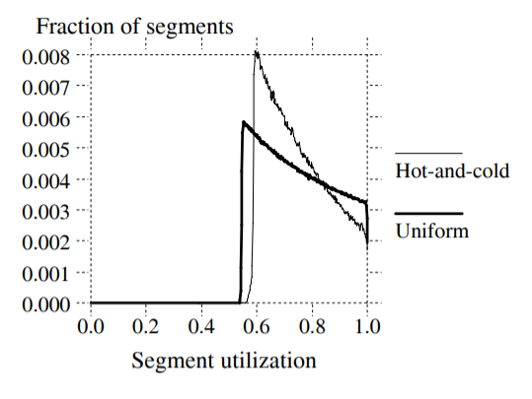
Simulation results
Under the greedy policy, a segment doesn’t get cleaned until it becomes the least utilized of all segments.
Hot and cold segments must be treated differently by the cleaner
The value of a segment’s free space: The stability of the data in segment
age

Slide 19

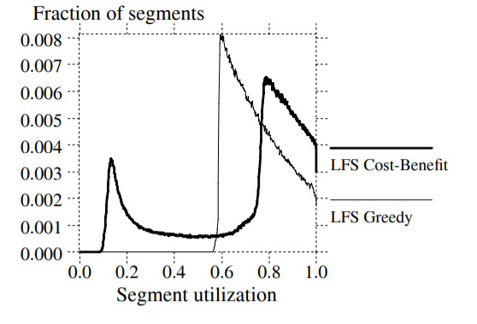
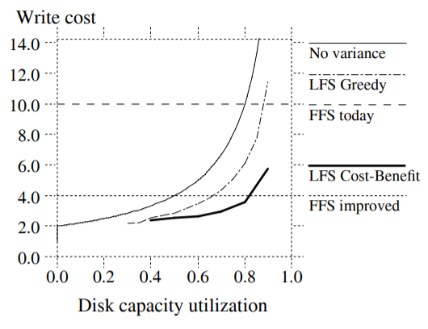
Simulation results
Cost-benefit policy

Slide 20
Segment usage table
The number of live bytes in the segment
The most recent modified time of any block in the segment
The blocks of the segment usage table are written to the log
The addresses of the blocks are stored in checkpoint region
The segment summary information
The age of the youngest block written to the segment

Slide 21
Crash recovery
Traditional Unix must scan all the metadata structures on disk to restore
LFS is easy to find the last operations
At the end of the log
Two-pronged approach
Checkpoints
Roll-forward

Slide 22
Checkpoints
Two-phase process to create a checkpoint
Writes out all modified information to the log
Writes a checkpoint region to a special fixed position on disk
Checkpoint region
The addresses of all the blocks in the inode map
Segment usage table
The current time & a pointer to the last segment written

Slide 23
Checkpoints
During reboot
Sprite LFS reads the checkpoint region
Uses that information to initialize its main memory structures
Two checkpoint region
To handle a crash during checkpoint
The system reads both, uses the one with the most recent time

Slide 24
Checkpoints
Checkpoint interval
30 secs – probably much too short
Alternative – perform checkpoints after a given amount of new data has been written to the log

Slide 25
Roll-forward
For any data written since the last checkpoint would be lost
Segment summary blocks
If data blocks are discovered for a file without a new copy of the file’s inode,
The new version of the file on disk is incomplete
Ignores the new data blocks
The segment usage table
The utilization of the segments written since the checkpoint will be zero
Reflect the live data left after roll-forward

Slide 26
Roll-forward
Directory operation log
Restore consistency between directories and inodes
Operation code(create, link, rename, unlink)
The location of directory entry(i-number for directory, the position within the directory)
The new reference count for the inode named in the entry
Ensure consistency between directory entries and inodes

Slide 27
Experience with the Sprite LFS
Part of the Sprite network operating system
Roll-forward has not been installed in the production system
Sprite LFS was not more complicated than FFS

Slide 28
Micro-benchmarks
Used a collection of small benchmarks to compare Sprite LFS and SunOS
The machine
Sun-4/260 (8.7 integer SPECmarks) with 32 megabytes of memory
a Sun SCSI3 HBA
A Wren IV disk (1.3 MBytes/sec maximum transfer bandwidth, 17.5 milliseconds average seek time)
Disk formatted with a file system having around 300MB
SunOS: 8KB block size
Sprite LFS: 4KB block size, 1MB segment size

Slide 29
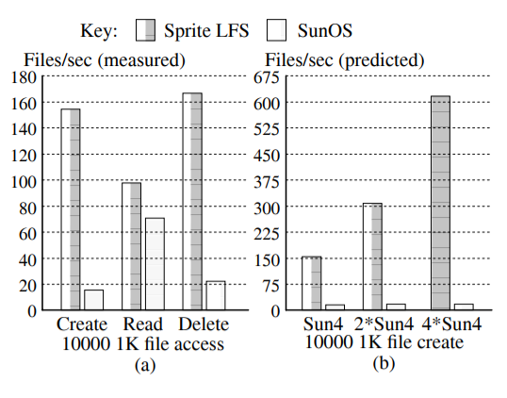
Micro-benchmarks
A benchmark that creates, reads, and deletes many small files
Files are read in the same order created
The performance of Sprite LFS will improved as CPUs get faster

Slide 30
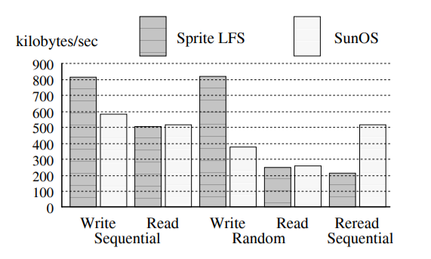
Micro-benchmarks
Competitive performance for large files
Random writes: Sprite LFS turns random writes into sequential writes to the log
Sequential writes: Sprite LFS groups many blocks into a single large I/O
LFS produces a different form of locality on disk than traditional file systems
Traditional: logical locality
LFS: temporal locality

Slide 31
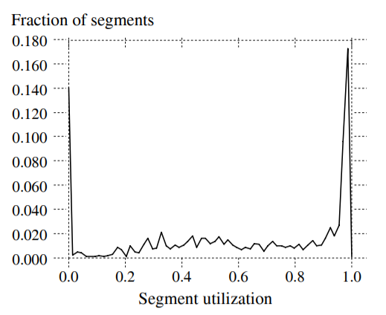
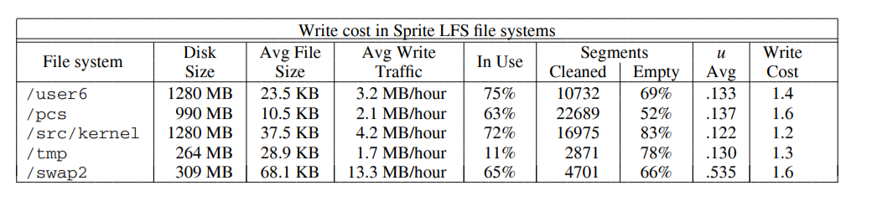
Cleaning overheads
Cleaning costs are lower in Sprite LFS than in the simulations
All the files in the simulations were just a single block long
The simulated reference patterns were evenly distributed within the hot and cold file groups

Slide 32
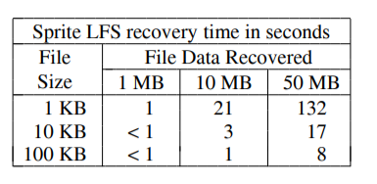
Crash recovery
The recovery time for different file sizes and amounts of file data recovered
Recovery time varies with the number and size of files written between the last checkpoint and the crash

Slide 33
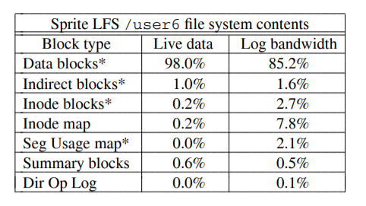
Other overheads
The relative importance of the various kinds of data written to disk
How much of the live blocks they occupy on disk
How much of the data written to the log they represent
The inode map alone accounts for more than 7% of all the dat written to the log
The short checkpoint interval forces metadata to disk more often
The log bandwidth overhead for metatdata
Expect installing roll-forward to drop overhead

Slide 34
Conclusion
Basic priciple:
Collect large amounts of new data in a file cache in main memory
Write the data to disk in a single large I/O
A simple cleaning policy based on cost and benefit
Also works well for large-file accesses
LFS can use disks an order of magnitude more efficiently than existing file systems

