Slide 1
DATE'20
ARS: Reducing F2FS Fragmentation for
Smartphones using Decision Trees
Lihua Yang, Fang Wang, Zhipeng Tan, Dan Feng, Jiaxing Qian, Shiyun Tu
CHANGWON NATIONAL UNIVERSITY

Slide 2
Introduction
F2FS
Severe fragmentation
Out-of-place updates
Highly synchronous, multi-threaded writing behaviors of mobile applications
Reserving space to prevent fragmentation
There are a large number of files

Slide 3
Introduction
ARS
Adaptive reserved space to choose some specific files to update in the reserved space
Decision tree

Slide 4
Motivations
The impact of fragmentation on F2FS
IPU(in-place update)
Effective in alleviating fragmentation
SQLite databases
The most fragmented files

Slide 5
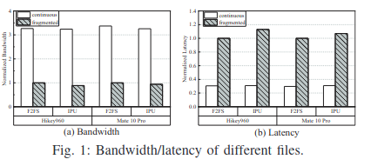
Motivations
4KB write followed by fsync()
Regardless of the traditional F2FS and IPU, The number of extent for a continuous file is 1 A fragmented file is about 32,767

Slide 6
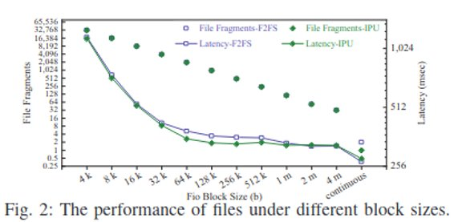
Motivations
When a file is split into fragments of different sizes
The fragment size ↑, the performance ↑
Fragmentation is the key factor contribution to I/O throughput

Slide 7
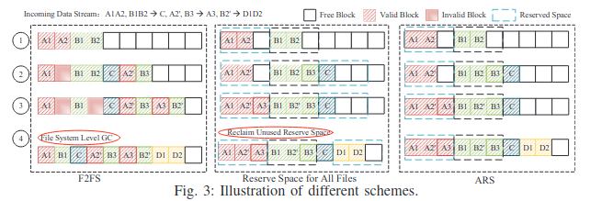
ARS
The solution to effectively choose reserved files
The amount of reserve space
The reservation and recycling strategies

Slide 8
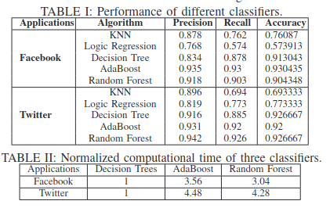
Reserved files
File features
File type
File size
File write time interval
Write request times

Slide 9
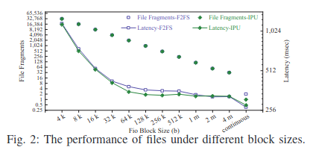
Reserved space
Too large -> waste space
Too small -> couldn't keep all data of a file
Larger than 1MB, small negative effect
GC unit: 2MB
Decide that the initial reserve space is 2MB

Slide 10
Reservation strategy
When free space is deficient, it is better to stop reserving
F2FS_IPU_UTIL
One of the IPU policies
Default file system space utilization threshold: 70%
Dynamic update policy for reserved files according to file system space utilization
Lower than 70%: reserving space for all target files
Between 70% and 80%: stop preallocating space for a new-coming reserved file
Higher than 80%: stop reserving and reclaiming unused reserved space

Slide 11
Evaluation
Implement ARS
A module in 657 lines of C code based on the traditional F2FS in AOSP 9.0
Only make some changes at the file system level
Hardware
Hikey960, Huawei Mate10 Pro
Compare the performance
ARS
traditional F2FS
IPU
ARS+IPU

Slide 12
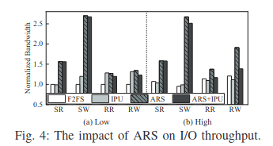
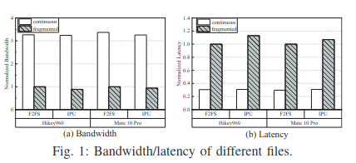
File and Free Space Fragmentation
The performance of ARS are similar to ARS+IPU
ARS performs better
ARS shortens the latency
Mobile systems are subject to costly random writes with frequent fsync

Slide 13
File and Free Space Fragmentation
The fragmentation is far reduced in ARS at High
The overheads of I/Os: ARS < traditional F2FS and IPU

Slide 14
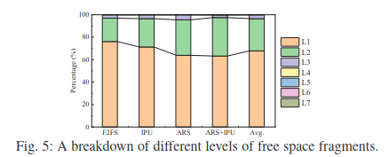
File and Free Space Fragmentation
The distribution of free space fragmentation
The least L1 and the most L3 free space fragments of all schemes
More reductions than F2FS and IPU for GC count, move blocks, read I/Os and write I/Os
I/O performance improvements
GC overhead reductions

Slide 15
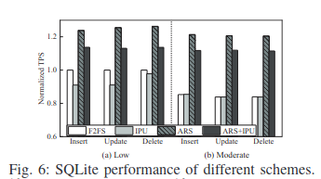
SQLite
SQLite performance measured by transactions per second (TPS)
Moderate.IPU performs worse than traditional F2FS
ARS outperforms traditional F2FS by up to 1.26×

Slide 16
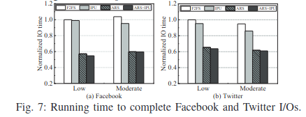
Running Time of Applications
ARS decreases the running time

Slide 17
Space and Time Overhead
Reserved objects are just a few files
Only the data of reserved files are updated in-place but there is no change in inode management
The running time is significantly shortened
ARS is superior than other scheme
Does not replicate data
Reduces GC
Selectively reserves space

Slide 18
Conclusion
Smartphones generate lots of fragments in F2FS
ARS
Decision trees : classify reserved files & reserve space for them
Effective in reducing file and free space fragmentation
Improving I/O performance
Reducing GC overhead
Outperforms traditional F2FS and F2FS IPU

