Slide 1
ICCAD’19
HAML-SSD: A Hardware Accelerated
Hotness-Aware Machine Learning based
SSD Management
Bingzhe Li, Chunhua Deng, Jinfeng Yang, David Lilja, Bo Yuan, David Du
CHANGWON NATIONAL UNIVERSITY

Slide 2
Introduction
Garbage collection
Extra writes and causes large overhead
HAML-SSD
Hotness-Aware Machine Learning based SSD management
Reduce the overhead of GCs in SSDs
K-Means algorithm
Define the “hotness” of a data page by clustering data with I/O access patterns

Slide 3
Introduction
Contributions
Update frequency, average update time interval
Machine learning method
A hardware unit, HAML-unit is designed to accelerate the machine learning algorithm
Analyze trade-offs between different values of parameters

Slide 4
Motivation
GC causes a large migration overhead
Previous works
Only defined the hotness by the update frequency
A constant threshold to partition data pages into hot and cold
HAML-SSD
Also consider about the average update time interval
Capable of dynamically classifying data access patterns by using ML

Slide 5

K-Means
Unsupervised learning
There is no ground truth to indicate which class they should belong to
K-Means
Sumpler, faster and more flexible

Slide 6
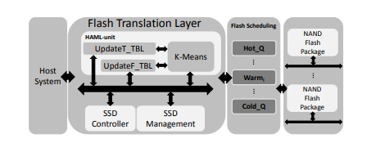
HAML-SSD Design
Overall architecture
UpdateF_TBL
UpdateT_TBL
K-Means unit
The hardware implementation of the K-Means algorithm

Slide 7
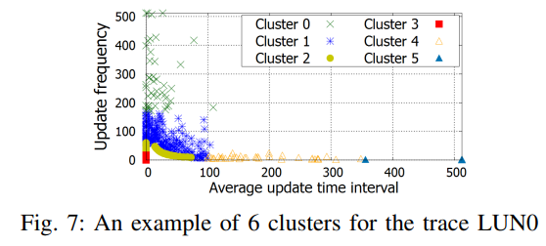
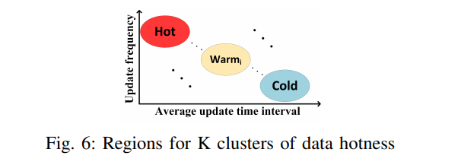
HAML-SSD Design
ML allocation policy
Parameters
Update frequency
Average update time interval
Slices
Split the SSD logical address into smaller contiguous regions called slices
The SSD records two parameters for each slice in each time period
Two-dimension K-Means clustering algorithm

Slide 8
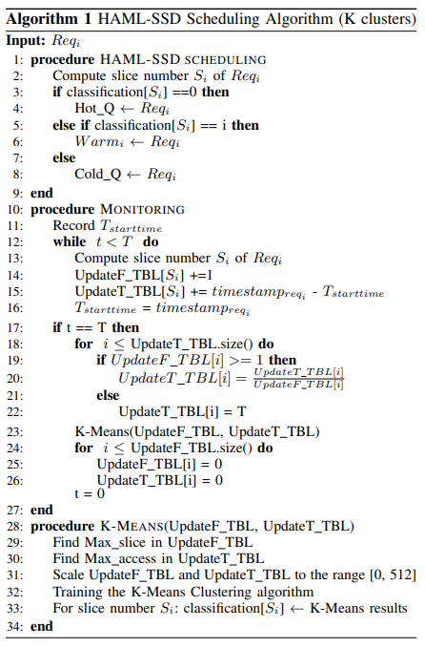
HAML-SSD Design
Major functions
Scheduling
Monitoring
K-Means clustering
Hot_Q, Cold_Q for wear-leveling

Slide 9
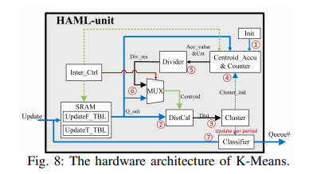
HAML-SSD Design
ML unit design
K-means clustering algorithm is time-consuming

Slide 10
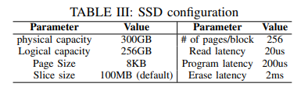
Experiment
Environment setup
Greedy GC scheme
GC activation threshold is set to 128 free blocks
SSDsim simulator
Cambridge MSR traces, Systor’17 traces
K-Means cluster will be re-trained every 6 hours

Slide 11
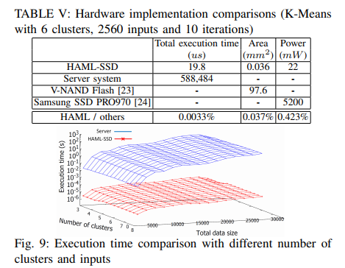
Experiment
HAML-SSD hardware implementation
Sysnopsys Design Compiler to synthesize the design with the TSMC 28nm technology
Execusion time comparison

Slide 12
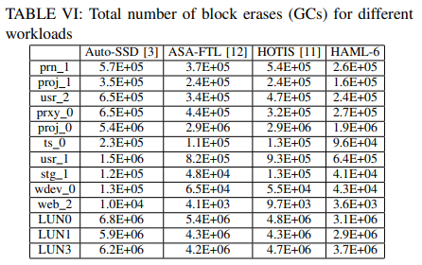
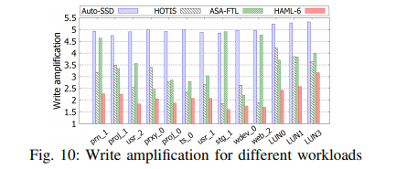
Experiment
Overall performance comparison

Slide 13
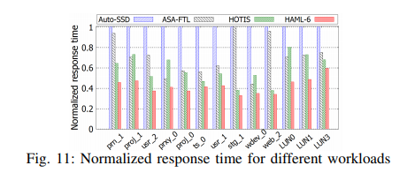
Experiment
Overall performance comparison

Slide 14
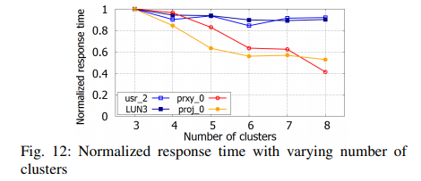
Experiment
Varying number of clusters
A large number of clusters has a higher ability to classify a lower number of cluser distribution

Slide 15
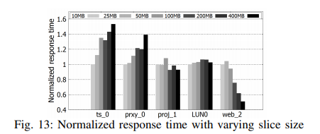
Experiment
Performance with varying slice size
Ts_0, prxy_0 have obvious difference in small slice size
proj_1, LUN0 are not sensitive to the slice size
Web_2 does not have enough update information for small slice sizes in one time period
Smaller slice sizes might provide better I/O performance but cause longer execution time

Slide 16
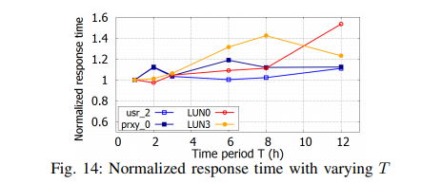
Experiment
Performance with varying T
Usr_2, prxy_0 have similar update patterns for different T
LUN0, LUN3 have significantly changed access patterns for differen T
A shorter time period will cause more training, a trade-off between the time period and clustering execution time

Slide 17
Conclusion
HAML-SSD to improve the garbage collection efficiently
Update frequency, update time interval
K-Means clustering algorithm
HAML-unit is designed in the SSD, which reducing overhead
HAML-SSD reduces the response time compared to previous works
Investigation about different design parameters

