Slide 1
IEEE ACCESS
SCJ: Segment Cleaning Journaling for Log-Structured File Systems
Hyunho Gwak, Dongkun Shin
CHANGWON NATIONAL UNIVERSITY
Notes:
Hello. My name is Minseon Cho from Changwon
Today, I will talk about “Interleaved Data Processing Scheme for Optimizing Tensorflow Framework”

Slide 2
Outline
Introduction
Background
Motivation
SCJ
Evaluation
Conclusion
Notes:
The first thing I’ll talk about is the hardware utilization issue in ML.

Slide 3
Log-Structured File System
Log-structured file system
Out-of-place update scheme → Sequential writes
But, segment cleaning is needed
Segment cleaning
Also known as GC, segment recycling, segment compaction
Copies all valid blocks in the dirty segments to other segments → become free segments
Invokes numerous block copy operations
Degrades performance

Slide 4
Log-Structured File System
Wandering tree problem
Metadata overhead
Lazy Indirect Block Update (LIBU)
Updates indirect block in memory instead of flushing them immediately to storage
Accumulated indirect blocks are periodically flushed during checkpointing
Roll-forward recovery, roll-back recovery

Slide 5
F2FS
Lazy Metadata Update (LMU)
Delay the flush of all file system metadata updates
Disadvantages of LMU
Roll-forward recovery becomes impossible
Many metadata updates are needed during segment cleaning
Roll-back recovery
Roll-forward recovery
Replay
In LMU, updated segment summary blocks are in memory.
When the system crash happened, all of them are lost
Checkpoint metadata
Segment summary block

Slide 6
Proposed Scheme
Segment cleaning journaling (SCJ)
Segment cleaning to be performed without checkpointing
Metadata updates during segment cleaning are logged at journal blocks
Checkpointing is delayed until excessive metadata updates are pending
Adaptive checkpointing which considering accumulated pre-invalid blocks

Slide 7
Outline
Introduction
Background
Motivation
SCJ
Evaluation
Conclusion
Notes:
The first thing I’ll talk about is the hardware utilization issue in ML.

Slide 8
F2FS
LFS considering the characteristics of flash memory
F2FS writes frequently updated metadata to the fixed metadata area
SIT, NAT, SSA are in the metadata area
F2FS uses the NAT to prevent recursive node block updates
Multi-head logging
Append logging, threaded logging
The proposed SCJ is implemented by using F2FS

Slide 9
Segment Cleaning
Victim selection
Identifies a victim segment among the dirty segments
Greedy policy, cost-benefit policy
Valid block migration
After the victim selection, LFS copies all valid blocks of the victim segment to the free segment
Node blocks of the migrated data blocks are updated
Metadata write
The LFS must flush the metadata updated before new write requests overwrite the victim segment
After flushing the metadata, the victim segment becomes a new free segment
checkpointing

Slide 10
Checkpoint
Rolling data back to the last checkpoint state when a sudden crash occurs
Flushes modified data and metadata to the storage persistently
→ Frequent checkpointing degrade performance
A checkpoint procedure
Data and node block flush
File system metadata flush
Checkpoint metadata flush

Slide 11
Outline
Introduction
Background
Motivation
SCJ
Evaluation
Conclusion
Notes:
The first thing I’ll talk about is the hardware utilization issue in ML.

Slide 12
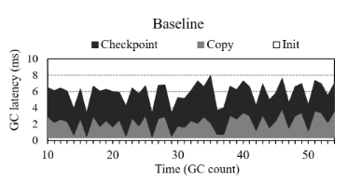
Time Consumption
Time consumption of each segment cleaning phase
Fileserver workload: a large sequential write pattern and invokes little fsync calls
Metadata write phase(checkpoint) was 52% of the total segment cleaning latency

Slide 13
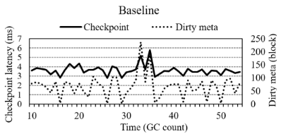
Time Consumption
The checkpoint latency and the amount of dirty metadata
Fileserver workload
The ckeckpoint latency increased with the amount of dirty metadata

Slide 14
Time Consumption
Segment cleaning & Checkpointing
When segment cleaning was performed, checkpointing was invoked Dirty metadata decreased to zero
After segment cleaning, the dirty metadata increased File operations occurred between each segment cleaning
However, most of the dirty metadata is irrelevant to the segment cleaning
Segment Cleaning
#1
Other file operations
Segment Cleaning
#2
Checkpointing of Segment Cleaning #2 flush all metadata
→ Segment cleaning without recording irrelevant metadata will reduce latency

Slide 15
Outline
Introduction
Background
Motivation
SCJ
Evaluation
Conclusion
Notes:
The first thing I’ll talk about is the hardware utilization issue in ML.

Slide 16
SCJ
Use SCJ in the metadata write phase instead of checkpointing
SCJ records only modified block addresses owing to segment cleaning
SCJ flushes metadata modifications as journal blocks
The modified block address of each valid block is stored as an entry
Replay logs during the recovery process
Storing the current checkpoint version for the recovery
Blocks recorded after the last checkpoint from valid blocks in the victim segment
SCJ should distinguish these blocks
The checkpoint valid bitmap of F2FS

Slide 17
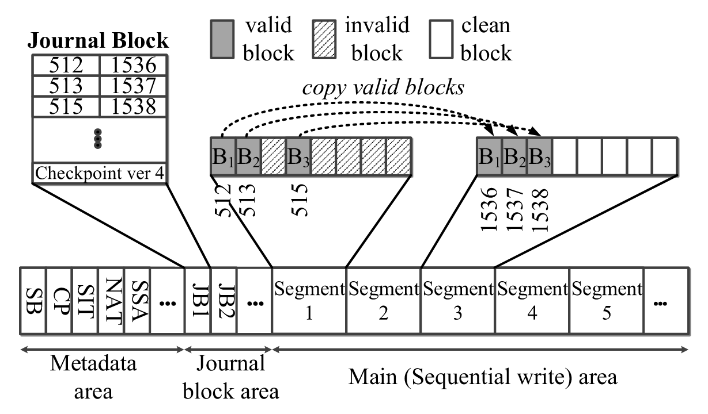
Segment Cleaning
An example of segment cleaning via SCJ
The journal block is flushed into the journal block area before the victim segment is changed into a free segment

Slide 18
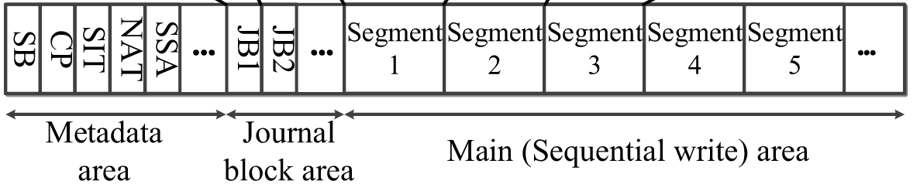
Journal Block Area
Journal blocks as replay logs in the recovery process
Journal blocks must be read in the order
Recorded sequentially in the journal block area
The Journal block area is a region in a fixed location of the storage

Slide 19
Journal Block Area
If no space is avaliable in the journal block area, the checkpointing is performed
Checkpointing flushes all accumulated metadata in the memory
All journal blocks recorded before checkpointing are invalidated
Both valid and invalid journal blocks can co-exist
LFS must distinguish between valid and invalid journal blocks with checkpoint version

Slide 20
Journal Block Area
The size of the journal block area
If it is small, then checkpointing will be performed frequently to create free space
If it is large, then the available storage space for incoming write requests is reduced
The journal block area must be set to an appropriate size
They found 256KB is enough for the journal block area

Slide 21
Recovery
A process of applying block address modifications from the valid journal blocks
The recovery of SCJ
Identify valid journal blocks Read journal blocks sequentially Examines the checkpoint version
Merge duplicate entries Duplicate entries are generated when blocks copied by GC ar re-copied by another GC
Update metadata Metadata that refoer to the old block address are modified to a new block address
Checkpointing & flushes the modified metadata

Slide 22
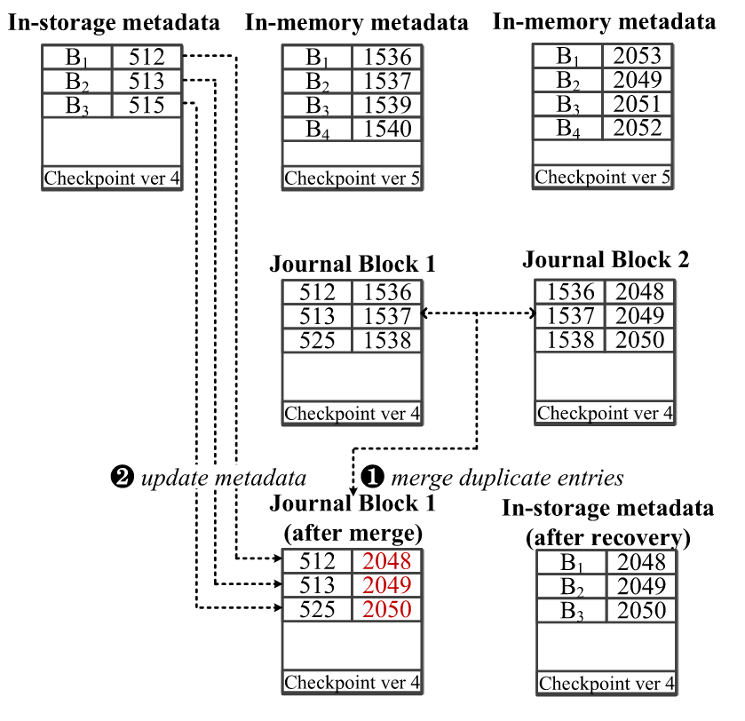
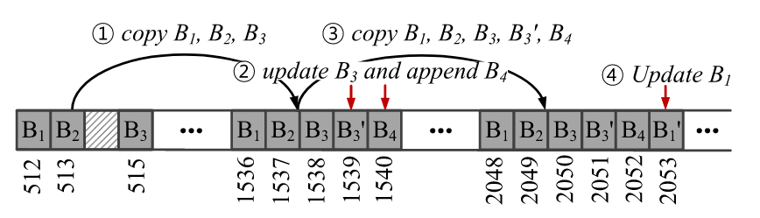
Recovery
A recovery example after a sudden crash occurs
Prior to the system crash ①③ : a journal block was created and flushed to storage ②④ : only in-memory metadata was modified
②
④
①
③
GC
New writes occurs

Slide 23
Recovery
A recovery example after a sudden crash occurs
After the system crash (recovery process)
Identifying valid journal blocks
Murging duplicate entries
Updating metadata
Updated node block is flushed via checkpointing

Slide 24
Recovery
The fsync of F2FS
F2FS flushes the in-memory metadata of fsynced files
If fsync is called after the third write(④), in-memory metadata including the block address of B1 is flushed
LFS can restore the B1's block

Slide 25
Adaptive Checkpoint
SCJ's block copy cost can be higher than that of normal segment cleaning
Due to pre-invalid blocks that are invalid but still referenced and are non-reclaimable
Pre-invalid blocks can be invalid after checkpointing
Adaptive checkpoint
Invokes checkpointing when the performance degradation caused by the pre-invalid blocks is more significant than the metadata flush overhead of the checkpoint
The number of accumulated pre-invalid blocks exceeded a threshold
The threshold is pproximately 128MB

Slide 26
Outline
Introduction
Background
Motivation
SCJ
Evaluation
Conclusion
Notes:
The first thing I’ll talk about is the hardware utilization issue in ML.

Slide 27
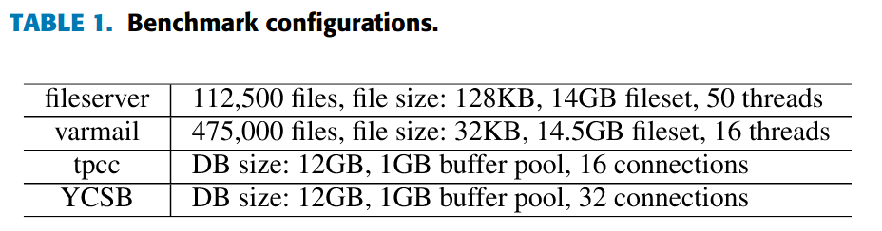
Setup
Hardware
3GHz quad-core processor
8GB of memory
SAMSUNG 970 SSD
Linux kernel 4.15
Benchmarks
Filebench (fileserver, varmail)
OLTP venchmarks (tpcc, YCSB on MySQL)
LFS
Baseline (original F2FS in LFS mode)
SCJ

Slide 28
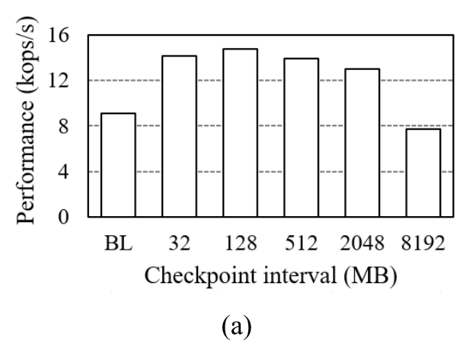
Adaptive Checkpoint
Performance
Varying the checkpoint interval(threshold of SCJ)
When the checkpoint interval exceeded 128MB, the performance of the SCJ began to deteriorate
Overhead caused by pre-invalid blocks

Slide 29
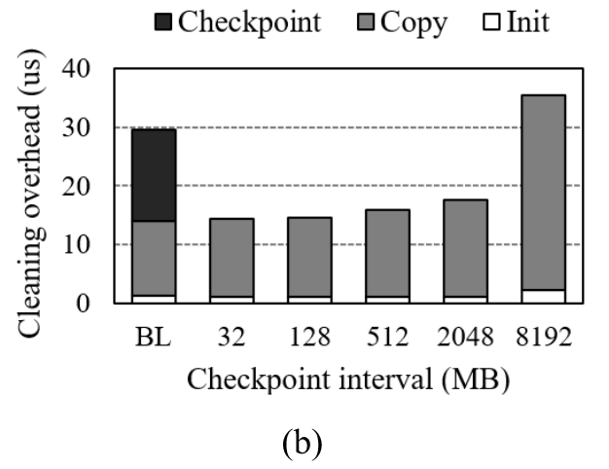
Adaptive Checkpoint
Segment cleaning overhead
Varying the checkpoint interval(threshold of SCJ)
As the checkpoint interval increased, the copy overhead of the SCJ increased

Slide 30
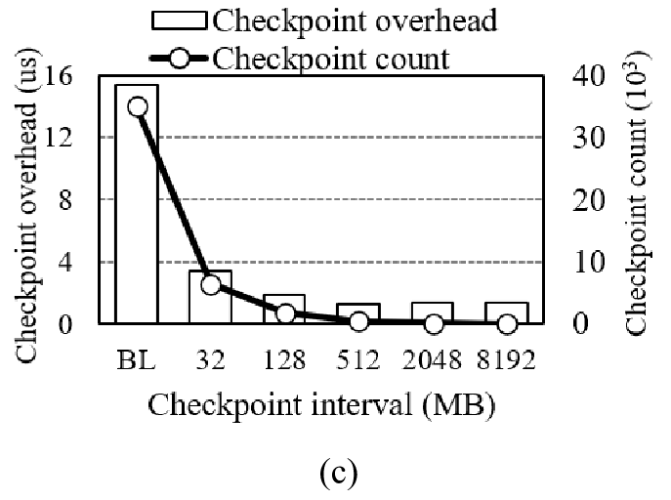
Adaptive Checkpoint
Checkpoint overhead & count
Varying the checkpoint interval(threshold of SCJ)
The checkpoint overhead decreased as the checkpoint interval increased

Slide 31
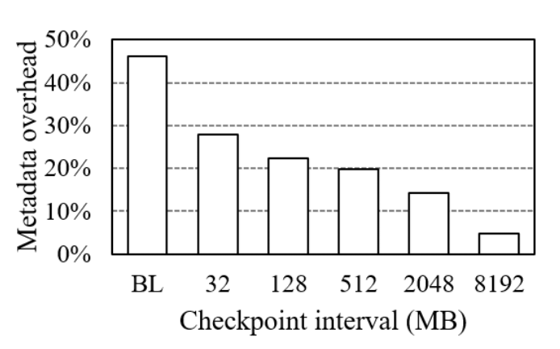
Adaptive Checkpoint
File system metadata overhead
Write traffic on the node blocks and the file system metadata blocks
As the checkpoint inerval increased, the number of metadata writes decreased

Slide 32
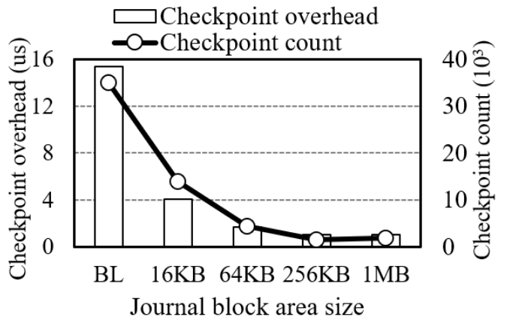
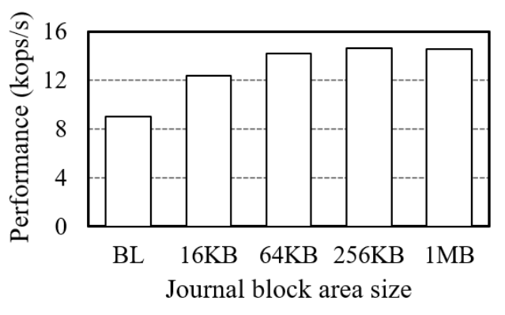
Journal Block Area Size
The effect of SCj while varying the size of the journal block area
When the size is 4KB, the SCJ performs checkpointing at every segment cleaning
When the size exceeded 256KB, there were no further improvement
The checkpoint overhead decreased as the size of the journal block increased
When the size excessded 256KB, additional checkpointing was not performed

Slide 33
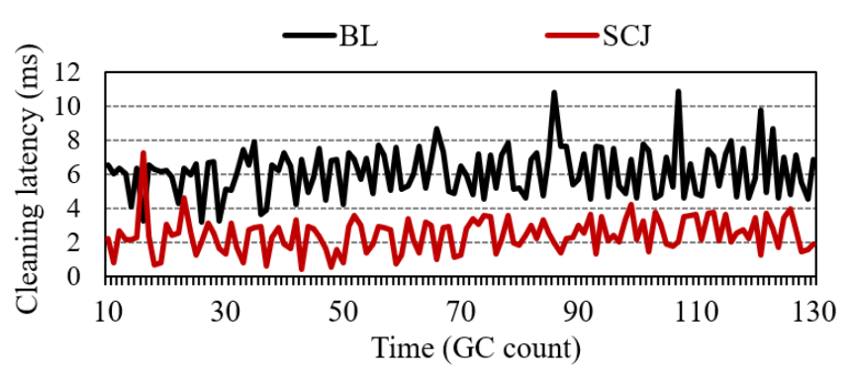
Changes in Segment Cleaning Latency
The segment cleaning latency was affected by the time spent on checkpointing
Segment cleaning latency of SCJ was lower than that of BL

Slide 34
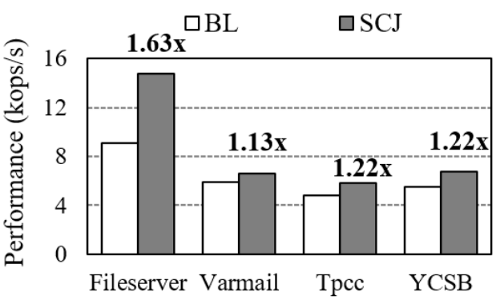
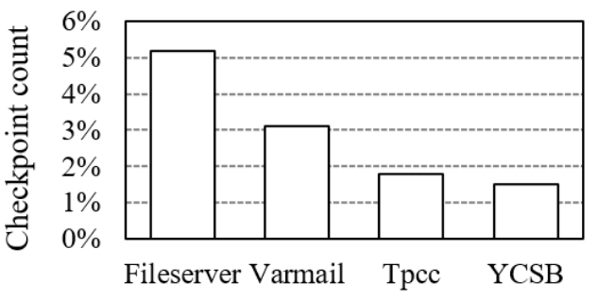
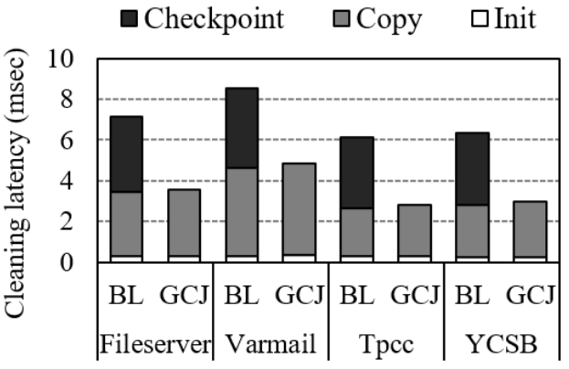
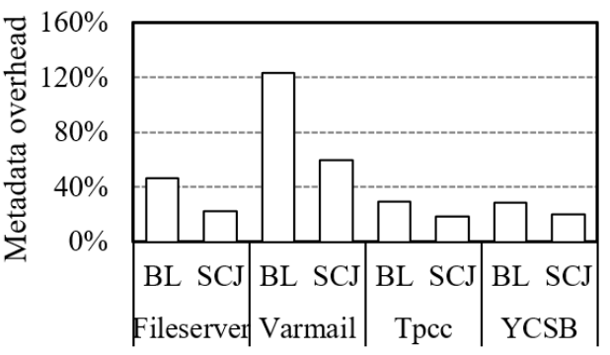
Overall Performance
The overall performance of the benchmarks

Slide 35
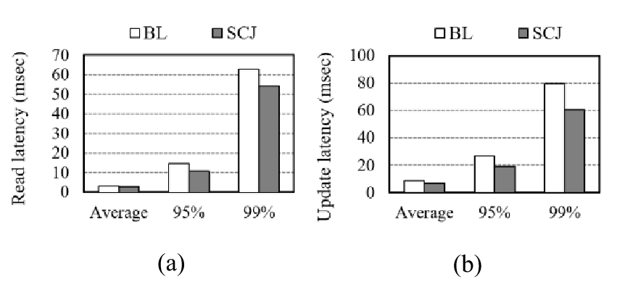
Overall Performance
IO latency
95%, 99% latency for the YCSB workload
SCJ can decrease the latency of both the read and update operations

Slide 36
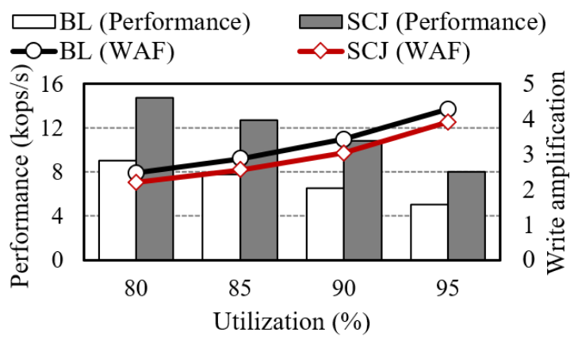
File System Utilization
The performances of schemes while varying the file system utilization
As the file system utilization increased, the WAF increased
More valid blocks migrated & frequent segment cleaning
The performance deteriorated as the utilization increased
SCJ only reduced the amount of metadata writes by checkpoint

Slide 37
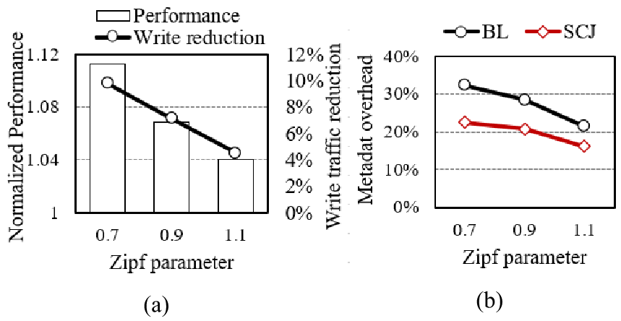
Metadata Write Ratio
The relationship between the proportion of metadata writes and the performance
Fio benchmark
The metadata overhead decreased as the update locality increased
The discrepancy in the write traffic and performance increased as the update locality decreased

Slide 38
Outline
Introduction
Background
Motivation
SCJ
Evaluation
Conclusion
Notes:
The first thing I’ll talk about is the hardware utilization issue in ML.

Slide 39
Conclusion
Current segment cleaning operation of the LFS
Unnecessary metadata write overhead
To optimize the performance of the file system, the GC latency must be reduces
SCJ
To remove unnecessary metadata writes and reduce GC overhead
GC without checkpointing
Adaptive checkpoint
To solve the pre-invalid block problem
Proposed schemes improved the performance by 1.13-1.63 times than normal GC

