Slide 1
MobileSwap: Cross-Device Memory Swapping for Mobile Devices
Changlong Li, Liang Shi, Chun Jason Xue
CHANGWON NATIONAL UNIVERSITY

Slide 2



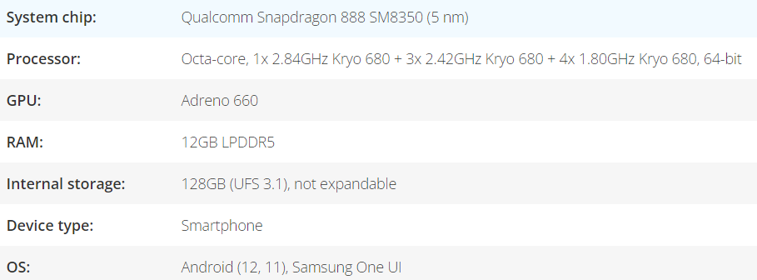




Introduction
The mobile device performance is rising rapidly
Many apps are installed and used by user
Enabling fast switching and state-restoration is critical for UX
Samsung Galaxy S 21-Ultra spec, https://www.phonearena.com/phones/Samsung-Galaxy-S21-Ultra_id11510
Samsung Galaxy S 21, https://www.samsungmobilepress.com/mediaresources/galaxy_s21_plus

Slide 3
Introduction
App caching is an important method for app switching
Caches the entire pages of apps in the main memory
This approach requires a large number of memory resources
Modern solution for app caching try to evicting memory page to local storage
Memory swap

Slide 4
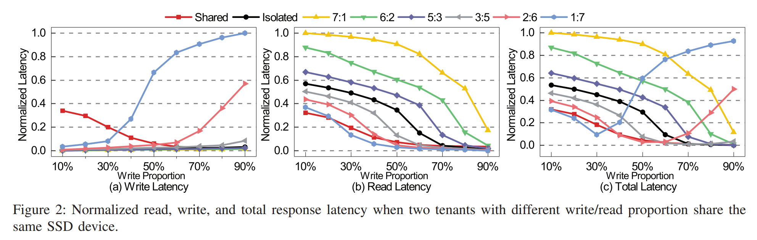
Introduction
However, swapping induces a large number of write requests to Flash storage
Read-write conflict* → performance degradation
WOW: Write Oriented Workload
ROW: Read Oriented Workload
Channel allocation
WOW:ROW = 7: 1
Channel allocation
WOW:ROW = 1: 7
Latency increasing by write conflict
* Liu, Renping, et al. "SSDKeeper: Self-adapting channel allocation to improve the performance of SSD devices." 2020 IEEE International Parallel and Distributed Processing Symposium (IPDPS). IEEE, 2020.

Slide 5
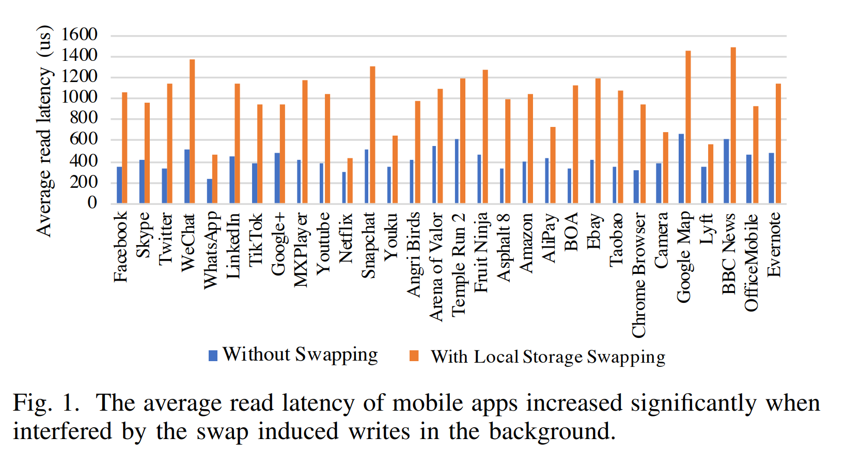
Introduction
I/O latency of mobile apps
Increased by 2.4x on average when read operations are interfered by the swapping induced writes
Additional writes generated by swapping are detrimental to Flash storage’s limited endurance
''Using storage for swapping is like
tail wagging the dog''

Slide 6
Motivation
InfiniSwap(Gu, Juncheng, et al. "Efficient memory disaggregation with infiniswap." NSDI USENIX, 2017)
Harvests unused memory by dividing the swap space of each machine
Distribute across machines’s remote memory.
To improve performance, the network stack is moved to the hardware.
CloudSwap(Chae, Dongju, et al. "CloudSwap: A cloud-assisted swap mechanism for mobile devices."CCGrid.
Selectively swap data to the cloud.

Slide 7
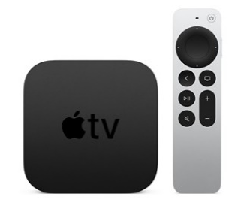


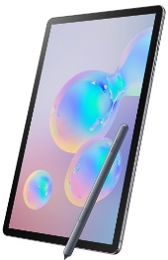
Motivation
The development of wireless communication technologies are significantly improved
Such as 5G and WiFi-Direct
Memory resource utilization is often unbalanced
Smart devices are relatively unused compared with smartphone
TV, laptop, tablet, …Etc.
idea: cross-device swapping among mobile devices
Remote swap

Slide 8
Contribution
Challenges for this idea: MobileSwap
Networking is not designed for swapping
Network disconnecting issue
Remote swap overhead control

Slide 9
Contribution
RDS: Resource Dedicated Swapping
To avoid performance degradation caused by swapping-networking overhead
Required resource dedicated and organize in the 'Right-size'
AAS: App Aware Swapping
Different from conventional page granularity memory reclaiming
App is treated as the basic unit of MobileSwap
Pages belonging to one app are swapped to the same remote device
Minimize impact of I/O disconnection
Implemented and deployed on real-world mobile device

Slide 10
Background
App caching
Android prefer to cache app in memory when switching them to the background for speed
Cold launch: launching app without caching, system first creating process for app
Warm launch: System switch the cached app to the foreground

Slide 11
Background
Cold launch
Warm launch
Generally, warm launch is 4-17x faster than cold launching
Prepare UI window
④Process fork
Window manager
Kernel
① Touch Icon
② Intent for app
③ Request fork
⑤ Initialize app
Launcher
ClickHandler.java
System Server Activity
Manager.java
Zygote
Zygoteinit.java
App Process
Activity.java
Data load from storage
Prepare UI window
Window manager
① Touch Icon
② Intent for app
③ Request resume
Launcher
ClickHandler.java
System Server Activity
Manager.java
Background process
App Process
(foreground)
Activity.java
Data already cached!

Slide 12
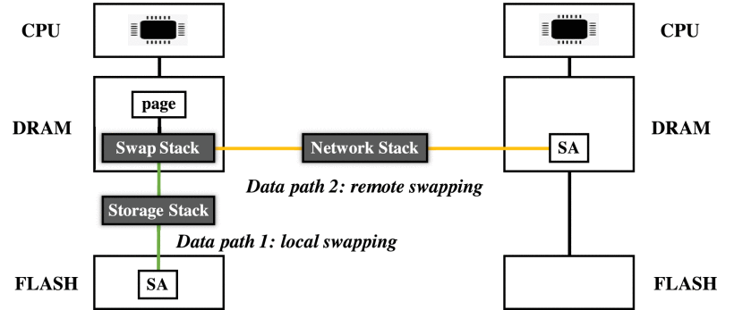
Related work
Local swapping: evict pages from memory to local swap area(SA)
MARS: Flash-aware swapping
ZRAM: Compresses pages to a RAM disk based swap area in DRAM
Two level swapping frameworks for UX
Remote swapping: maintaining SA in remote device memory
InfiniSwap
CloudSwap

Slide 13
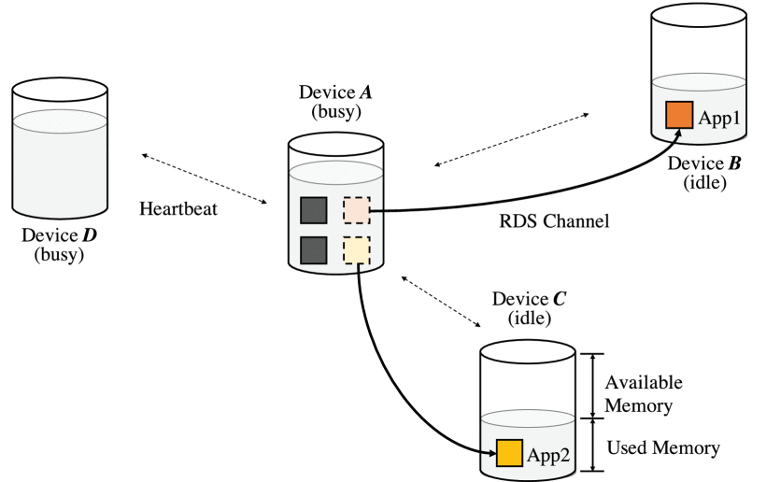
Design
Key idea
enhancing capability of busy device by swapping memory pages to remote idle devices
4 mobile devices with unbalanced resource utilization
Device A detect idle device (B,C)
swappin process constitute a fast channel between A and Idle remote device
A's data move to B, C

Slide 14
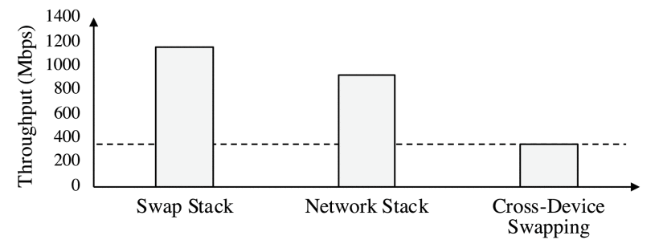
Design
Swap stack throughput relies on the host system performance
Network stack throughput relies on network bandwidth
Cross-Device Swapping combined above stacks
Context switching overhead is high(several processes are used)
The swapped data is not in the right size, Linux kernel memory is managed at page granularity
Not efficient approach to networking

Slide 15
Design
RDS(Resource Dedicated Swapping)
Key design: fast channel, page batching
RDS channel
Allocating dedicated resources for swapping → avoids redundant context switching
Three set of dedicated resources for build channel: network link, swap queue, computing unit
Network link: dedicated to each remote device using TCP socket
Swap queue: dedicated to the swap pages → all pages swapping to the same destination are inserted into same queue
Computing unit: per-core worker thread is dedicated to moving swapped pages

Slide 16
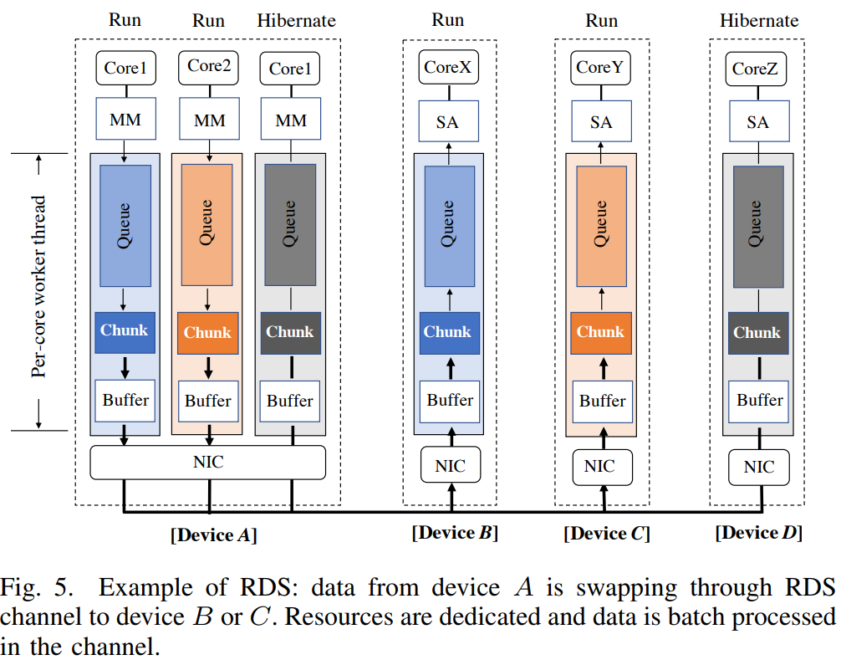
Design
Device A build channel with Device B, C and D
Worker threads preempts per-core
Run without context switching
But, not core-channel one-to-one mapped
Two channel can be maintain by one core
If Ch. A1 to B on running by using Core1,
Only one of other two channel allowed to run using Core2
Ch. A1
Ch. A2
Ch. A3
Channel B
Channel C
Channel D
worker thread

Slide 17
Design
Resource efficiency & power saving
Unused channel can be hibernate & release dedicated resource(network link, Etc.)
If one swapping cycle finished
Sleep until a new swapping start
Ch. A1
Ch. A2
Ch. A3
Channel B
Channel C
Channel D

Slide 18
Design
Page batching
Same queue, same destination → Possible to batching
Worker thread merges the pages to huge page
Chunk size : 64KB → maximum packet size supported common protocol(TCP Segmentation Offload)
Chunks send to TCP buffer for transmission
PTE information not update before swapping process
complete
Ch. A1
Ch. A2
Ch. A3
Channel B
Channel C
Channel D
TCP buffer
Network Interface Card

Slide 19
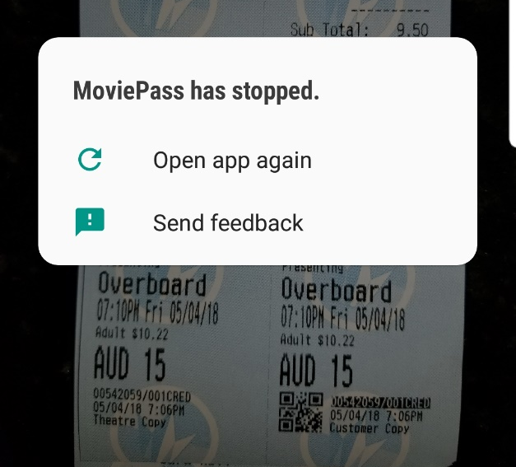

Design
What if page is demanded during the process?
Required pages can be directly obtained in the local memory
Interrupted swapping Ops will be withdrawn
How about disconnected during the process?
Reddit, https://www.reddit.com/r/MoviePassClub/comments/8h3tyg/
app_crashed_during_ticket_verification_what/
App crash meme, https://imgflip.com/i/17iqaw

Slide 20
Design
AAS(App Aware Swapping) minimizes app crash
Swap the pages owned by one app to the same destination
Indexing these pages based on the process VA space and corresponding VMAs*
MobileSwap prefers to swap the app to the device which has the most memory available
If a remote device disconnected, kill the impacted apps → then, can be cold launch without crash
Sacrifice app caching benefit, minimize disconnection induced app crash
* Virtual Memory Area

Slide 21
Design
If device disconnection occurs on running foreground?
Kill the foreground app and cold launch? → unacceptable!
Swaps all pages if that app back when it is launched
MobileSwap maintain Least-Recently-Used to determine which app to swap
Thanks to RDS(fast channel, batching), app swap back takes 7% ~ 16% longer than warm launch
App caching benefit + Faster than cold launch(x9 faster)

Slide 22
Implementation
MobileSwap has security issue
Designed for multiple device of the same owner, also deployed on shared devices of multiple owners
MobileSwap provides a security interface: ls_encrypt_fn()
Protect user privacy, data encrypted before swapping out
Private key is stored locally
Encryption algorithm: RSA, AES
Security module can be disable

Slide 23
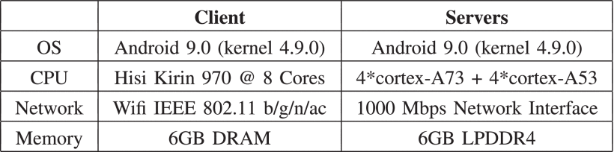
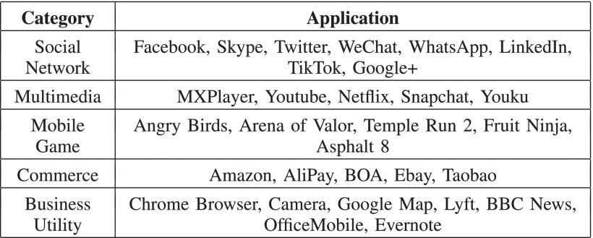
Experiments
Experimental platforms and workloads
1 client 4 server
Client: obtain swapping service
Server: provide swapping service

Slide 24
Experiments
5 scheme for comparison
NoSwap: disable swap
LocalSwap: swap only local flash
RemoteSwap: swap remote device
CloudSwap: swap to the cloud
MoblieSwap: proposed scheme, RDS+AAS

Slide 25
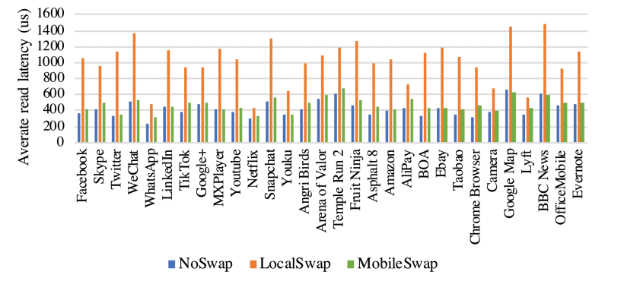
Experiments
User experience
Comparison read latency of each app
MobileSwap reduced by 53.7% average compared to LocalSwap
Higher 1.1x compared to NoSwap
Batch paging + low context-switching can cover cross-device overhead

Slide 26
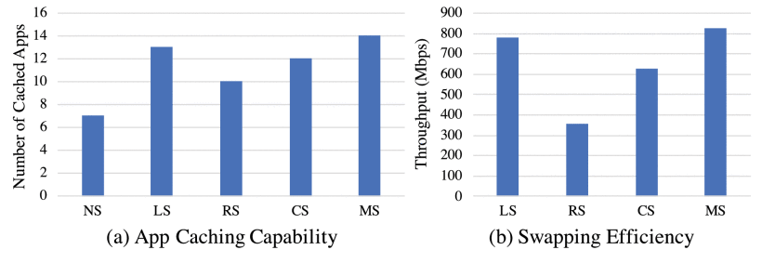
Experiments
Efficiency and stability improvement
Pre-installed apps are repeated launched for 10 rounds to create memory pressure
Upper bound of swap is set to 2GB
MobileSwap has 1.4x, 1.7x of capacity compared to RS and CS
Many pages are not swapped efficiently
Memory reclaiming slower than memory->memory pressure increasing-> system kill the app

Slide 27
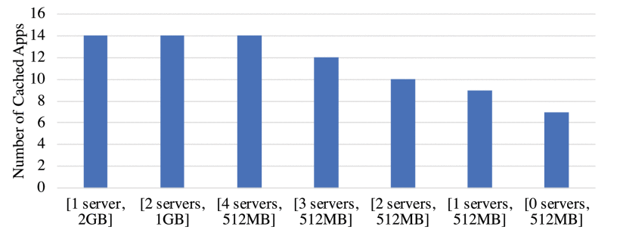
Experiments
Sensitive
Number of cached apps when enabling MobileSwap with the change of partition size and number
Many partition → unstable(disconnection probability ↑) , network overhead ↑

Slide 28
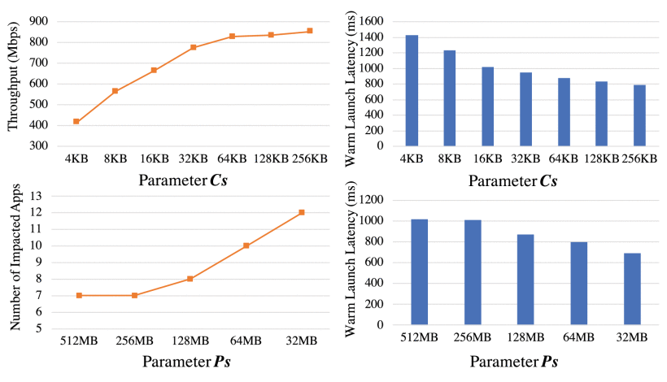
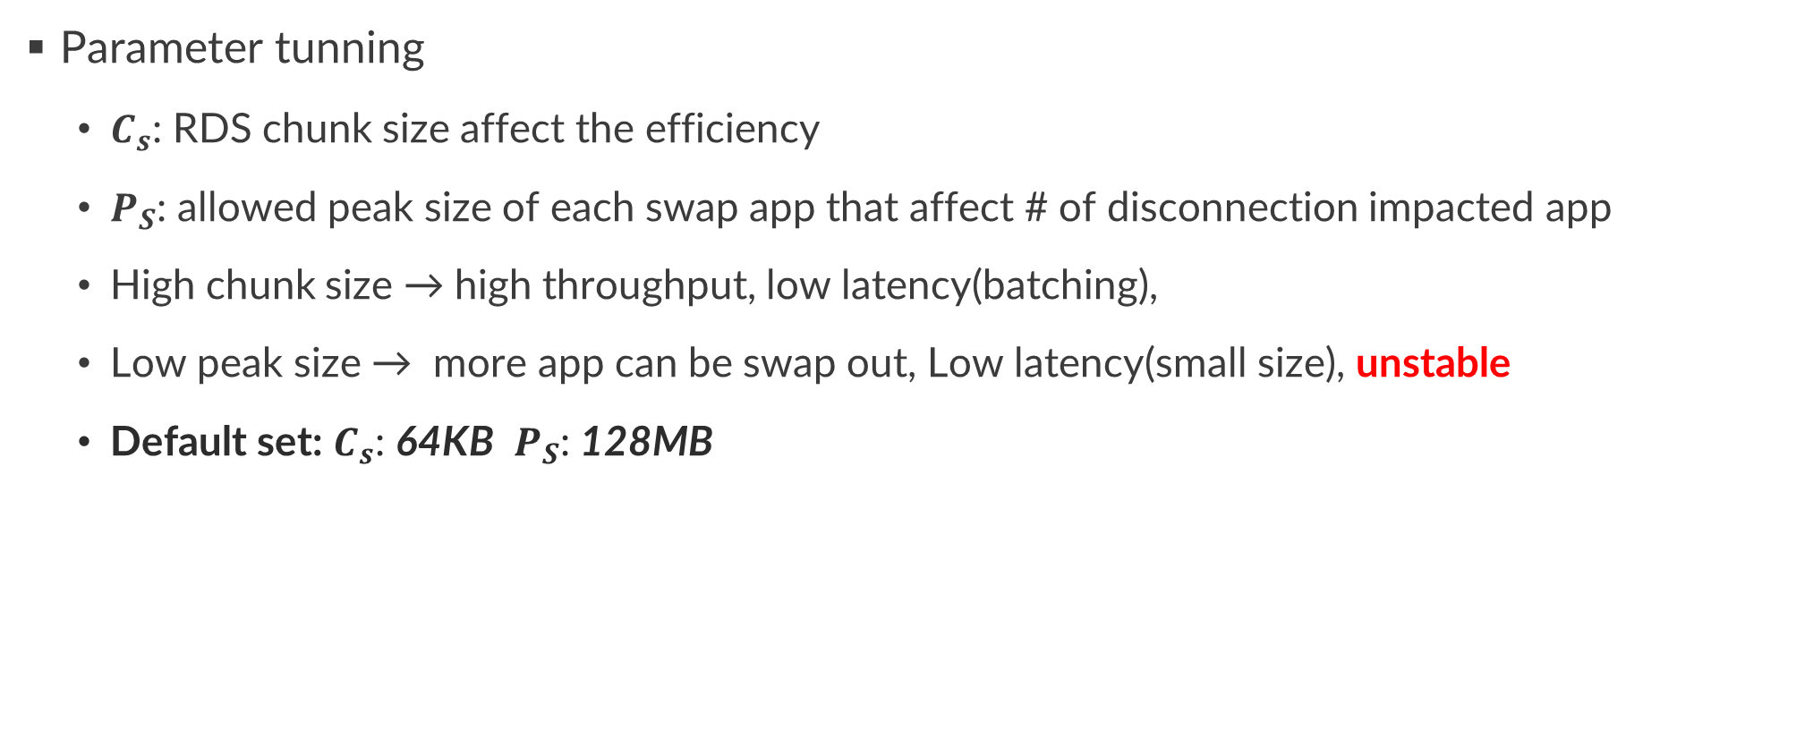
Experiments
Parameter tunning
$C_{s}$: RDS chunk size affect the efficiency
$P_{S}$: allowed peak size of each swap app that affect # of disconnection impacted app
High chunk size → high throughput, low latency(batching),
Low peak size → more app can be swap out, Low latency(small size), unstable
Default set: $C_{s}$: 64KB $P_{S}$: 128MB

Slide 29
Conclusion
MobileSwap: cross-device memory swapping scheme of mobile device
The memory pressure can be relieved without interfering at local I/O
MobileSwap demonstrates significant performance gain compares with state-of-art techniques(CloudSwap, RemoteSwap)

