Slide 1
IEEE Transaction on Mobile Computing
File Fragmentation in Mobile Devices: Measurement, Evaluation, and Treatment
Cheng Ji, Li-Pin Chang, Sangwook Shane Hahn, Sungjin Lee, Riwei Pan, Liang Shi, Jihong Kim, Chun Jason Xue
CHANGWON NATIONAL UNIVERSITY

Slide 2
Introduction
I/O efficiency is among the key factors that affect the overall responsiveness of mobile devices
File fragmentation
The progressive response time degradation in mobile devices
The goals of this study
To understand how bad file fragmentation in Android devices is
How fragmentation is produced
How fragmentation impacts on user-perceived latencies
The dfficacy and limitation of existing methods of fragmentation management

Slide 3
Introduction
Fragmentation measurement
How bad file fragmentation is in real smartphones
Identified file fragmentation is closely related to the file access & I/O behaviors
Designed AutoAge tool for systematically ages a file system in a reproducible manner
Evaluation of performance impact
How fragmentation impacts on user-perceive latencies of mobile apps
Launching time, installing time, SQLite query processing time
Fragmentation treatment
The efficacy and limitation of existing methods for fragmentation treatment
Space allocation, persistent journal, file defragmentation

Slide 4
Fragmentation in File Systems
File fragmentation
File contents are not entirely stored contiguously
Amplifies the disk seek frequency
Degrades the performance of HDD storage systems
File deletion
Leaves non-contiguous free space in the file system

Slide 5
Fragmentation in File Systems
File fragmentation in SSDs
Common belief: file defragmentation has little effect on SSDs, but harmful to SSD lifespan
Conway et al. Observed that the read performance of data servers could severly degrade due to poor file layouts on hard disks or SSDs
In this study, they found that file fragmentation is a serious problem in real smartphones

Slide 6
File Defragmentation
E4defrag
A file defragmentation tool for Ext4 file system
Creates a large sequential donor file, copies data from the fragmented file to the donor file
Based on data copying

Slide 7
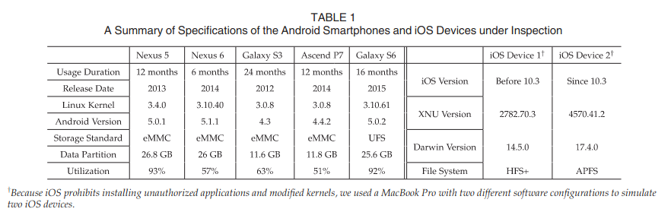
A Empirical Study of Real Smartphones
Setup
Daily use – including Facebook, Twitter, Chrome, Gmail, Camera, Google Earth

Slide 8
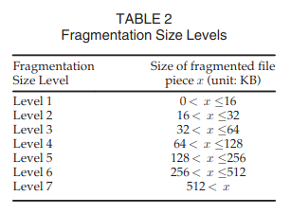
A Empirical Study of Real Smartphones
Degree of Fragmentation (DoF)
As a major evaluation metric
{The number of extents allocated to the file x} / {The ideal number of extents necessary for the file x}
A single extent can cover up to 128MB in Ext4
Fragment Size (FS)
File fragmentation has a larger performance impact on small fragments than larger ones

Slide 9
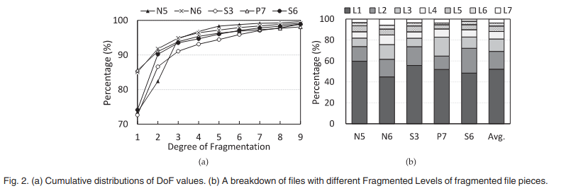
A Empirical Study of Real Smartphones
File system snapshot analysis
The higher the file system space utilization was, the more files were fragmented N5 (high space utilization: 93%)
Files in older smartphones tend to be more fragmented S3 (2 years), N6 and P7 (no more than one year)

Slide 10
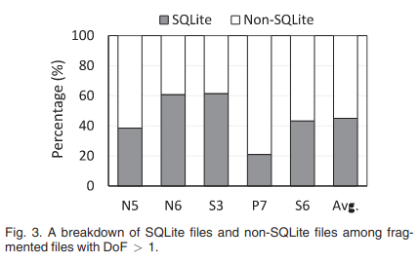
A Empirical Study of Real Smartphones
File system snapshot analysis
Whether fragmentation is correlated with file types
45% of the fragmented files were SQLite files
Non-SQLite files were fragmented in aged file systems

Slide 11
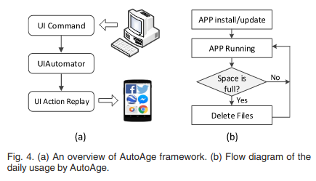
File Fragmentation Reproduction
Scenario-driven application replay
Developed a UI testing tool AutoAge based on the UIAutomator framework
Applications installing, updating, running

Slide 12
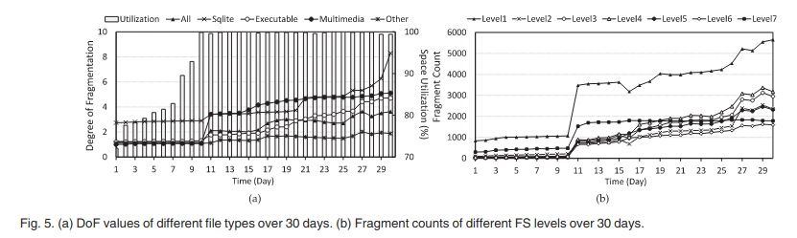
File Fragmentation Reproduction
Scenario-driven application replay
The space fullness was not high on the first day, but the DoF of SQLite files was already high as 3
From the 11th day, the fragmentation of SQLite files progressively developed as the File system aging

Slide 13
File Fragmentation Reproduction
Scenario-driven application replay
DoF of Multimedia and Executable files noticeably increased on the 11th day and onward because file system is nearly full

Slide 14
File Fragmentation Reproduction
Scenario-driven application replay
The number of fragments of the smallest FS level significantly increased on the 11th day
Free space was severly fragmented into small holes when the file system is was nearly full

Slide 15
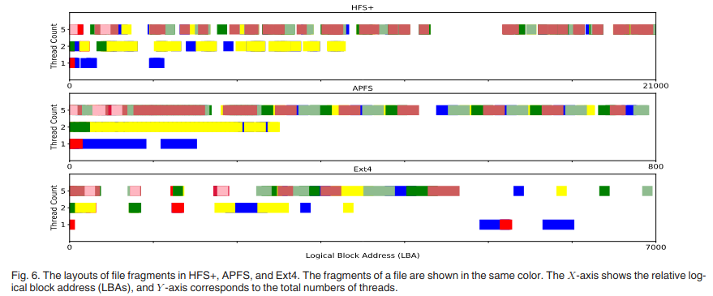
File Fragmentation Reproduction
Multi-Threaded SQLite Operations
When the total number of concurrent threads was large, small fragments from different files were severely interleaved with one another
File fragmentation is also a sever problem in IOS

Slide 16
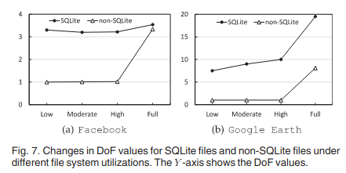
File Fragmentation Reproduction
Causes of fragmentation
Impact of high space utilizations
SQLite files of Google Earth were much larger than those of Facebook

Slide 17
File Fragmentation Reproduction
Causes of fragmentation
Impact of write behaviors
Even when the space utilization was Low, DoF of SQLite files were high
This result is closely related to frequent deletion of journal files & concurrent writing to DB files

Slide 18
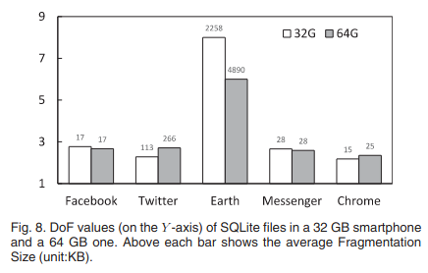
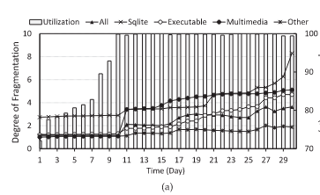
File Fragmentation Reproduction
Causes of fragmentation
Impact of storage capacity
No matter how large the storage device was, the SQLite files were still badly fragmented
Using a large storage device or decreasing the file system space utilization effectively avoids fragmentation of non-SQLite files, but it has no effect on SQLite files

Slide 19
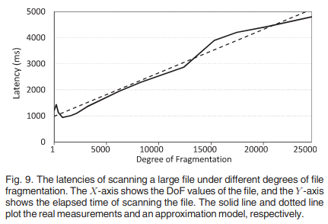
Performance Impact
A basic performance model
The correlation between the time overhead of accessing file and the DoF of the file
The latency linearly increased with the DoF value
The latency slightly dropped when the DoF increased 1 to 400 related to the internal data placement of the eMMC device

Slide 20
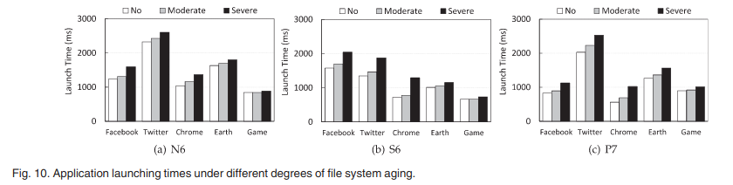
Performance Impact
User-perceived latencies
Application launching
File fragmentation contributes to user-perceived latencies of application launching

Slide 21
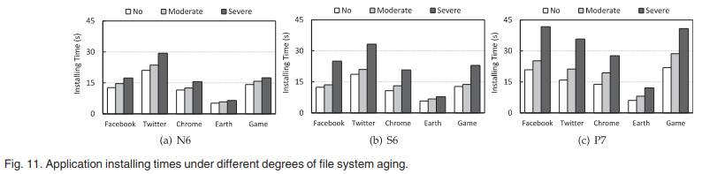
Performance Impact
User-perceived latencies
Application installing
File fragmentation contributes to user-perceived latencies of application installing

Slide 22
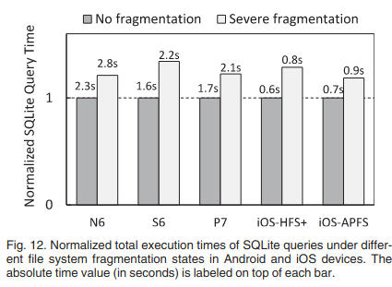
Performance Impact
User-perceived latencies
SQLite query processing
File fragmentation contributes to user-perceived latencies of application installing

Slide 23
Causes of Performace Impact
Increased block I/O frequency
Accessing fragmented files would result in an increased I/O frequency
Blktrace
The block I/O count with file fragmentation was significatly higher than that without fragmentation (47,570 vs 812)
This amplified block I/O frequency increased the total time of file reading by 1.6 seconds

Slide 24
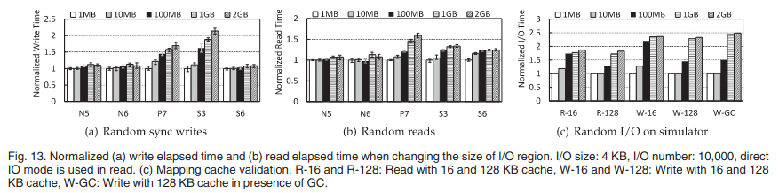
Causes of Performace Impact
Dispersed I/O pattern
The larger the write region, the more dispersed the write operations in the storage spac
The total write times on P7 & S3 with the largest write region were slow
On N5, N6, the total write time is less sensitive to the write region size

Slide 25
Causes of Performace Impact
Pattern-induced I/O pattern
Closely related to the logical-to-physical map caching mechanism inside of mobile flash storage
A large cache size (128 KB), a small cache size (16 KB)
The I/O region was enlarged, both read and write time increased
GC amplified the overhead of cache miss management

Slide 26
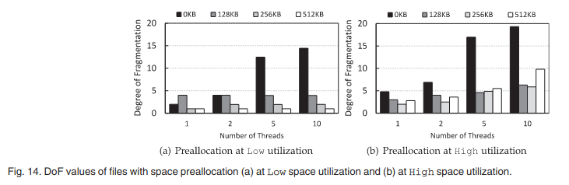
Fragmentation Treatment
Space preallocation
When the number of threads was large at the low space utilization level, file fragmentation was completely eliminated using space preallocation with units of 512 KB
DoF values under high space utilization were higher than those under low space utilization

Slide 27
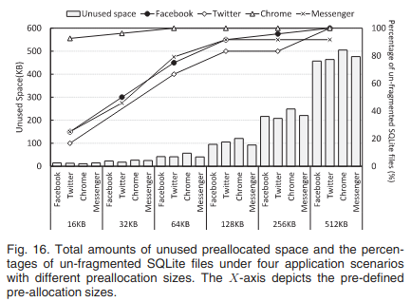
Fragmentation Treatment
Space preallocation
Attempt to find a proper preallocation size for SQLite files of real mobile applications
When the preallocation size was 128 KB, at least 83% of SQLite files were not fragmented

Slide 28
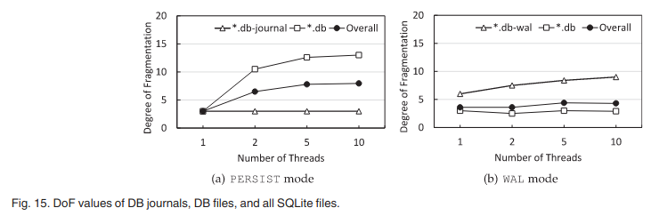
Fragmentation Treatment
Persistent journal
In PERSIST mode, journal(.db-journal) were lightly fragmented because they were written as a whole and barely grew DB files were badly fragmented because of the concurrent frequent growth of multiple db
In WAL mode, journal(.db-wal) were badly fragmented because of the same reason above DB files were lightly fragmented because of large batch writes

Slide 29
File Defragmentation
Conventional defragmentation (e4defrag)
Copy-based
Find as large extents as possible and re-locate the fragments of the file to the large extents
Ideal DoF
A fragmented file still has a DoF value larger than 1 after defragmentation with e4defrag when e4defrag cannot find a sufficiently large extent

Slide 30
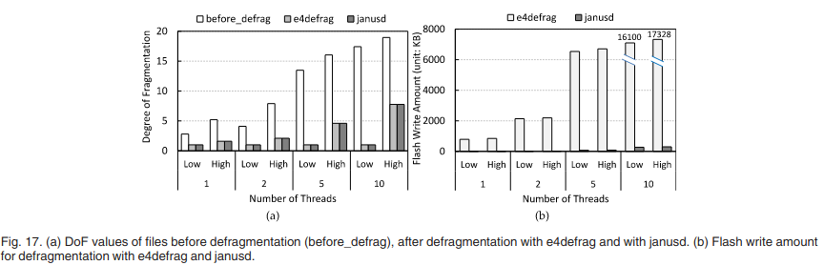
File Defragmentation
Conventional defragmentation (e4defrag)
When the file system space utilization was low, e4defrag eliminated all file fragmentation
E4defrag decreased the average DoF only by ½ compared to no defragmentation with 10 threads

Slide 31
File Defragmentation
Copyless defragmentation
The data copying introduces extra write stress to mobile storage
Janusd
For defragmenting files on flash-based mobile storage
Exploit the existing logical-to-physical mapping in the firmware layer inside of mobile storage
Remap existing data in flash memory from fragmented logical addresses to continuous ones
Modifies the mapping information inside of mobile storage
No data copying

Slide 32
File Defragmentation
Janusd
The same average DoF values as e4defrag
Janusd is based on the same defragmentation logic as that of e4defrag
Write stress reduction: 98% fewer flash writes than e4defrag did

Slide 33
Conclusion
Examined how severe file fragmentation is in real mobile devices
How fragmentation negatively impacted user-perceived latencies
The increased block I/O frequency and defraded device mapping cache efficiency
Evaluated existing methods for fragmentation treatment
File defragmentation (conventional and copyless) is useful to write-once files
Space allocation is effective on SQLite files

