Slide 1
ICDAR ‘19
TableNet: Deep Learning model for end-to-end Table detection and Tabular data extraction from Scanned Document Images
Shubham Paliwal, Vishwanath D, Robit Rahul, Monika Sharma, Lovekesh Vig
TSC Research, New Delhi
CHANGWON NATIONAL UNIVERSITY

Slide 2
Outline
Abstract
Introduction
Related work
TableNet: Deep model for table and column detection
Table row extraction
Dataset preparation
Experiments and result
Conclusion

Slide 3
Abstract
Need for extracting the information trapped in unstructured document images
A unique set of challenge to extract data from tabular sub-images presents
TableNet: A novel end-to-end deep learning model for both table detection and structure recognition
To exploit the interdependence between the twin tasks :
Table detection and table structure recognition
Semantic rule-based row extraction from identified tabular sub-regions

Slide 4
Outline
Abstract
Introduction
TableNet: Deep model for table and column detection
Table row extraction
Dataset preparation
Experiments and result
Conclusion

Slide 5
Introduction
Increasing uploading documents via mobile device
To need for information extraction from images more processing
A key component of information extracting of document :
Digitizing the data present in the tabular sub-images
Most existing approaches : To try to solve isolated issues
Table detection
Table structure recognition

Slide 6
Introduction
To propose : TableNet
A novel end-to-end deep learning model : 테이블 감지 & 테이블 구조 식별의 상호 의존성 활용
Base network: Pre-trained VGG-19
Two decoder branches :
Segmentation of the table region
Segmentation of the columns within a table region
Rule based row extraction

Slide 7
Introduction
A single input image → Two different output images for tables and columns
To share the encoding layer of VGG-19 for the table and column detection
Separated two tasks for decoding
Dataset
ICDAR-2013 dataset
Marmot dataset

Slide 8
Outline
Abstract
Introduction
TableNet: Deep model for table and column detection
Table row extraction
Dataset preparation
Experiments and result
Conclusion

Slide 9
TableNet: Deep model for table and column detection
A prior deep learning-based approach to detect table
Considered separately as two different problems (To detect table & to detect column)
Easy to detect table
Difficult to detect column : Columns are vertically aligned word / numerical blocks
Goal : To know all columns in advance
Idea : To reinforce convolution filters to detect tables as to detect column
Encoding layer : To use the ground truth
Decoding layer : To separate table and column branches

Slide 10
TableNet: Deep model for table and column detection
Model preprocessing by tesseract OCR
To transform into an RGB image
To resize to 1024 * 1024 resolution
Detection
A single model to produce output mask of table & column region
To detect tables and column like detecting objects in real images
To apply pre-trained layer of VGG-19

Slide 11
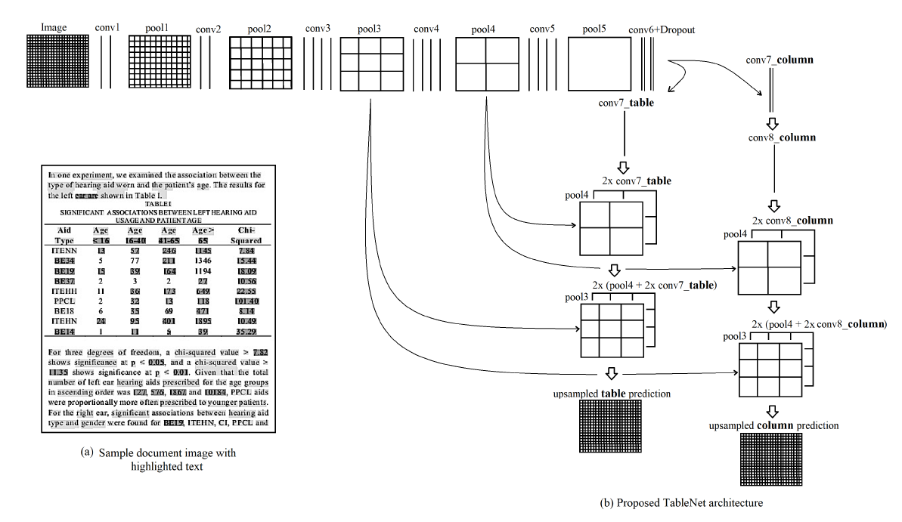
TableNet: Deep model for table and column detection
To use a pre-trained VGG-19 layer as the base network

Slide 12
TableNet: Deep model for table and column detection
To replace the fully connected layer with two convolution layers
Two convolution layers use Dropout layer

Slide 13
TableNet: Deep model for table and column detection
To append two different branches of the decoder network
The output (conv6 + dropout) layer to distribute to both decoder branches

Slide 14
TableNet: Deep model for table and column detection
To use conv7_table for upscaling the image

Slide 15
TableNet: Deep model for table and column detection
To up-scale conv7_table using fractionally strided convolutions
To append with the pool4 pooling layer of the same dimension

Slide 16
TableNet: Deep model for table and column detection
To upscale again and to append pool3 pooling layer

Slide 17
TableNet: Deep model for table and column detection
To upscale to meet the original image dimension

Slide 18
TableNet: Deep model for table and column detection
To upscale to meet the original image dimension

Slide 19
Outline
Abstract
Introduction
TableNet: Deep model for table and column detection
Table row extraction
Dataset preparation
Experiments and result
Conclusion

Slide 20
Table Row Extraction
TableNet to generate masks for table & column regions
All word position already known by tesseract OCR
To make one row by the similar horizontal level
However, few rows are defined as multiple lines
→ To formulate three rule for row segmentation

Slide 21
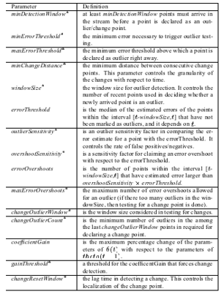
Table Row Extraction
The presence of line demarcation
From first word to end word in block
Adapted by Marmot dataset

Slide 22
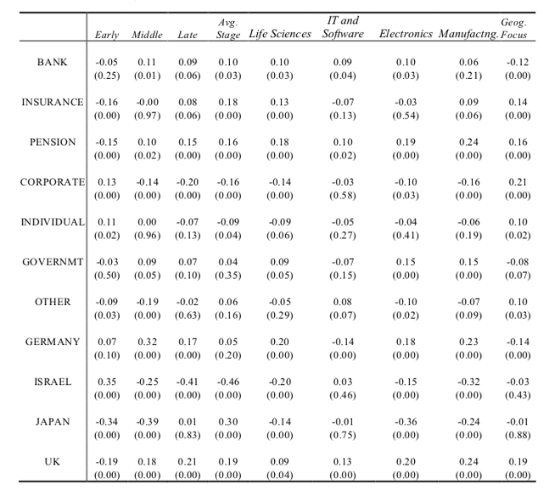
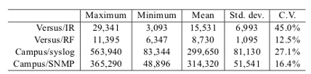
Table Row Extraction
The absence of line demarcation
To decide new row if all values in all columns are filled
To decide separate row if all values in all columns are filled
Adapted by Marmot dataset
Adapted by Marmot dataset

Slide 23
Outline
Abstract
Introduction
TableNet: Deep model for table and column detection
Table row extraction
Dataset preparation
Experiments and result
Conclusion

Slide 24
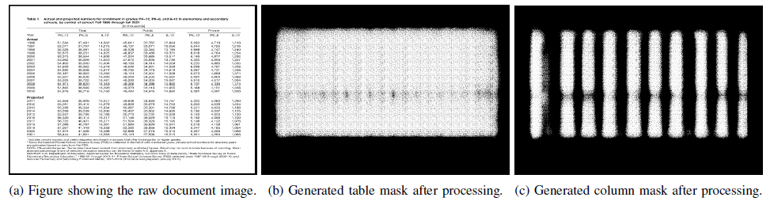
Dataset preparation
To use Marmot table recognition dataset for training
To add annotation to Marmot dataset
Providing Semantic Information
To preprocess table image by histogram equalization
After then, to extract word blocks
To make binary mask image by TableNet

Slide 25
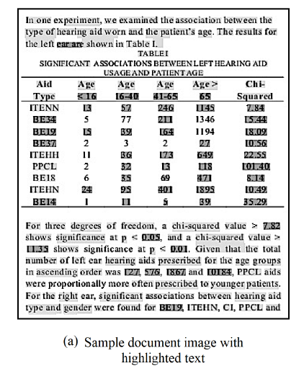
Dataset preparation
Training Data Preparation for TableNet
To make word patches with color coded
To get all word patches by tesseract OCR
Regular expression to determine data type
Each data type has unique color and shaded as the same color

Slide 26
Outline
Abstract
Introduction
TableNet: Deep model for table and column detection
Table row extraction
Dataset preparation
Experiments and result
Conclusion

Slide 27
Experiments and result
Dataset
Marmot table detection data + Manual fixed (Annotation)
Total 1,016 documents (Chinese and English)
Environment
Tensorflow
Intel® Xeon® Silver CPU 6 GB (32 Cores)
RAM 128 GB
Tesla V100-PCIE-1 GPU (6 GB GPU)

Slide 28
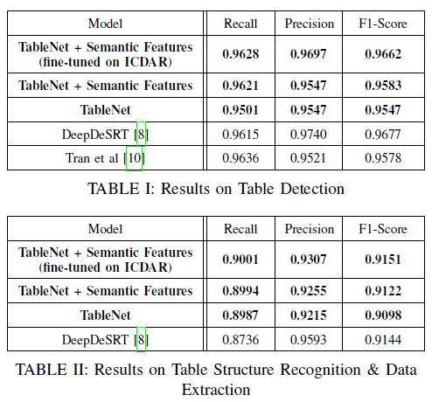
Experiments and result
Experiment 1
Training all positive sample of Marmot, Test on the ICDAR 2013 table competition dataset
Initial phase : The table branch – computed twice, the column branch – computed once (2:1)
After around 500 iterations, loss of both are comparable, training scheme is modified (1:1)

Slide 29
Experiments and result
Experiment 2
Enhanced marmot dataset (Colored with word patches)
Slight improvement

Slide 30
Experiments and result
Experiment 3
Both : Fine-tuned on ICDAR
The result of TableNet are not conclusively better than DeepDSert
Expectation of further improvement because of end-to-end model

Slide 31
Outline
Abstract
Introduction
TableNet: Deep model for table and column detection
Table row extraction
Dataset preparation
Experiments and result
Conclusion

Slide 32
Conclusion
A novel deep learning model trained on dual tasks of table detection and structure recognition in an end-to-end fashion
The first model to jointly address both tasks simultaneously, by exploiting the inherent interdependence between table detection and table structure identification

