Slide 1
MDPI
Features Recognition form P&ID
In Image Format Using a
Deep Learning Network
Eun-Seop Yu, Jae-Min Cha, Taekyong Lee, Jinil Kim, Duhwan Mun
CHANGWON NATIONAL UNIVERSITY

Slide 2
Introduction
Piping and Instrumentation diagram(P&ID) is a key drawing
Includes detailed schematic of each plant process flow and working fluid
P&ID provides the basic design and serves as a basic resource for detail design
Power plant, Ship building, Construction

Slide 3
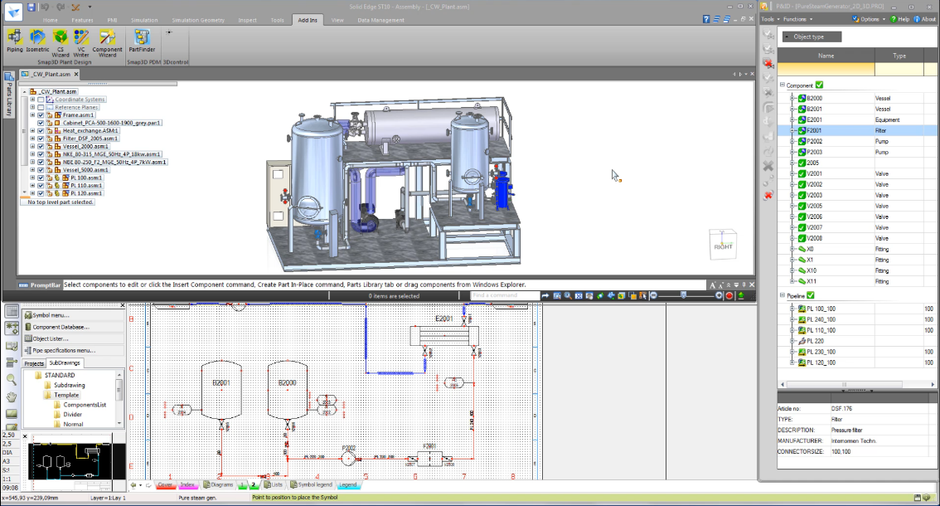
Introduction
Digital P&ID
All objects are made amenable to computerized data
Digital P&ID can be linked to the project database including 3D design models.
Assigned tag ID to each symbol which is mapped with 3D model by networking
https://solidedge.siemens.com/ko/solutions/products/3d-design/modular-plant-design/

Slide 4
Introduction
However, plant operators use and archive them as image file of P&ID
When rebuild old plant, image P&ID cannot be fixed by using drawing tool
To overcome this issue, P&ID converted from an image to digital format
Currently, the P&ID process is mostly manual
Time-consuming and error-prone
P&ID digitization
A method to recognize and extract object from P&ID should be developed

Slide 5
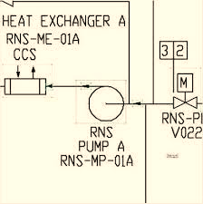
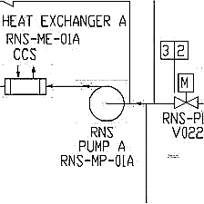
Related works
Diagram recognition using traditional image recognition method
Their faced limitations when conducting robust recognition of various types of objects contained in analog diagrams(text, symbol, line, etc.)
Input image
Edge detection
Feature extraction
Hough transform
Difference of Gaussian(D. G. Lowe et al. (2004))
Morphological operation
Hierarchical Gaussianization(Zhou et al. (2009))
…
Local Binary Pattern(Tan et al. (2016))
…

Slide 6
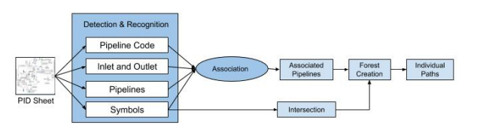
Related works
Recently, advanced research on recognizing complex P&IDs has been conducted
Tesseract OCR engine(text recognition)
Deep Neural Network for image classification(symbol recognition)
CNN based symbol recognition
Fu et al., 2011
Rahul et al., 2019
Above studies are not consider diagram preprocessing and line and object relation
Rahul, et al., Automatic Information Extraction from Piping and Instrumentation Diagrams,2019

Slide 7
Contribution
Propose the method of recognize not only symbol and line but also text
Improve the diagram recognition efficiency by providing a preprocessing stage
Also propose the training data structure for P&ID recognition

Slide 8
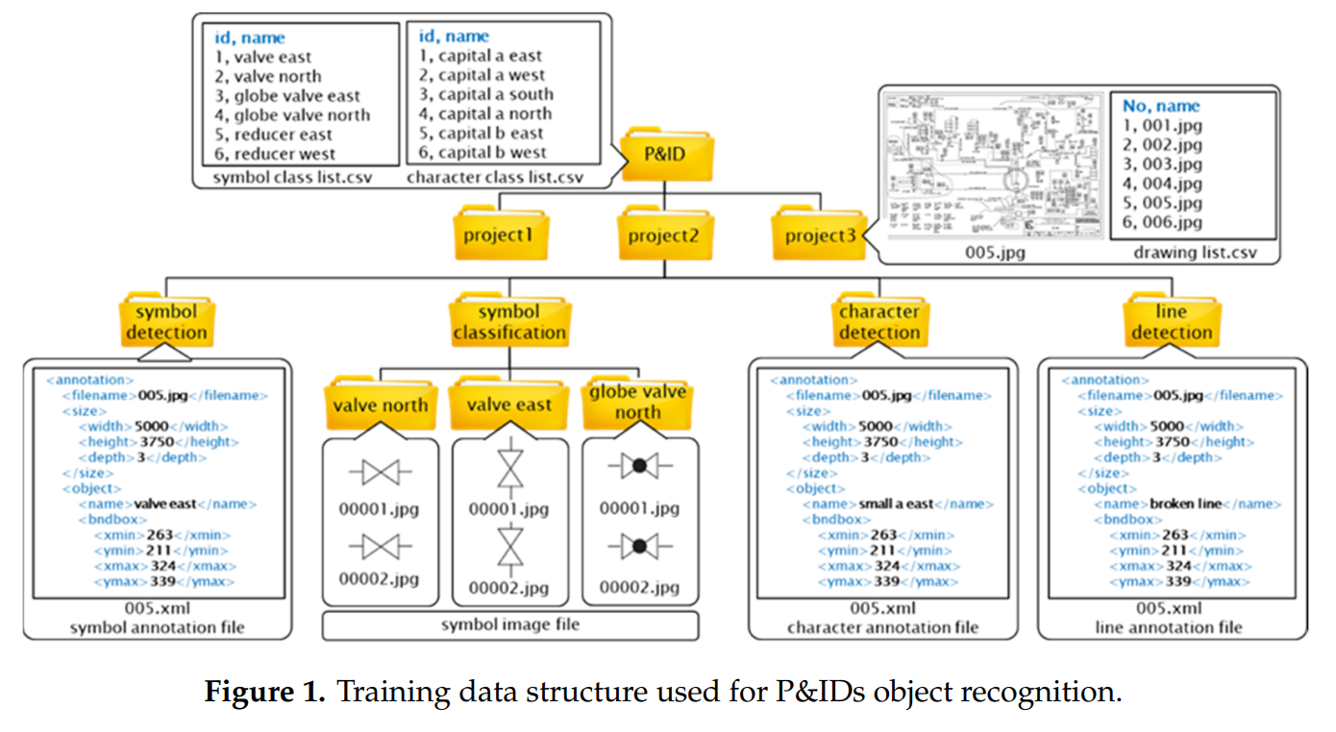
Training Data Definition
Define symbol, texts, lines and tables as the object to be recognized
Symbol: Class, bounding box(top-left coordinate), direction
Text: Bounding box, direction
Line: Class, start point, end point, line, shape of edge, flow direction

Slide 9
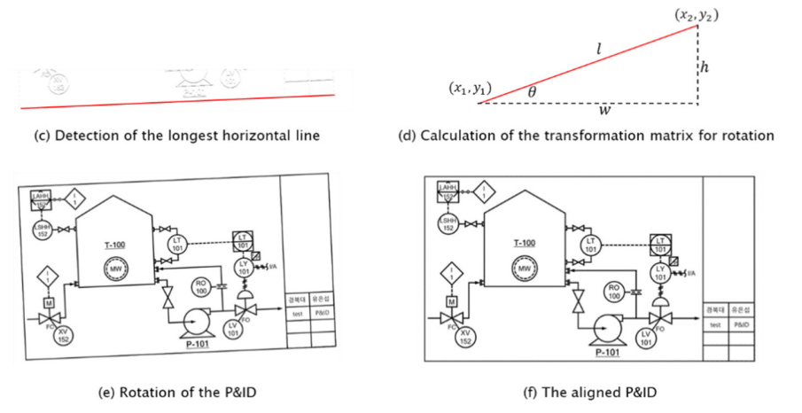
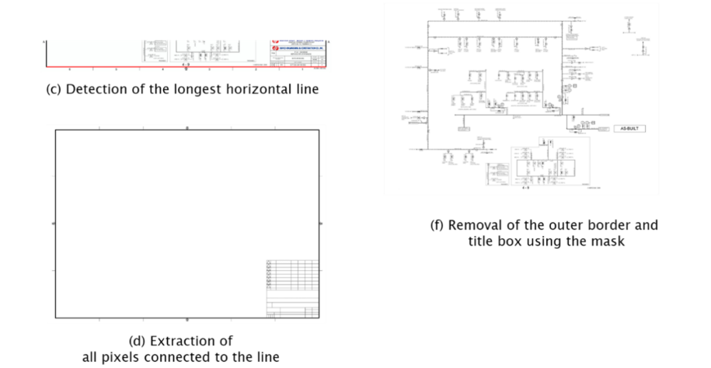
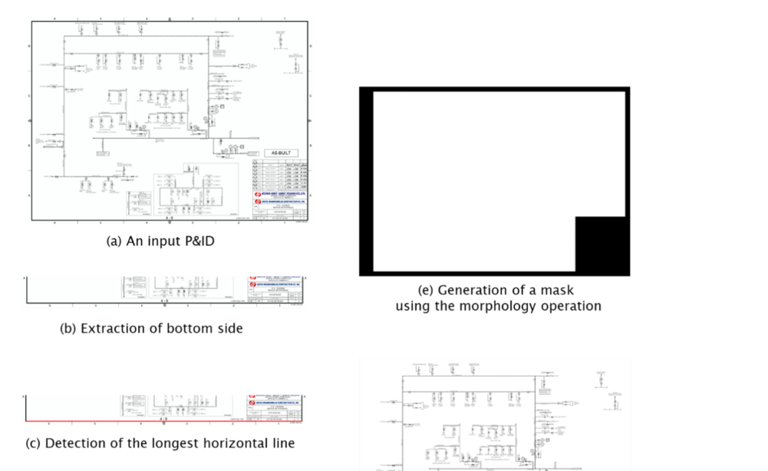
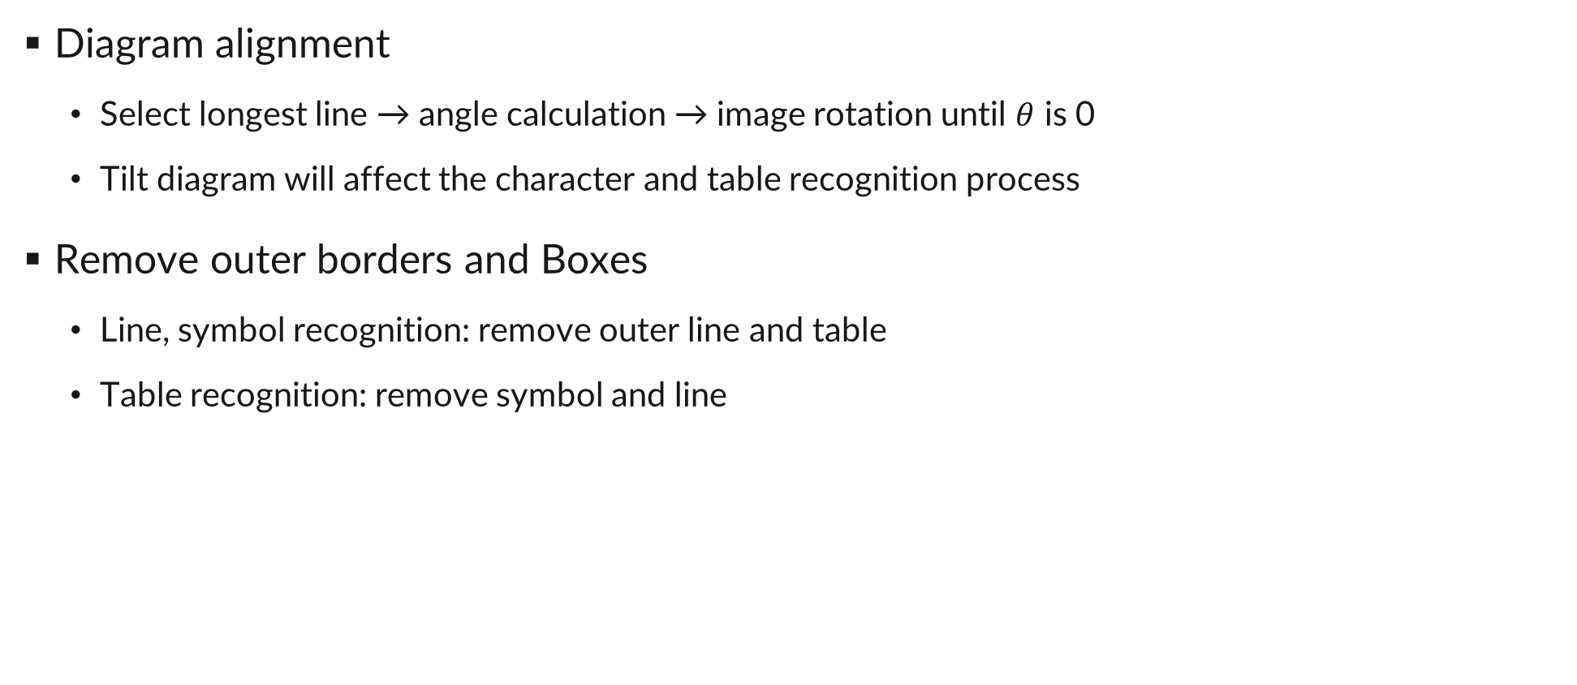
Preprocessing
Diagram alignment
Select longest line → angle calculation → image rotation until $θ$ is 0
Tilt diagram will affect the character and table recognition process
Remove outer borders and Boxes
Line, symbol recognition: remove outer line and table
Table recognition: remove symbol and line

Slide 10
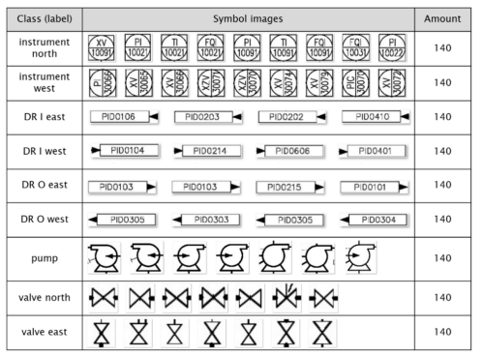
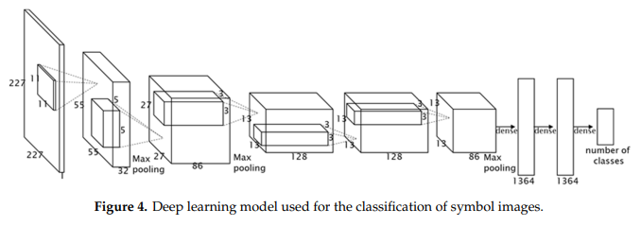
Symbol Detection
Define DNN model for symbol image classification based on AlexNet
Due to limitation of data volume, model cannot be deeper(hazard of overfitting)
In this study, model classify 4 type of symbol + 5 direction
Pump, instrument, valve, diagram reference(DR)
Input 227x227 area
where most likely to
symbol exist

Slide 11
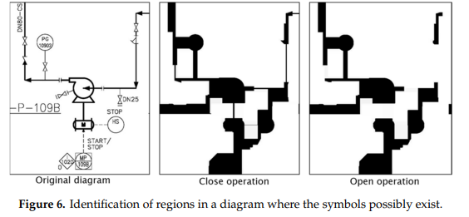
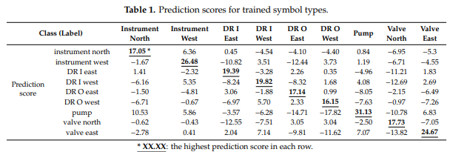
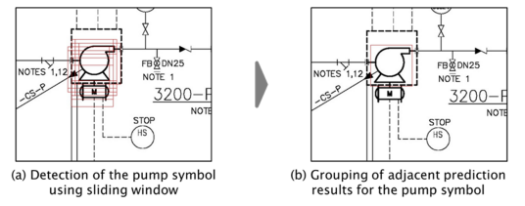
Symbol Detection
Overcome sliding window overhead
P&ID resolution: 5000x3000
Scan by selecting area where symbols are most likely to exist
Closing(dilation →erosion) → Opening(erosion→dilation)
Classification performance
Filling symbol
Remove pipe

Slide 12
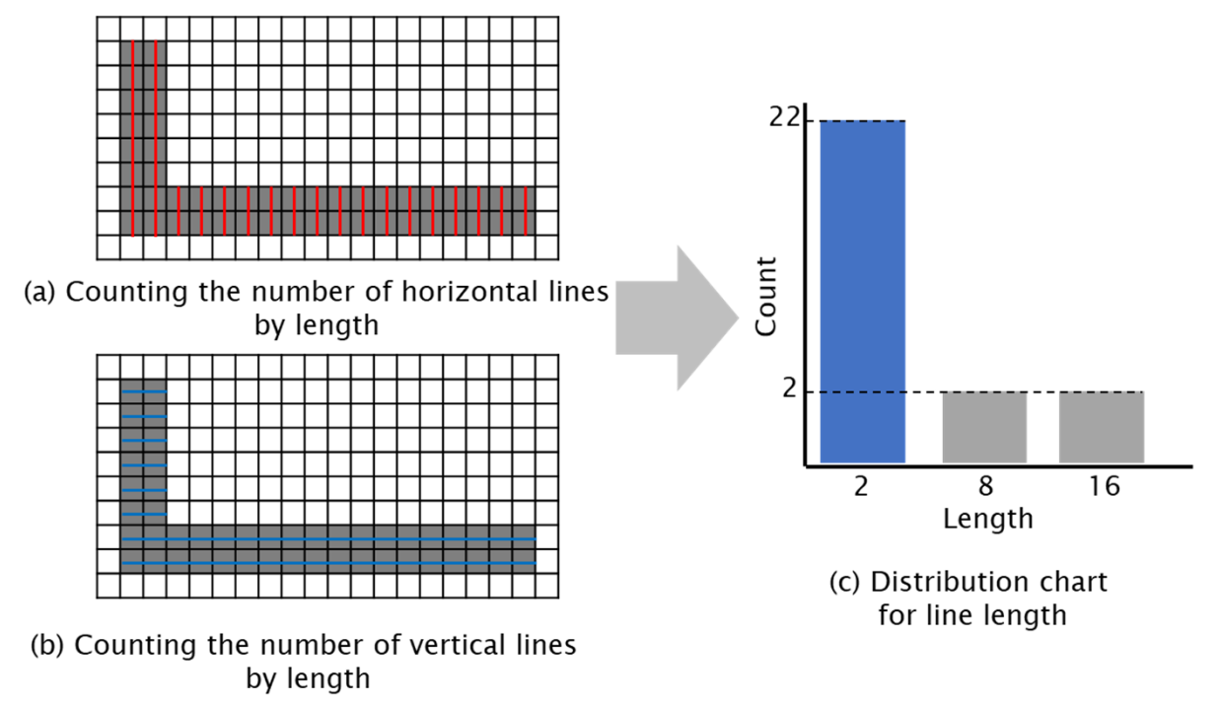
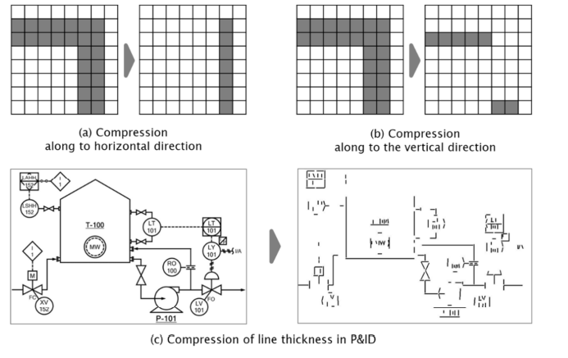
Text & Line Detection
Using CPTN(Connection Text Proposal Network) to find the character position
Line objects are divided continuously and dotted lines by type
Also divided horizontal and vertical by orientation
For line detection training, the continuous line type and H/V line were chosen
Determine line thickness
Compress one pixel
Extract Length and coordiante
Merge seperated line object
Count continuous black pixel
0
n
8
0
n
8
2
2
2
2
2
2
2
2
2
2
2
2
2
2
2
2
0
n
Line detection result
if Gap < 3*thickness(2):
merge
Start = 0
end = n
while x of current pixel < end
If next pixel is black:
change current pixel to white
current pixel += 1
end while
2
0
n
2
2
2
line object | start, end
vertical | (6,1), (6,n)
horizon | (0,3), (5,3)
horizon | (5,n), (6,n)
2
n
2
16
16
n

Slide 13
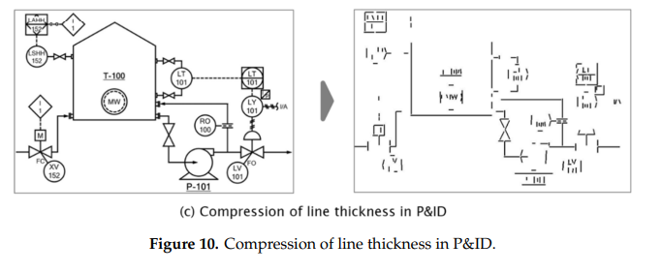
Text & Line Detection
Line detection result
Several lines pertaining to the symbol object were recognized line object
Detection accuracy can be improved by removing symbol area

Slide 14
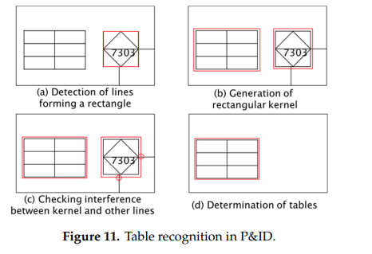
Table Detection
Some P&ID contain tables listing details of equipment included in the diagram
Identify the line combinations that form a table
Check the connection of horizontal line and vertical line
Detect rectangular
Generate rectangular kernel with the identified line
Check if the kernel is connected to other element
If not, that kernel defined as a table

Slide 15
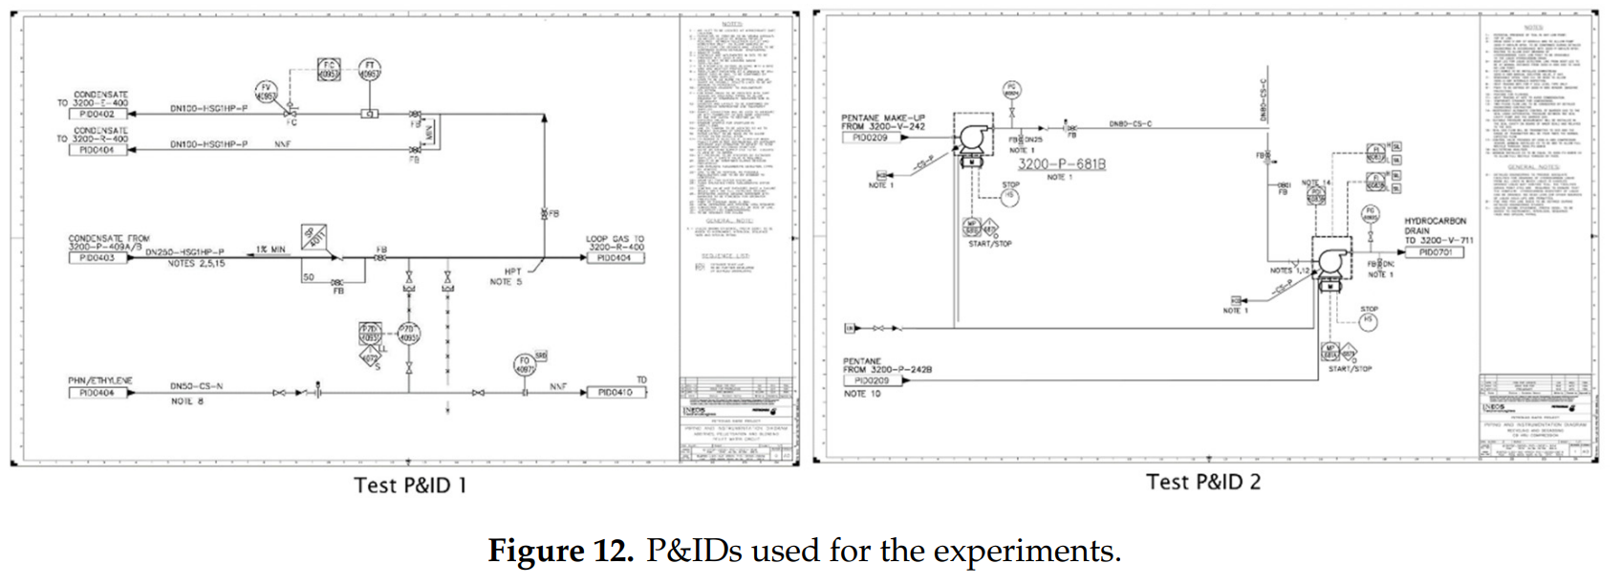
Evaluation
Two test P&IDs are prepared
P&ID provided by ‘S’ engineering
Resolution: 1460x840, 1360x780
Sliding window size for symbol recognition
Instrument: 70x70
Diagram reference: 40x200
Pump: 120x120
Valve: 25x40
IOU* threshold : 0.8
CPU | AMD Ryzen7 2700x
Memory | 64GB
GPU | NVidia GeForce RTX 2080Ti
OS | Window10
Language | Python3.7
Framework | TensorFlow 1.1.4.0
* Intersection Over Union.
Degree of overlap, IOU = 1; fully overlapped

Slide 16
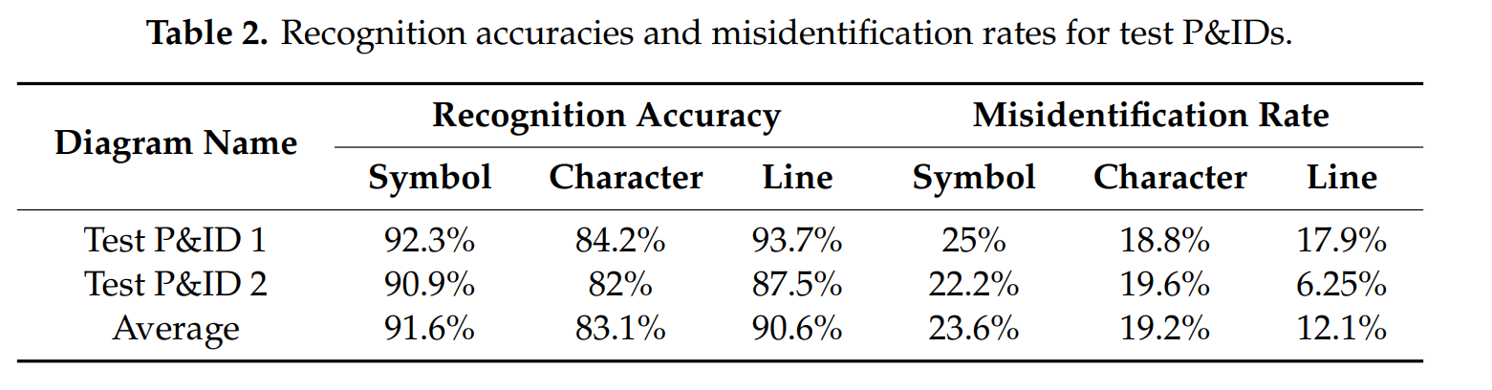
Evaluation
Symbol recognition model training time: 12 min
Preprocessing stage execution time: less than 1 min
Average recognition time
Symbol recognition time: 36.5 min
Text recognition time: 5.53 sec
Line detection time: 3.25 sec
Accuracy

Slide 17
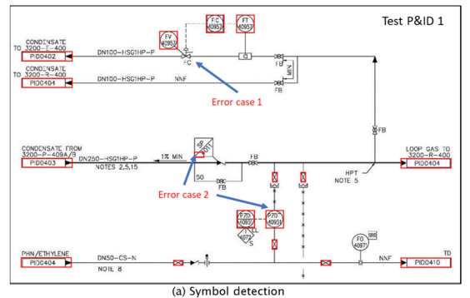
Evaluation
Error case(symbol recognition)
Symbol recognition result revealed that specific type were identified as incorrect type(case 2)
This problem can be solved by increasing recognition type and training data

Slide 18
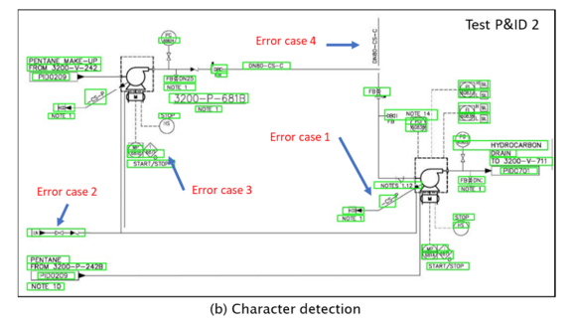
Evaluation
Error case(character detection)

Slide 19
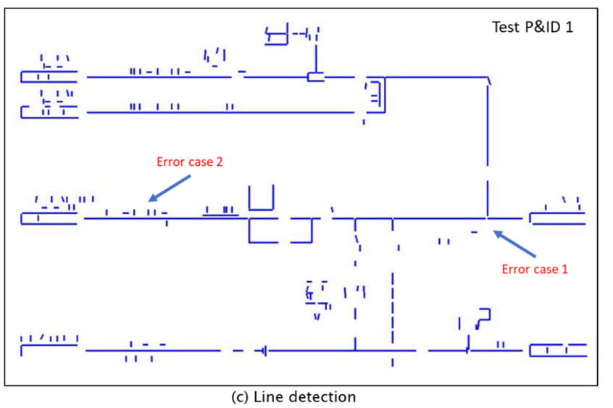
Evaluation
Error case(Line detection)

Slide 20
Conclusion
This paper proposed a method to detect and extract object in image P&ID
Symbol, Text, Line, Table
The method consist of the preprocessing and recognition stage
For symbol recognition, deep learning model is defined based on AlexNet
Also employed the CPTN model for text recognition
Table also can be detected by traditional image processing techniques
This study expected to contributes to the digitization of tons of paper-based P&ID in energy industry

