Slide 1
OSDI'04
MapReduce: Simplified Data Processing on Large Clusters
Jeffrey Dean, Sanjay Ghemawat
CHANGWON NATIONAL UNIVERSITY

Slide 2
Introduction
Process large amounts of raw data
Crawled documents, web request logs, etc.
Input data is usually large
The computations have to be distributed across thousands of machines to finish in a reasonable amount of time

Slide 3
Introduction
A new abstraction
Express the simple computation but hides the messy details
Parallelization, fault-tolerance, data distribution, load balancing
Inspired by map and reduce present in functional languages
Map
Applying to each logical "record" in order to compute a set of intermediate key/value paires
Reduce
Applying to all the values that shared same key, inorder to combine the derived data appropriately

Slide 4
Programming Model
Computation
Input: A set of input key/value pairs
Output: A set of output key/value pairs
split 1
I 1
Input key/value
pairs
Output
Key/value
pairs
split 2
I 2
split N
I N

Slide 5
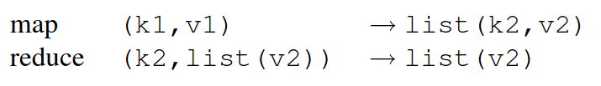
Programming Model
Map
Input: an input key/value pair
Output: a set of intermediate key/value pairs
The MapReduce library groups together all intermediate values associated with the same intermediate key I and passes them to the Reduce function
split 1
I 1
Input key/value
pairs
Output
Key/value
pairs
split 2
I 2
split N
I N

Slide 6
Programming Model
Reduce
Input: an intermediate key I & a set of values for that key
Merges together these values to form a possibly smaller set of values
Only zero or one output value is produced per Reduce invocation
split 1
I 1
Input key/value
pairs
Output
Key/value
pairs
split 2
I 2
split N
I N

Slide 7
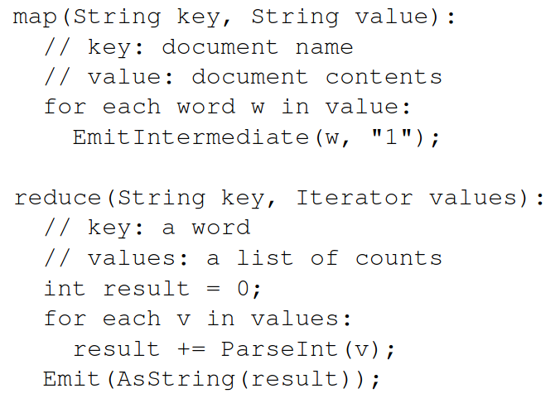
Programming Model
Examples
Counting the number of occurences of each word in a large collection of documents
각 단어에 대해 1로 세팅
값을 더해서 map의 결과를 합친 결과를 생성

Slide 8
Implementation
Implementation targeted to the computing environment in wide use at Google
Large clusters of commodity PCs connected together with switched Ethernet
Machines | Dual-processor x86 processors Linux 2-4GB of memory per machine
Network | 100 megabits/sec or 1 gigabit/sec at the machine level
Cluster | 100s or 1000s of machines
Storage | Inexpensive IDE disks distributed file system
User jobs | Each job consists of a set of tasks Mapped bythe scheduler to a set of available machines within a cluster

Slide 9
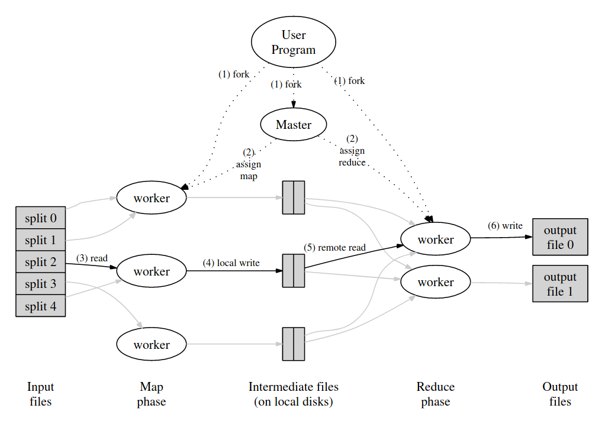
Implementation
Execution overview

Slide 10
Implementation
Master data structures
The master keeps several data structures
The state(idle, in-progress, completed), the identity of the worker machine for each map task and reduce task
The locations and sizes of the R intermediate file regions for each completed map task

Slide 11
Implementation
Worker failure
The master pings every worker periodically
If no response is received from a worker in a certain amount of time, the master marks the worker as failed
Any task in progress on a failed worker is also reset to idle and becomes eligible for rescheduling
Completed map tasks are re-executed on a failure because their output is stored on the failed machine
Completed reduce tasks do not need to be re-executed since their output is stored in a global file system
Master failure
Periodic checkpoints of the master data structures

Slide 12
Implementation
Locality
MapReduce master takes the location information of the input files
Master attempts to schedule a map task on a machine that contains a replica of the input data
Task granularity
Subdivide the map phase into M pieces and reduce phase into R pieces

Slide 13
Implementation
Backup tasks
"Straggler": a machine that takes an unusually long time to complete on of the last few map or reduce tasks in the computation
When a MapReduce operation is close to completion, the master schedules backup executions of the remaining in-progress tasks

Slide 14
Refinements
Partitioning function
The users specify the number of reduce tasks/output files that they desire (R)
A default partitioning function if provided that uses hashing (e.g. "hash(key) mod R")
Ordering guarantees
The intermediate key/value pairs are processed in increasing key order
Combiner function
Partial merging of the intermediate data before it is sent over the network

Slide 15
Refinements
Input and output types
The MapReduce library provides support for reading input data in several different formats
"text": treats each line as a key/value pair
Knows how to split itself into meaningful ranges for processing as separate map tasks
Users can add support for a new input type by providing an implementation of a simple reader interface

Slide 16
Refinements
Side-effects
Convenient to produce auxiliary files as additional outputs from their map and/or reduce operators
Skipping bad records
Local execution
Sequentially executes all of the work for a MapReduce operation on the local machine to help facilitate debugging, profiling, and small-scale testing

Slide 17
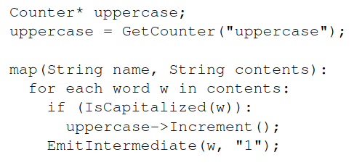
Refinements
Status Information
The master runs an internal HTTP server and exports a set of status pages for human consumption
Counters
Provide a counter facility to count occurrences of various events

Slide 18
Performance
Cluster configuration
A cluster that consisted of approximately 1800 machines
Two 2GHz Intel Xeon processors with Hyper-Threading enabled
4GB memory
Two 160GB IDE disks
Gigabit Ethernet link
Two-level tree-shaped switched network

Slide 19
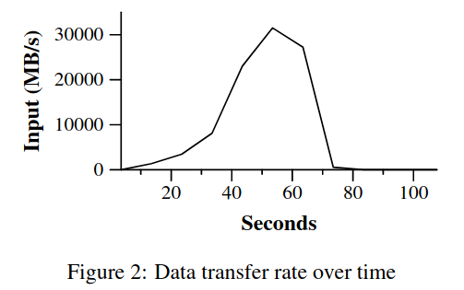
Performance
Grep
The grep program scans through 10^10 100-byte records, searching for a relatively rare three-character pattern
As the map tasks finish, the rate start dropping and hits zero about 80 seconds
The entire computation takes approximately 150 seconds which includes startup overhead
The overhead is due to the propagation of the program to all worker machines

Slide 20
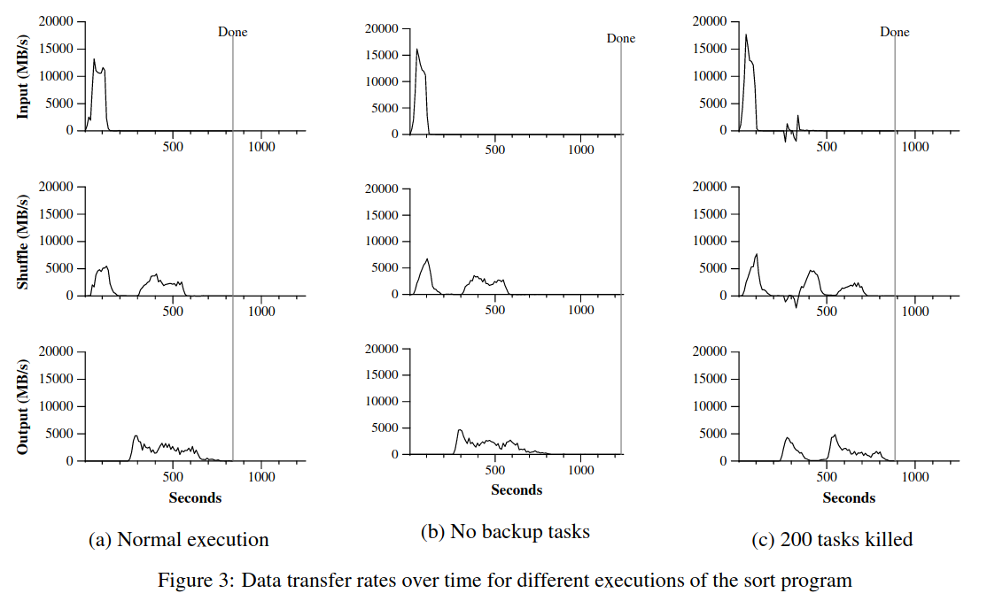
Performance
Sort
The sort program sorts 10^10 100-byte records
TeraSort benchmark

Slide 21
Performance
Effect of backup tasks
Very long tail where hardly any write activity occurs

Slide 22
Performance
Machine failures
The worker deaths show up as a negative input rate
The entire computation time increases just 5% over the normal execution time

Slide 23
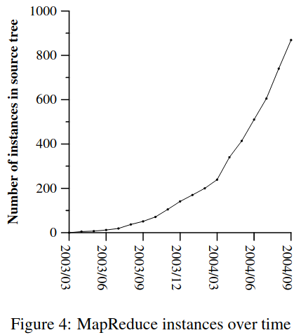
Experience
It has been used across a wide range of domains within Google
Large-scale machine learning problems
Clustering problems for the Google News and Froogle products
Extraction of data used to produce reports of popular queries
Extraction of properties of web pages for new experiments and products
Large-scale graph computations

Slide 24
Conclusions
The MapReduce programming model has been successfully used at Google
The reasons for this success
The model is easy to use
A large variety of problems are easily expressible as MapReduce computations
Developed an implementation of MapReduce that scales to large clusters
Learned several things from this work
Restricting the programming model makes it easy to parallelize and distribute computations
Network bandwidth is a scarce resource
Redundant execution can be used to reduce the impact of slow machines, and to handle failures

