Slide 1



XRP: In-Kernel Storage Functions with eBPF
Yuhong Zhong¹, Haoyu Li¹, Yu Jian Wu¹, Ioannis Zarkadas¹, Jeffrey Tao¹, Evan Mesterhazy¹, Michael Makris¹, Junfeng Yang¹ Amy Tai², Ryan Stutsman³, and Asaf Cidon¹
1
2
3
1

Slide 2
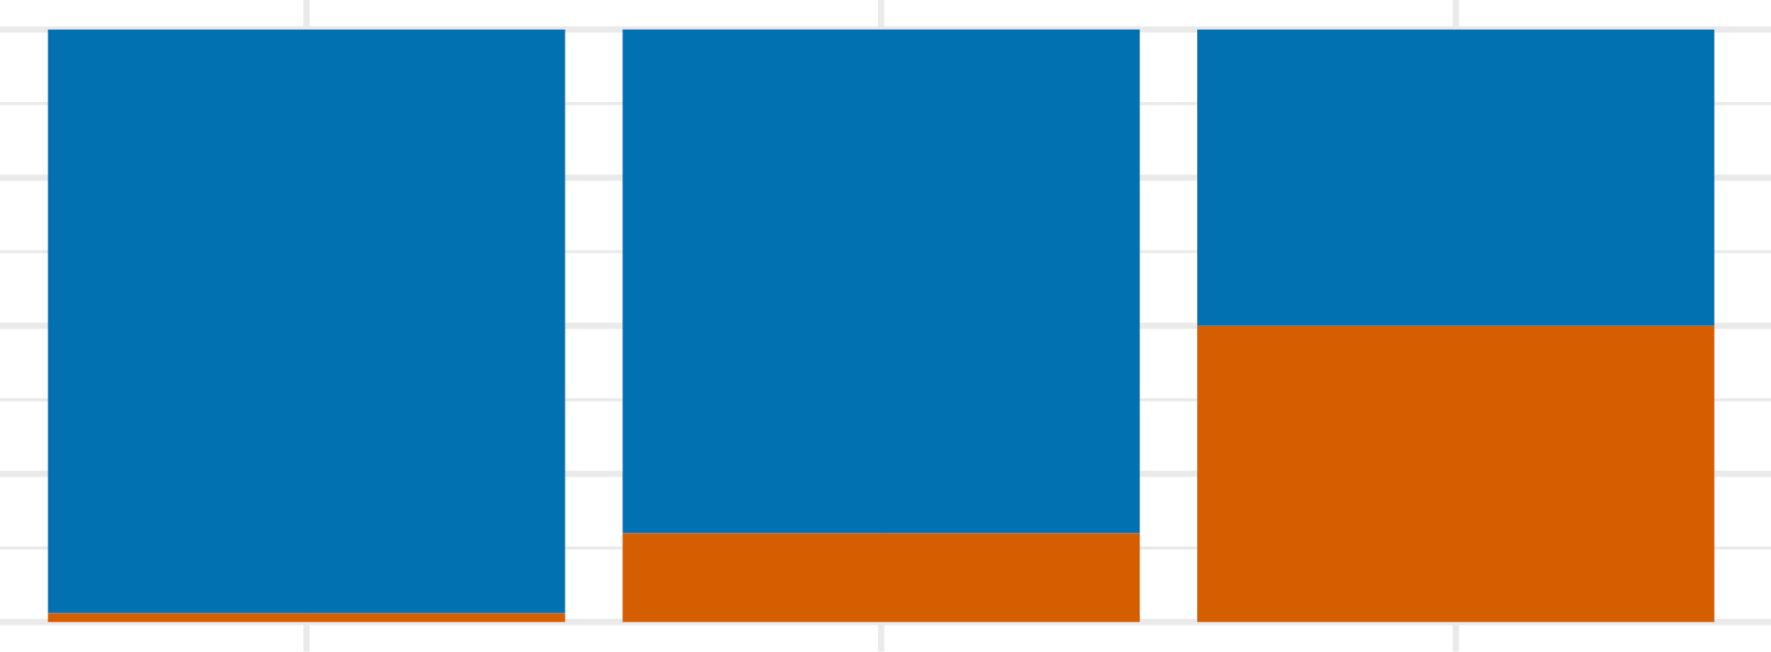


Kernel Software is Becoming the Bottleneck for Storage
Kernel software overhead accounts for ~50% of read latency on
Optane SSD Gen 2 (P6800X)
Average Read Latency Breakdown
100%
75%
50%
Hardware
Kernel Software
25%
~50%
0%
NAND SSD
Optane SSD (Gen 1)
Optane SSD (Gen 2)
Kernel software overhead accounts for ~50% of read latency on Optane SSD Gen 2
Workload: Random 512B Read
2

Slide 3
Where Does the Latency Come From?
User Space Application Read Request _{Kernel}
Syscall Layer ^{Boundary} Read Request
File System and Block Layer Read Request
NVMe Driver Read Request
Storage Device Read Response
0.4 μs
0.2 μs
(5.6%)
(3.2%)
Kernel Software (48.6%)
2.4 μs (38.0%)
0.1 μs
(1.8%)
Hardware
3.2 μs (51.4%)
Workload: Random 512B Read, Disk: Optane SSD P5800X
3

Slide 4
Bypass Kernel to Eliminate Overhead
In industry, the most common library is SPDK
Academic Work
Demikernel (SOSP ’21),
Shenango (NSDI ’19),
Snap (SOSP ’19),
IX (SOSP ’17),
Arrakis (OSDI ’14),
mTCP (NSDI ’14)
…
User Space Application Kernel
Syscall Layer ^{Boundary}
File System and Block Layer
NVMe Driver
Storage Device (Managed by User Space, Interrupt Disabled)
0.4 μs
0.2 μs
(5.6%)
(3.2%)
Kernel Bypass
Reduce read latency by 49%
2.4 μs (38.0%)
0.1 μs
(1.8%)
3.2 μs (51.4%)

Slide 5


Kernel Bypass is Not a Panacea
User Space Application Kernel
Syscall Layer ^{Boundary}
File System and Block Layer
NVMe Driver
Storage Device (Managed by User Space, Interrupt Disabled)
Does not incur the overhead of the
✅
kernel storage stack
❌ No fine-grained access control
❌ Requires busy polling for completion
Kernel Bypass
Processes cannot yield CPU when waiting for I/O
❌
❌ CPU cycles are wasted when I/O utilization is low
❌ CPU cannot be shared efficiently among multiple processes

Slide 6
Move Application Logic Into the Kernel
User Space Application Custom Function _{Kernel}
Syscall Layer ^{Boundary}
File System and Block Layer
_{NVMe Driver} Submit read requests Process read responses Read Request
Storage Device Read Response
0.4 μs
0.2 μs
(5.6%)
(3.2%)
Potentially reduce read latency by up to 47%
Kernel Software (48.6%)
2.4 μs (38.0%)
0.1 μs
(1.8%)
3.2 μs (51.4%)

Slide 7
B+ Tree Index Lookup from User Space
Node parsing and I/O request submission are performed in user space
User Space
Parse Node
Parse Node
Fetch Root Node
Parse Node
Kernel Boundary (5.6%)
Syscall Layer
3.2%
Traverse the full
File System and Block Layer
Fetch
Fetch
kernel software stack multiple times
Next Node
Next Node
38.0%
NVMe Driver
1.8%
Storage Device
51.4%

Slide 8
B+ Tree Index Lookup With an In-Kernel Function
A Chain of Dependent Read Requests:
User Space
Kernel Boundary (5.6%)
Syscall Layer
3.2%
Only traverse
Fetch
Return
File System and Block Layer
Root Node
Leaf Node
the full kernel software stack once
38.0%
NVMe Driver
Parse Node
Custom Function
1.8%
Storage Device
Reduce the latency of the intermediate I/O by up to 47%
51.4%

Slide 9
Chains of Dependent Read Requests are Common
Both B-Tree and LSM-Tree issue dependent read requests to perform lookups
Goal: Build a framework for storage engines to accelerate dependent read requests using in-kernel functions

Slide 10
XRP: A Framework for In-Kernel Storage Functions
eXpress Resubmission Path
XRP can accelerate many types of operations such as index lookups, range
Load a custom function into the kernel
Initiate a chain of read requests
queries, and aggregations
User Space
Kernel Boundary (5.6%)
Syscall Layer
3.2%
File System and Block Layer
Return final result
to user space
38.0%
NVMe Driver
Custom Function f
f() f() f()
1.8%
Storage Device
51.4%
Req 1
Req 2
Req 3

Slide 11


Using BPF to Offload Custom Functions Safely
How to ensure that user-defined
(BPF)
functions cannot compromise the kernel?
lets application offload simple functions to the Linux kernel safely
Load
a custom
Initiate a chain of read requests
User Space
function into the kernel
Kernel Boundary (5.6%)
Syscall Layer
BPF programs are statically checked before being loaded into the kernel
3.2%
File System and Block Layer
38.0%
NVMe Driver
Function f
f() f() f()
1.8%
Custom
Storage Device
May be buggy or malicious
51.4%

Slide 12

BPF is Widely Used in Networking
Packet Filtering
Packet Forwarding
A BPF program can operate on each packet independently
Packet Tracing
Network Scheduling
However, a storage BPF program needs to traverse a large on-disk data structure in a stateful way

Slide 13
Adopting BPF in Storage is Challenging
XRP is the first system that adopts BPF to reduce the kernel software overhead for storage
XRP enables the NVMe interrupt handler to resubmit I/Os
based on user-defined BPF functions
Key research challenges:
Address translation and security
- Need to translated file offset to physical block address
- NVMe driver has no access to file system metadata
Concurrency and caching
- Write issued from file system will only be reflect in the page cache,
which is not visible to XRP

Slide 14
Insights & Design Principles
Typically implemented on a small set of large files
Most on-disk data structures are stable
Files are updated orders of magnitude less frequently than they are read
One file at a time
Minimizes the metadata that is needed to be pushed down to NVMe driver
Stable data structures
User-managed caches
XRP cannot safely be run concurrently if blocks are buffered in page cache
Popular storage engines often implement their own user space cache
Slow path fallback

Slide 15
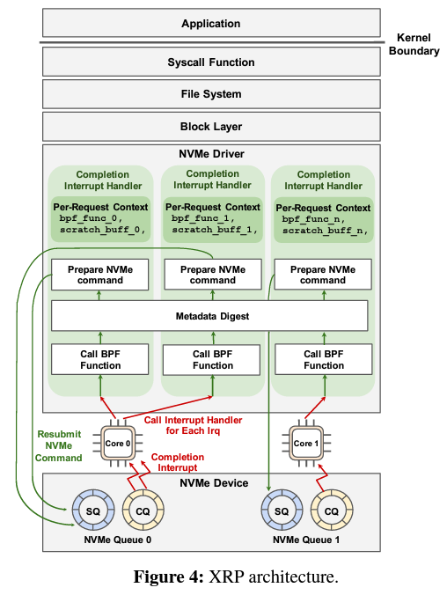
Resubmission Logic
For completed NVMe request, XRP calls its associated BPF function
XRP invokes the metadata digest
Digest of file system that enables translation of logical address of the next resubmission
XRP prepares the next NVMe cmd
resubmission by setting corresponding
fields in the NVMe request & submit
to SQ

Slide 16
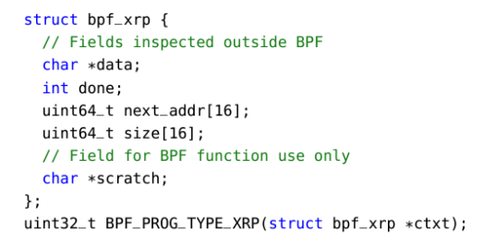
BPF Hook
data: buffers data read from disk
B-tree page waiting to be parsed by BPF function
Next_addr & size: arrays of logical addresses & sizes that indicate next logical address for resubmission
scratch: pass parameters form user / store intermediate data in between I/O resubmissions & return data to the user

Slide 17
Metadata Digest
Thin interface between file system and interrupt handler
Let the file system share its L2P block mappings
Update function: called within the file system when mapping is updated
Lookup function: called within the interrupt handler, returns the mapping for given offset & length
Also enforces access control
In ext4, extent status tree is cached and is accessed by the update & lookup function on the interface

Slide 18

XRP: In-Kernel Storage Functions with eBPF
BPF-KV
A simple B+ tree key-value store
XRP
Integrate
(LSM Tree)
A popular production key-value store

Slide 19
BPF Can Traverse Different Types of Data Structures
u32 btree_lookup(struct bpf_xrp *context) {
struct node *n = (struct node *) context->data; u64 search_key = *(u64 *) context->scratch;
if (node->type == LEAF) { context->done = true; return 0;
Data Buffer
Scratch Buffer
type
fanout
key[0]
key[1]
...
key[n]
addr[0]
...
addr[n]
search_key
(unused)
}
MAX_FANOUT ensures for loop is bounded
int i;
for (i = 1; i < MIN(n->fanout, MAX_FANOUT); ++i) { if (search_key < n->key[i]) break;
}
context->done = false;
context->next_addr[0] = n->addr[i - 1]; return 0;
(Data fetched from disk)
(Private scratch space)
}

Slide 20
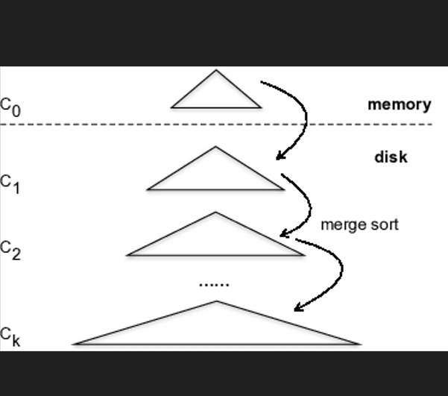
WiredTiger
Provides an option to use an LSM tree where
each level contains a single file
Each file uses a B-tree index with KV pairs
embedded in leaf nodes
Where buffer is full, the data is written out
in a new file
WiredTiger caches the entire lookup path including the leaf page
BPF function returns all traversed pages by storing traversed pages in scratch buffer

Slide 21
Evaluation
6-core i5-8500 3 GHz server with 16GB memory
Ubuntu 20.04, Linux 5.12.0 with Intel Optane 5800X prototype
All experiments use O_DIRECT
What is the performance benefit of XRP?
How does XRP scale to multiple threads?
Can XRP accelerate a production key-value store?

Slide 22
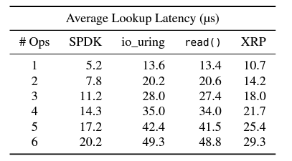
Overhead of Using BPF for Storage
XRP saves one or more storage layer traversals
XRP’s latency increases by about 3.5~3.9us, which is close to device’s latency
SPDK exhibits better latency than XRP, but need to use polling

Slide 23
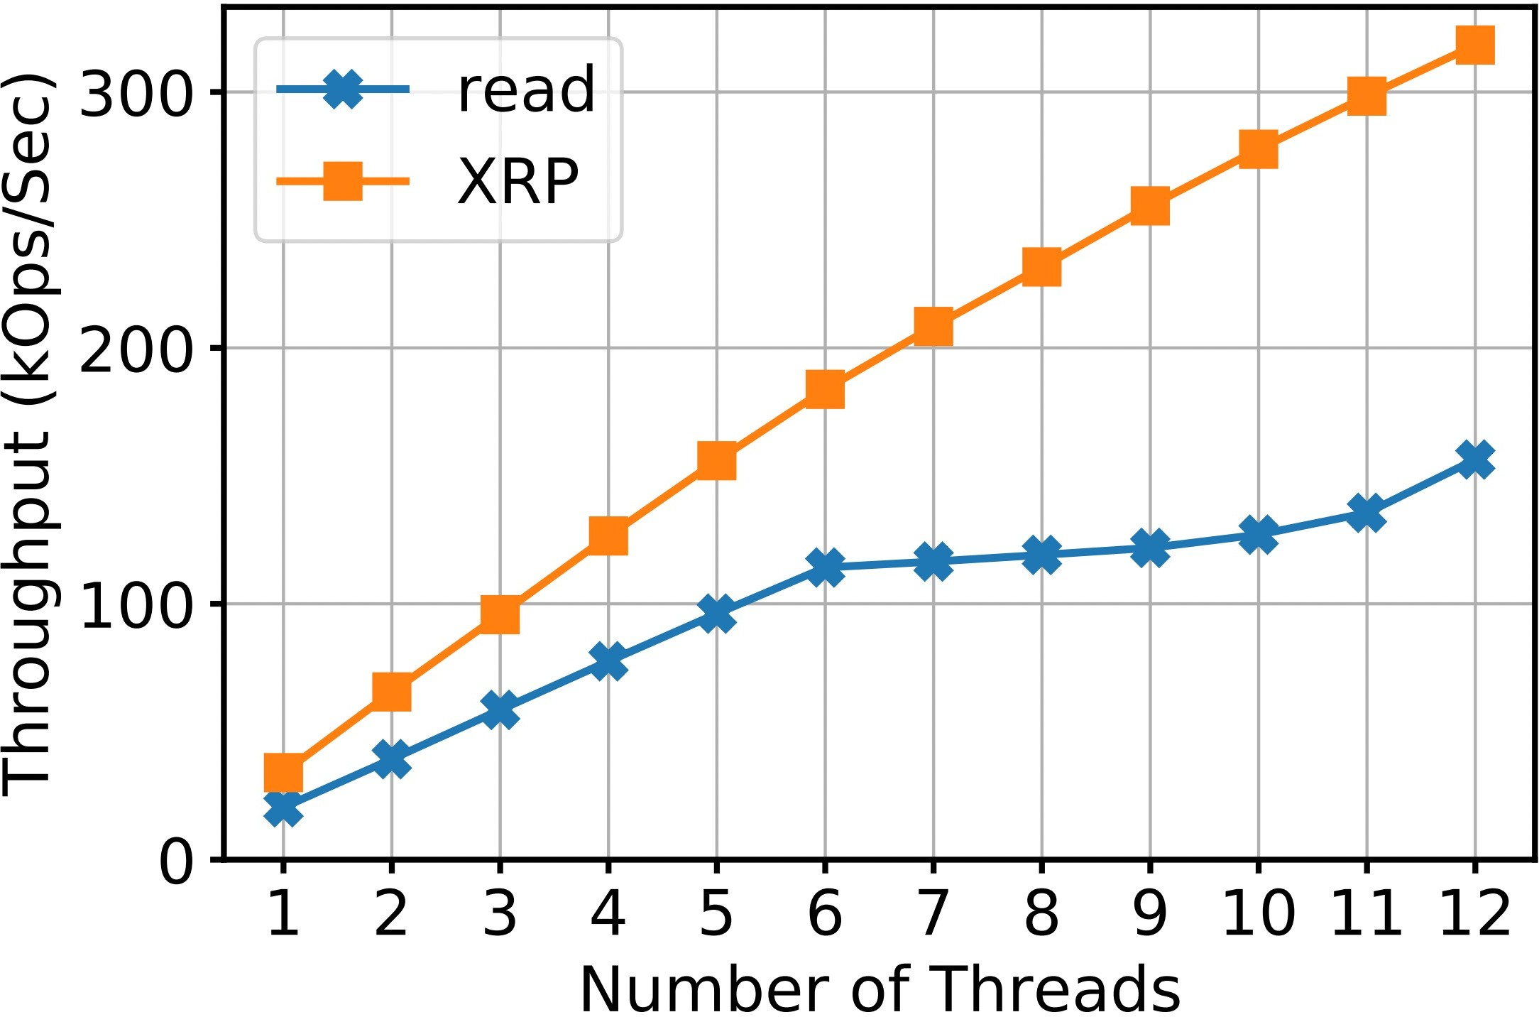


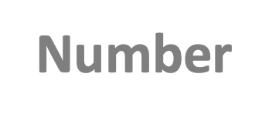


Kernel Software Overhead & Thread Scaling
Multi-threaded throughput in BPF-KV with uniform random 512B read
Throughput
XRP can scale well even if the # of threads exceeds the # of cores
This is because XRP alleviates the CPU contention by reducing the CPU overhead per IO request
Increase by up to 120%

Slide 24
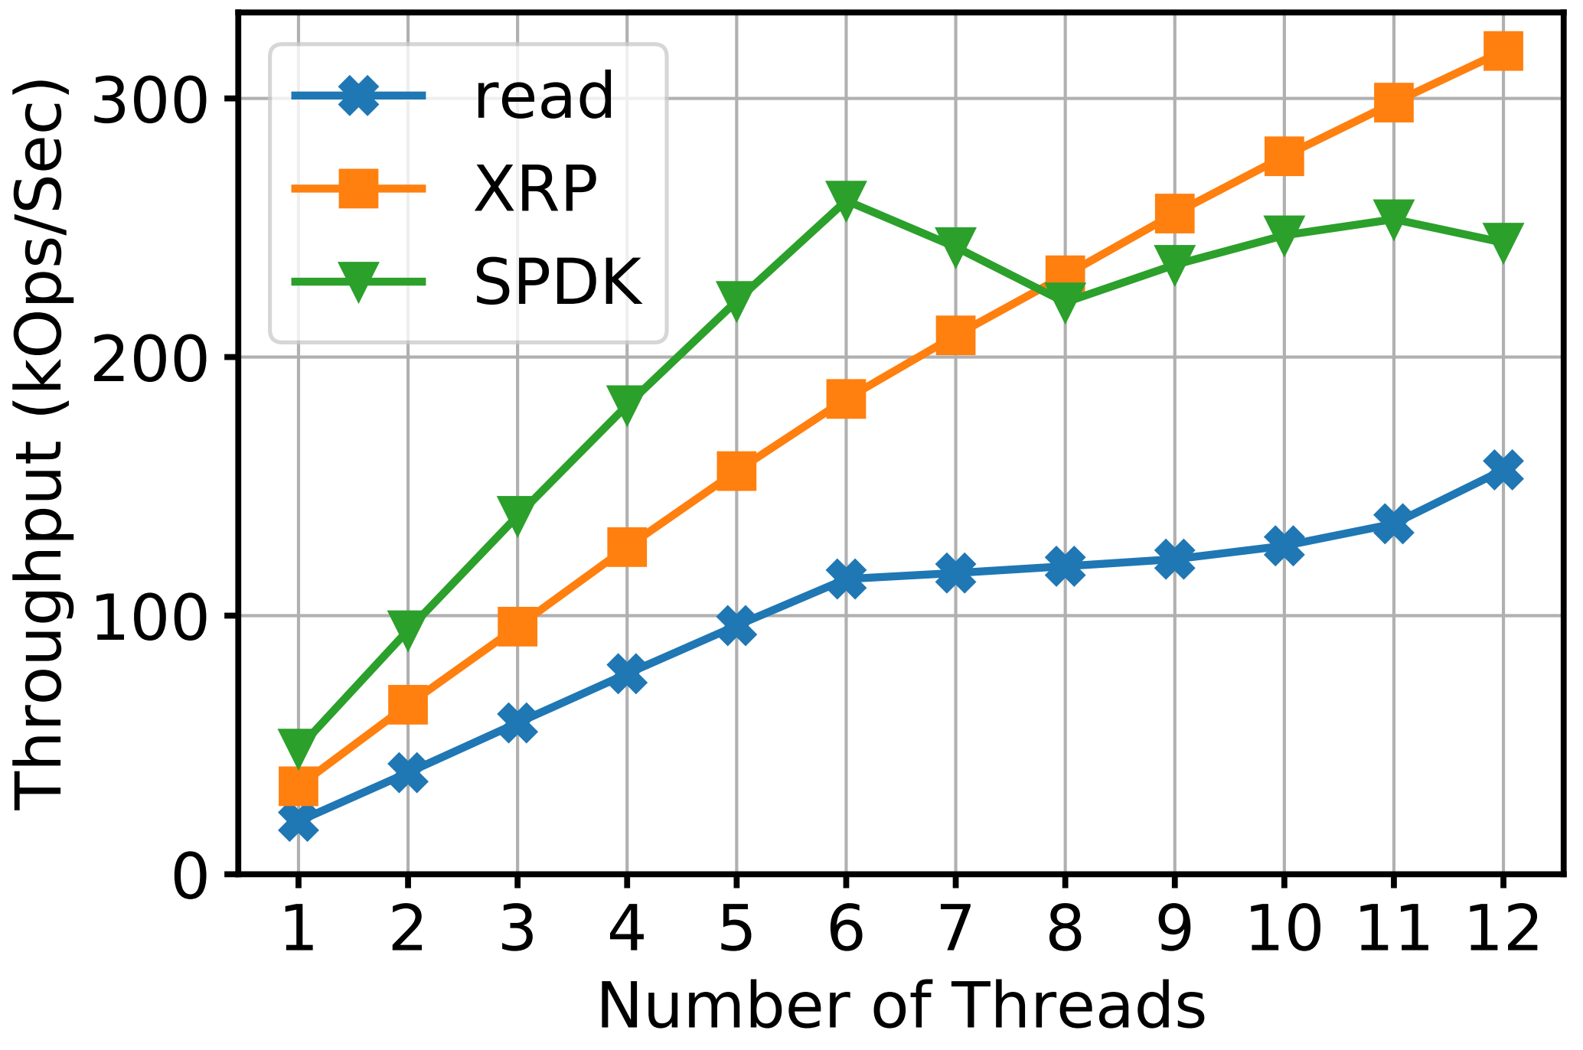
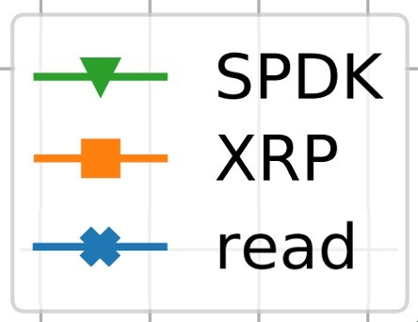

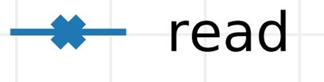
XRP vs. SPDK - Throughput
Multi-threaded throughput in BPF-KV with uniform random 512B read
Throughput
SPDK fails to scale beyond 6 threads because SPDK threads cannot yield CPU when waiting for I/O to complete
XRP provides performance that is close to/better than SPDK without sacrificing isolation and CPU efficiency
Each thread represents a different storage application on the same machine
18

Slide 25
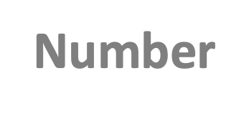

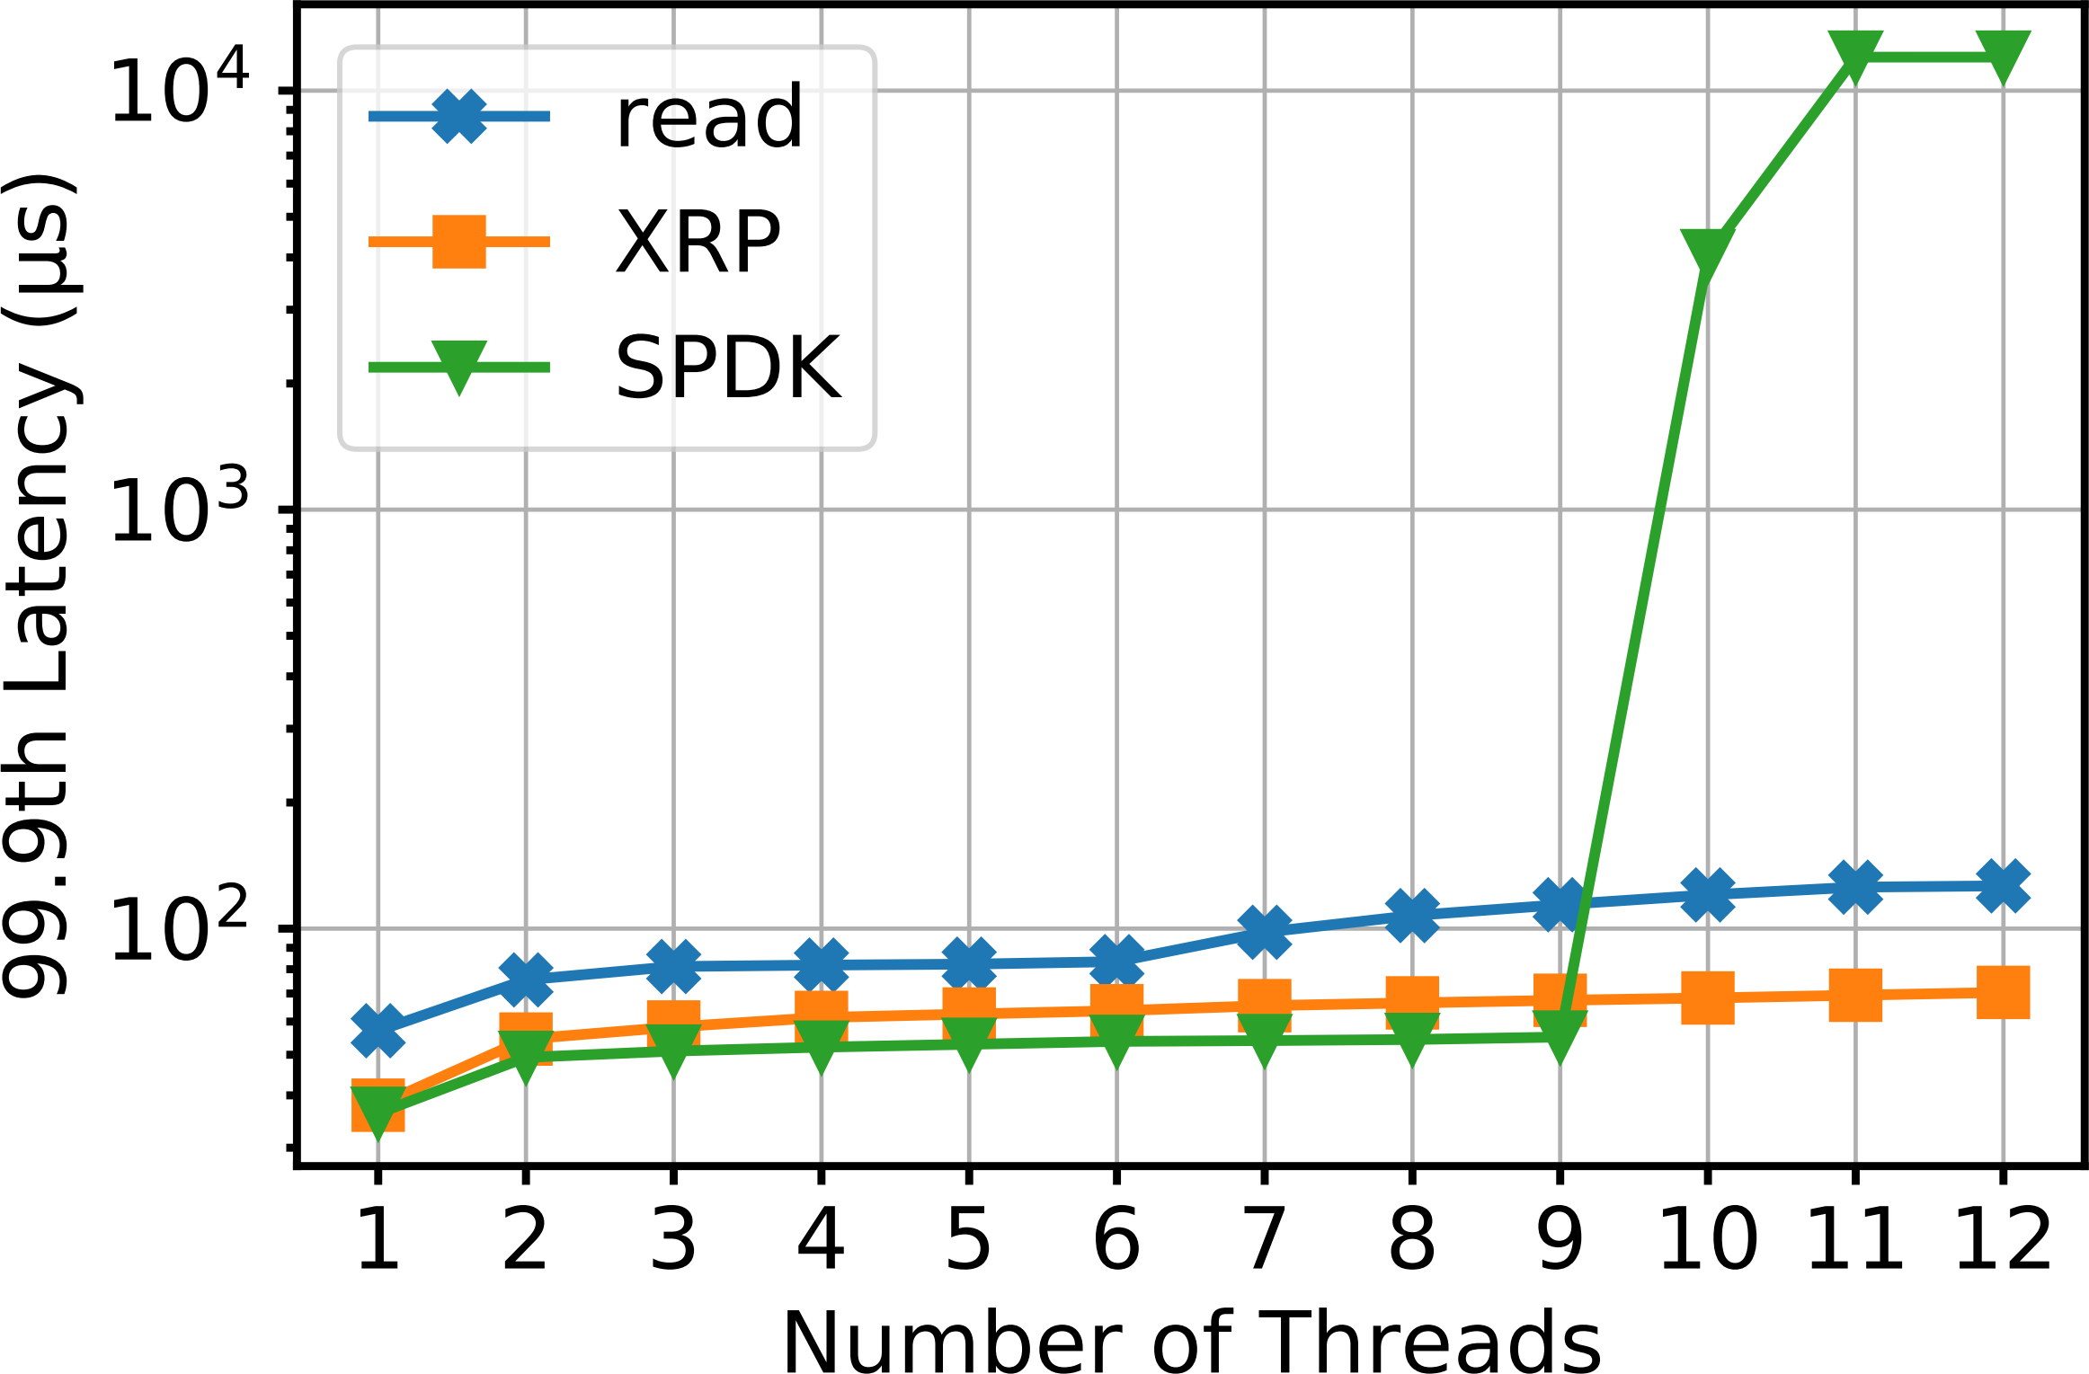

XRP vs. SPDK – Tail Latency
Multi-threaded tail latency in BPF-KV with uniform random 512B read:
Tail Latency
Compared to read, XRP improves tail latency by up to 45%
Tail latency of SPDK spikes to ~10 ms when the number of threads is greater than the number of cores by more than 50%

Slide 26
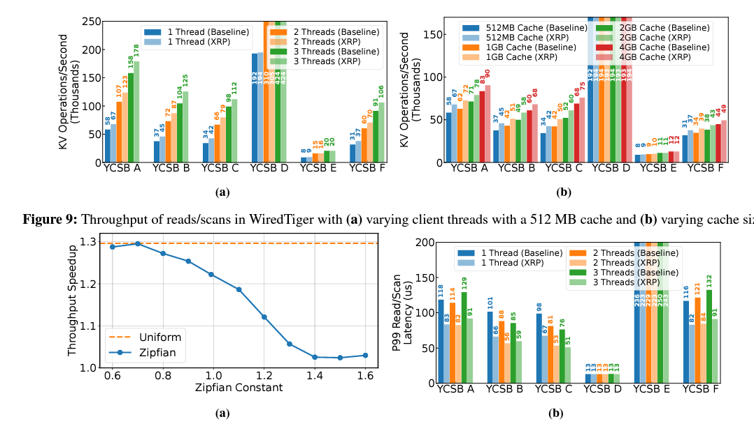
WiredTiger YCSB
Populate DB with IB KV pairs (K:16B, V:16B)

Slide 27



Conclusions
XRP is the first system to use BPF to accelerate common storage functions
XRP captures most of the performance benefit of kernel bypass, without sacrificing CPU utilization and access control
We are actively integrating XRP with other popular key-value stores including RocksDB
Try it out: http://xrp-project.com/ yuhong.zhong@columbia.edu

