Slide 1
CEPH:
A SCALABLE, HIGH-PERFORMANCE
DISTRIBUTED FILE SYSTEM
S. A. Weil, S. A. Brandt, E. L. Miller
D. D. E. Long, C. Maltzahn
U. C. Santa Cruz
OSDI 2006

Slide 2
Paper highlights
Yet another distributed file system using
object storage devices
Designed for scalability
Main contributions
  Uses hashing to achieve distributed dynamic metadata management
  Pseudo-random data distribution function replaces object lists

Slide 3
System objectives
Excellent performance and reliability
Unparallel scalability thanks to
  Distribution of metadata workload inside metadata cluster
  Use of object storage devices (OSDs)
Designed for very large systems
  Petabyte scale (10⁶ gigabytes)

Slide 4
Characteristics of very large systems
Built incrementally
Node failures are the norm
Quality and character of workload changes over time

Slide 5
SYSTEM OVERVIEW
System architecture
Key ideas
Decoupling data and metadata
Metadata management
Autonomic distributed object storage

Slide 6
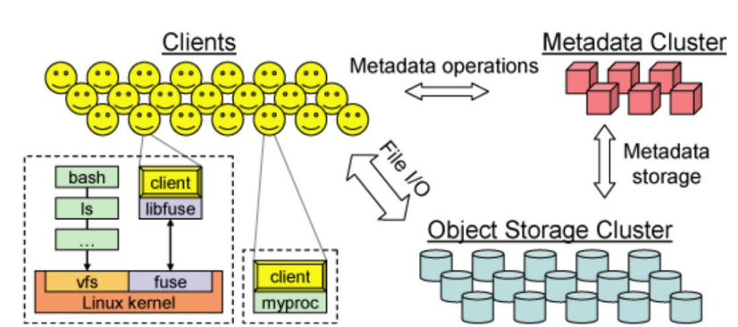
System Architecture (I)

Slide 7
System Architecture (II)
Clients
  Export a near-POSIX file system interface
Cluster of OSDs
  Store all data and metadata
  Communicate directly with clients
Metadata server cluster
  Manages the namespace (files + directories)
  Security, consistency and coherence

Slide 8
Key ideas
Separate data and metadata management tasks
  - Metadata cluster does not have object lists
Dynamic partitioning of metadata data tasks inside metadata cluster
  Avoids hot spots
Let OSDs handle file migration and replication tasks

Slide 9
Decoupling data and metadata
Metadata cluster handles metadata operations
Clients interact directly with OSD for all file I/O
Low-level bloc allocation is delegated to OSDs
Other OSD still require metadata cluster to hold object lists
  Ceph uses a special pseudo-random data distribution function (CRUSH)

Slide 10
Old School
File xyz?
Metadata
server
cluster
Client
Where to find the
container objects

Slide 11
Ceph with CRUSH
File xyz?
Metadata
server
cluster
Client
How to find the
container objects
Client uses CRUSH and
data provided by MDS
cluster to find the file

Slide 12
Ceph with CRUSH
Metadata
server
cluster
File xyz?
Here is how to find these
container objects
Client
Client uses CRUSH and
data provided by MDS
cluster to find the file

Slide 13
Metadata management
Dynamic Subtree Partitioning
  Lets Ceph dynamically share metadata workload among tens or hundreds of metadata servers (MDSs)
  Sharing is dynamic and based on current access patterns
Results in near-linear performance scaling in the number of MDSs

Slide 14
Autonomic distributed object storage
Distributed storage handles data migration and data replication tasks
Leverages the computational resources of OSDs
Achieves reliable highly-available scalable object storage
Reliable implies no data losses
Highly available implies being accessible almost all the time

Slide 15
THE CLIENT
Performing an I/O
Client synchronization
Namespace operations

Slide 16
Performing an I/O
When client opens a file
  Sends a request to the MDS cluster
  Receives an i-node number, information about file size and striping strategy and a capability
    Capability specifies authorized operations on file (not yet encrypted )
  Client uses CRUSH to locate object replicas
  Client releases capability at close time

Slide 17
Client synchronization (I)
POSIX requires
  One-copy serializability
  Atomicity of writes
When MDS detects conflicting accesses by different clients to the same file
  Revokes all caching and buffering permissions
  Requires synchronous I/O to that file

Slide 18
Client synchronization (II)
Synchronization handled by OSDs
  Locks can be used for writes spanning object boundaries
Synchronous I/O operations have huge latencies
Many scientific workloads do significant amount of read-write sharing
  POSIX extension lets applications synchronize their concurrent accesses to a file

Slide 19
Namespace operations
Managed by the MDSs
  Read and update operations are all synchronously applied to the metadata
Optimized for common case
  readdir returns contents of whole directory (as NFS readdirplus does)
Guarantees serializability of all operations
  Can be relaxed by application

Slide 20
THE MDS CLUSTER
Storing metadata
Dynamic subtree partitioning
Mapping subdirectories to MDSs

Slide 21
Storing metadata
Most requests likely to be satisfied from MDS in-memory cache
Each MDS lodges its update operations in lazily-flushed journal
  Facilitates recovery
Directories
  Include i-nodes
  Stored on a OSD cluster

Slide 22
Dynamic subtree partitioning
Ceph uses primary copy approach to cached metadata management
Ceph adaptively distributes cached metadata across MDS nodes
  Each MDS measures popularity of data within a directory
  Ceph migrates and/or replicates hot spots

Slide 23
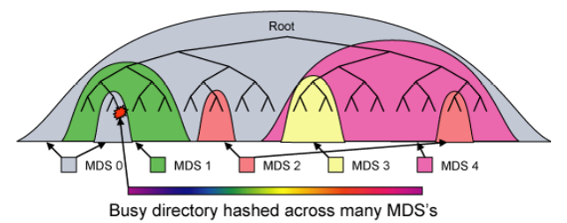
Mapping subdirectories to MDSs

Slide 24
DISTRIBUTED OBJECT STORAGE
Data distribution with CRUSH
Replication
Data safety
Recovery and cluster updates

Slide 25
Data distribution with CRUSH (I)
Wanted to avoid storing object addresses in MDS cluster
Ceph firsts maps objects into placement groups (PG) using a hash function
Placement groups are then assigned to OSDs using a pseudo-random function (CRUSH)
  Clients know that function

Slide 26
Data distribution with CRUSH (II)
To access an object, client needs to know
  Its placement group
  The OSD cluster map
  The object placement rules used by CRUSH
    Replication level
    Placement constraints

Slide 27
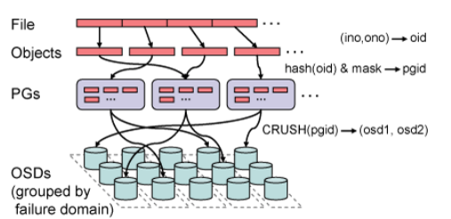
How files are striped

Slide 28
Replication
Ceph’s Reliable Autonomic Data Object Store autonomously manages object replication
First non-failed OSD in object’s replication list acts as a primary copy
  Applies each update locally
  Increments object’s version number
  Propagates the update

Slide 29
Data safety
Achieved by update process
  Primary forwards updates to other replicas
  Sends ACK to client once all replicas have received the update
    Slower but safer
  Replicas send final commit once they have committed update to disk

Slide 30
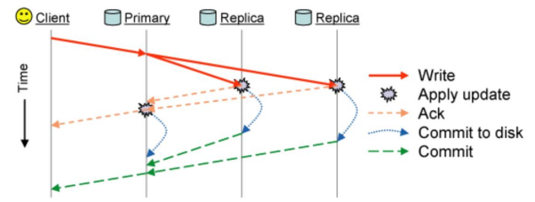
Committing writes

Slide 31
Recovery and cluster updates
RADOS (Reliable and Autonomous Distributed Object Store) monitors OSDs to detect failures
Recovery handled by same mechanism as deployment of new storage
  Entirely driven by individual OSDs

Slide 32
Low-level storage management
Each Ceph OSD manages its local object storage with EBOFS (Extent and B-Tree based Object File System)
  B-Tree service locates objects on disk
  Block allocation is conducted in term of extents to keep data compact
  Well-defined update semantics

Slide 33
PERFORMANCE AND SCALABILITY
Want to measure
  Cost of updating replicated data
    Throughput and latency
  Overall system performance
  Scalability
  Impact of MDS cluster size on latency

Slide 34
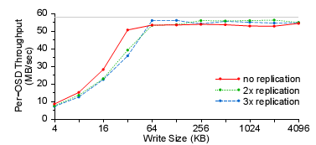
Impact of replication (I)

Slide 35
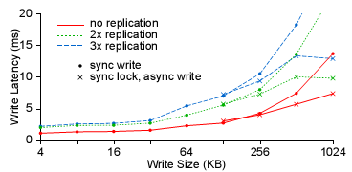
Impact of replication (II)
Transmission times dominate for large synchronized writes

Slide 36
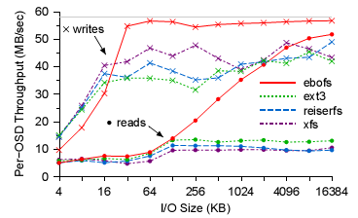
File system performance

Slide 37
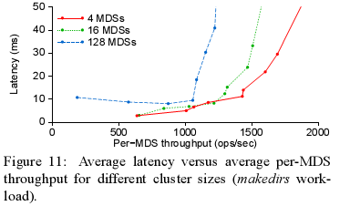
Impact of MDS cluster size on latency

Slide 38
Conclusion
Ceph addresses three critical challenges of modern DFS
  Scalability
  Performance
  Reliability
Achieved though reducing the workload of MDS
  CRUSH
  Autonomous repairs of OSD

