Slide 1


JavaScript III
Scripting, Event handling and DOM

Slide 2
Objective
The Script Element in HTML
Functions in JS (intro)
Function Declaration (Creating Functions)
Calling a Function
Events
JavaScript Functions as Events Handlers
Built - in JavaScript Methods
Scopes

Slide 3
The Script Element
The HTML <script> element is used to embed or reference executable code like JavaScript
The browser will execute the JavaScript statements in the <script> element as the page is loading
You can insert JavaScript directly into the <script> element of the HTML page
Or you can put the JavaScript in an external JavaScript file and link to that file in the <script> element

Slide 4
Introduction to Functions in JavaScript
Function: a unit/block of code that contains all the instructions needed to complete a specific task
User-defined
Built-in

Slide 5
Creating your own Functions: Function Declaration
Easiest method of declaring a function:
General syntax of a function in JavaScript:
function doubleNumber(number) { return number * 2; }
function functionName(parameters){ statements; return (expression); }

Slide 6
Calling a Function
You call a function by using the function’s name followed by the values you would like to pass to the parameters within parentheses. The values that you pass to the function are referred to as arguments.
Example:
let doubleTen = doubleNumber(10);

Slide 7
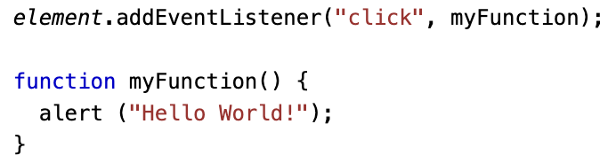
Events
Event: an action that occurs that your program responds to

Slide 8
Event | Description
onchange | Some html element has been modified
onclick | An html element has been clicked on
onmouseover | An html element was hovered over
onmouseout | Mouse cursor moves off html element
onkeydown | A keyboard button is pressed
onload | The html page has finished loading

Slide 9
JavaScript Functions as Events Handlers
JavaScript is often used to handle events that occur on a website.
To do this, identify the DOM event and specify the name of the JavaScript function you want to call when the event is triggered

Slide 10
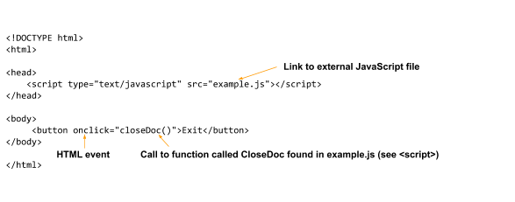
JavaScript Functions as Events Handlers

Slide 11
Built-in JavaScript Methods
Commonly used built-in methods:
Method | Description
document.createElement(‘tag’); | Creates an element with the given tag name. E.g. document.createElement(‘p’) would create a <p> element.
document.getElementById(‘id’);z | Returns an object reference to the identified element. For example if you had a <div> element for which you had set the id attribute of that element to ‘myDiv’ and you called document.getElementById(‘myDiv’) that <div> element would be returned.
element.appendChild(aChild); | Nests an element to another element. See “Example 3” for more information.

Slide 12



Resources
https://www.w3resource.com/javascript-exercises/javascript-functions-exercises.php
https://www.w3resource.com/javascript-exercises/javascript-dom-exercises.php
https://cs.lmu.edu/~ray/notes/javascriptfunctions/

Slide 13
Summary
The Script Element in HTML
Functions in JS (intro)
Function Declaration (Creating Functions)
Calling a Function
Events
JavaScript Functions as Events Handlers
Built - in JavaScript Methods
Scopes

