Slide 1


JavaScript V: OOP

Slide 2
Objective
What is Object Oriented Programming
JavaScript Objects
Procedural Programming vs. OOP
How do we Design OO Systems
Creating Defined Objects
Function meets Object

Slide 3
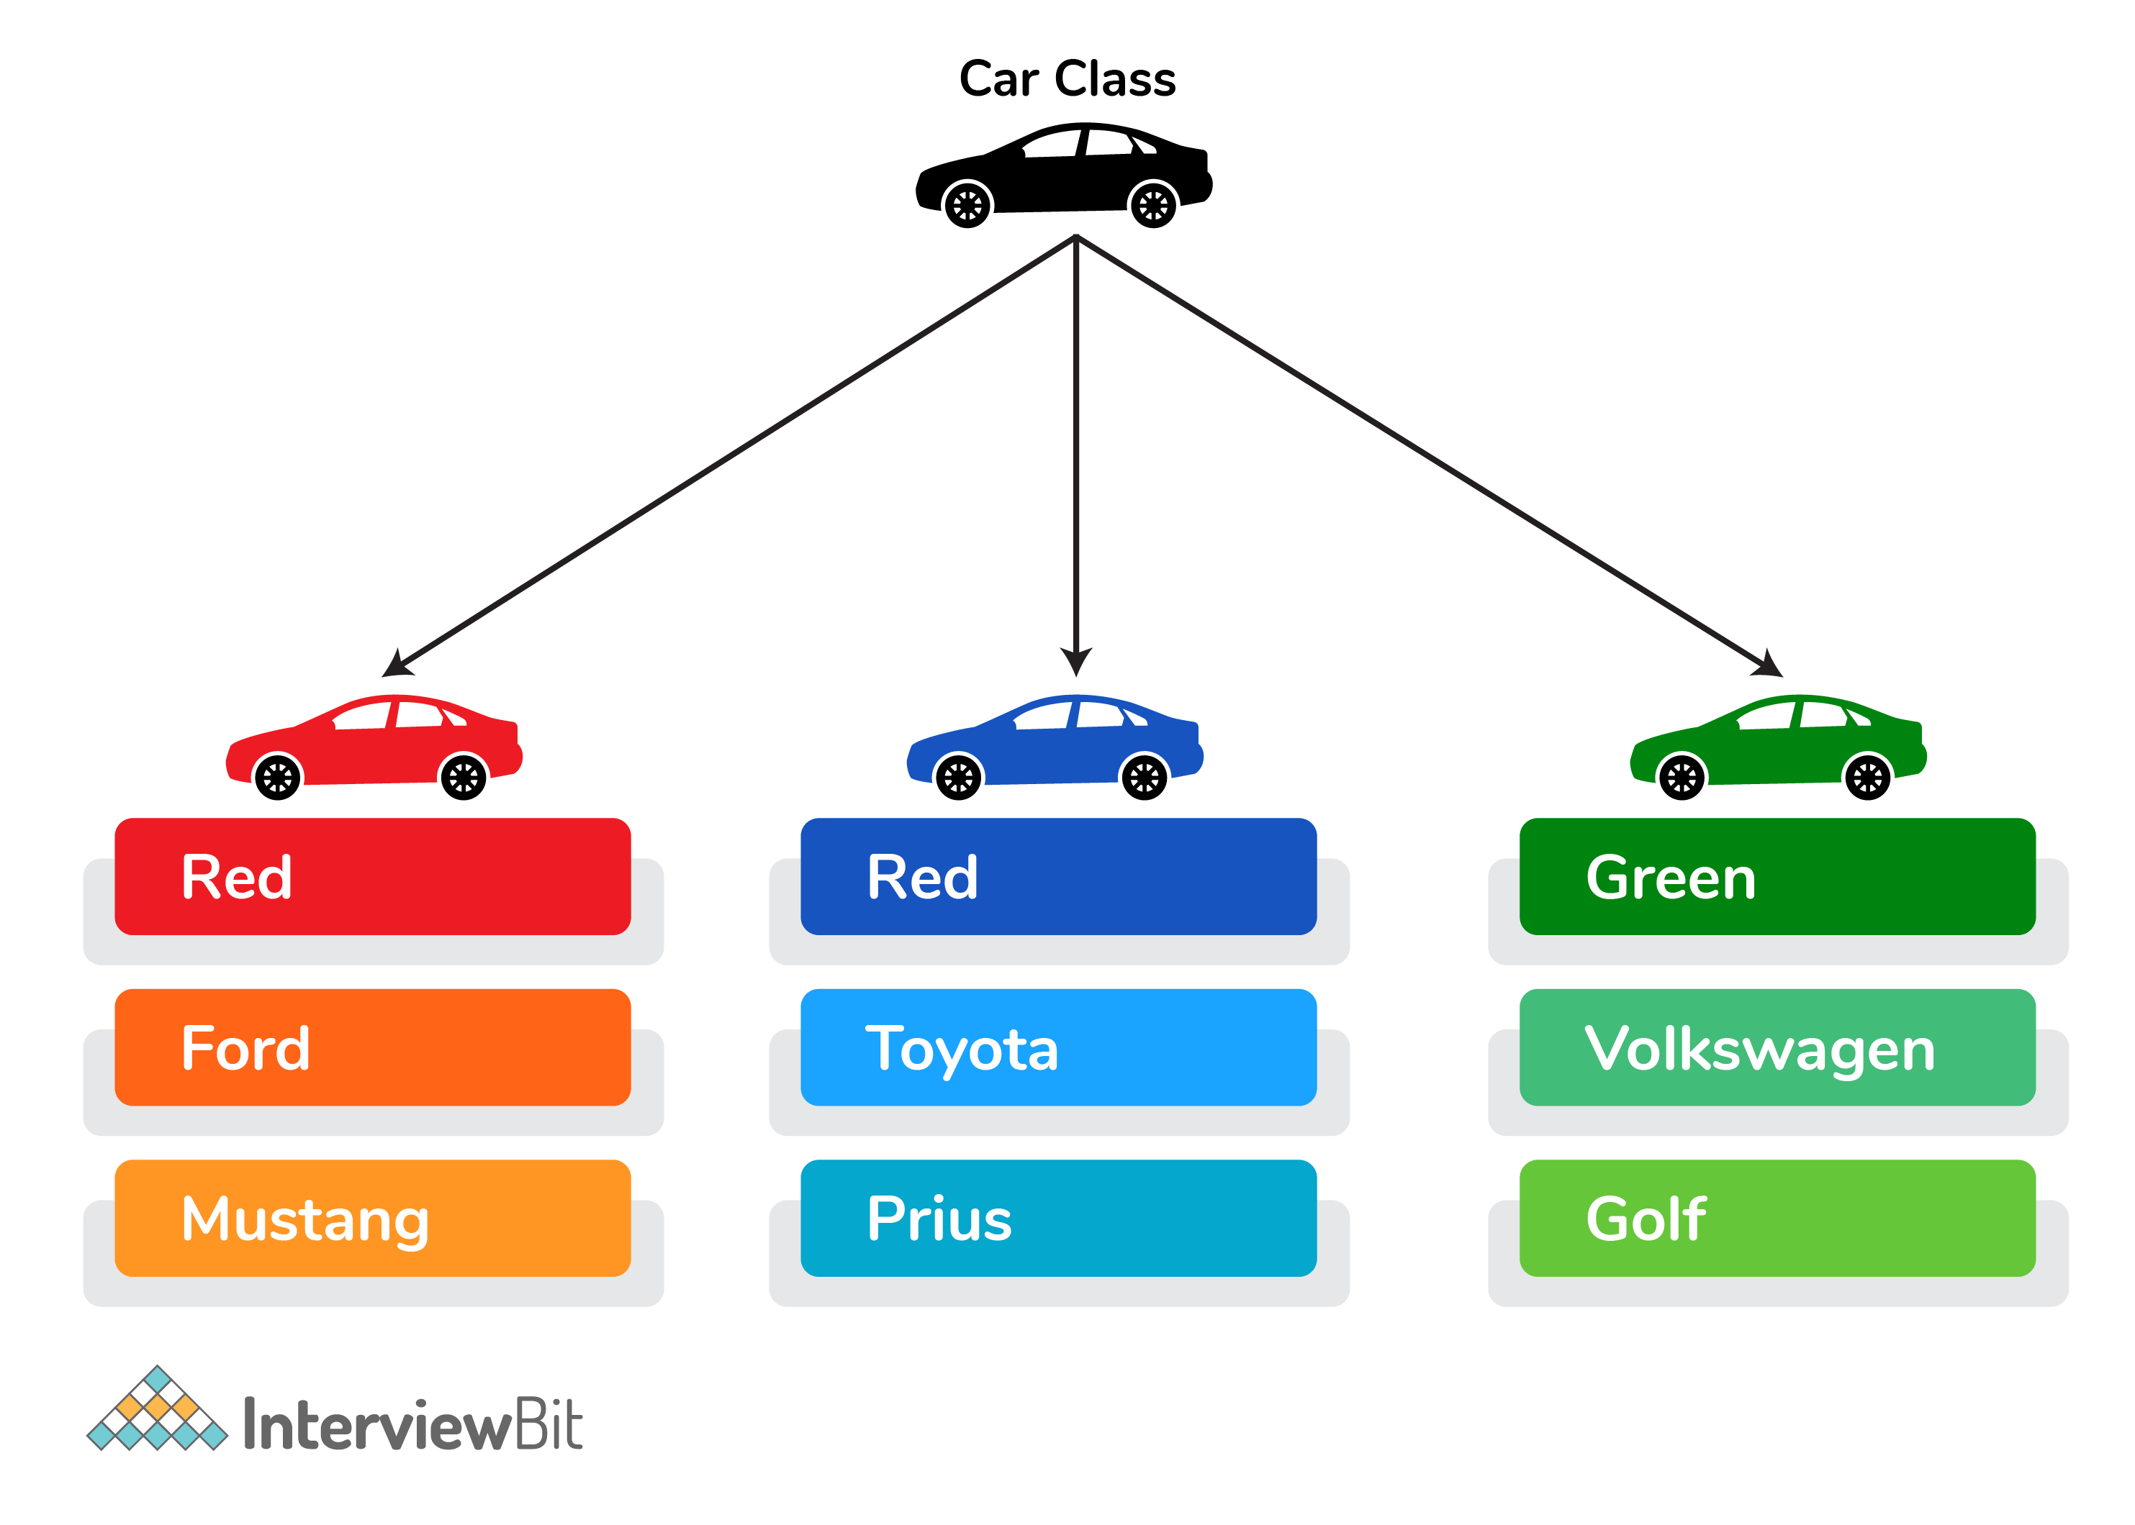
What is Object Oriented Programming
We as humans think in terms of objects.
Object Oriented programming (OOP) is a programming paradigm that relies on the concept of classes and objects.

Slide 4
JavaScript Objects
Easier debugging
12 of 15
6 / 10
JS is an object-based language
OOP serves to allow the components of your code to be as modular as possible.
Benefits:
Shorter development time
Easier debugging

Slide 5
Procedural Programming vs. OOP
Procedural Programming | OOP
Waterfall sequence | System is designed in terms of objects which communicate with each other to accomplish a given task
Data are separate from the code | Data and code are encapsulated into a single module. Data is passed to modules using methods

Slide 6
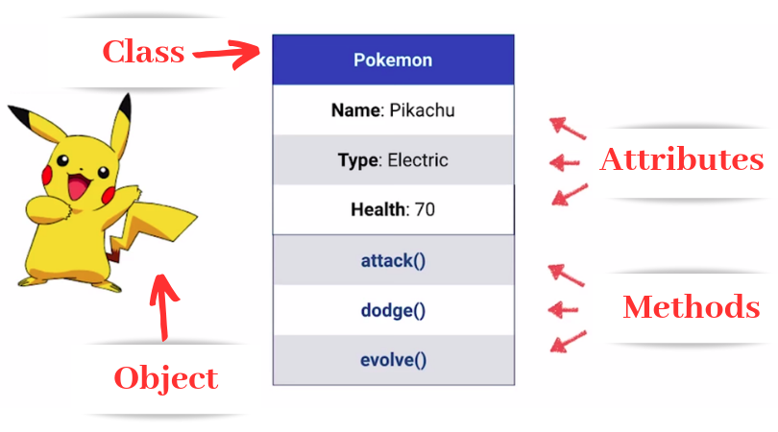
How do we Design OOP Systems?
Class: blueprint from which objects are made and consists of data and the code that manipulates it
Attributes: characteristics of an object
Methods: a function related to an object

Slide 7
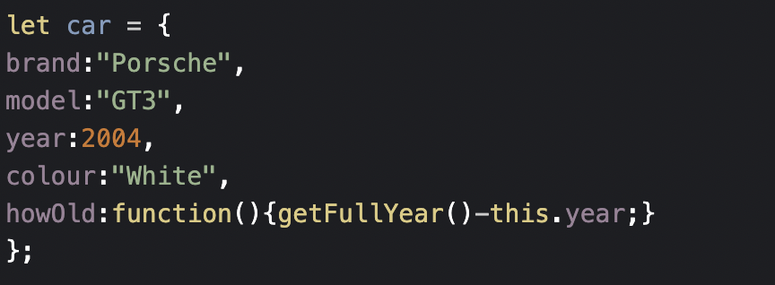
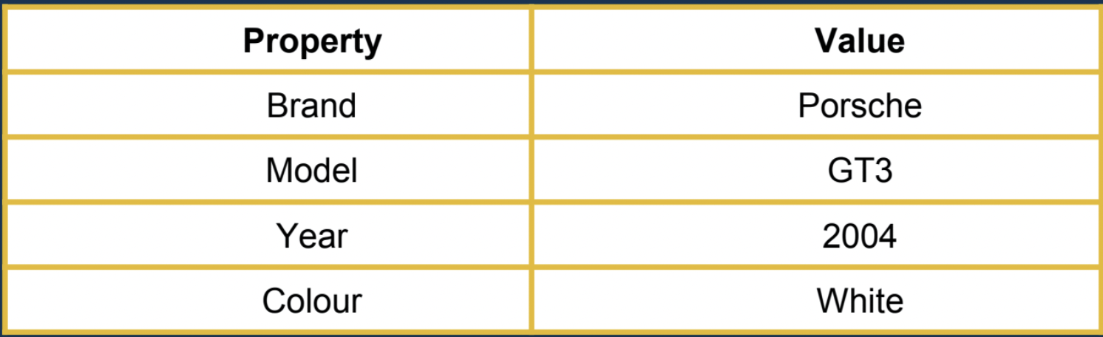
Creating Defined Objects
There is 2 methods to create defined objects:
Method 1:Using Object Literal
Attributes:

Slide 8
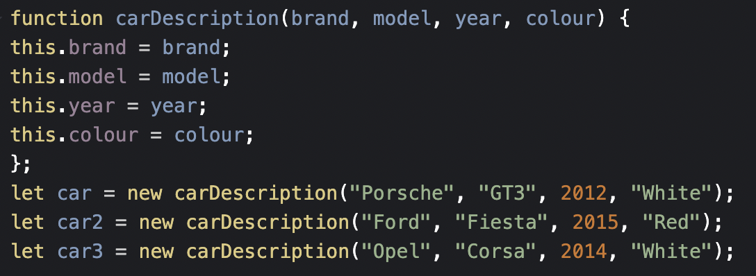
Creating Defined Objects
Method 2: Using Object Constructor:
To change the colour: car.colour =“Black”;
To delete properties of an object: deletecar.colour;

Slide 9
Some Objects that you have Already Encountered
Most of the built-in code that you have worked with so far has used objects.
When you use code such as
let htmlSelect = document.getElementById('personList’)
you have been using the document object
Every time you create an array, you are actually creating an array object that is defined by an array class

Slide 10
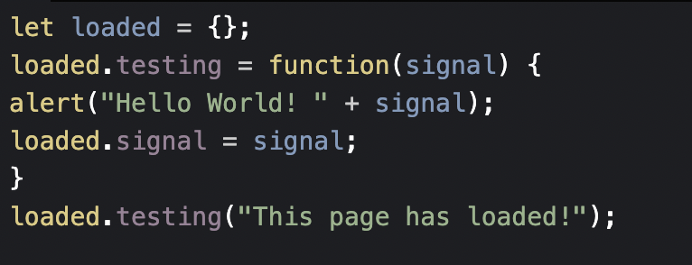
Function meets Object
Let’s consider the declaration of an object with implementation through a function.

Slide 11
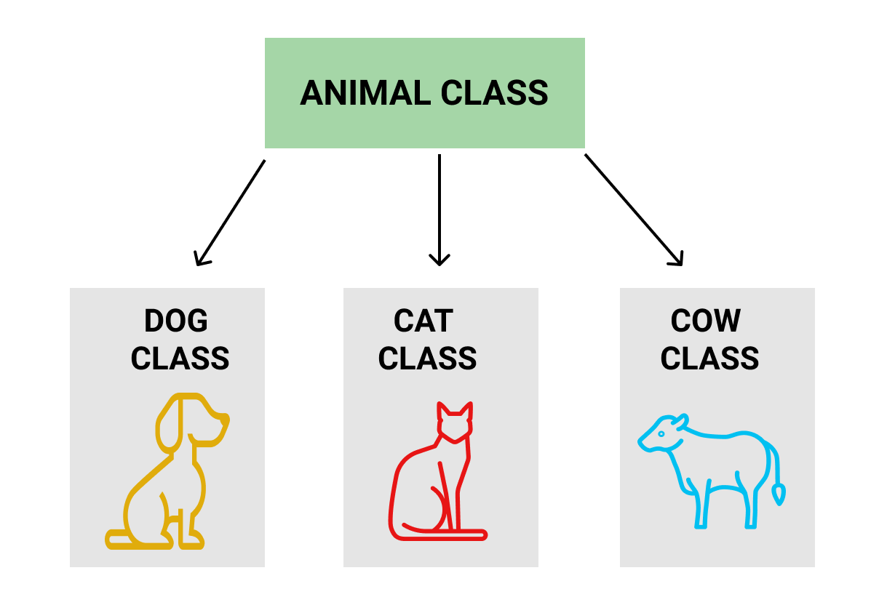
Inheritance
Inheritance is a mechanism in which one class acquires the property of another class.

Slide 12
Summary
What is Object Oriented Programming
Procedural Programming vs. OOP
How do we Design OO Systems
JavaScript Objects
Creating Defined Objects
Function meets Object

Slide 13



Resources
JHD

