Slide 1


JavaScript I
Variables, operators and Pseudocode

Slide 2
Objective
Using the JavaScript Console
Variables and Declaring them
Essential Data Types and Finding the Type
Operators
Creating a JS File
Pseudocode

Slide 3
Introduction to JavaScript
Usually used as a front-end scripting language.
Can also be used for server-side programming.
JavaScript is used to change web pages from static web pages to dynamic web pages.

Slide 4

JavaScript Background
ECMAScript
ECMA is basically the organization that has designed JavaScript and ECMAScript is basically JavaScript
Based on technologies including JavaScript and JScript
Released in 1997 — a lot of changes have been made since
ES6 (aka ES2015 or Harmony) was the biggest revision
ES6, ES7 and ES8
ES6 has introduced many changes to JavaScript (which basically is the same thing as ECMAScript) which improve the programming language greatly
ECMA now releases updates annually

Slide 5
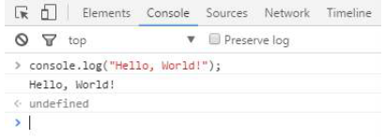

👨‍💻👩‍💻 Using the JavaScript Console
Open the Console
Type the code console.log("Hello World!!"); into the console
Hit enter
If everything isn’t typed correctly, you may get an error, remember to follow your syntax rules!

Slide 6
Variables
Programs usually process data that is put into the program and output the results of the processing.
Variables: ‘containers’ to store the data we need to manipulate
In calculations we use variables to hold values that can be changed

Slide 7
Declaring Variables
to declare a variable is to use the keyword ‘let’. You can also use the keywords ‘var’ and ‘const’ to declare variables.
var: is the old way of creating a variable.
const: is used when you want to declare a variable that’s value can’t change
To assign storage space in memory and give it a name we can reference it with:
let variable_name = value_you_want_to_store;

Slide 8

Rules in naming variables
Use camelCase style convention
Contains only letters, numbers, underscores and dollar signs. No other characters can be used in variable names, including spaces. “My name” would thus not be an acceptable variable name.
Starts with a letter.
Is not a reserved word. In JavaScript, certain words are reserved. For example, you would not be able to name a variable “var”, “console” or “log”, because these are reserved words.

Slide 9
Good✔ vs. bad ❌ naming conventions
Allowed |  | Not Allowed/ Not recommended
let userName | Best Practice: camelCase | let user_name | Allowes but bad practice
let ageGroup5 | Only letters and digits | let 21Players | Starting digits not allowed
let $kindOfSpecial | Starting with $ is allowed | let user-b | No special characters
let userName | Starting with _ is allowed | let let | Keywords not allowed

Slide 10
Essential Data Types
Data Type: the type of data that is stored by a variable
Data Type | Declaration
Numeric | let someNumber = 25;
String | let someName = "Joe";
Boolean | let someBool = true;
Array | let someArray = [15, 17, 19];
Object | let someObject = {firstName: "James", lastName: "Bond"}

Slide 11
Type Identification
JavaScript is Weakly typed programming language, this mean its able to detect variable types automatically based on the value you assign to the variable
let myString = "12";
let myNumber = 12;
🤔So what will happen with this line of code?
let unknownType = 53 + "Bond";
Notes:
In many programming languages this would cause a type conflict error because mathematically you can’t add a number and a string, but JavaScript simply solves this issue by converting the entire variable contents into a string. The logic is that JavaScript first sees a number and assumes a number variable type but, once it detects a string, the variable is reclassified as a string.

Slide 12
Finding the Type
We use the typeof built-in function
👨‍💻👩‍💻 Enter the following code into your console and then press enter
let myName = "Tom"; let num = 33.33; let pass = true; console.log(myName); console.log(num); console.log(pass); let myDataType = typeof num; console.log(myDataType); console.log(typeof pass);

Slide 13
Mathematical Calculations with JavaScript
Arithmetic Operations | Symbol used in JavaScript
Addition | +
Subtraction | -
Multiplication | *
Division | /
Modulus (Divides left-hand operand by right-hand operand and returns remainder, e.g. 5%2 = 1) | %
Add one to a variable (e.g. 2++ = 3) | ++
Subtract one from a variable (e.g. 2-- = 1) | --

Slide 14
👨‍💻👩‍💻 Type the following into your console.
let num1 = 12; let num2 = 34; console.log("num1 = " + num2); console.log("num2 = " + num2); console.log("num1 + num2 = " + num1+num2); console.log("num1 / num2 = " + num1/num2); console.log("num2 % num1 = " + num2%num1); console.log("num1++ = " + num1++); console.log("num2-- = " + num2--);

Slide 15
👨‍💻👩‍💻 Creating .js Files
Create a new file (using VS code)
Enter the JavaScript instructions in this file one instruction per line
Save this file with the .js extension.
Save all your compulsory tasks as JavaScript files.

Slide 16
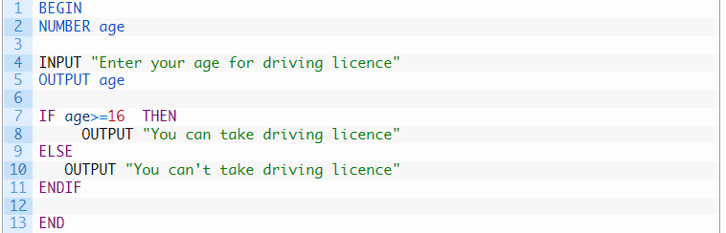
Pseudocode
Pseudocode is a compact and informal high-level description of a program using the conventions of a programming language, but intended more for humans.
Pseudocode is not an actual programming language. So it cannot be compiled into an executable program. It uses short terms or simple English language syntaxes to write code for programs before it is actually converted into a specific programming language.
Issue for driver license (Pseudocode If Else Example)

Slide 17
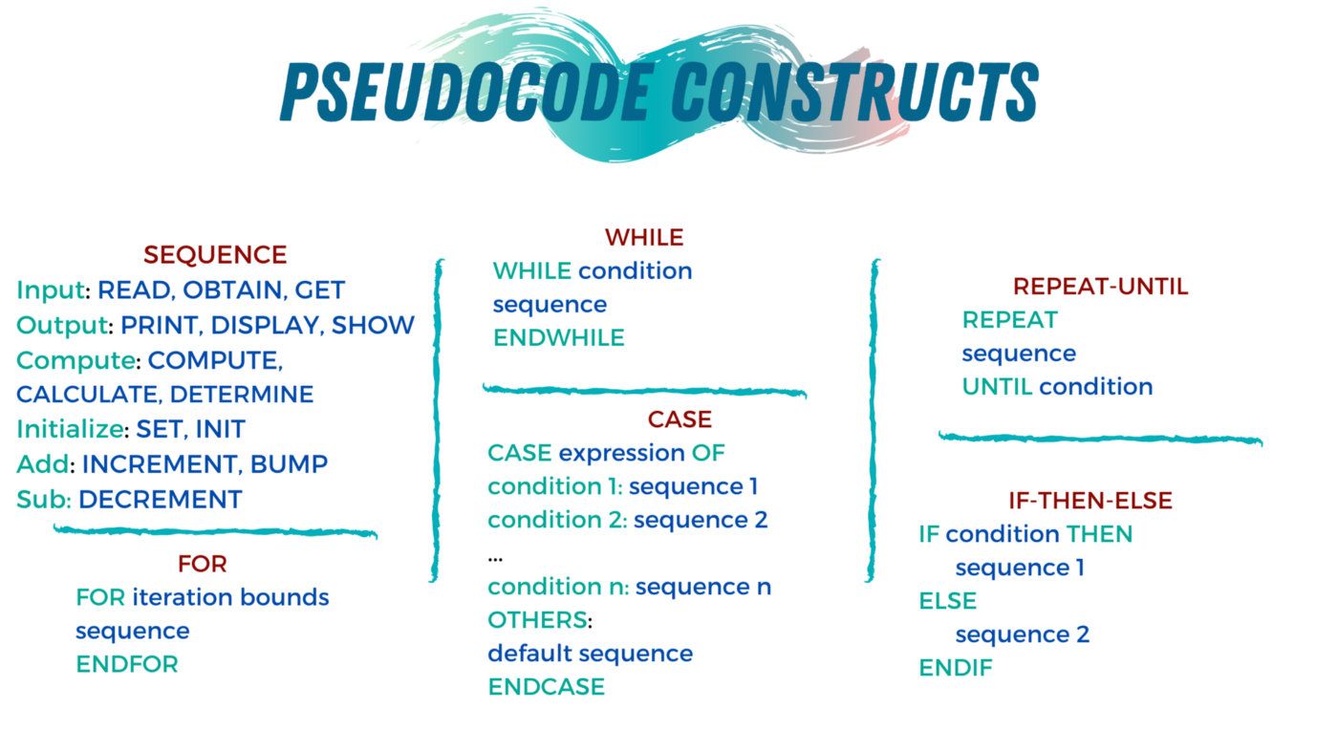
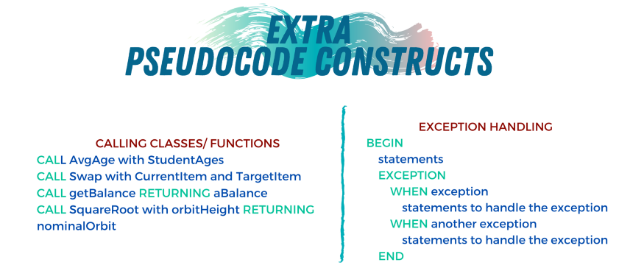
Pseudocode constructs

Slide 18
Rules
Always capitalize the initial word (often one of the main 6 constructs).
Have only one statement per line.
Indent to show hierarchy, improve readability, and show nested constructs.
Always end multiline sections using any of the END keywords (ENDIF, ENDWHILE, etc.).
Use the naming domain of the problem, not that of the implementation. E.g., “Append the last name to the first name” instead of “name = first+ last.”
Keep it simple, concise, and readable.

Slide 19
👨‍💻👩‍💻 Write a pseudocode to Check a Number is Positive or Negative

Slide 20



Resources
Pseudocode Examples
Pseudocode 101: An Introduction to Writing Good Pseudocode | by Sara A. Metwalli
Academind

Slide 21
Summary
Using the JavaScript Console
Variables and Declaring them
Essential Data Types and Finding the Type
Operators
Creating a JS File
Pseudocode

