Slide 1


JavaScript II
Conditionals and loops

Slide 2
Objective
Comparison Operators
If, else and else if conditional
Logical Operators
Switch Conditional
While loop, do while loop and for loop
Infinite loops and nested loops

Slide 3
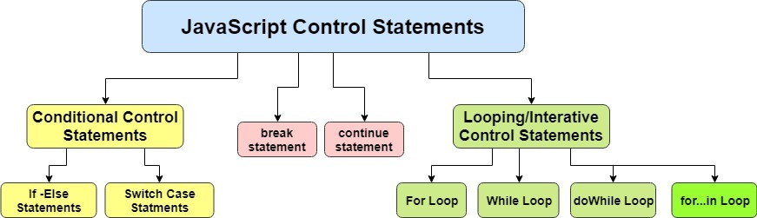
Control Structures in JavaScript
The control structures allow the flow of your program to change within a unit of code or function.
These statements can determine whether given statements are executed, or they can repeat the execution of a block of code.

Slide 4
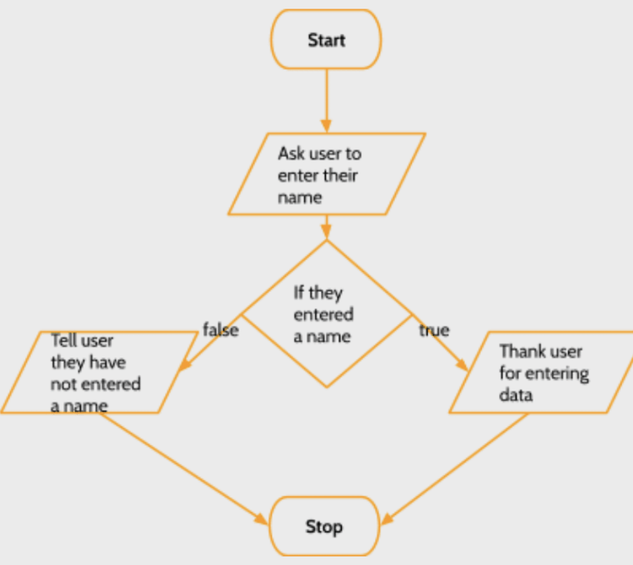
The if Conditional
If Statement: is able to compare two or more variables or scenarios and perform a certain action based on the outcome of that comparison
In JavaScript if statements have the following general syntax:
If (condition) {
Indented statements;
}

Slide 5
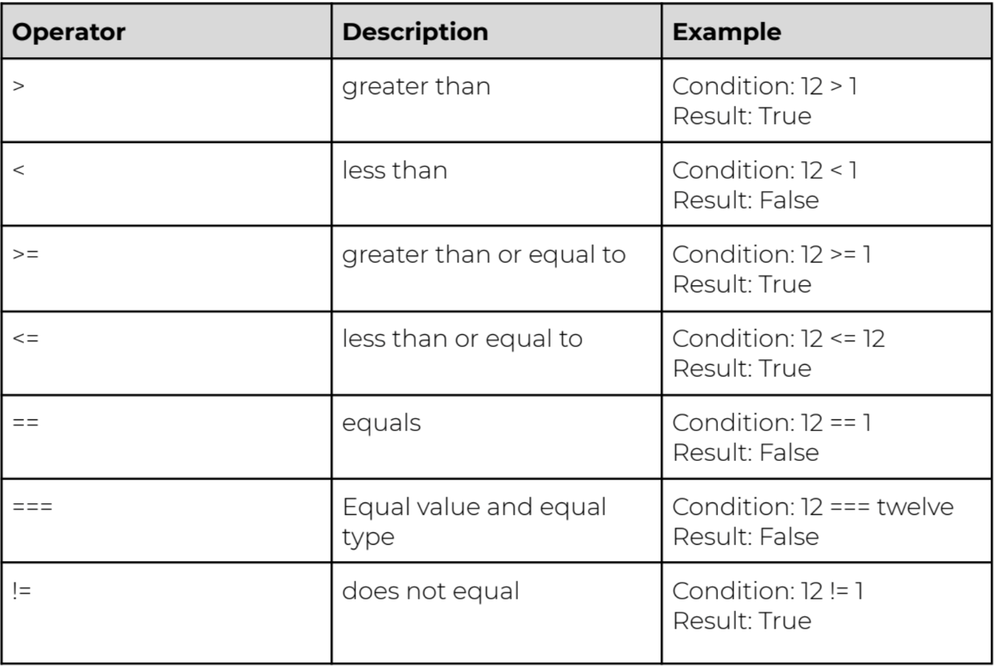
Comparison Operators

Slide 6
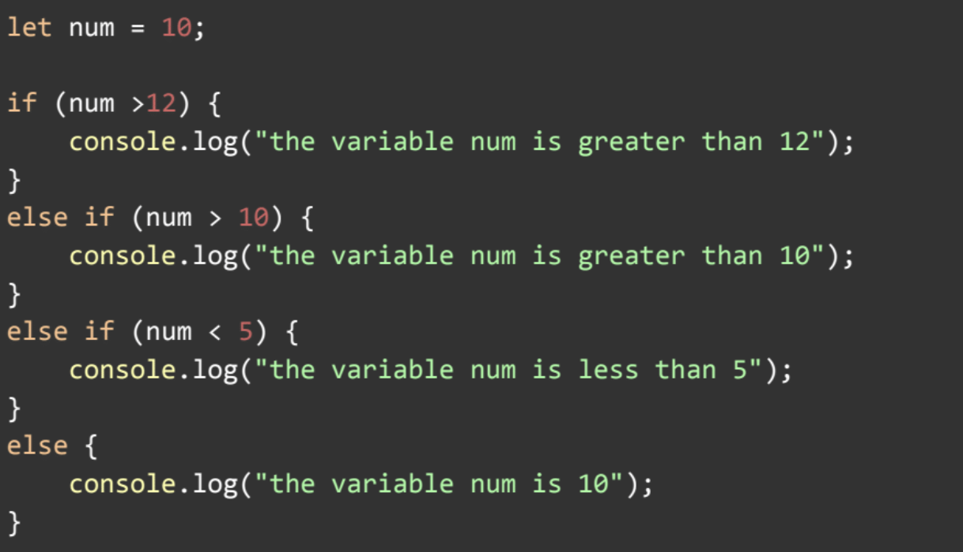
ELSE and ELSE IF Statement

Slide 7
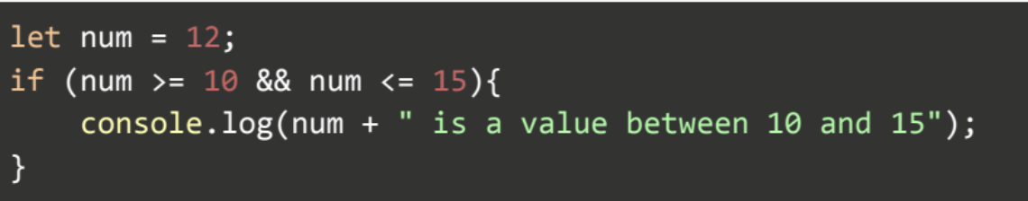
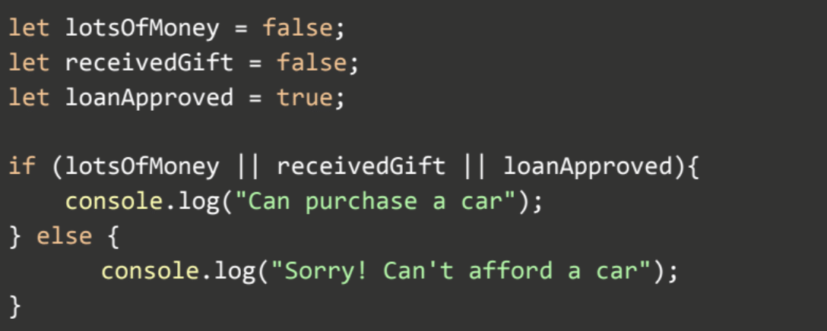
Logical Operation
AND (&&):
OR (||):
NOT (!)

Slide 8
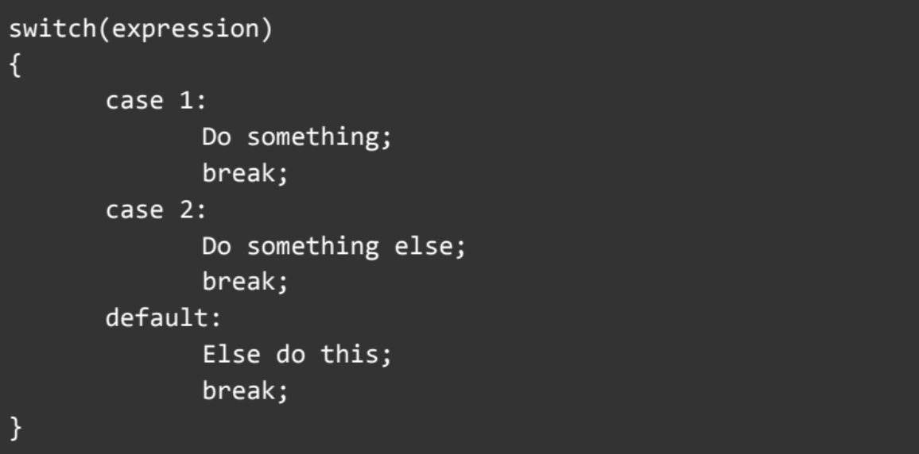
The Switch Conditional

Slide 9
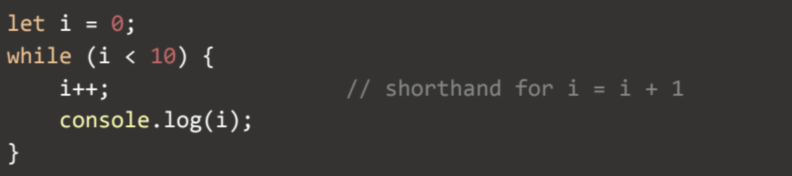
Repetition or Looping Control Structures
The while loop: will repeatedly execute a block of code for as long as the evaluation condition is met.

Slide 10
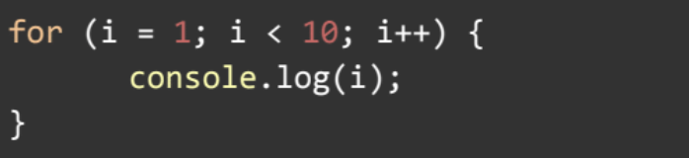
Repetition or Looping Control Structures
The for loop: very similar functionality to a while loop, but runs a predetermined number of times.

Slide 11
If statement vs Conditional (Ternary) Operator
let age = 15;
if(age<18){
console.log("Too young")
}
else{
console.log("Old enough")
}
let age = 15;
let voteable = (age < 18) ? "Too young":"Old enough";
console.log(voteable)

Slide 12
Break & Continue statement
Break statement causes an immediate exit from the loop to the first statement after the loop body.
Continue statement breaks one iteration (in the loop), if a specified condition occurs, and continues with the next iteration in the loop.
for (let i = 0; i < 10; i++) { if (i === 3) {
break;
} console.log("The number is " + i ); }
for (let i = 0; i < 10; i++) { if (i === 3) {
continue;
} console.log("The number is " + i ); }

Slide 13
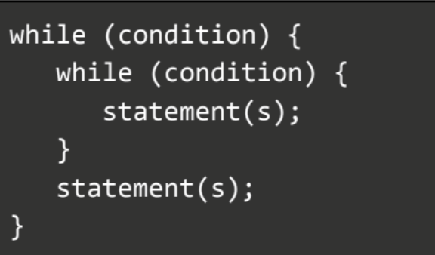
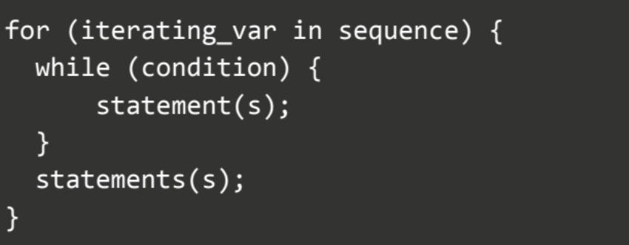
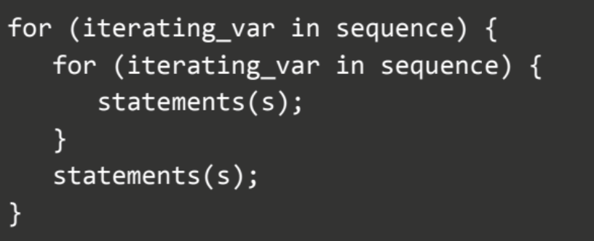
Nested loop
A nested loop is simply a loop within a loop.
Each time the outer loop is executed, the inner loop is executed right from the start. That is, all the iterations of the inner loop are executed with each iteration of the outer loop.
Nested for loop in another for loop
Nested while loop in another while loop
Nested for loop in another while loop

Slide 14
Which Loop to Choose?
Both the while loop and the for loop have 4
Common components:
Initialization of control variable
Termination condition
Update control variable
Body to be repeated
A while loop is generally used when we don’t know how many times to run through the loop
If we do know how many times to run through the loop, we use the for loop

Slide 15



Resources
JavaScript conditional statements and loops - Exercises, Practice, Solution

Slide 16
Summary
Comparison Operators
If, else and else if conditional
Logical Operators
Switch Conditional
While loop, do while loop and for loop
Infinite loops and nested loops

