Slide 1


Responsive design

Slide 2
Objective
What is responsive design
Media types
Breakpoints
Viewport
Mobile first design

Slide 3

What is Responsive Web Design?
Responsive Web Design is about using HTML and CSS to automatically resize, hide, shrink, or enlarge, a website, to make it look good on all devices (desktops, tablets, and phones):
A responsive web design will automatically adjust for different screen sizes and viewports.

Slide 4
Media types
Media queries in CSS3 extended the CSS2 media types idea: Instead of looking for a type of device, they look at the capability of the device.
Media queries can be used to check many things, such as:
width and height of the viewport
width and height of the device
orientation (is the tablet/phone in landscape or portrait mode?)
resolution
Value of media type | Description
all | Used for all media type devices
print | Used for printers
screen | Used for computer screens, tablets, smart-phones etc.
speech | Used for screenreaders that "reads" the page out loud
Examples:
https://www.w3schools.com/css/css3_mediaqueries_ex.asp

Slide 5
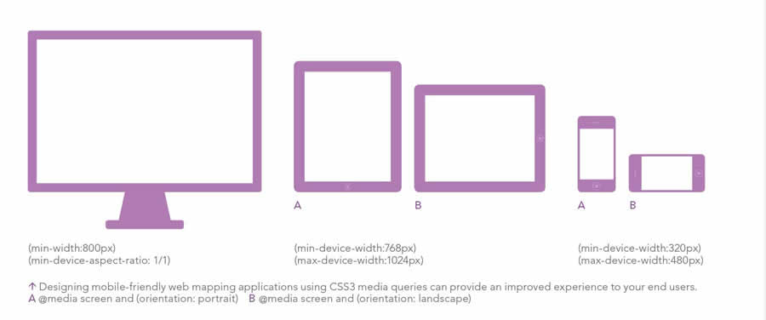
Sizes, breakpoints

Slide 6
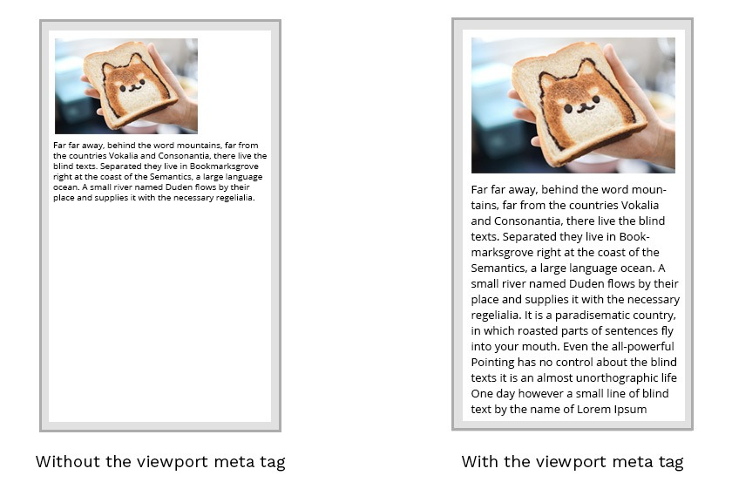
Setting the viewport
To create a responsive website, add the following <meta> tag to all your web pages:
Example:
<meta name="viewport" content="width=device-width, initial-scale=1.0">

Slide 7
The form
Target a min-width with @media and provide property and its value inside of the current style sheet.
.text-design {
font-size:28px;
}
@media (min-width:480px){
.text-design{
font-size:34px
}
}

Slide 8
CSS viewport units
CSS viewport units were specially created to allow measurements in CSS (including font-size) to be relative to the viewport size. They allow a truly responsive font-size, by defining the size as a percentage of the viewport width or height. We have four possible values:
vw. Viewport width. 1vw equals 1% of the viewport width.
vh. Viewport height. 1vh equals 1% of the viewport height.
vmin. Viewport minimum. It’s relative to the shortest dimension (width or height).
vmax. Viewport maximum. It’s relative to the longest dimension.

Slide 9
Pixels, ems, rems and Media Queries
The other way to implement a responsive font size is to use media queries along with fixed-size text. For fixed-size text we can use:
px. It specifies the height of the letters in CSS pixels
em. It’s relative to parent’s font size. i.e. 2em = 20px if parent element’s font-size is 10px.
rem. It’s relative to the html font size. i.e. 1rem = 10px if html element’s font-size is 10px.

Slide 10
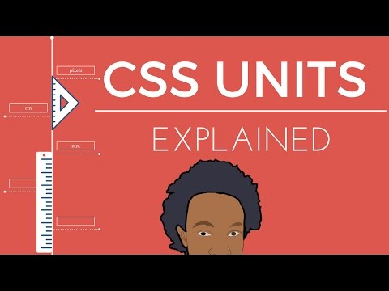

Slide 11

Mobile First Design
Widespread usage of mobile devices to access the web has led to new development methods like mobile-first design which encourages mobile-friendly web design.

Slide 12
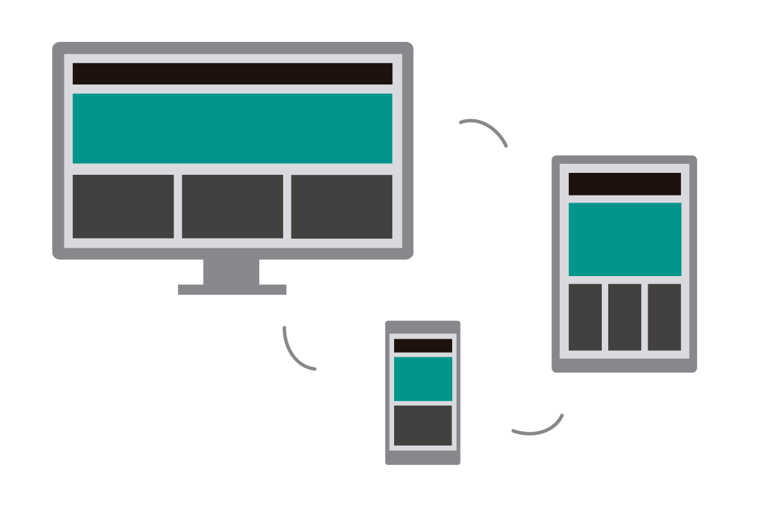
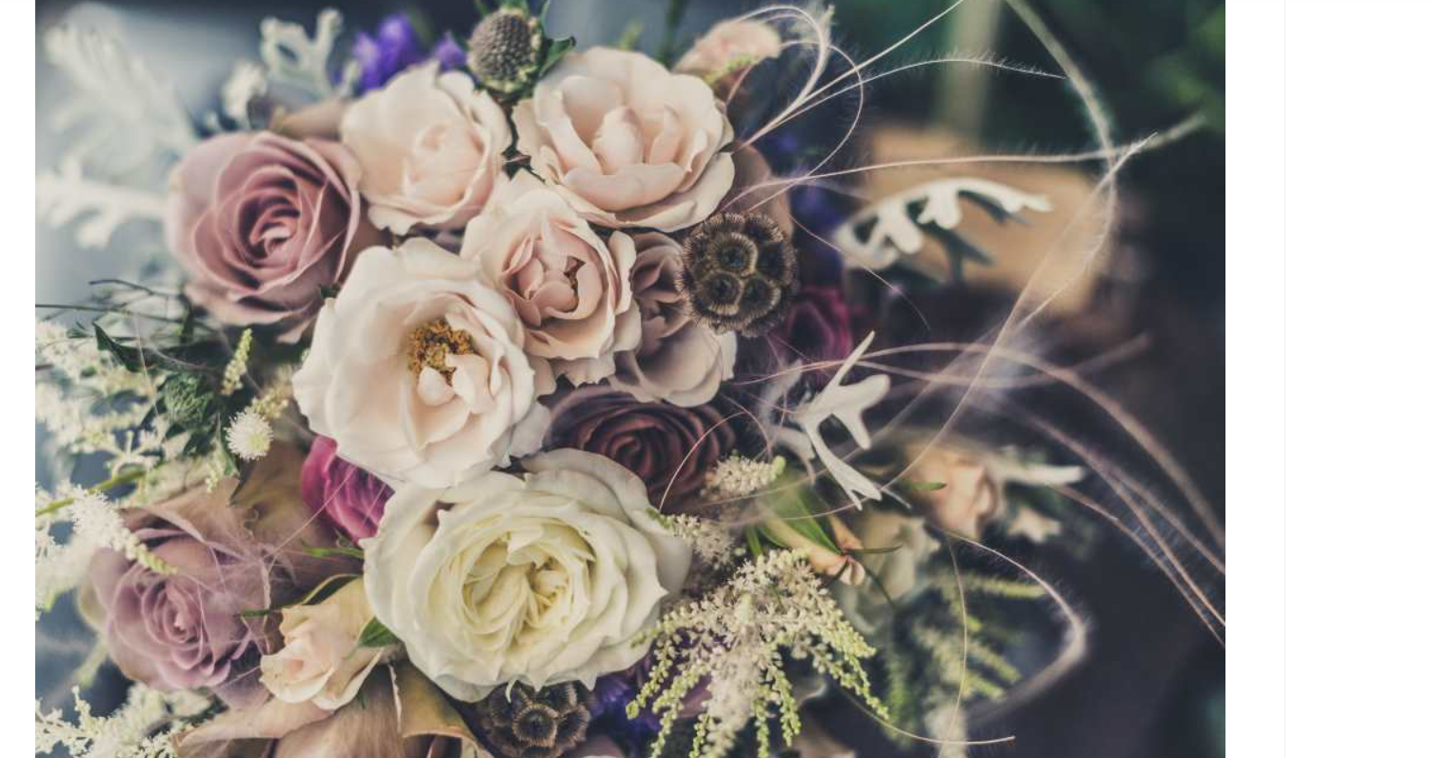
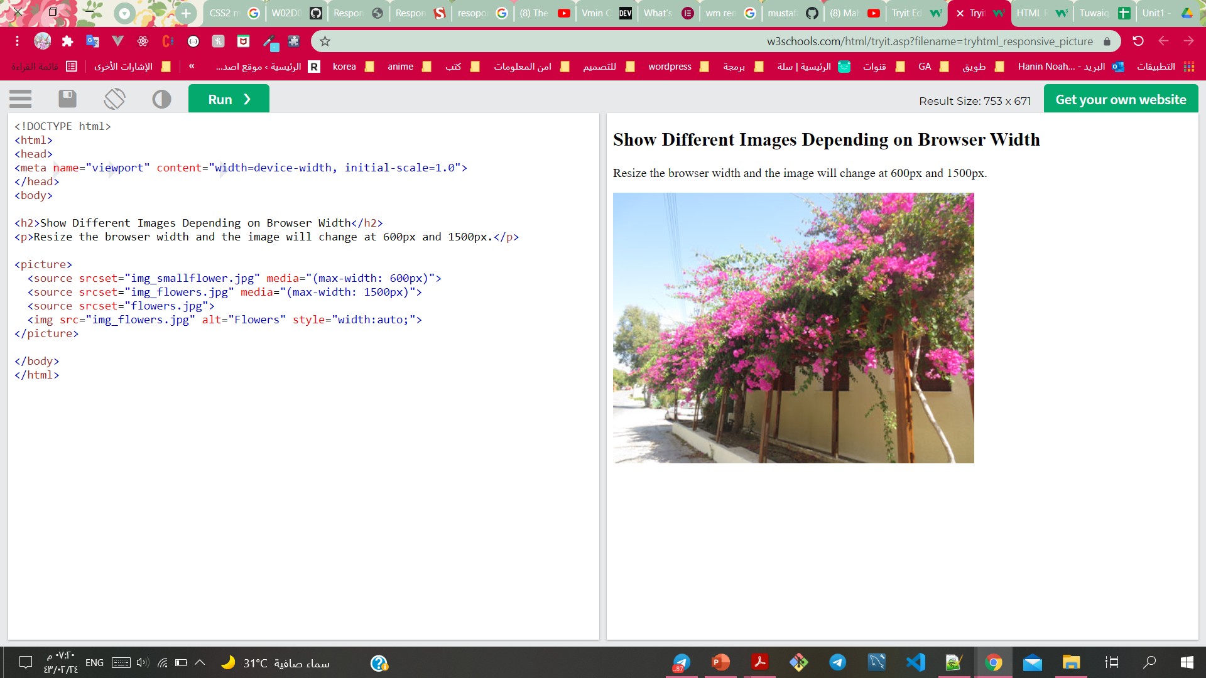
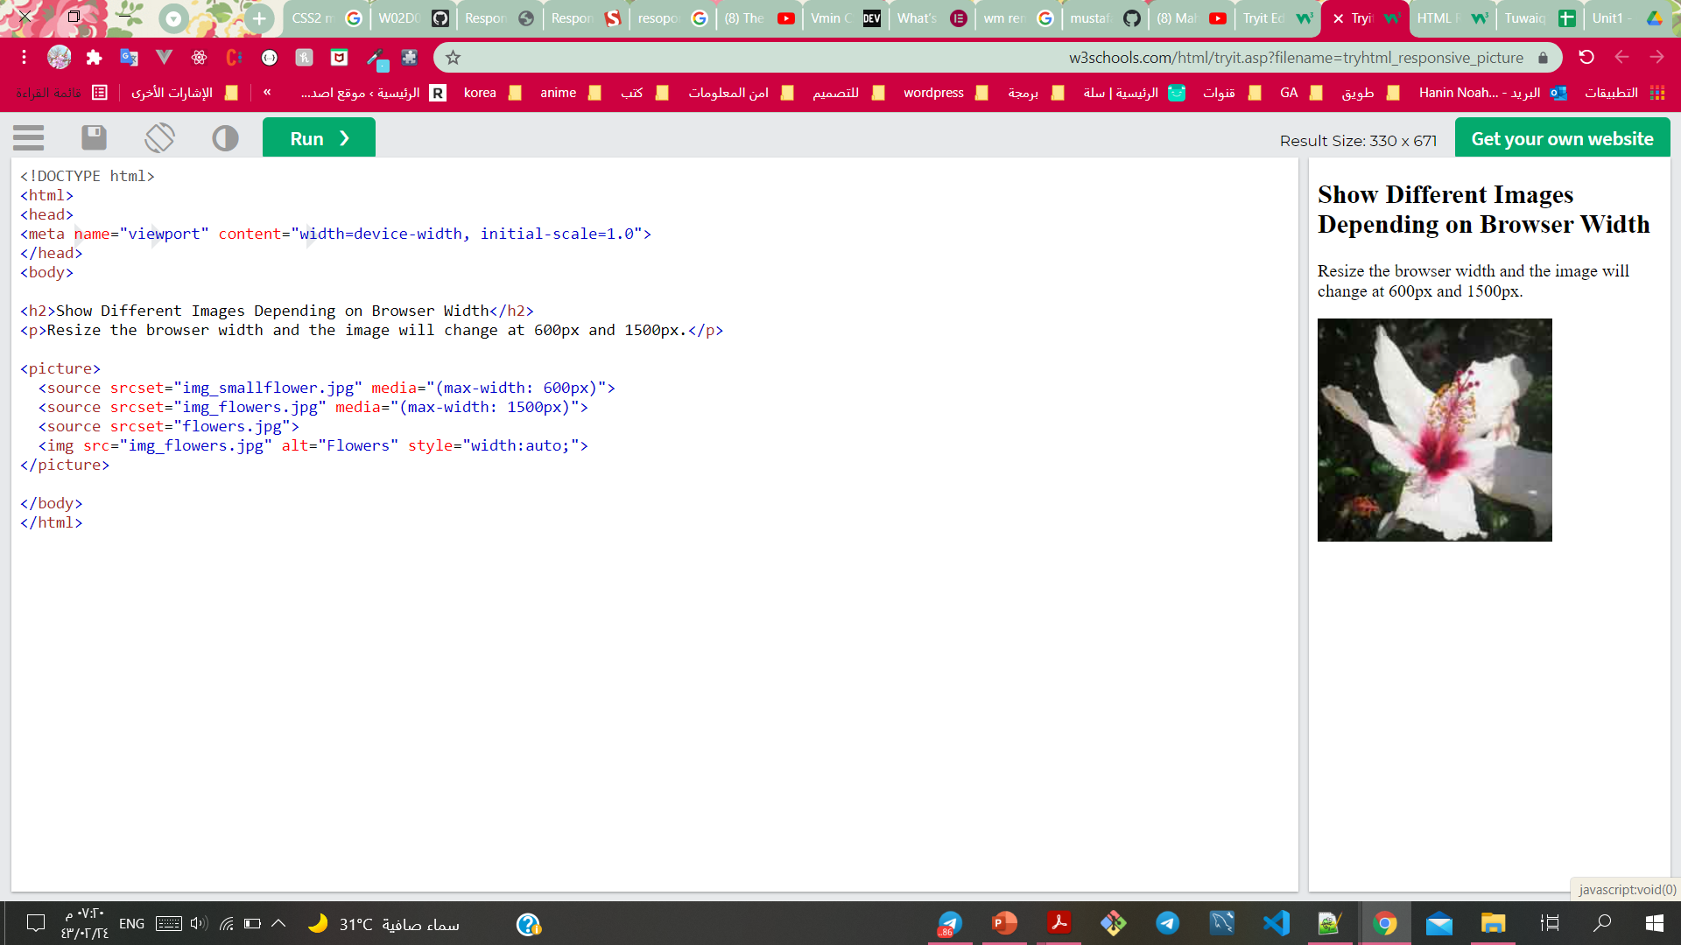
Different Images Depending on Browser Width
The HTML <picture> element allows you to define different images for different browser window sizes.
<picture>
<source srcset="img_smallflower.jpg" media="(max-width: 600px)">
<source srcset="img_flowers.jpg" media="(max-width: 1500px)">
<source srcset="flowers.jpg">
<img src="img_smallflower.jpg" alt="Flowers">
</picture>

Slide 13
Summary
What is responsive design
Media types
Breakpoints
Viewport
Mobile first design

Slide 14



Resources
HTML Responsive Web Design

